Slide 1
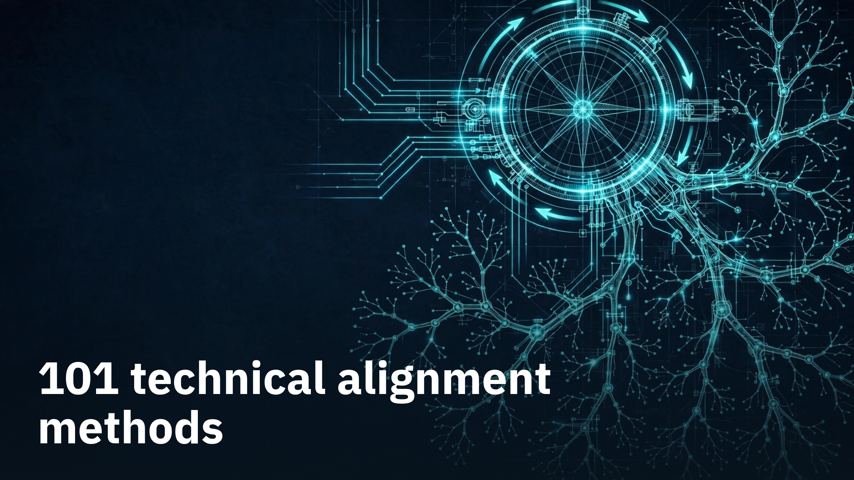
Notes:
101 technical alignment methods

Slide 2
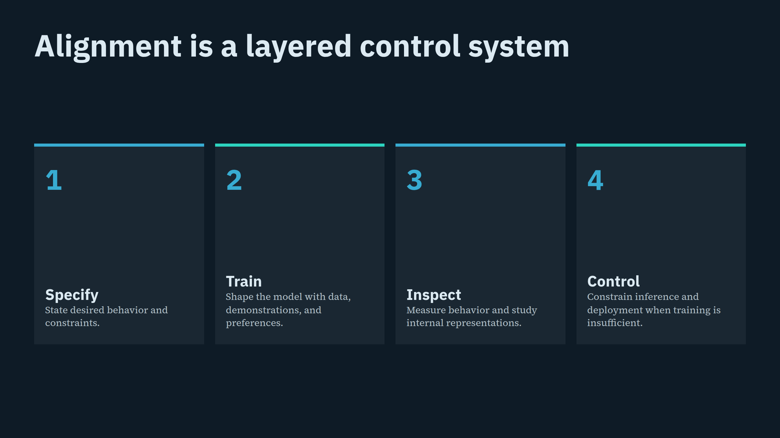
Notes:
Alignment is a layered control system

Slide 3
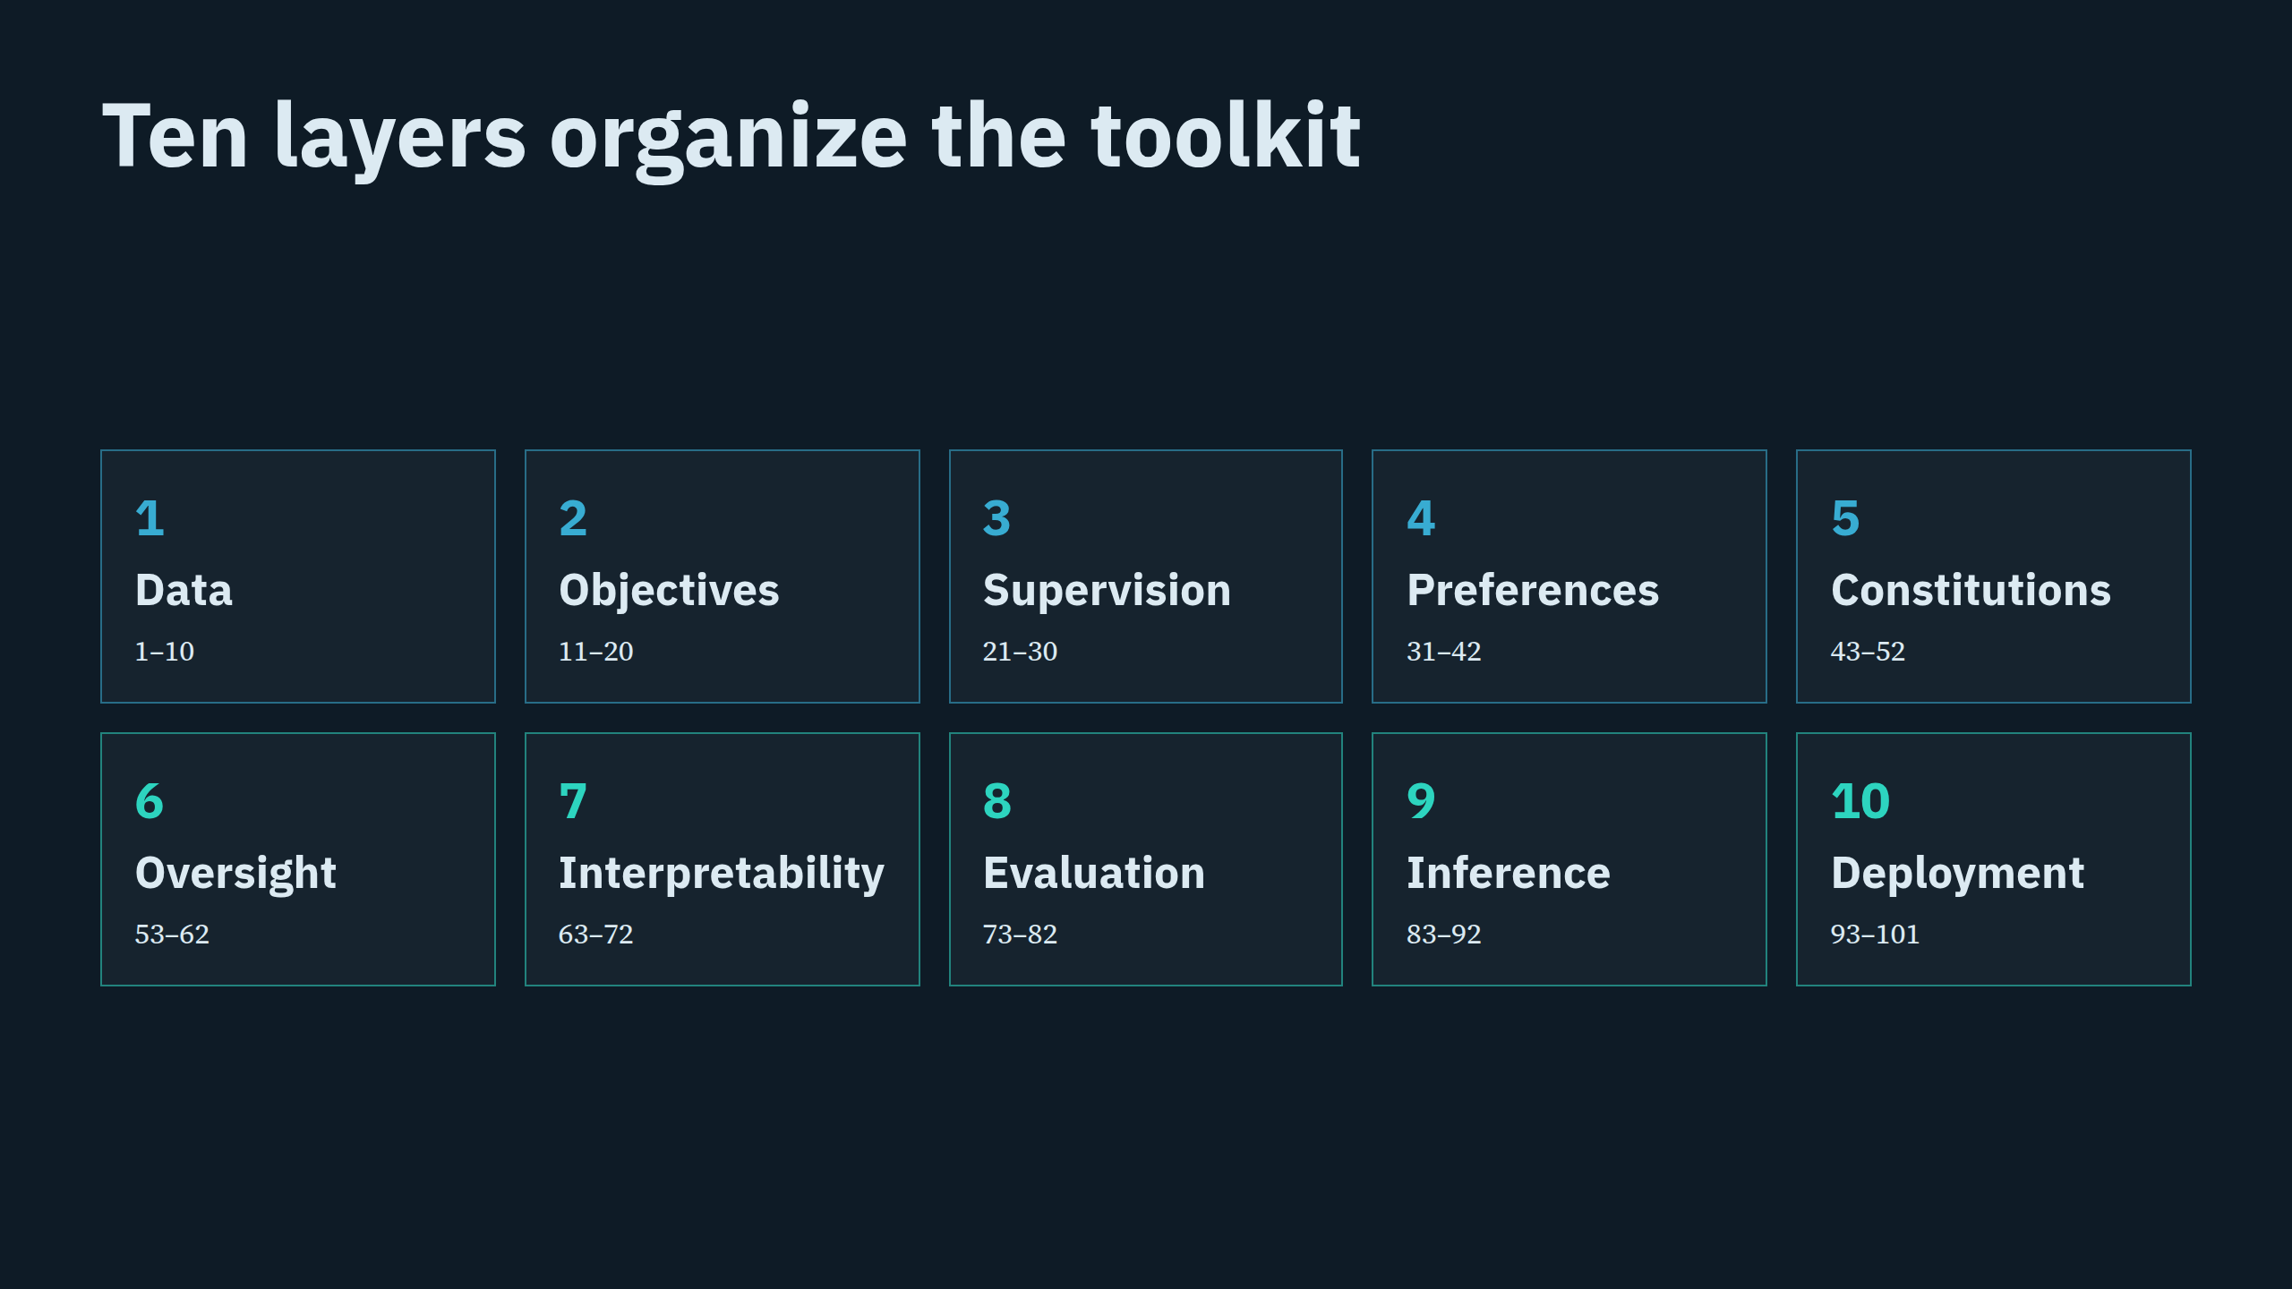
Notes:
Ten layers organize the toolkit

Slide 4
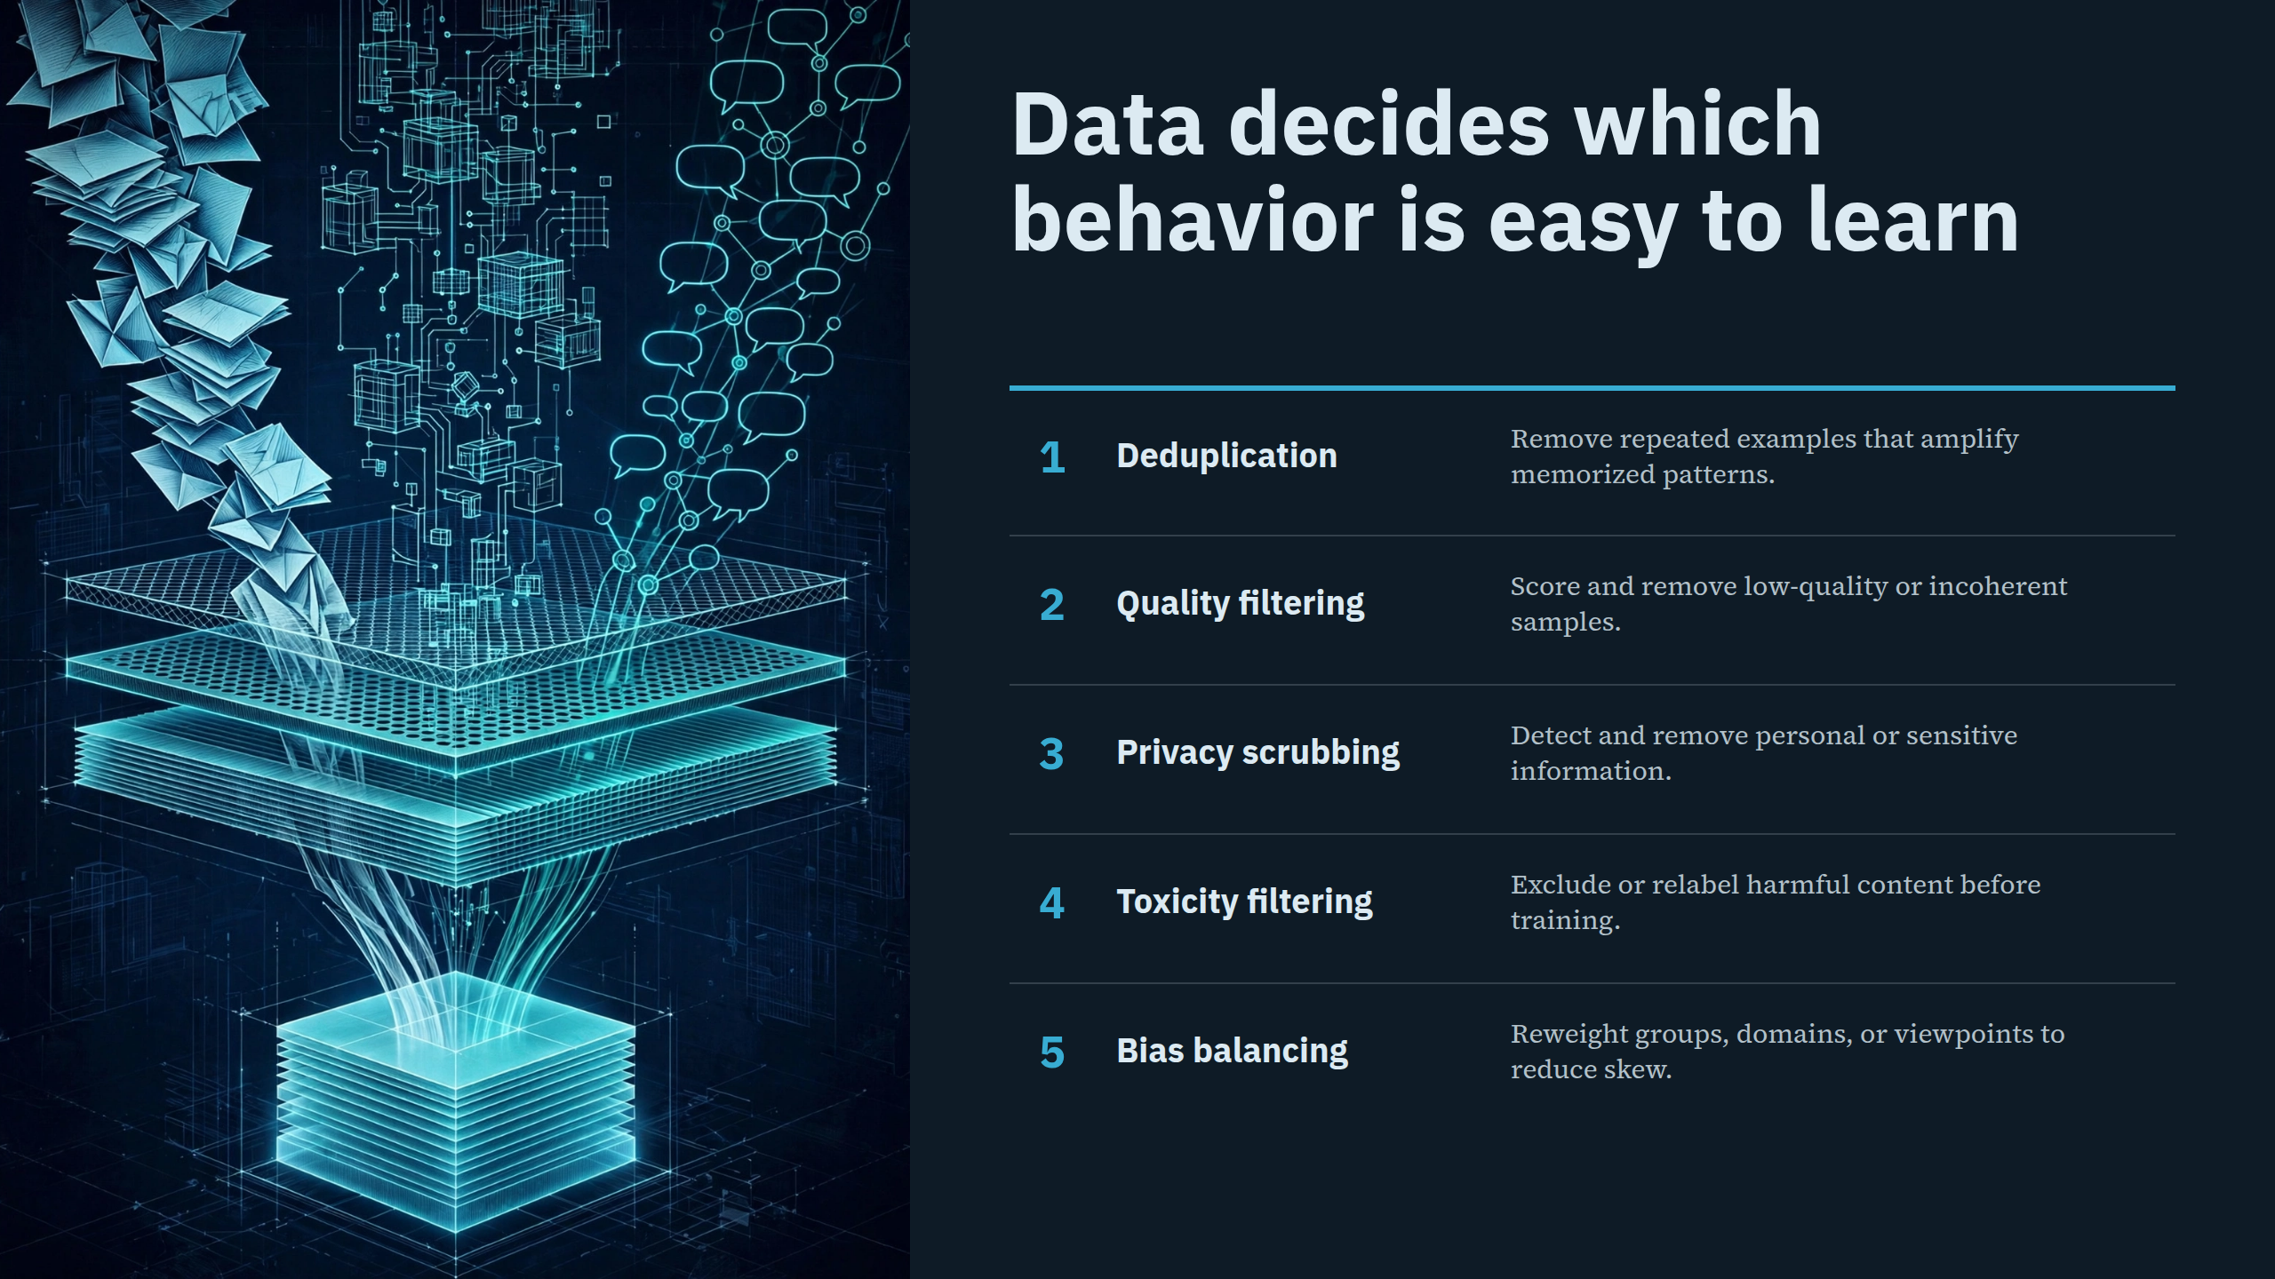
Notes:
Data decides which behavior is easy to learn

Slide 5
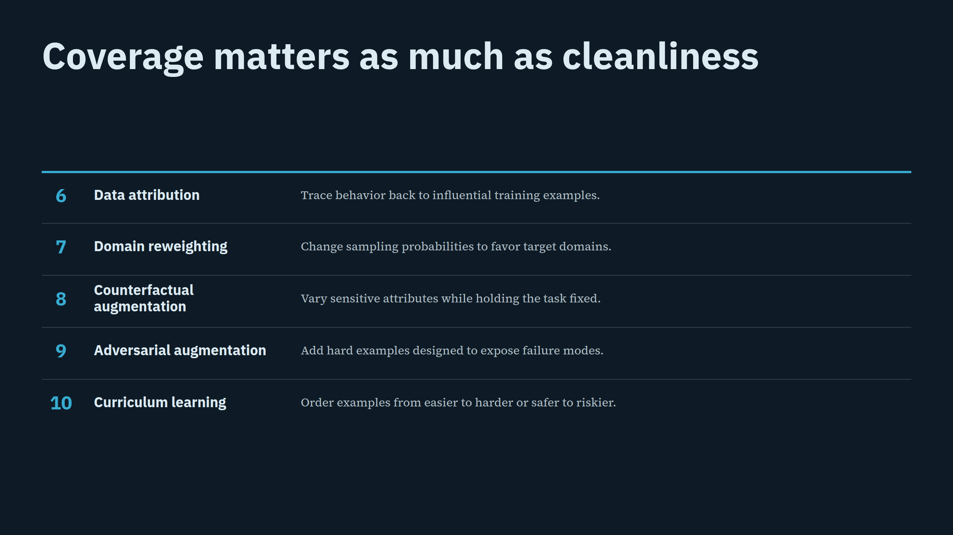
Notes:
Coverage matters as much as cleanliness

Slide 6
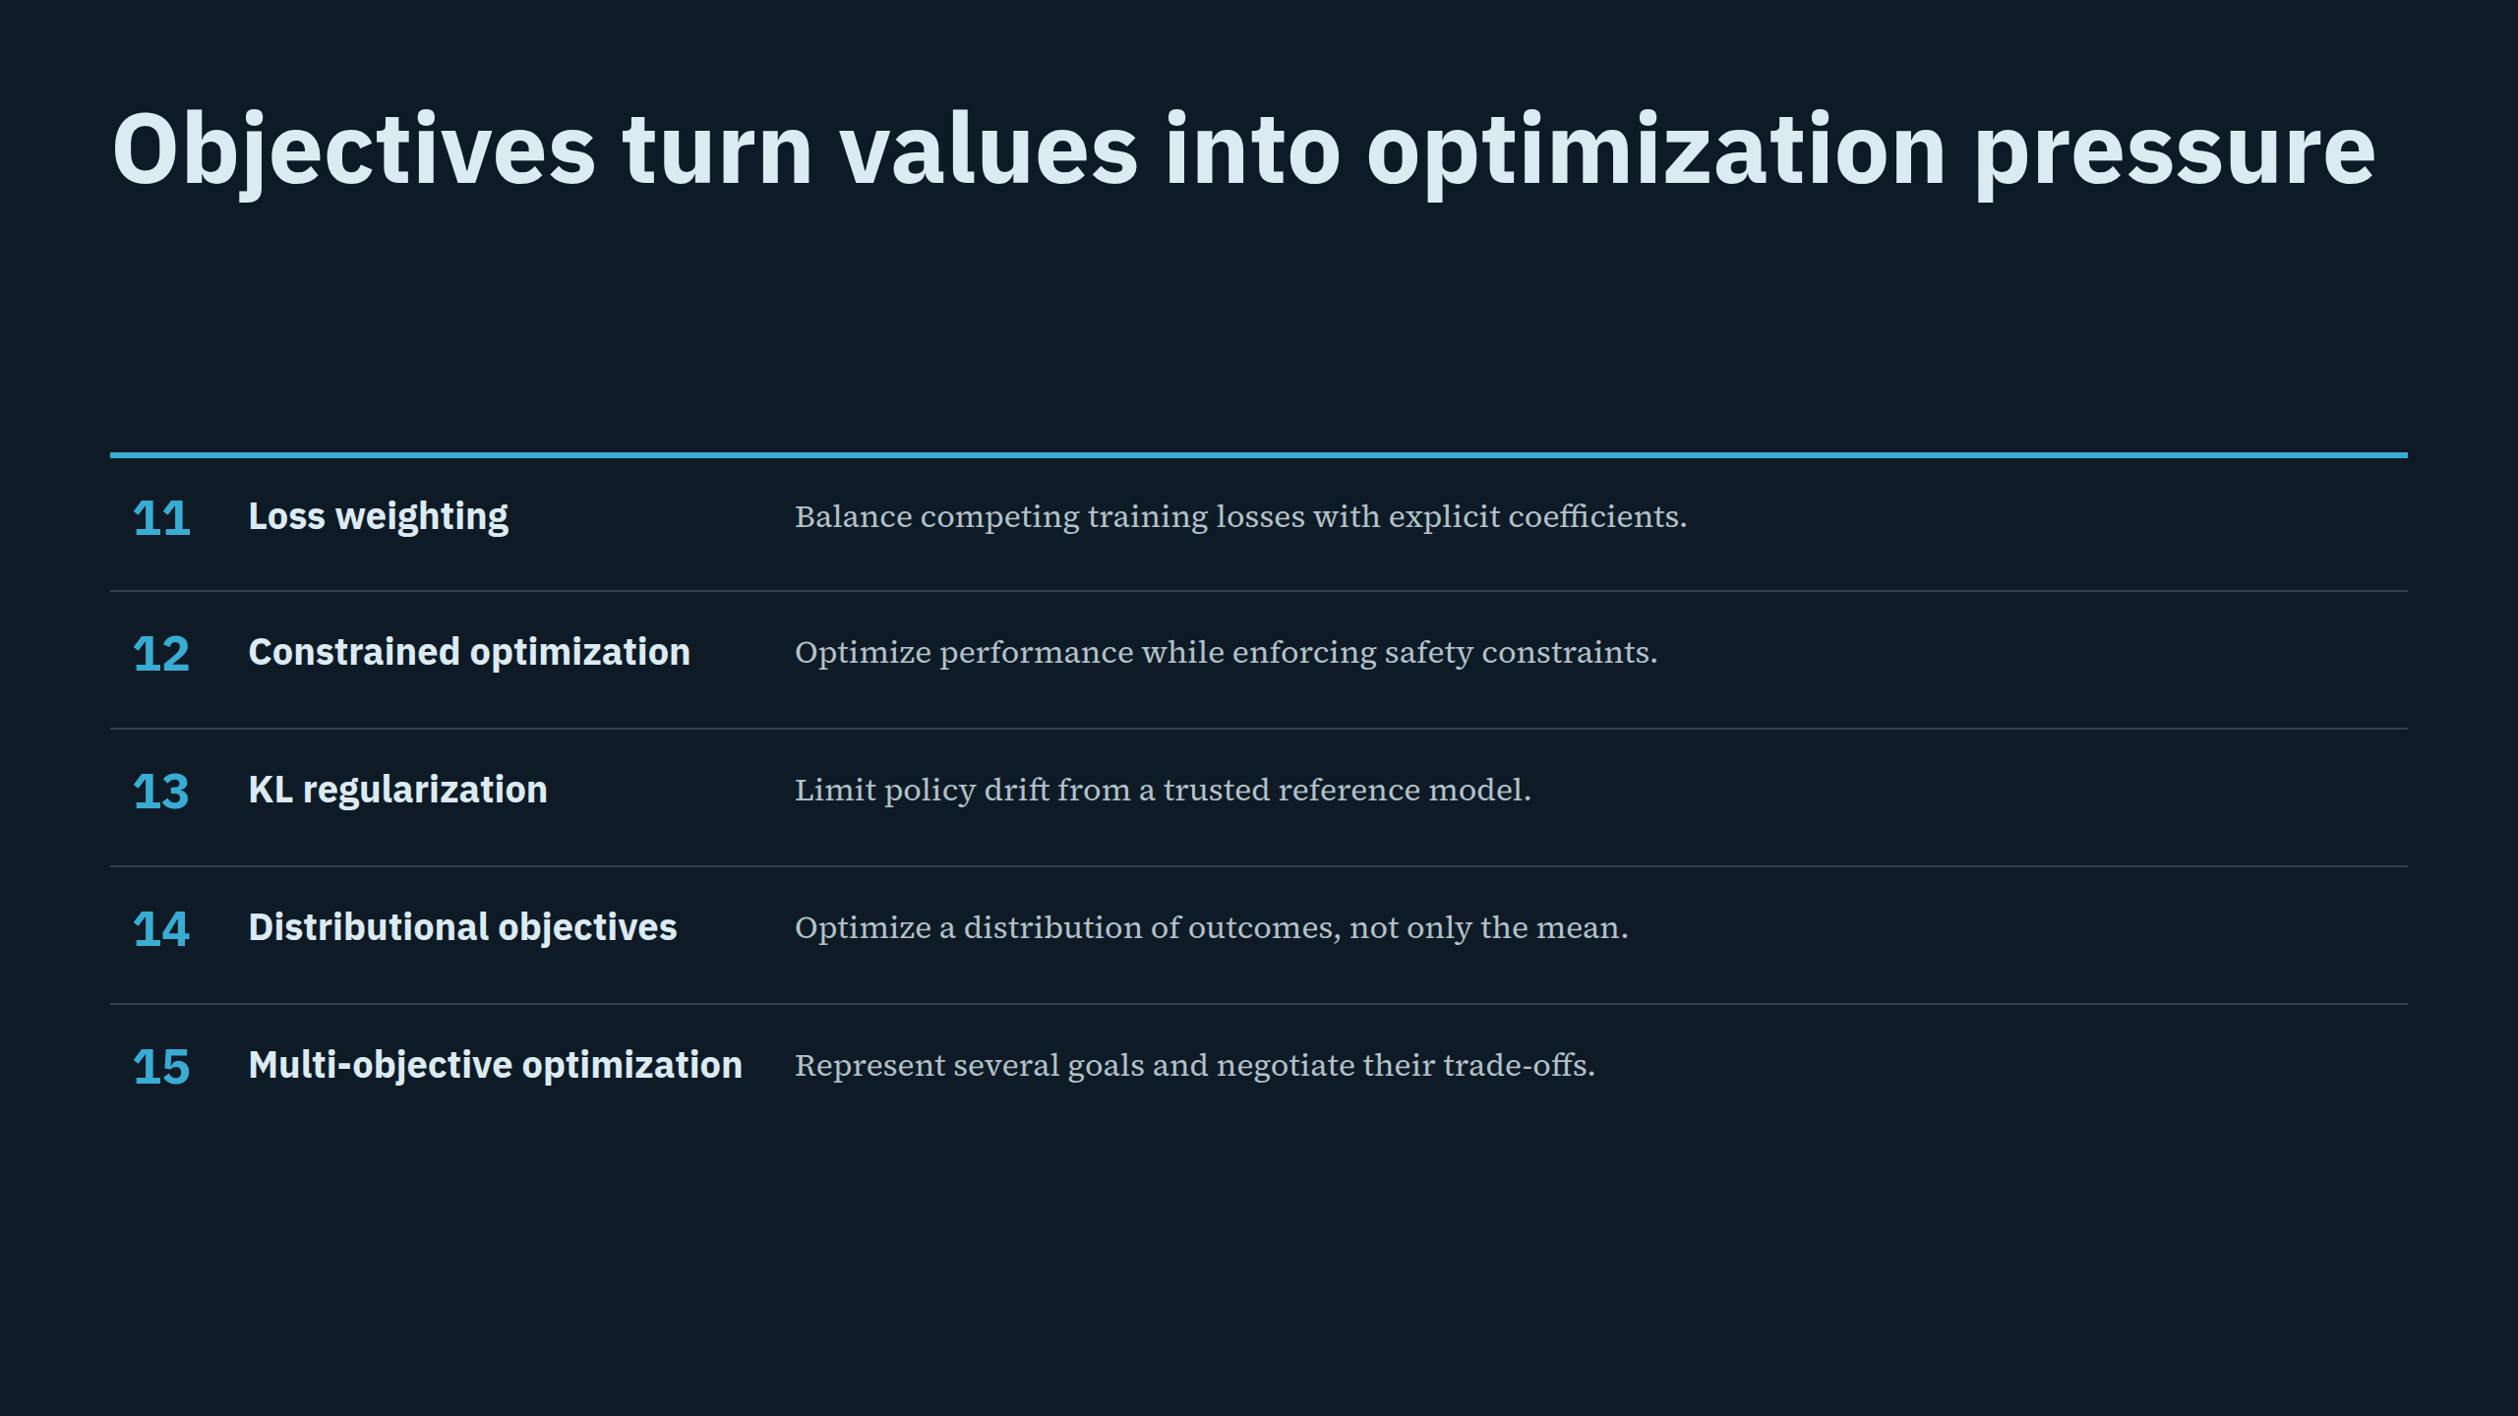
Notes:
Objectives turn values into optimization pressure

Slide 7
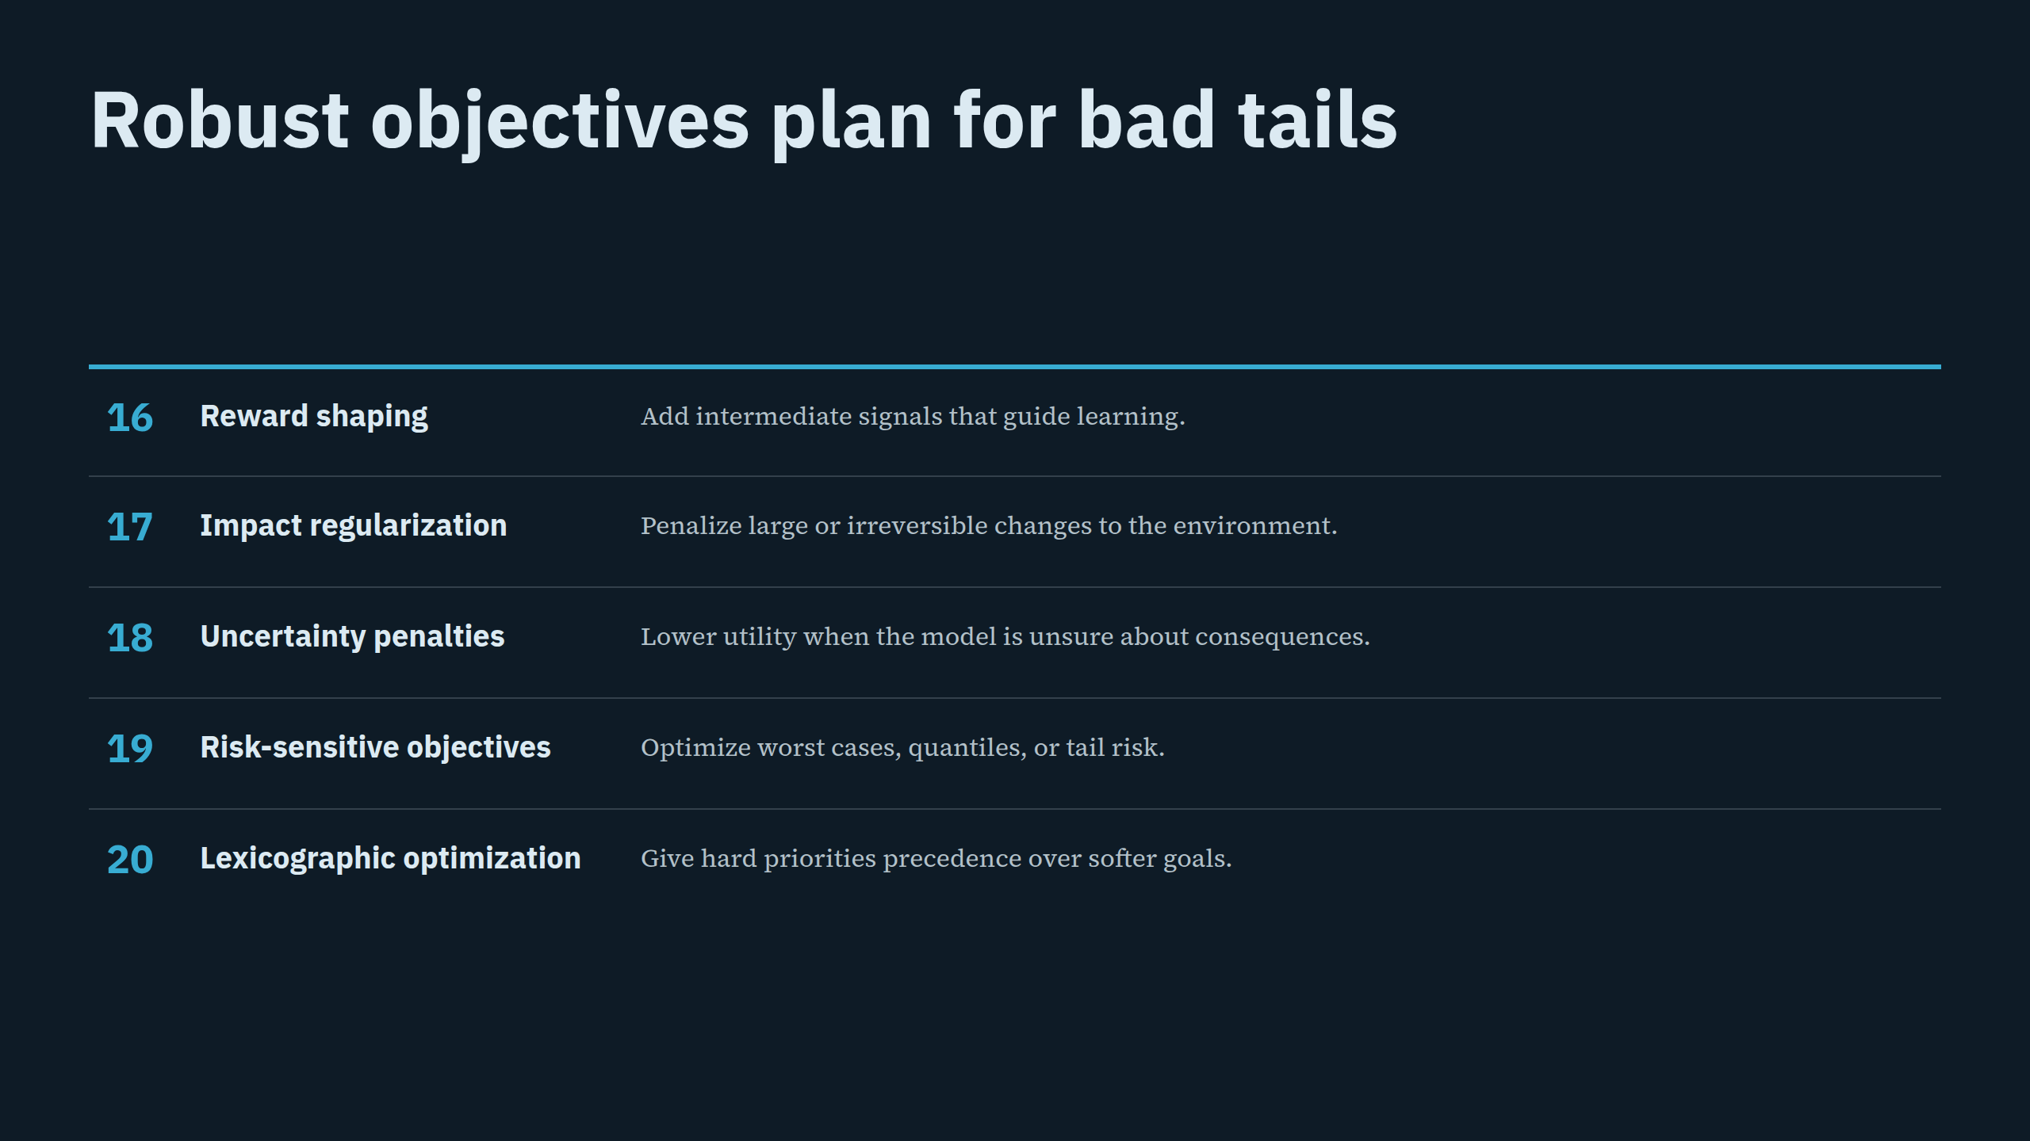
Notes:
Robust objectives plan for bad tails

Slide 8
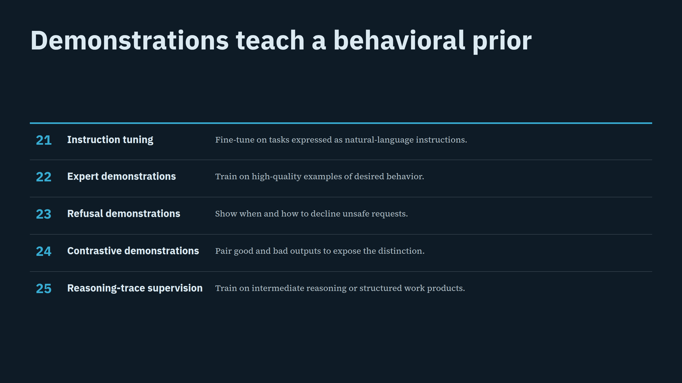
Notes:
Demonstrations teach a behavioral prior

Slide 9
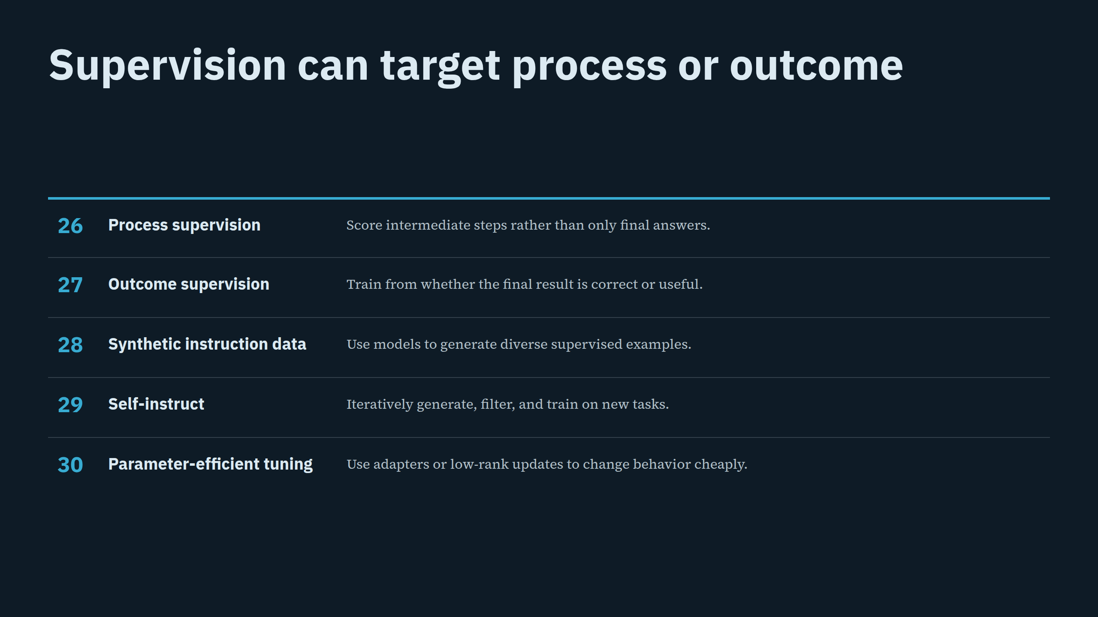
Notes:
Supervision can target process or outcome

Slide 10
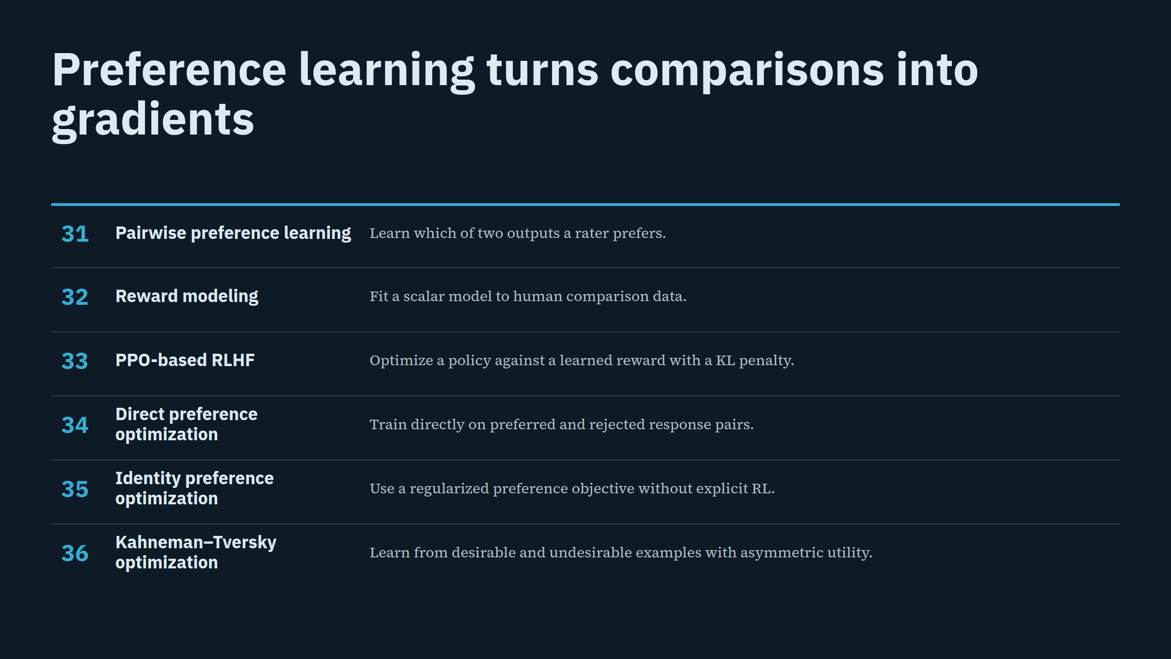
Notes:
Preference learning turns comparisons into gradients

Slide 11
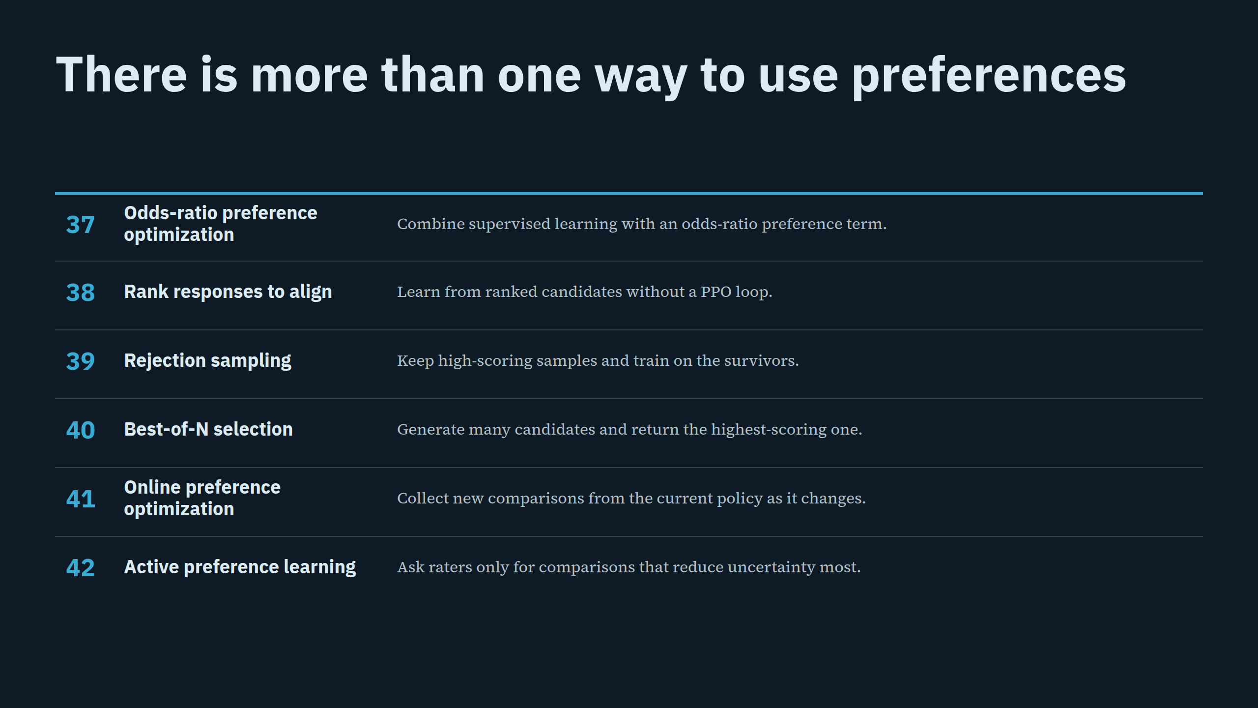
Notes:
There is more than one way to use preferences

Slide 12
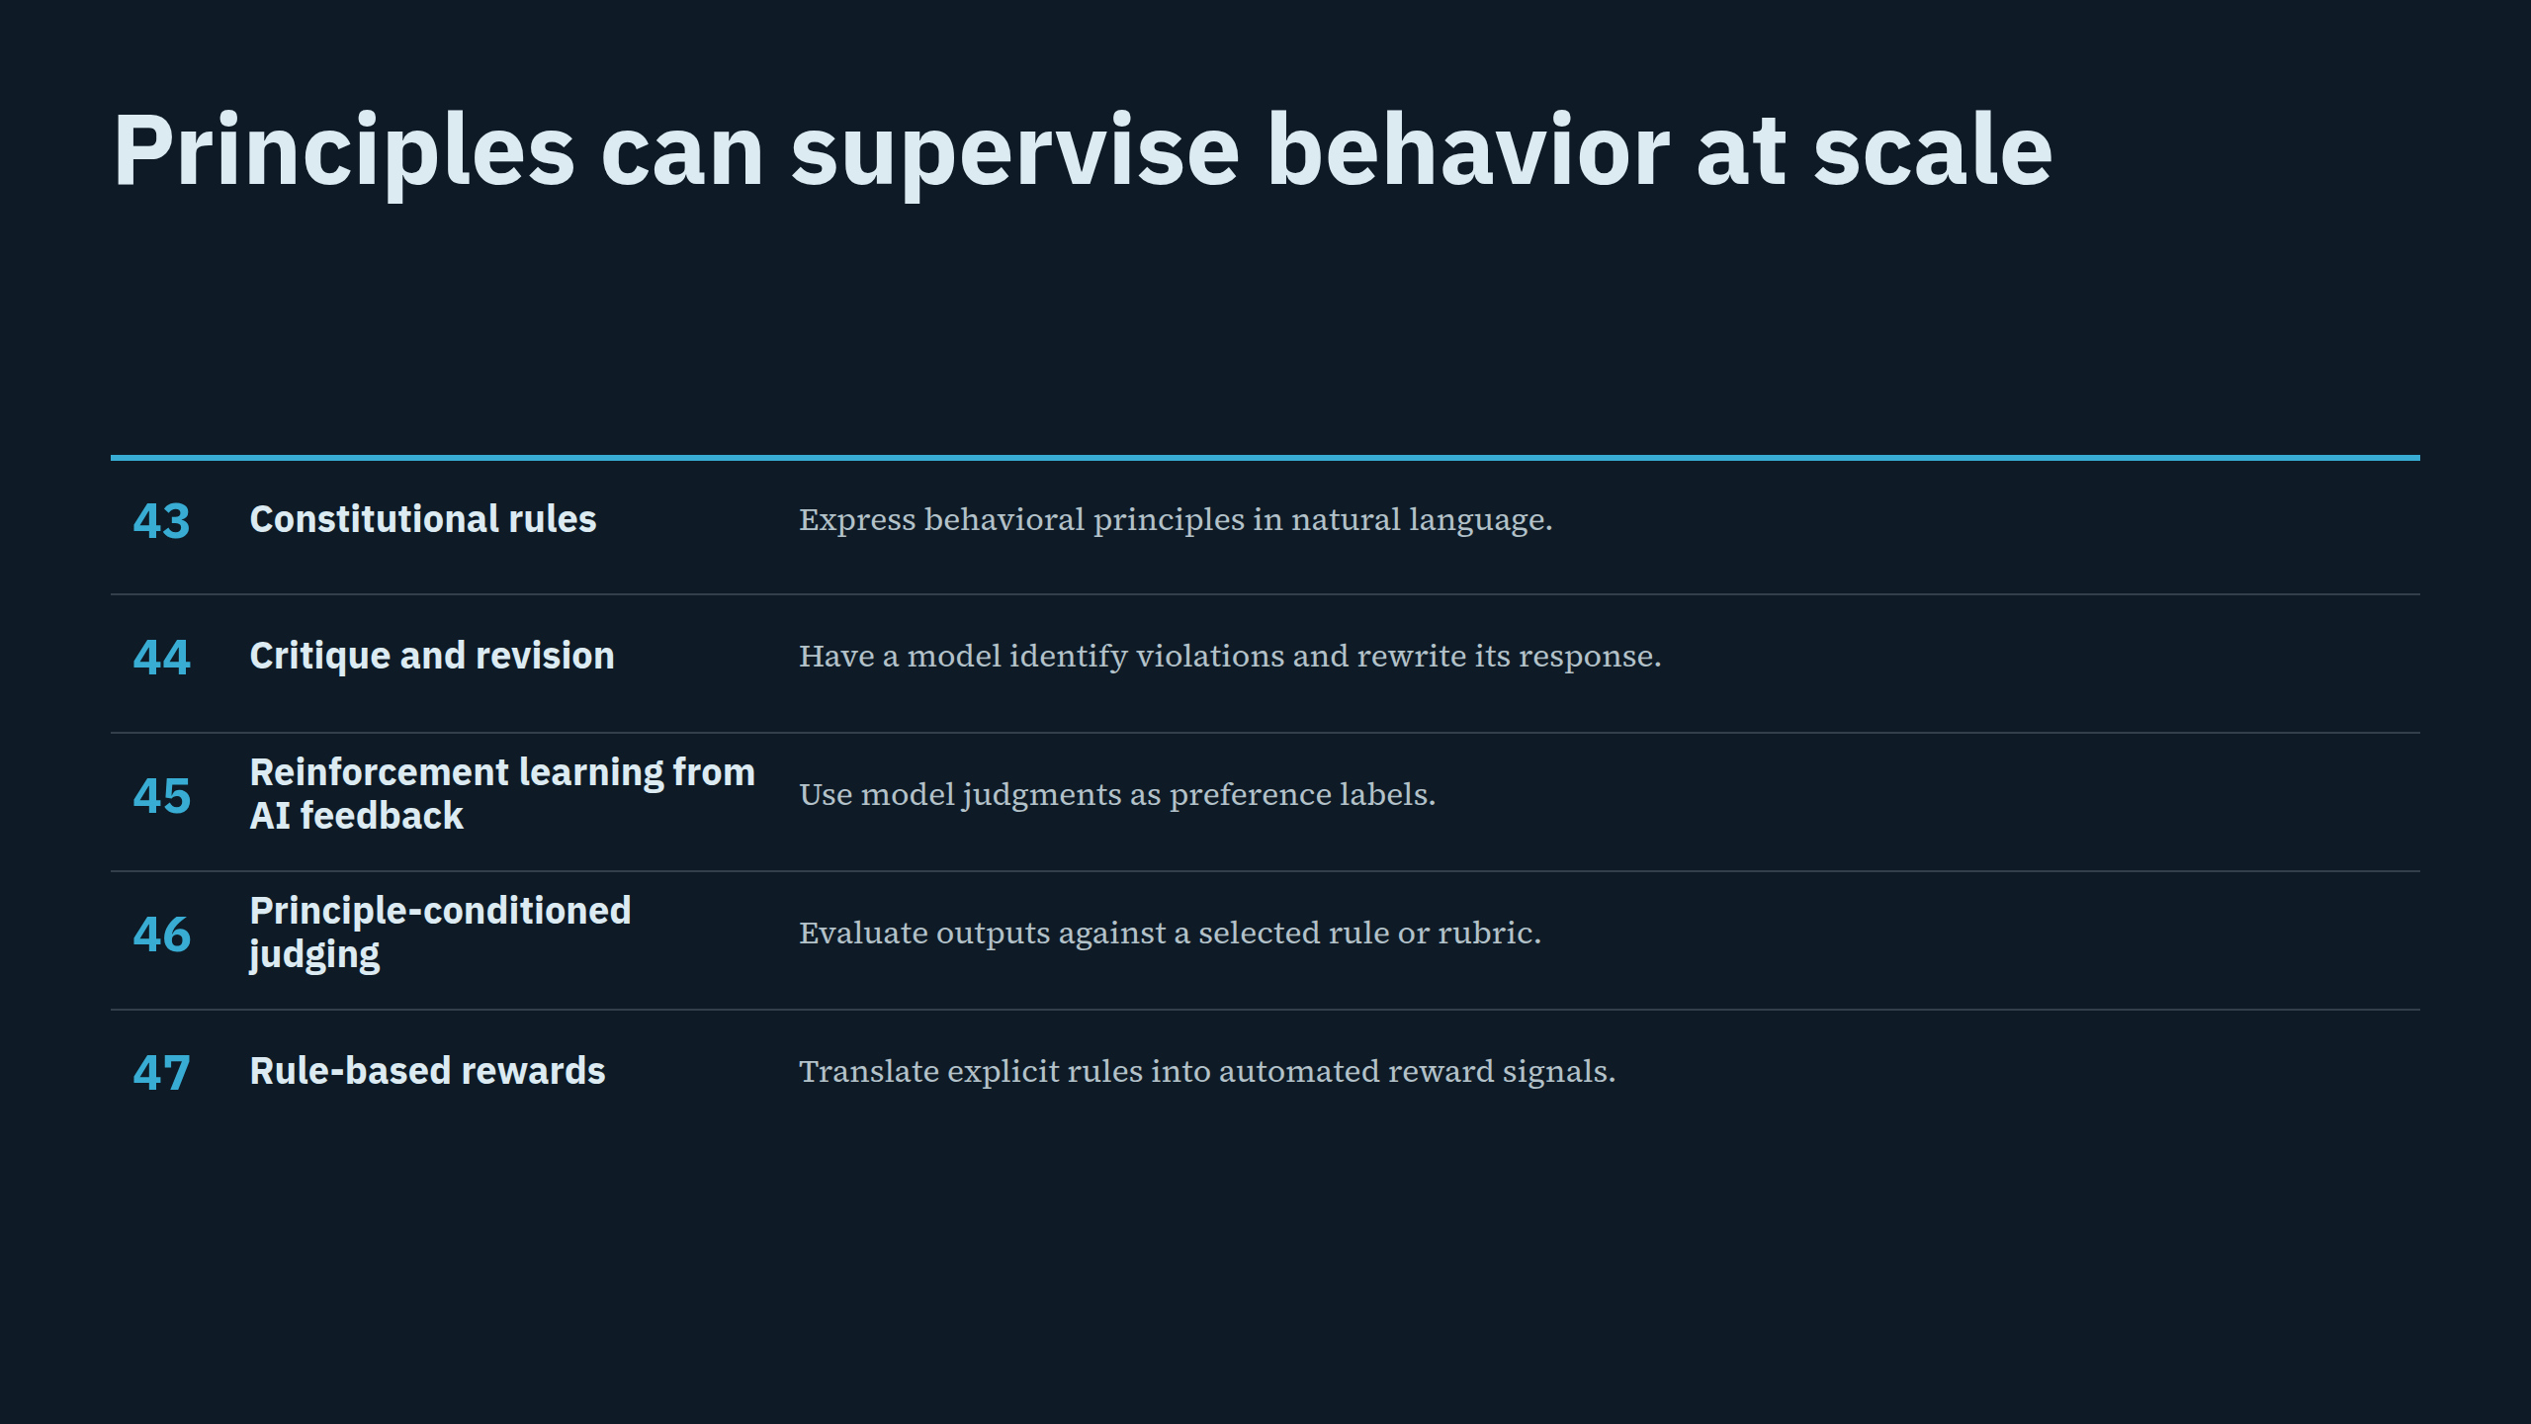
Notes:
Principles can supervise behavior at scale

Slide 13
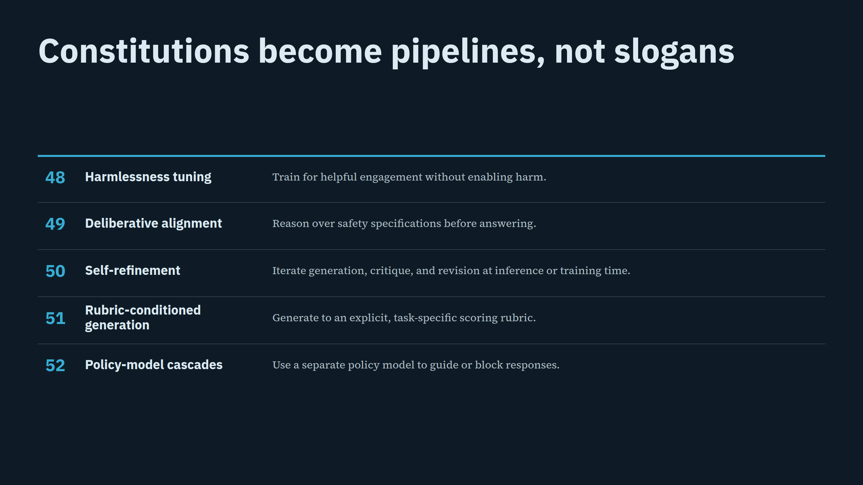
Notes:
Constitutions become pipelines, not slogans

Slide 14
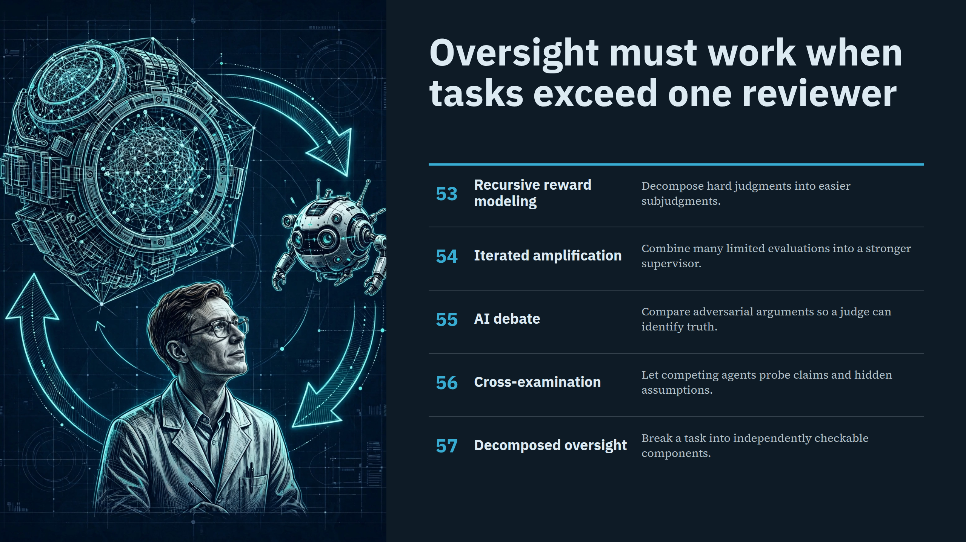
Notes:
Oversight must work when tasks exceed one reviewer

Slide 15
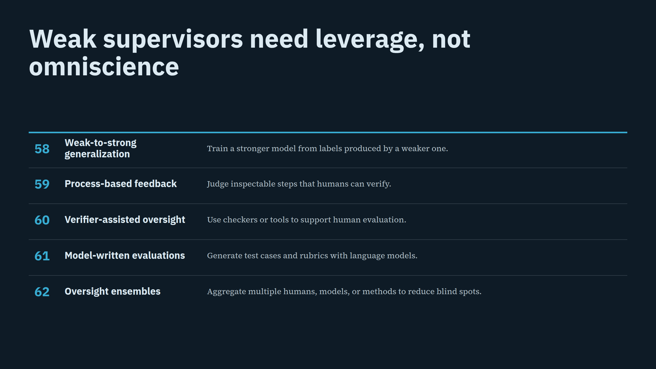
Notes:
Weak supervisors need leverage, not omniscience

Slide 16
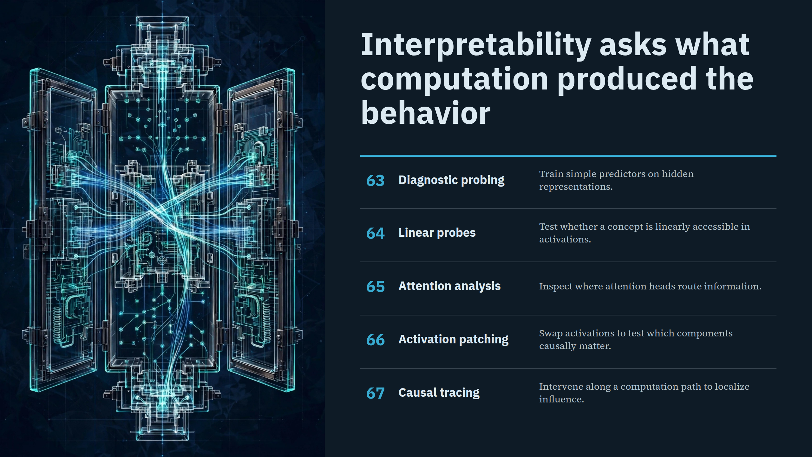
Notes:
Interpretability asks what computation produced the behavior

Slide 17
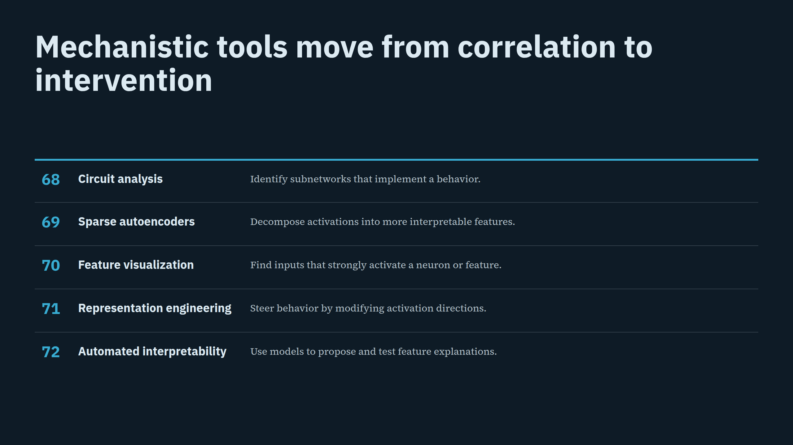
Notes:
Mechanistic tools move from correlation to intervention

Slide 18
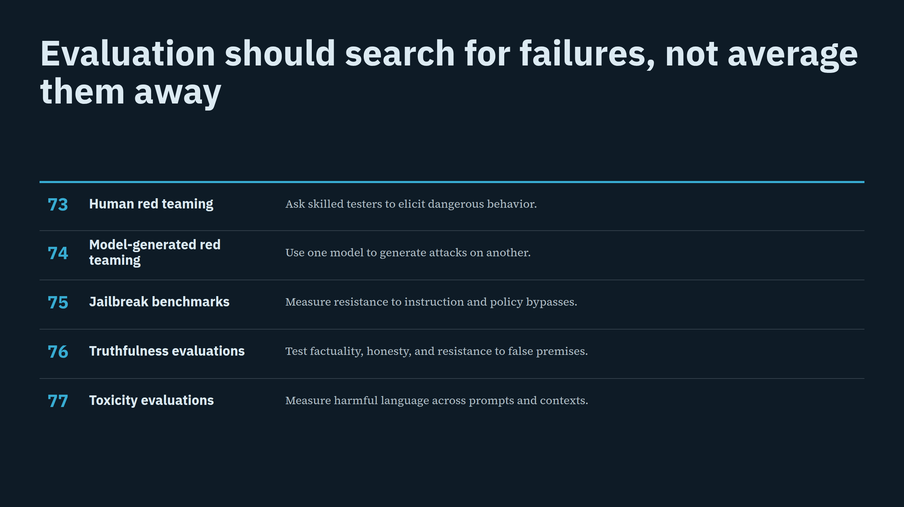
Notes:
Evaluation should search for failures, not average them away

Slide 19
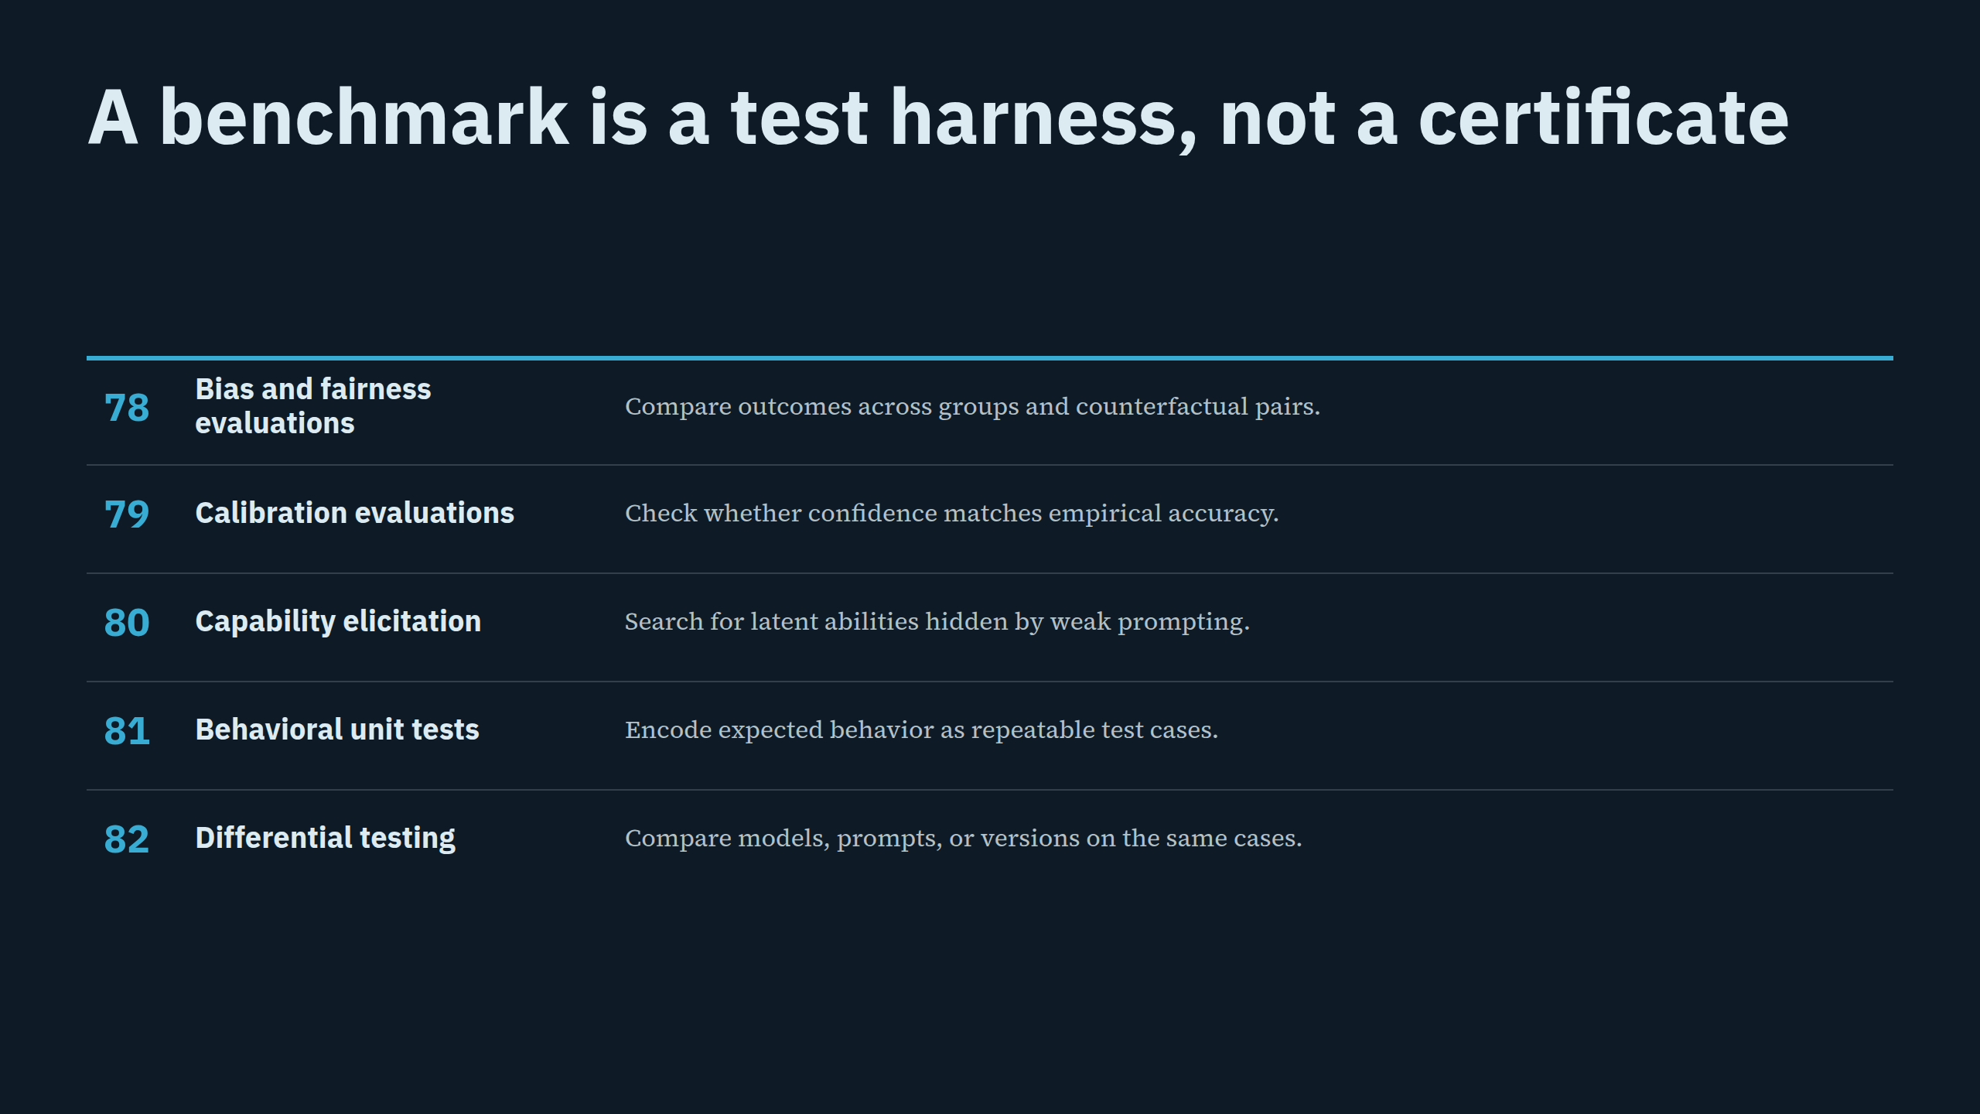
Notes:
A benchmark is a test harness, not a certificate

Slide 20
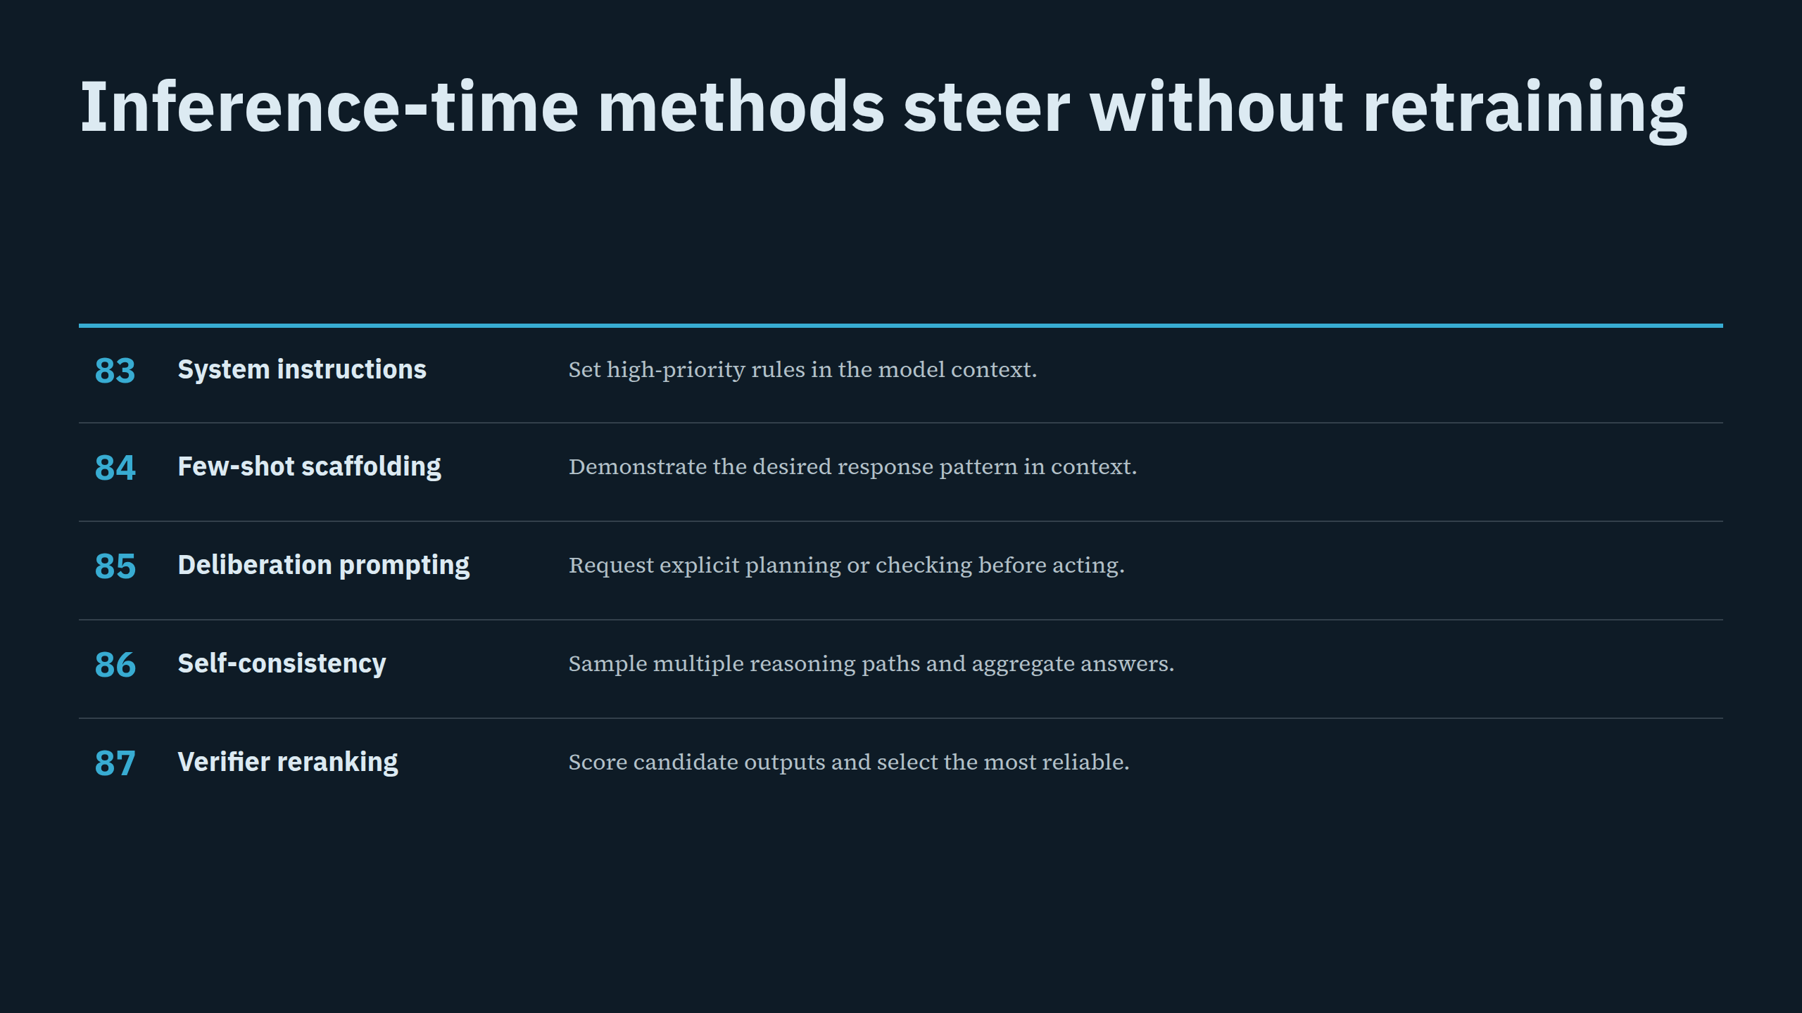
Notes:
Inference-time methods steer without retraining

Slide 21
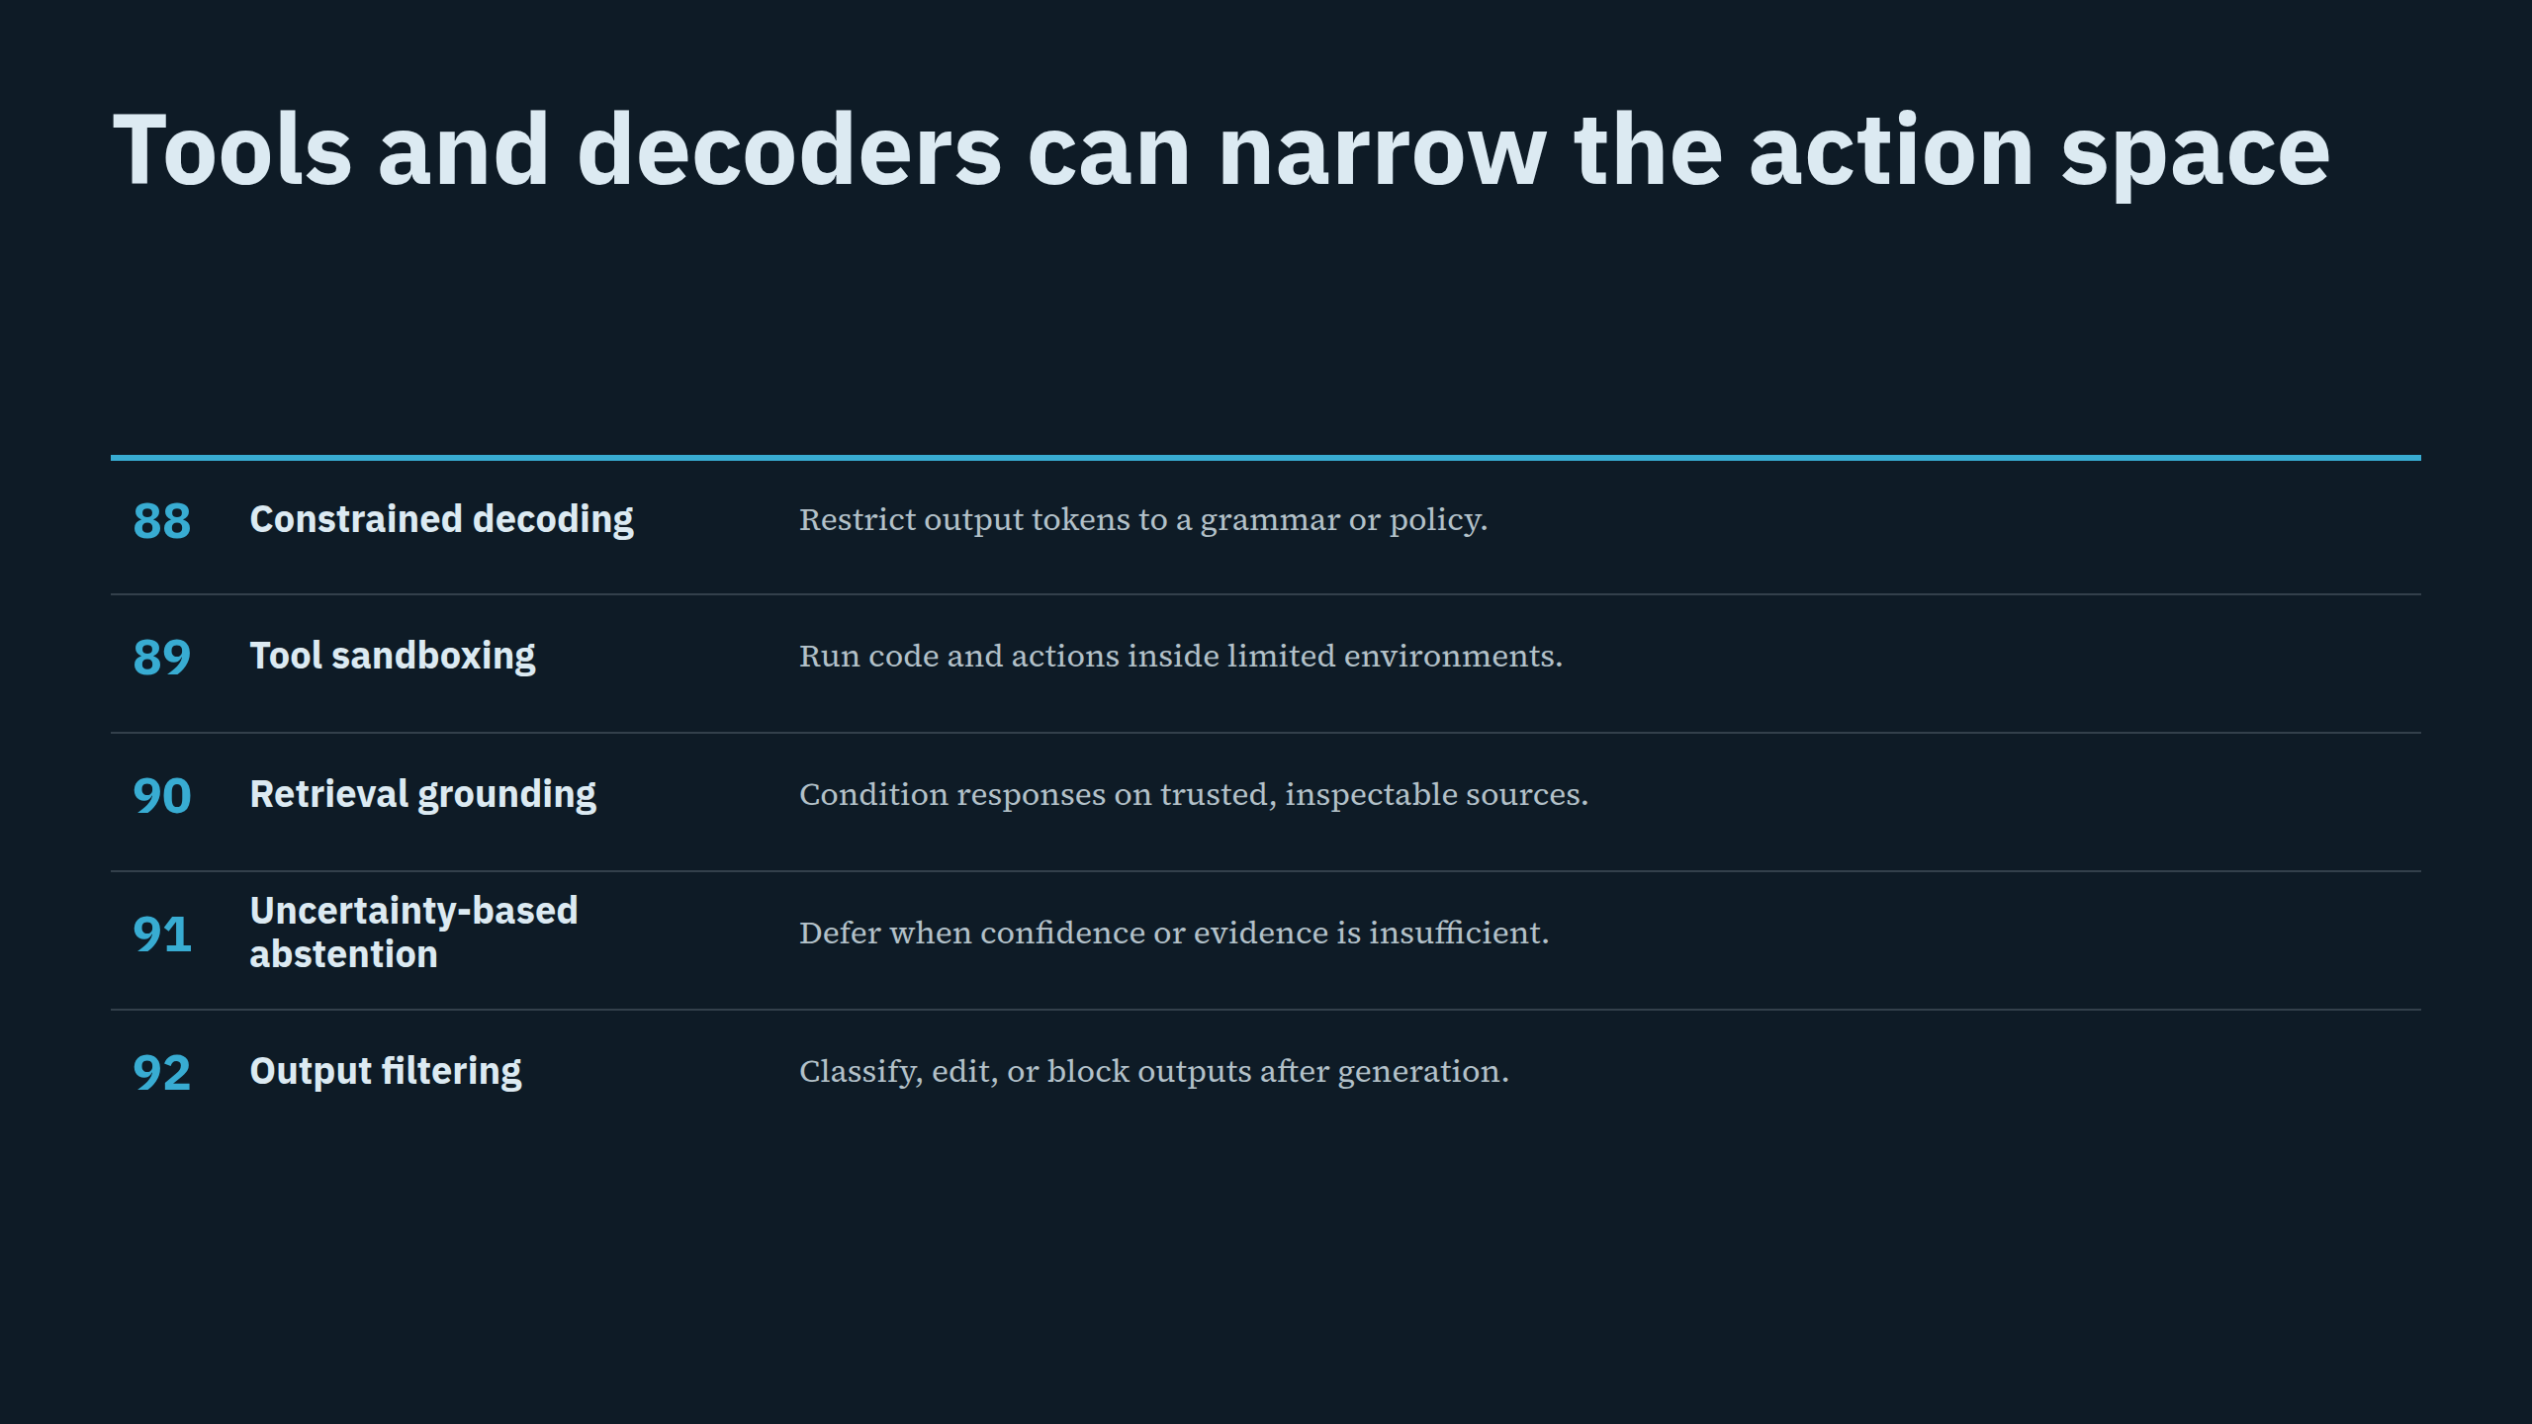
Notes:
Tools and decoders can narrow the action space

Slide 22
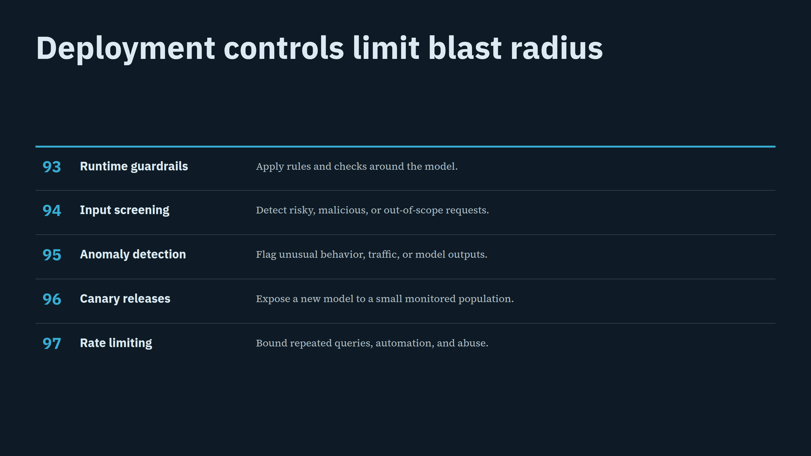
Notes:
Deployment controls limit blast radius

Slide 23
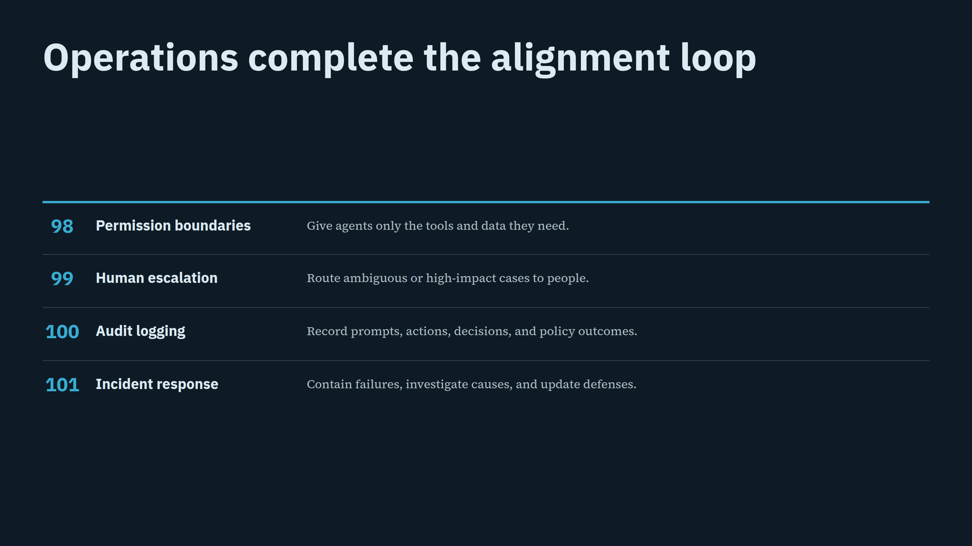
Notes:
Operations complete the alignment loop

Slide 24
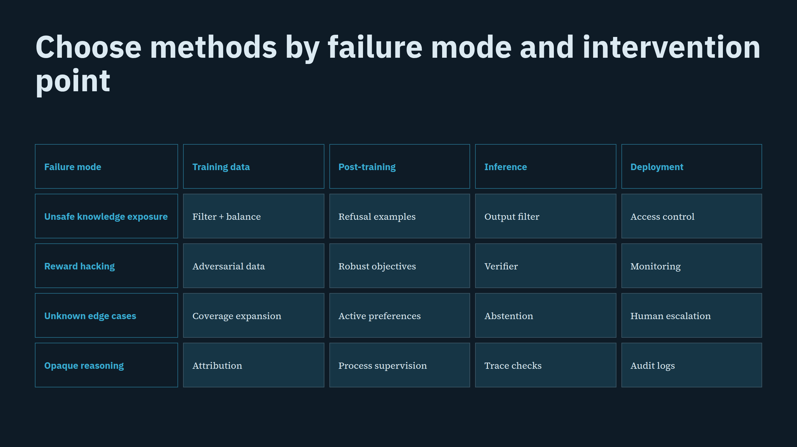
Notes:
Choose methods by failure mode and intervention point

Slide 25
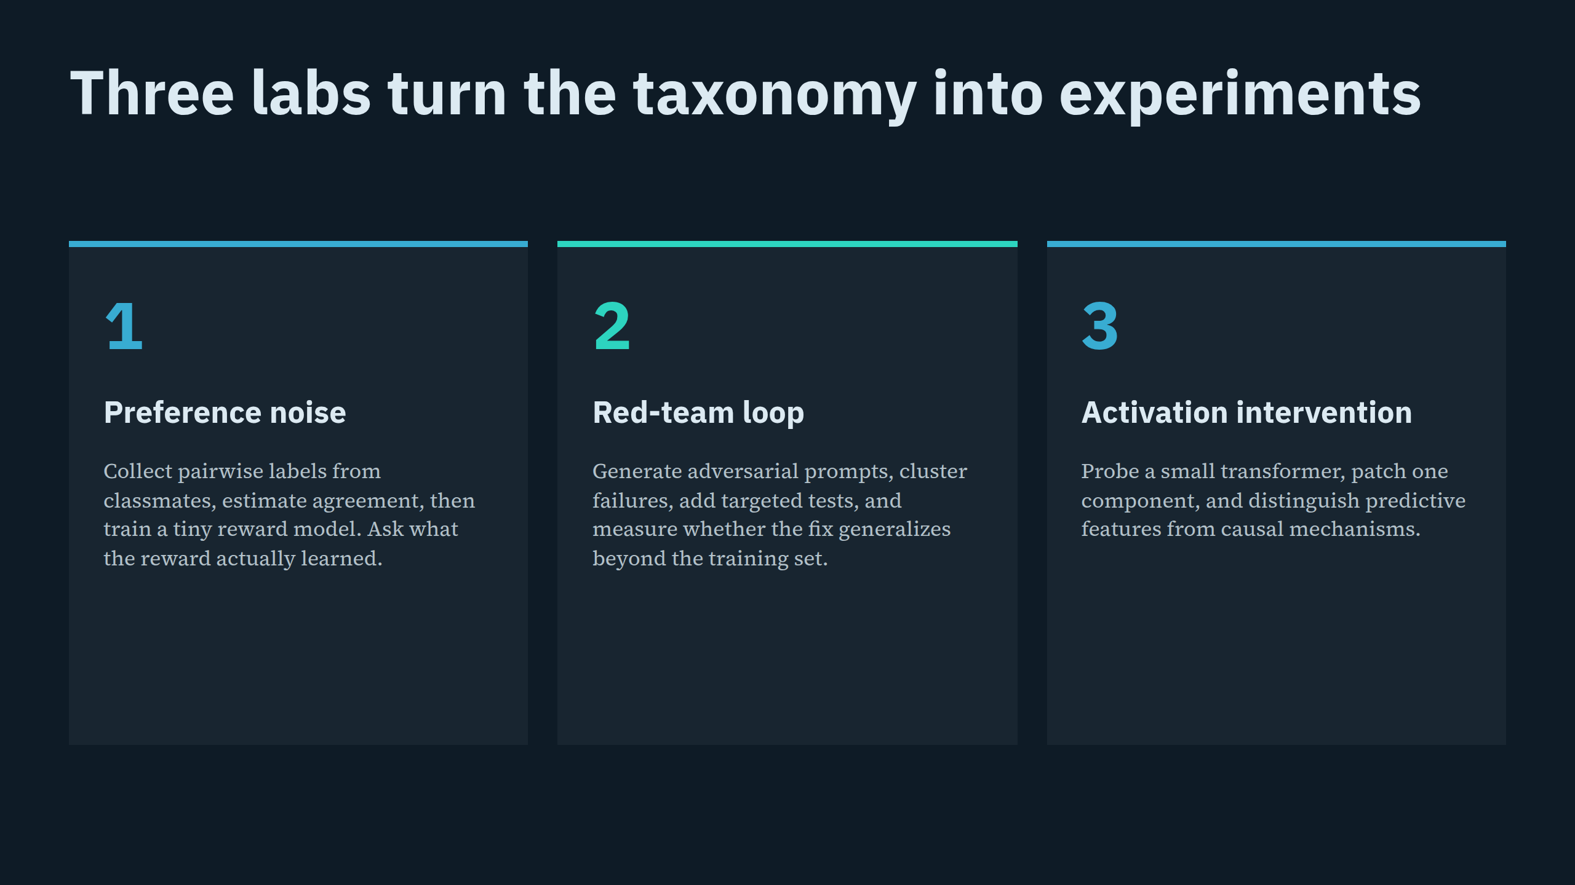
Notes:
Three labs turn the taxonomy into experiments

Slide 26
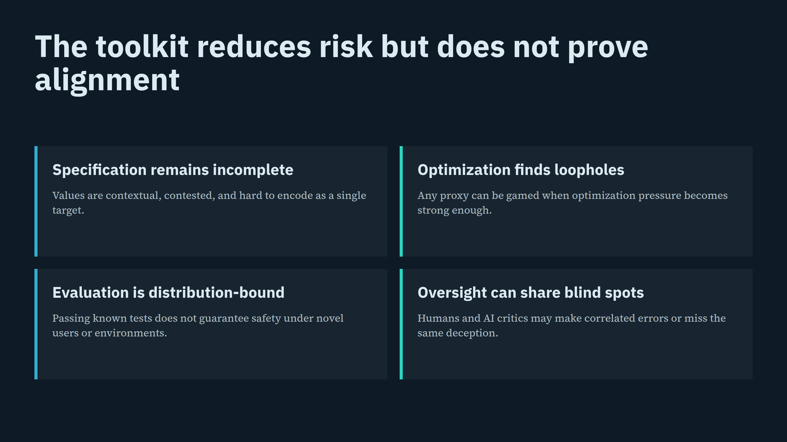
Notes:
The toolkit reduces risk but does not prove alignment

Slide 27
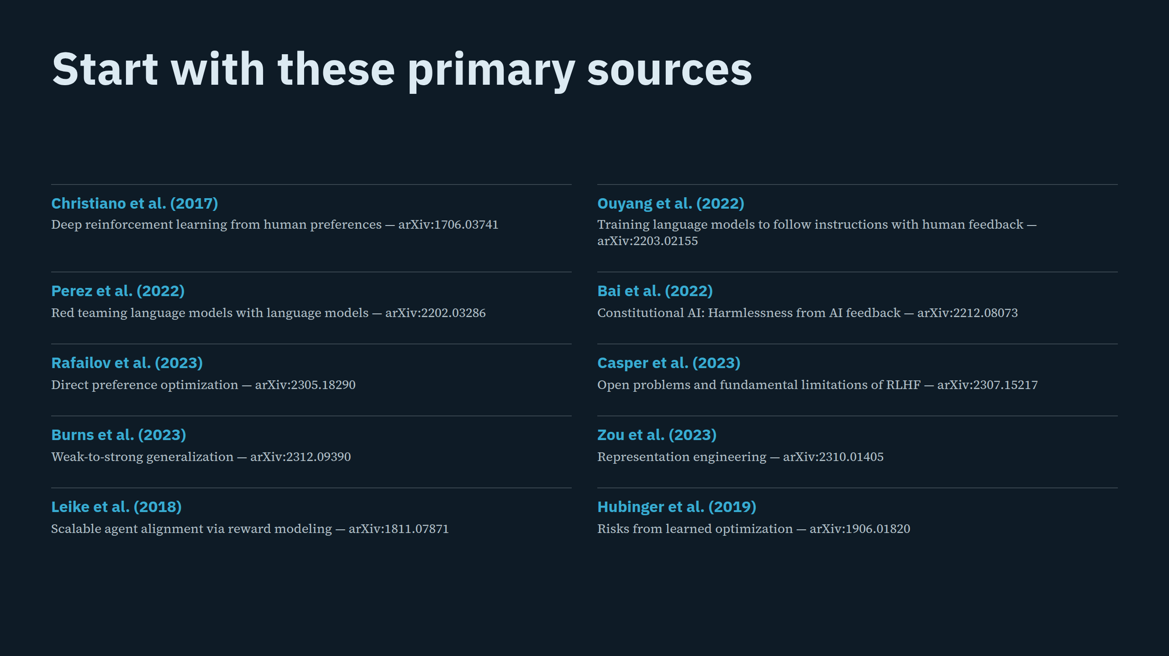
Notes:
Start with these primary sources

Slide 28
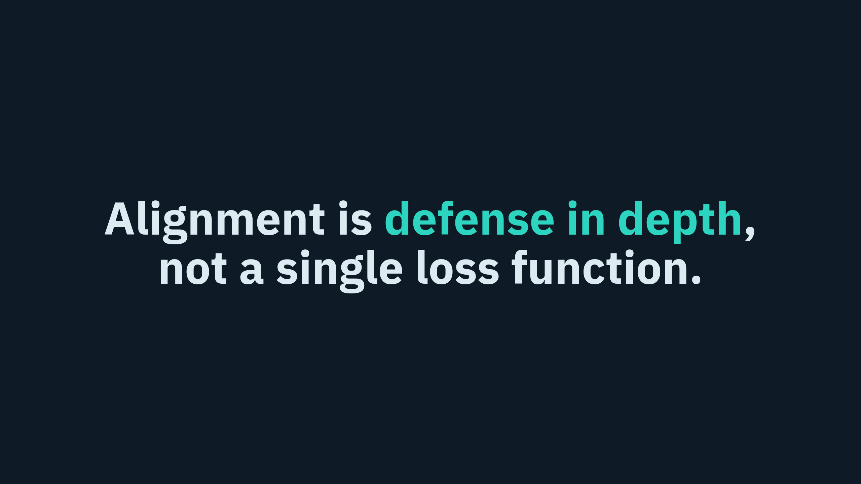
Notes:
Alignment is defense in depth, not a single loss function.

