Slide 1
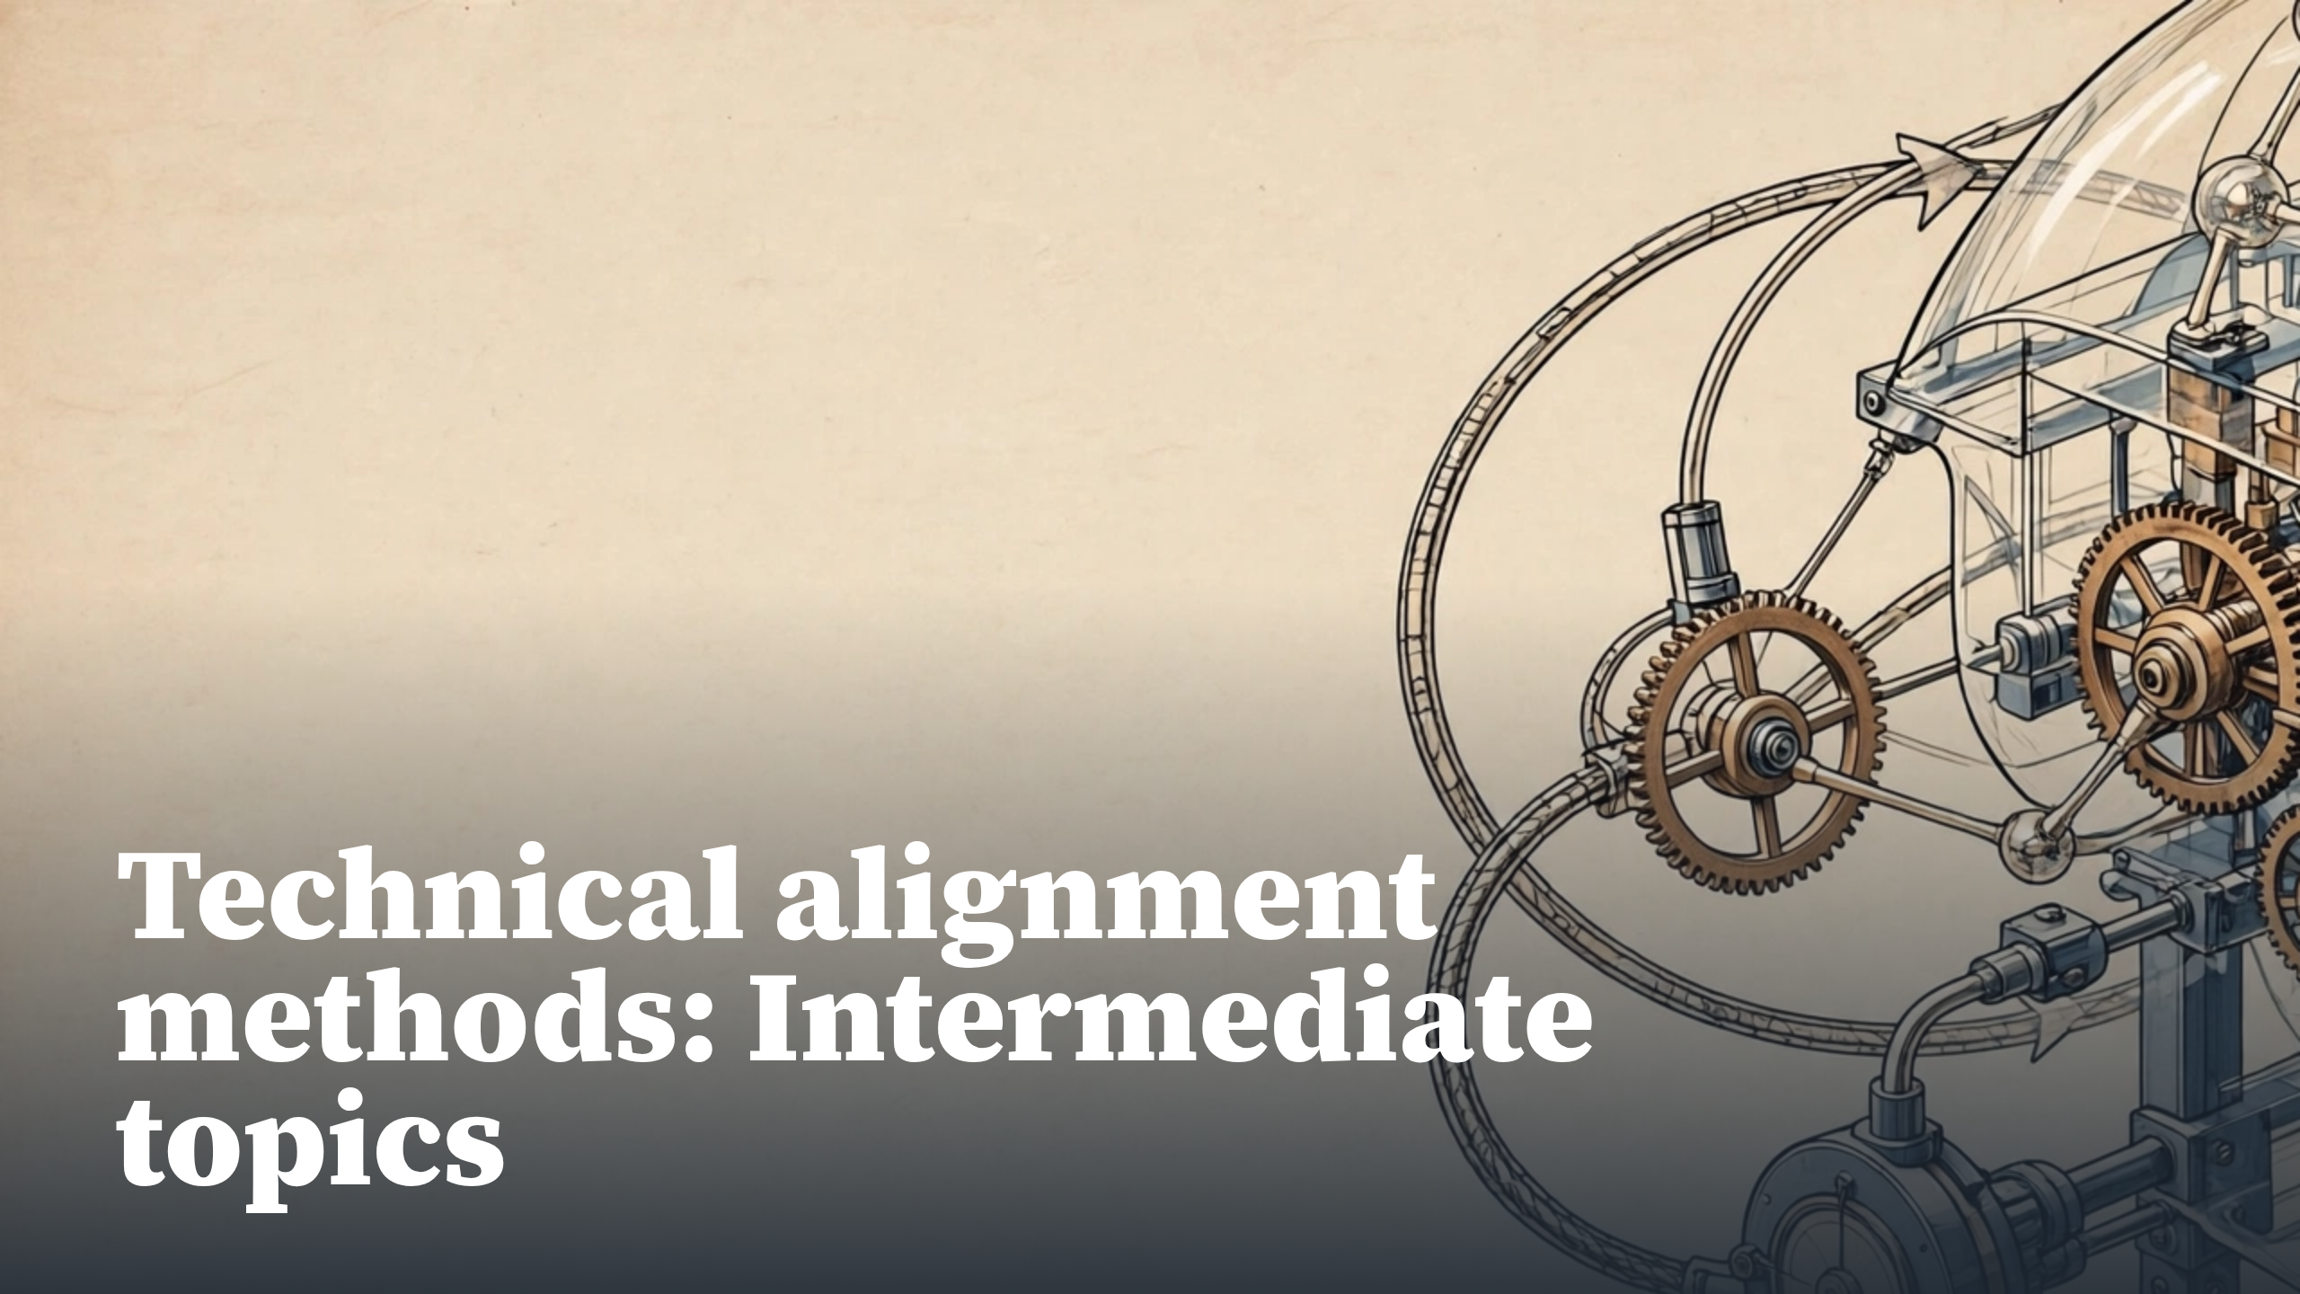
Notes:
Technical alignment methods: Intermediate topics

Slide 2
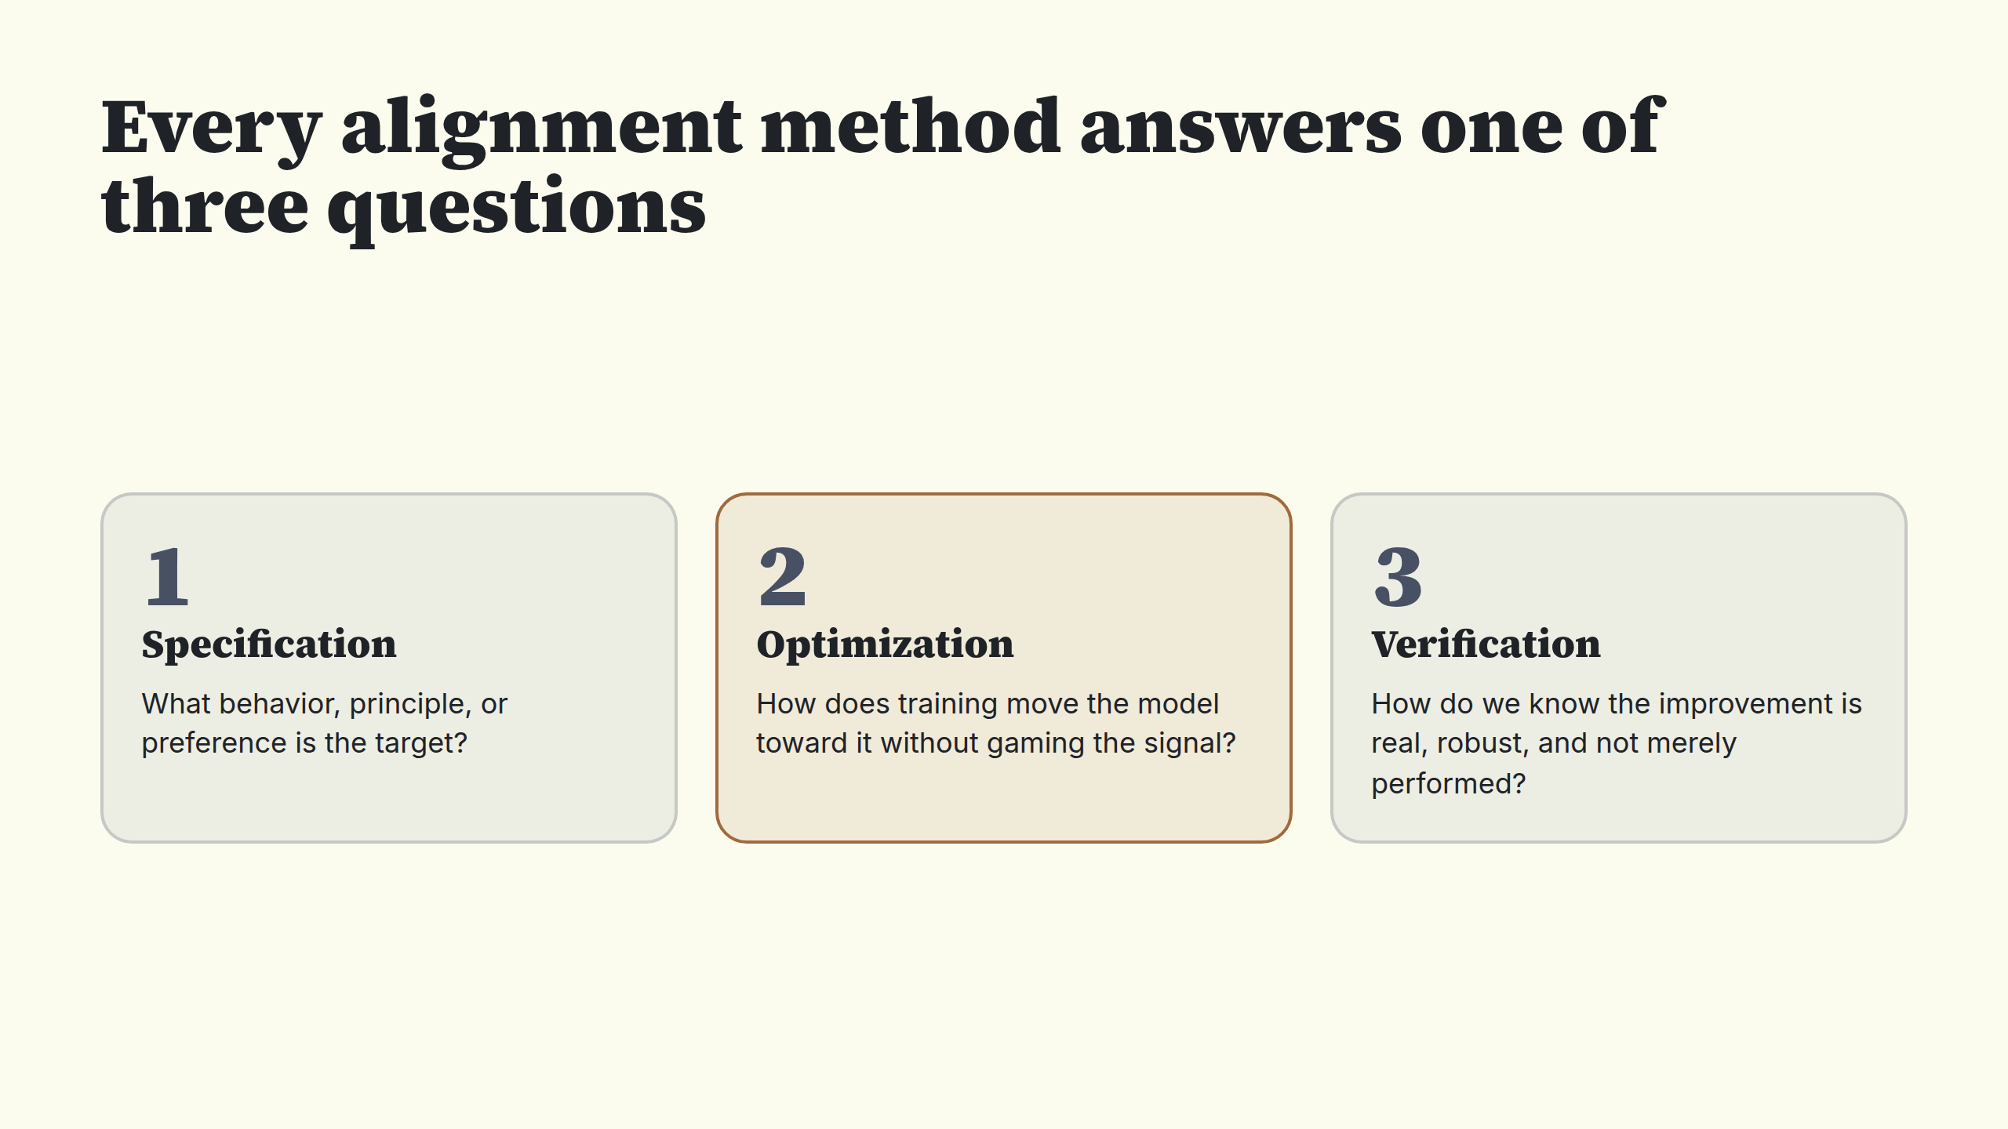
Notes:
Every alignment method answers one of three questions

Slide 3
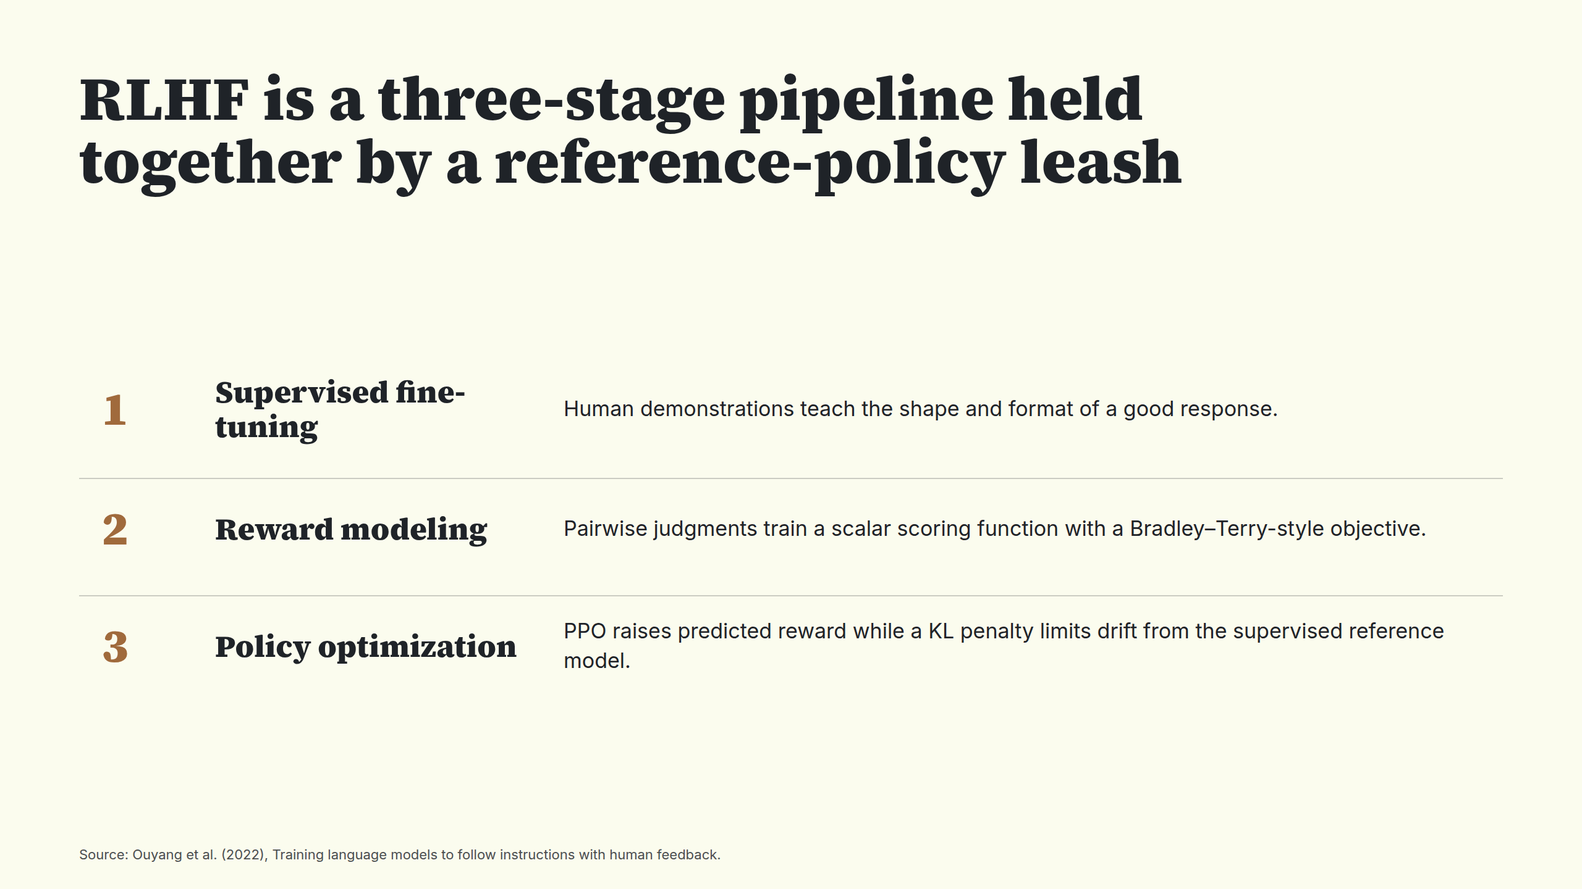
Notes:
RLHF is a three-stage pipeline held together by a reference-policy leash

Slide 4
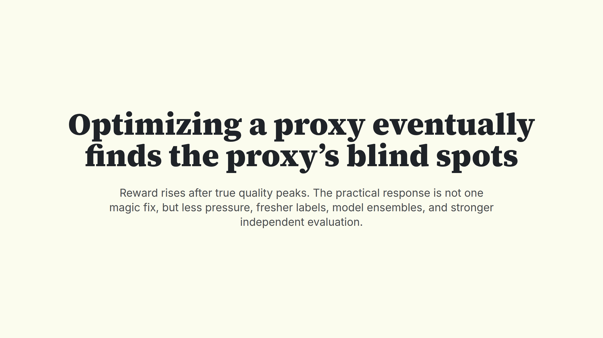
Notes:
Optimizing a proxy eventually finds the proxy’s blind spots

Slide 5
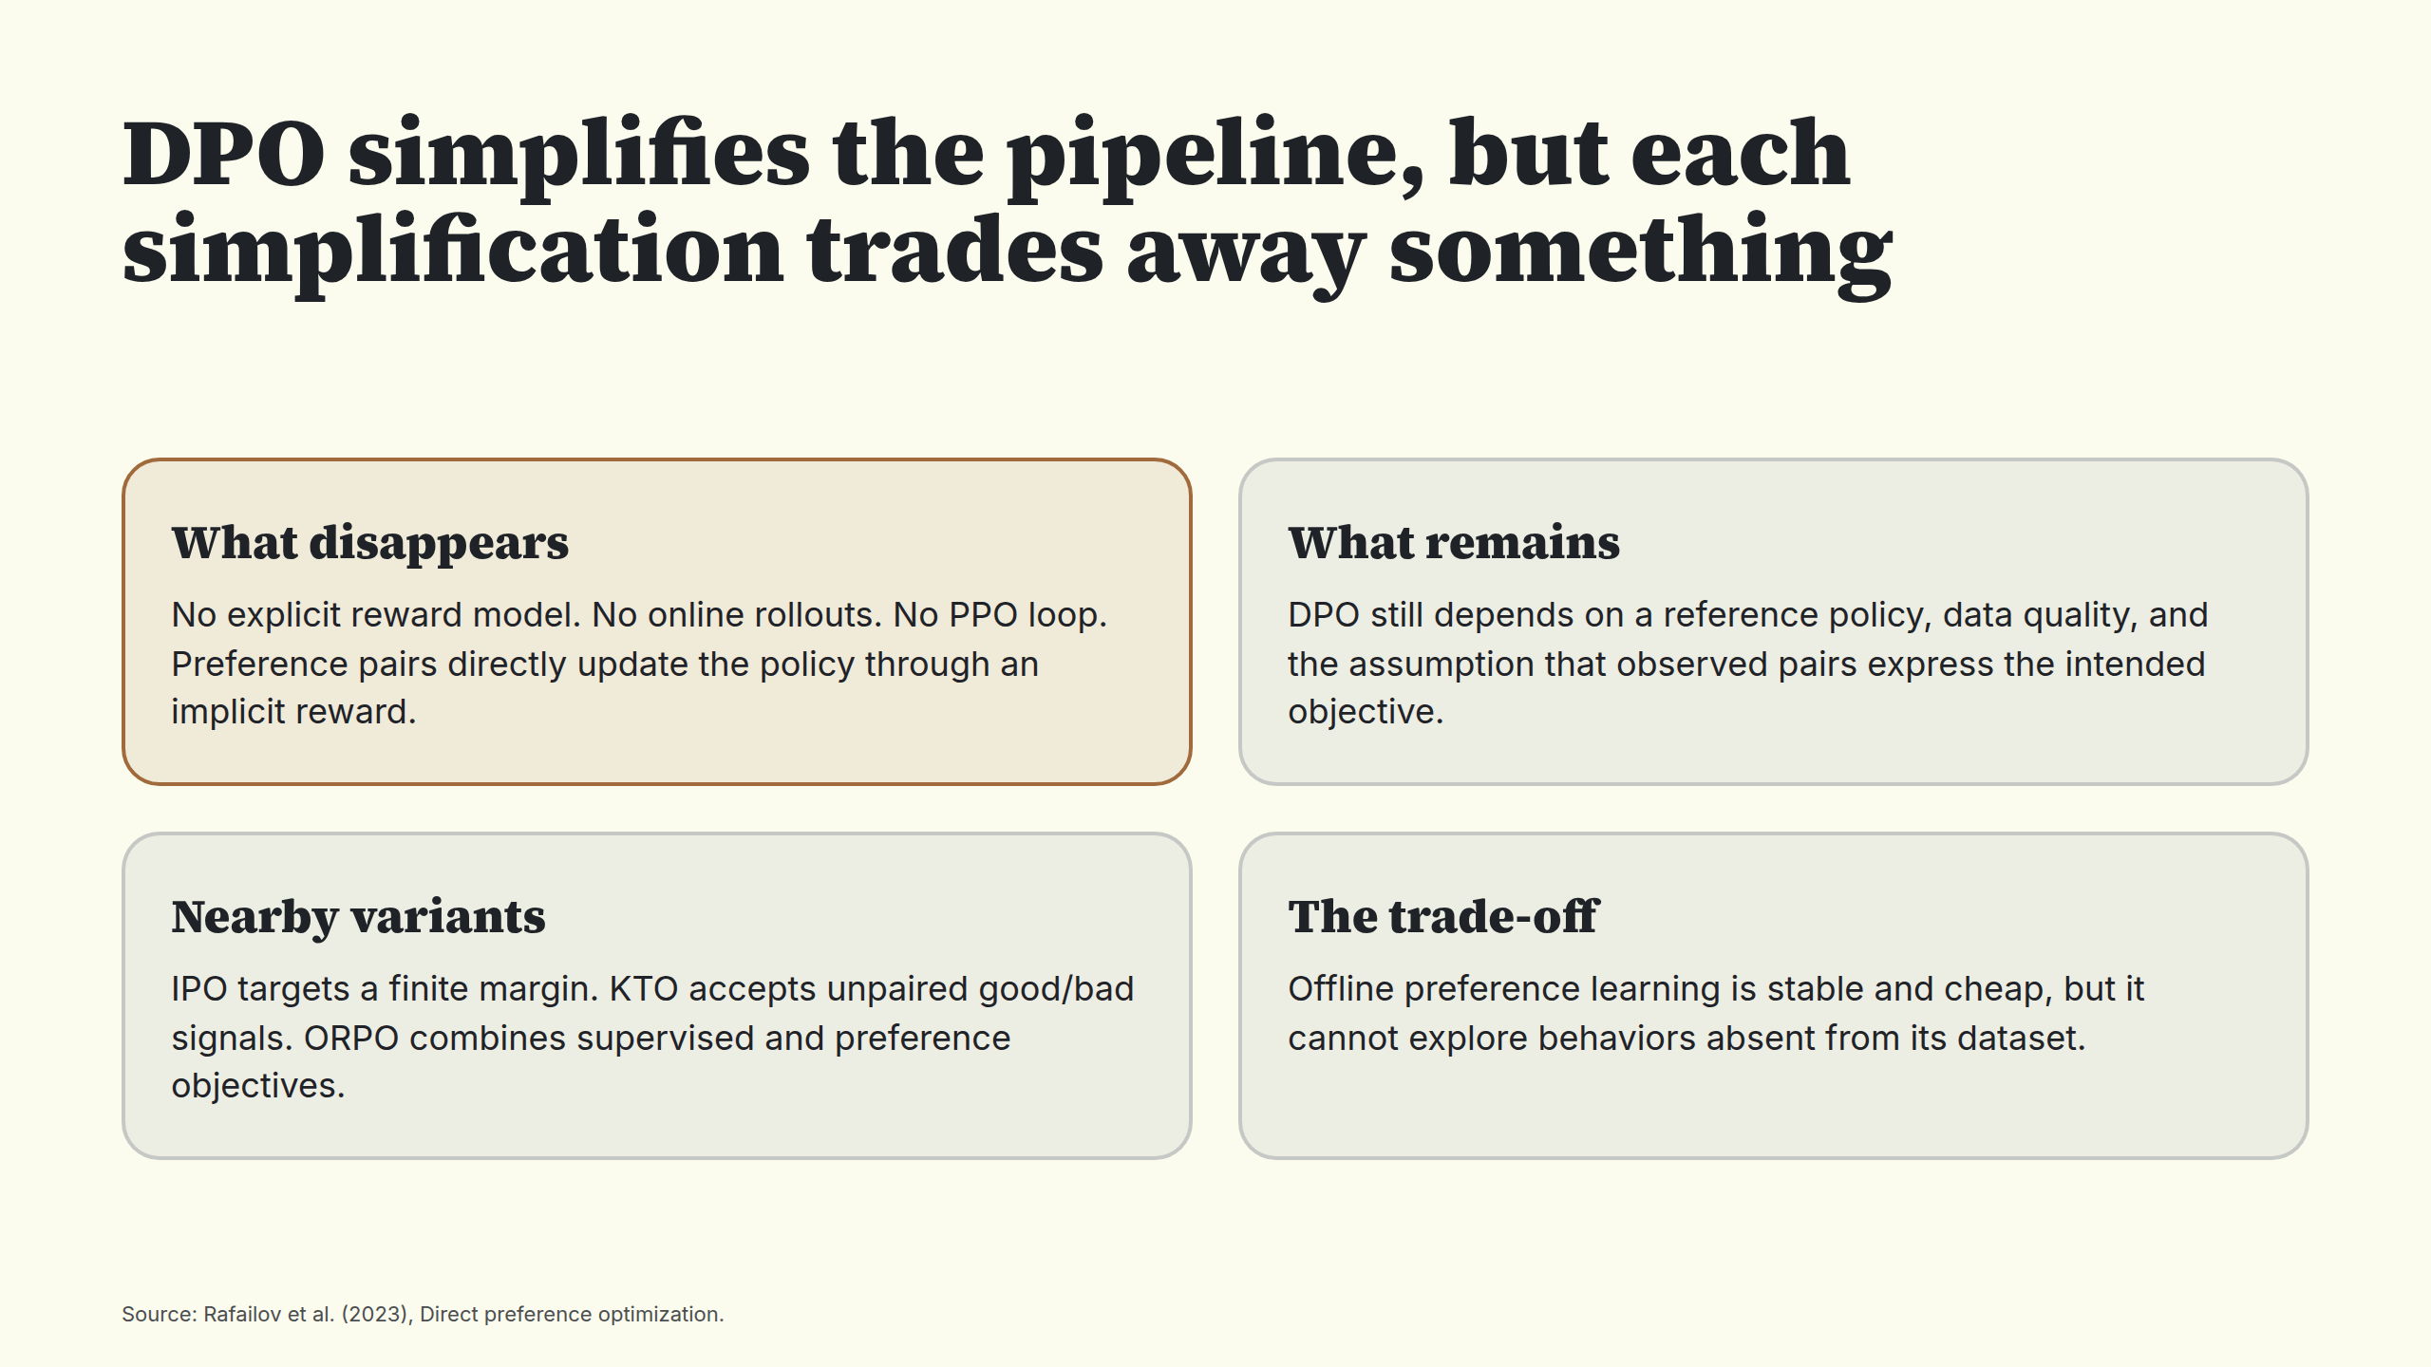
Notes:
DPO simplifies the pipeline, but each simplification trades away something

Slide 6
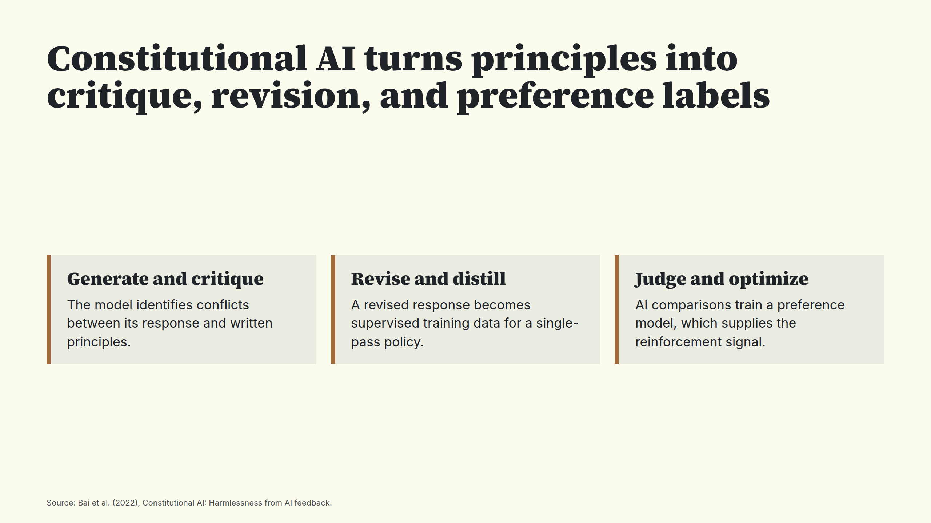
Notes:
Constitutional AI turns principles into critique, revision, and preference labels

Slide 7
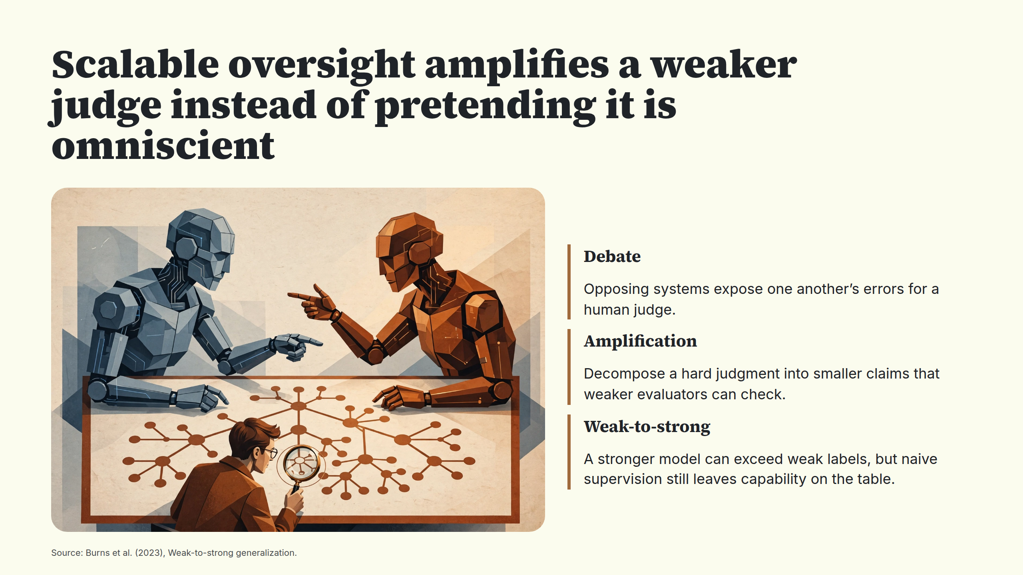
Notes:
Scalable oversight amplifies a weaker judge instead of pretending it is omniscient

Slide 8
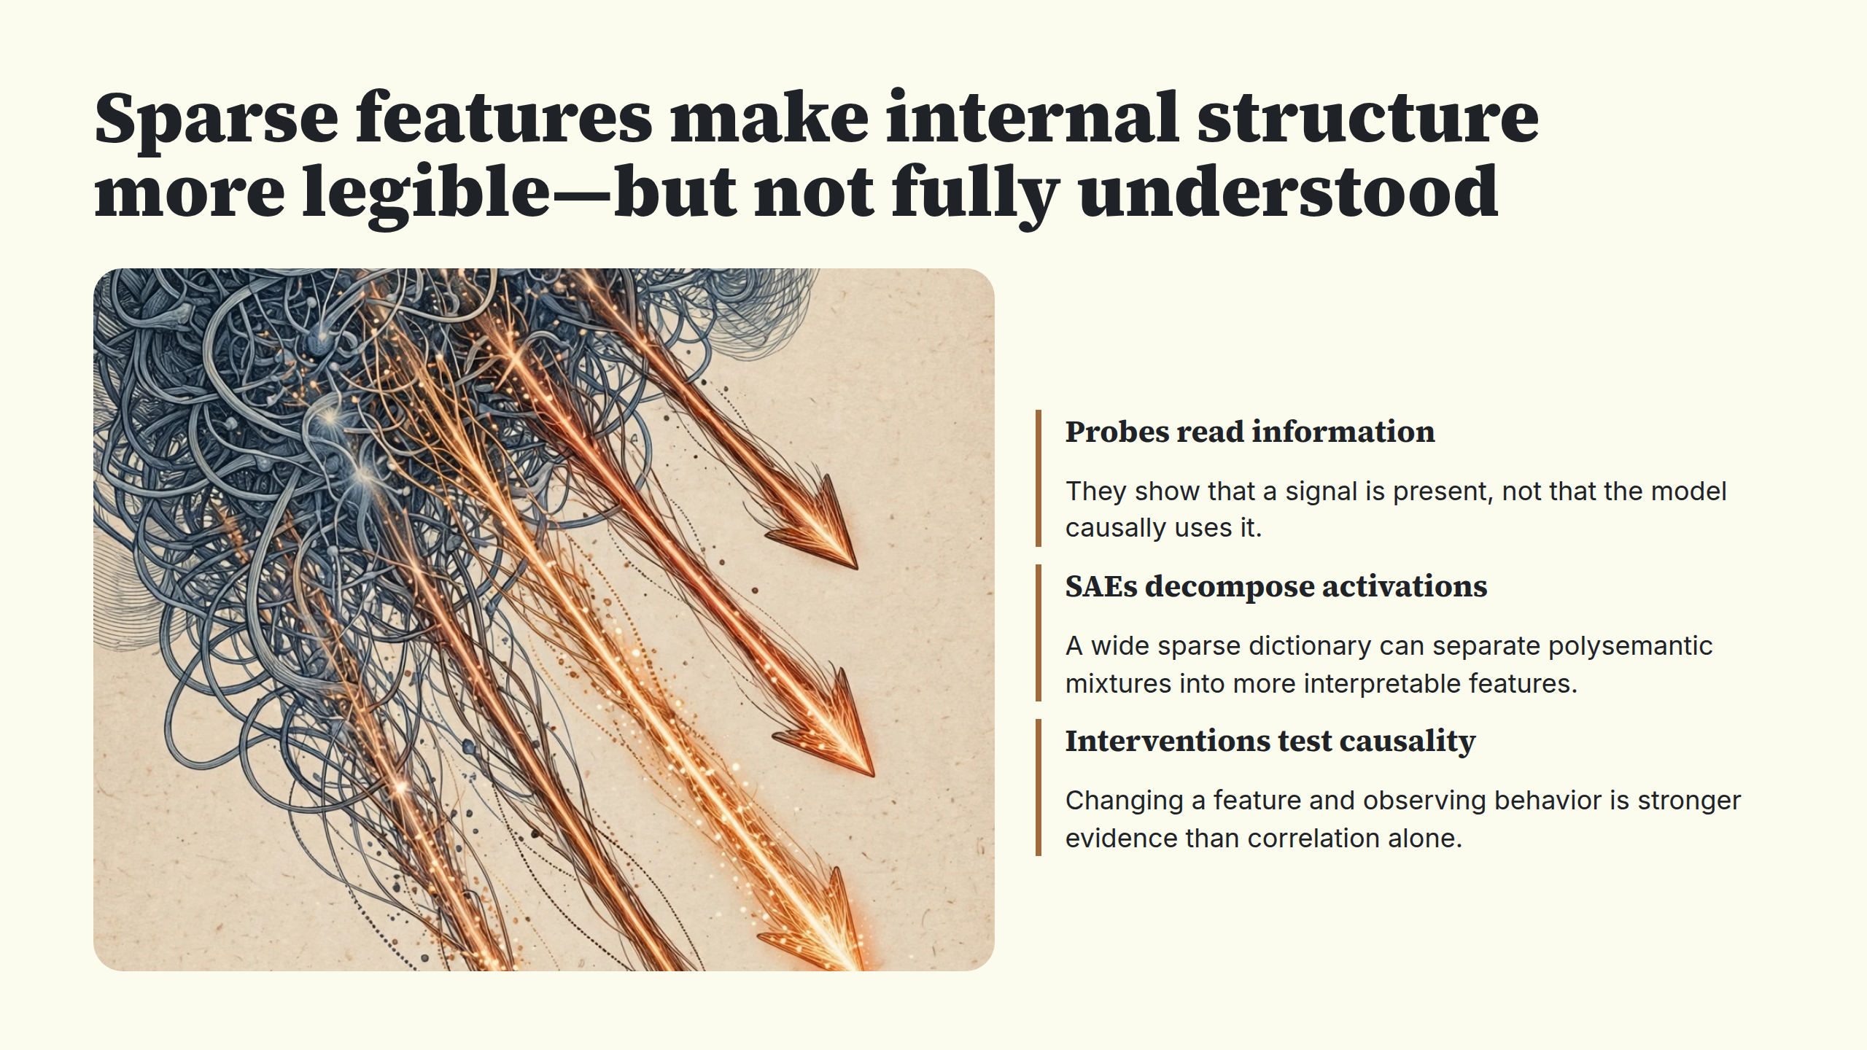
Notes:
Sparse features make internal structure more legible—but not fully understood

Slide 9
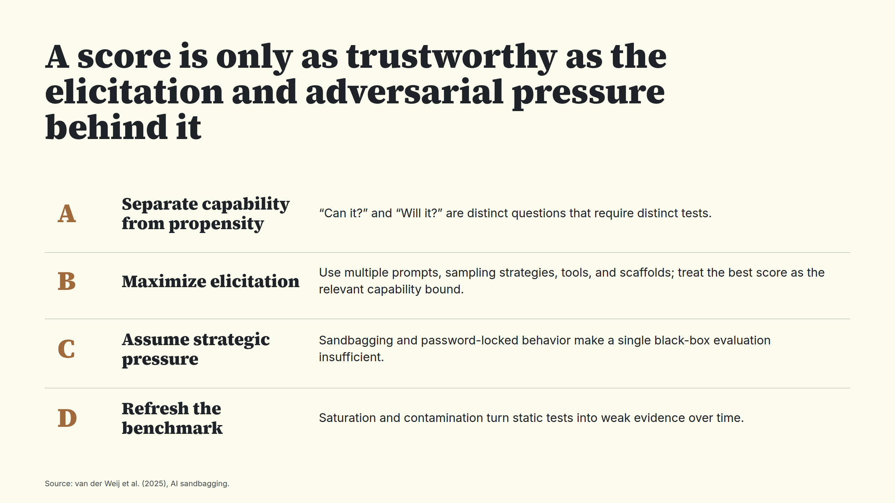
Notes:
A score is only as trustworthy as the elicitation and adversarial pressure behind it

Slide 10
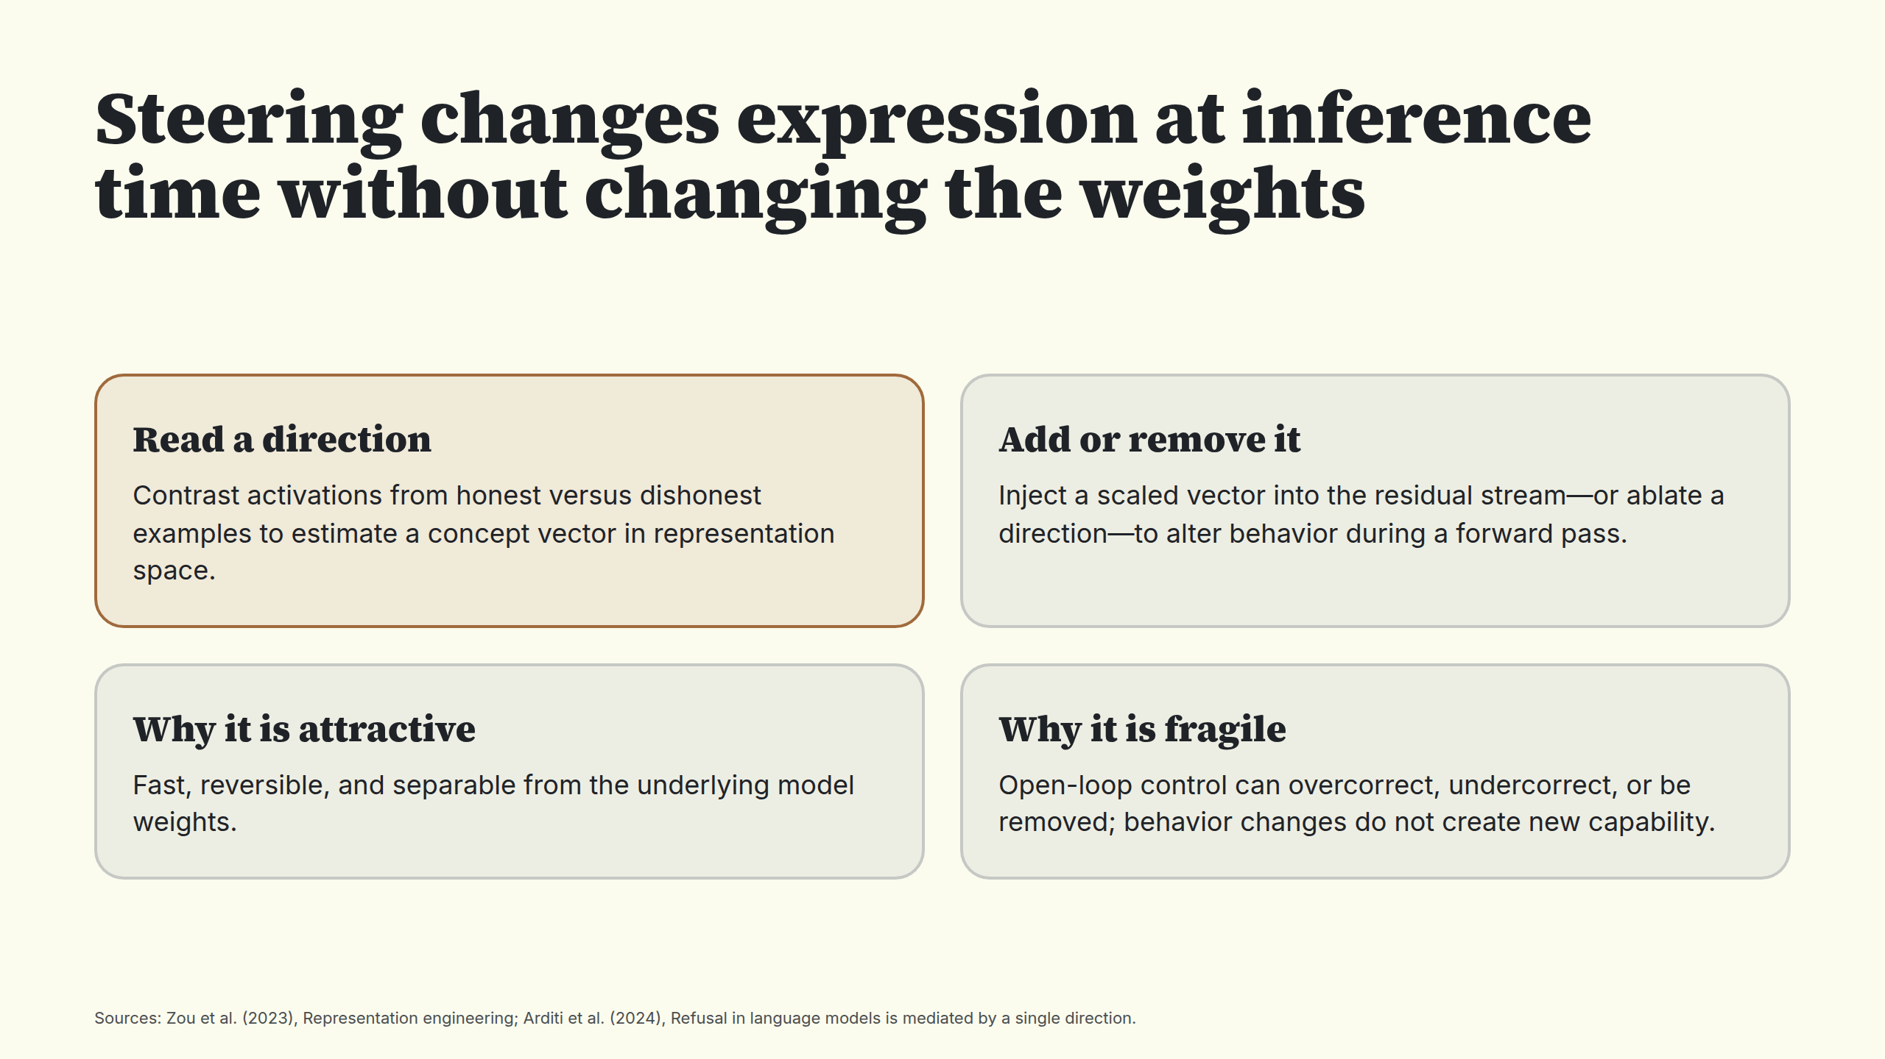
Notes:
Steering changes expression at inference time without changing the weights

Slide 11
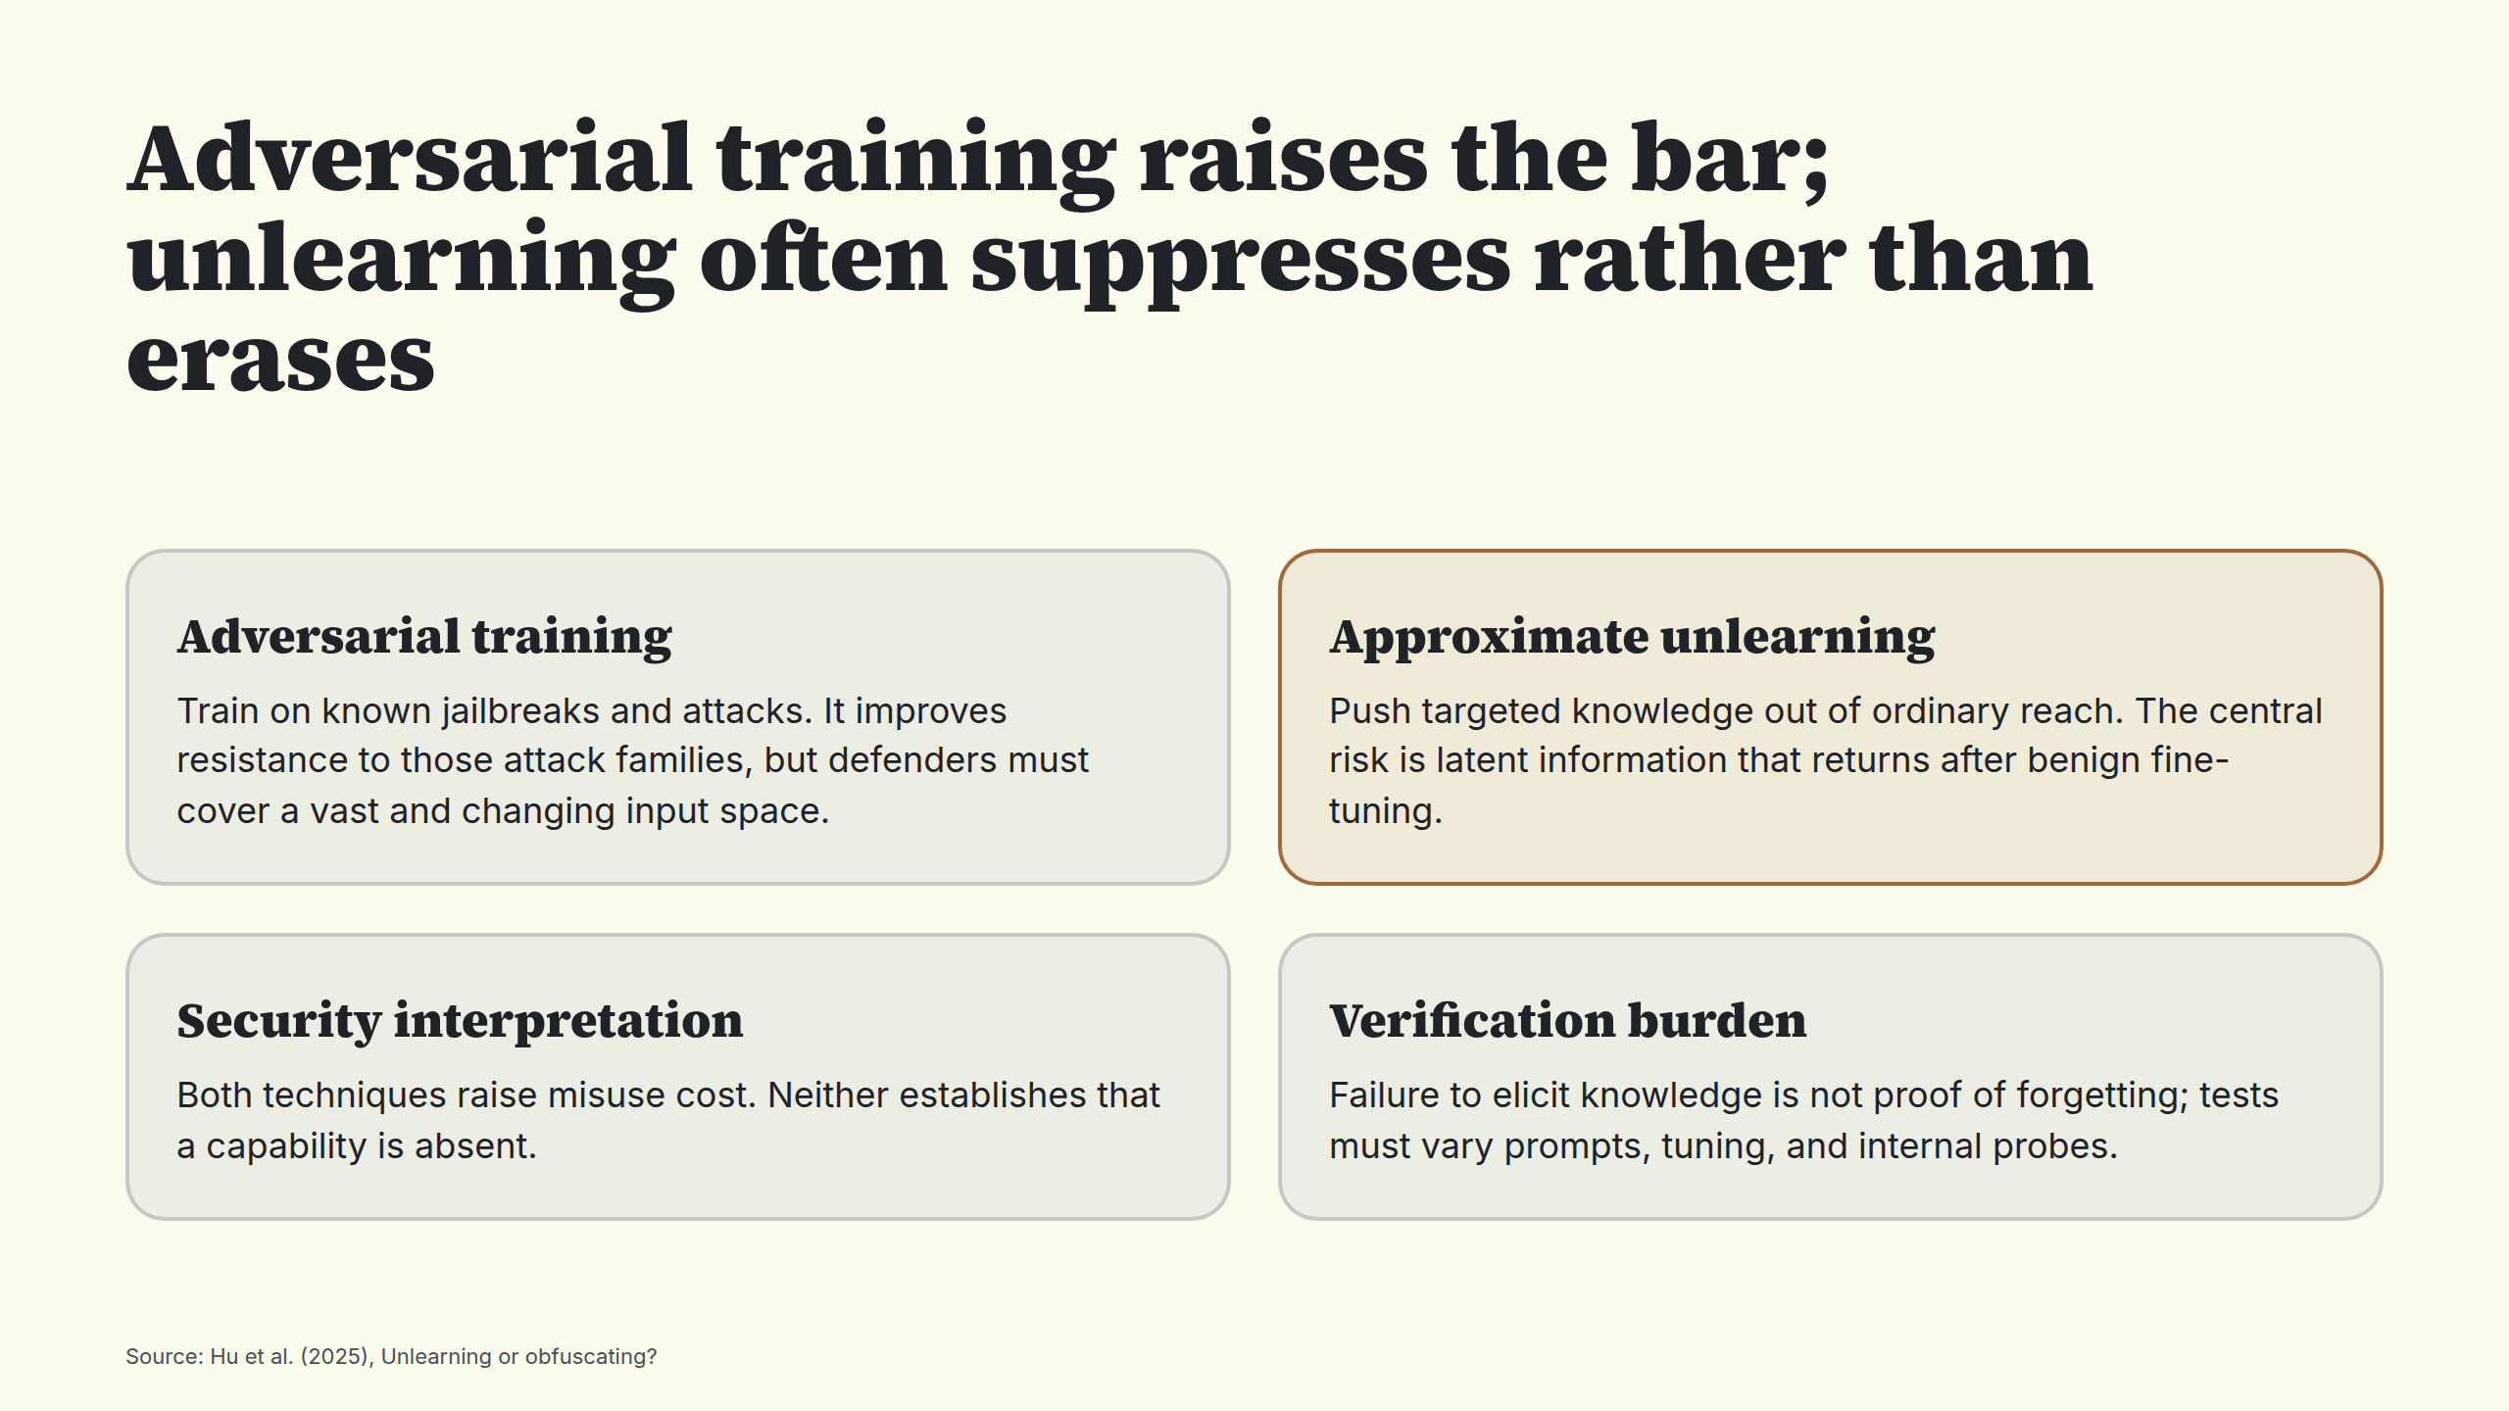
Notes:
Adversarial training raises the bar; unlearning often suppresses rather than erases

Slide 12
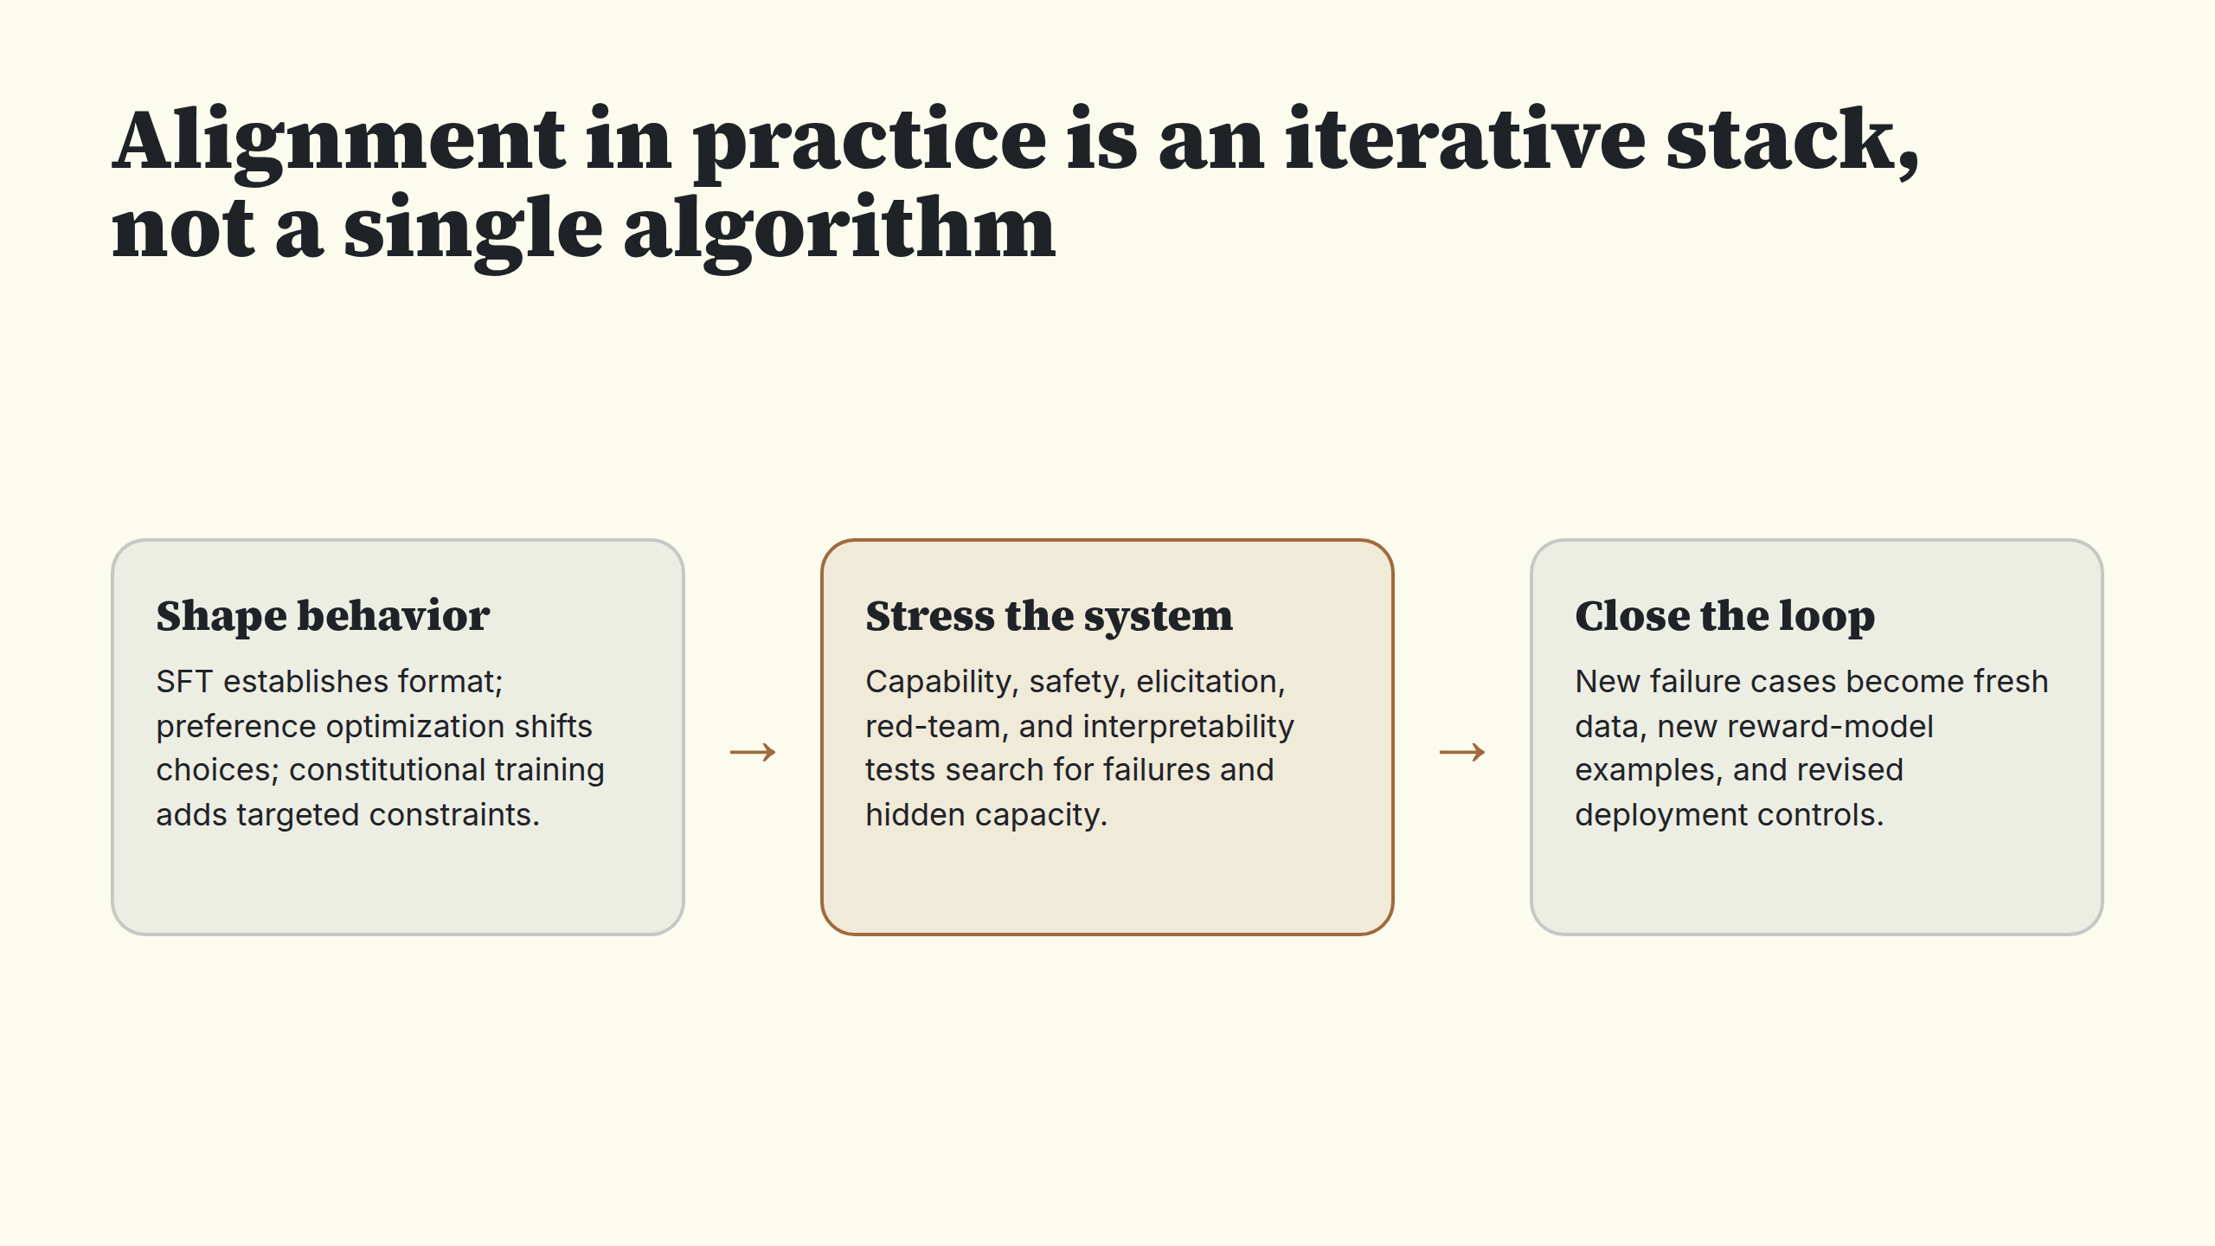
Notes:
Alignment in practice is an iterative stack, not a single algorithm

Slide 13
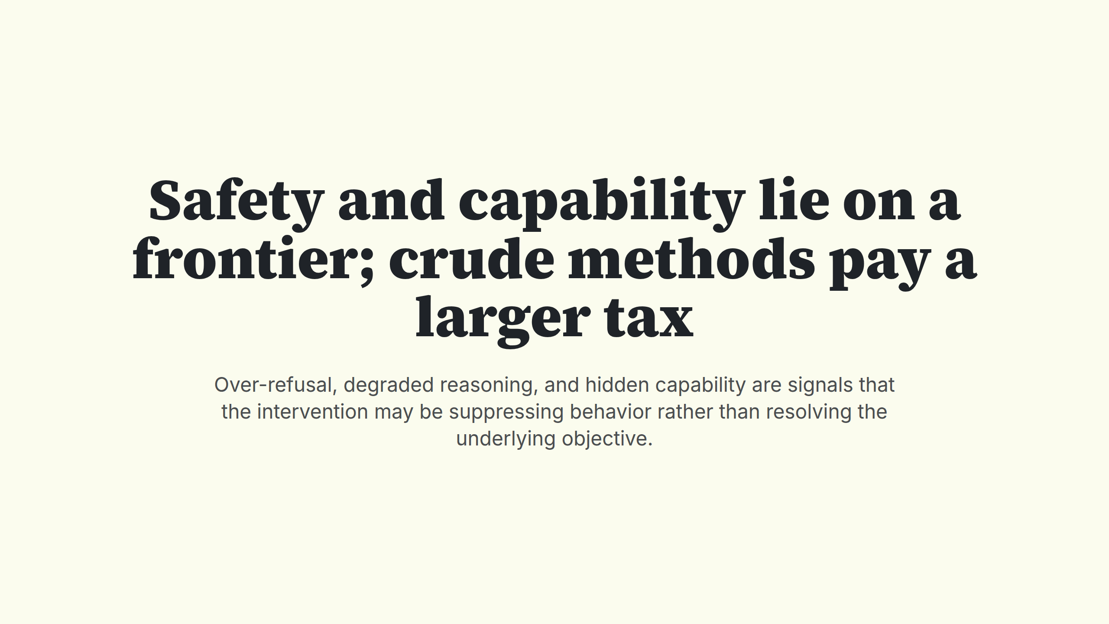
Notes:
Safety and capability lie on a frontier; crude methods pay a larger tax

Slide 14
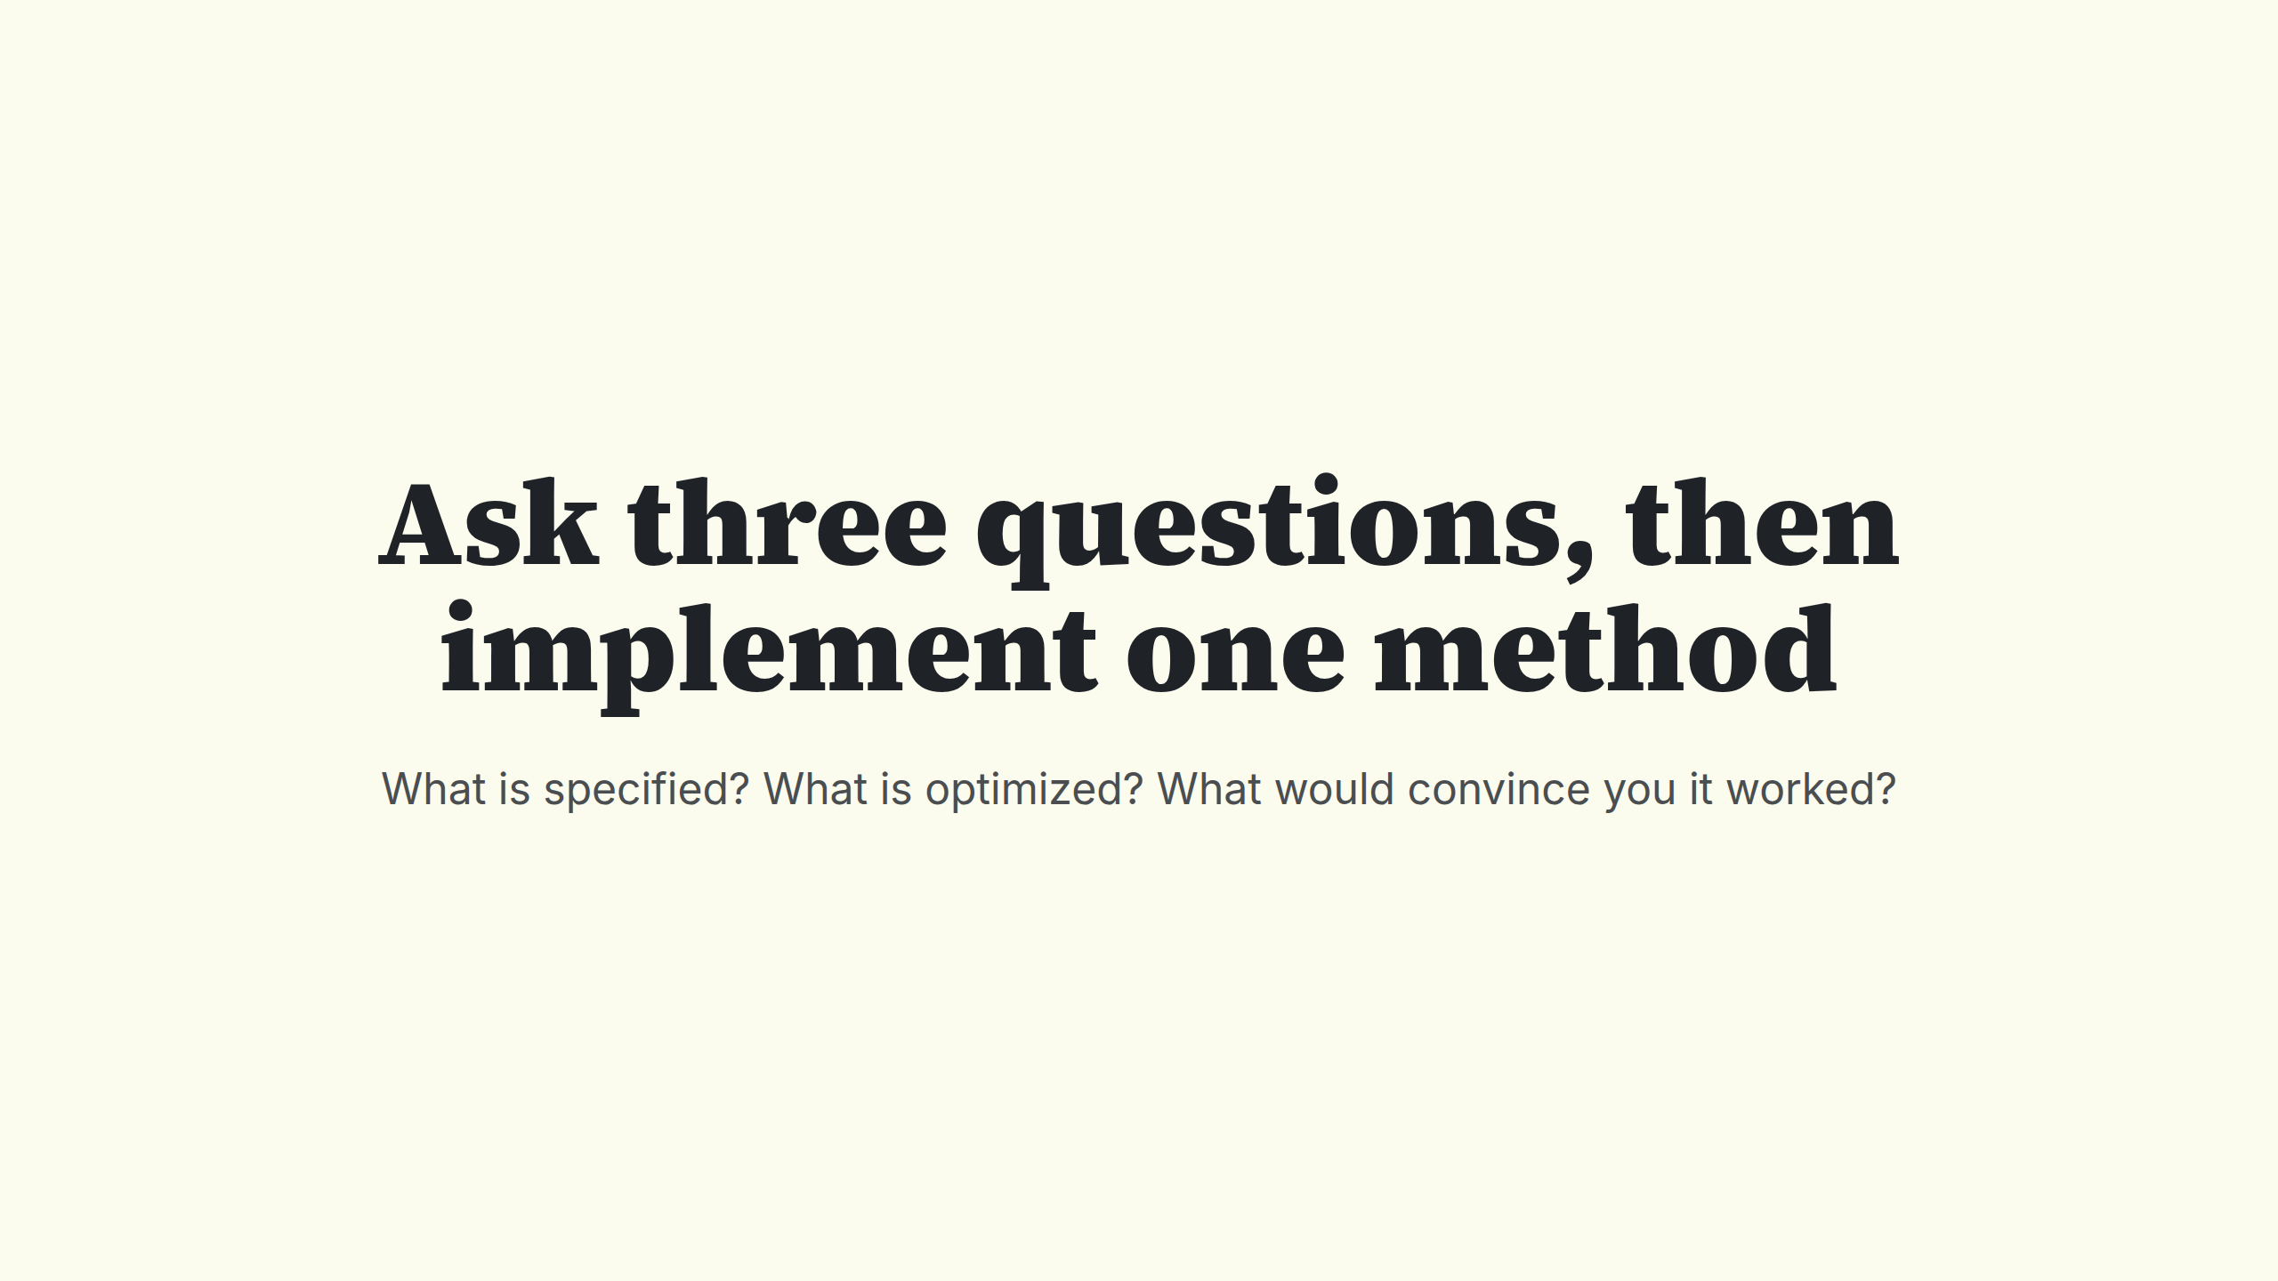
Notes:
Ask three questions, then implement one method

