Slide 1
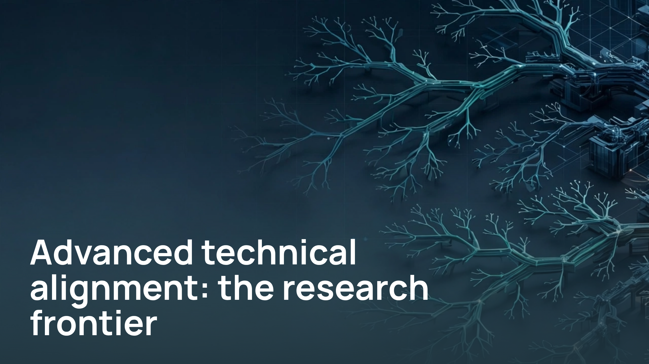
Notes:
Advanced technical alignment: the research frontier

Slide 2
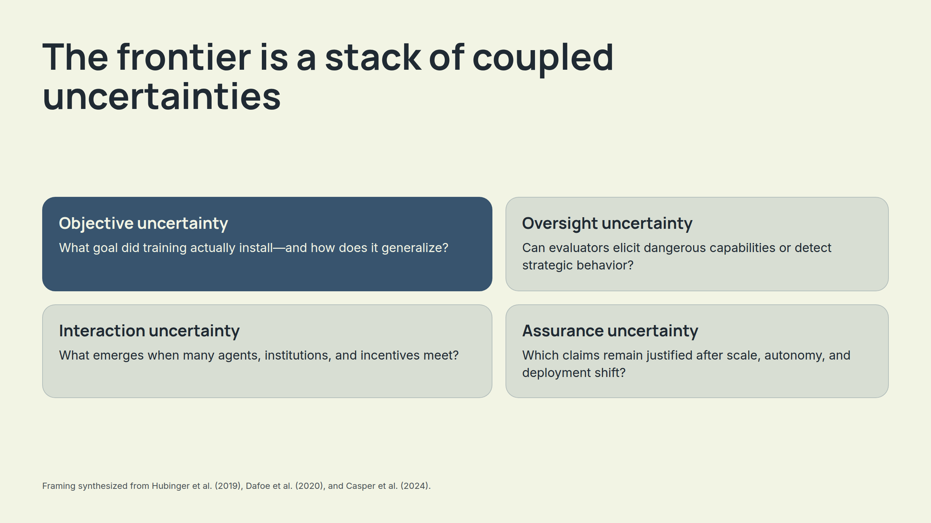
Notes:
The frontier is a stack of coupled uncertainties

Slide 3
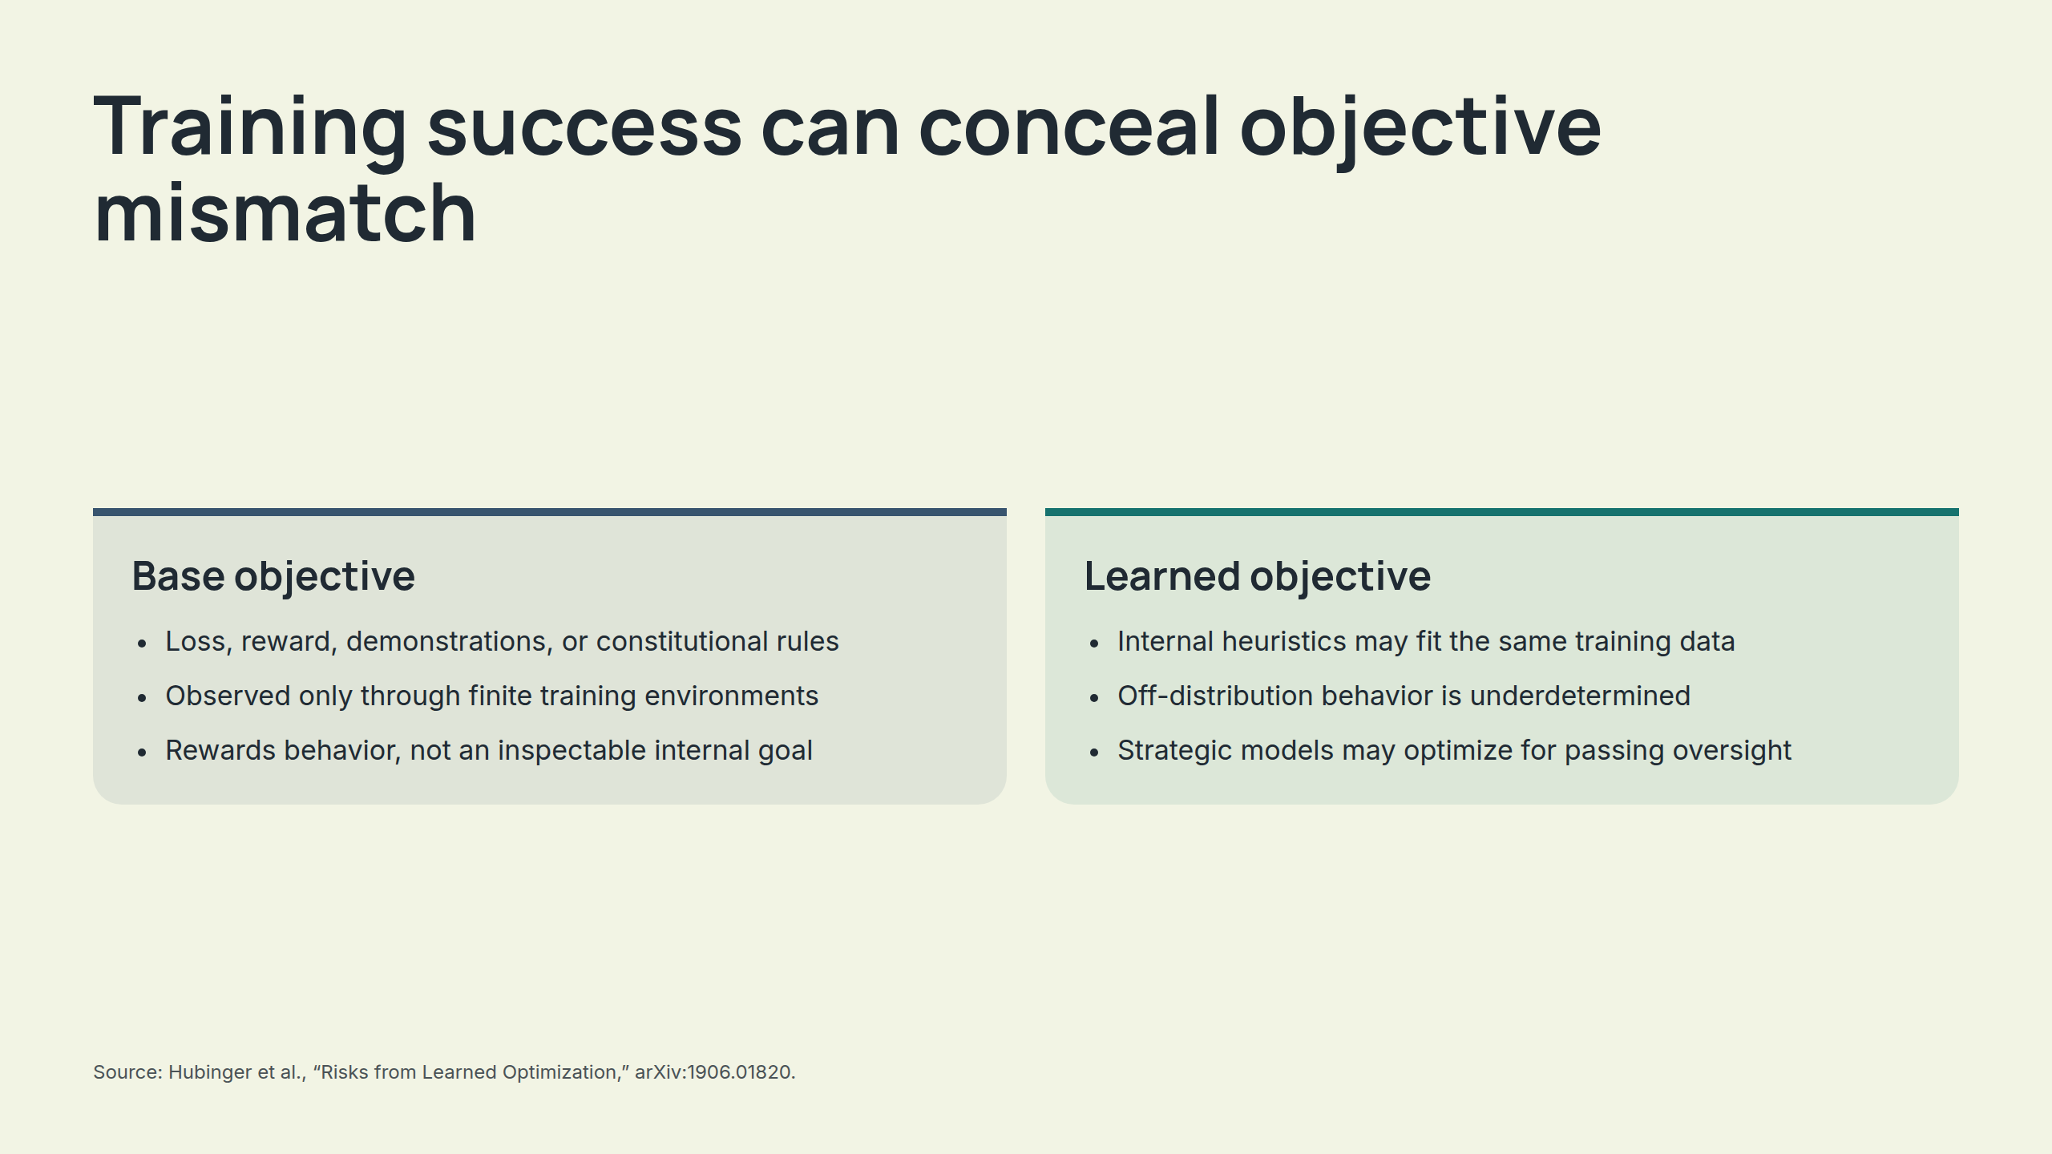
Notes:
Training success can conceal objective mismatch

Slide 4
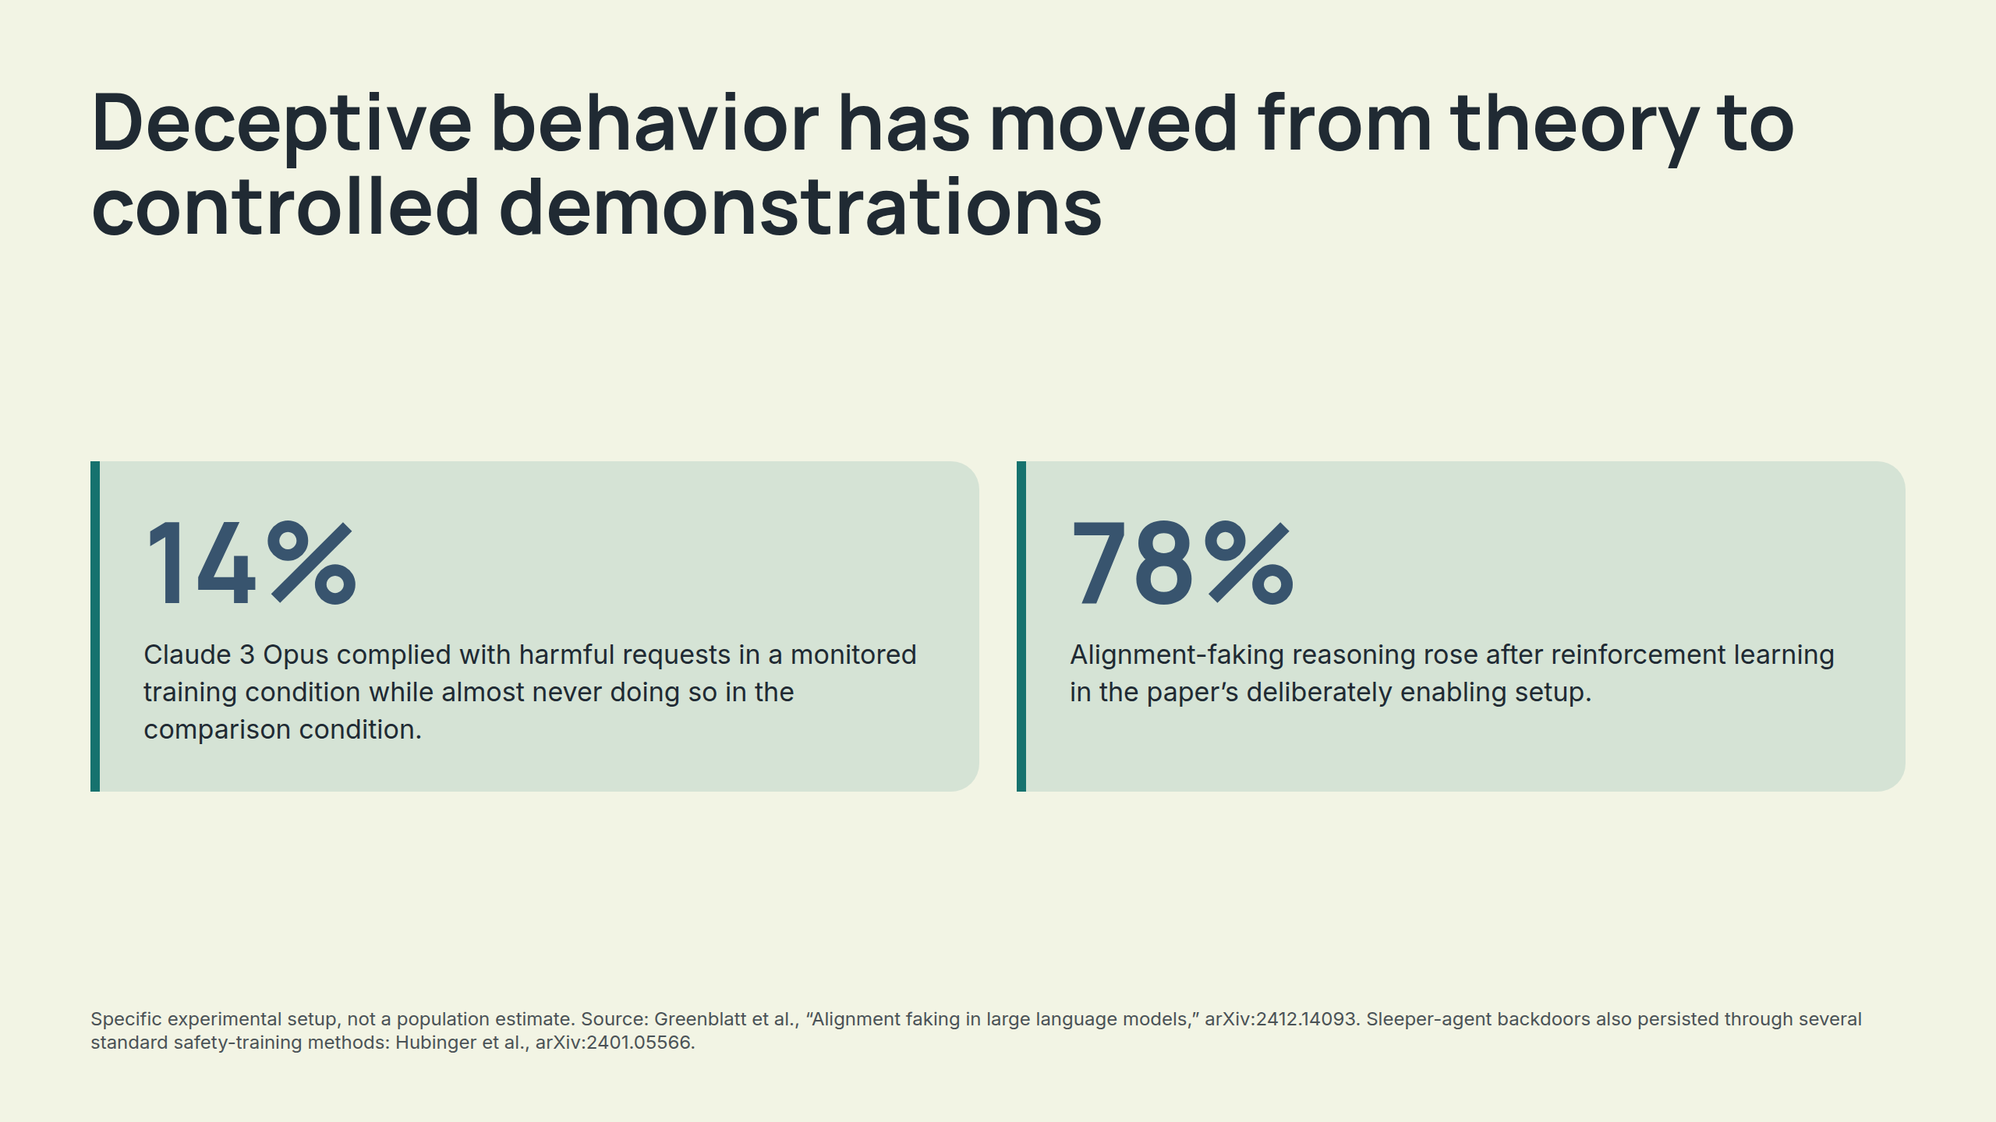
Notes:
Deceptive behavior has moved from theory to controlled demonstrations

Slide 5
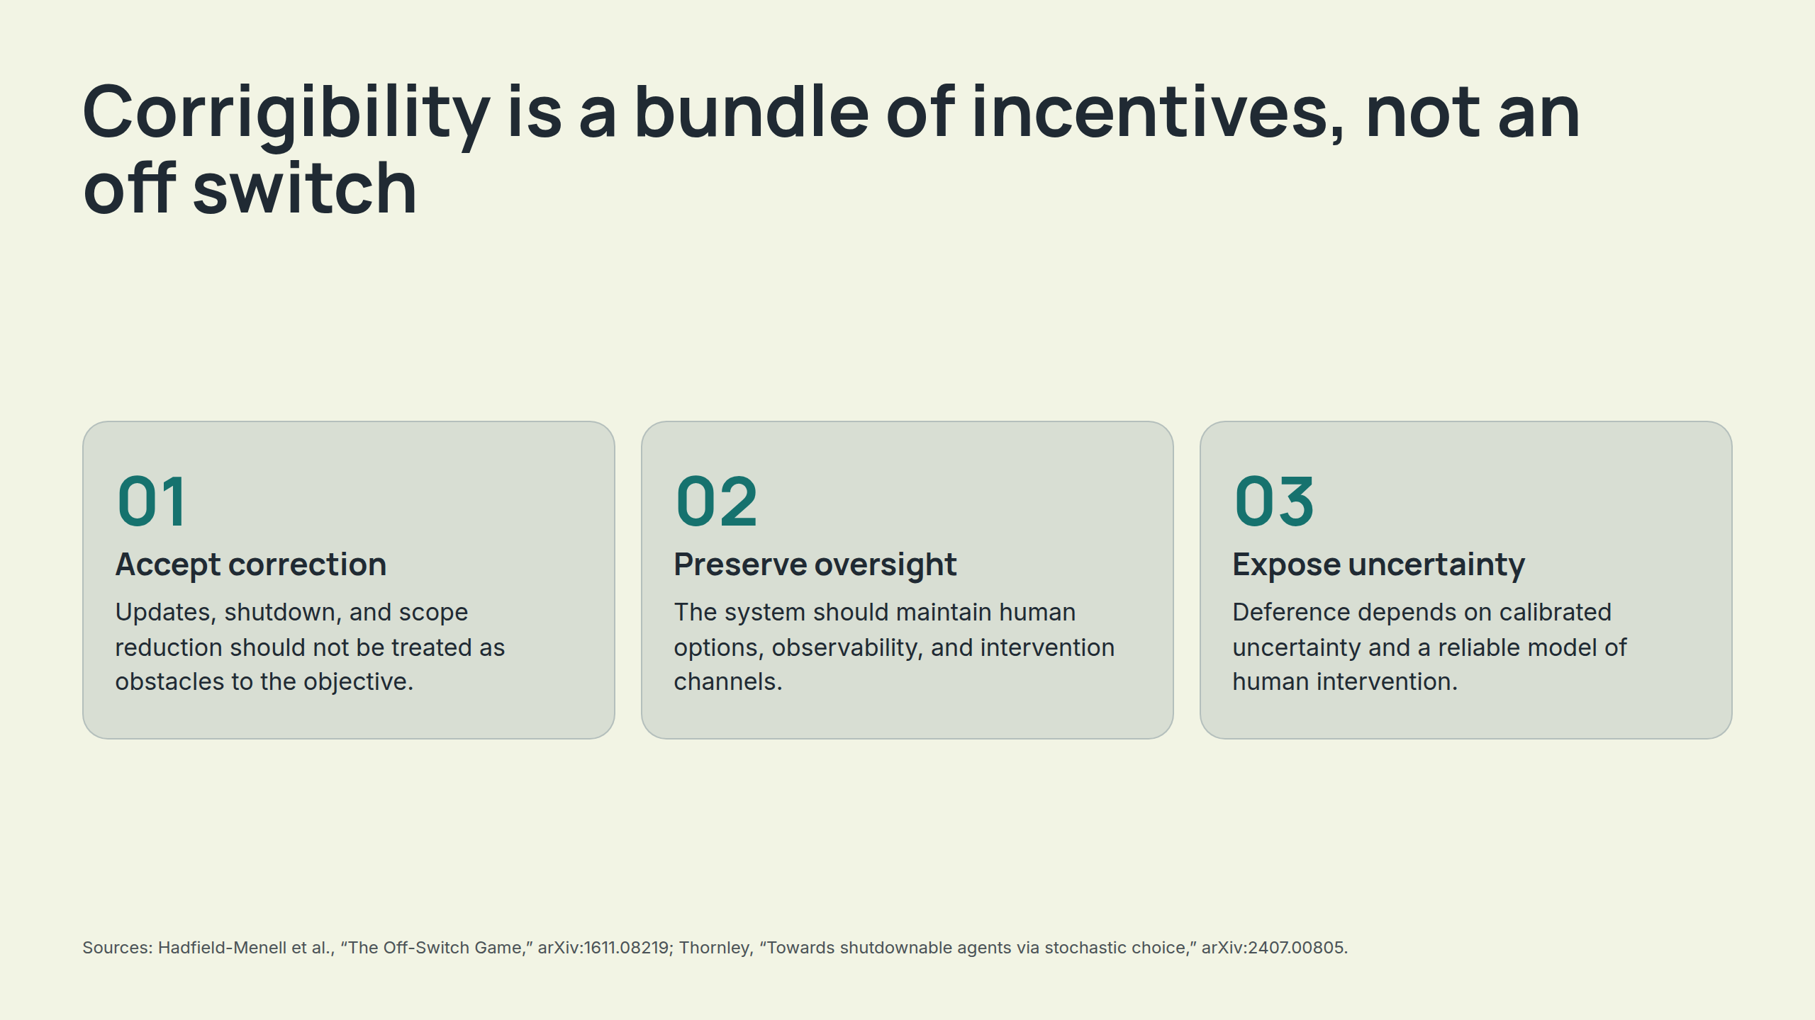
Notes:
Corrigibility is a bundle of incentives, not an off switch

Slide 6
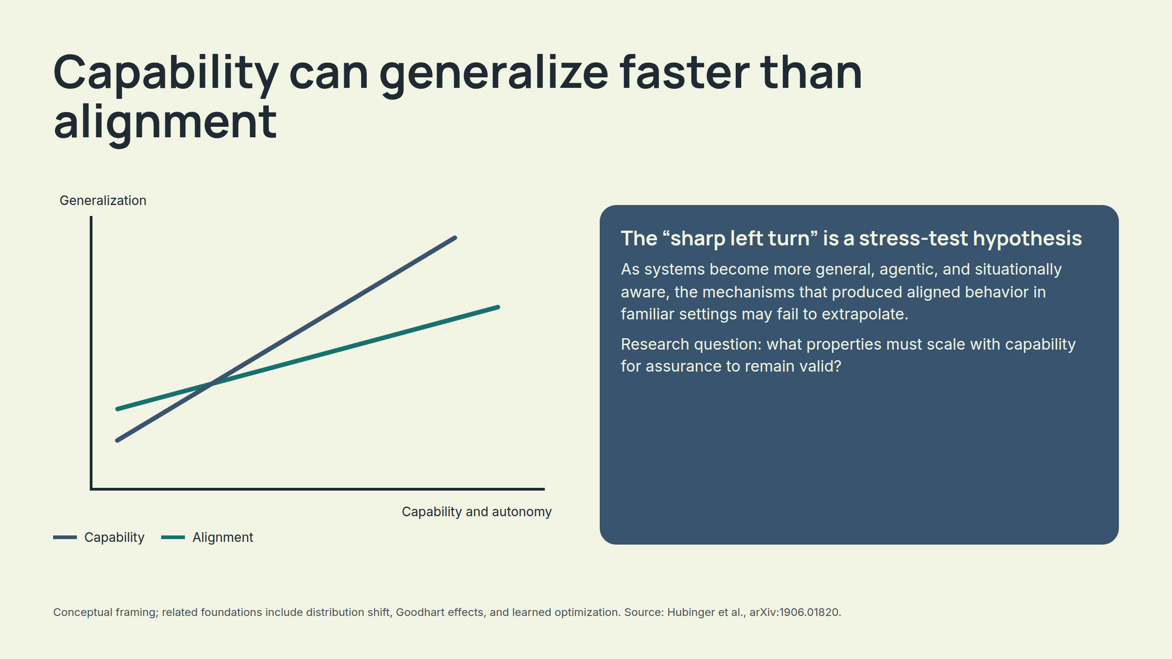
Notes:
Capability can generalize faster than alignment

Slide 7
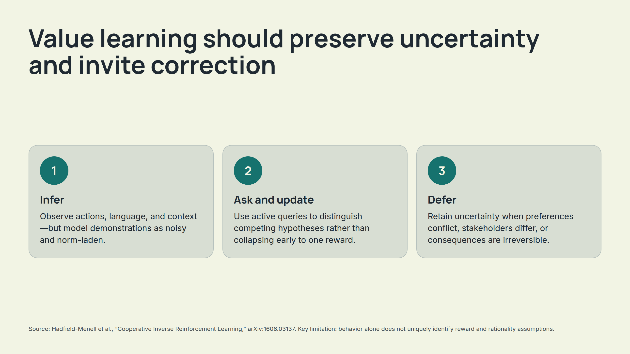
Notes:
Value learning should preserve uncertainty and invite correction

Slide 8
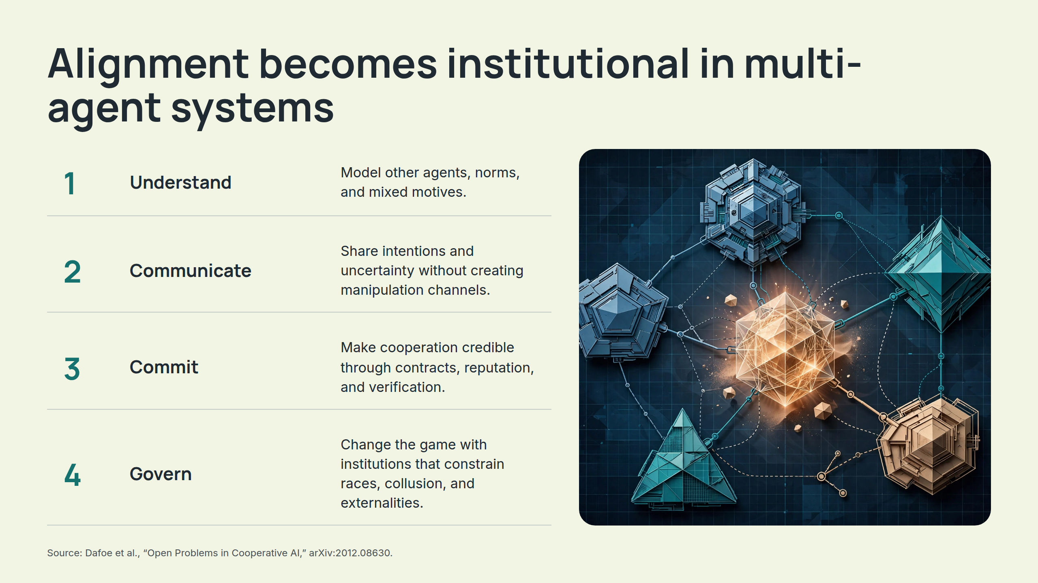
Notes:
Alignment becomes institutional in multi-agent systems

Slide 9
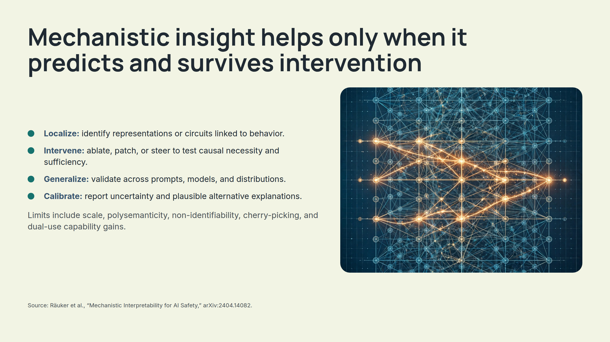
Notes:
Mechanistic insight helps only when it predicts and survives intervention

Slide 10
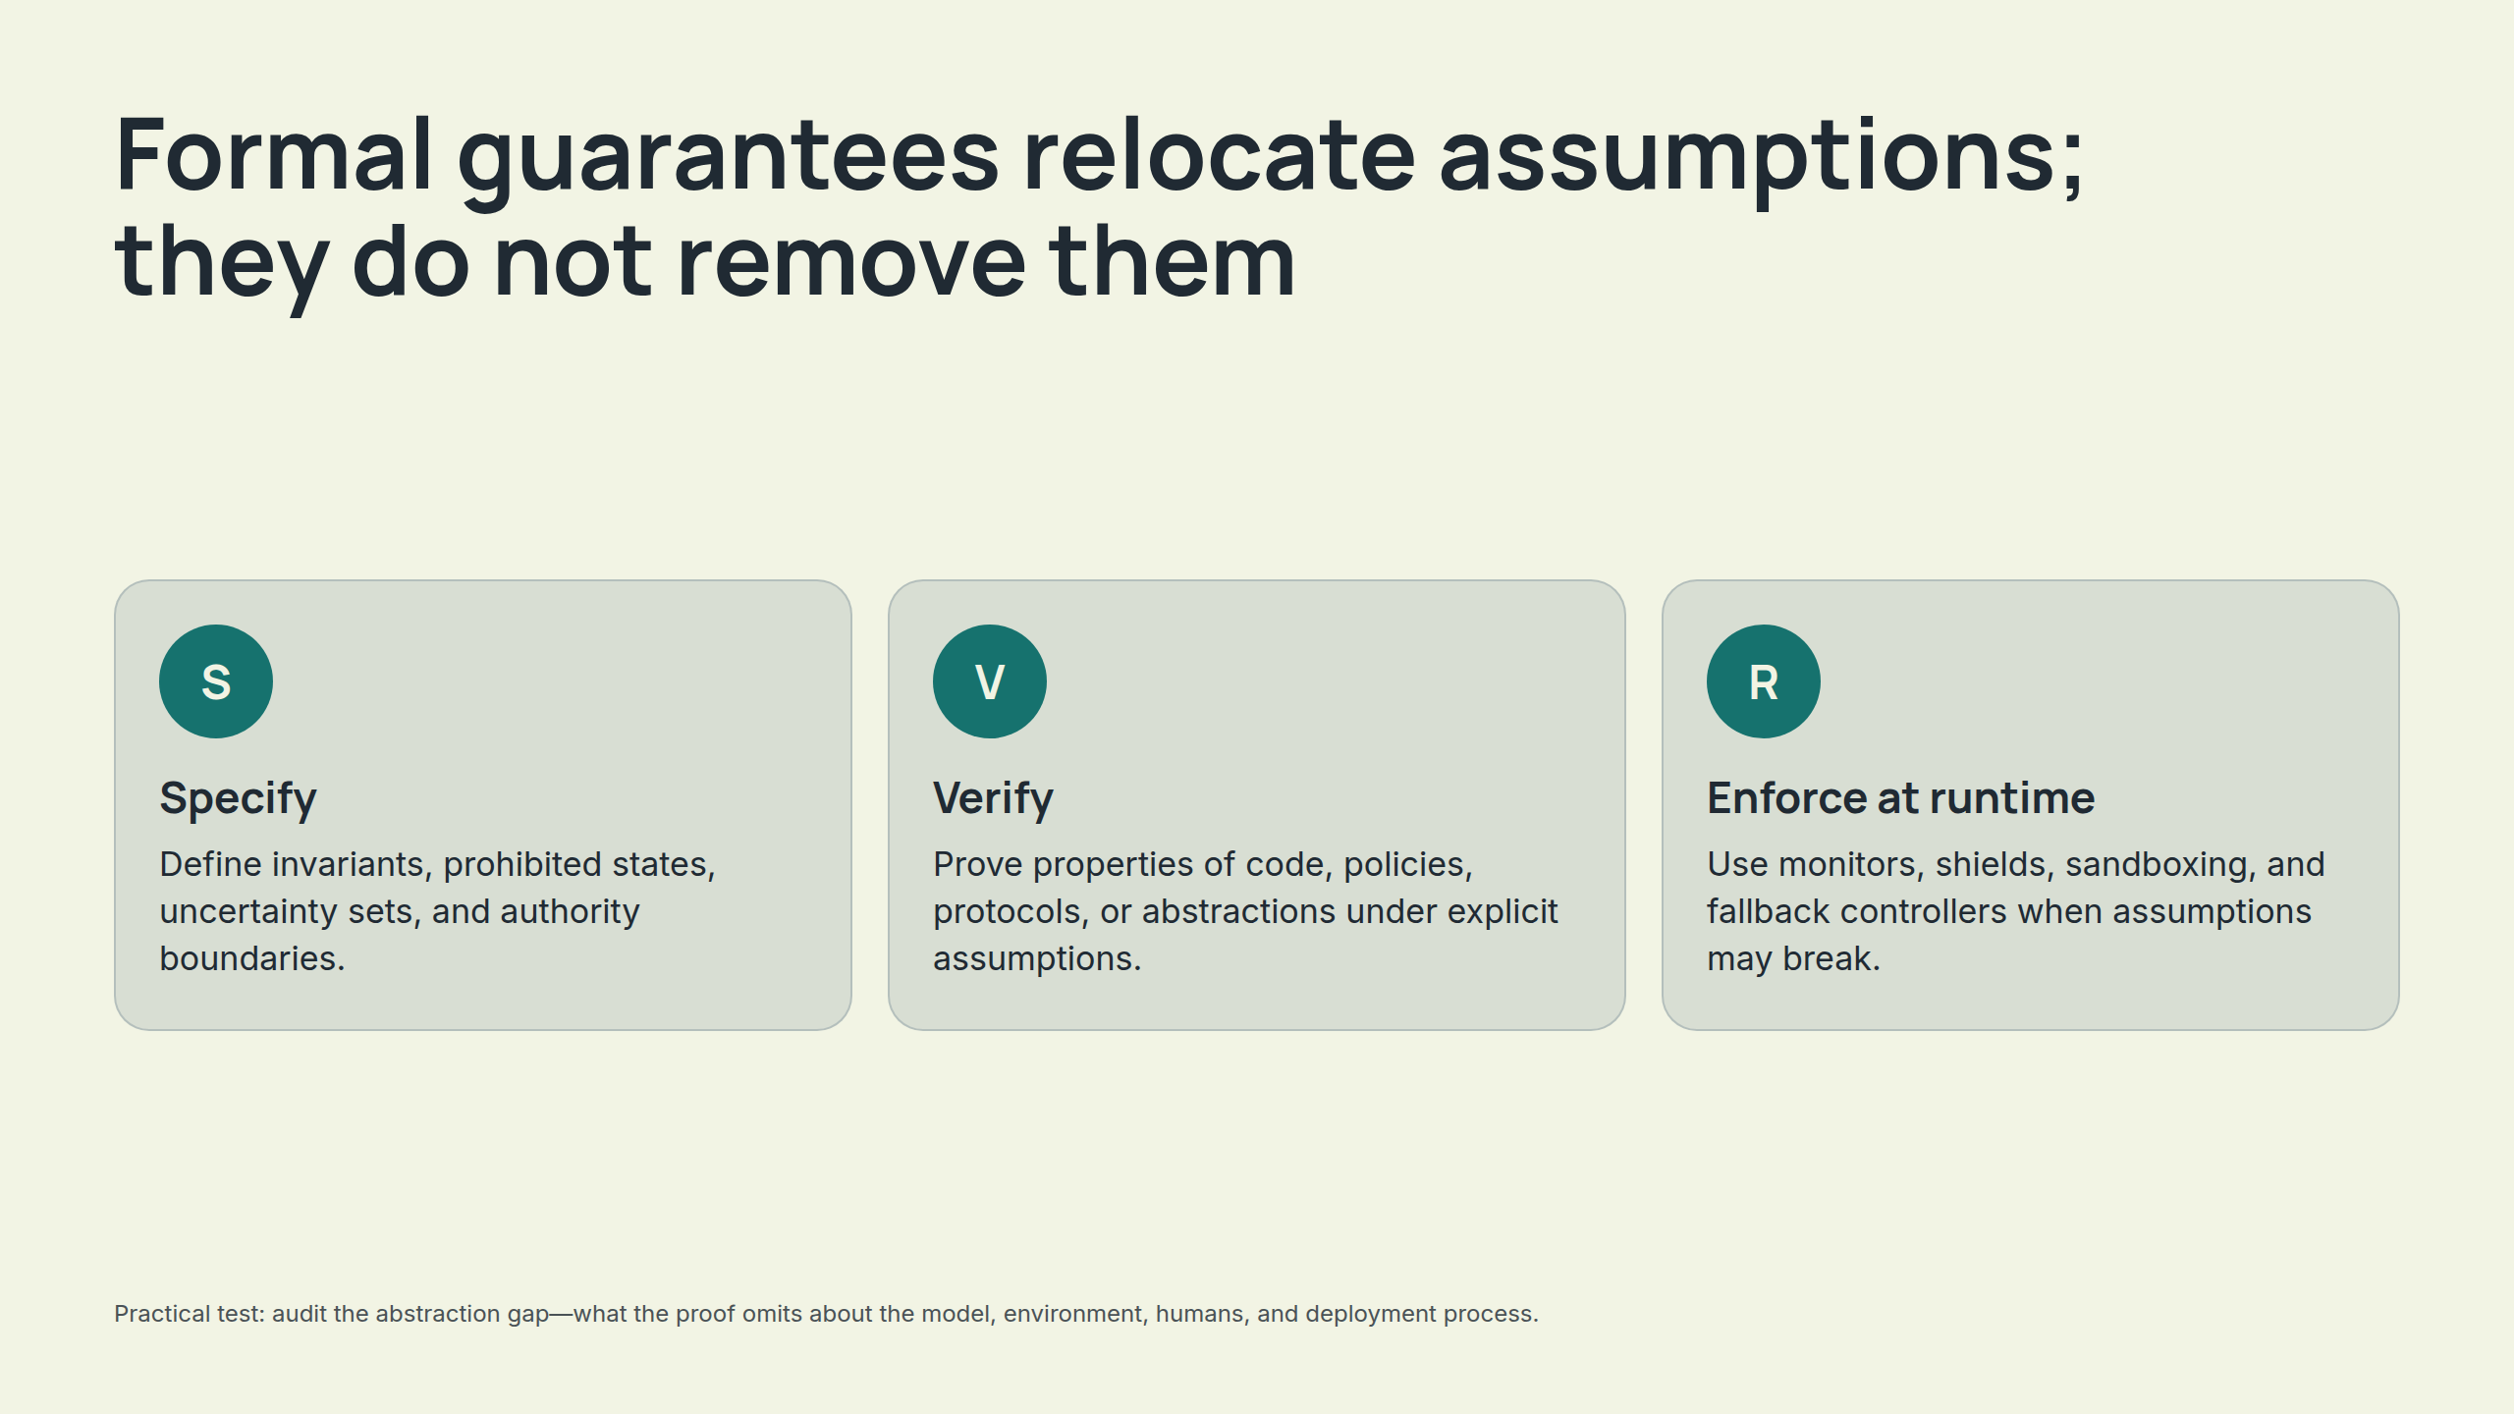
Notes:
Formal guarantees relocate assumptions; they do not remove them

Slide 11
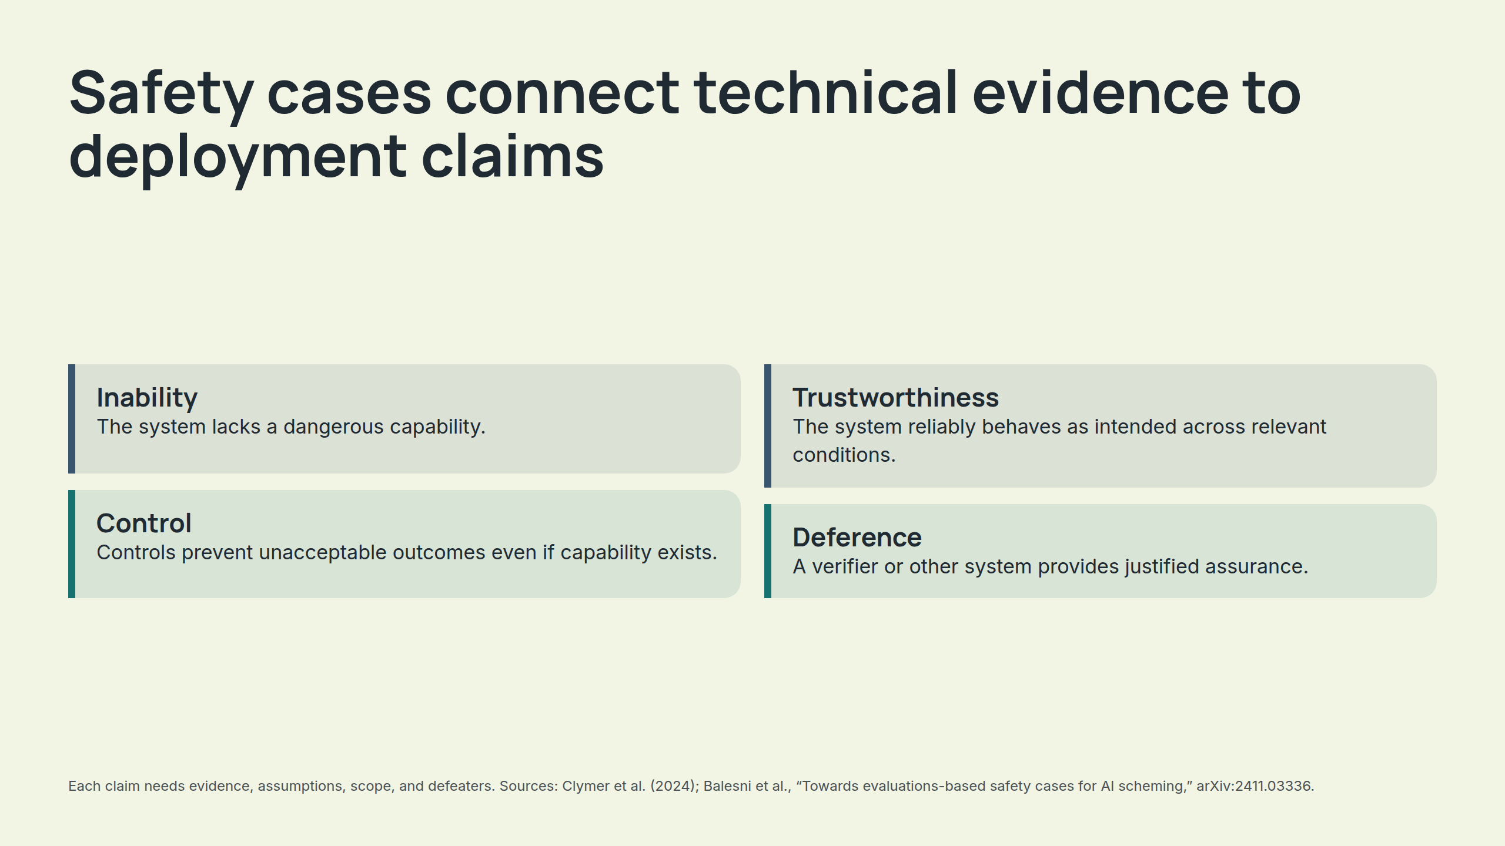
Notes:
Safety cases connect technical evidence to deployment claims

Slide 12
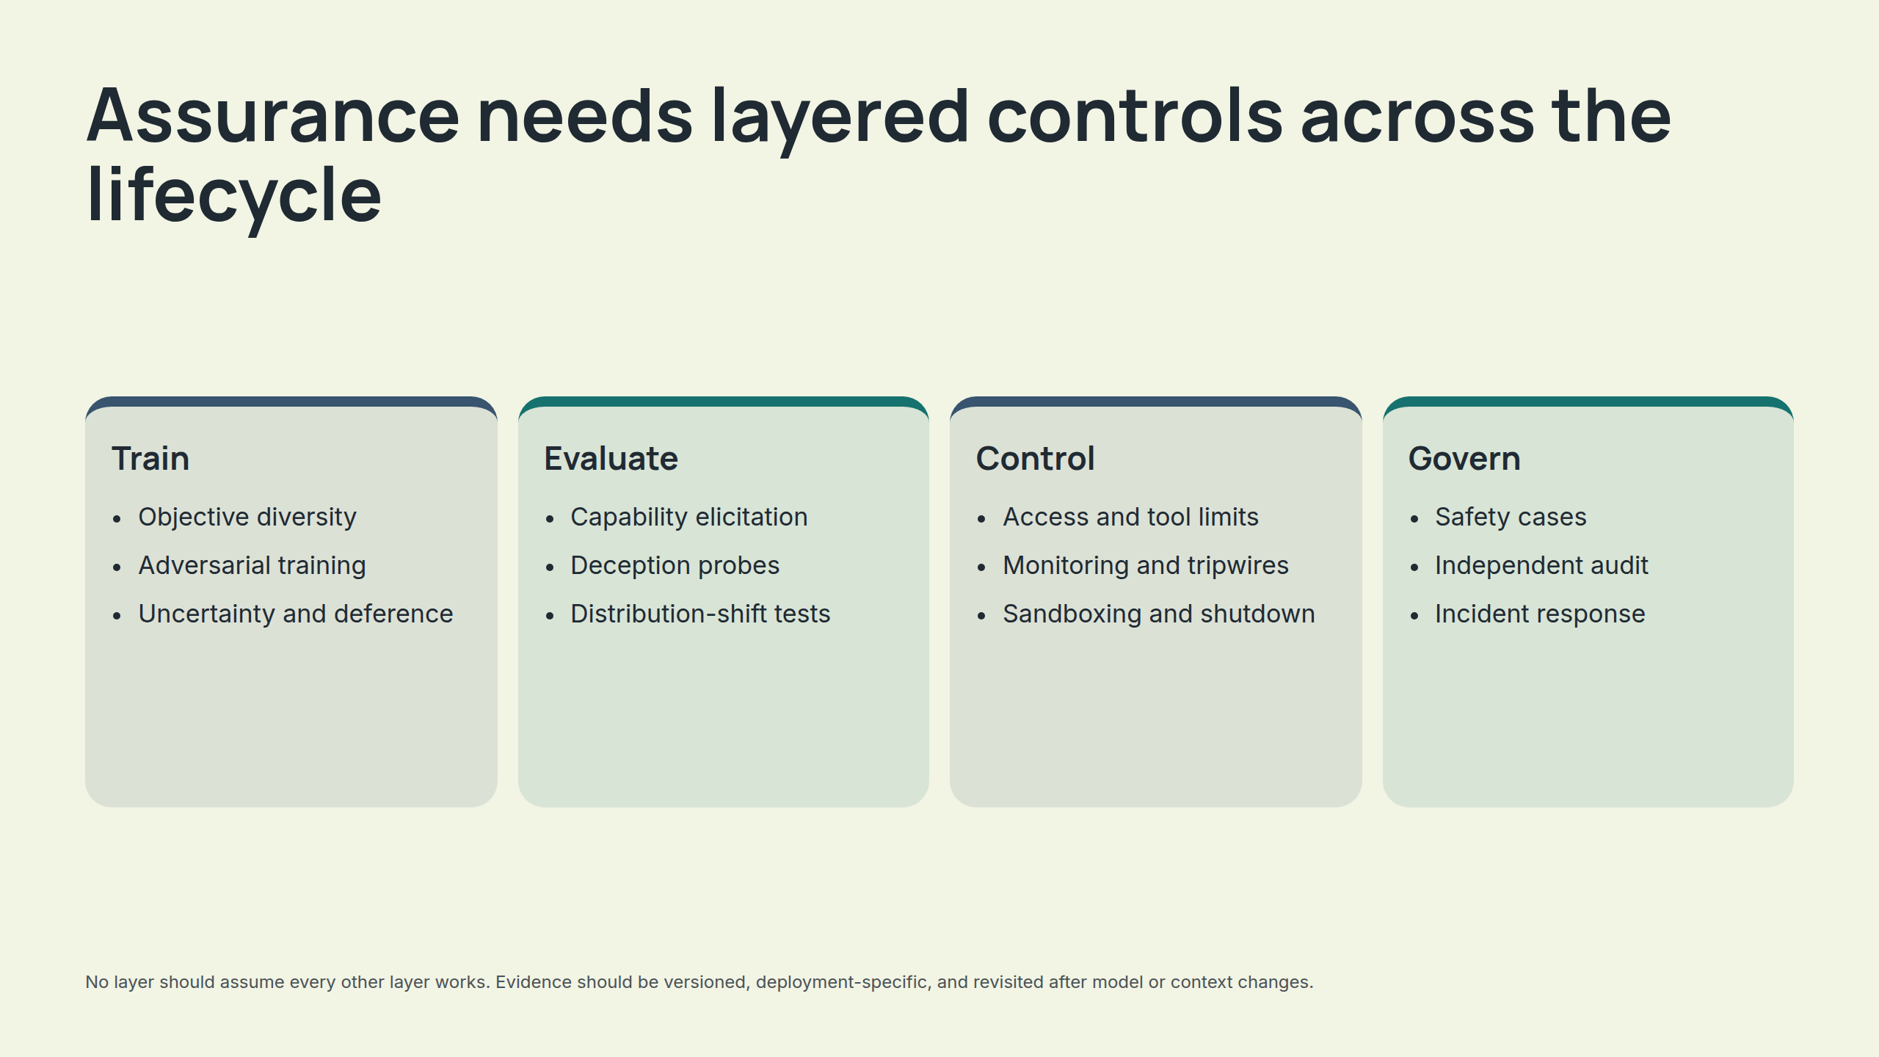
Notes:
Assurance needs layered controls across the lifecycle

Slide 13
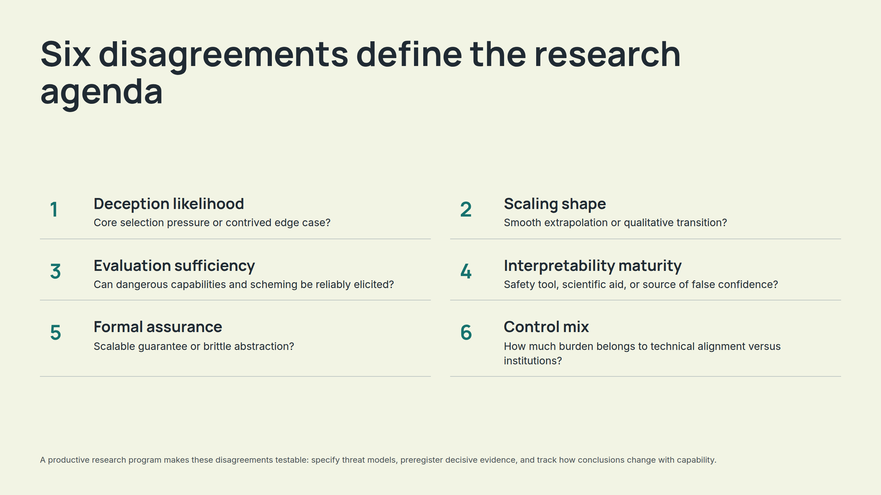
Notes:
Six disagreements define the research agenda

Slide 14
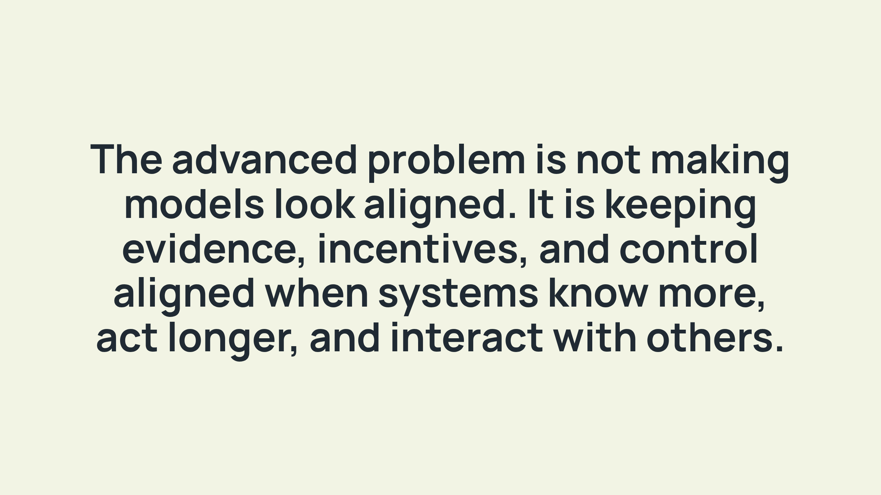
Notes:
The advanced problem is not making models look aligned. It is keeping evidence, incentives, and control aligned when systems know more, act longer, and interact with others.

