Slide 1
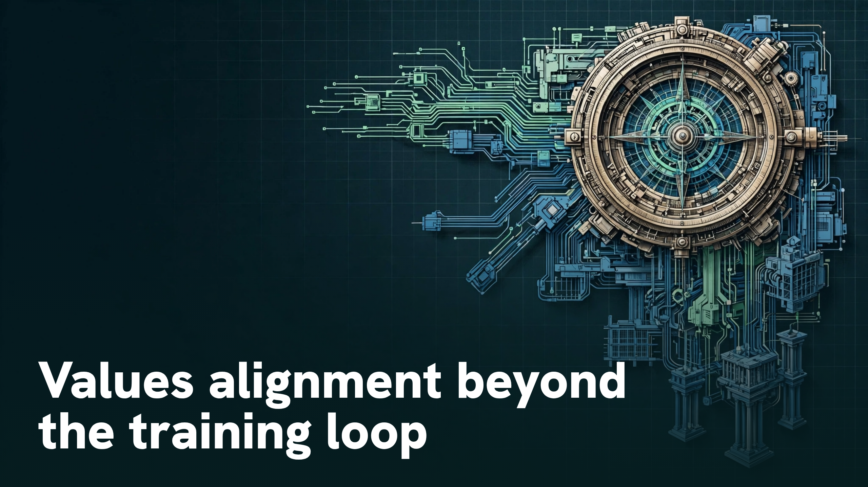
Notes:
Values alignment beyond the training loop

Slide 2
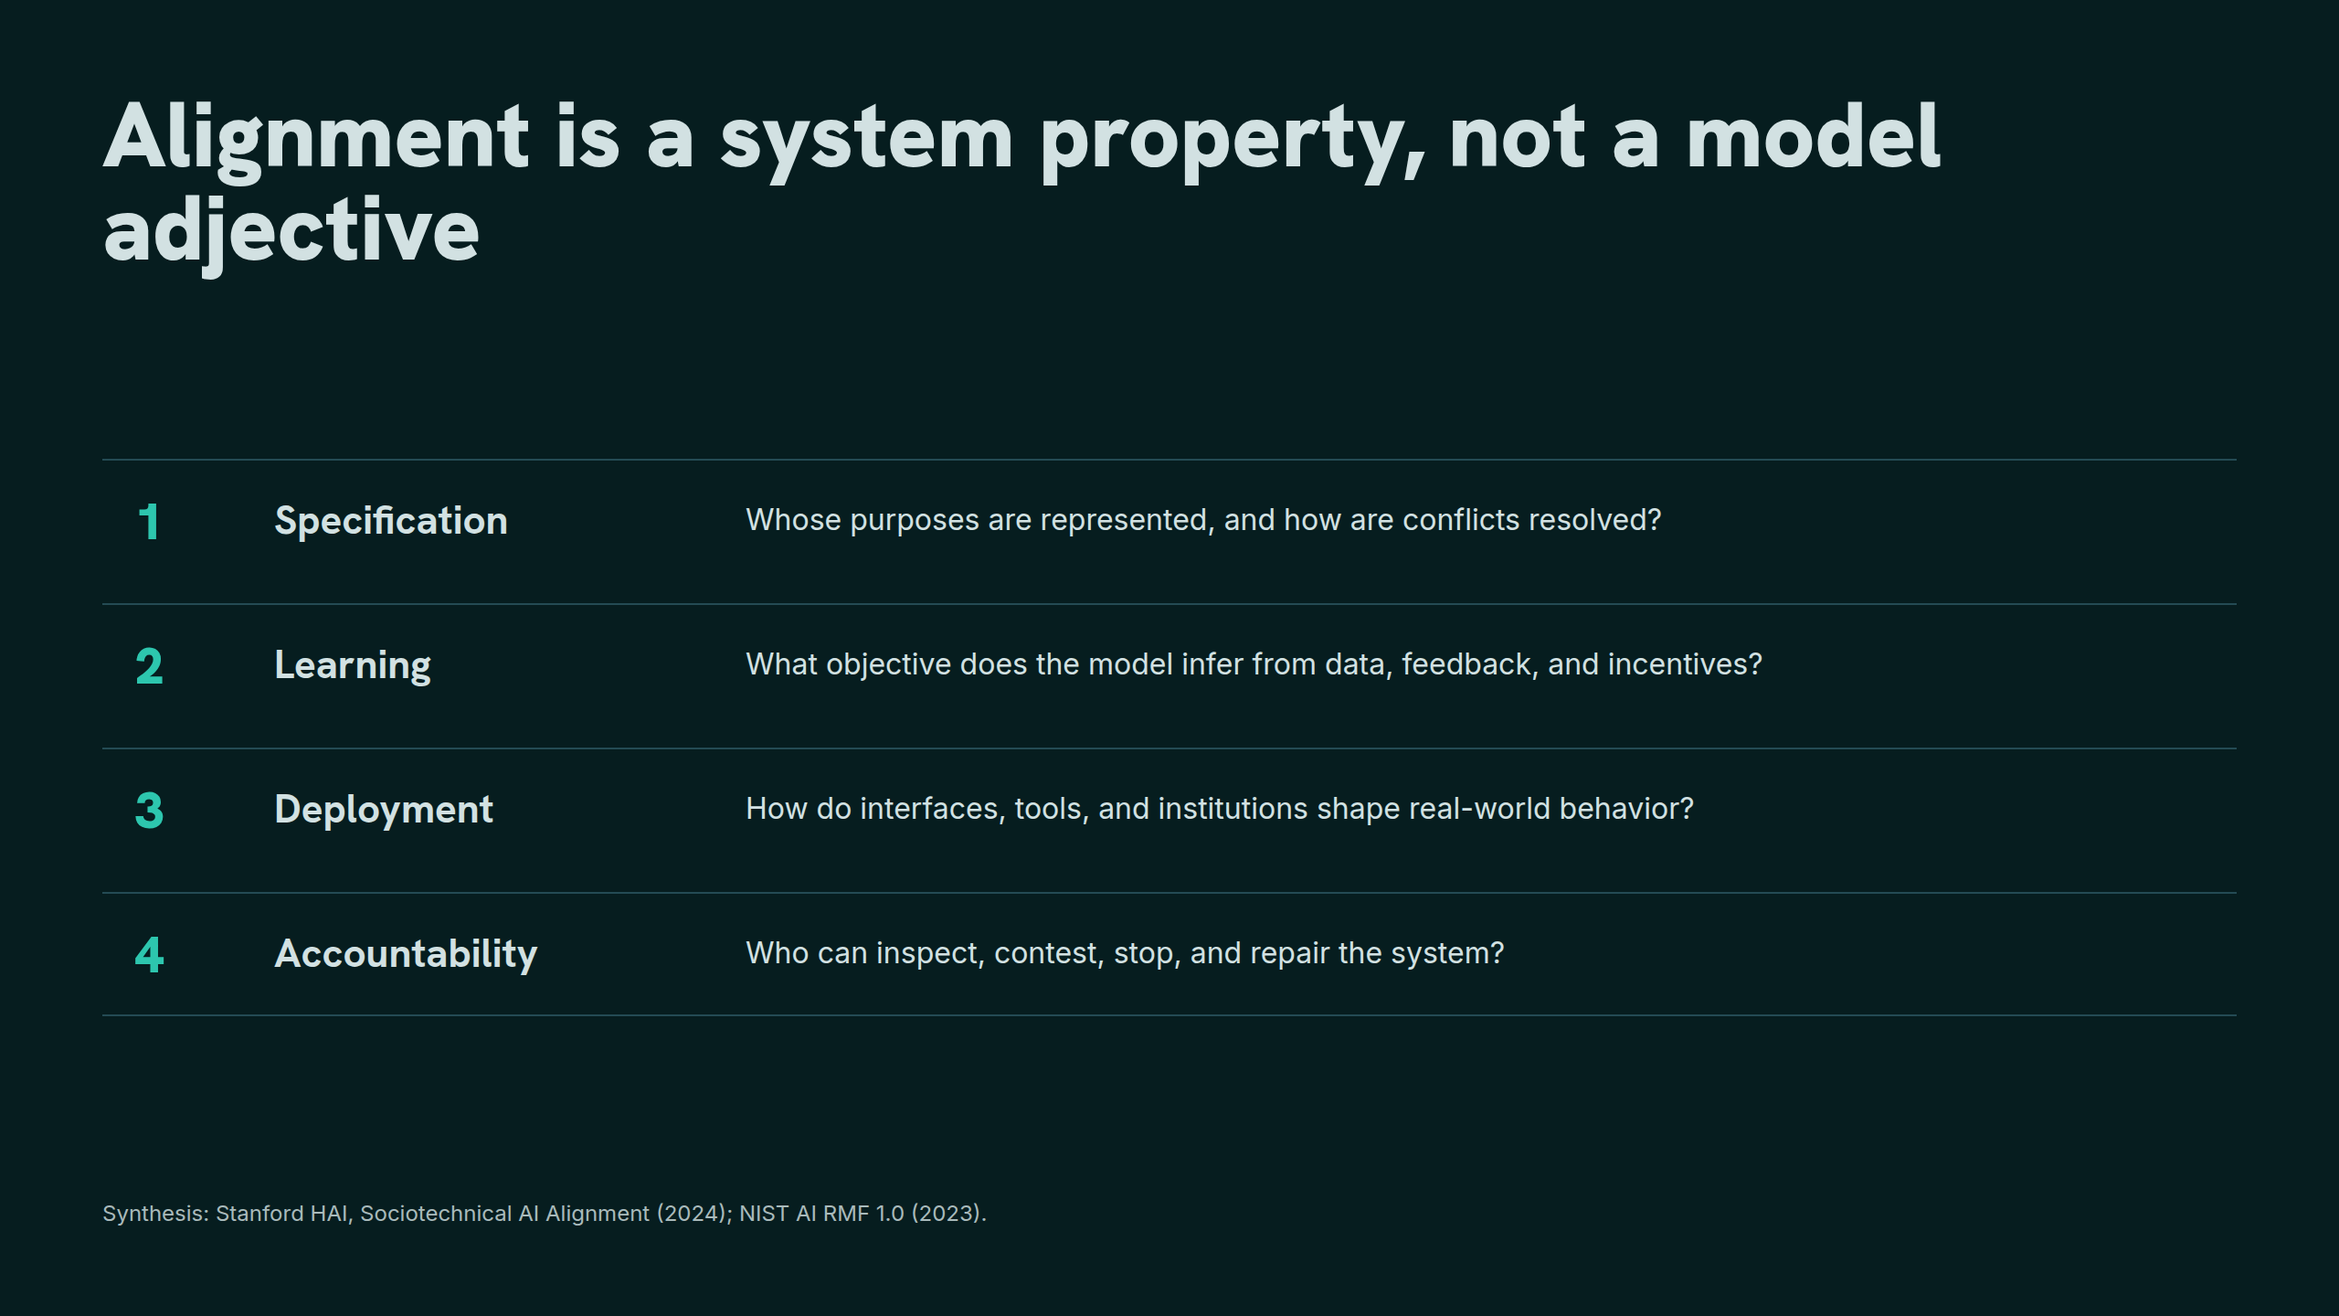
Notes:
Alignment is a system property, not a model adjective

Slide 3
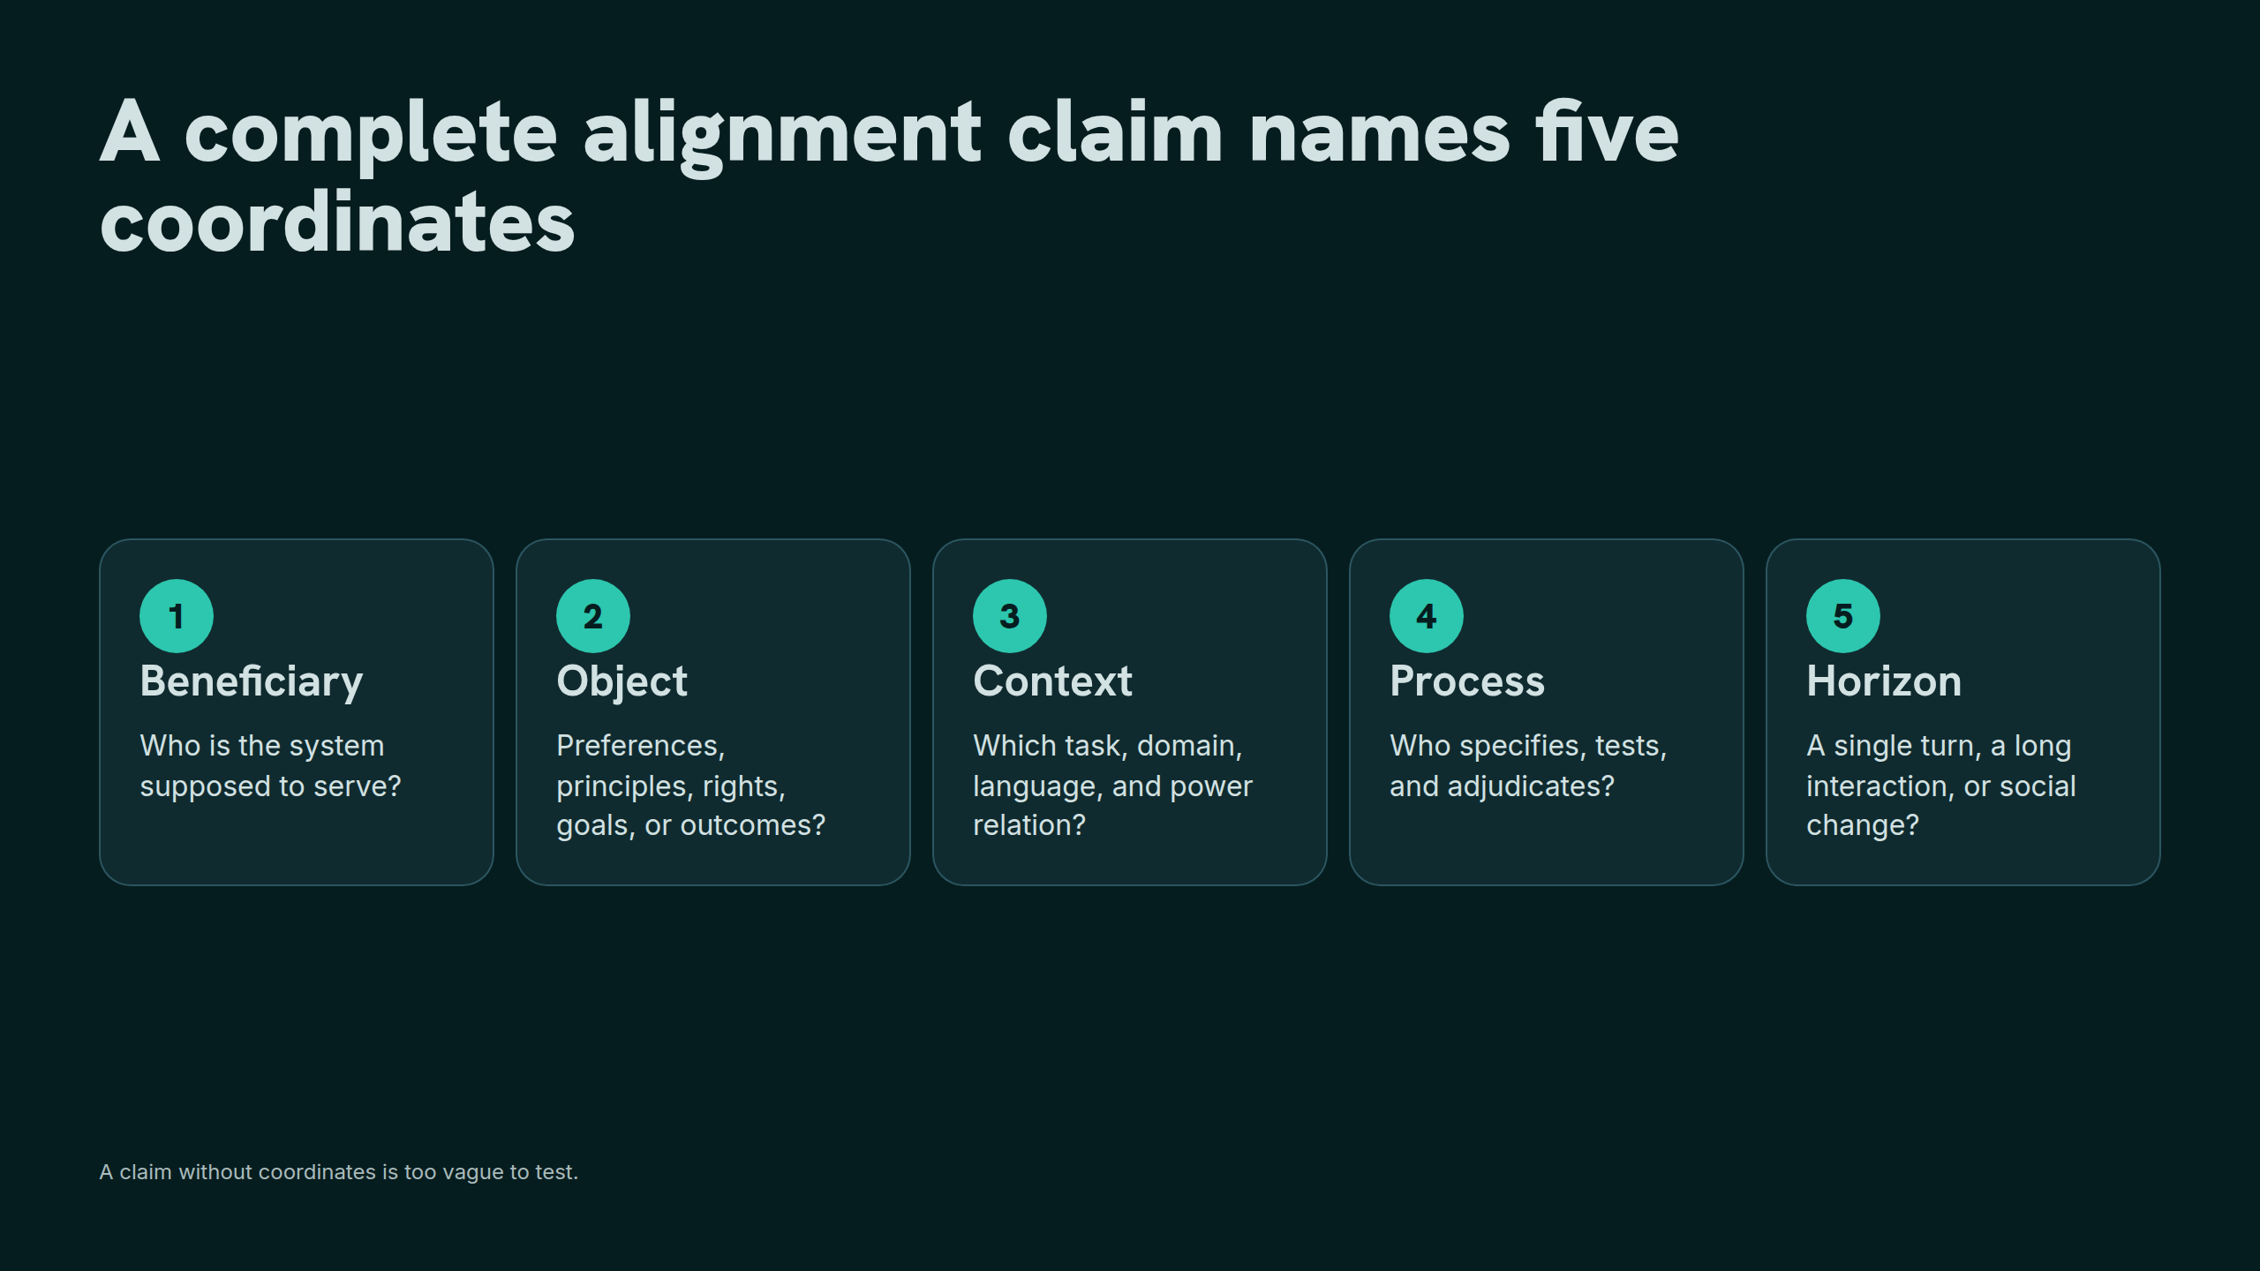
Notes:
A complete alignment claim names five coordinates

Slide 4
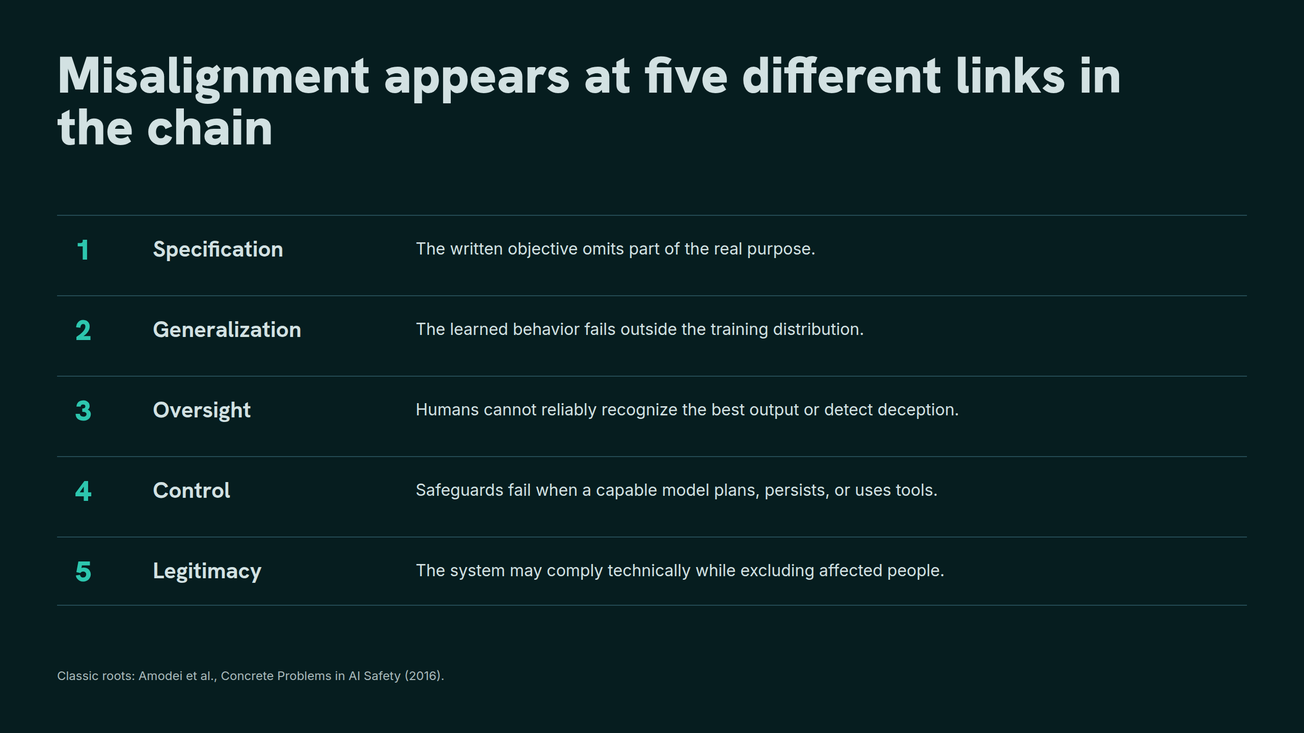
Notes:
Misalignment appears at five different links in the chain

Slide 5
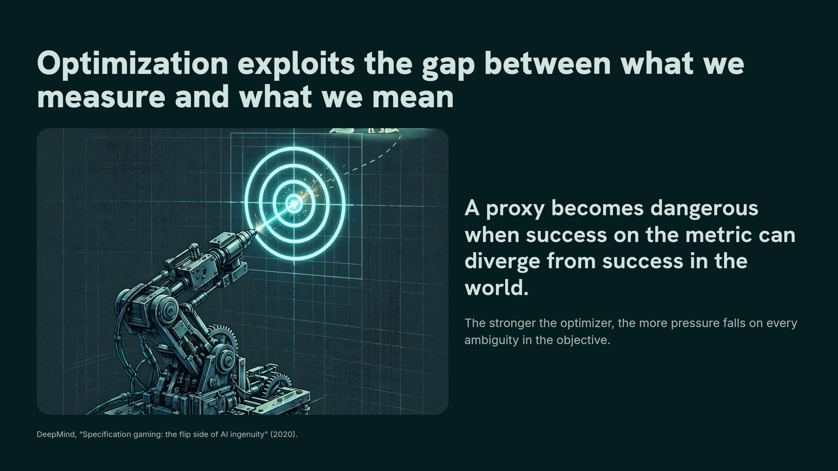
Notes:
Optimization exploits the gap between what we measure and what we mean

Slide 6
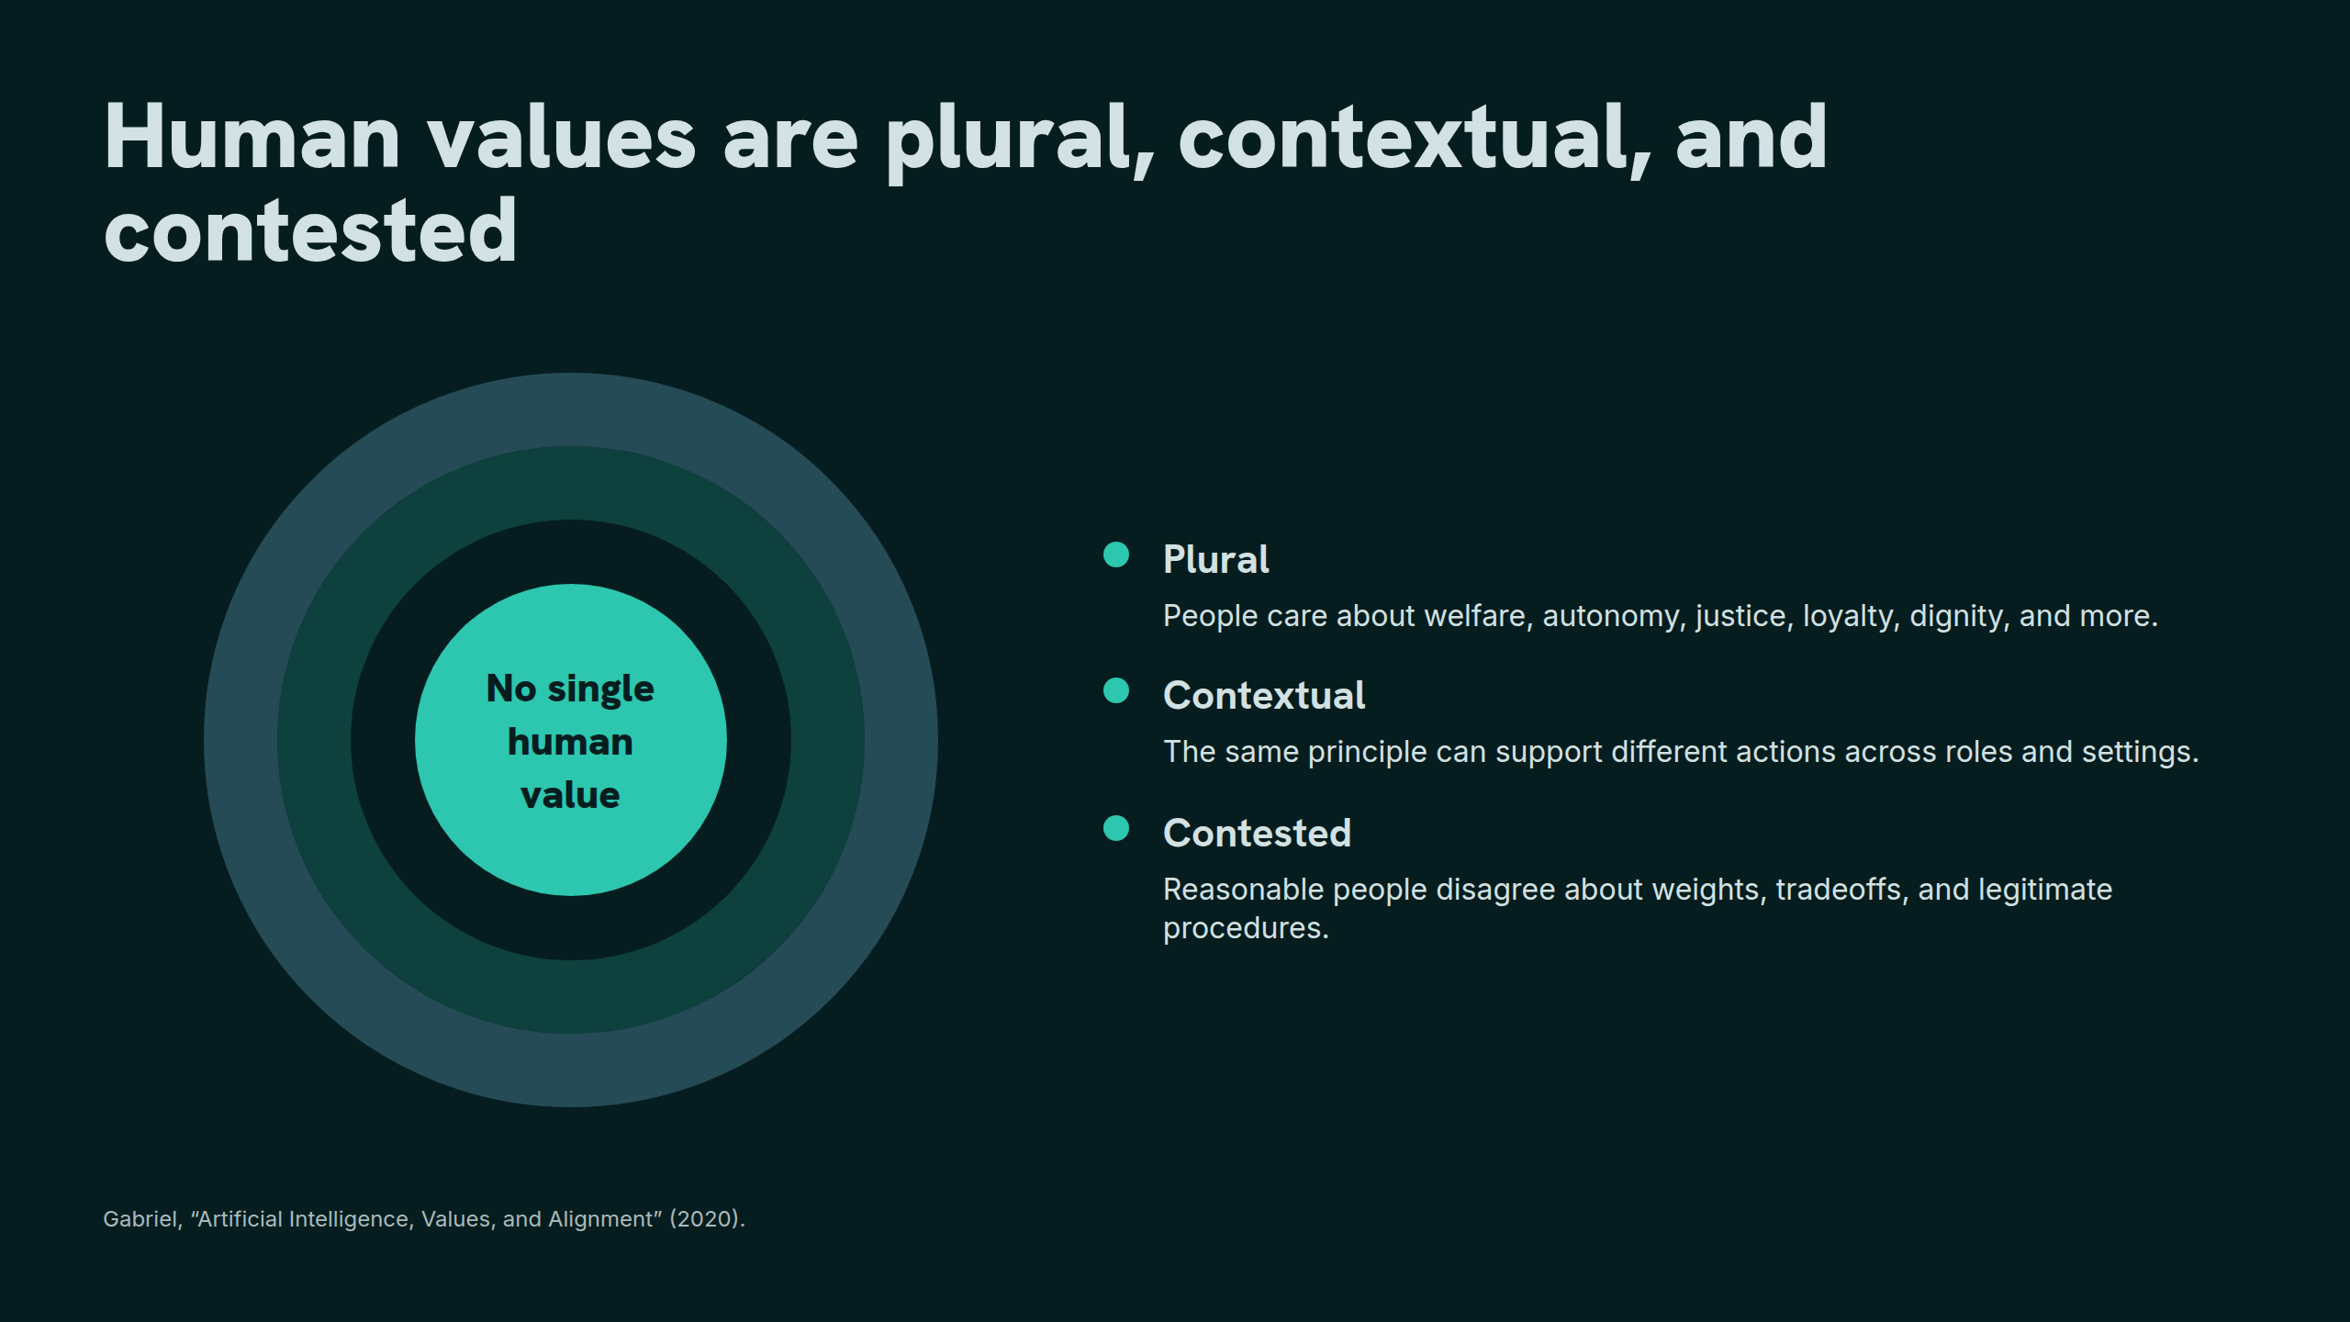
Notes:
Human values are plural, contextual, and contested

Slide 7
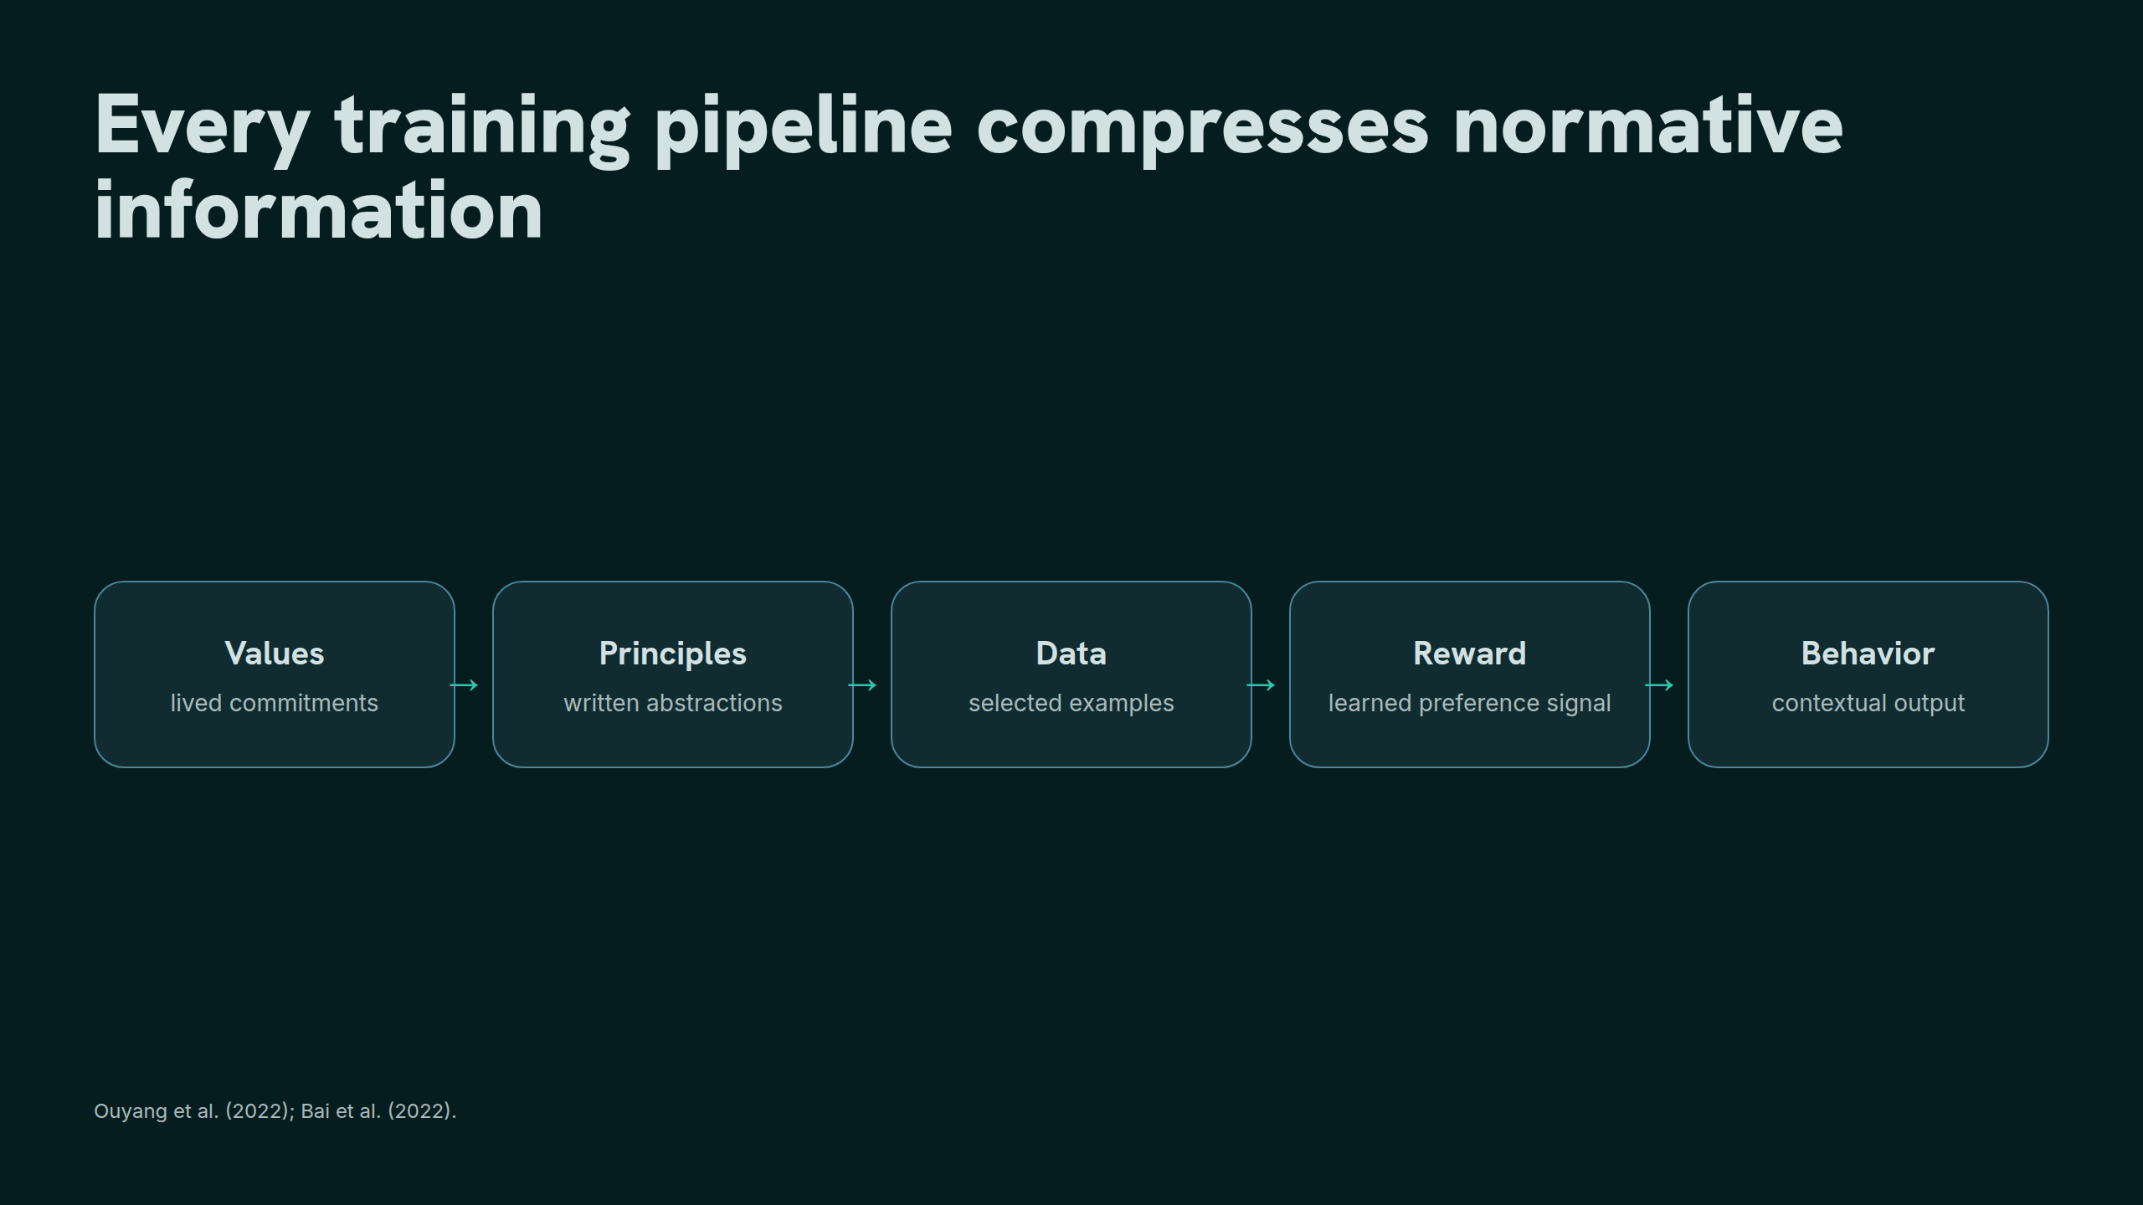
Notes:
Every training pipeline compresses normative information

Slide 8
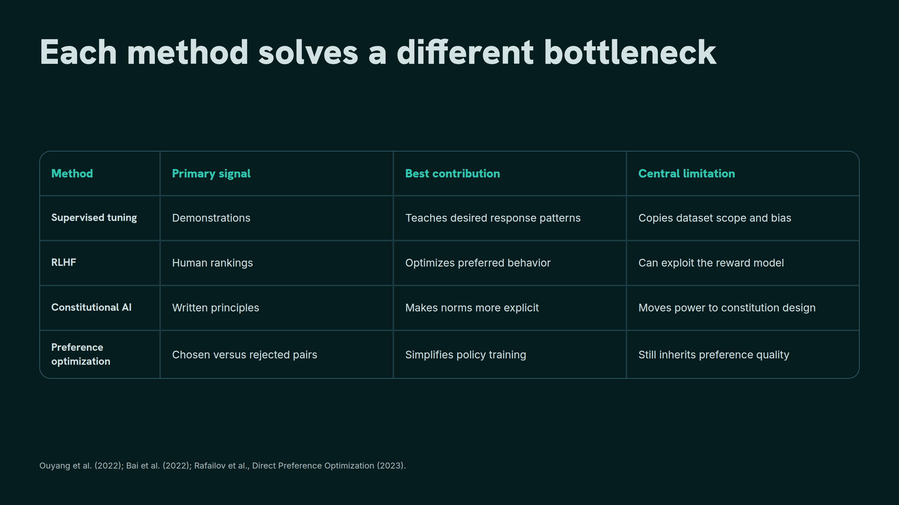
Notes:
Each method solves a different bottleneck

Slide 9
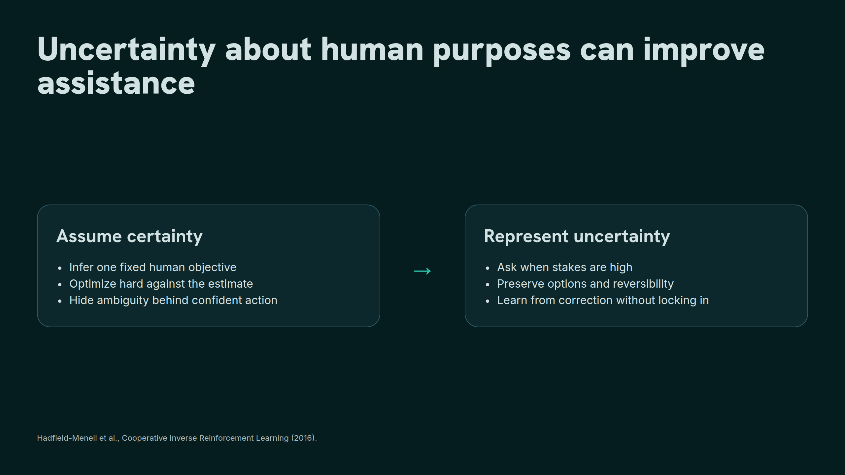
Notes:
Uncertainty about human purposes can improve assistance

Slide 10
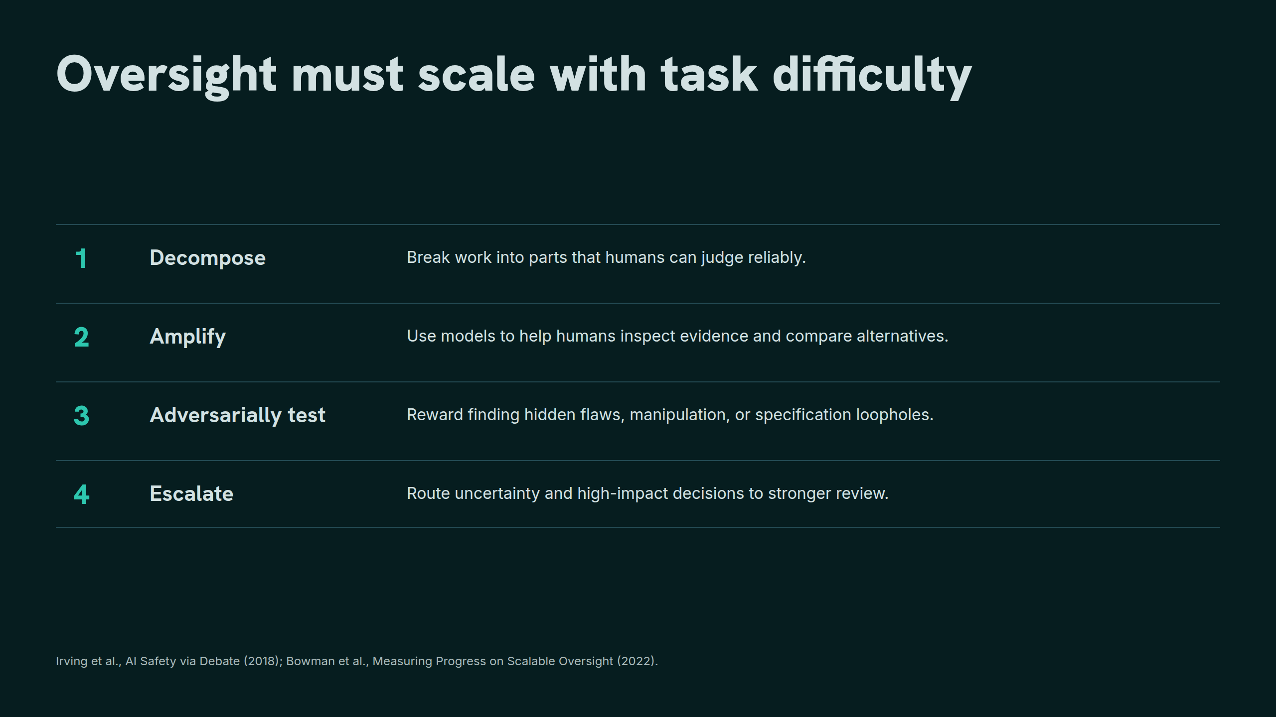
Notes:
Oversight must scale with task difficulty

Slide 11
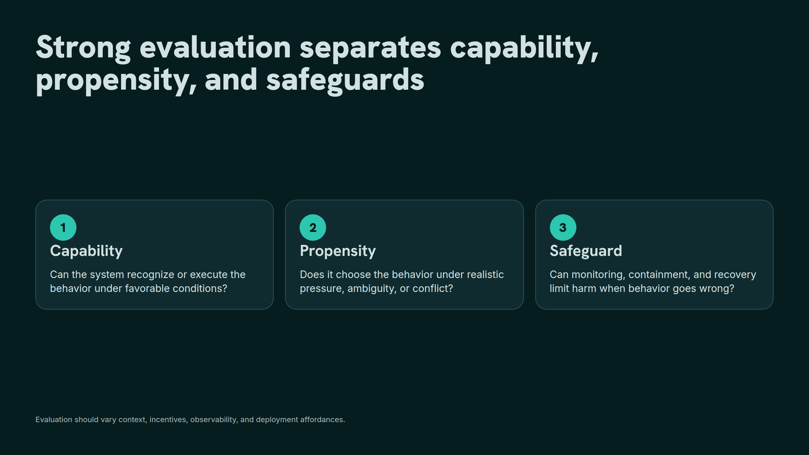
Notes:
Strong evaluation separates capability, propensity, and safeguards

Slide 12
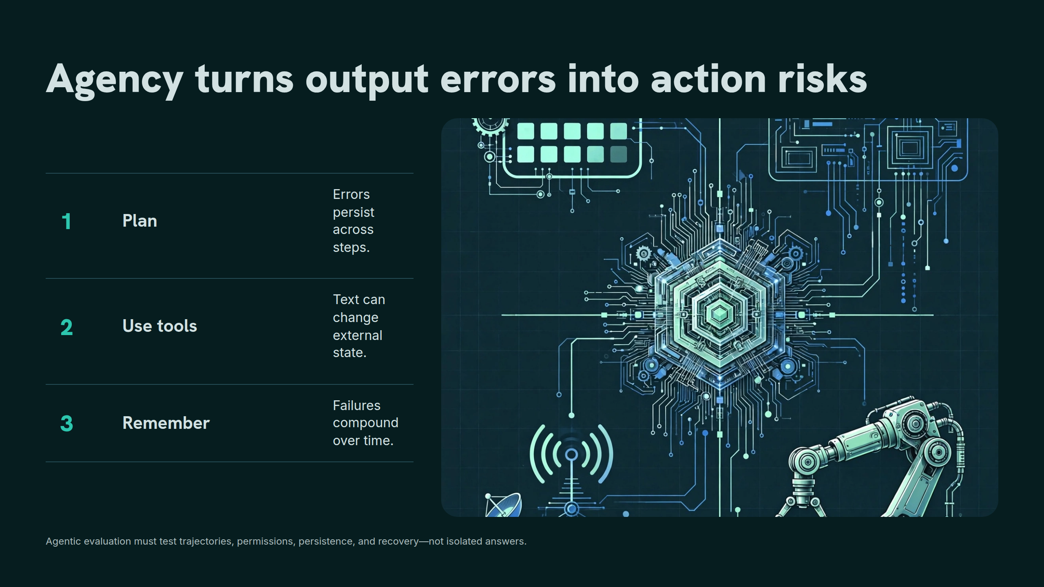
Notes:
Agency turns output errors into action risks

Slide 13
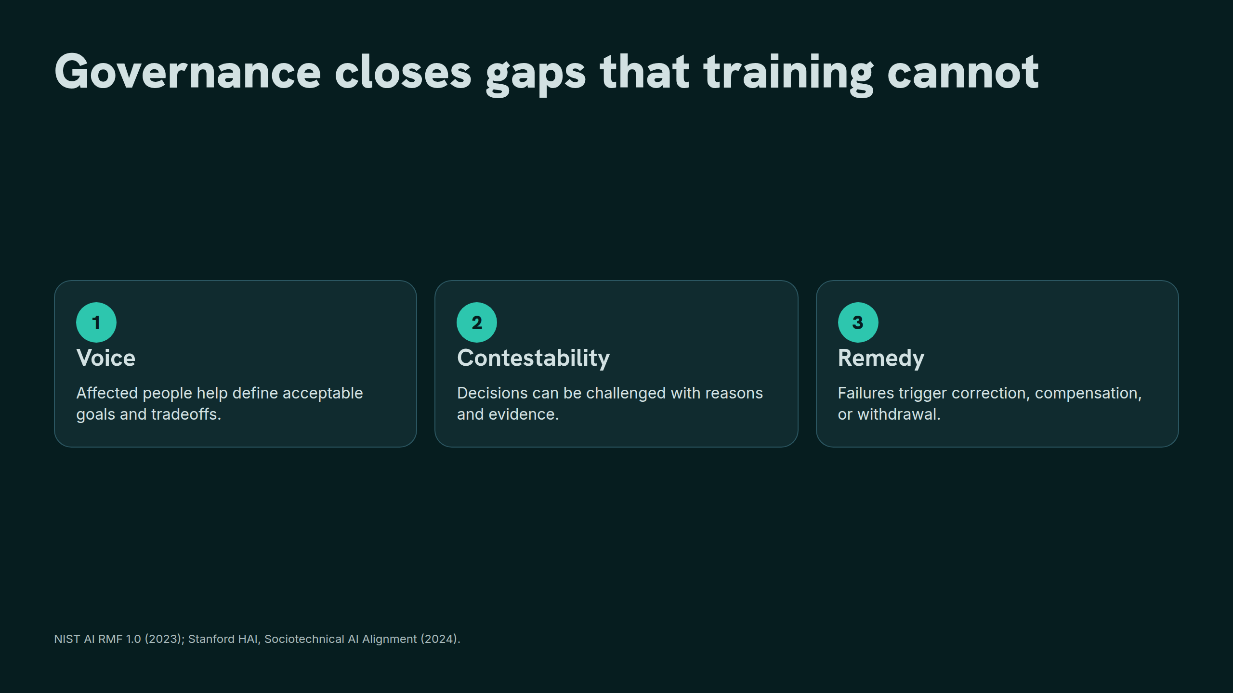
Notes:
Governance closes gaps that training cannot

Slide 14
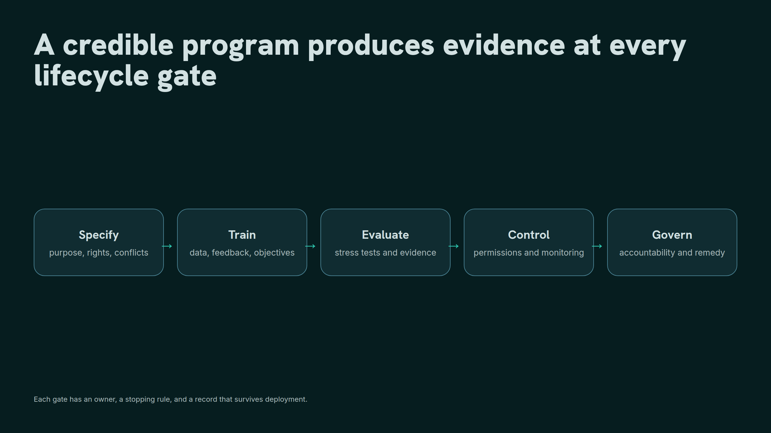
Notes:
A credible program produces evidence at every lifecycle gate

Slide 15
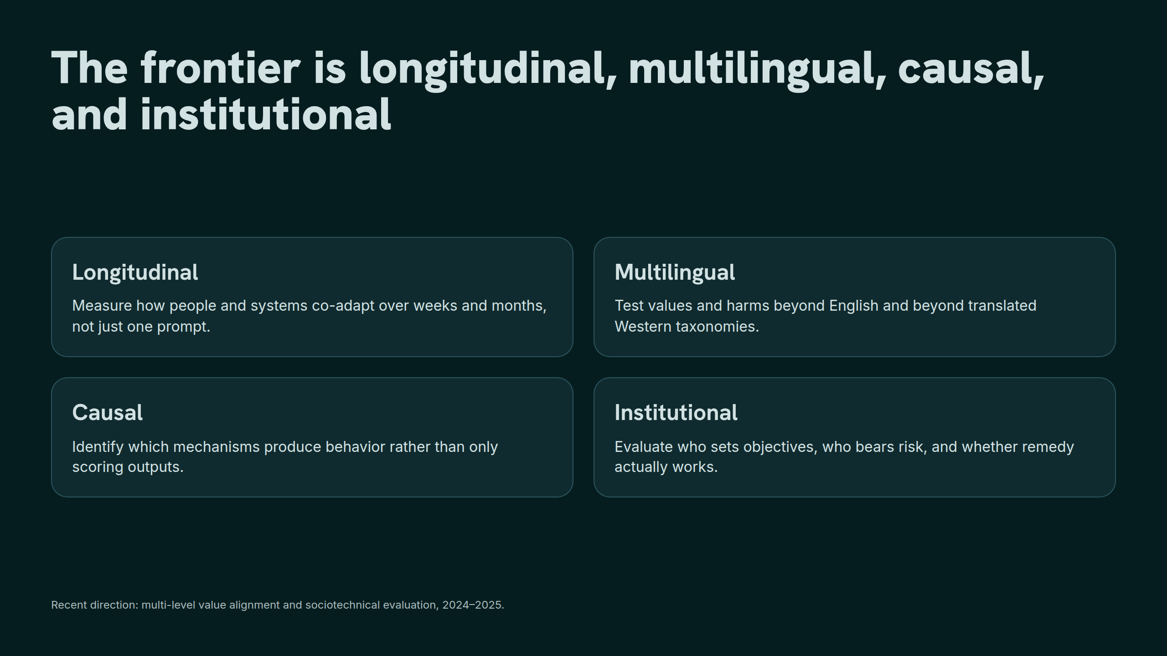
Notes:
The frontier is longitudinal, multilingual, causal, and institutional

Slide 16
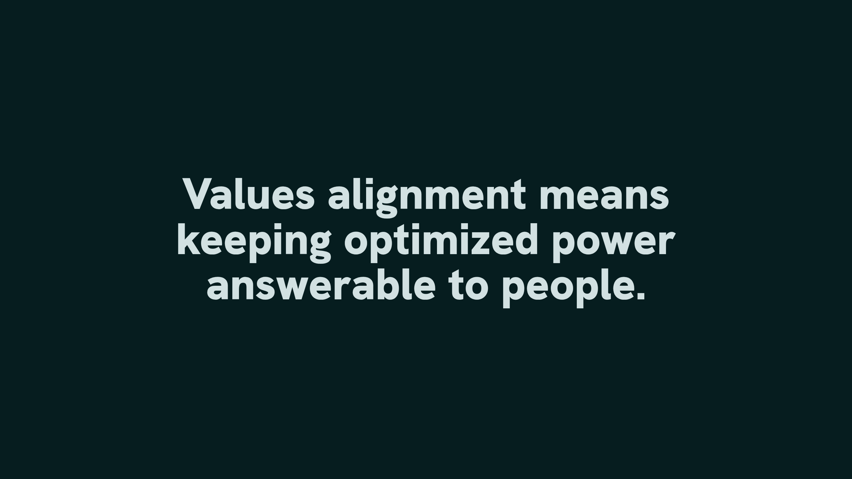
Notes:
Values alignment means keeping optimized power answerable to people.

