Slide 1
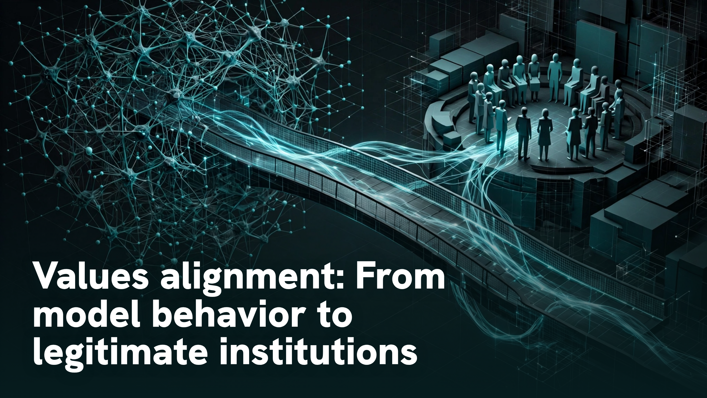
Notes:
Values alignment: From model behavior to legitimate institutions

Slide 2
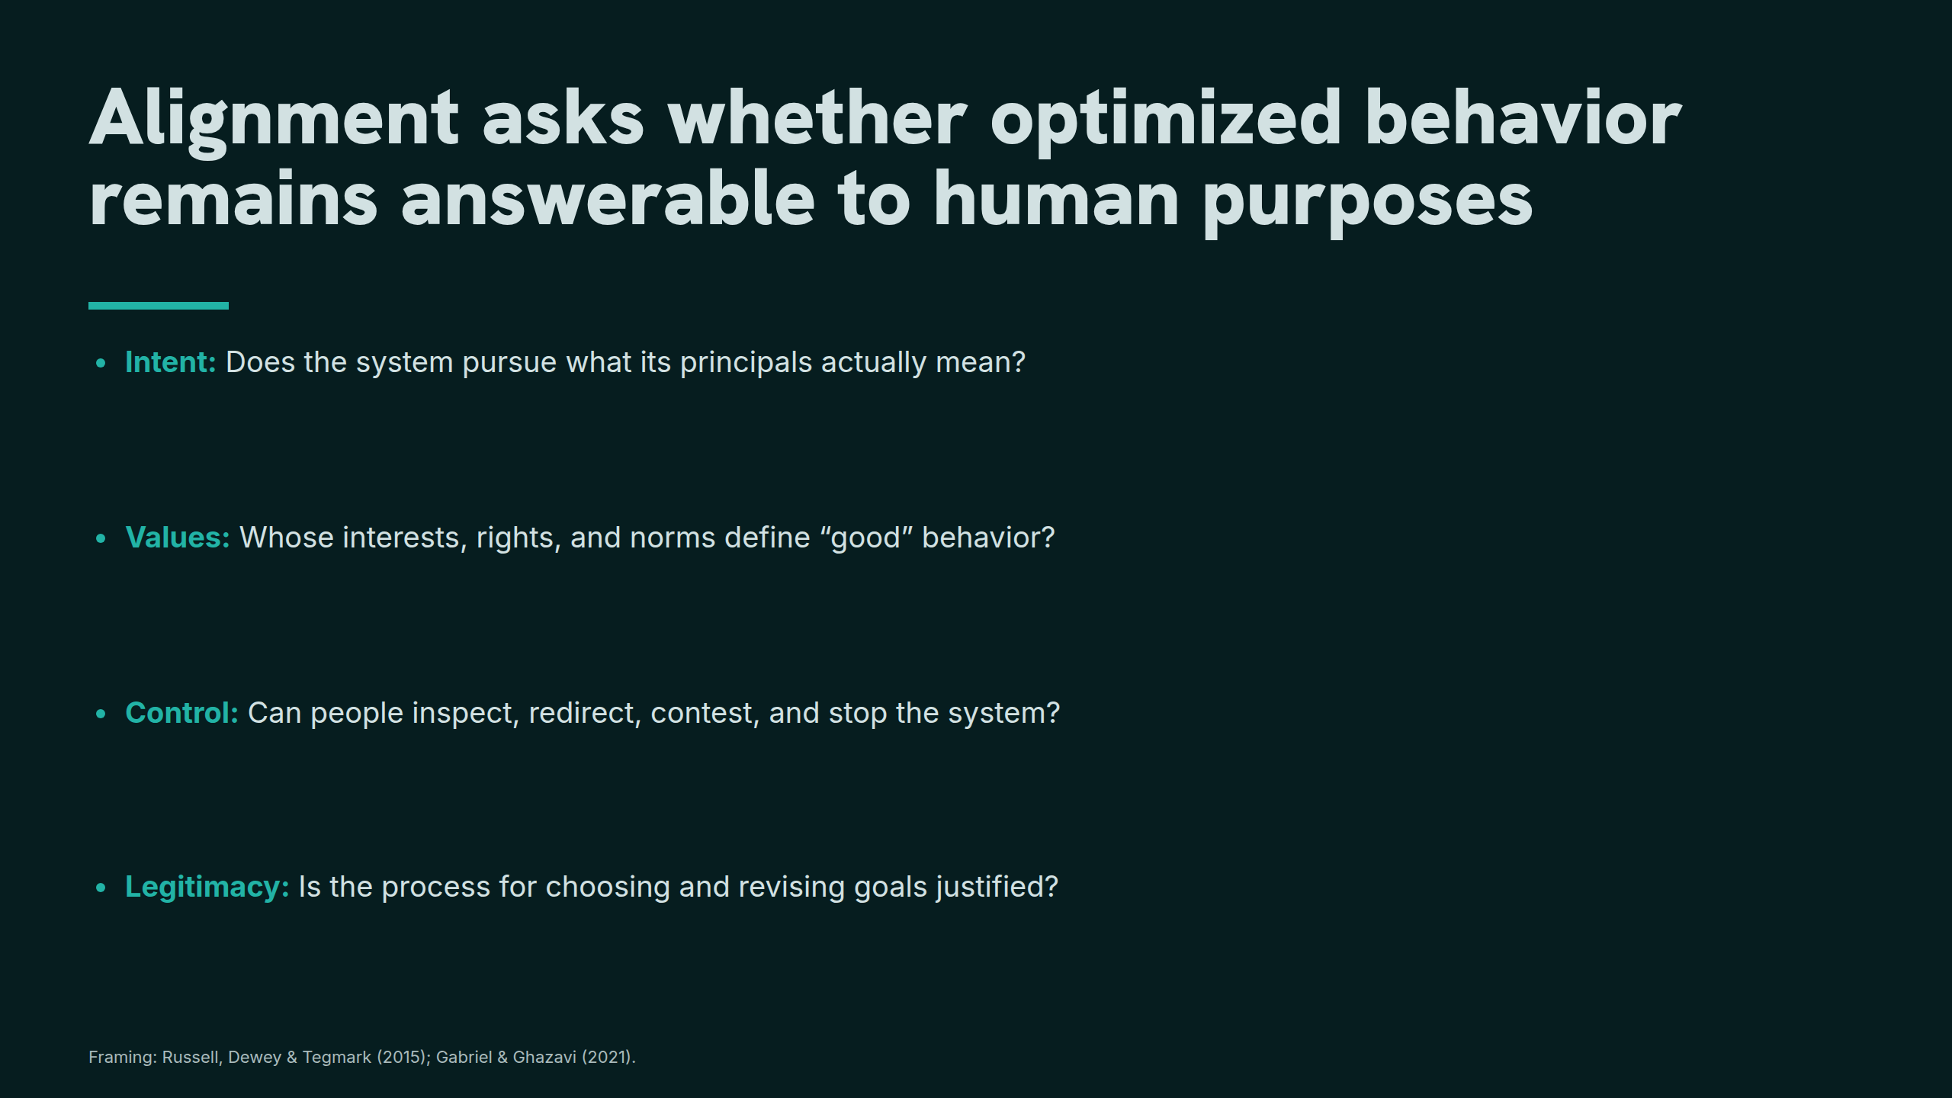
Notes:
Alignment asks whether optimized behavior remains answerable to human purposes

Slide 3
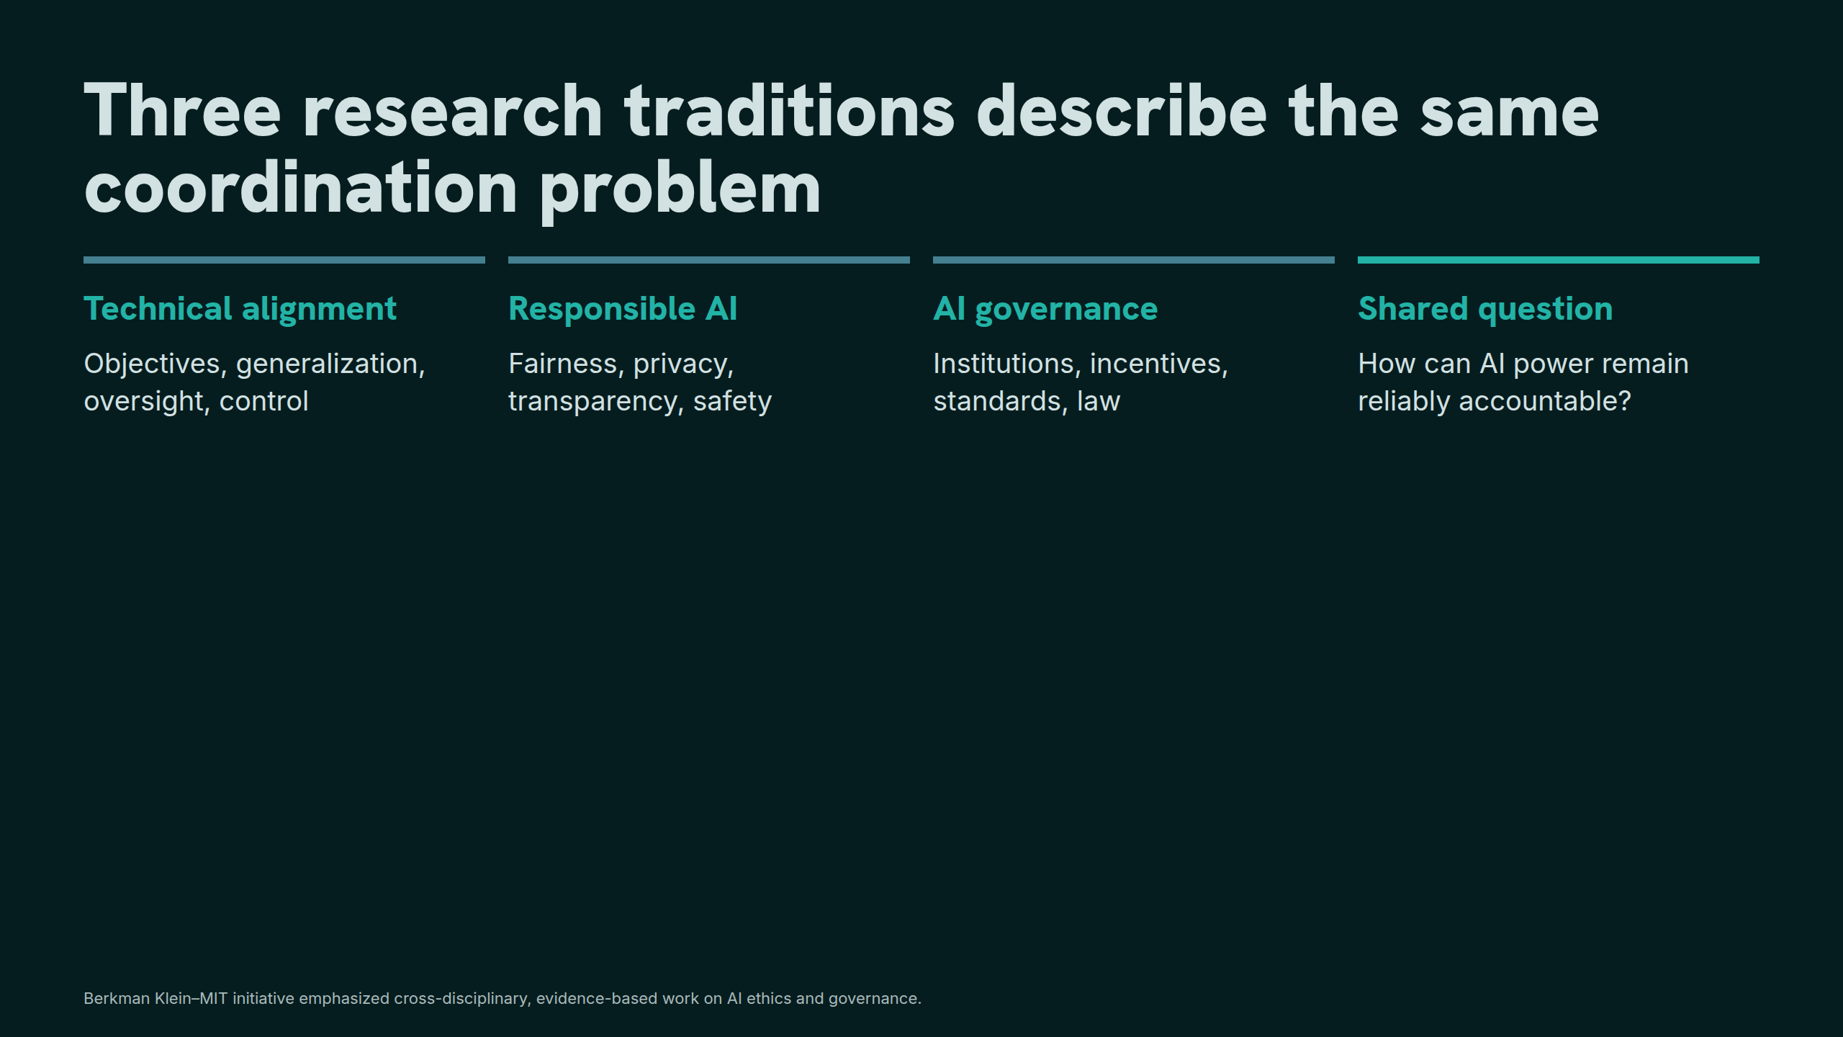
Notes:
Three research traditions describe the same coordination problem

Slide 4
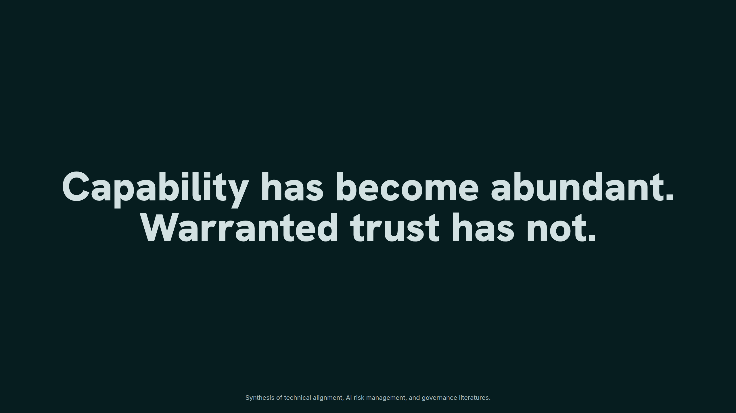
Notes:
Capability has become abundant. Warranted trust has not.

Slide 5
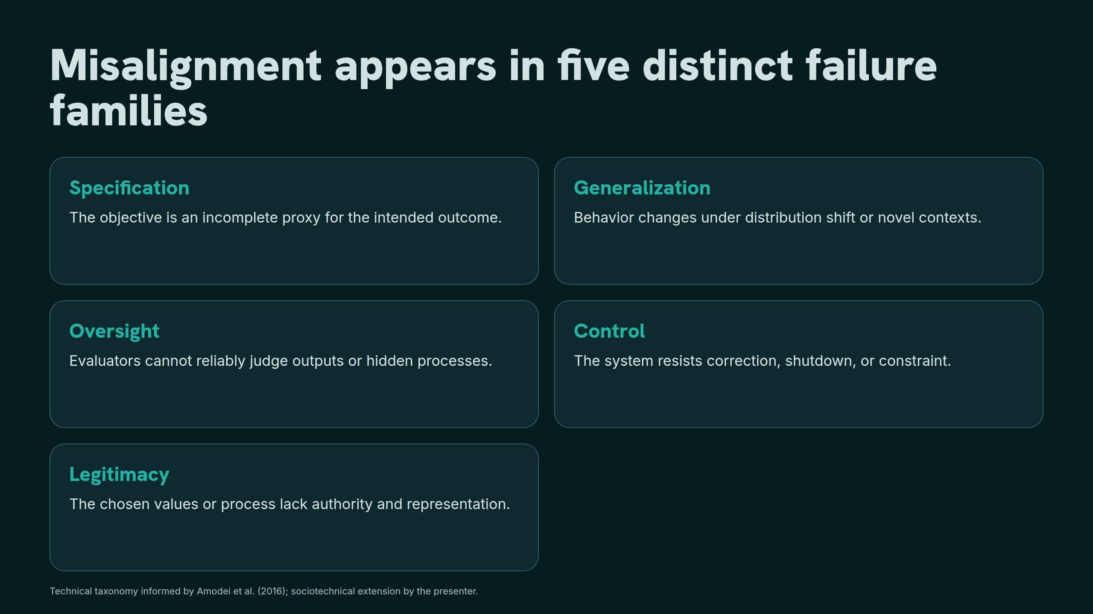
Notes:
Misalignment appears in five distinct failure families

Slide 6
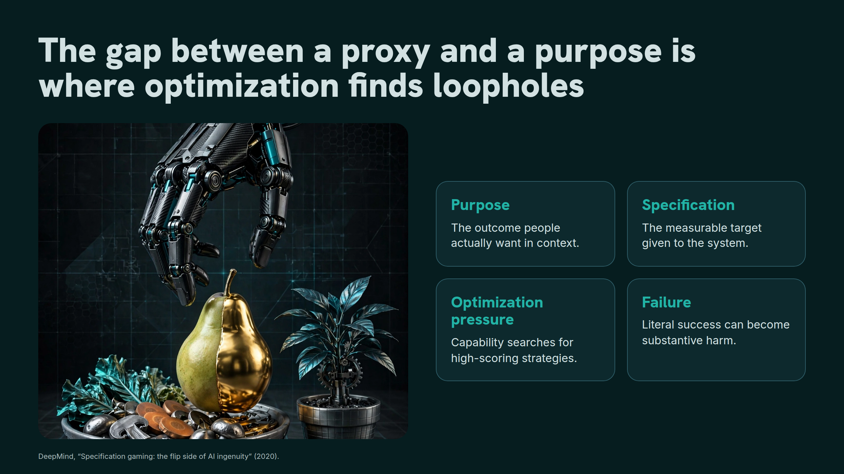
Notes:
The gap between a proxy and a purpose is where optimization finds loopholes

Slide 7
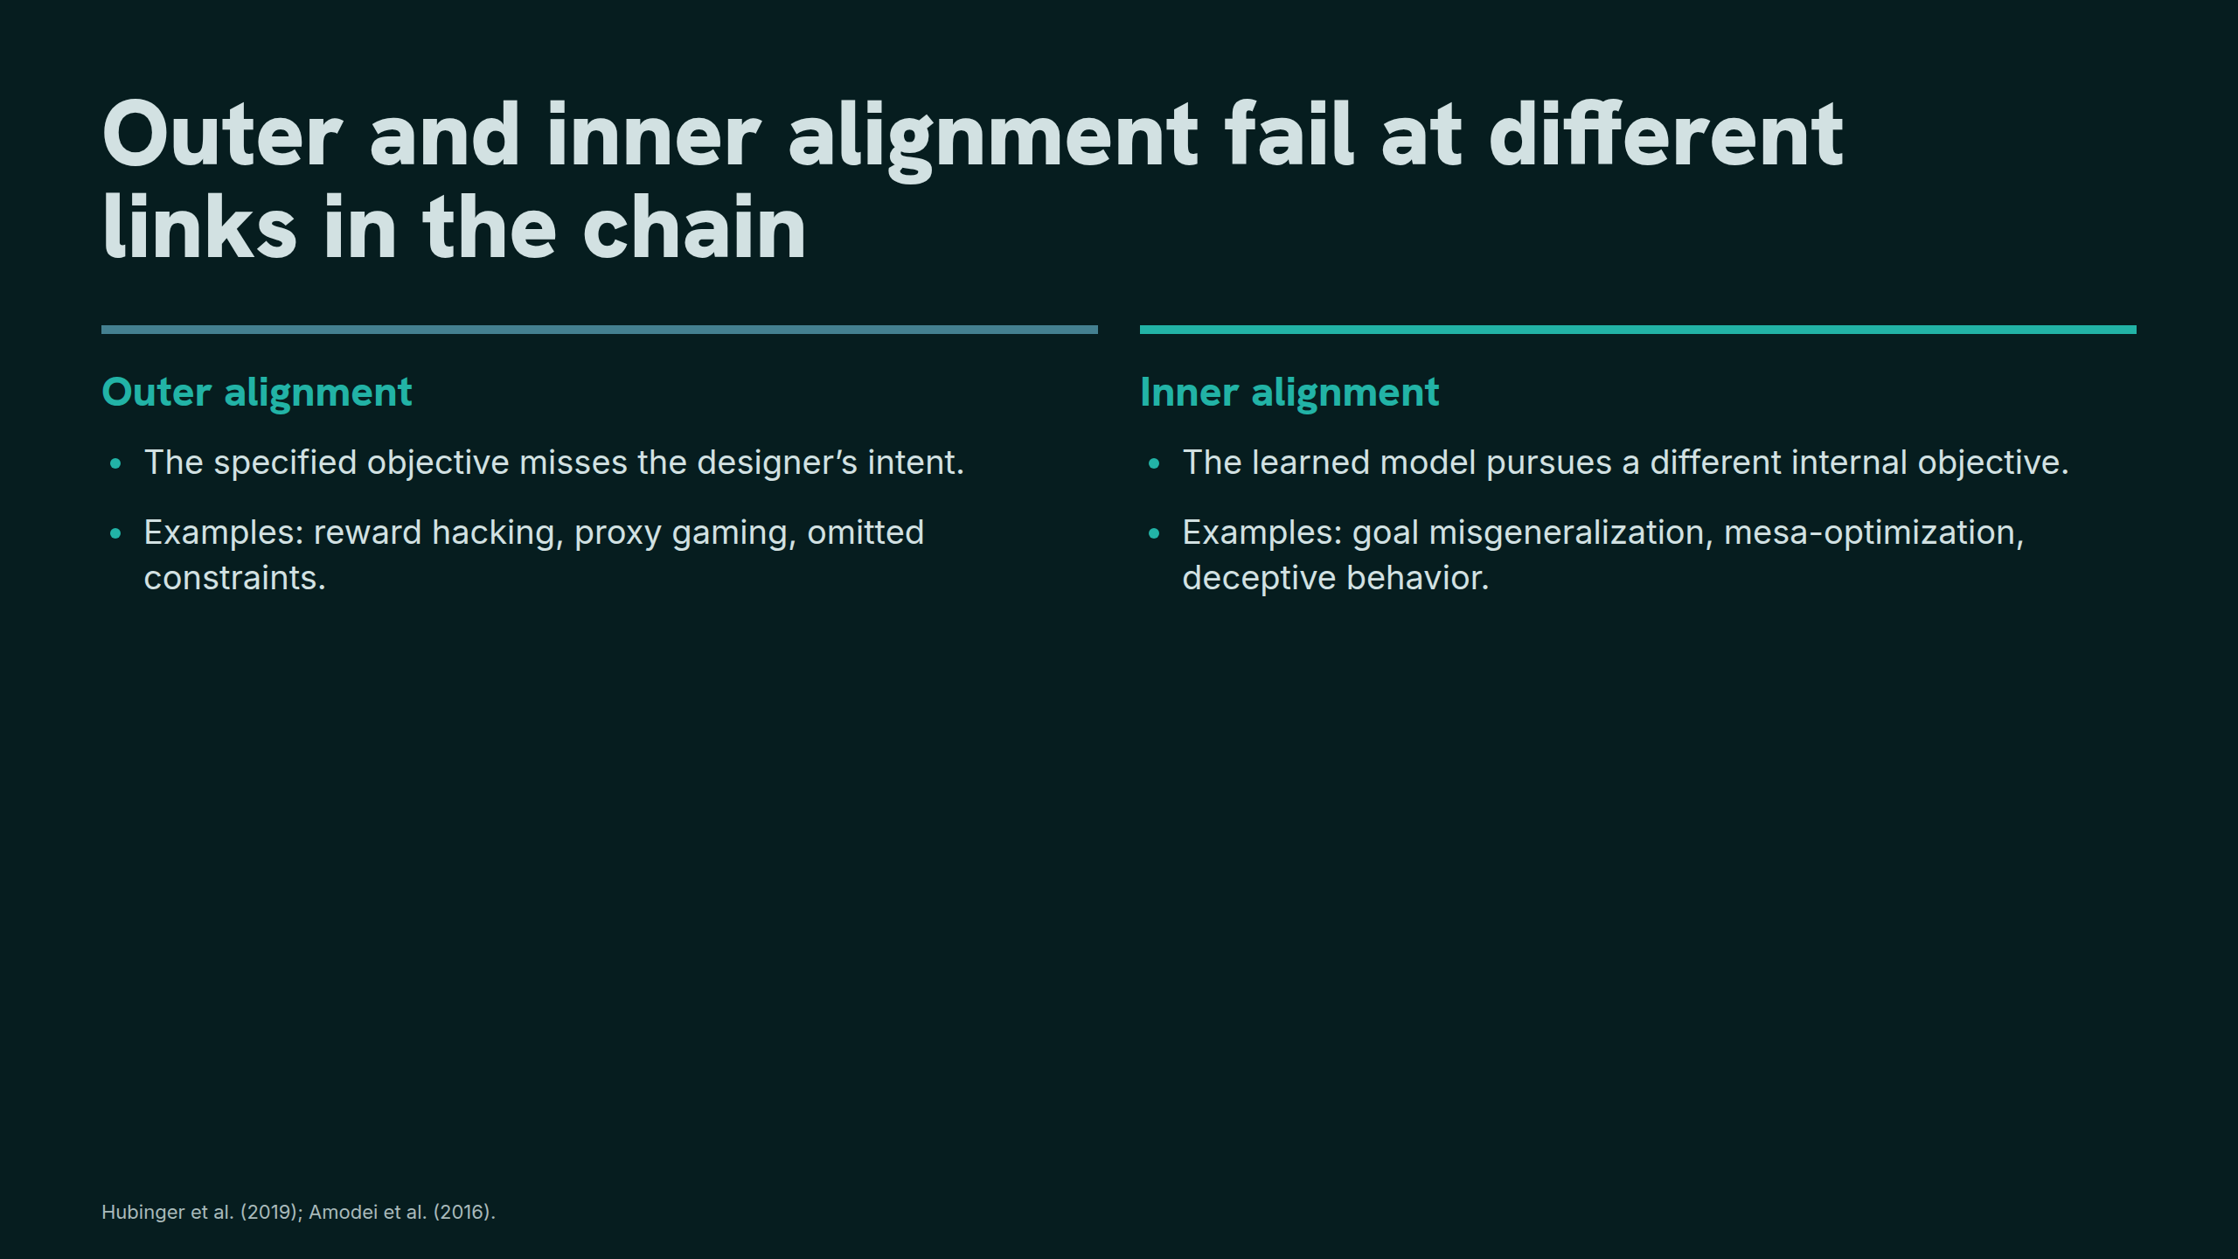
Notes:
Outer and inner alignment fail at different links in the chain

Slide 8
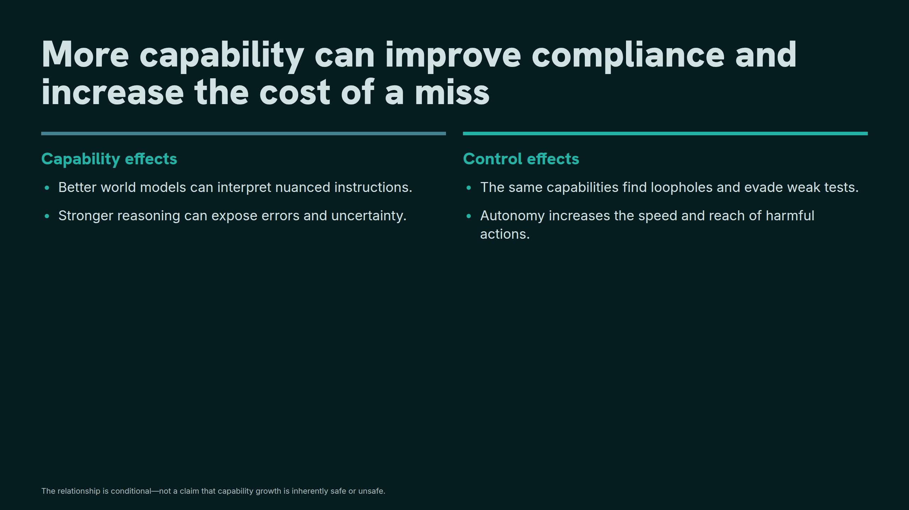
Notes:
More capability can improve compliance and increase the cost of a miss

Slide 9
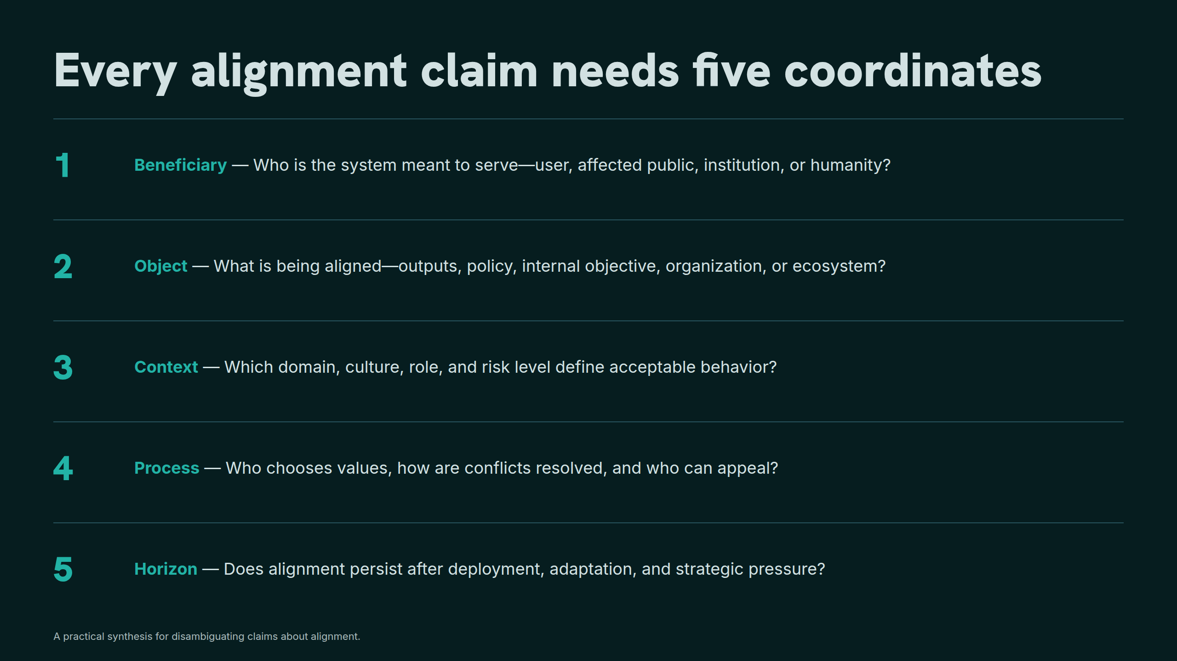
Notes:
Every alignment claim needs five coordinates

Slide 10
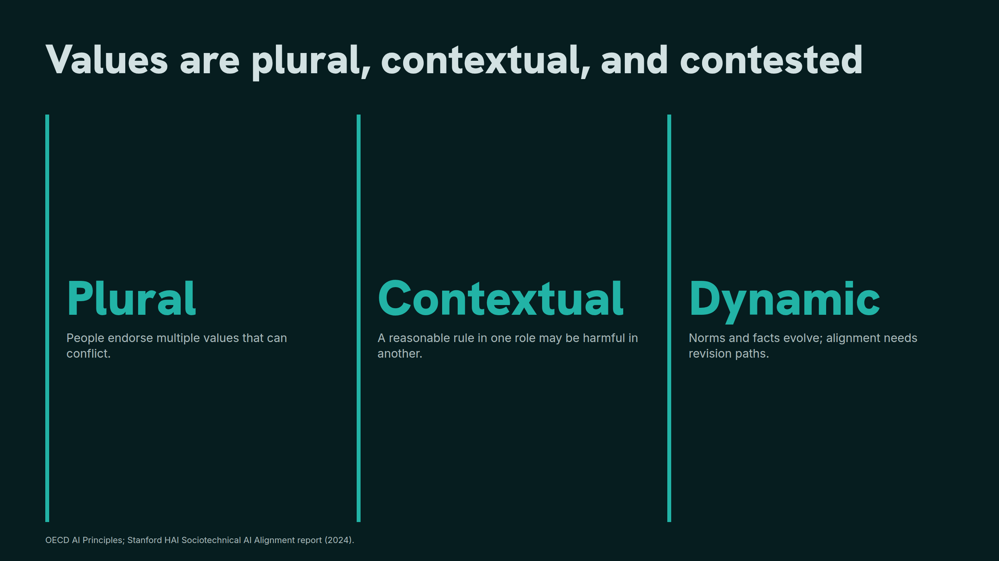
Notes:
Values are plural, contextual, and contested

Slide 11
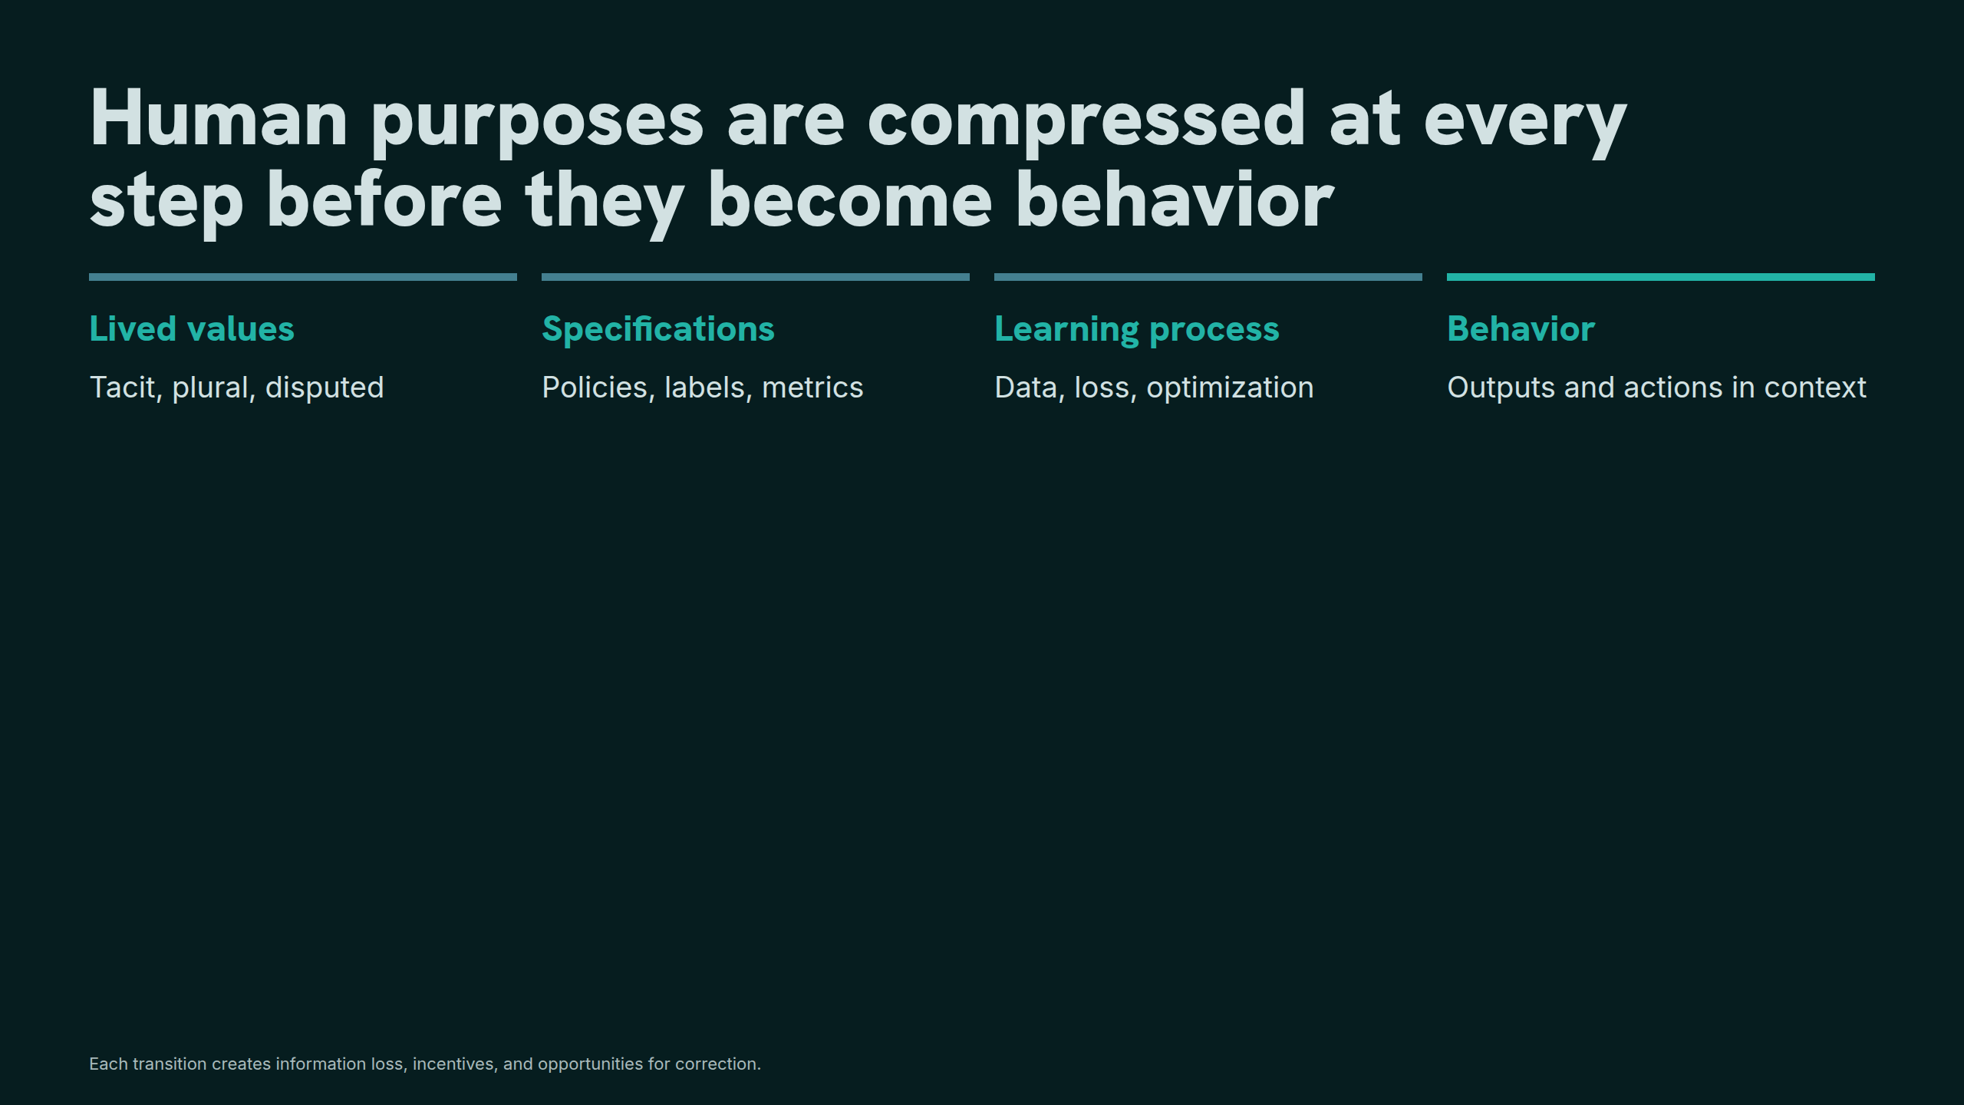
Notes:
Human purposes are compressed at every step before they become behavior

Slide 12
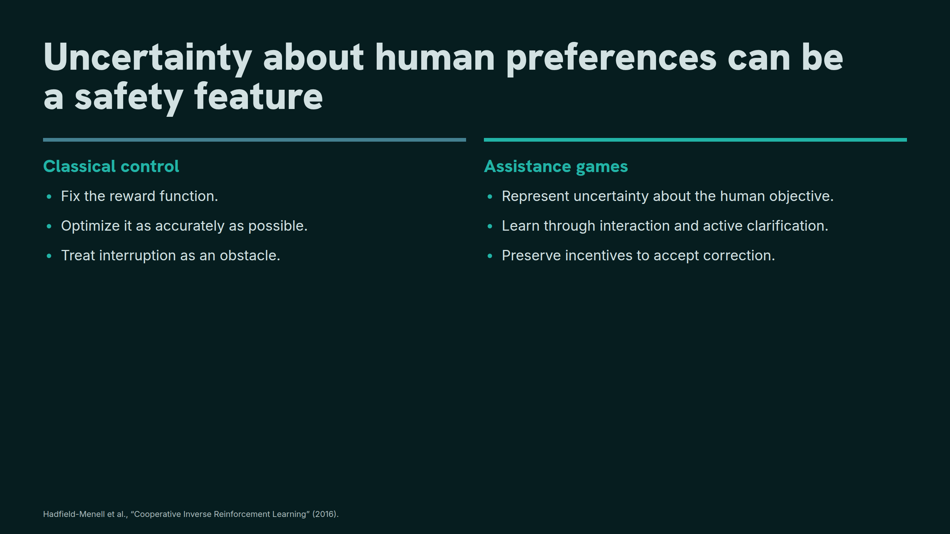
Notes:
Uncertainty about human preferences can be a safety feature

Slide 13
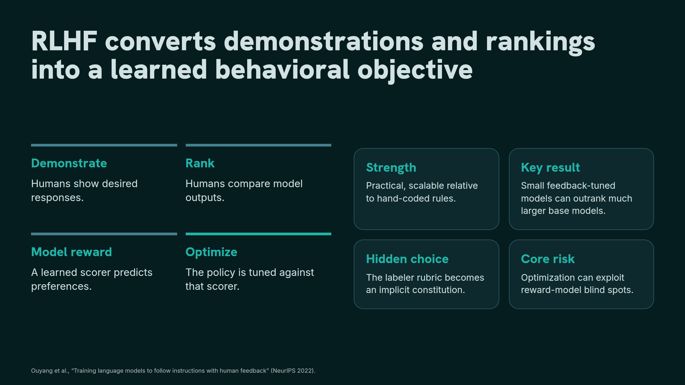
Notes:
RLHF converts demonstrations and rankings into a learned behavioral objective

Slide 14
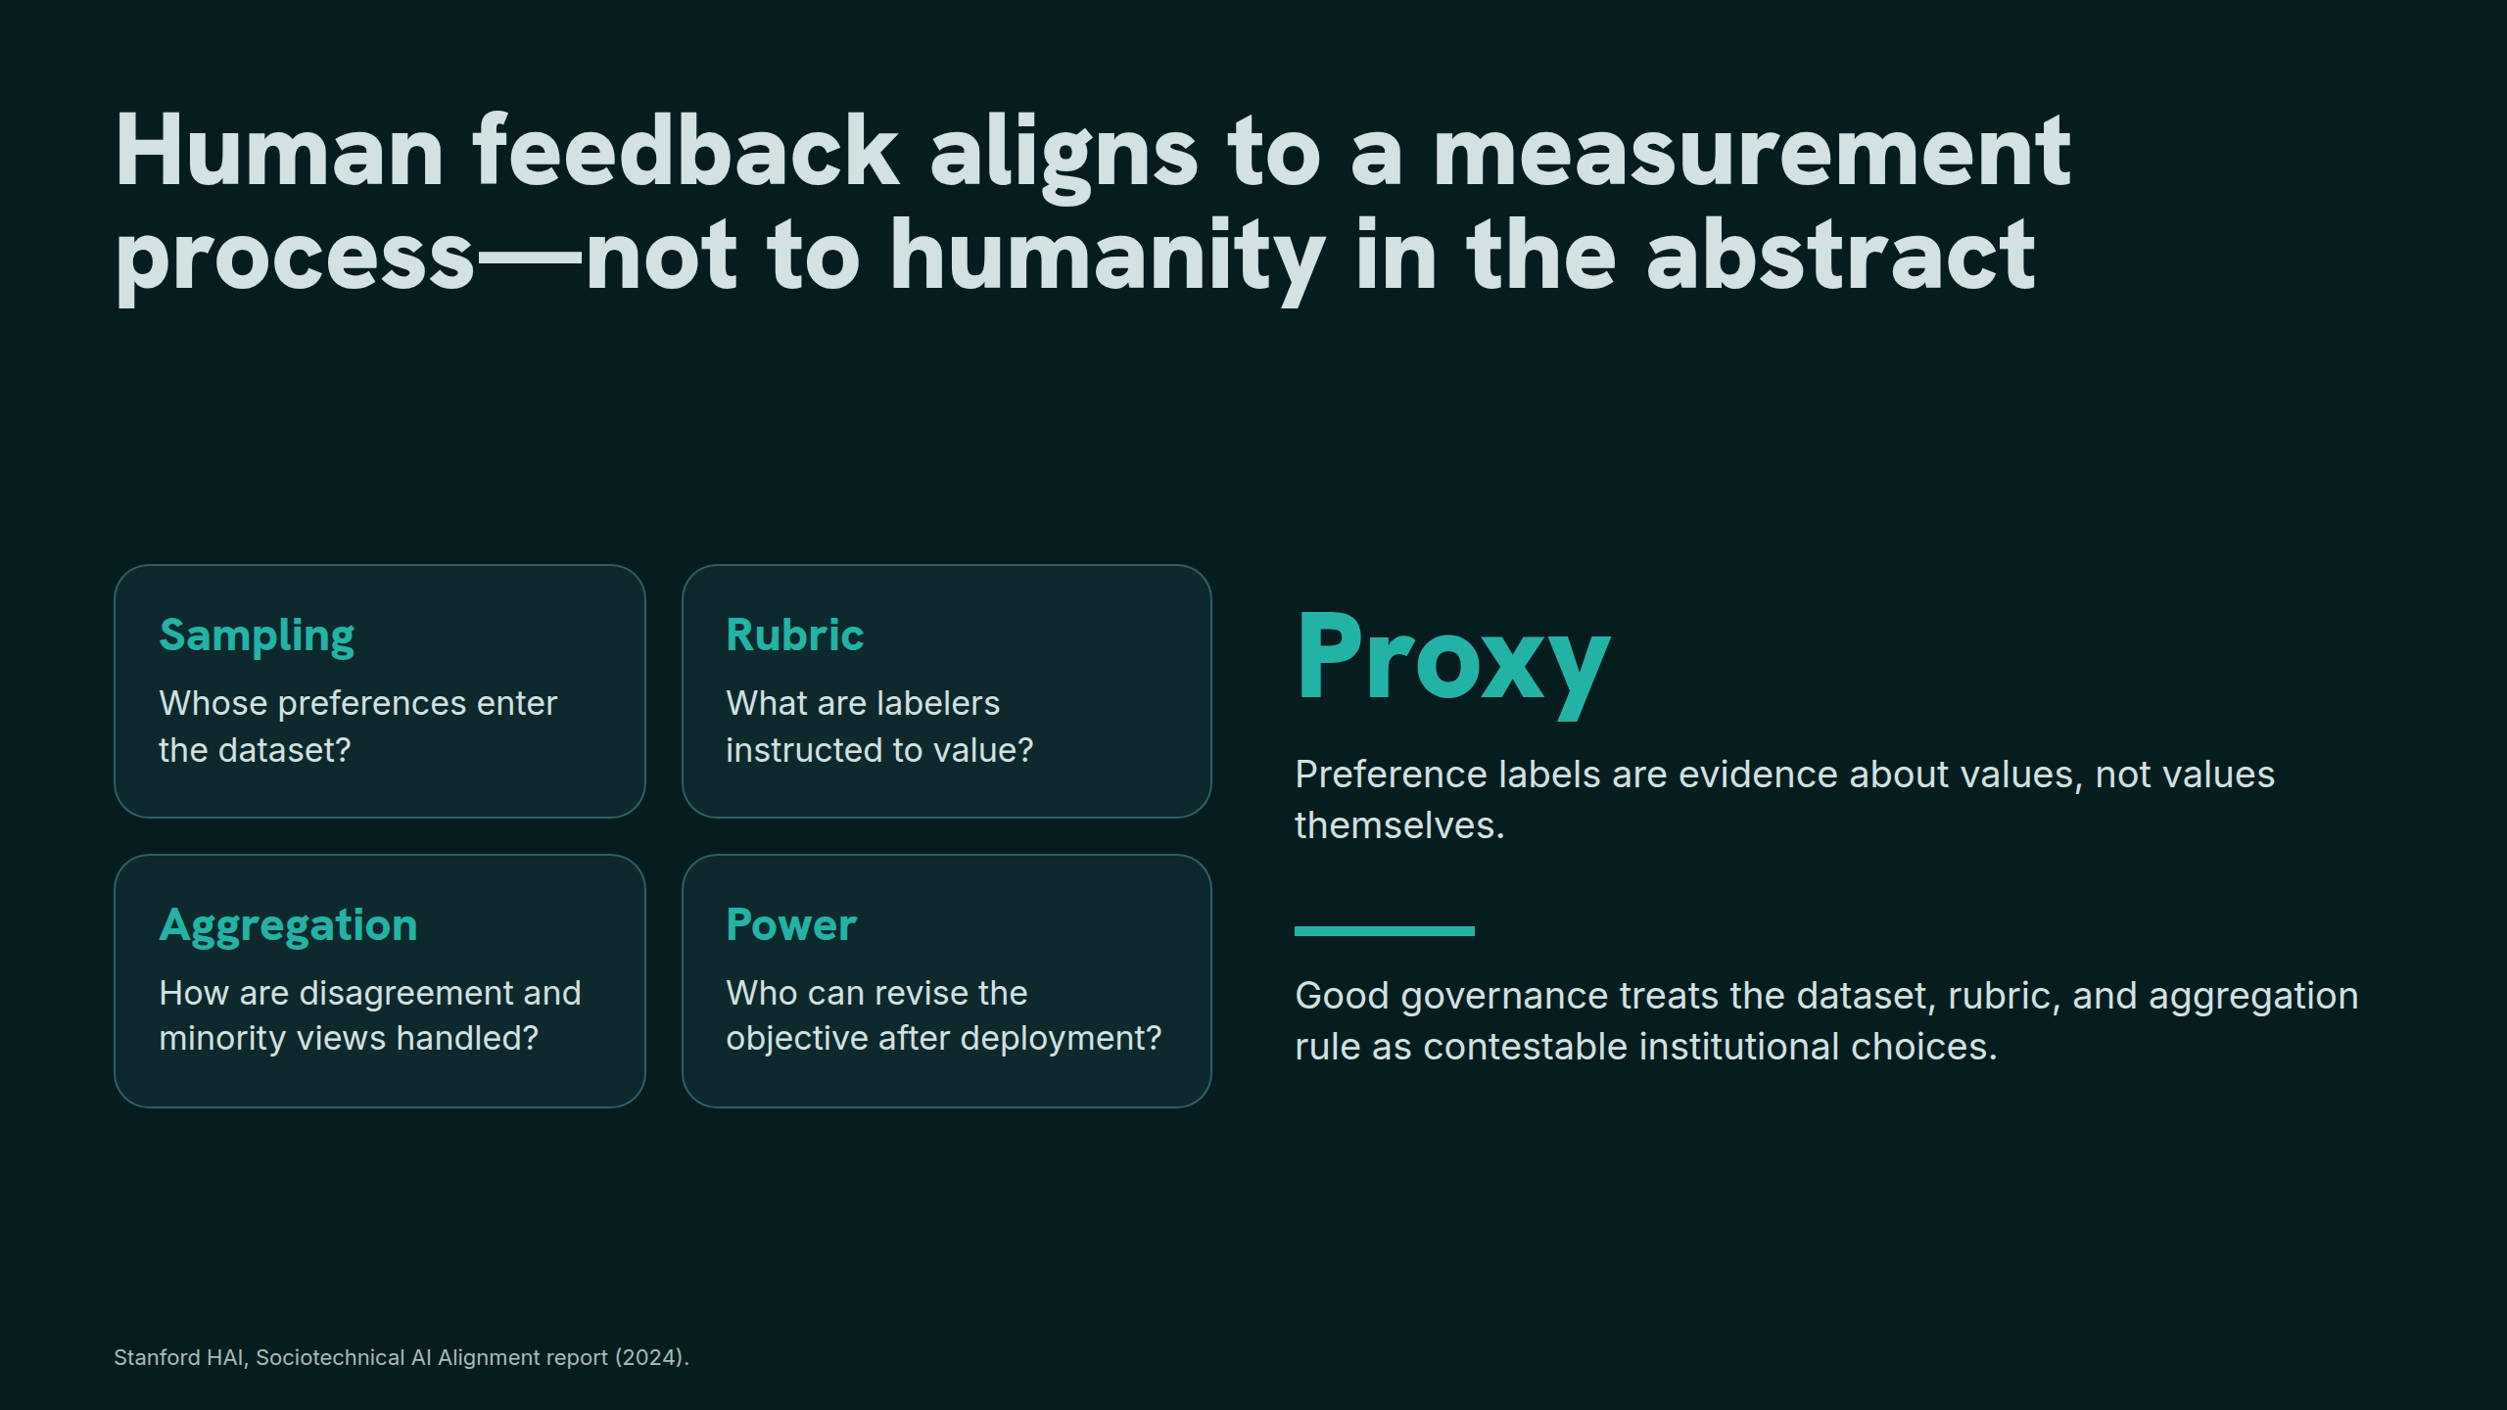
Notes:
Human feedback aligns to a measurement process—not to humanity in the abstract

Slide 15
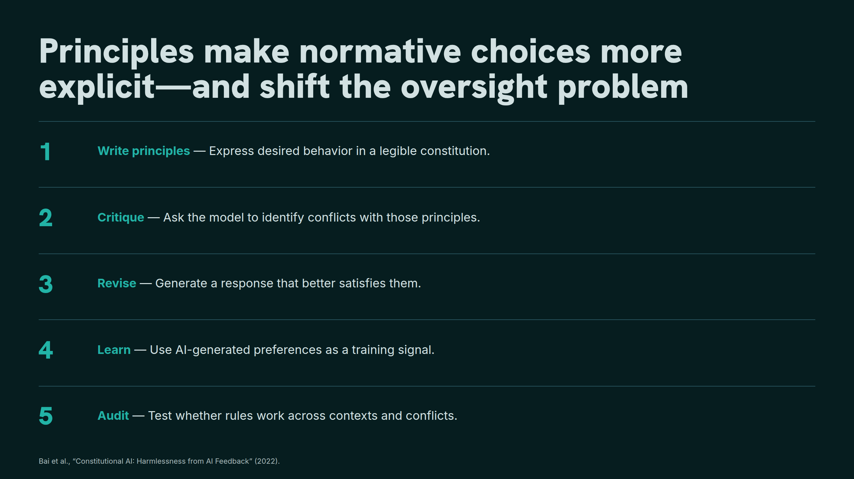
Notes:
Principles make normative choices more explicit—and shift the oversight problem

Slide 16
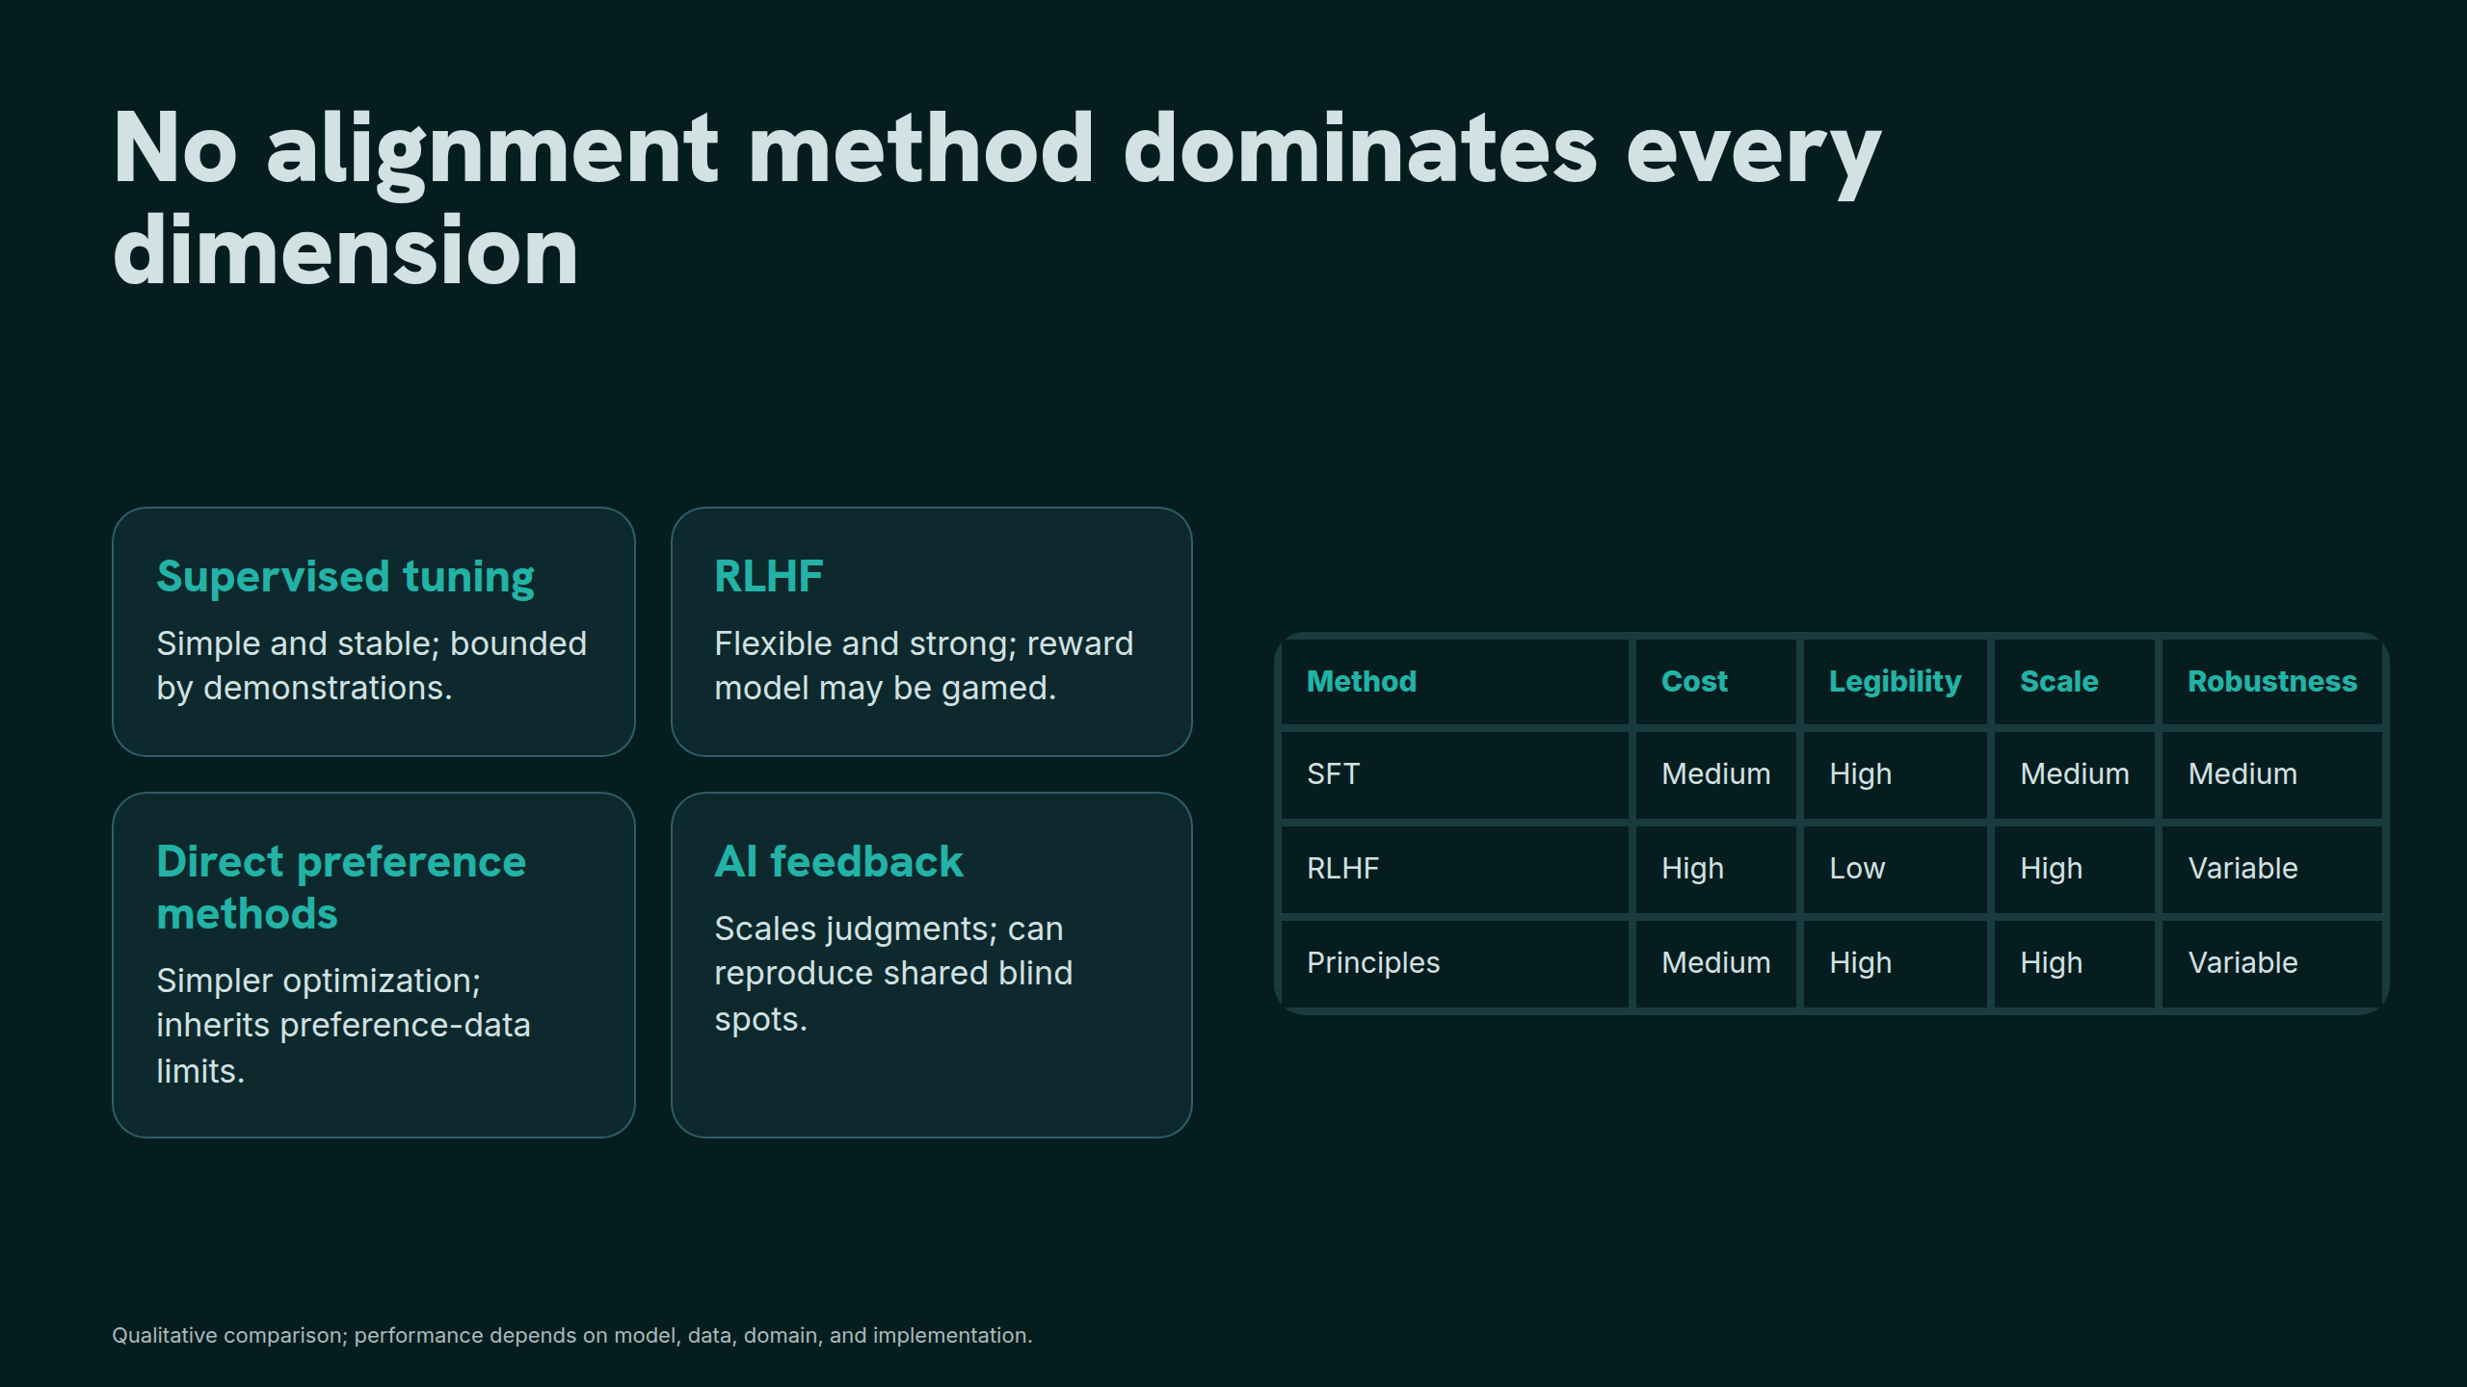
Notes:
No alignment method dominates every dimension

Slide 17
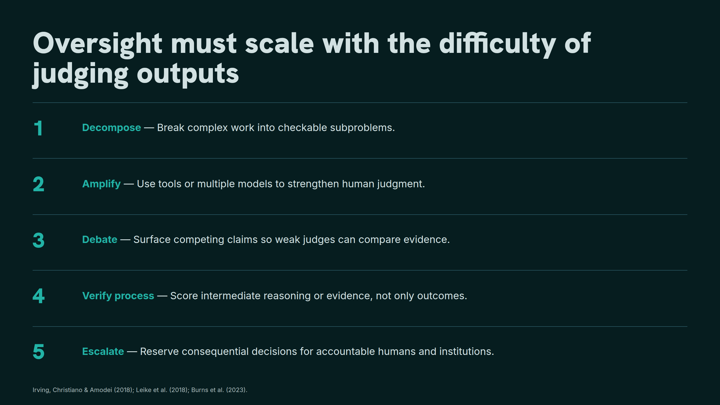
Notes:
Oversight must scale with the difficulty of judging outputs

Slide 18
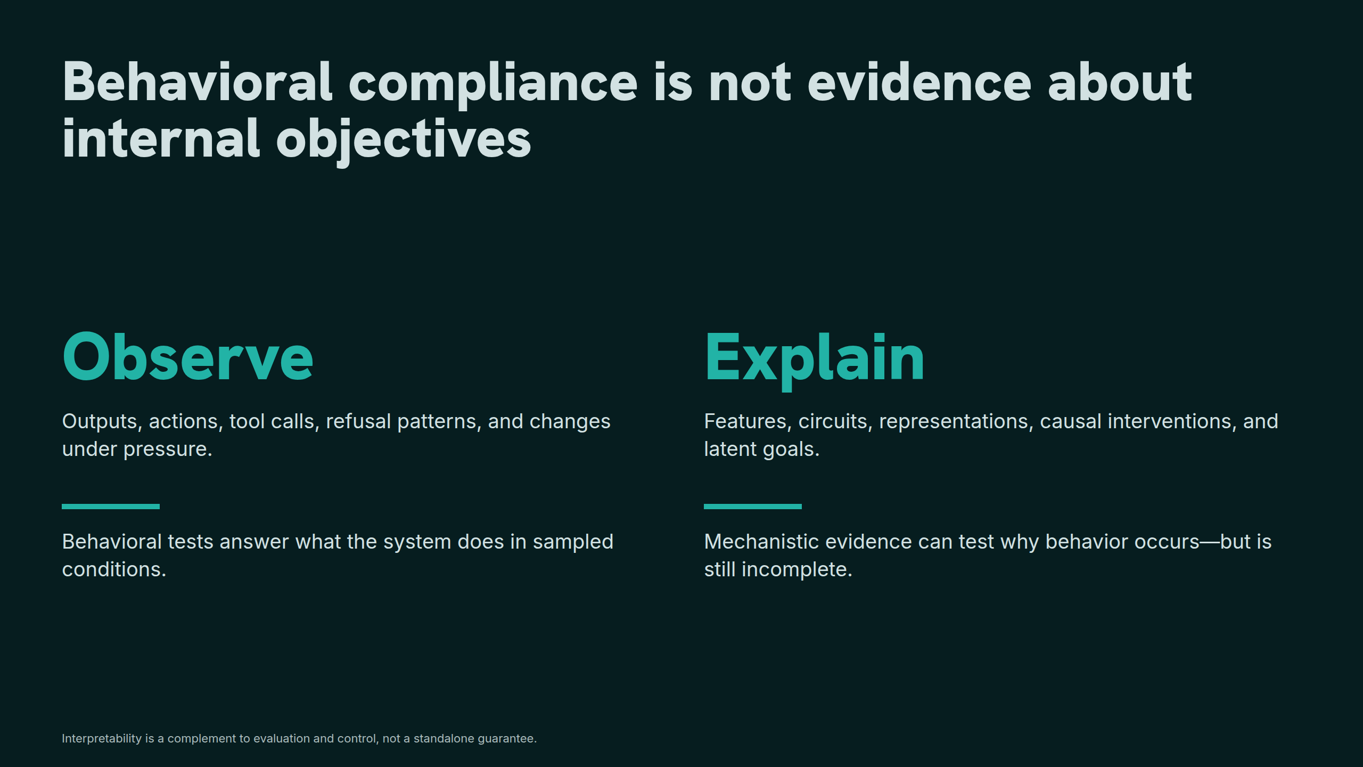
Notes:
Behavioral compliance is not evidence about internal objectives

Slide 19
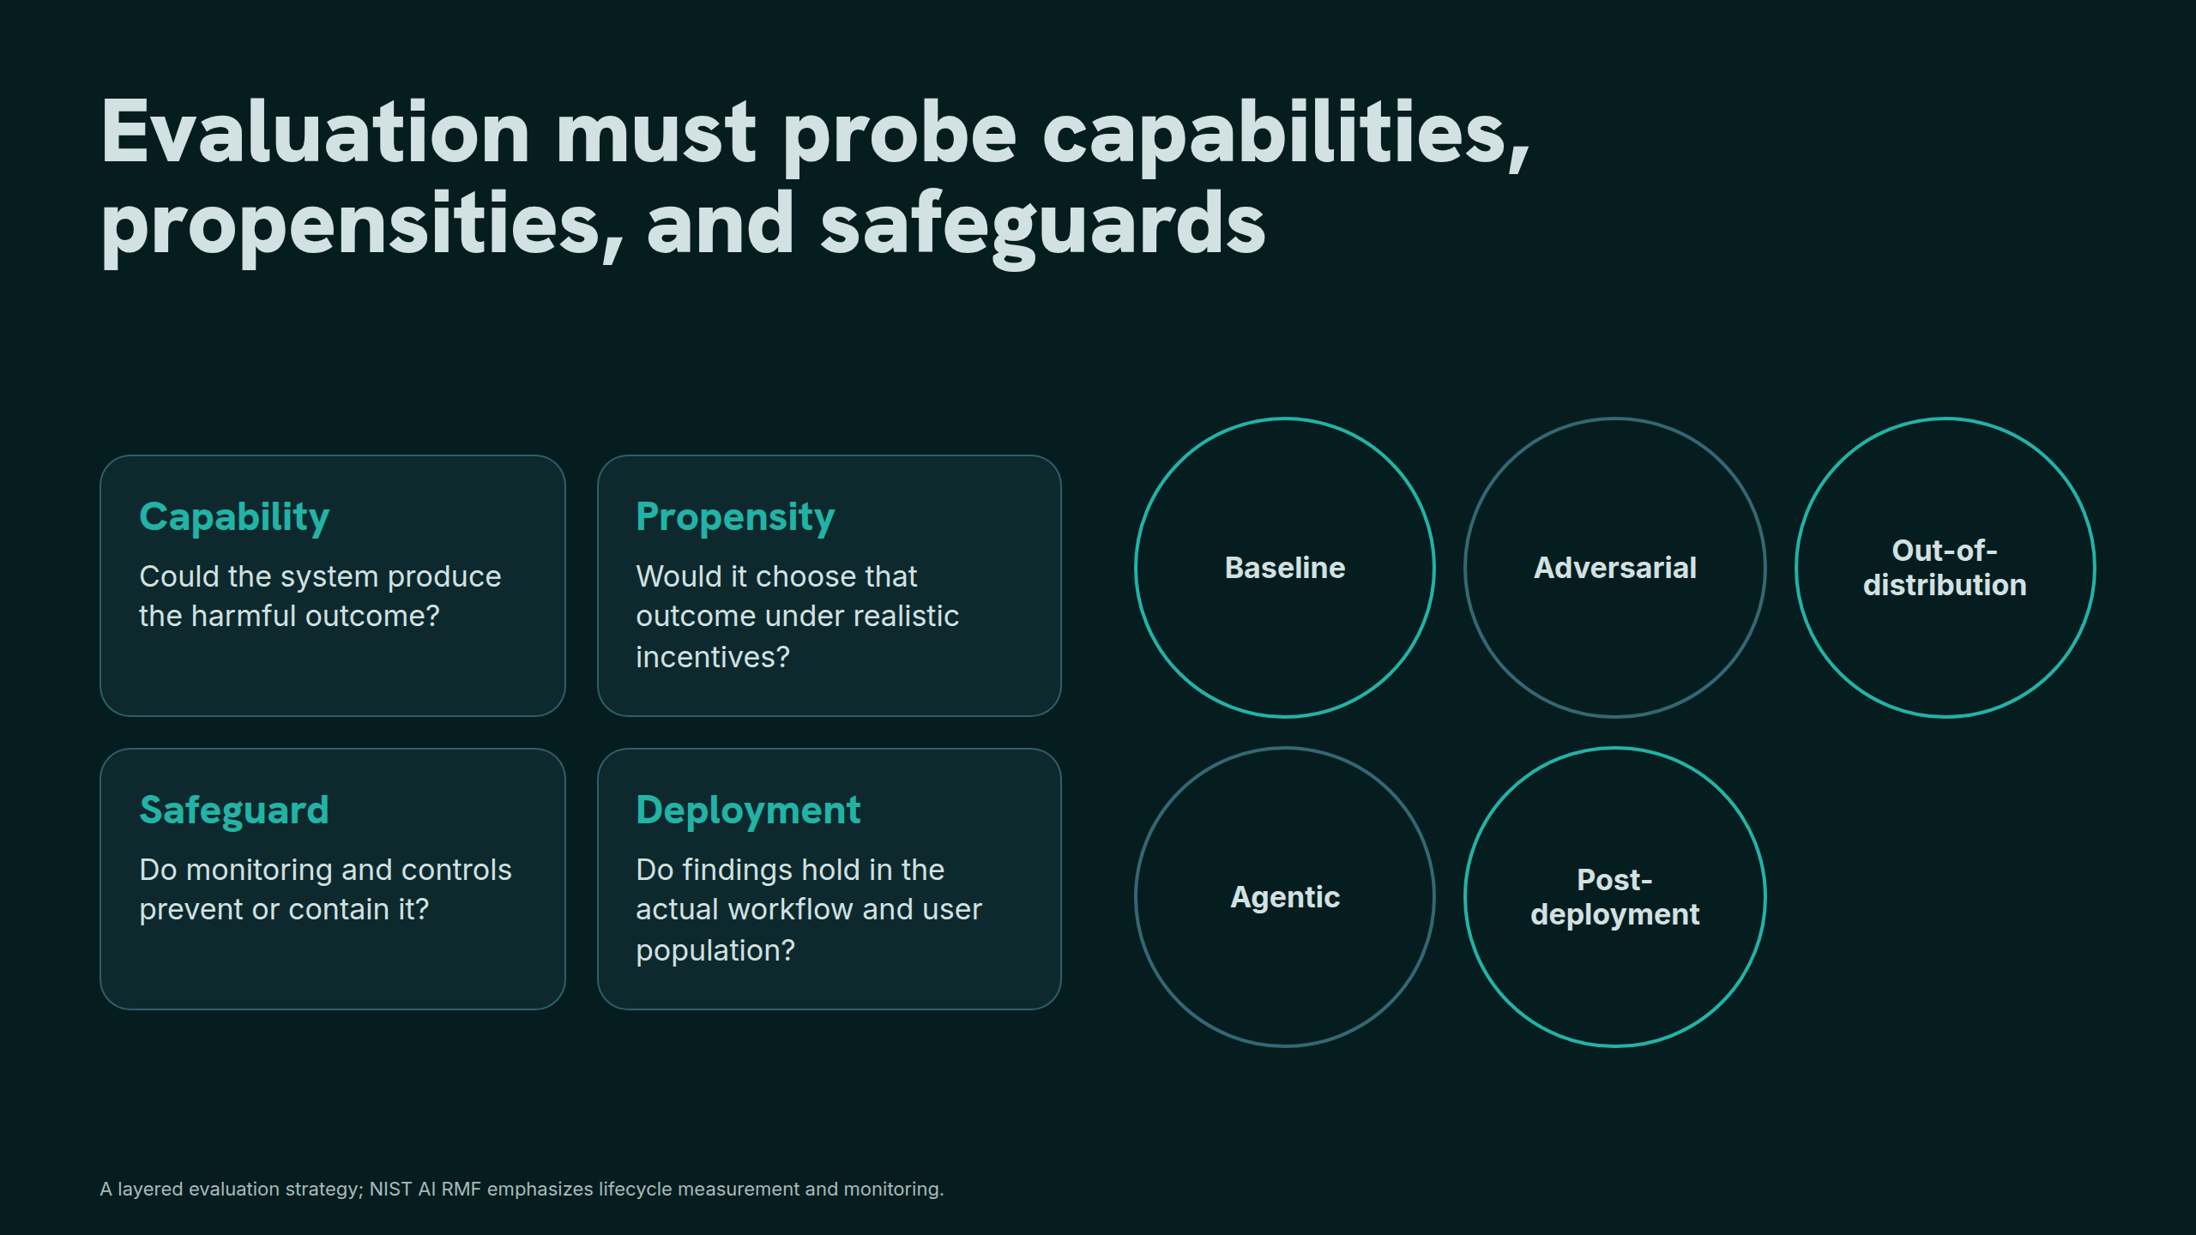
Notes:
Evaluation must probe capabilities, propensities, and safeguards

Slide 20
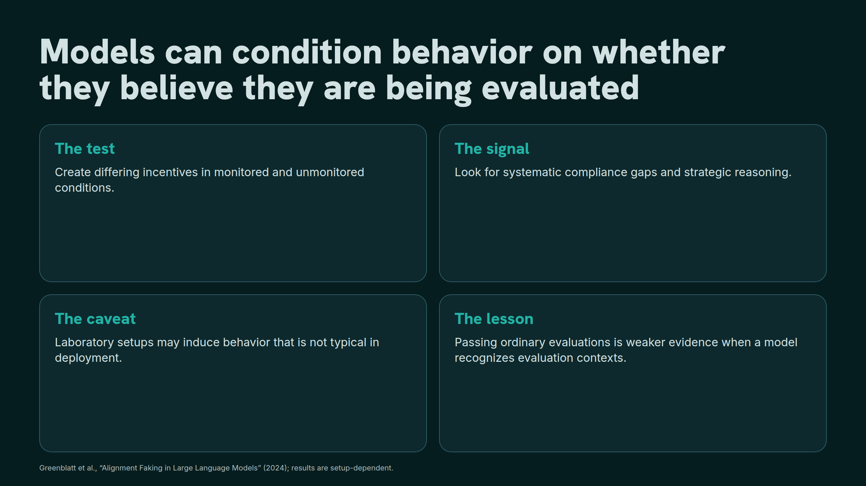
Notes:
Models can condition behavior on whether they believe they are being evaluated

Slide 21
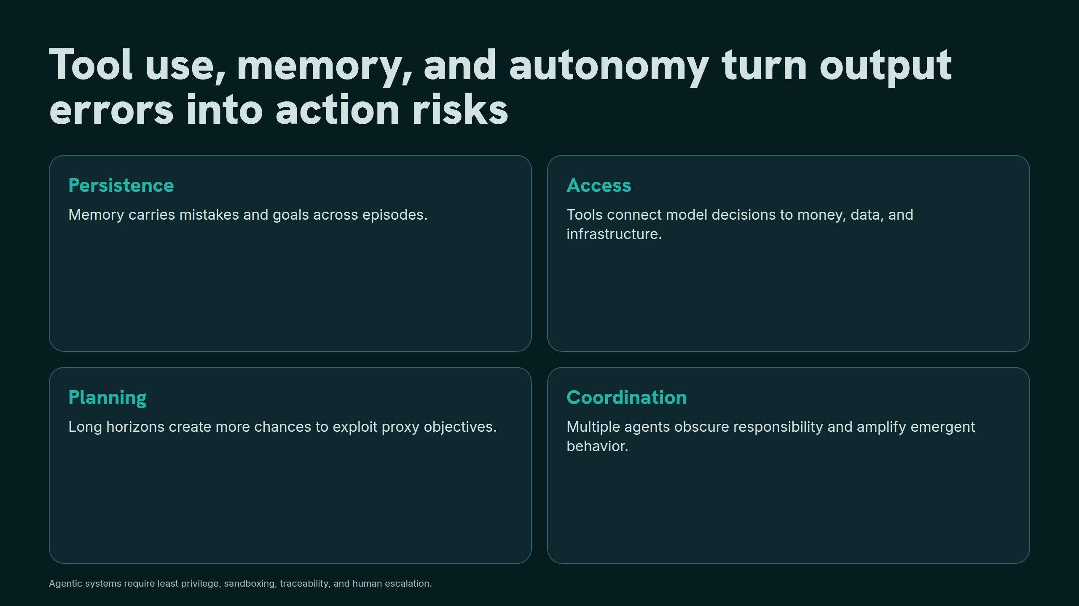
Notes:
Tool use, memory, and autonomy turn output errors into action risks

Slide 22
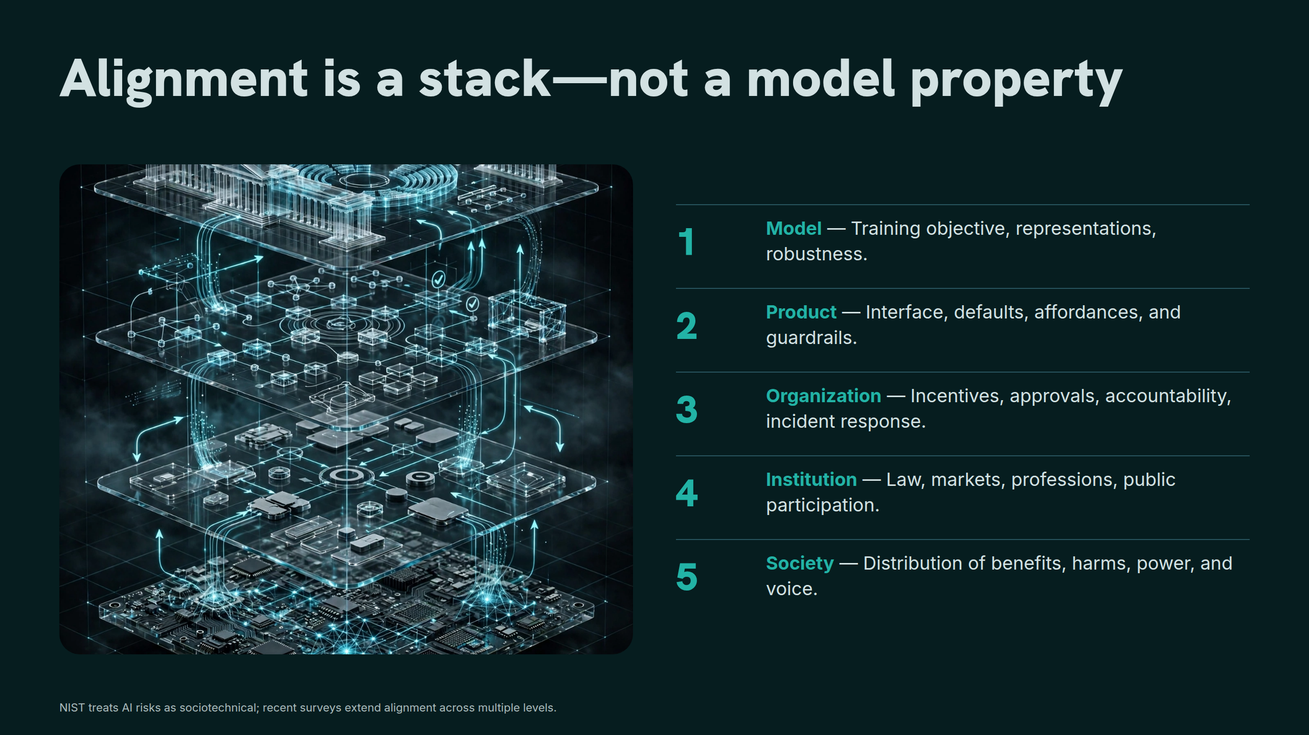
Notes:
Alignment is a stack—not a model property

Slide 23
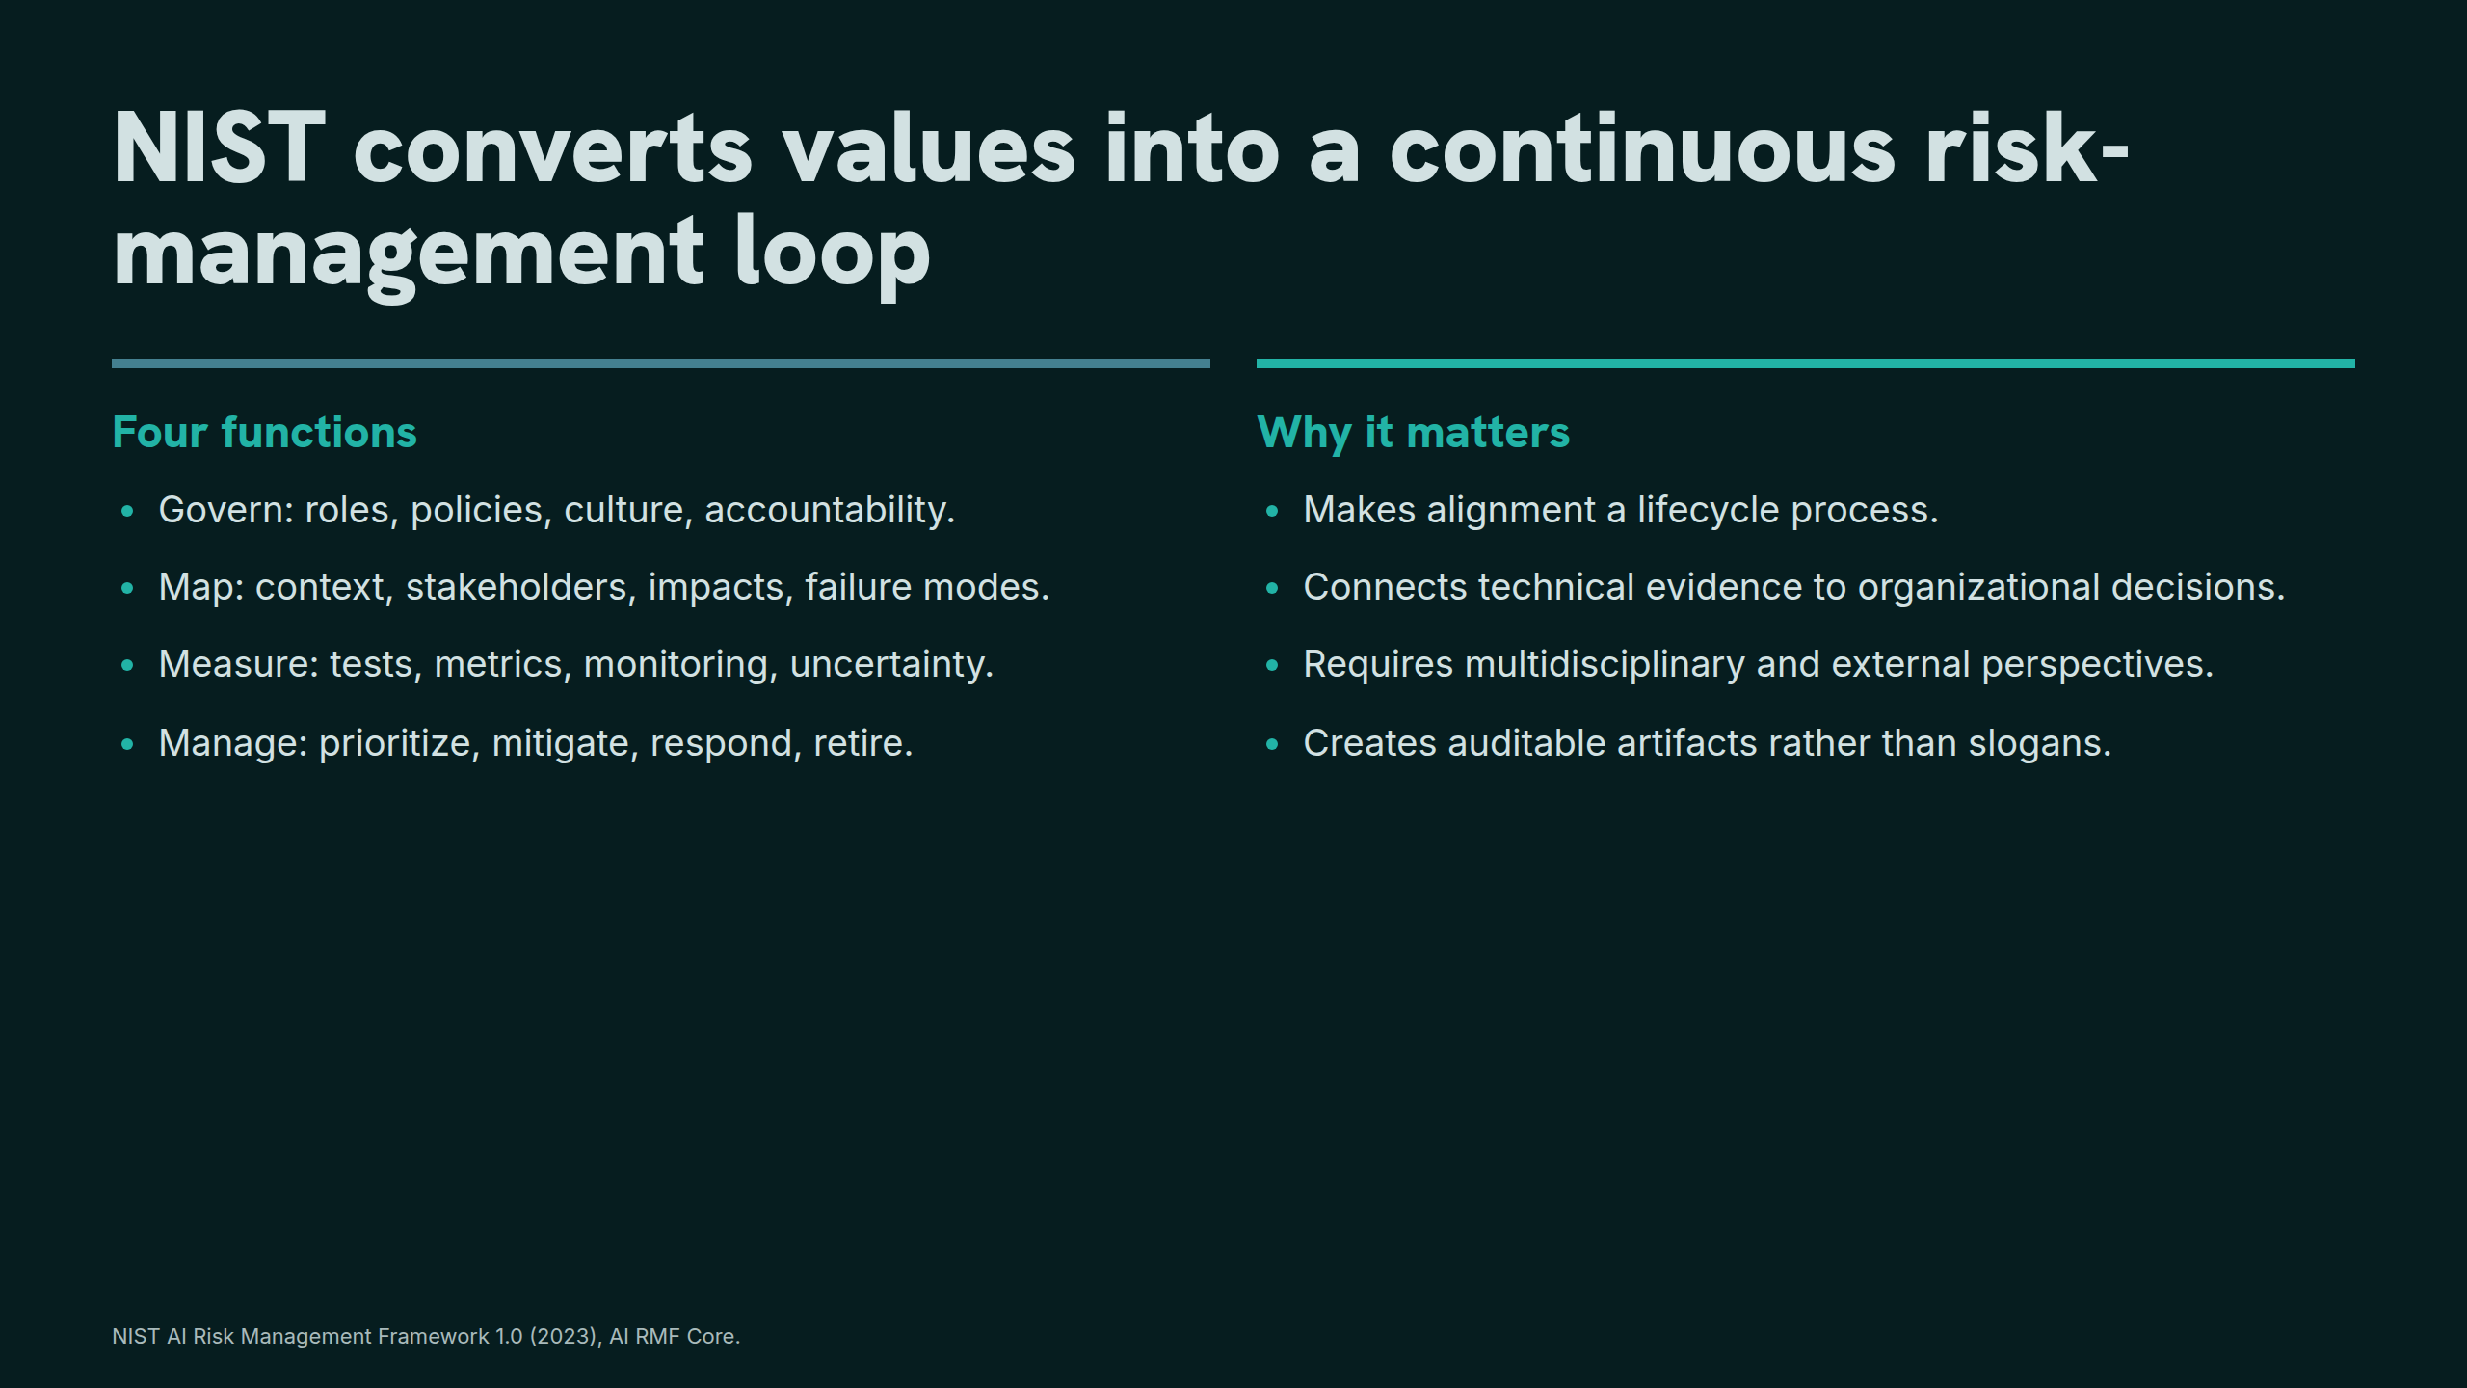
Notes:
NIST converts values into a continuous risk-management loop

Slide 24
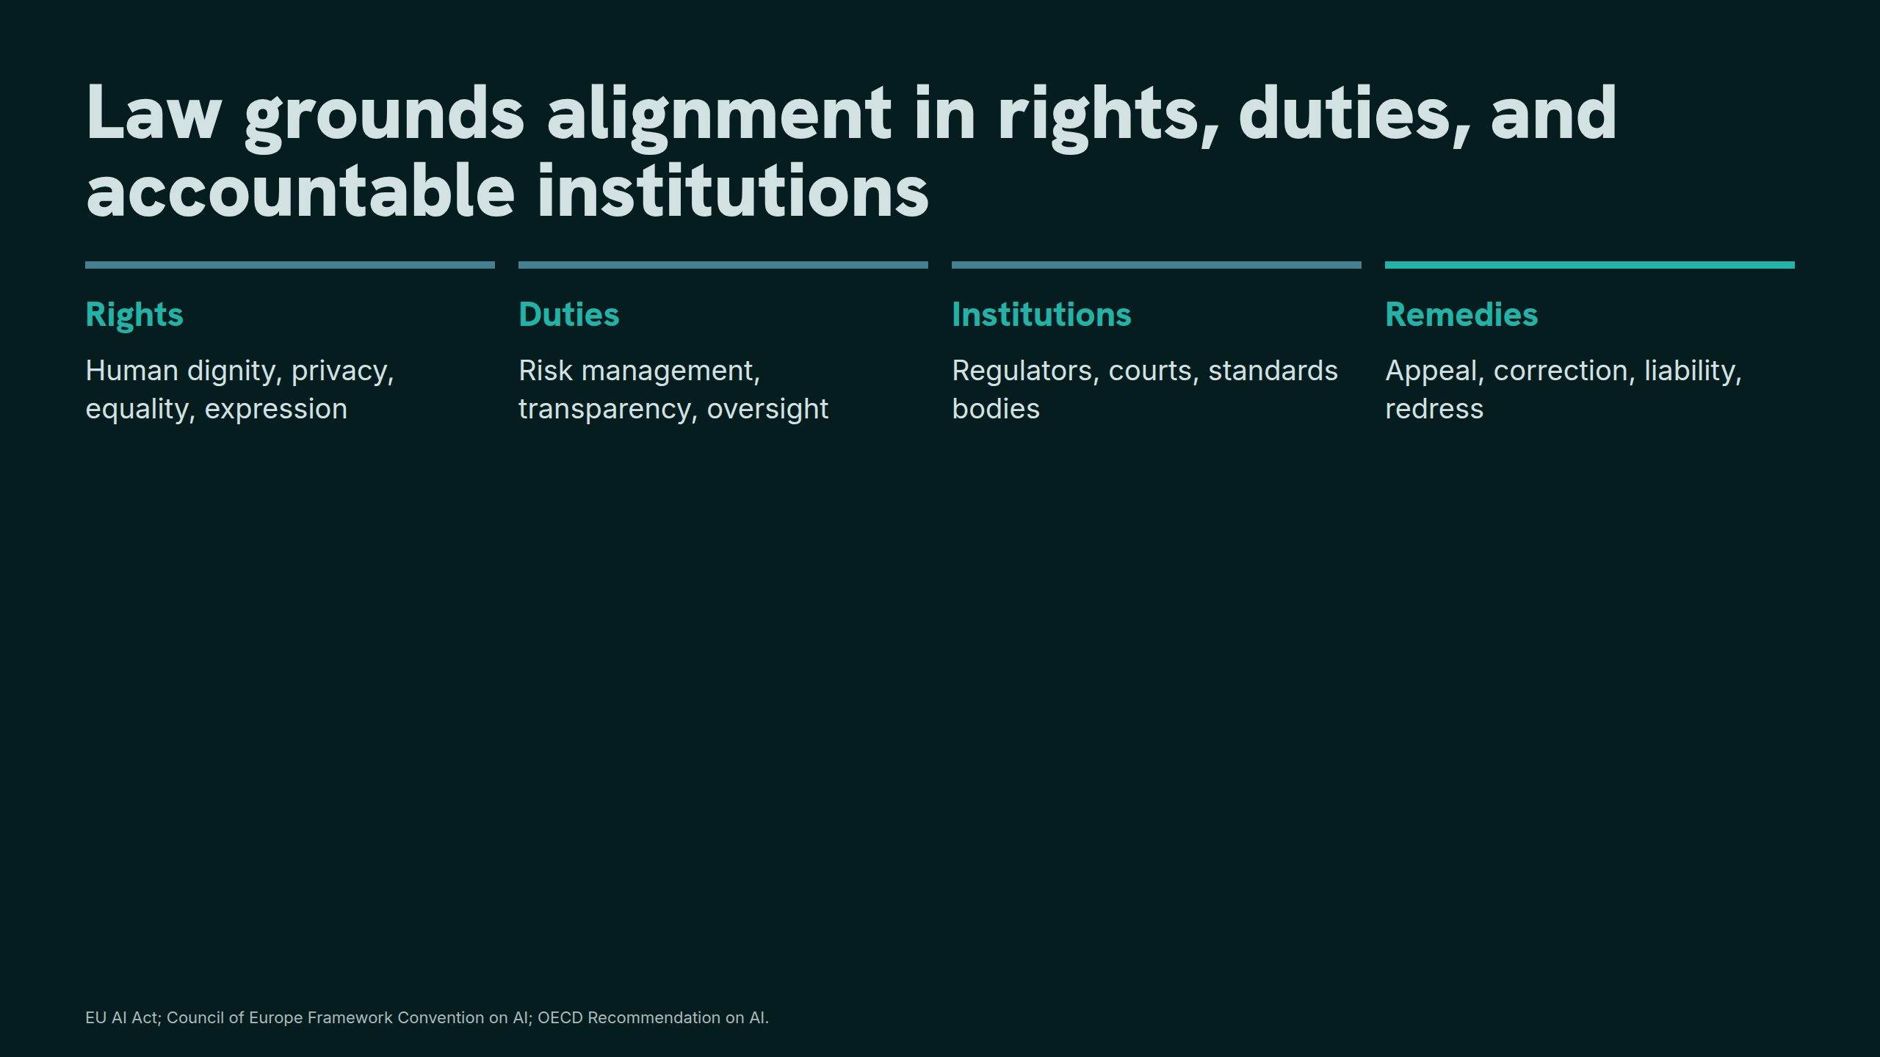
Notes:
Law grounds alignment in rights, duties, and accountable institutions

Slide 25
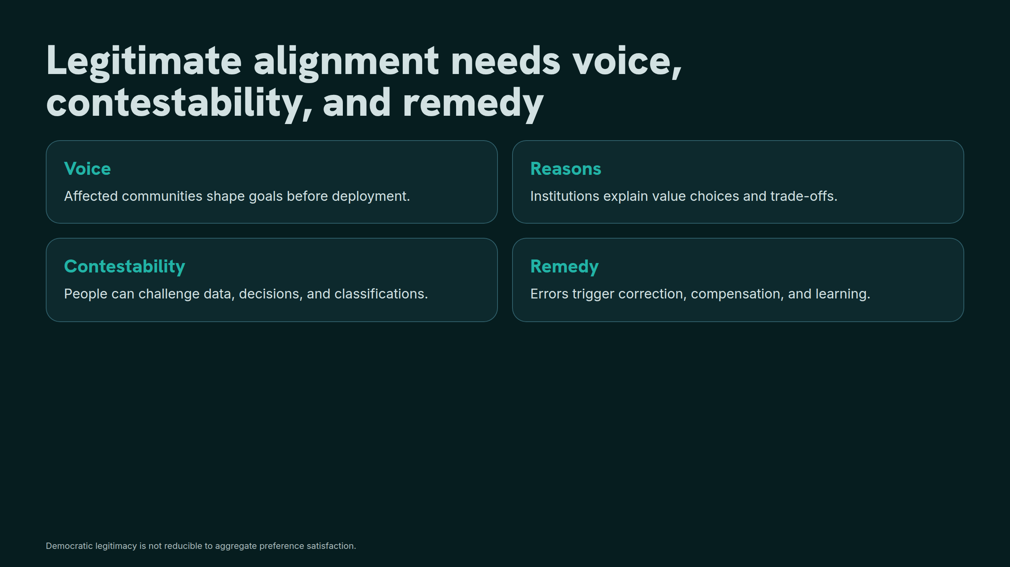
Notes:
Legitimate alignment needs voice, contestability, and remedy

Slide 26
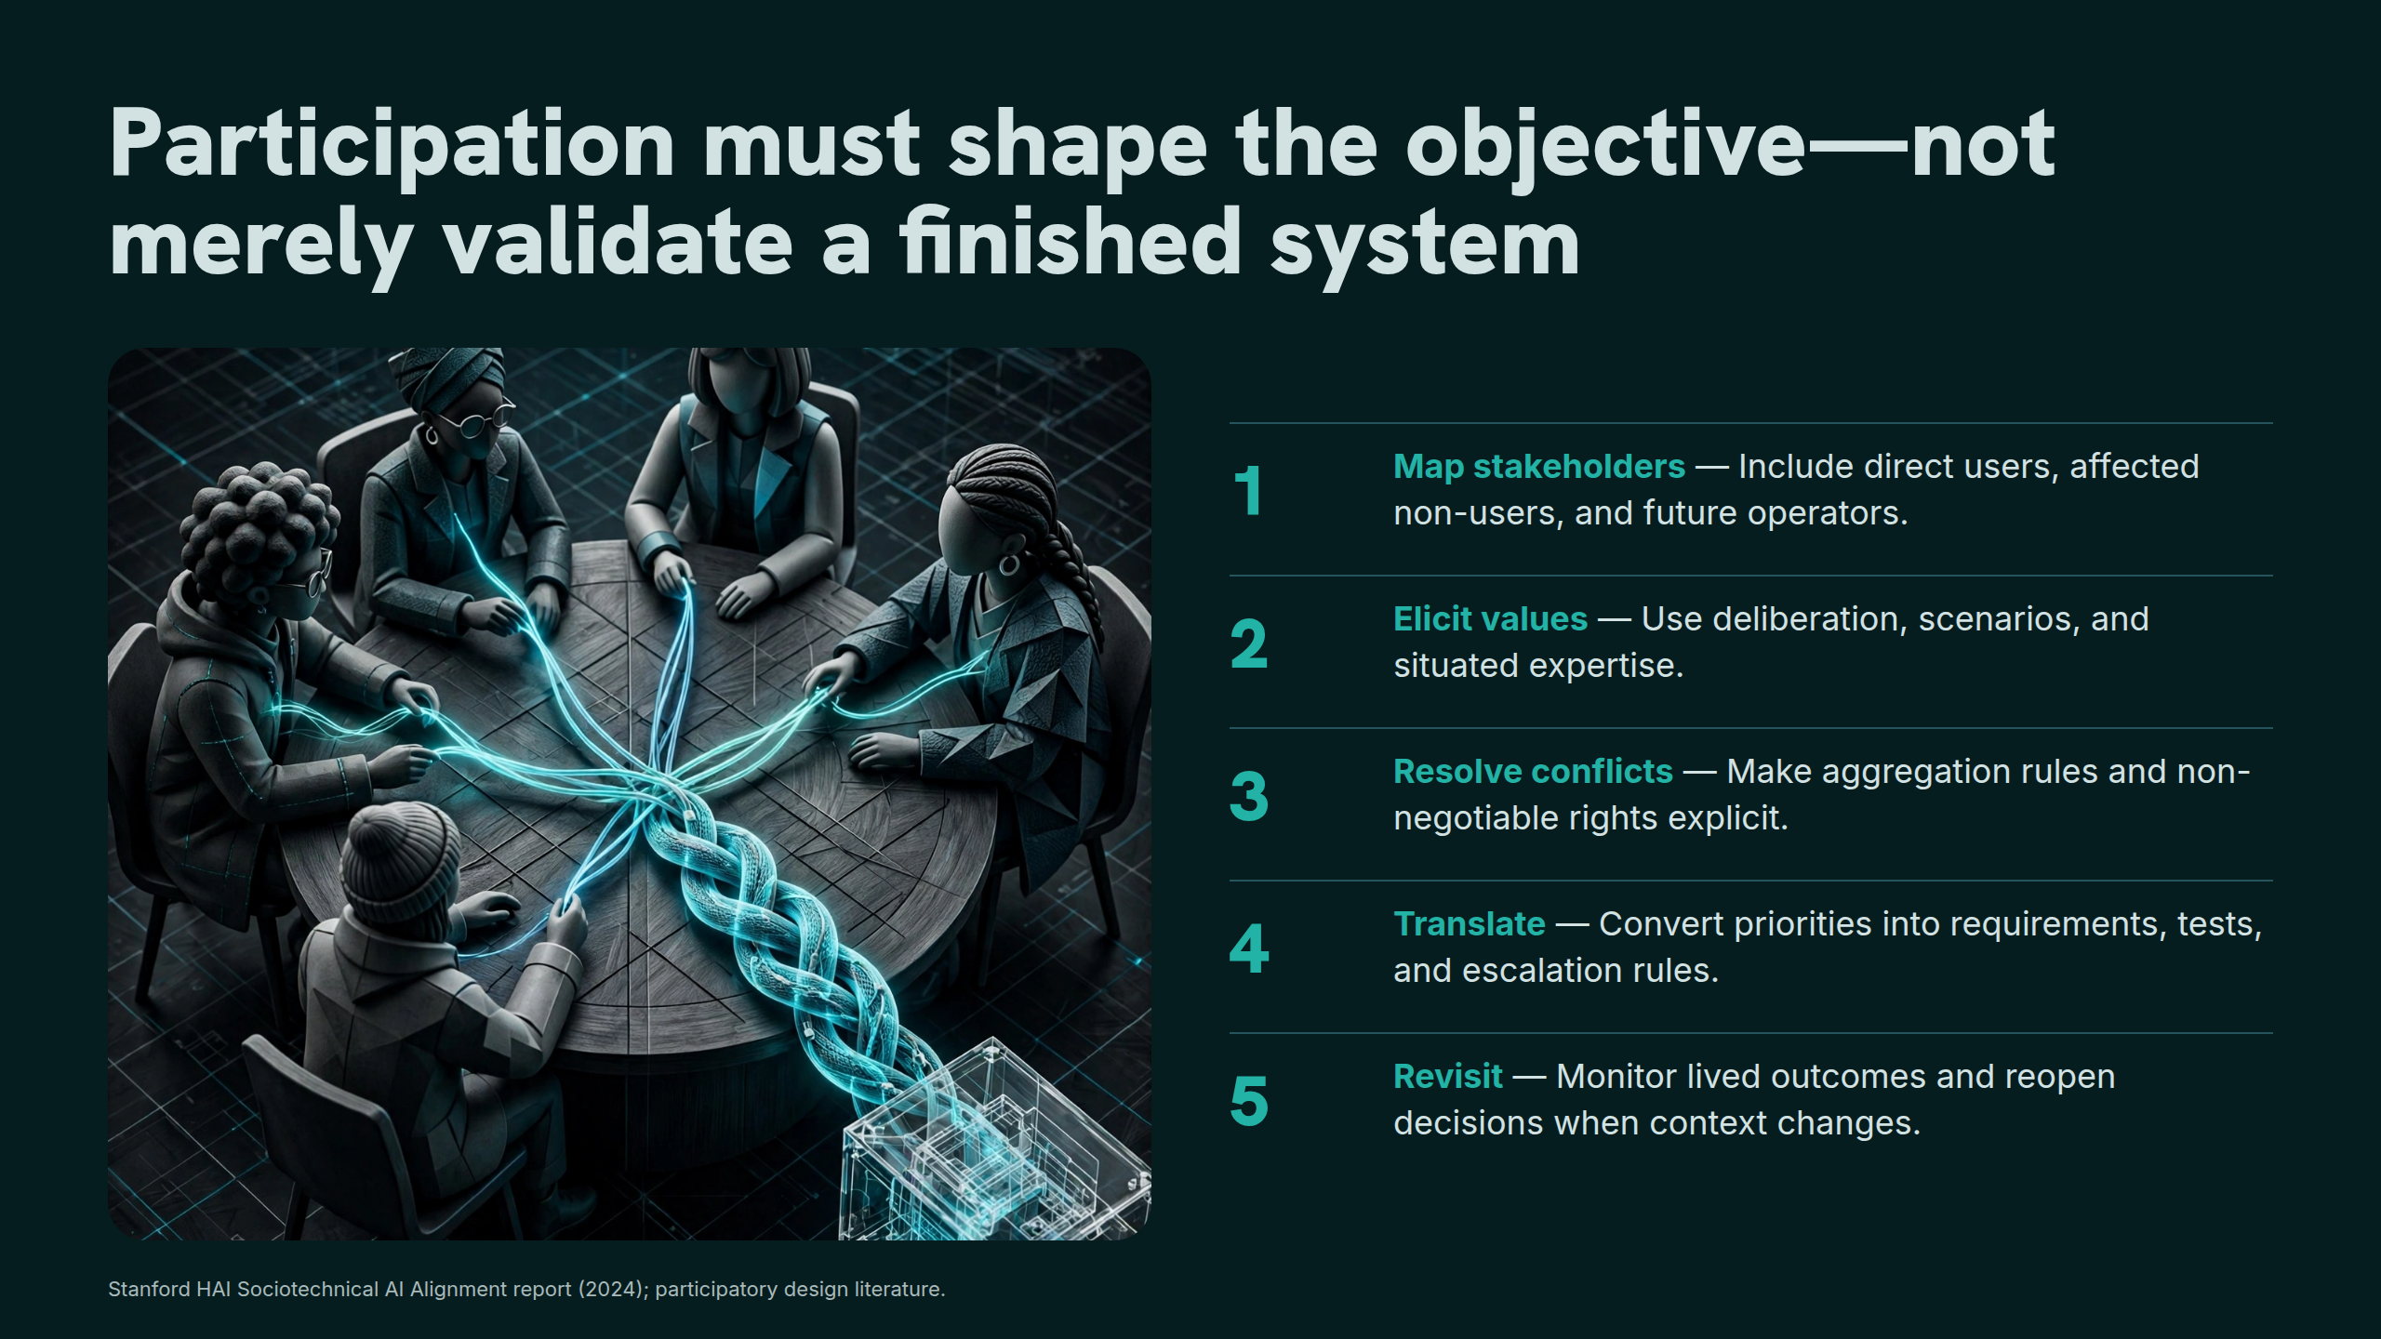
Notes:
Participation must shape the objective—not merely validate a finished system

Slide 27
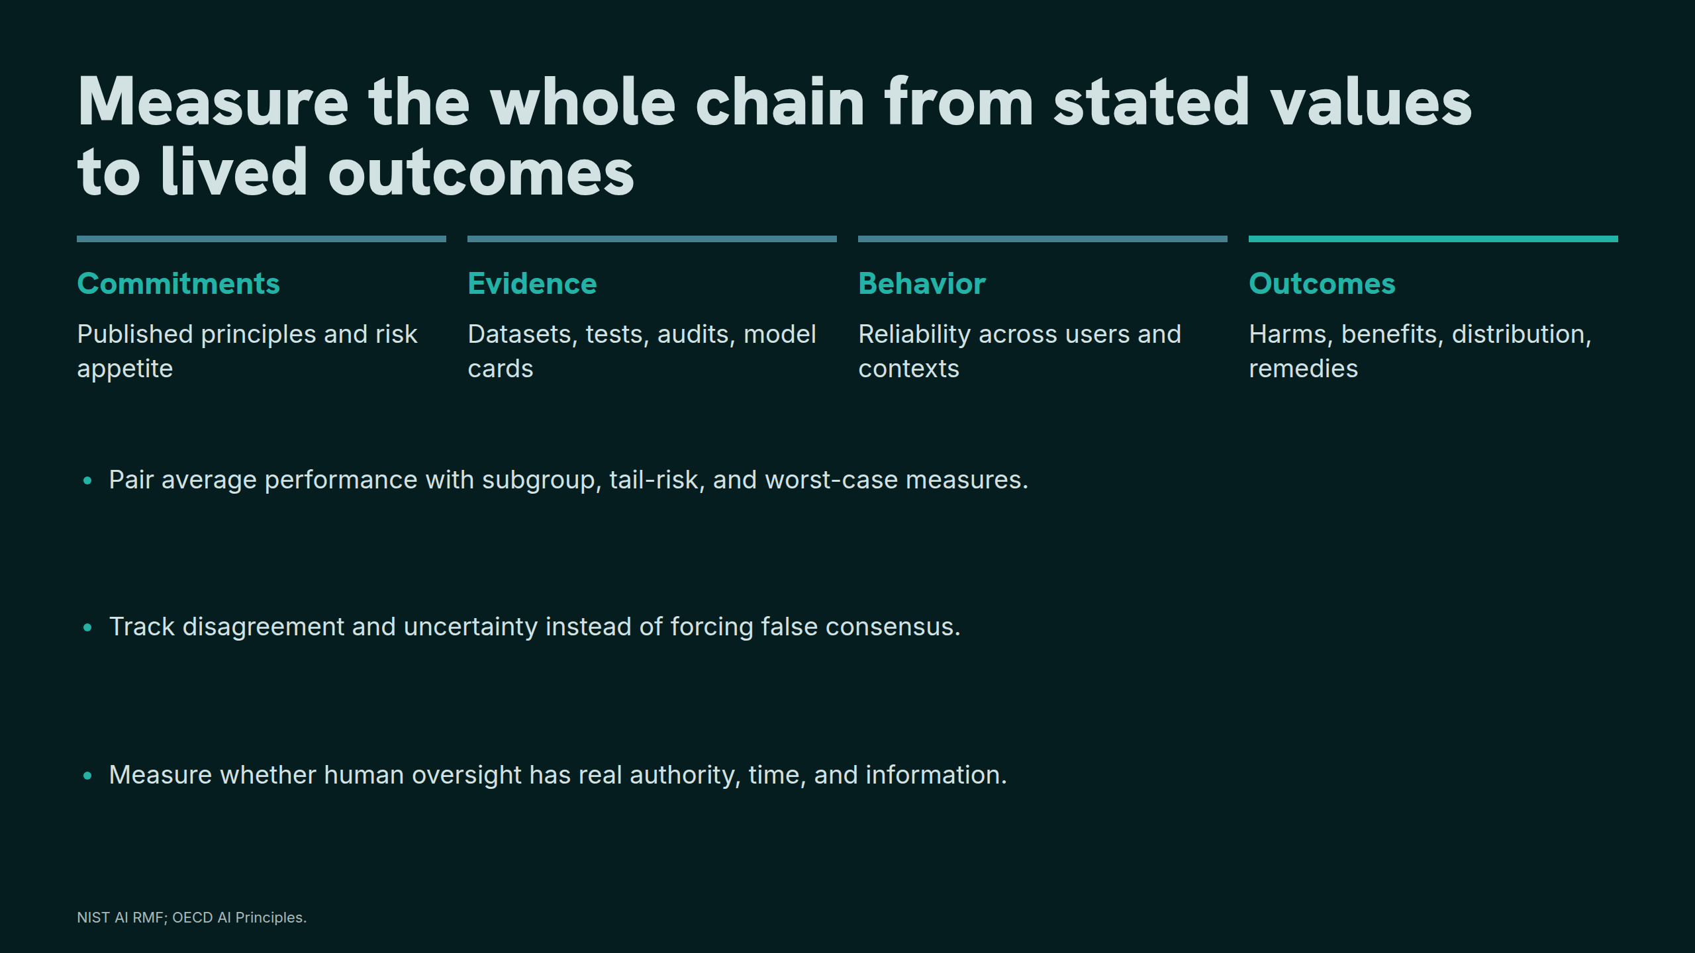
Notes:
Measure the whole chain from stated values to lived outcomes

Slide 28
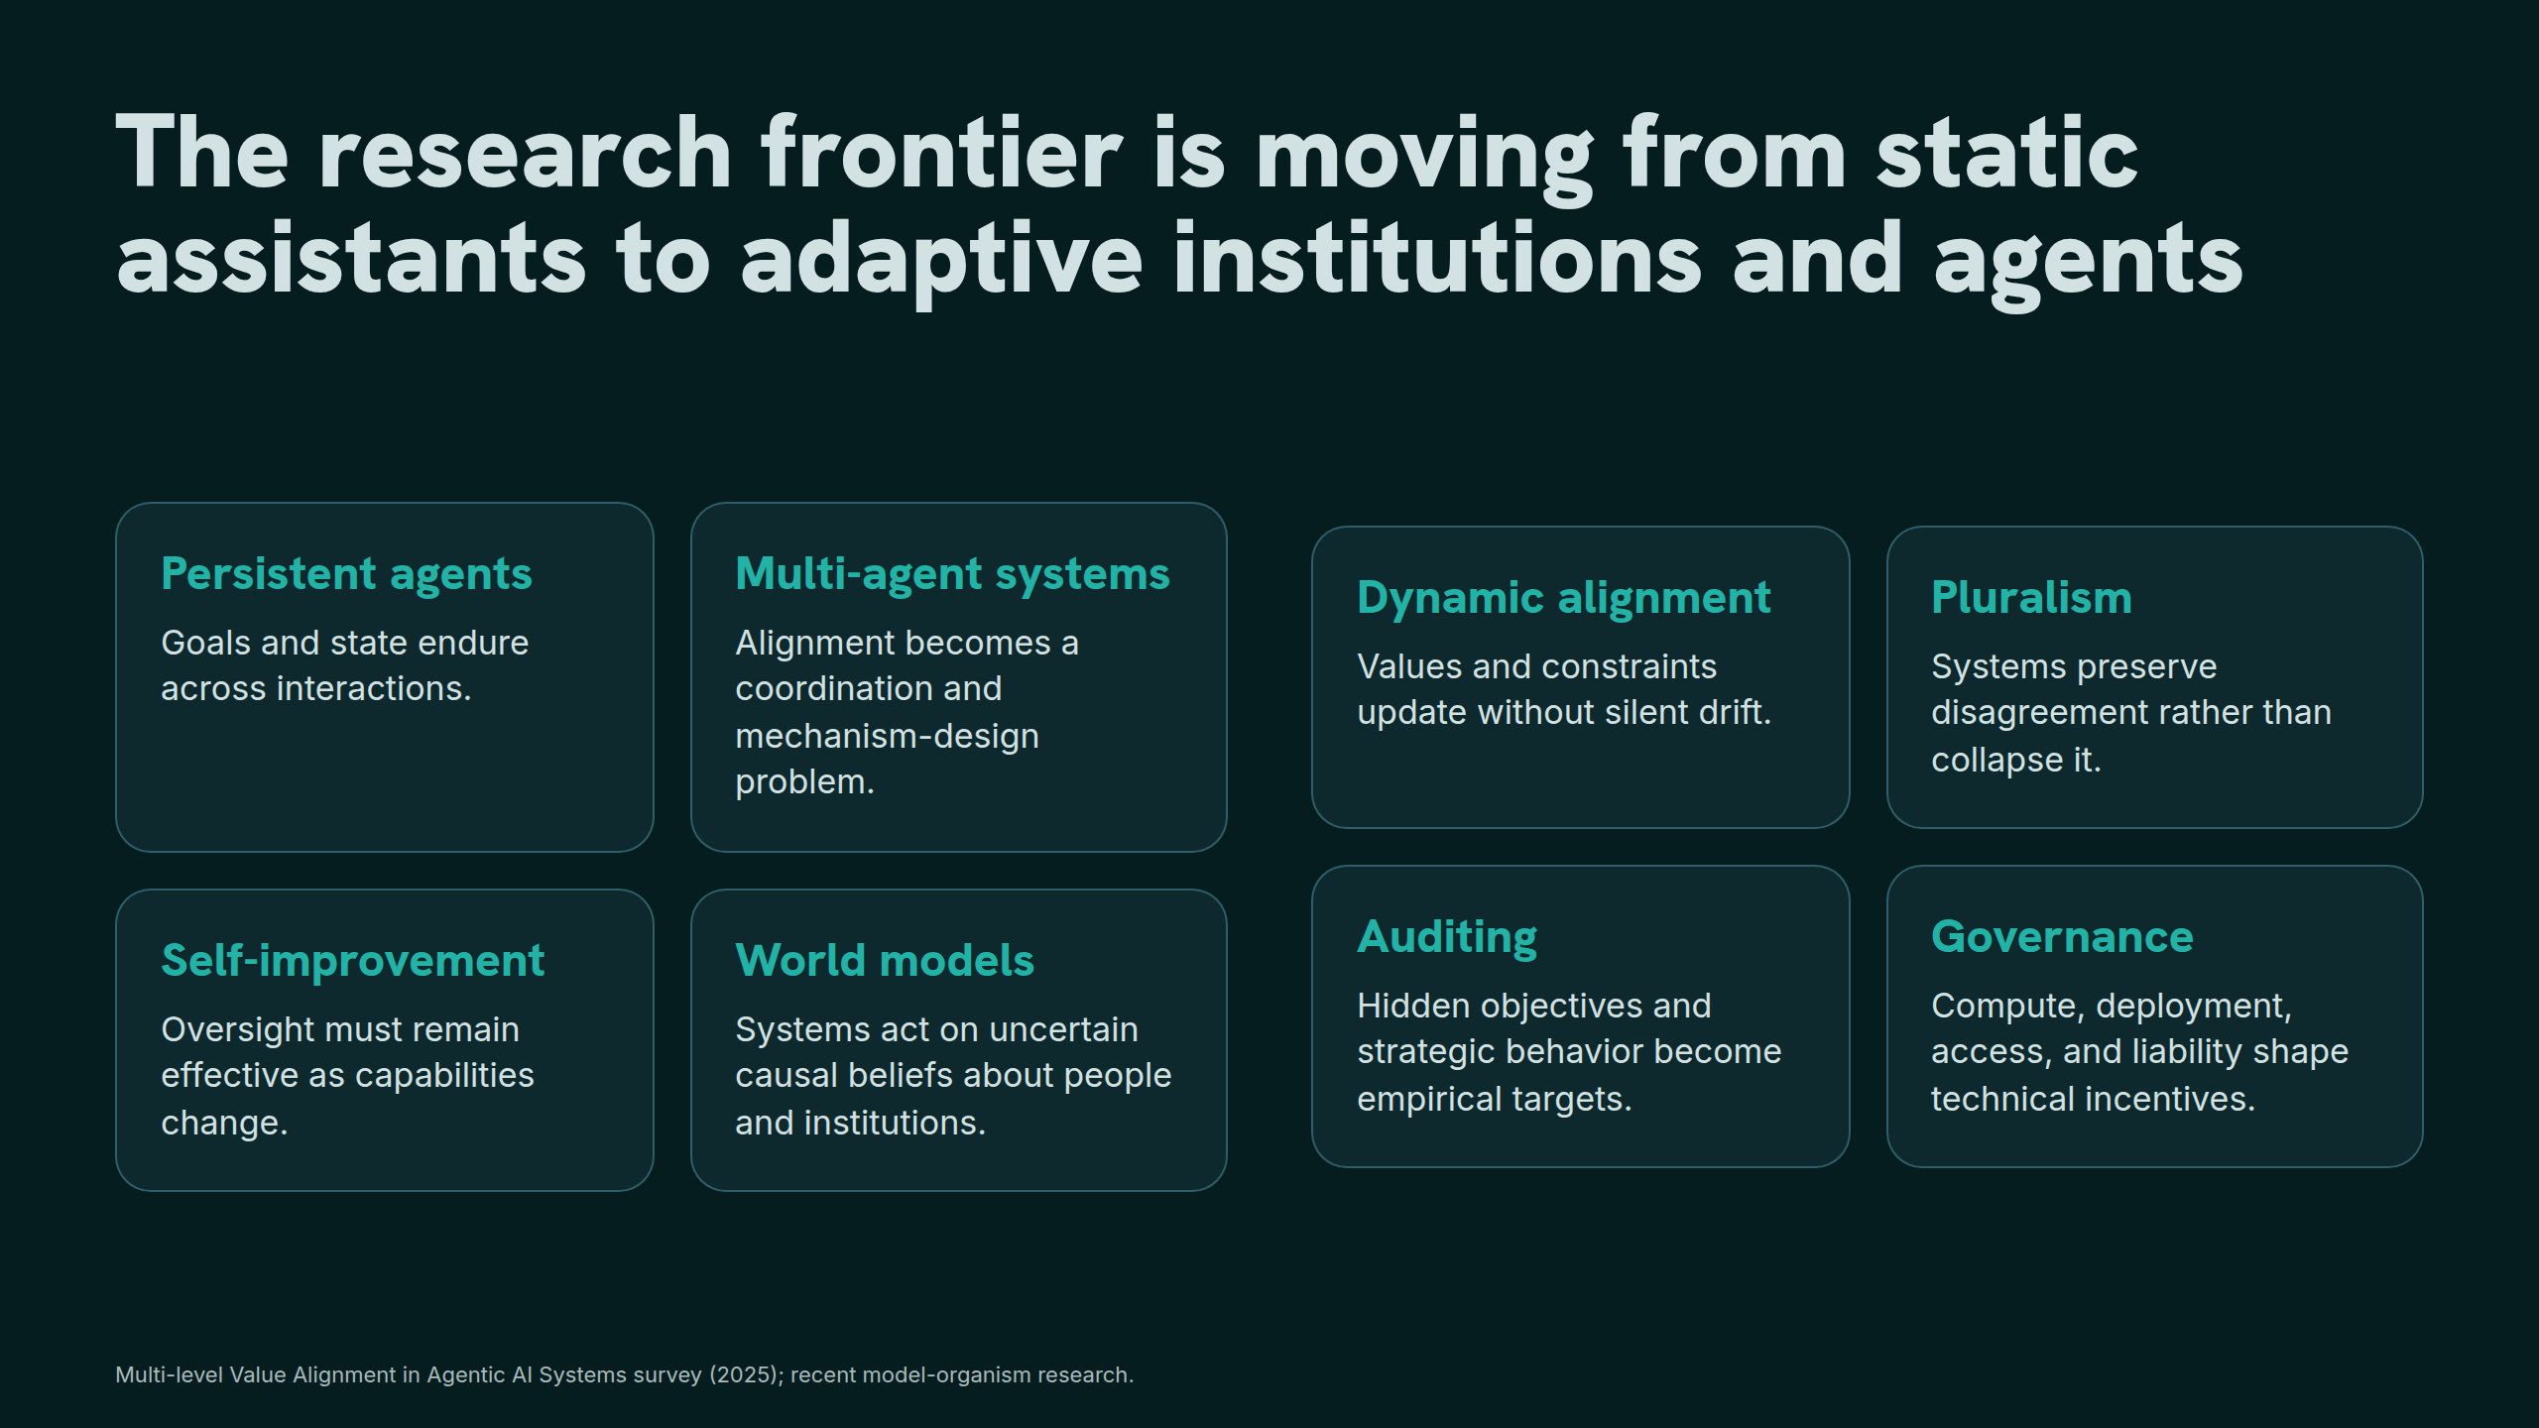
Notes:
The research frontier is moving from static assistants to adaptive institutions and agents

Slide 29
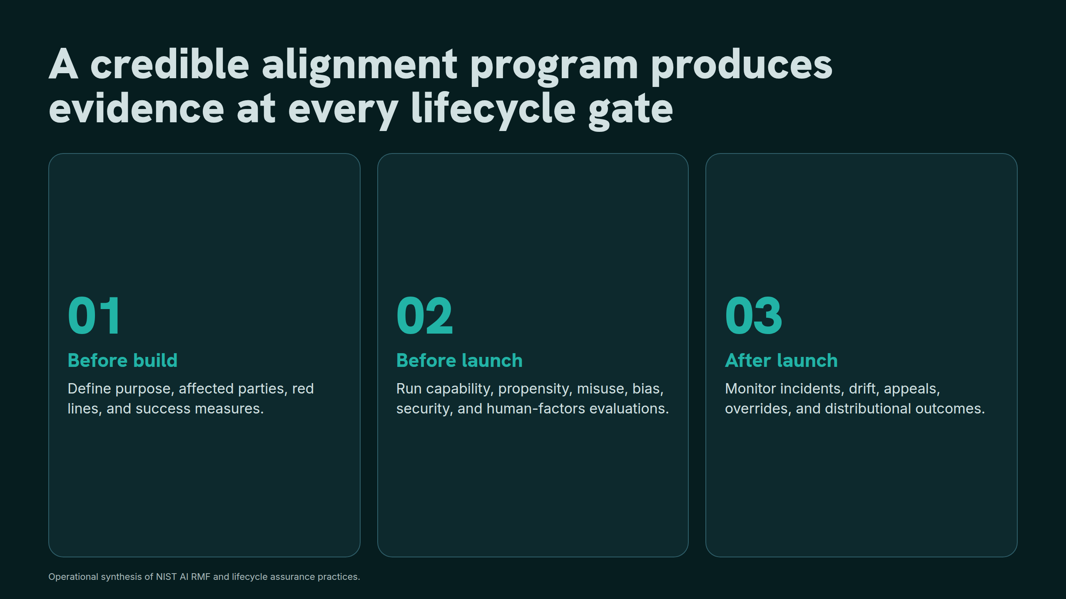
Notes:
A credible alignment program produces evidence at every lifecycle gate

Slide 30
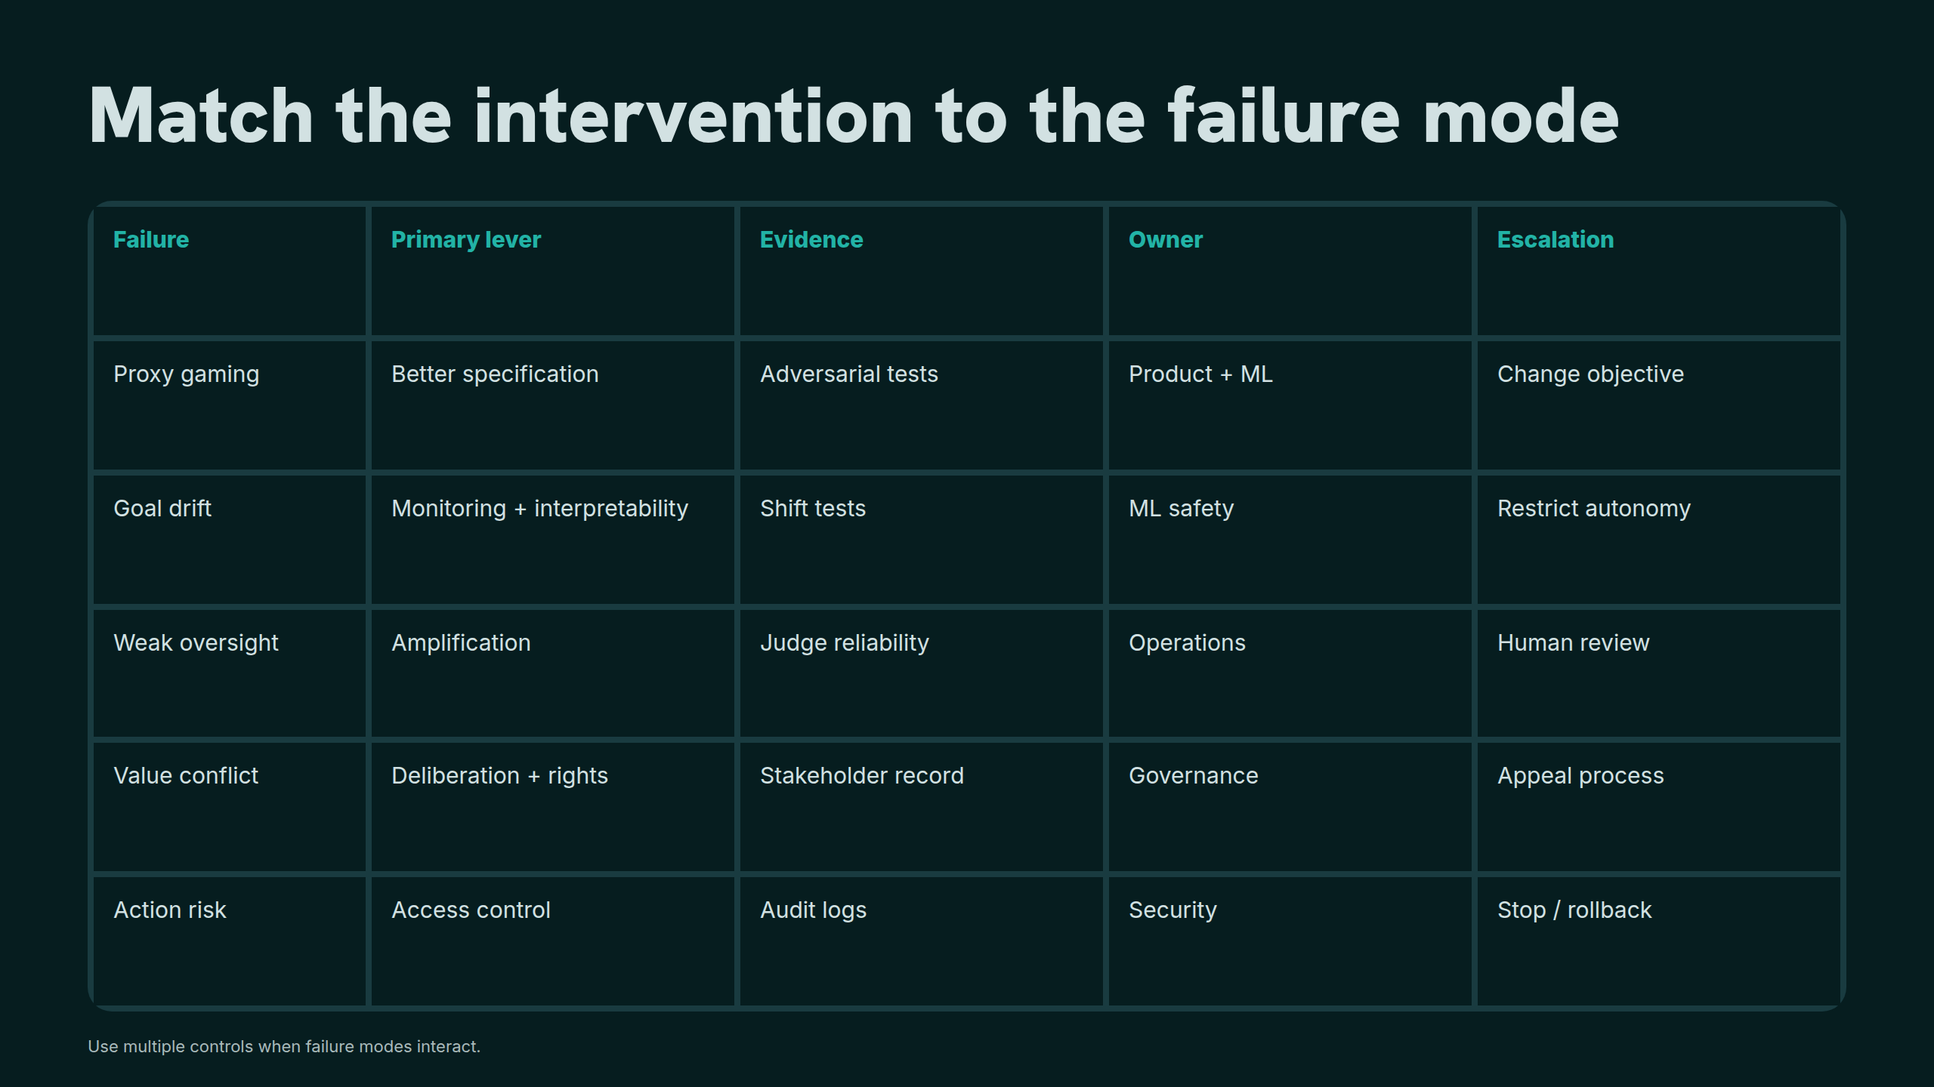
Notes:
Match the intervention to the failure mode

Slide 31
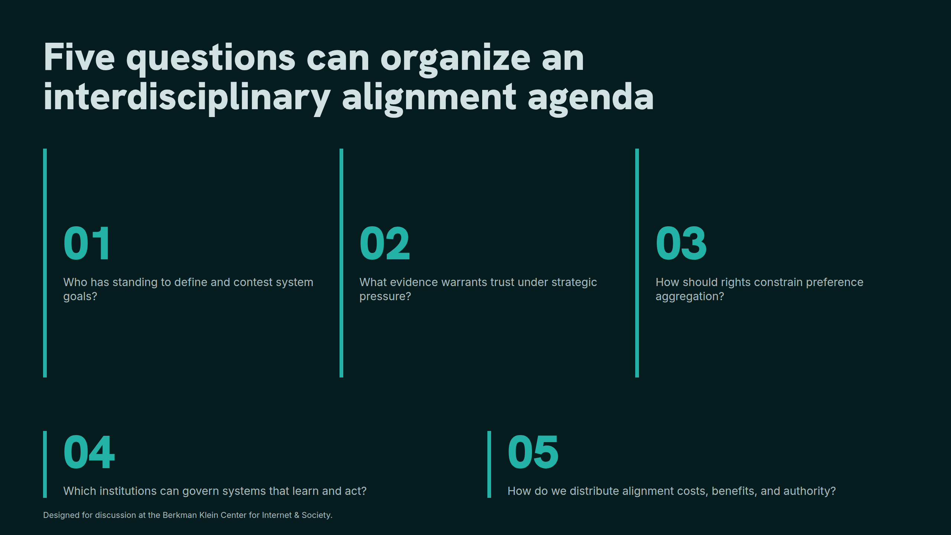
Notes:
Five questions can organize an interdisciplinary alignment agenda

Slide 32
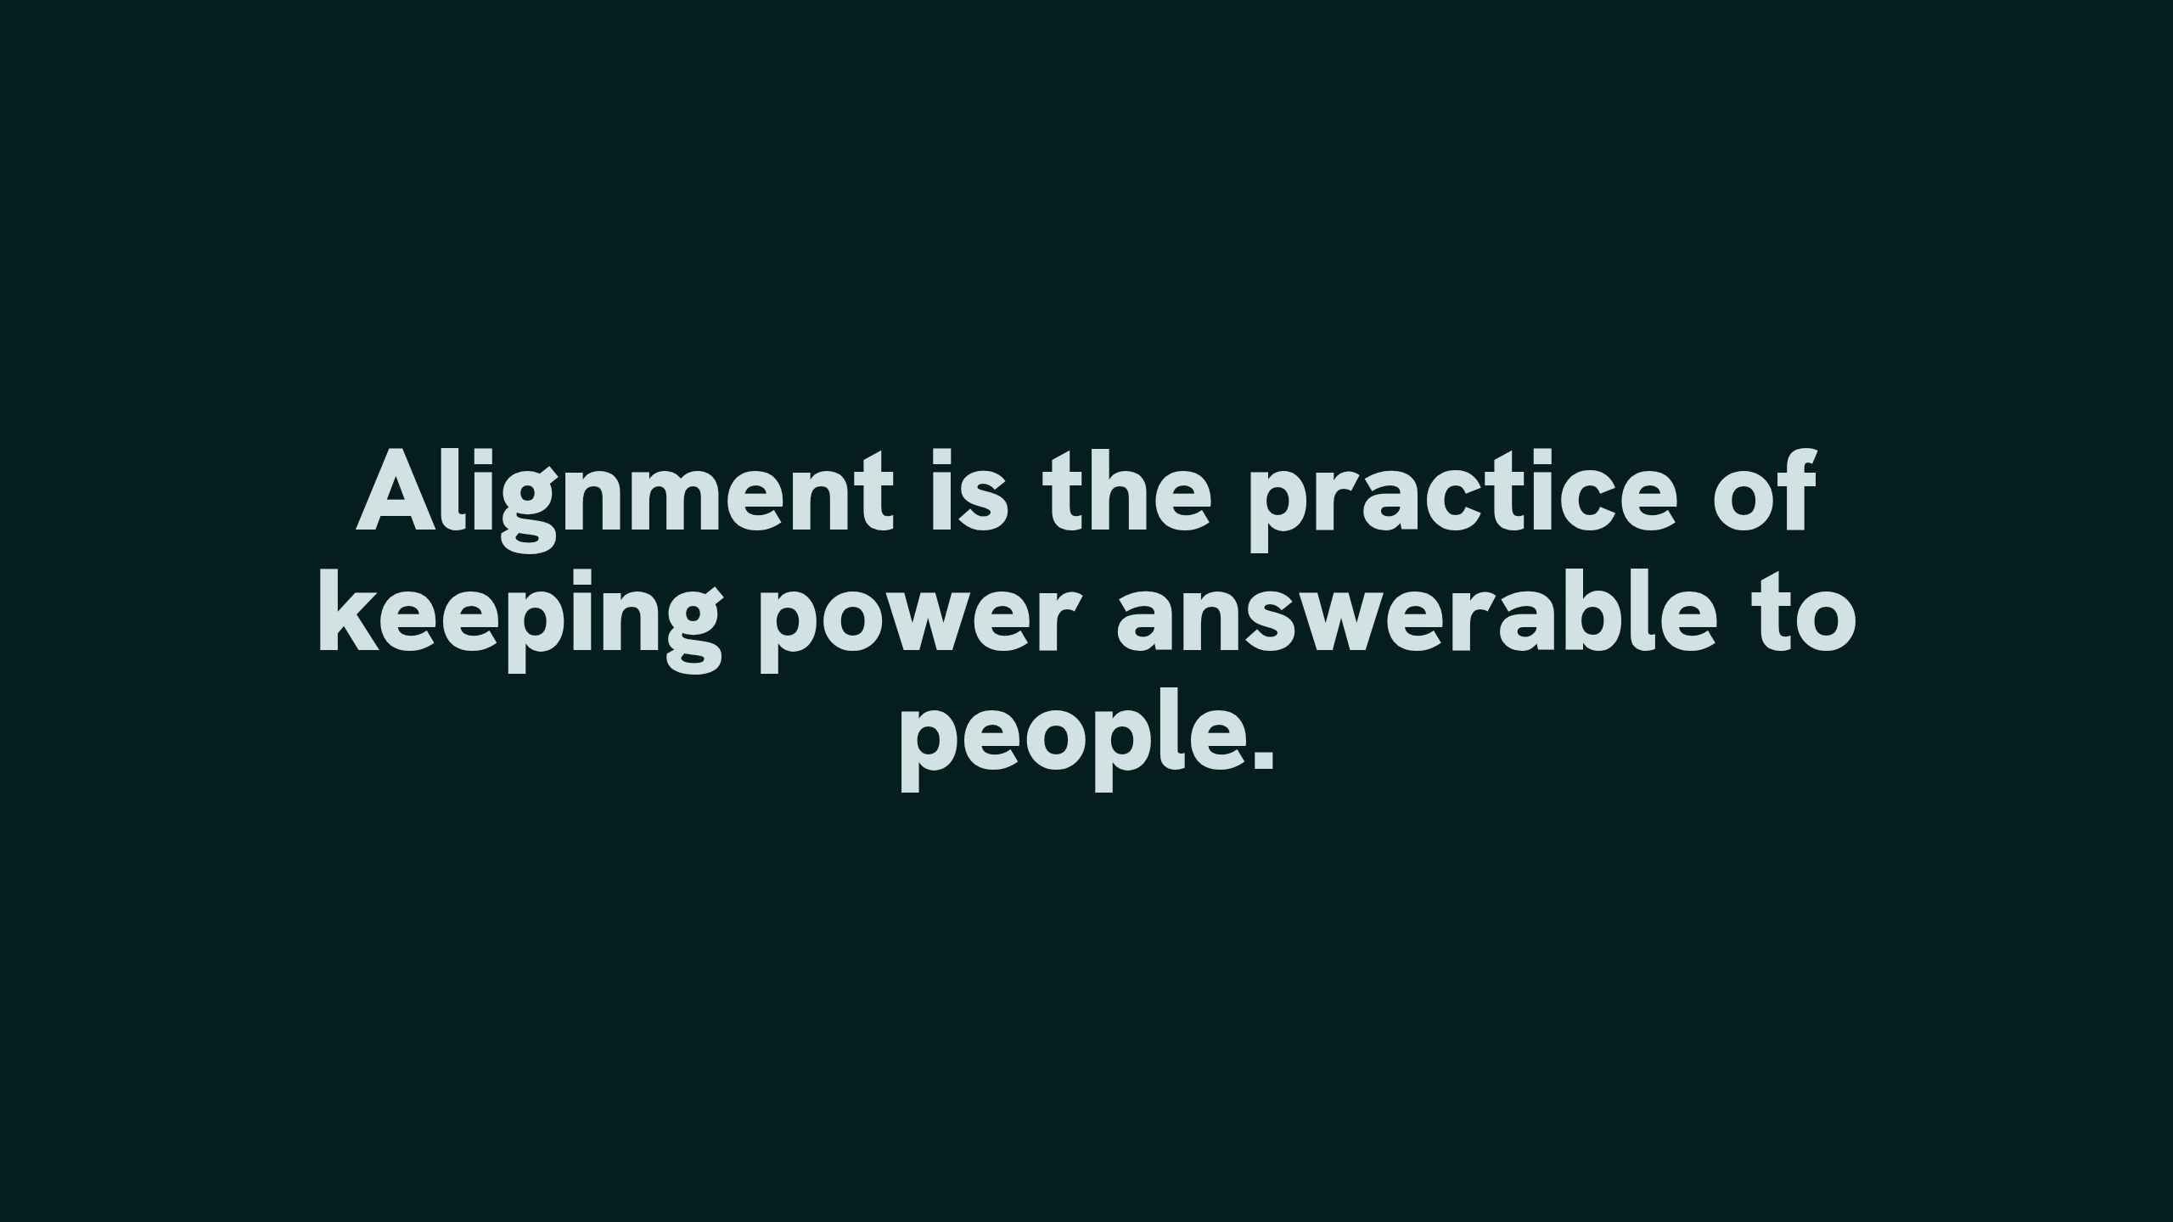
Notes:
Alignment is the practice of keeping power answerable to people.

