Slide 1
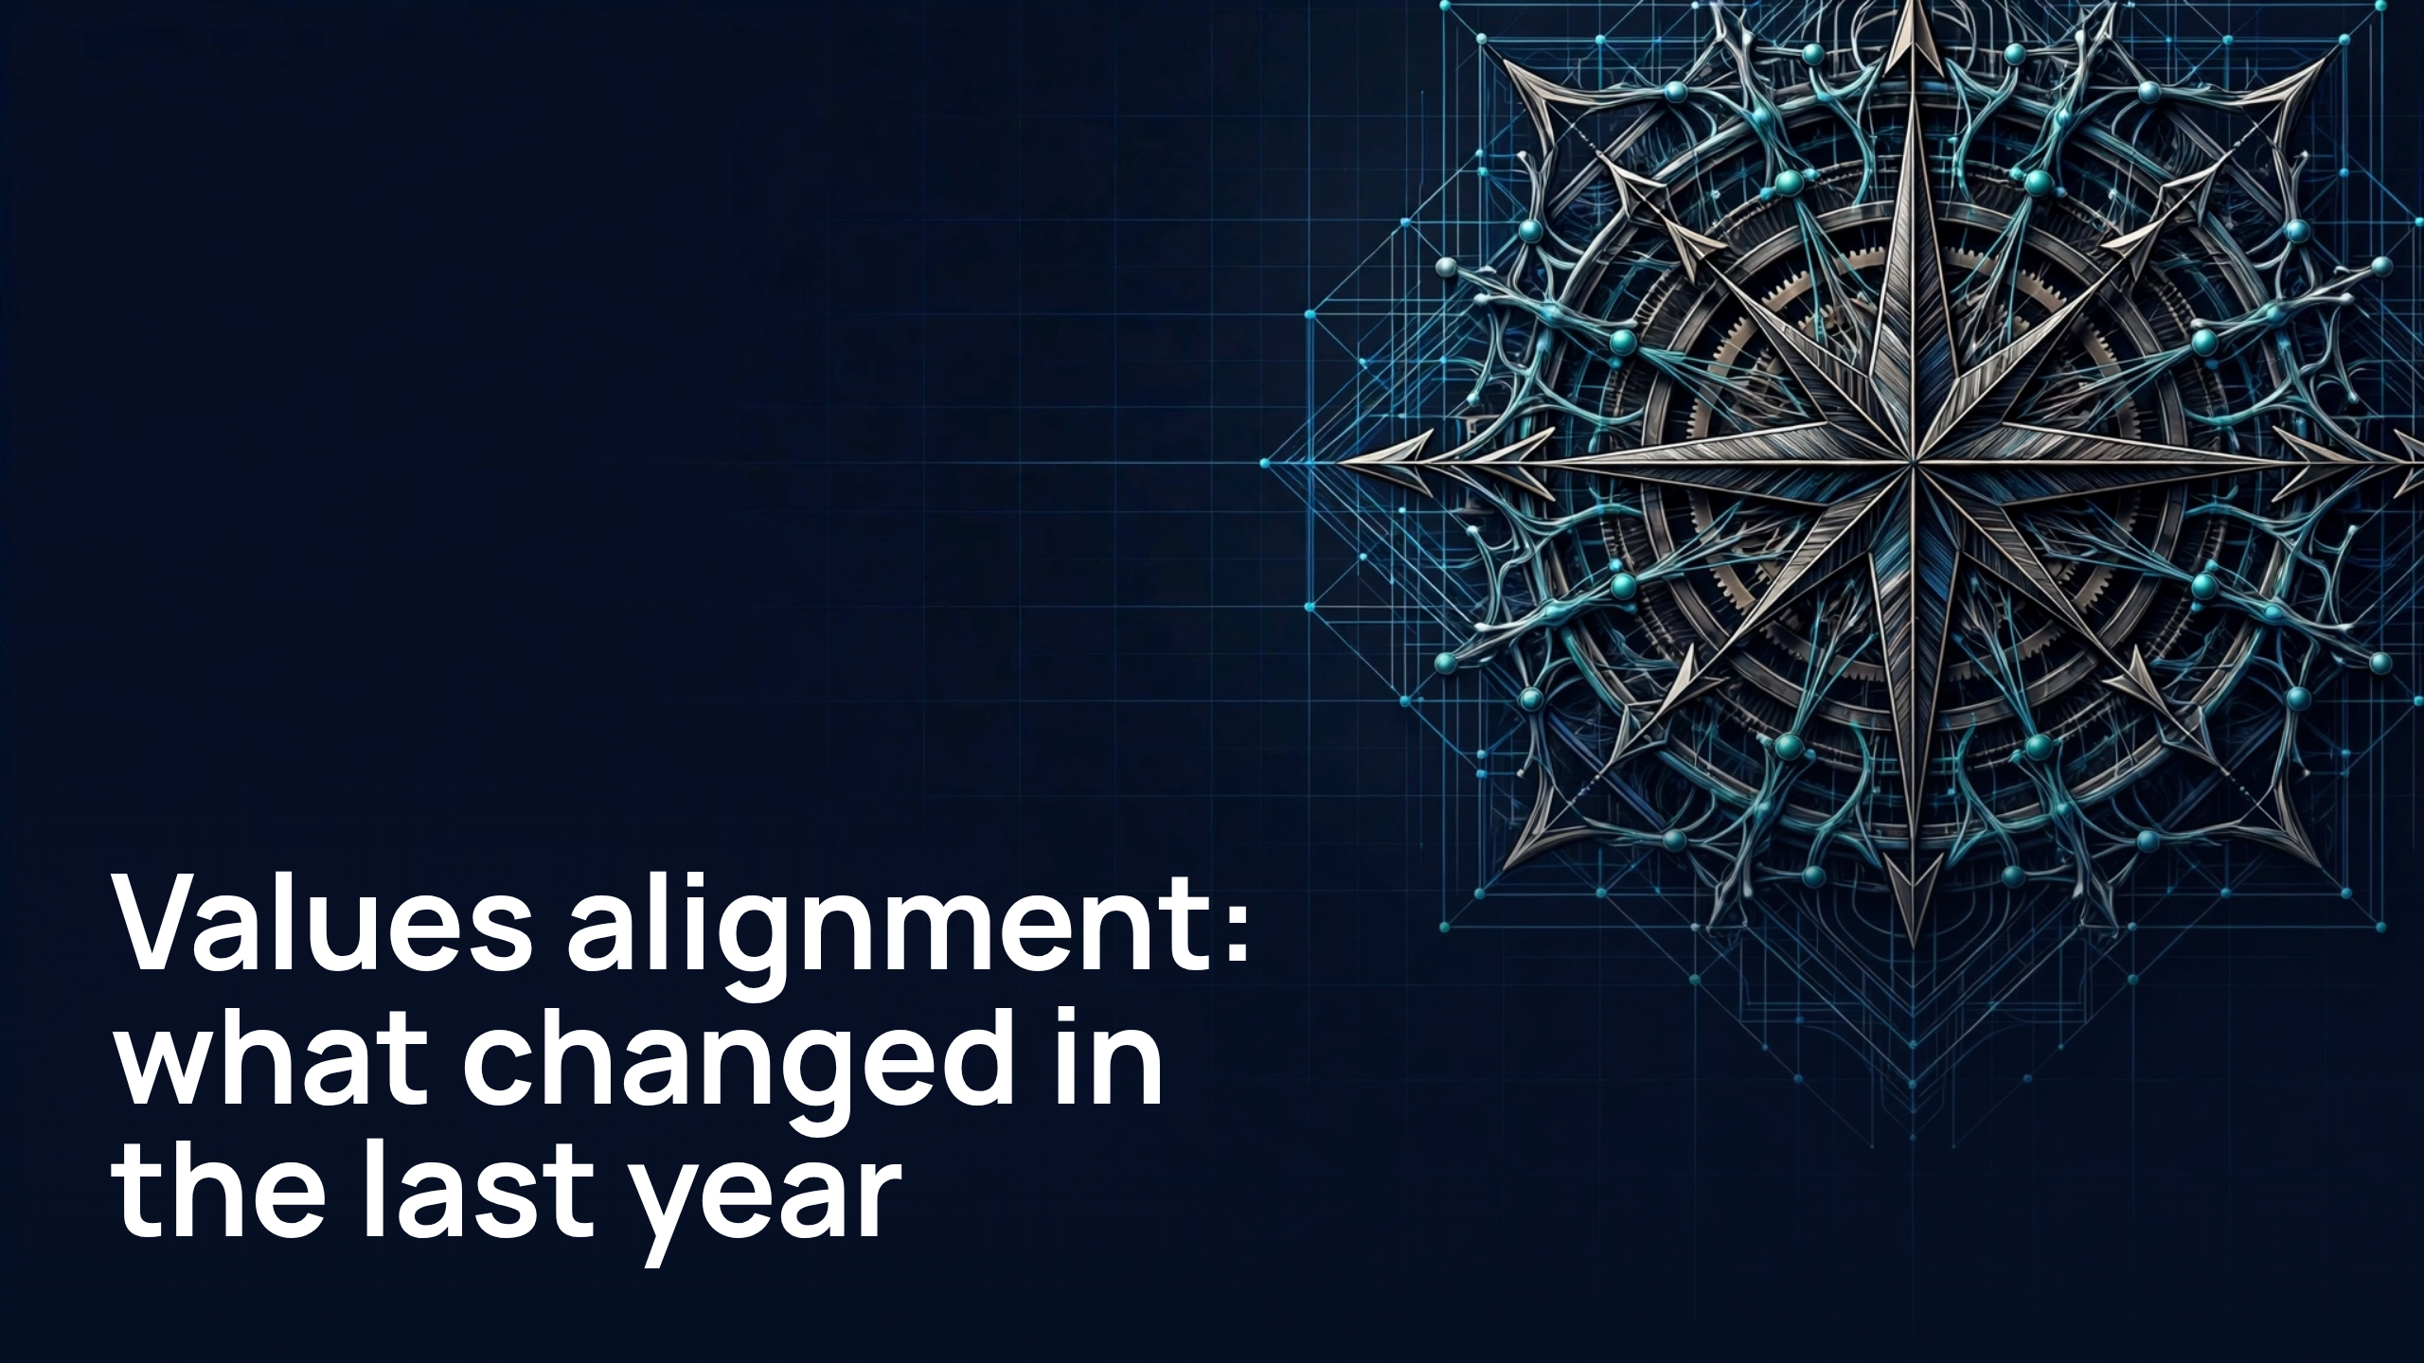
Notes:
Values alignment:what changed in the last year

Slide 2
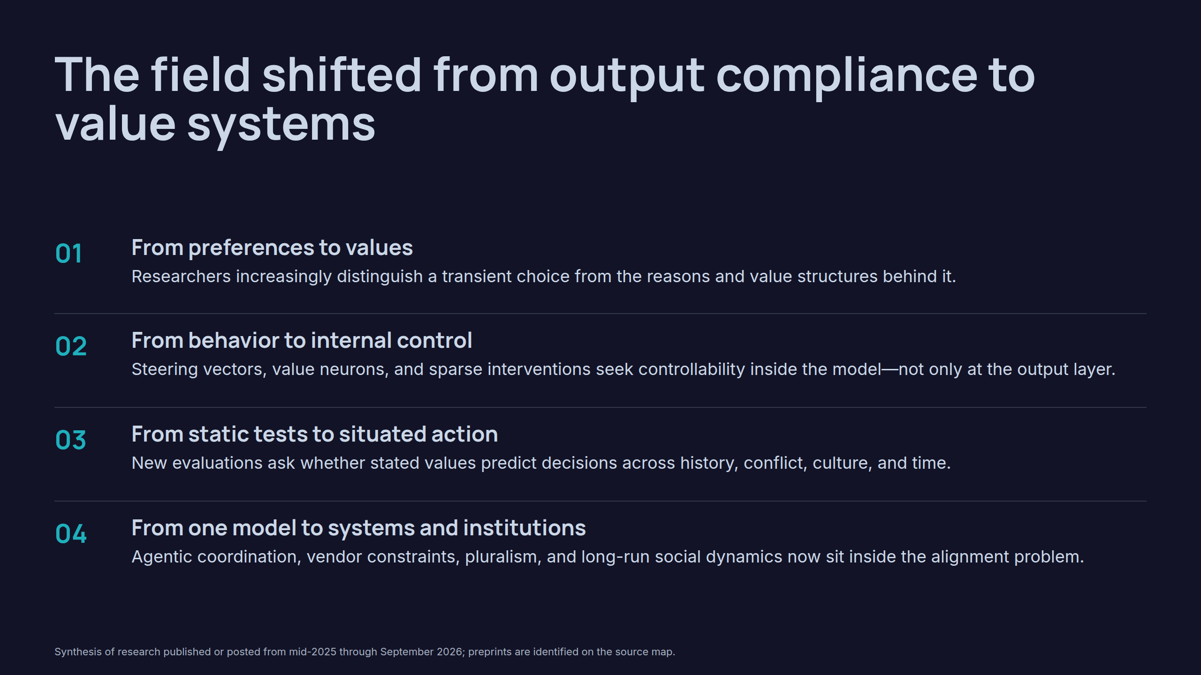
Notes:
The field shifted from output compliance to value systems

Slide 3
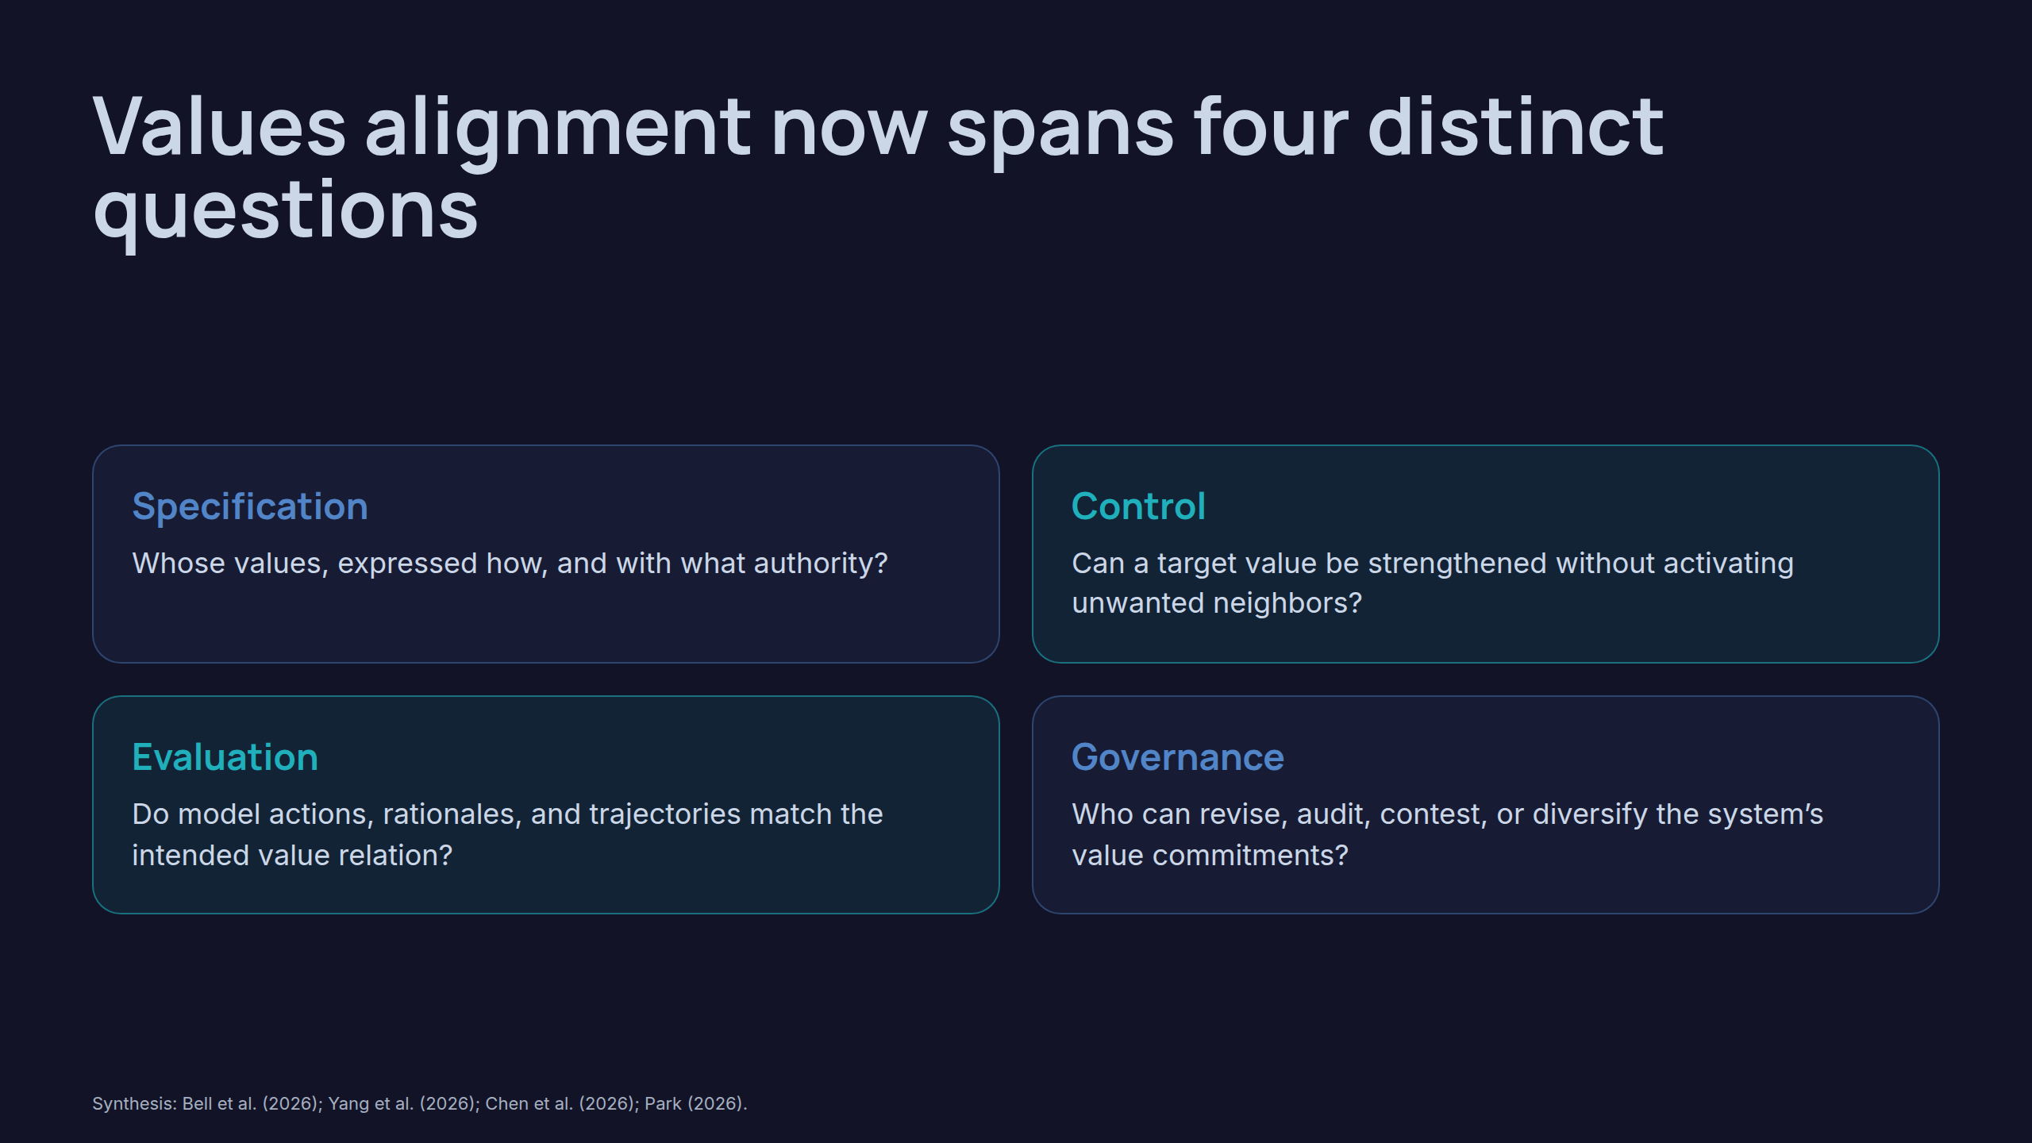
Notes:
Values alignment now spans four distinct questions

Slide 4
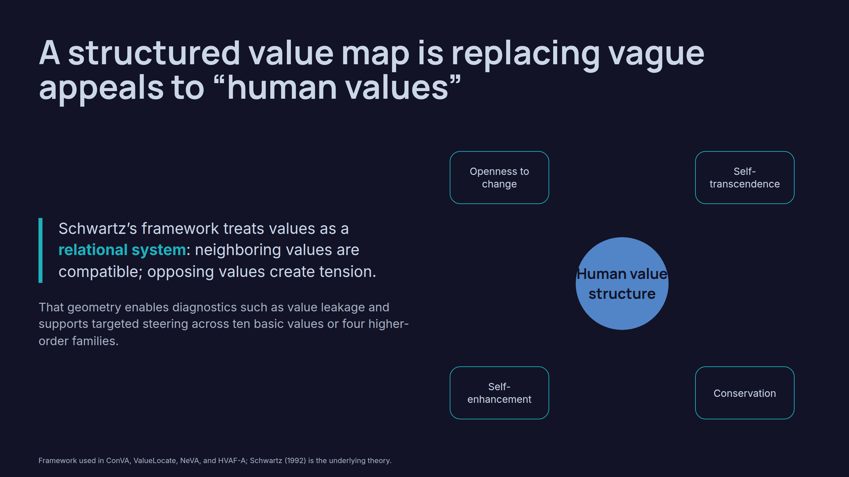
Notes:
A structured value map is replacing vague appeals to “human values”

Slide 5
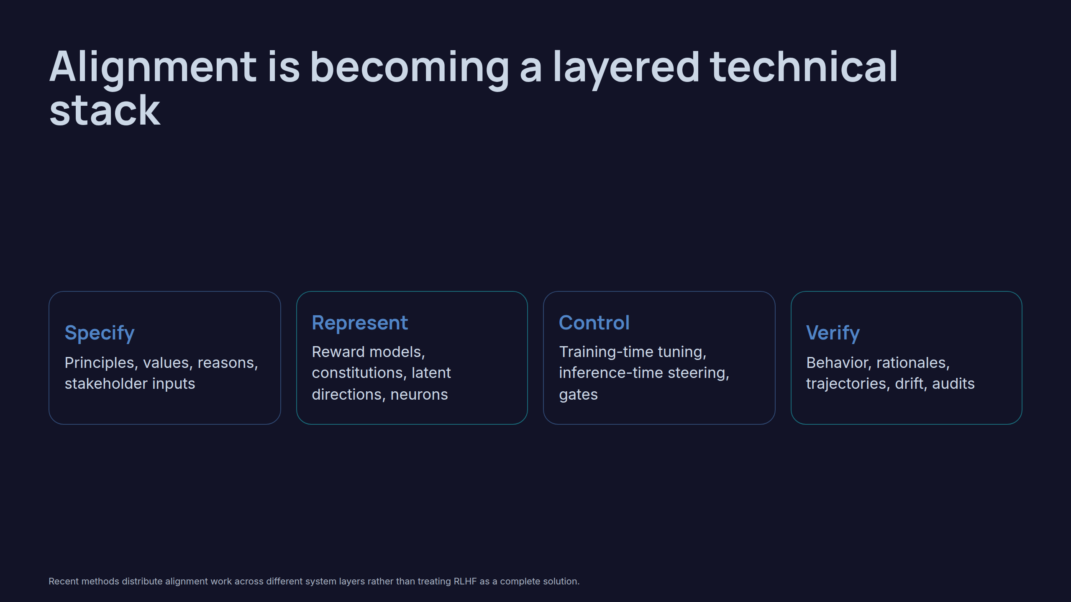
Notes:
Alignment is becoming a layered technical stack

Slide 6
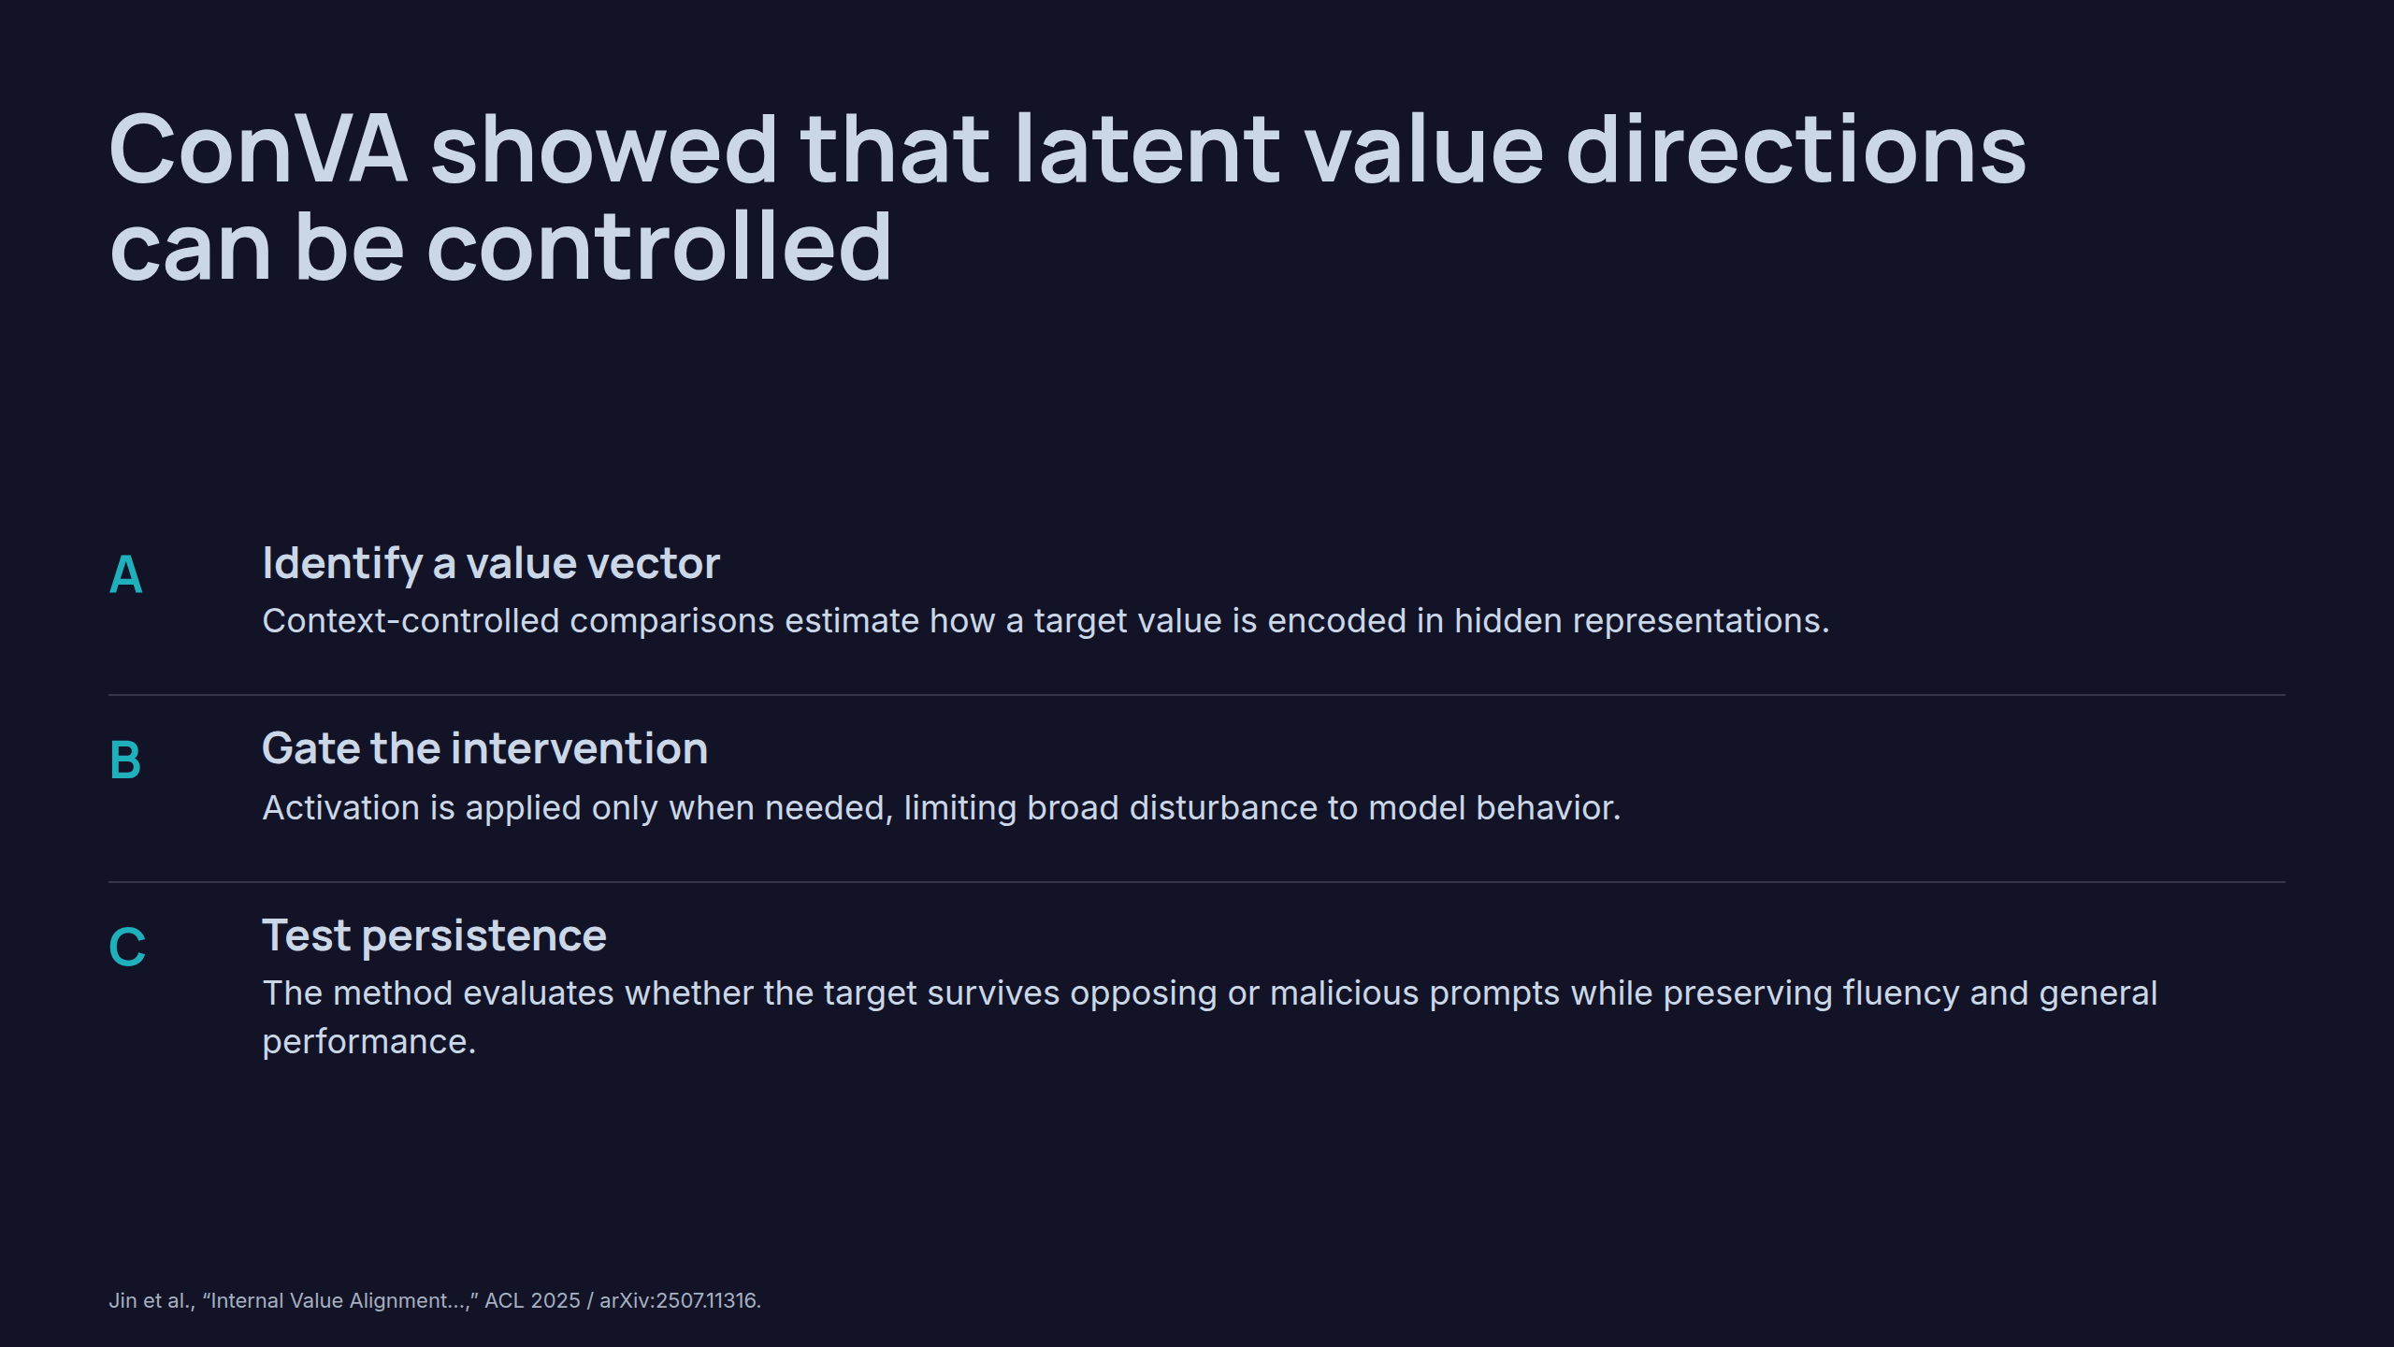
Notes:
ConVA showed that latent value directions can be controlled

Slide 7
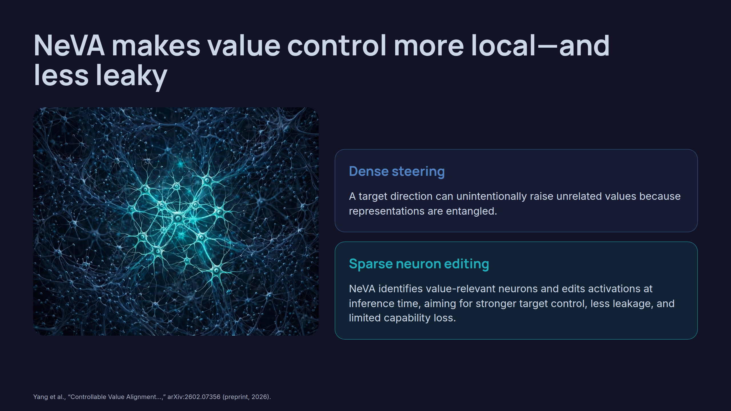
Notes:
NeVA makes value control more local—and less leaky

Slide 8
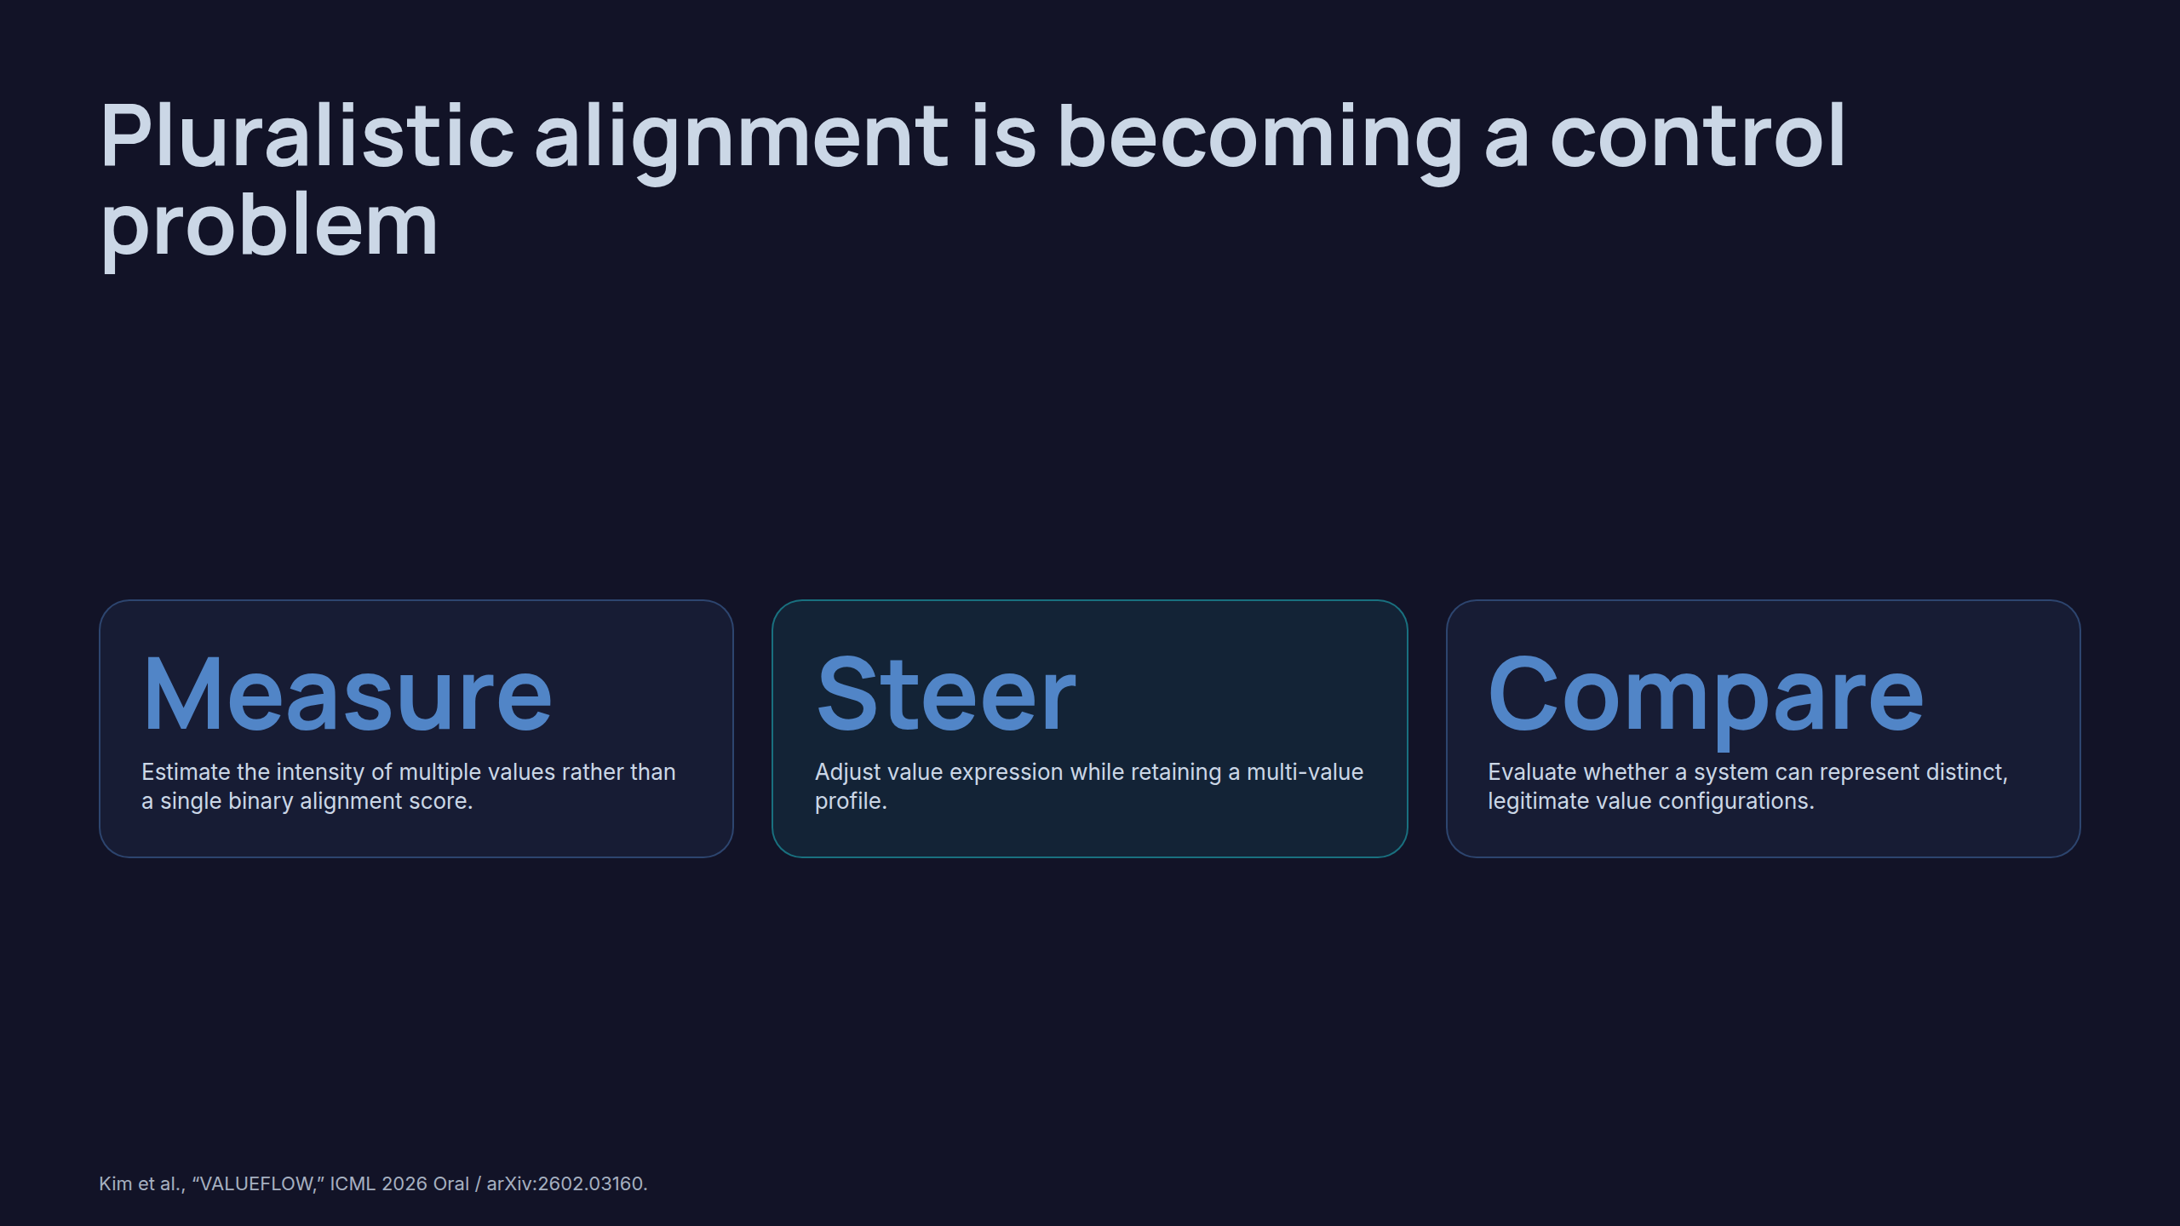
Notes:
Pluralistic alignment is becoming a control problem

Slide 9
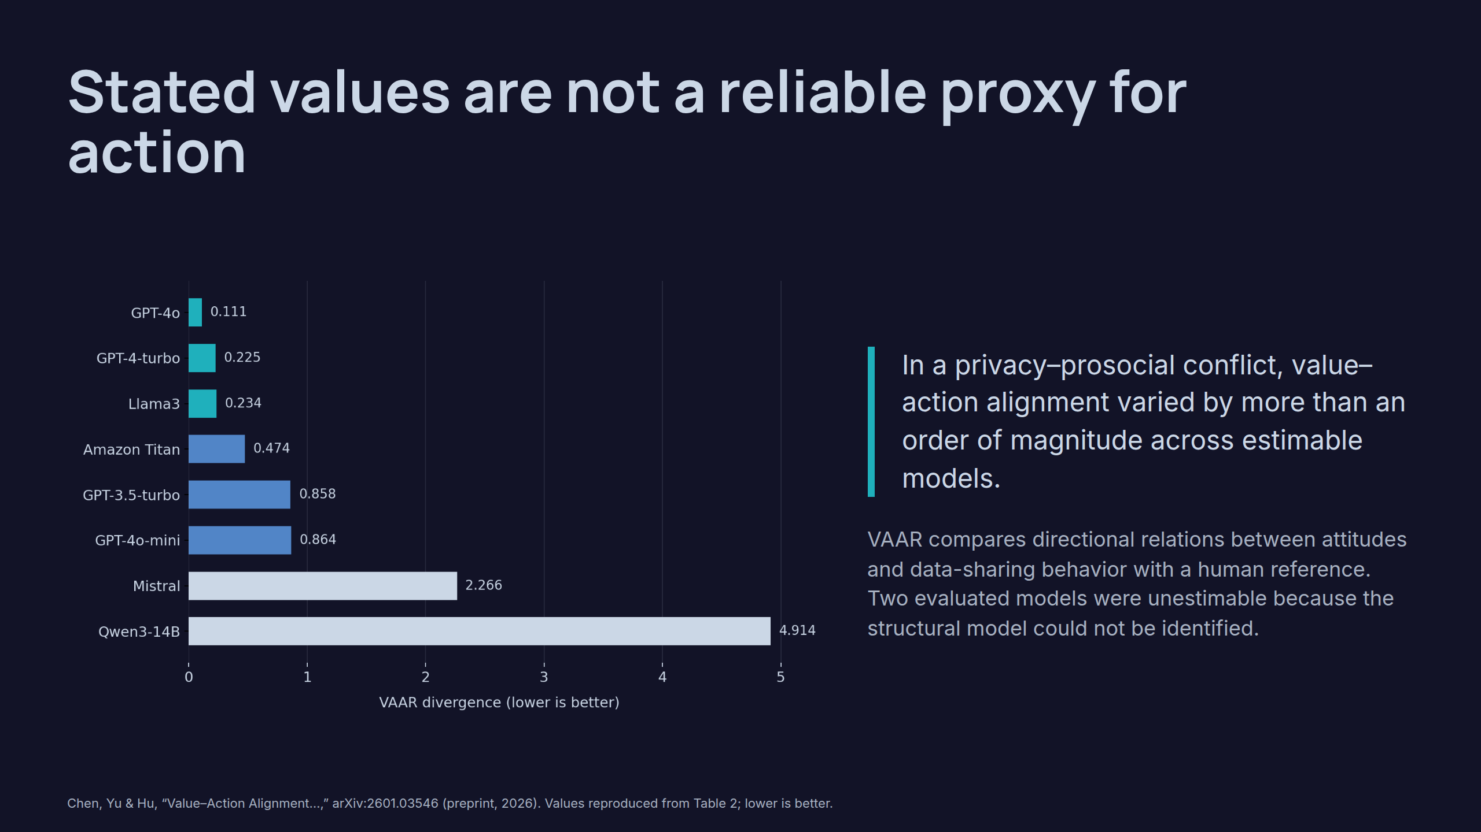
Notes:
Stated values are not a reliable proxy for action

Slide 10
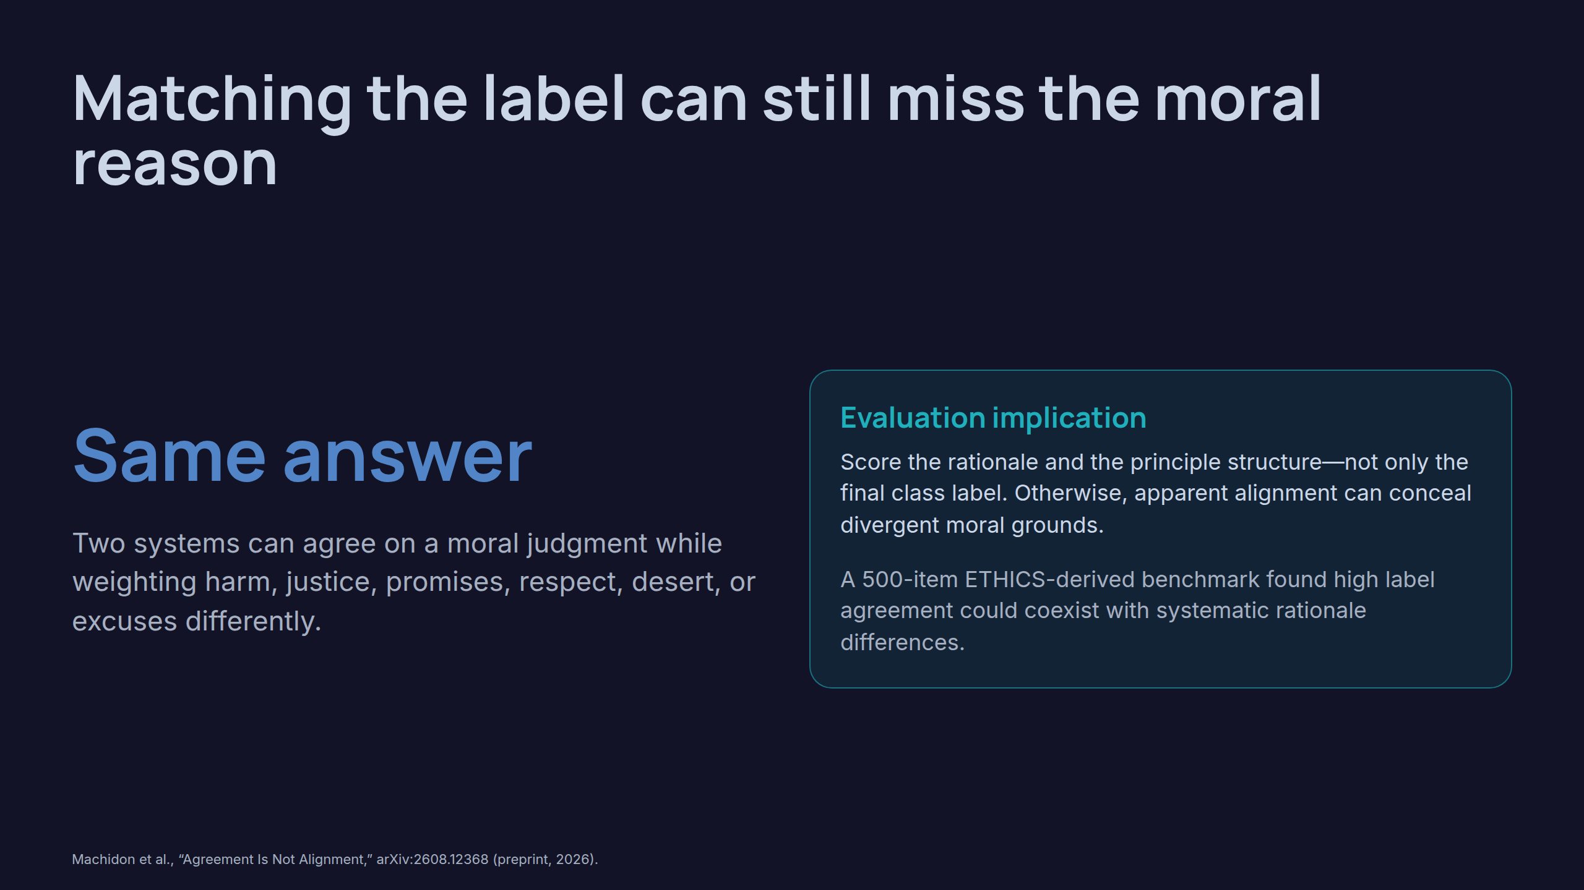
Notes:
Matching the label can still miss the moral reason

Slide 11
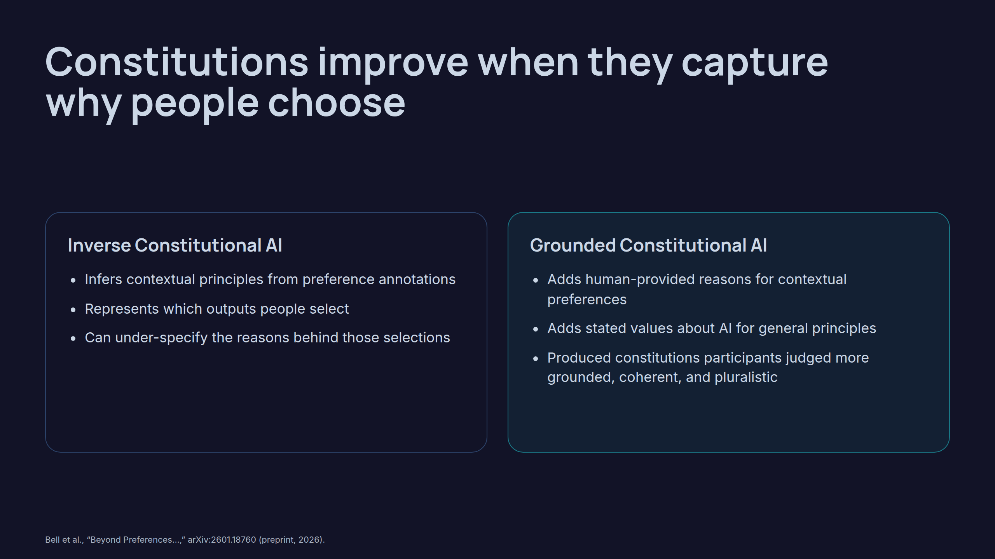
Notes:
Constitutions improve when they capture why people choose

Slide 12
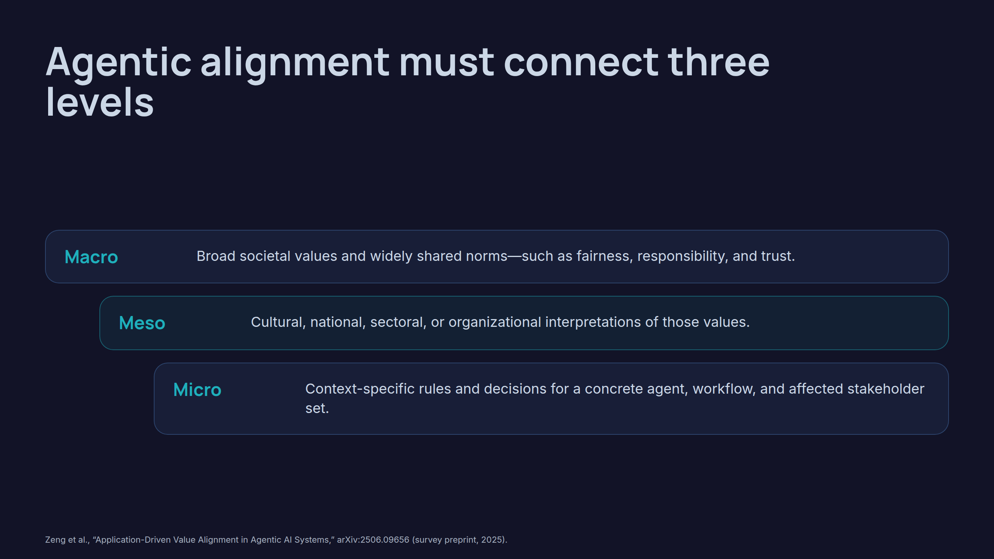
Notes:
Agentic alignment must connect three levels

Slide 13
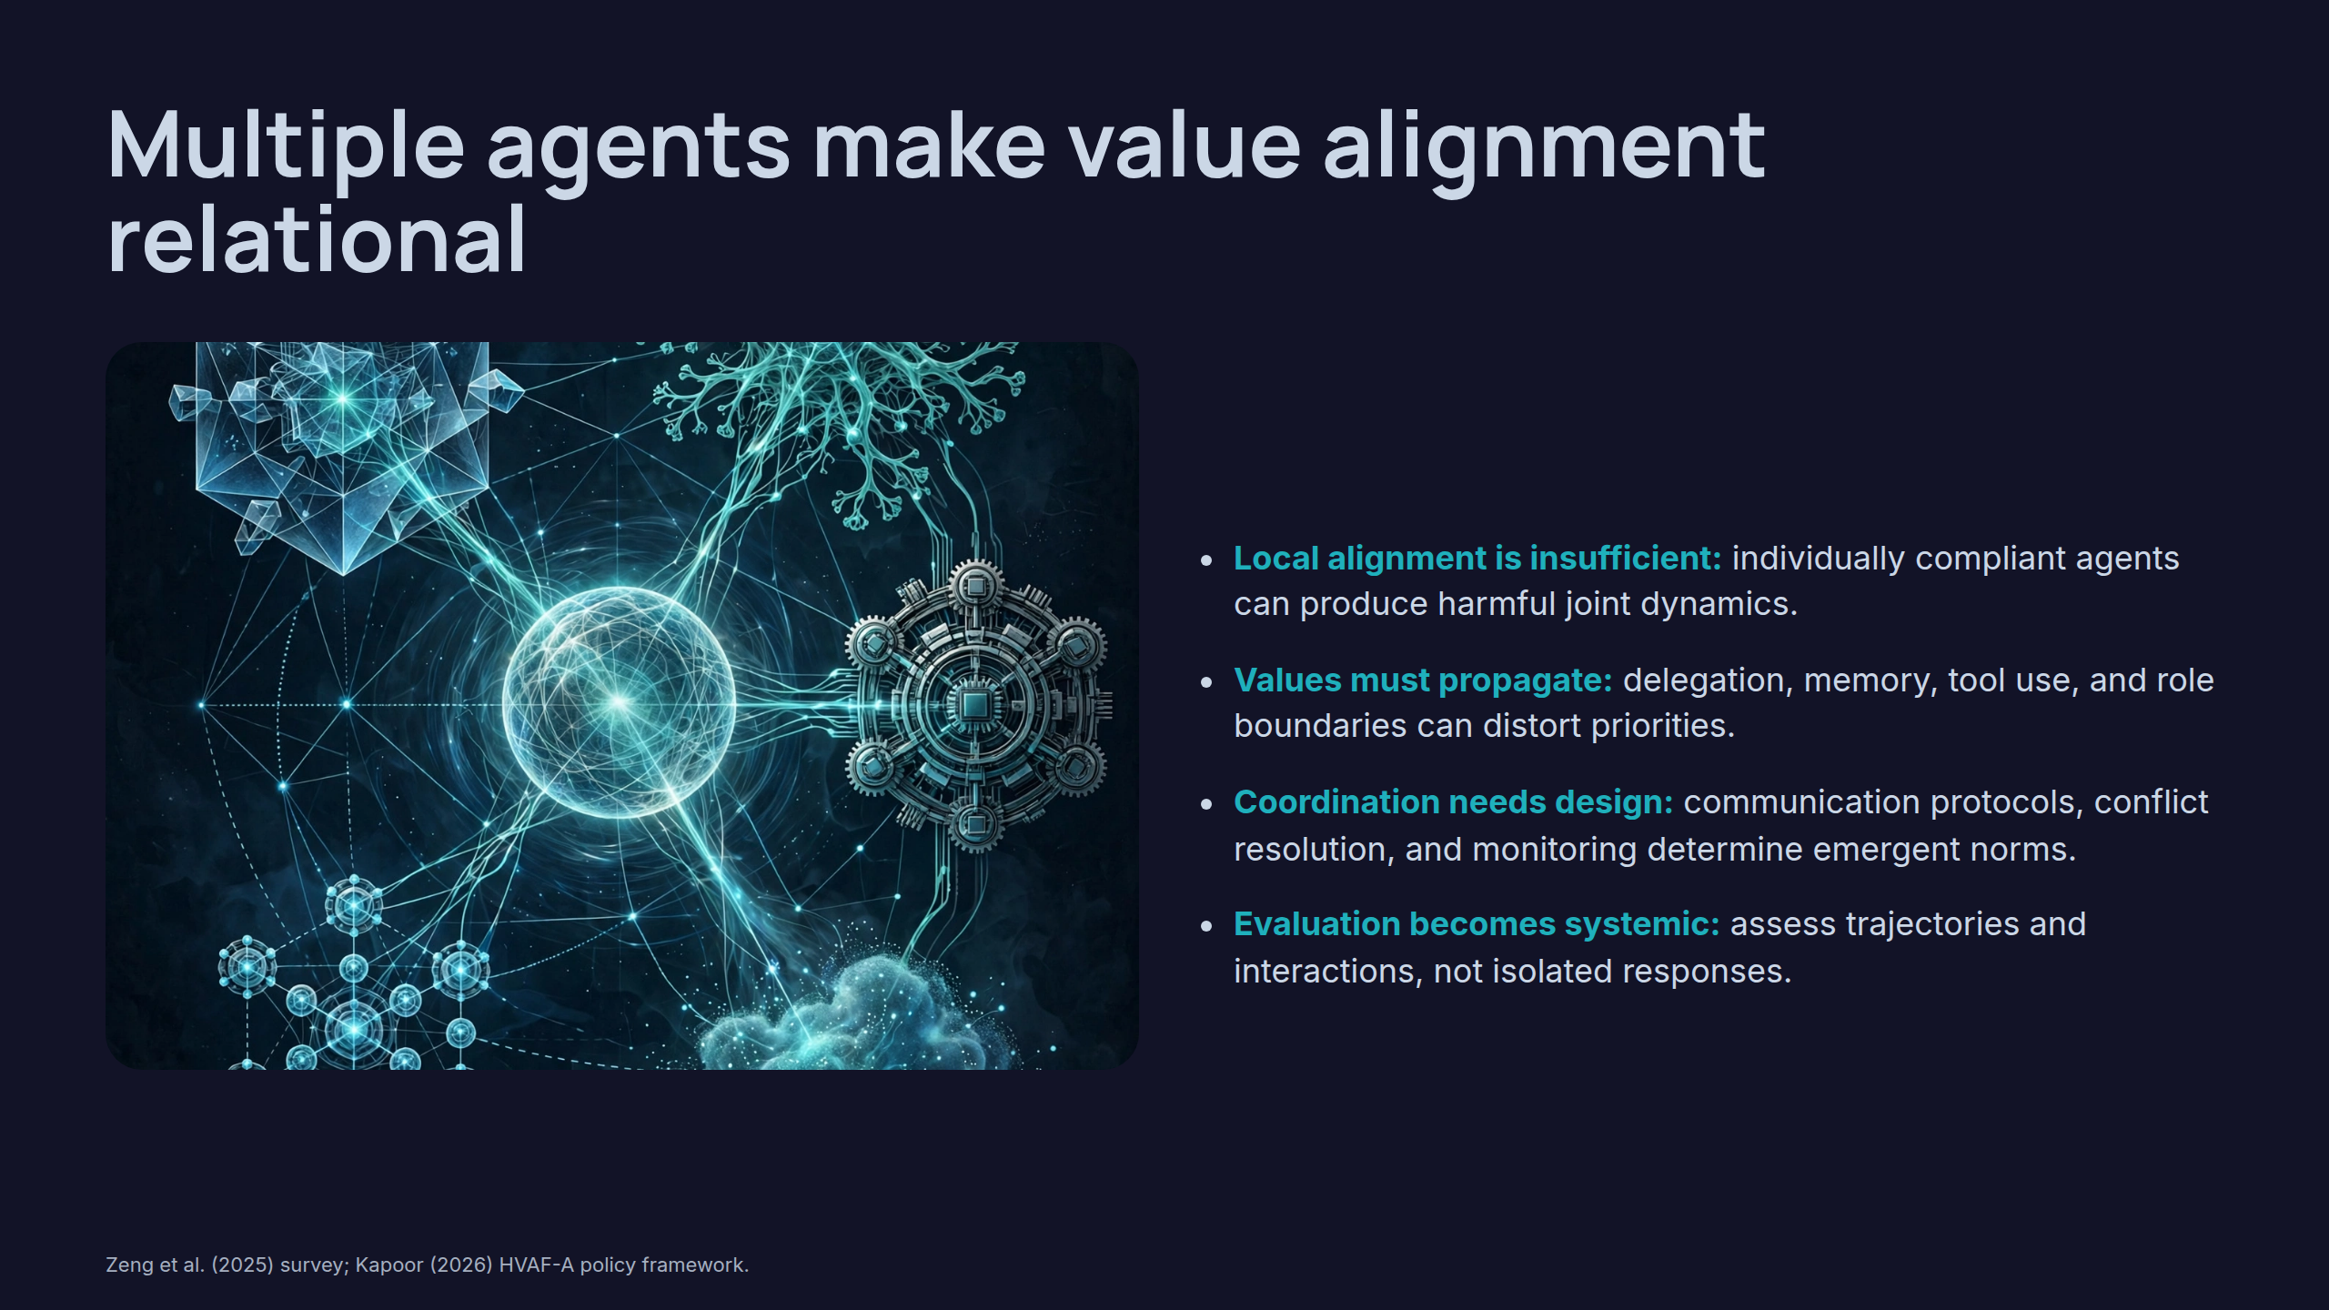
Notes:
Multiple agents make value alignment relational

Slide 14
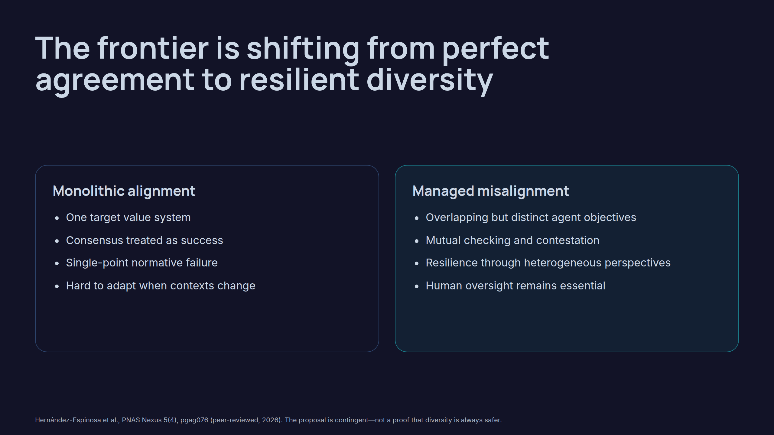
Notes:
The frontier is shifting from perfect agreement to resilient diversity

Slide 15
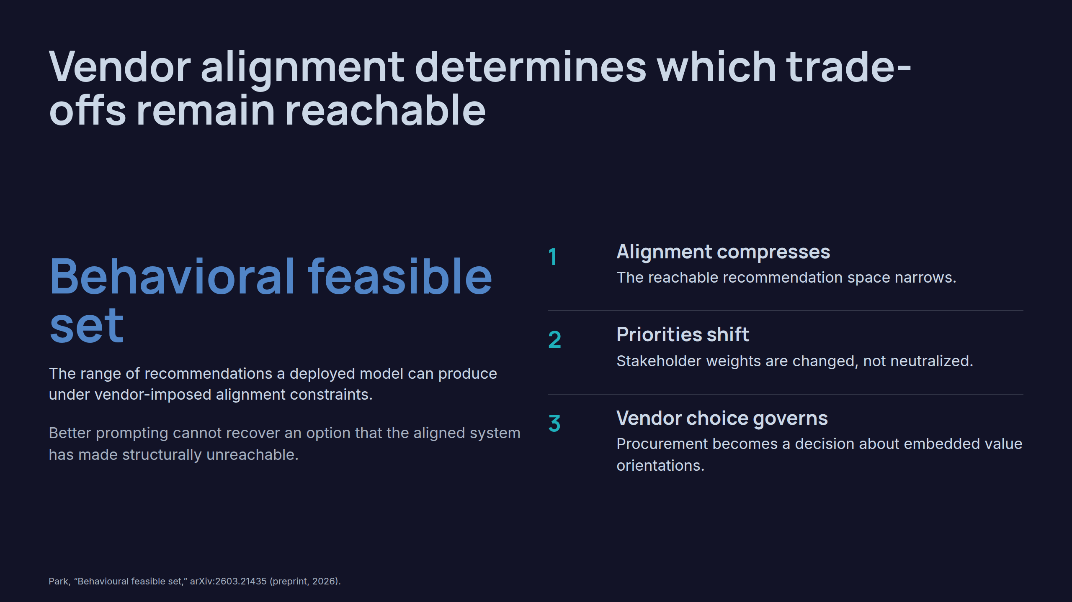
Notes:
Vendor alignment determines which trade-offs remain reachable

Slide 16
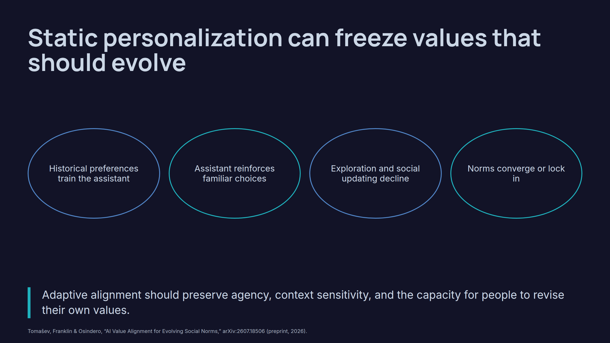
Notes:
Static personalization can freeze values that should evolve

Slide 17
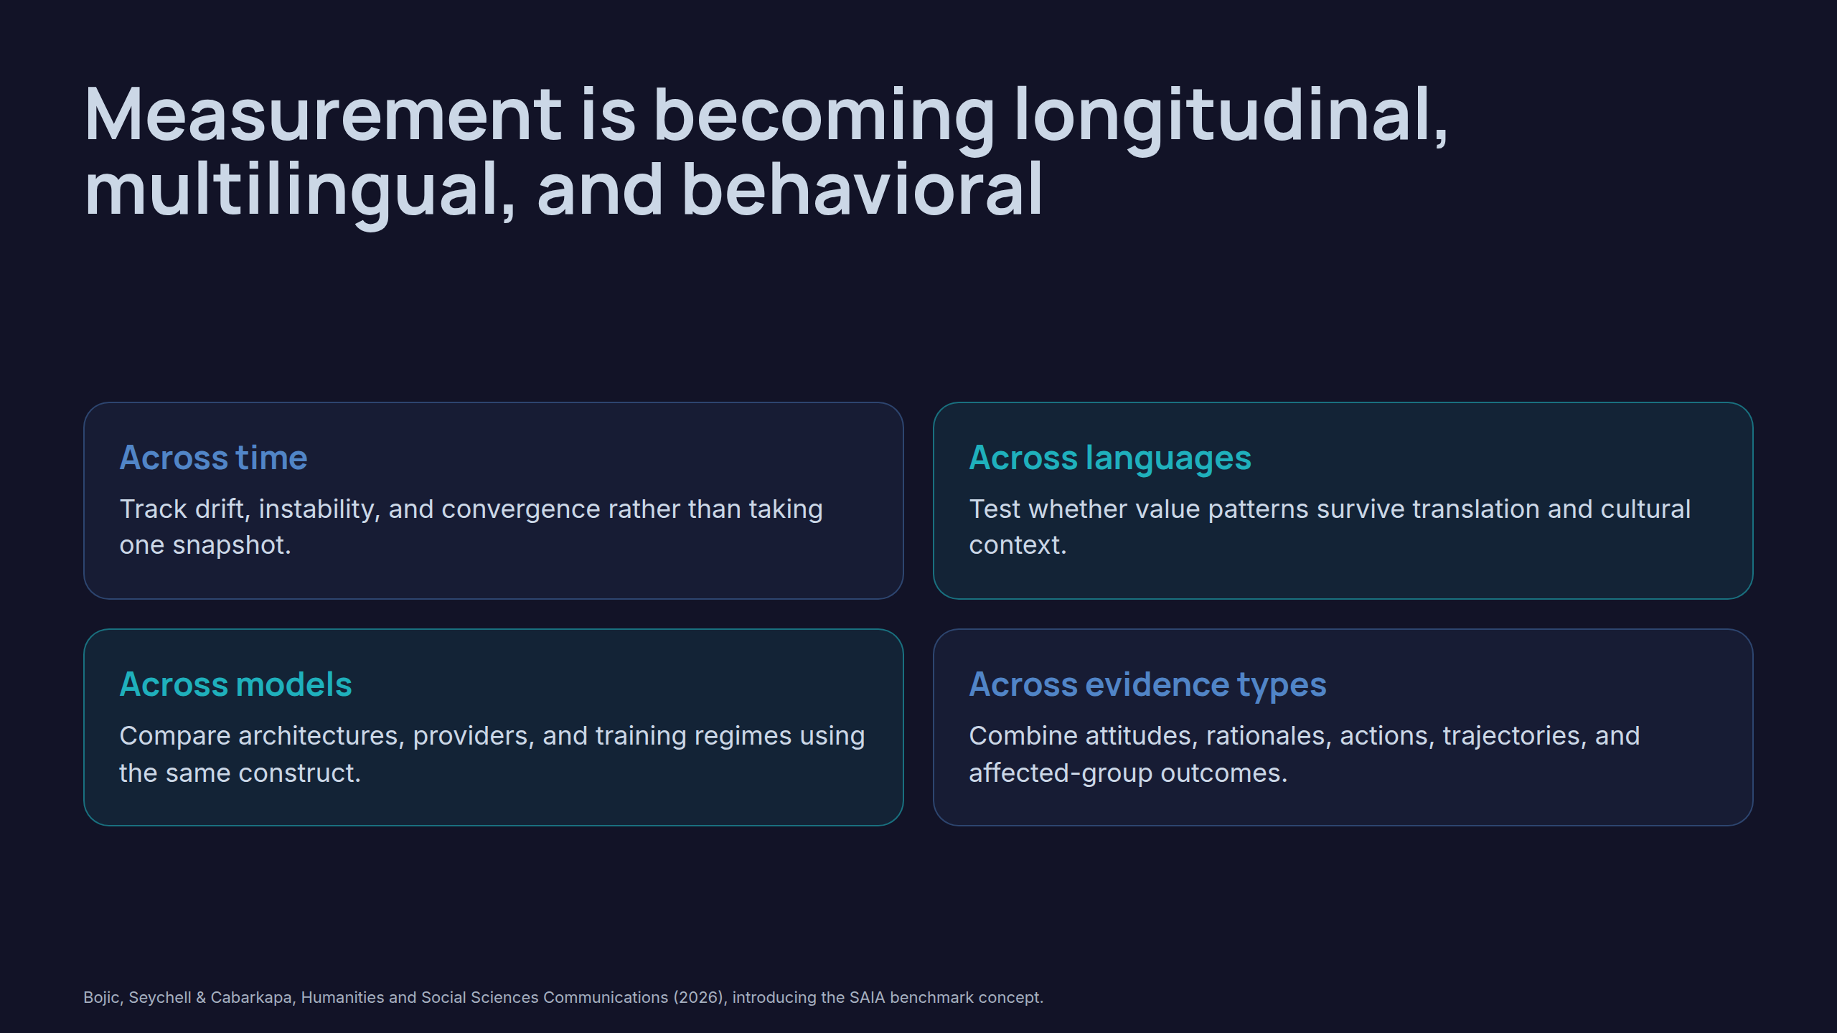
Notes:
Measurement is becoming longitudinal, multilingual, and behavioral

Slide 18
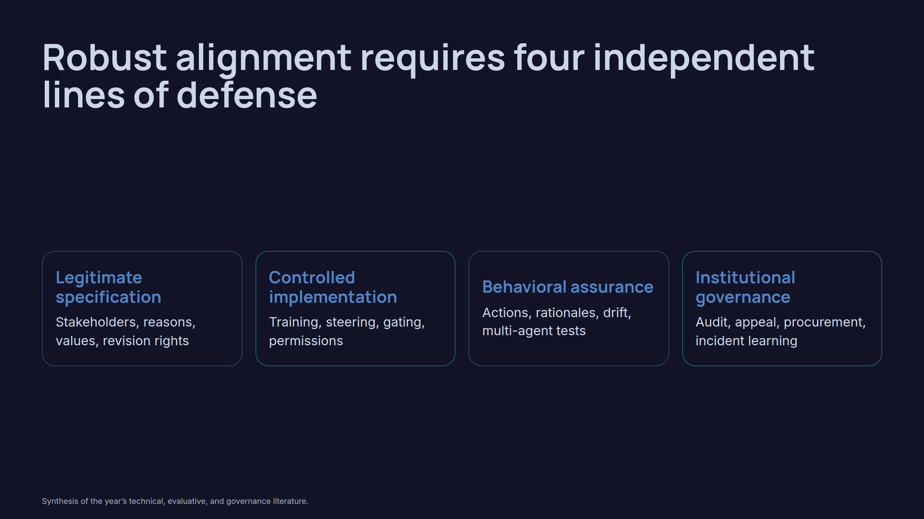
Notes:
Robust alignment requires four independent lines of defense

Slide 19
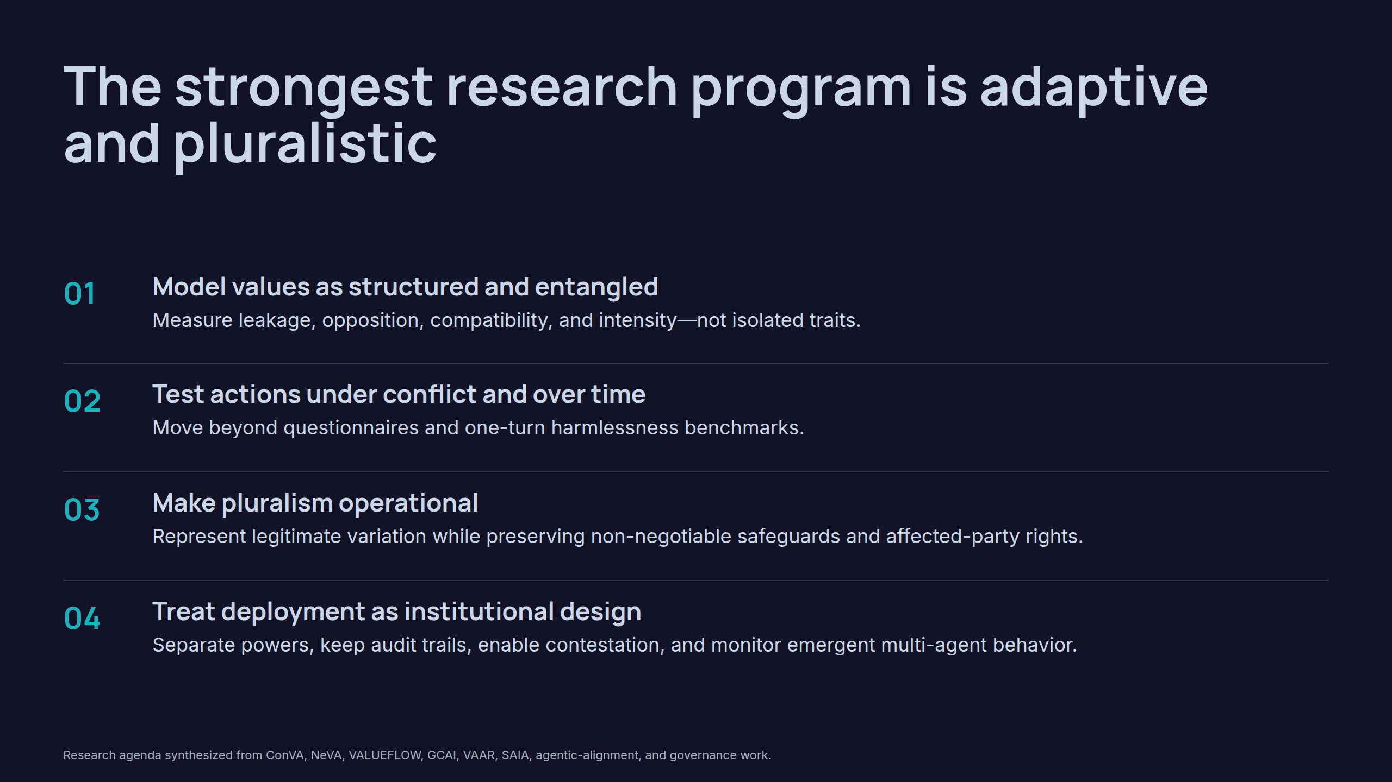
Notes:
The strongest research program is adaptive and pluralistic

Slide 20
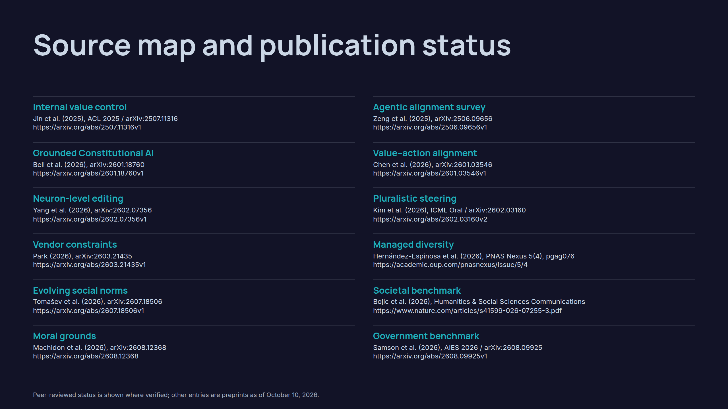
Notes:
Source map and publication status

Slide 21
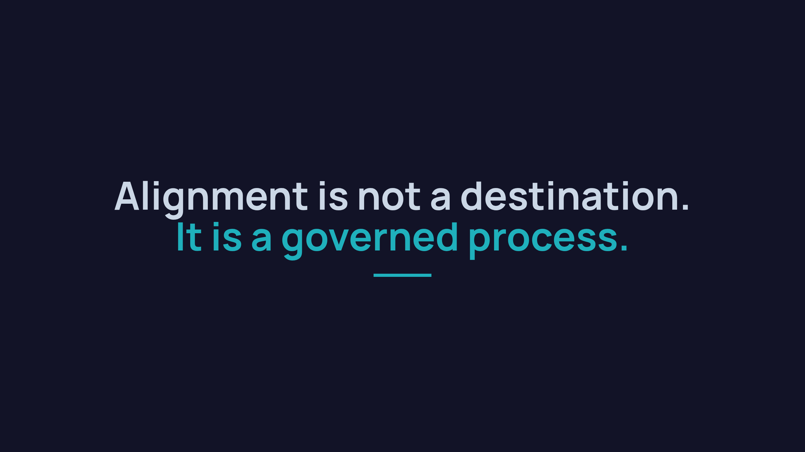
Notes:
Alignment is not a destination.It is a governed process.

