Slide 1
INSTITUTE OF ENGINEERING, NASHIK
Department Of Computer Engineering
PRESENTATION ON B.E. PROJECT
‘Artificially Intelligent Traffic Management System’
PROJECT STAGE 1 EXAMINATION
UNDER GUIDANCE OF
Prof. Ravindra Aher
GROUP MEMBER:
• Saquib Akhtar Aneesur Rahman • Giwil Gidwani
• Vrushabh Dattatray Nikam • Rutuja Shinde Rajesh
CLASS: B. E. Computer Engineering A.Y.: 2021-2022

Slide 2
Abstract –
Congestion of traffic in urban areas and smart cities is one of the major issues with increasing population in metropolitan areas. Traffic jams are not only a cause of delay and inconvenience in day to day life but also a major source of noise and air pollution. Modern approaches to deal with this issue range from complicated software handling dozens of traffic signals throughout an entire city to simpler single-intersection solutions. However these can be costly, difficult to implement and may require a lot of manual monitoring.
This project proposes a traffic management system which uses concepts from artificial intelligence and graph theory to control and optimize traffic flow. Its aim is to optimize traffic flow on a small to medium scale in a manner which adapts to the real time changes in traffic.

Slide 3
Introduction –
Project Title - Artificially Intelligent Traffic Management System
Application Name - AITMS
Traffic congestion is becoming one of the critical issues in cities with increasing population and number of vehicles. They not only cause problems like delays and stress to drivers but also cause secondary problems like increasing fuel consumption, transportation costs and pollution.

Slide 4
Introduction Contd. –
This project proposes an Artificially Intelligent Traffic Management System which uses existing CCTV feed and API data if needed to optimize traffic control over small to medium scale road networks. It uses an artificially intelligent agent or model to handle the complexity of day to day traffic in real-time. Furthermore, simulations will be performed to demonstrate and test the model.

Slide 5
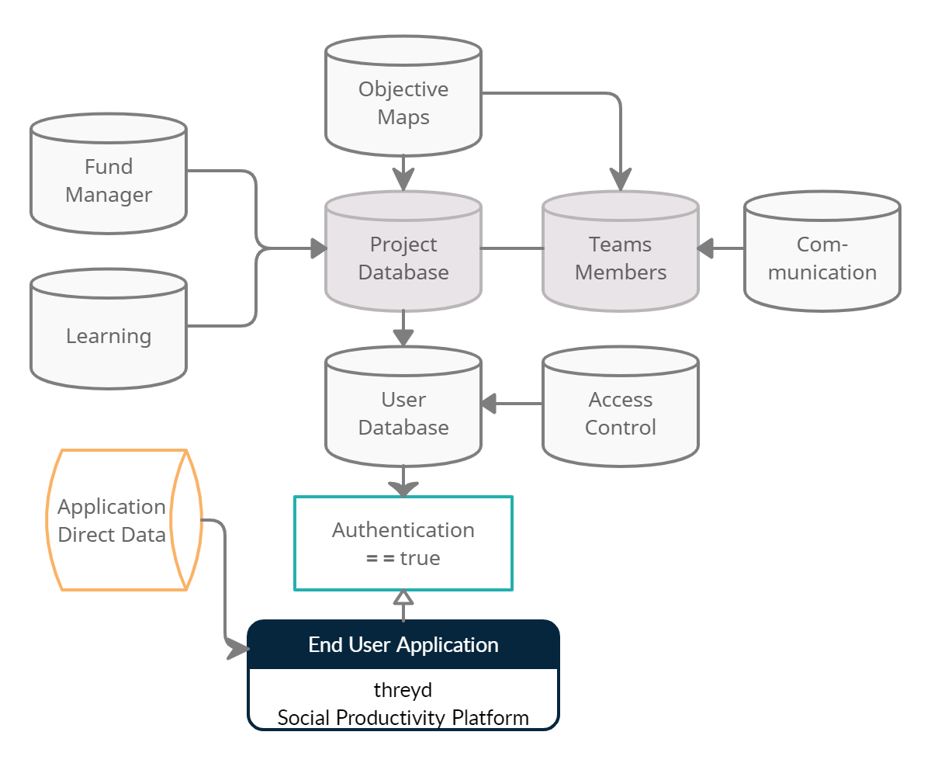
Workflow Map –

Slide 6


Functionalities

Slide 7
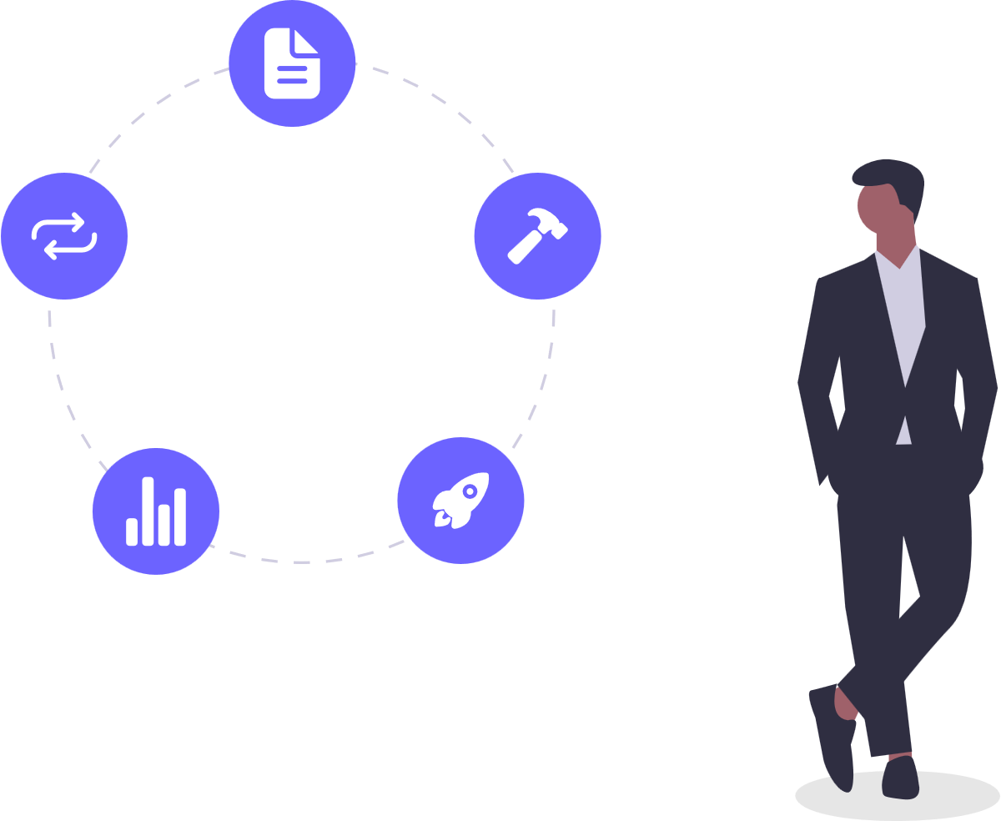
Functionalities –
User-
User on app can manage it’s project on app. Every opacity user has access to create and manage his/ her own project. Also Employees, interns and members, can join pre-created opacity based projects using authentication they have.
Upgrade of Individual managed projects will unlock Conversation Feature to get members connected. Fund management, Objective markup, Co-Learn will be available for both individual projects and collaborated projects.

Slide 8

Functionalities –
Team Maker -
Team maker is a feature where a team of people come together to work united to achieve a common productivity goal.
Proper team work boosts productivity and as like most organization bringing stress free culture for employees, exactly the application will be give clean, fast, ease-ax and seamless connectivity for members.

Slide 9

Functionalities –
‘CoLearn’ for members –
A member can bookmark skills learning platform links.
This bookmarks can be helpful for him/her, other colleagues so they can learn along while working and improve skills, knowledge.
This learnable links can be schedulable for fast learn, contains video, podcasts, presentation and books.

Slide 10

Functionalities –
Fund Management
Managing the money is the important task for any kind of team or for a particular project.
A project developed by a single developer or the small team, which require money transaction logging, needs to hire person or purchase software for keeping transaction’s records.
Fund Management is addon feature for keeping records of transaction.
It has stipend-salary tracker, Purchase tracker, billing system required for project.

Slide 11

Functionalities –
Kanban Objectives:
Project tasks can be created, assigned, managed, removed in Kanban Style – Scrum Board.
This can be used as user-only or collab-shared.
Objectives help member to marking work completion. Work progress will be calculated using percentage of work completion and time estimation.

Slide 12

Functionalities –
Events Scheduling
Calendar Events can be create, modify and remove personalized calendar event for team. Events can be meeting, webinars, deadlines etc.
It is available for user. Members can be added in event attendees, so event will be accessible for those only. Public-RegisterToJoin events can also be generated.
Event Digi-Cards consist of Subject, Time, Date, Attendees, Description Mode etc. In future, web meeting can be implemented for reducing rely on third party apps.

Slide 13

Functionalities –
Conversation / Stories
Conversations are used to make communication in group, with enhanced user experience. It will be cross-connected with all other features of application. And other notifications are served in chats without bothering existing chats
Project Migration
Individual, school/ college level projects can be upgraded to team, organization.

Slide 14
System Requirements

Slide 15
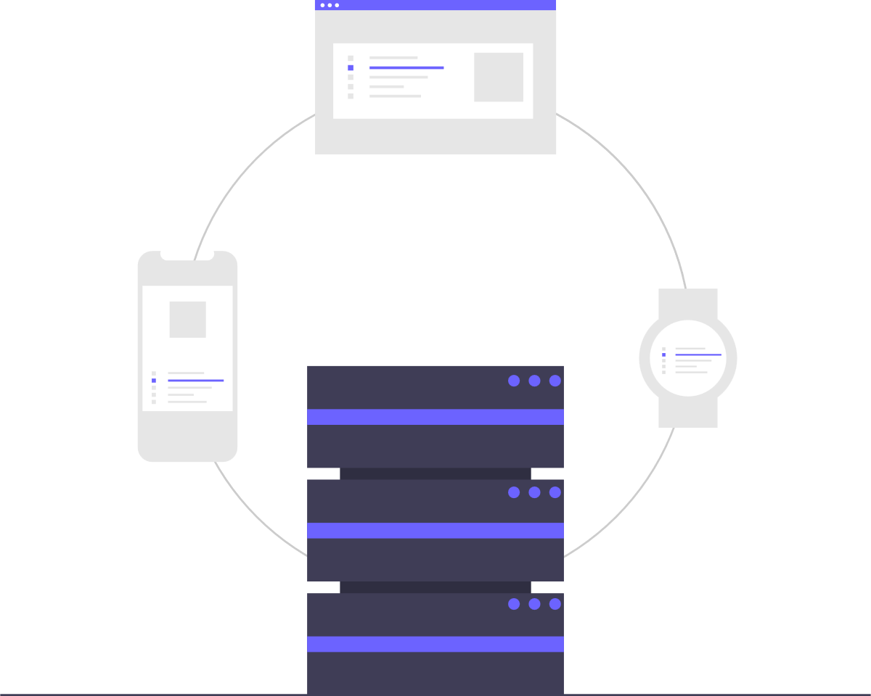
System Requirements –
Hardware and Networking
For Application Development -
Desktop / Laptop with
8 Gigabytes RAM
256 GB SSD
Internet Connectivity approx. 25 Mbps
For Testing / Real Device -
Android Smartphone with
2 Gigabytes RAM
300 MB Internal Storage
3G/WLAN Internet connectivity

Slide 16

System Requirements –
Software and Application
For Application Development -
Android Studio
Plugins
Adobe XD and Figma
Browser
For Testing / User Device -
Android v6.0+
UpToDate Google services

Slide 17

System Requirements – Database and cloud storage
Authentication and Database -
Firebase
MySQL Storage
MongoDB
Cloud Storage -
Firebase Storage
Web Hosted Storage

Slide 18




menAn Stack Development

Slide 19



FRONTEND

Slide 20

BACKEND HANDLER

Slide 21



DATABASE

Slide 22
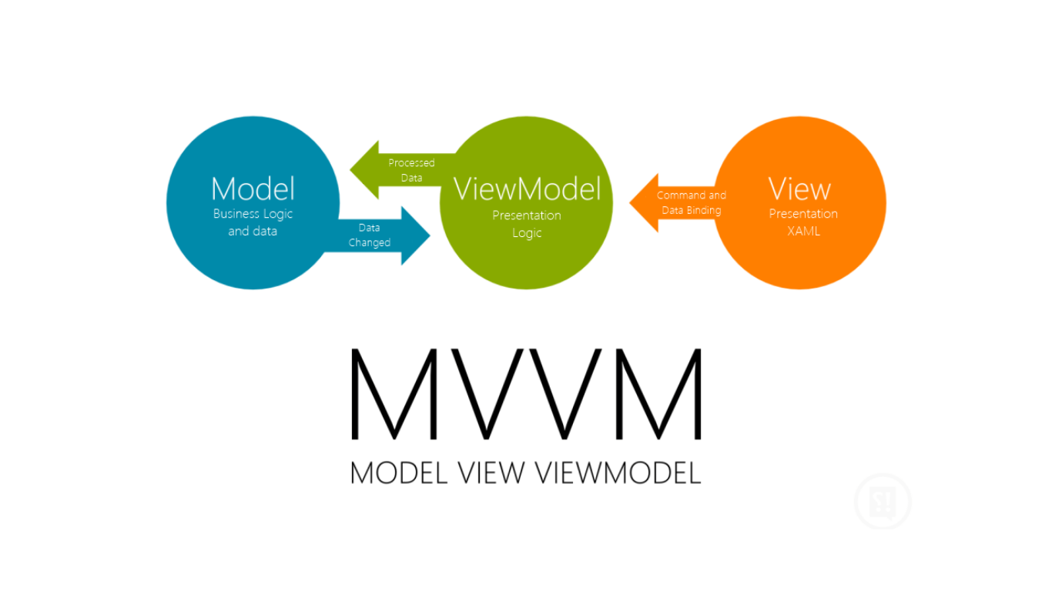

Slide 23
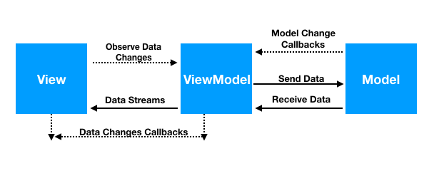

Slide 24
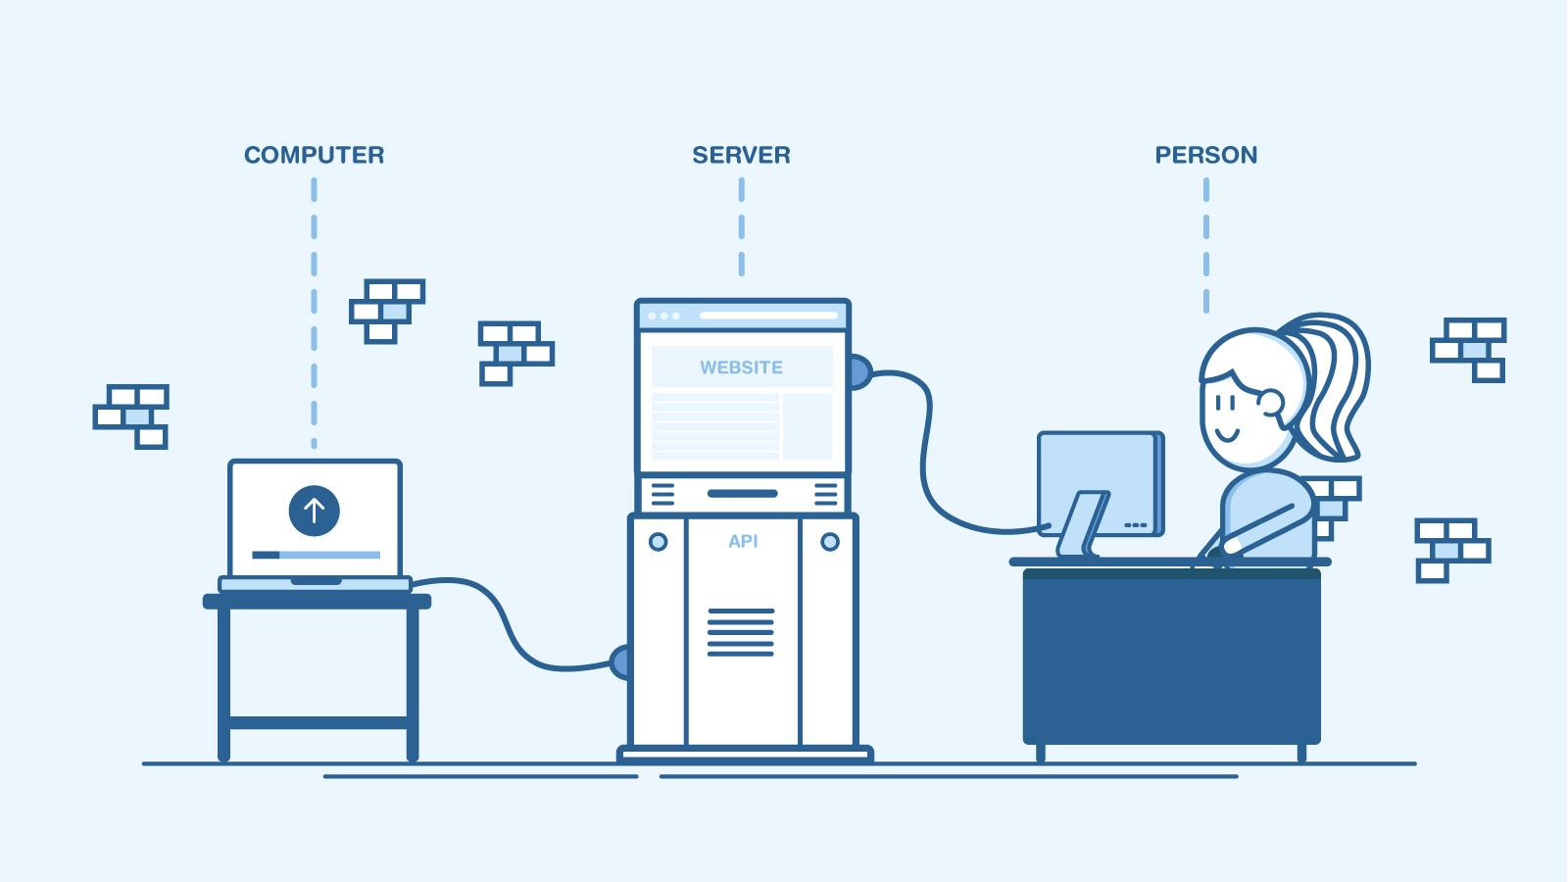
API

Slide 25
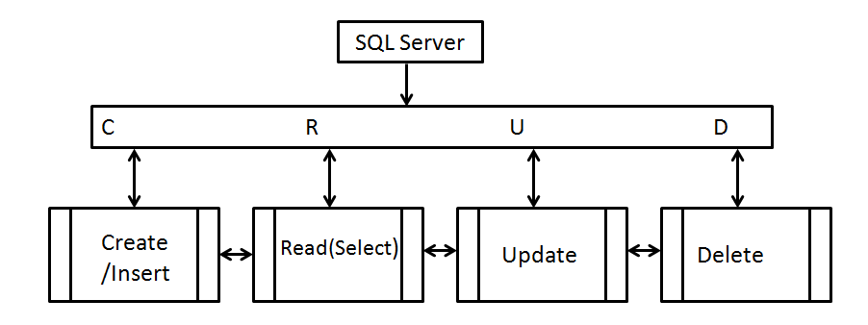

Slide 26
Development Objective
Authentication
Firebase Phone Authentication
Server Setup
Cloud Setup
Database Schema Development
MVVM Implementation
Testing API
ViewModel Attachment
Interconnecting Different Database Platform

Slide 27

Thank You!

