Slide 1

PLEASE REFRAIN FROM TAKING PHOTOS

Slide 2
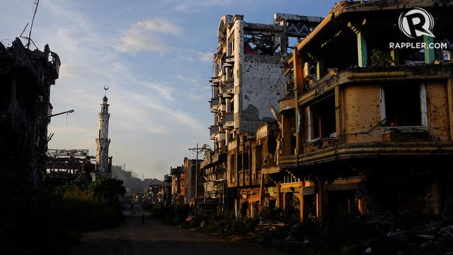
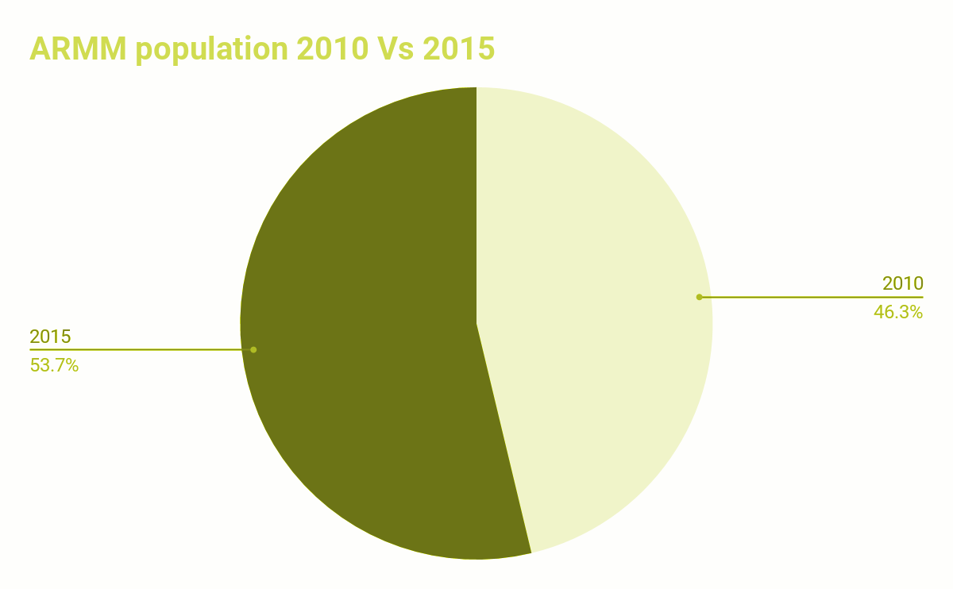
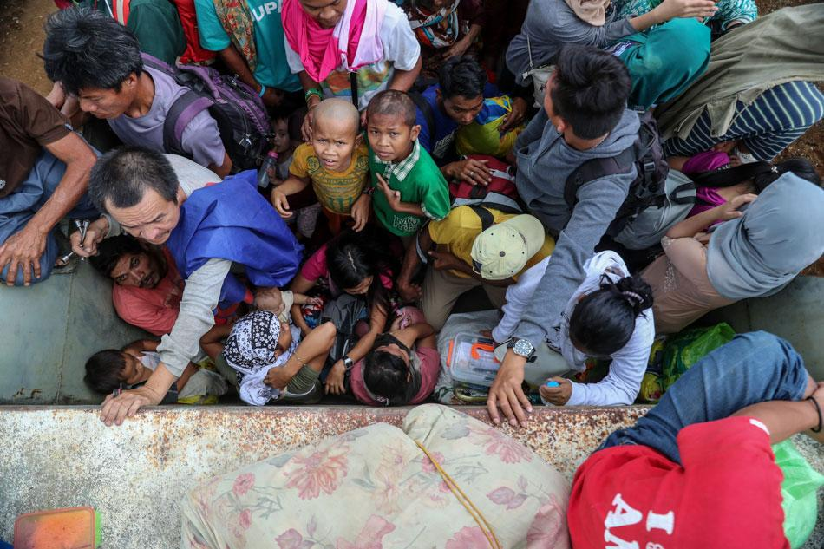
16.19%
Growth
Source: Tabular Data
Marawi Siege
Area | Poverty Threshold (in PhP) |  | Food threshold (in PhP)
 | 2015 | 2018 | 2015 | 2018
B/ARMM | 11,183 | 13,578 | 7,947 | 9,6511
Source: PSA
Source: ABS-CBN

Slide 3
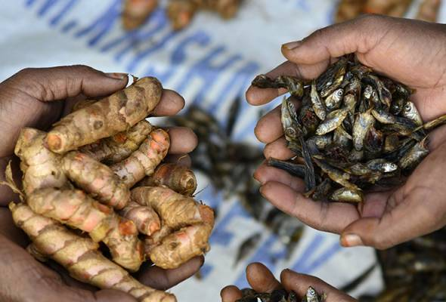


“Barter” system, definition
Exchanges goods and services in return for other goods and services
Doesn’t involve money and organized through groups or individuals

Slide 4



The App
Features
Displays trader’s profile and details of their goods and services to Mu’amalah (Barter).
Mapping of the agricultural sector’s production and other goods or services in the area.
Provides redeemable Amana (Social points) from feedbacks in exchange to social and medical services.
Directly uploads barter transactions to the bank and cloud storage database.
Tidjara in Arabic is “trade” Ta in Visayan is “tayo”

Slide 5

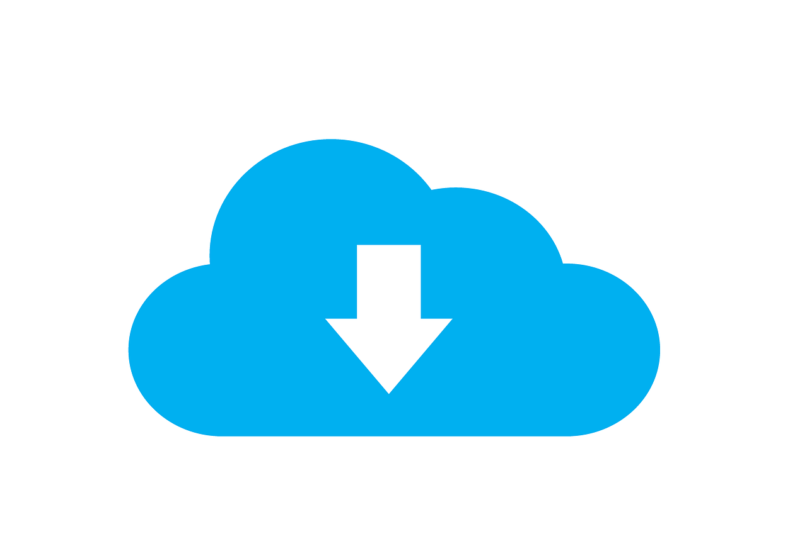
The process
Step 1
Step 2
Step 3
Step 4
Step 5
Usage of the application in locating nearby traders that matches the profile of your need.
Proceed to the Mu’amalah (Barter) transaction and proceed on completing it.
Provide rating that is redeemable Amana (Social points).
Usage of Amana (Social points) from the feedback in transactions to access a free social and medical services.
COMPLETE!

Slide 6
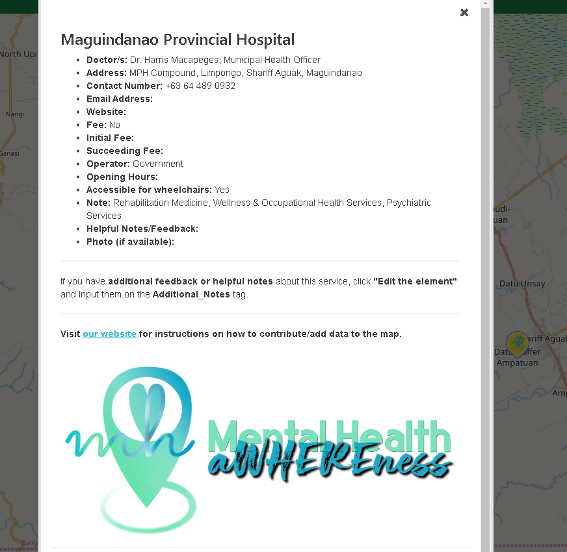
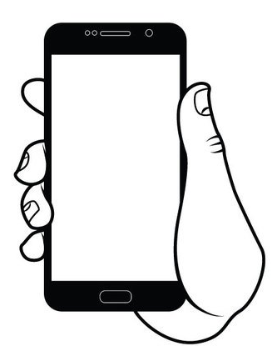
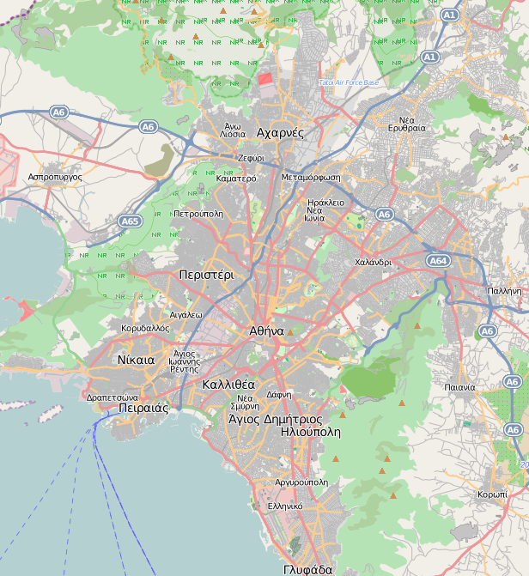

Geolocation

Slide 7
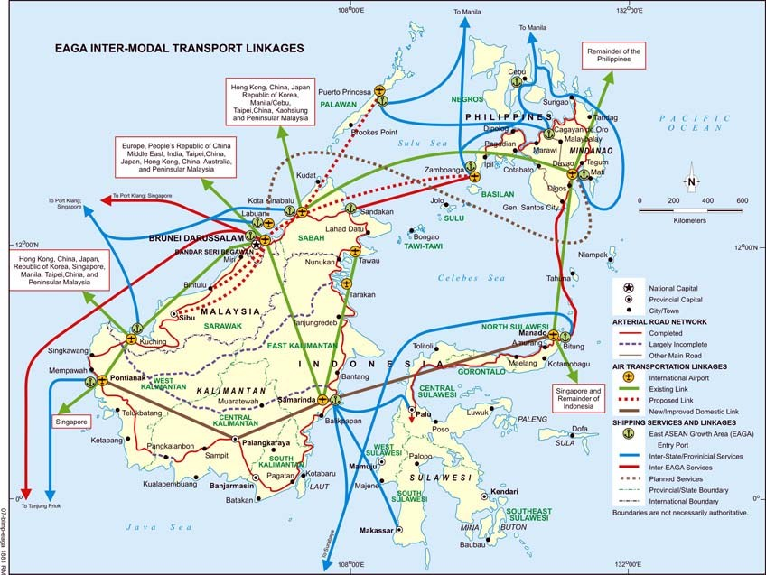
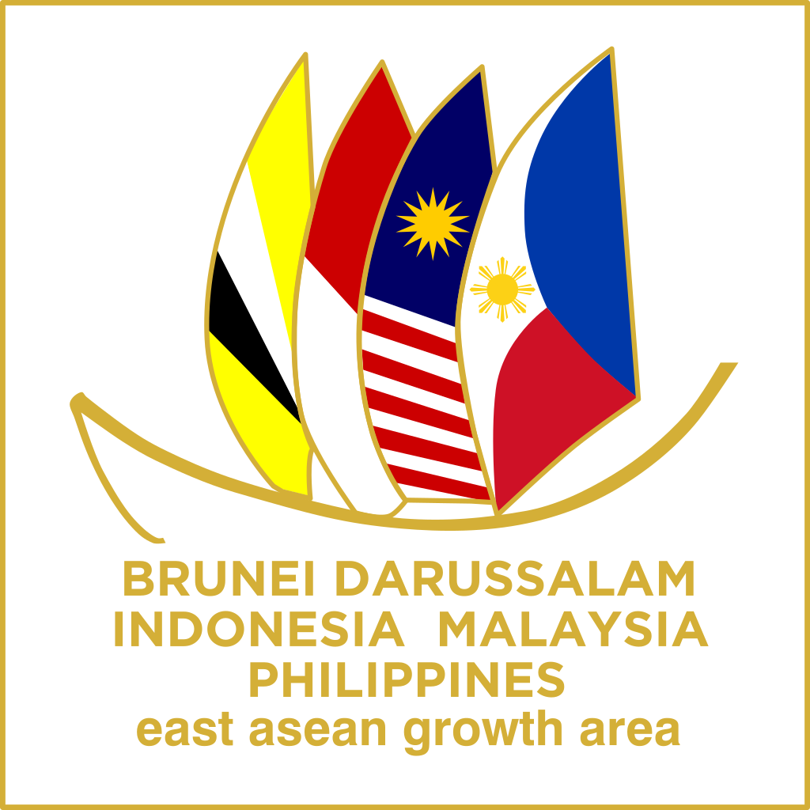
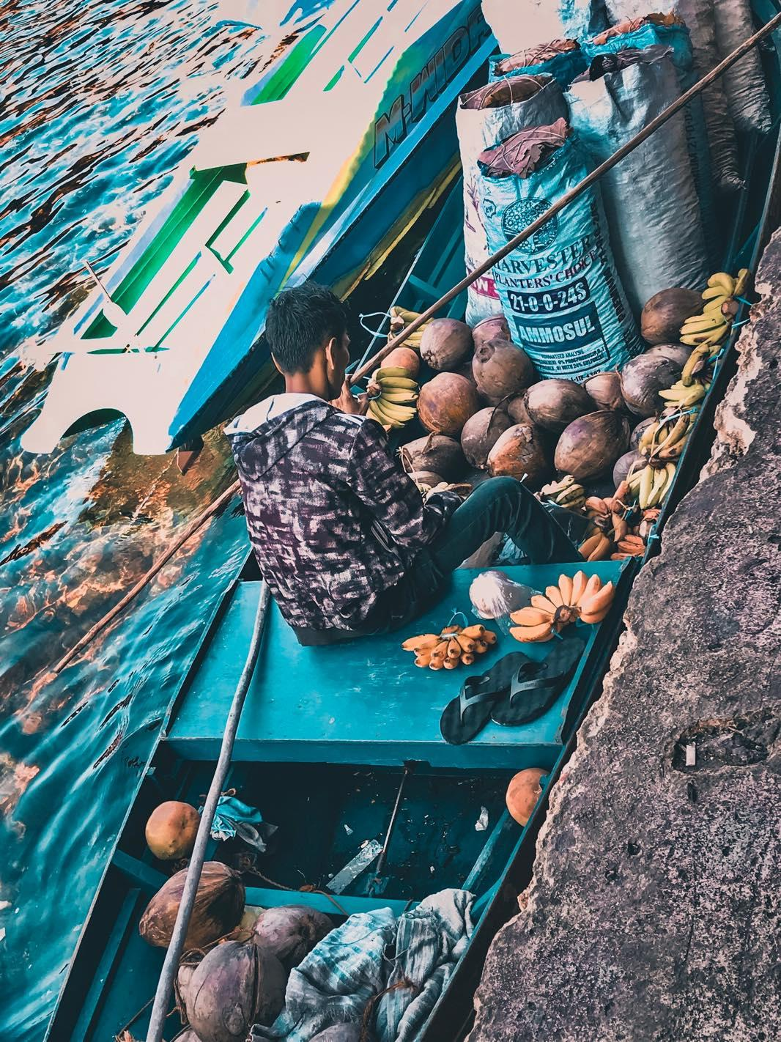
Discussion
APP FEATURES
Source: CDODEV

Slide 8
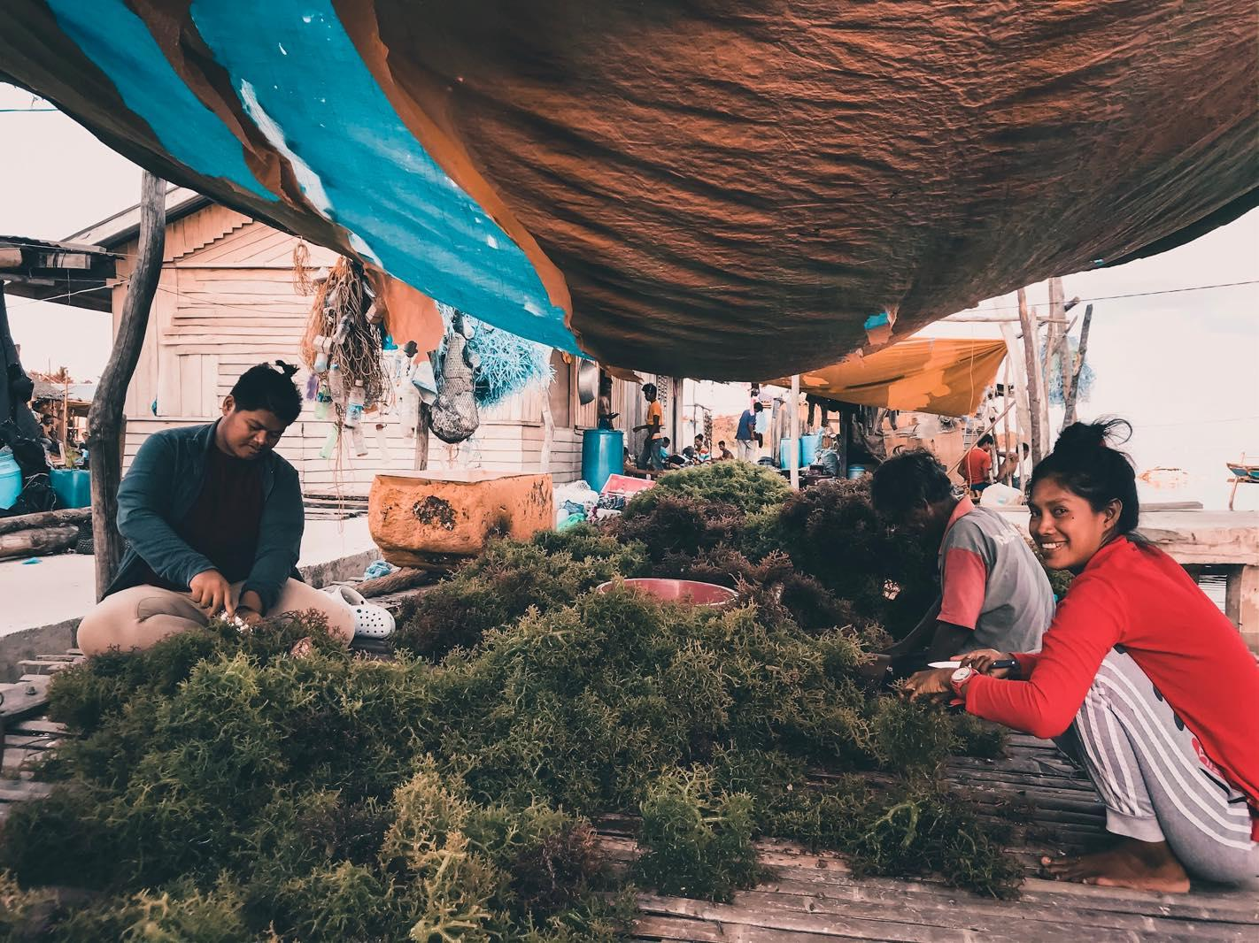
Tidjara Ta
Reynier C. Tasico, Raquel Garcia, and Lennard Garcia
February 2020

