Slide 1
Chapter 16
Stacks and Queues

Slide 2
Summary
An array-based implementation of the stack and queue
A linked list–based implementation of the stack and queue
A brief comparison of the two methods

Slide 3

Stacks
Courtesy: www.maxpixel.net
push
pop
top
topAndPop
isEmpty
makeEmpty
Note: All basic operations are expected to take constant time

Slide 4
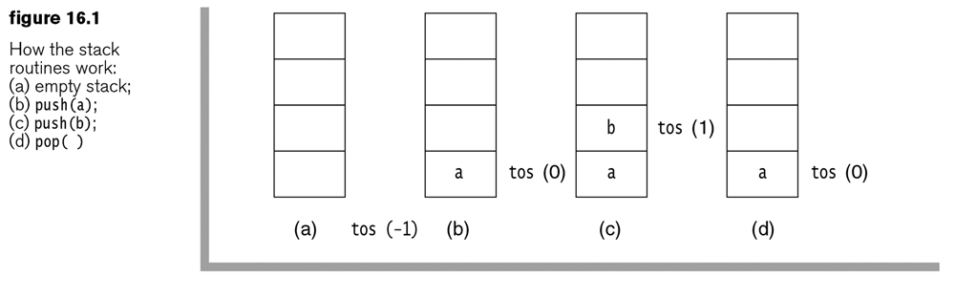
Stack Basics with Arrays
tos is Top Of Stack integer index
Stacks can push and pop

Slide 5
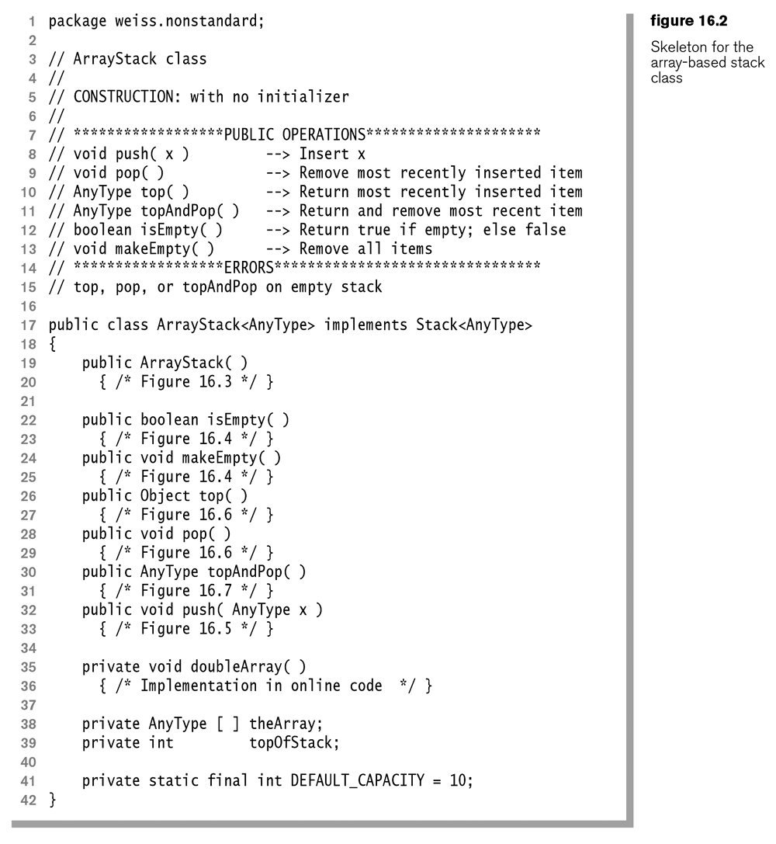
Let’s try to write these

Slide 6
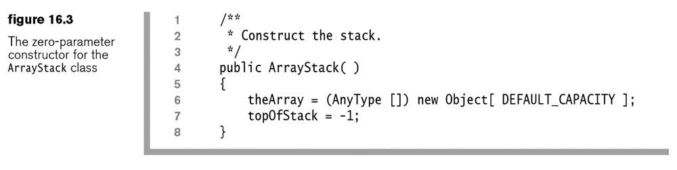
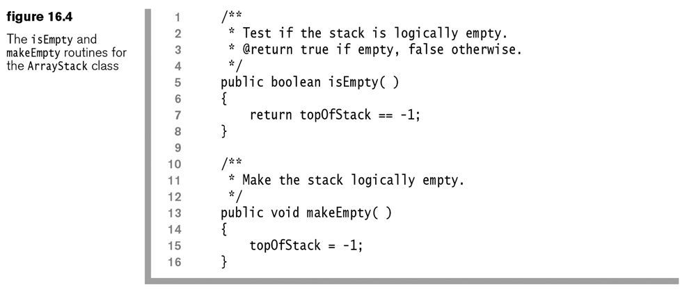

Slide 7
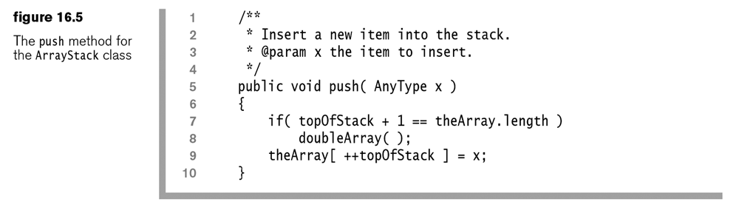

Slide 8
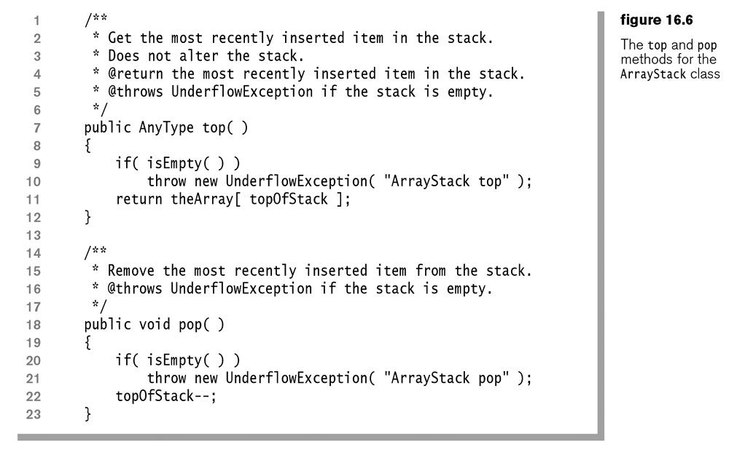

Slide 9
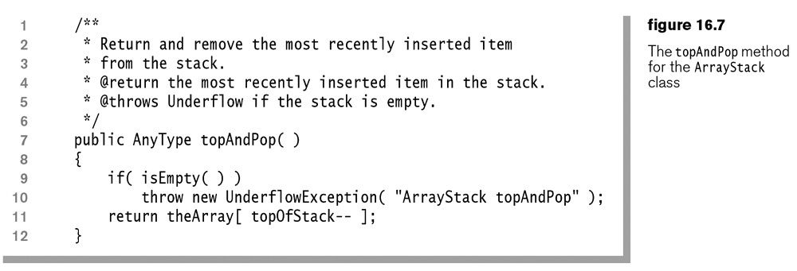

Slide 10

Queue
Courtesy: gemenacom
Thoughts on these methods using an array?
enqueue
getFront
dequeue
isEmpty
makeEmpty
Note: All basic operations are expected to take constant time

Slide 11
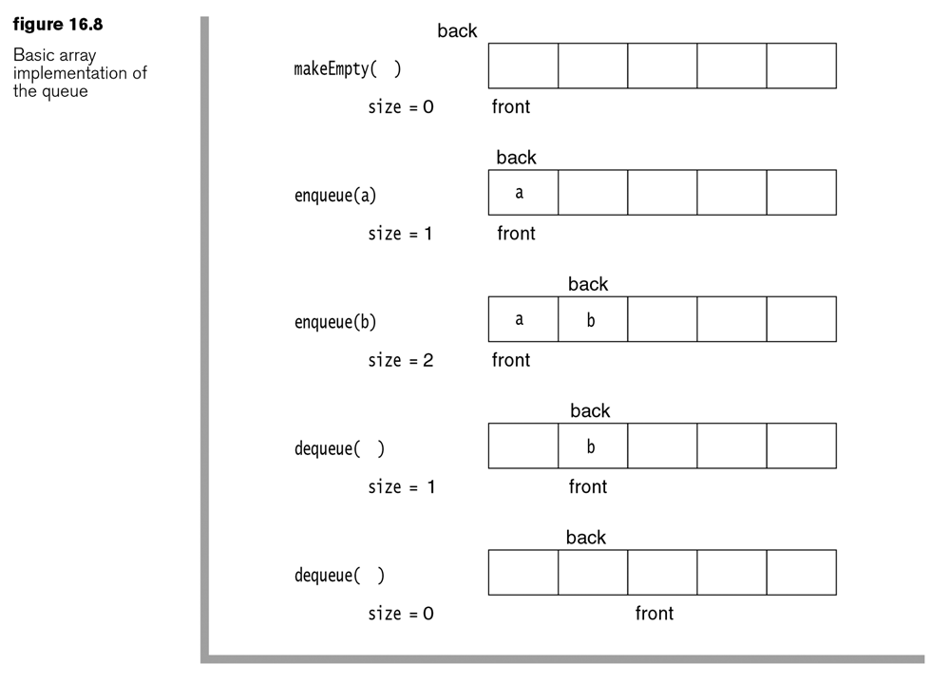
Queue Basics with Arrays
Why move the front?

Slide 12
What to do?
Given an array with 5 spots, as shown
Do
Enqueue 2 items
Dequeue 2 items
So far so good
Repeat the “do” one more time.
Ideas?

Slide 13
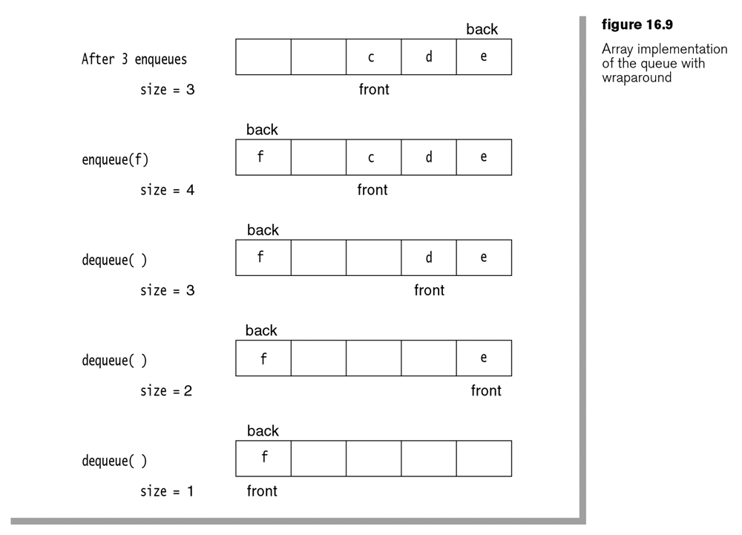

Slide 14
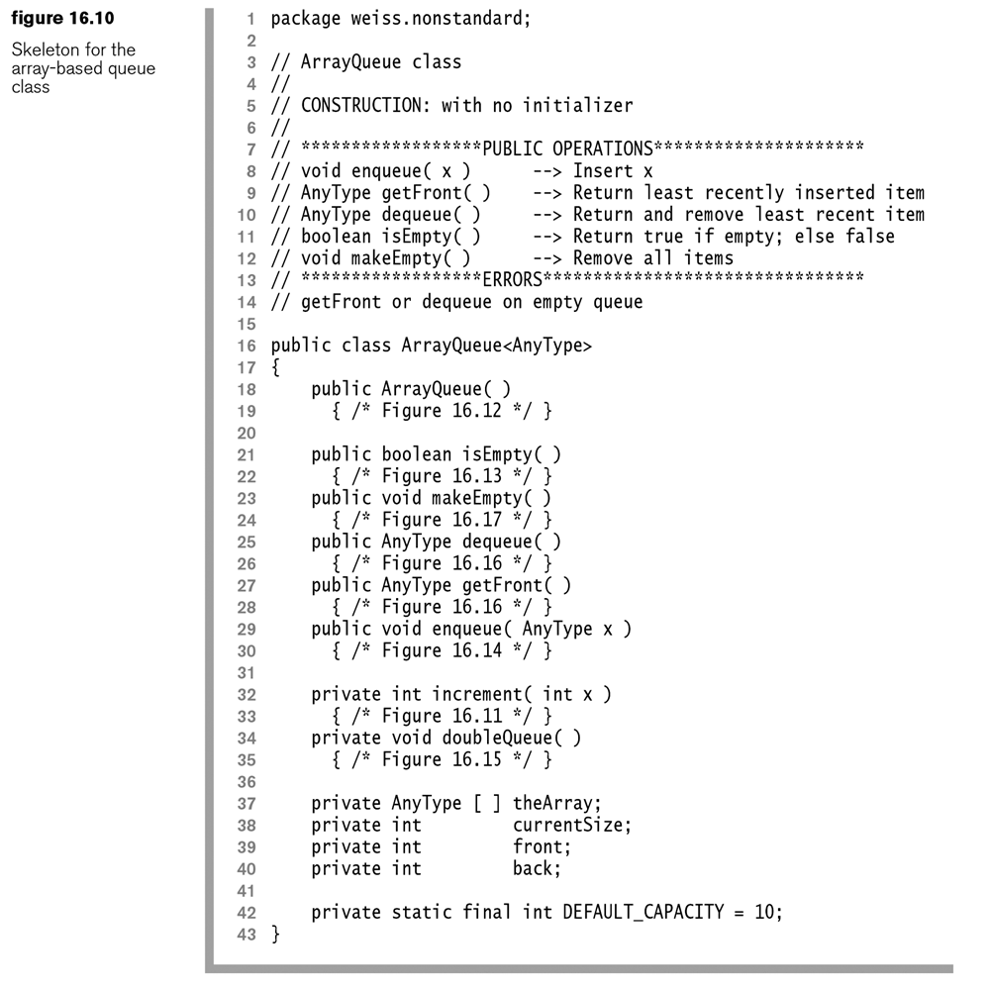
Let’s try to write at least the enqueuer and dequeue

Slide 15
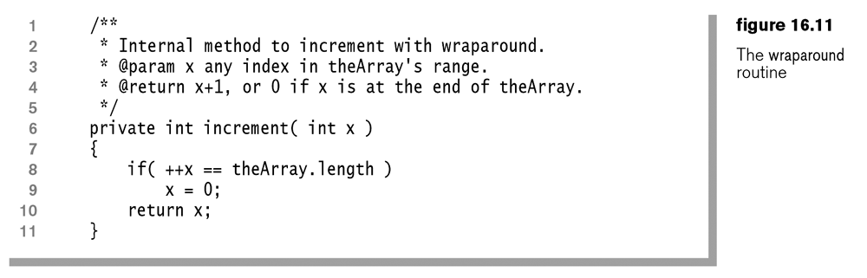
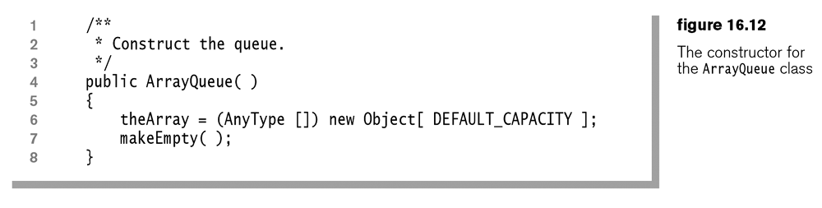

Slide 16
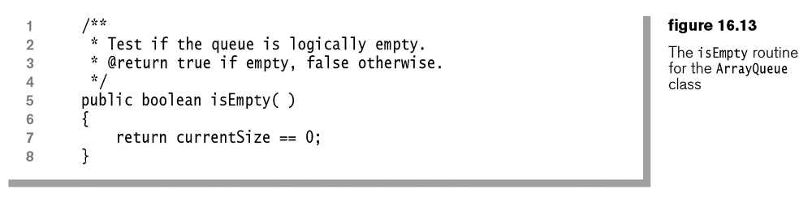
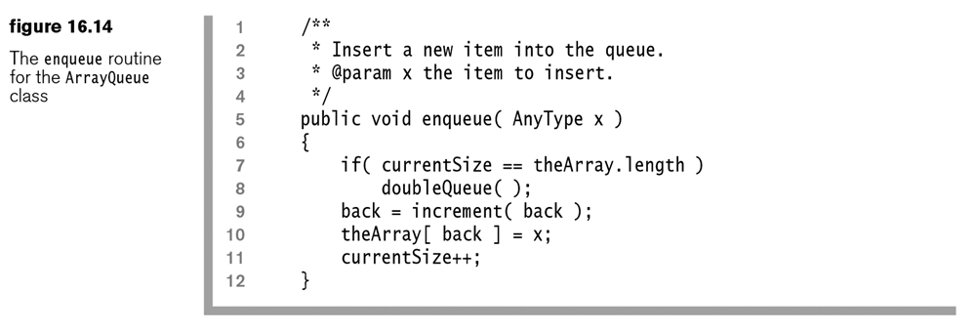

Slide 17
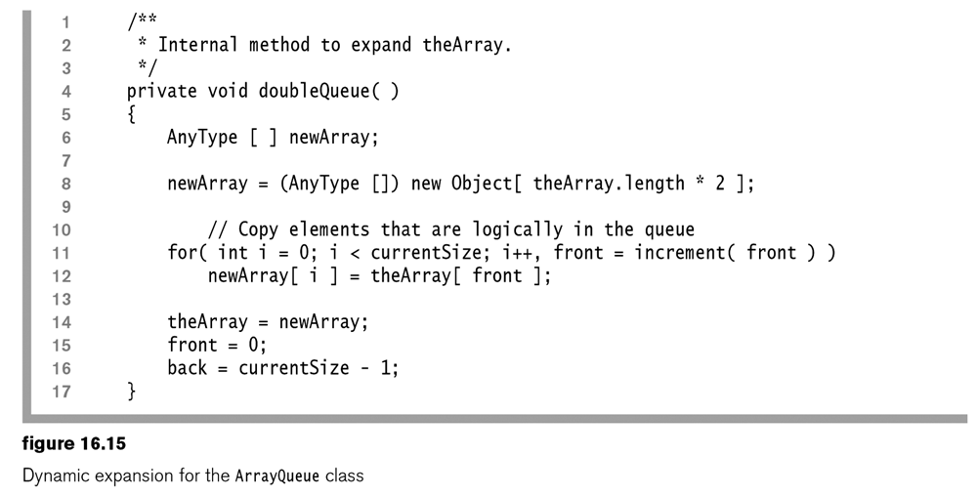

Slide 18
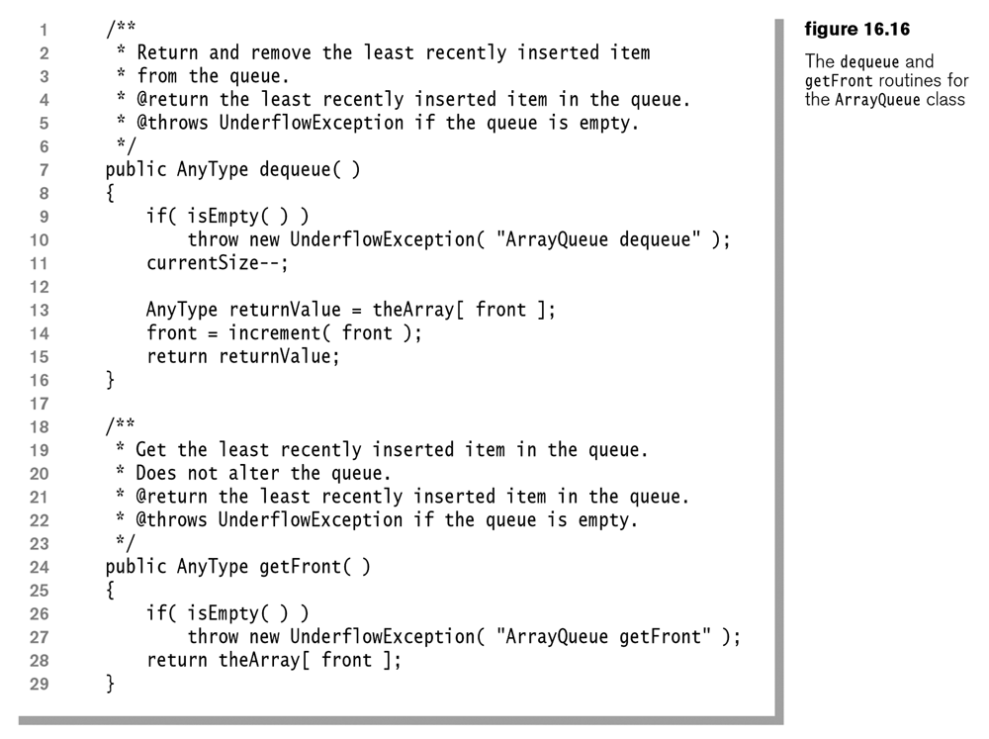

Slide 19
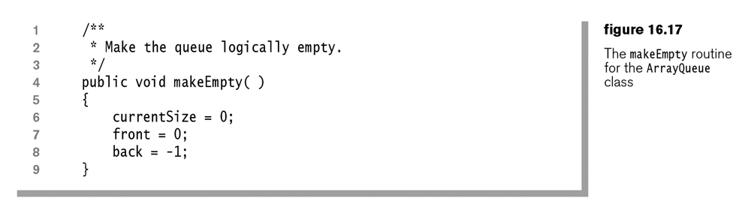

Slide 20
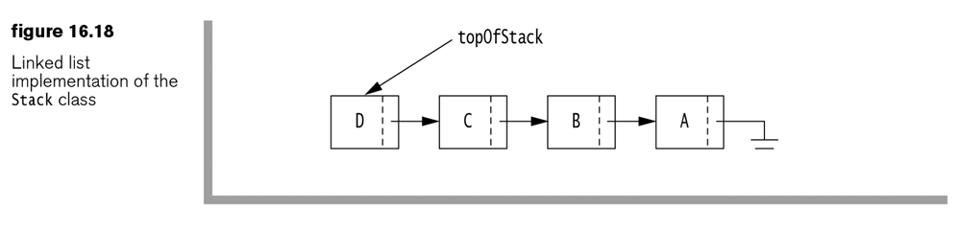
Stack using a Linked List
How is this better than using an array implementation?
How is it worse than using an array implementation?

Slide 21
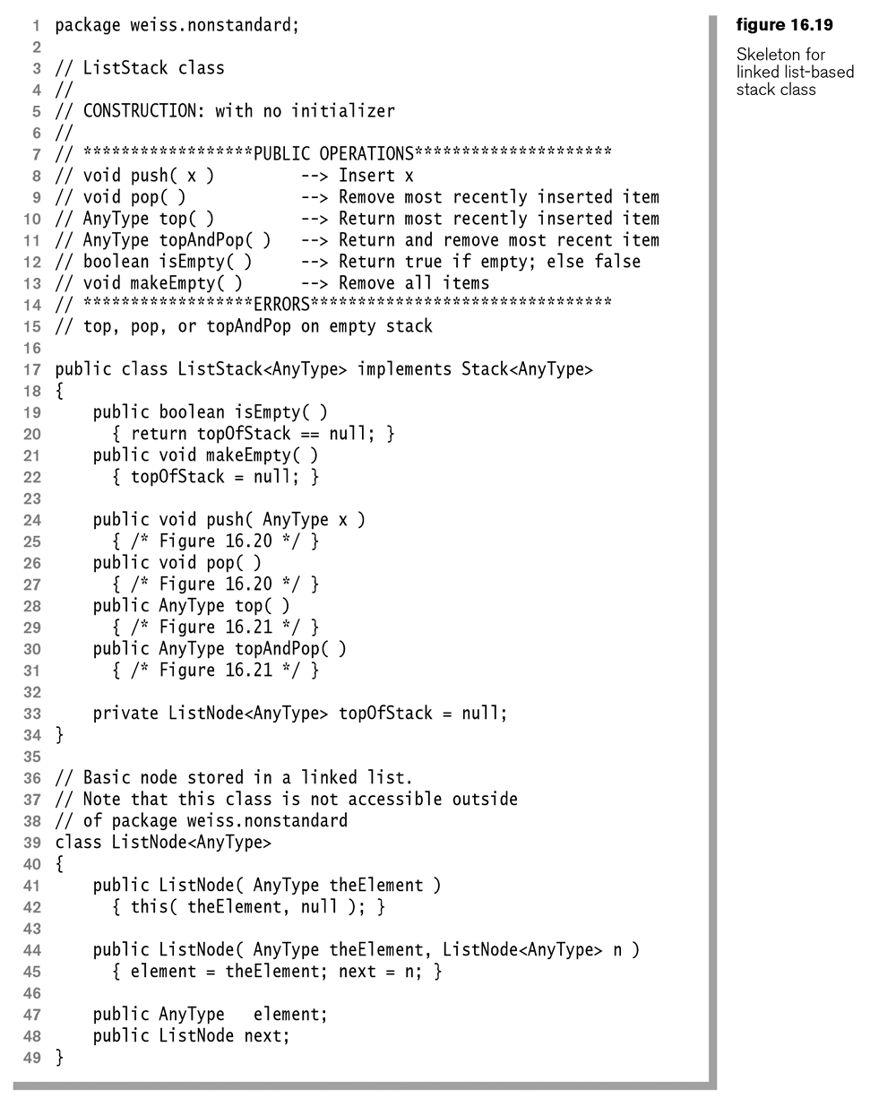
Let’s try to write at least the push and topAndPop

Slide 22
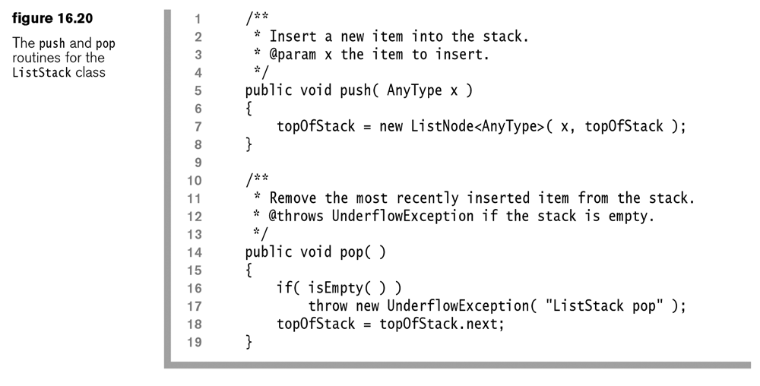

Slide 23
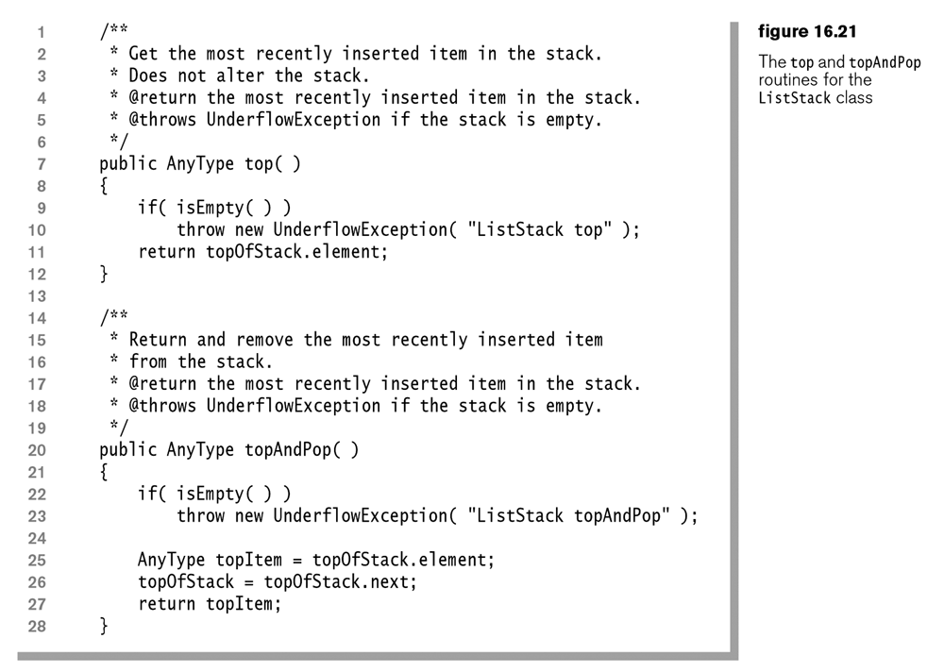

Slide 24
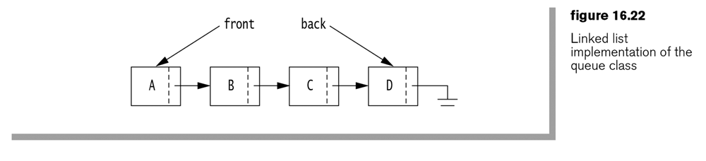
Queue using a Linked List
How is this better than using an array implementation?
How is it worse than using an array implementation?

Slide 25
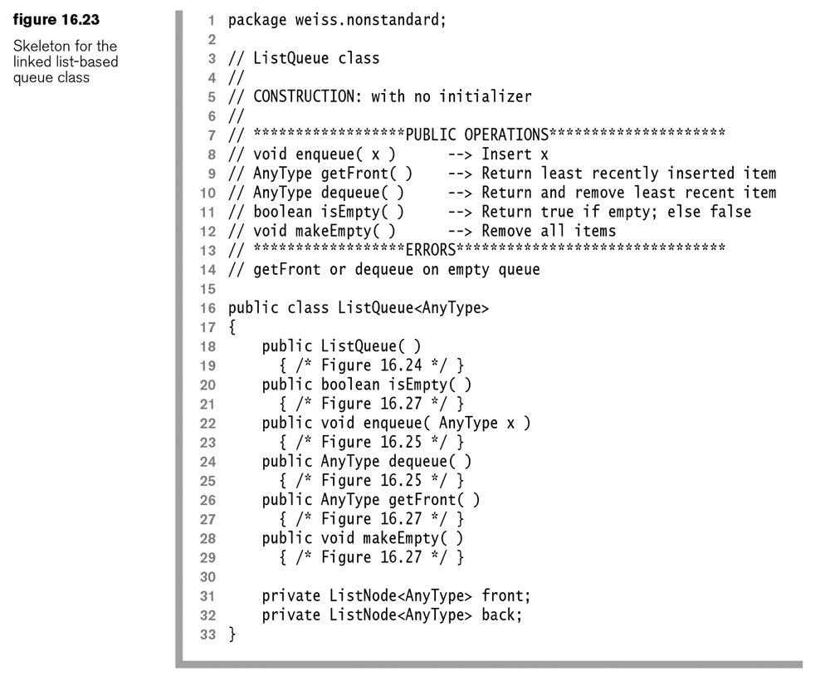
Let’s try to write at least the enqueue and dequeue methods

Slide 26
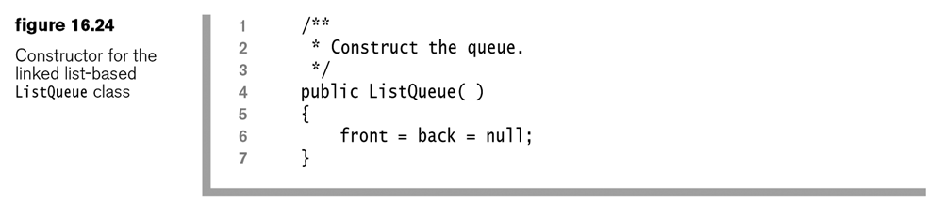

Slide 27
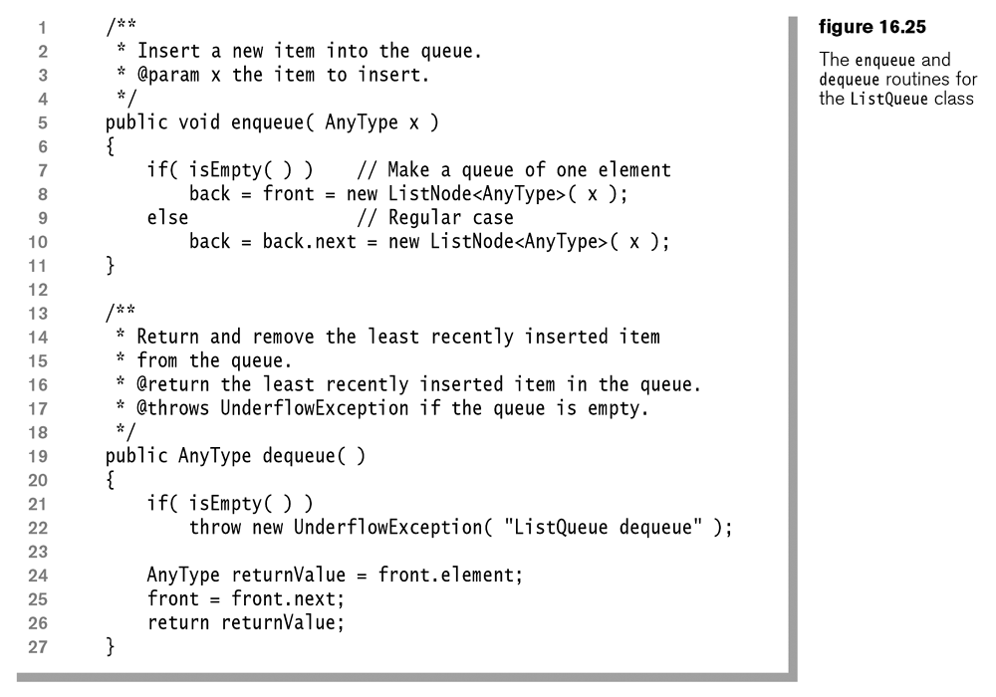

Slide 28
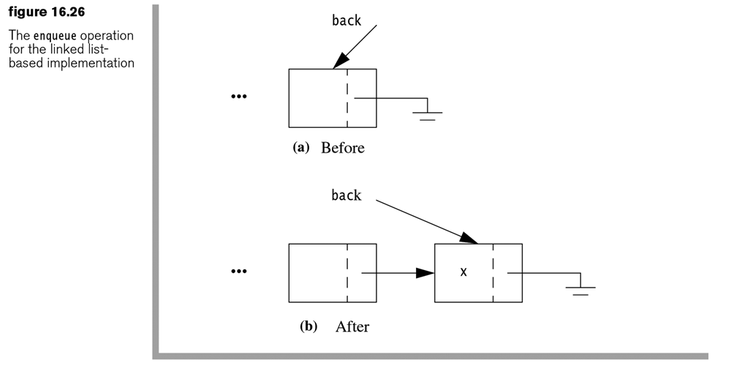

Slide 29
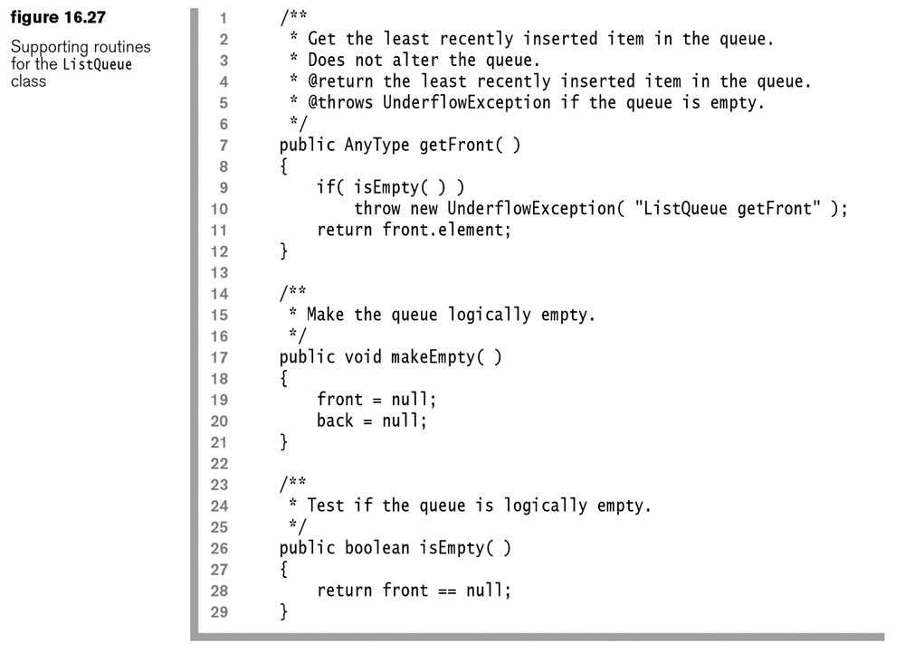

Slide 30
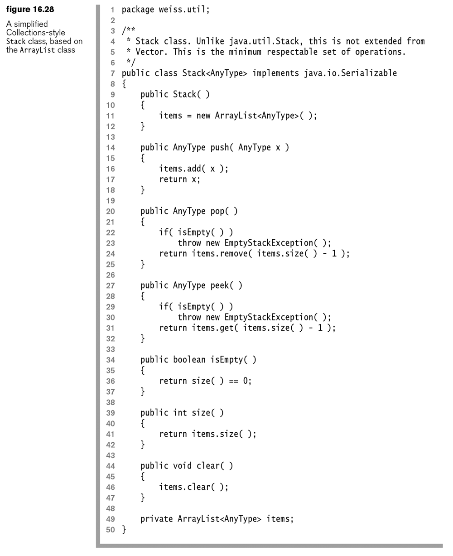

Slide 31
Double Ended Queue
Access is allowed at both ends
addFront
addRear
removeFront
removeRear

Slide 32
Homework – Written
Answer the following questions from the In Theory portion of the book:
16.1 Draw the stack and queue data structures (for both the array and linked list implementations) for each step in the following sequence:
add(1), add(2), remove, add(3), add(4), remove, remove, add(5).
Assume an initial size of 3 for the array implementation.

Slide 33
Homework – Programming
Create a java class, or PDF file that answers the following questions:
16.2 Add constructors to the ArrayStack and ArrayQueue classes that allow the user to specify an initial capacity.
16.3. Compare the running times for the array and linked list versions of the stack class. Use Integer objects.
Note: Use the code developed earlier in the semester that creates an array and fills it with random data, test on arrays of size 100, 1,000, 10,000 and 100,000. Further clarification. Start the timer, push random data 100,000 times, then pop 100,000 times, then stop the timer.

