Slide 1
Chapter 17
Linked Lists

Slide 2
Linked List Lab Day
Be sure to complete the files for the Linked List Lab day to better help you understand this chapter.

Slide 3
Summary
How to allow access to any item by using a general linked list
The general algorithms for the linked list operations
How the iterator class provides a safe mechanism for traversing and accessing linked lists
List variations, such as doubly linked lists and circularly linked lists
How to use inheritance to derive a sorted linked list class
How to implement the Collections API LinkedList class

Slide 4
Why a linked list
Arrays are great, but they can’t grow
ArrayLists are great, and they can grow, so why are they bad?
Inserting items into and array takes what Big-Oh time?
At the end where there is still space
In the middle of a mostly full array
At the beginning of a mostly full array

Slide 5
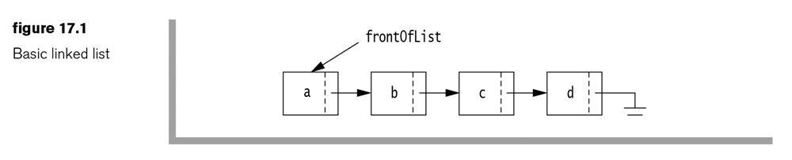
Basic Linked List
class ListNode {
Object element;
ListNode next;
}
Try:
Add an item E at the end
Add an item b2 after b
Add an item to the front
What’s the Big-Oh Time?

Slide 6
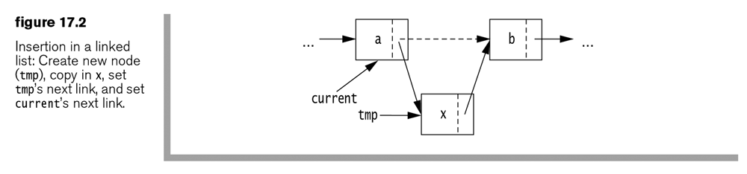
Insert
We must perform the following steps:
tmp = new ListNode( ); // Create a new node
tmp.element = x; // Place x in the element member
tmp.next = current.next; // x's next node is b
current.next = tmp; // a's next node is x
Or
tmp = new ListNode( x, current.next ); // Improved Constructor
current.next = tmp; // a's next node is x
Or
current.next = new ListNode( x, current.next );

Slide 7
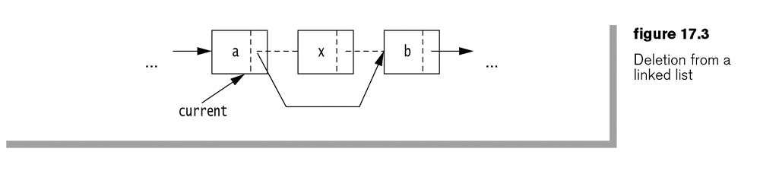
Remove or Delete a node
What is the code? (Move picture for answer)
current.next = current.next.next;

Slide 8
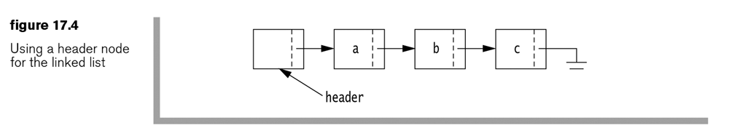
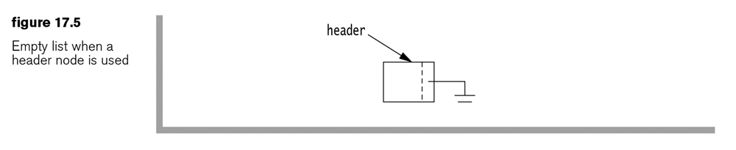
LinkedList variables
Something has to remember where this list starts
There has to be some way to insert at the front
There has to be a way to delete the first item
In the book the header node doesn’t have data, because it makes the algorithms simpler. They mention this is controversial.

Slide 9
List Iterators
Routines like printing, searching, or sorting need to be able to traverse the list. Code that walks through the list is called an iterator.
Generally iterators can:
Return things about the current item
Go to the next item
Go to the previous item
What would an iterator look like for an array?
For a Linked List.

Slide 10
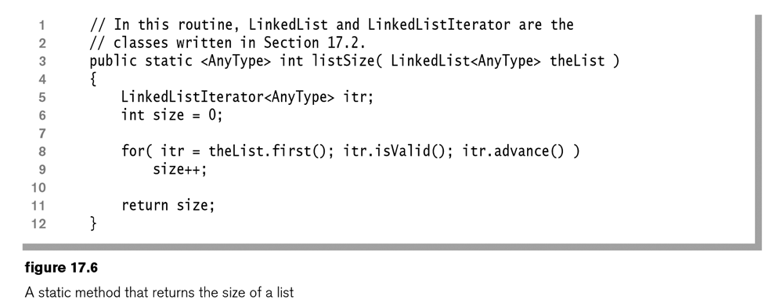
Size
How do you know the size of an array?
Maybe how full it is?
How do you know the size of a list?

Slide 11
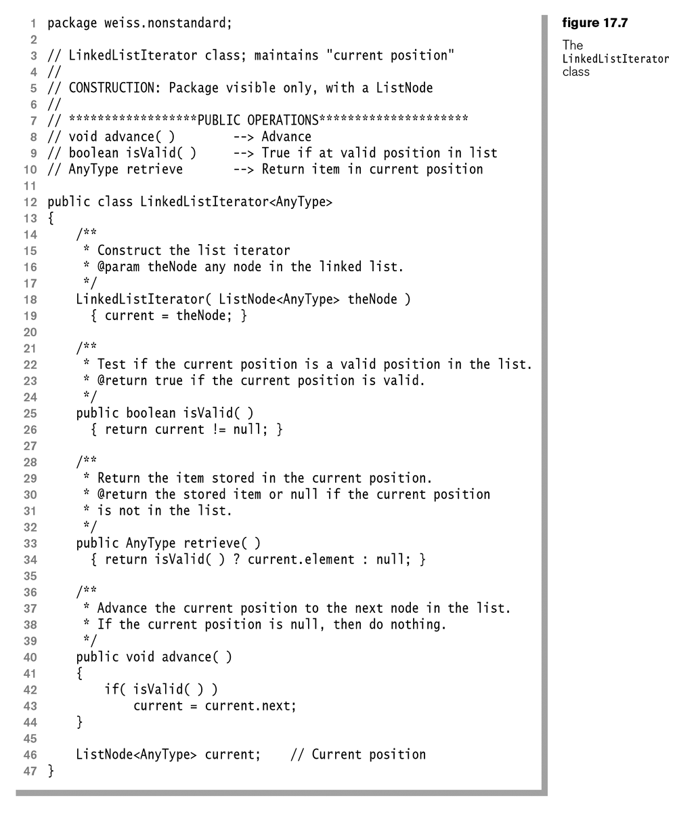

Slide 12
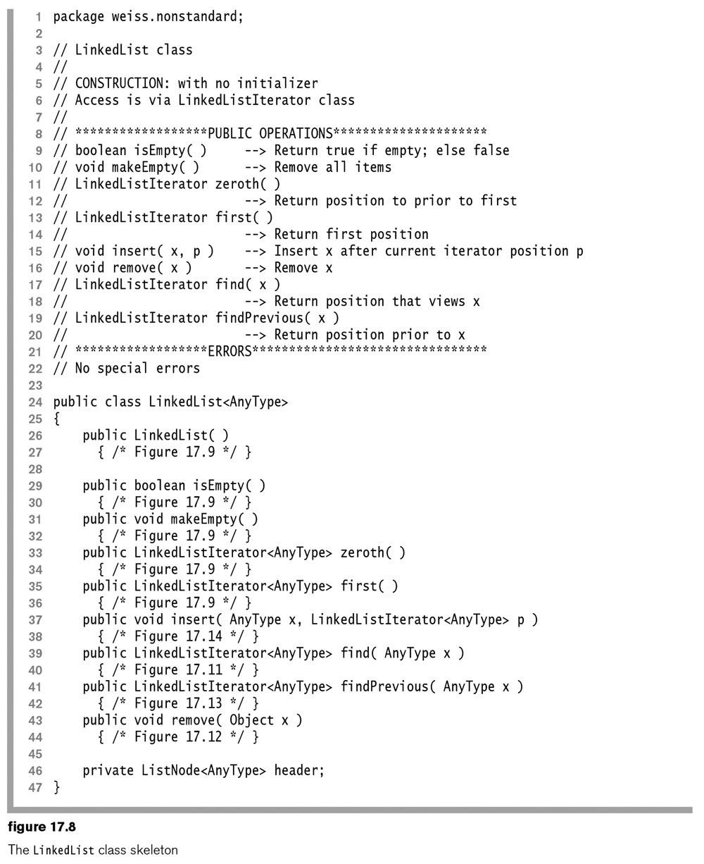
Lets code up at least the insert and remove methods
We need a ListNode class
This should have data of type ??, and a pointer to the next list item ??, using generic code <AnyType>, and maybe just public instance variables for now, in the same file as LinkedList

Slide 13
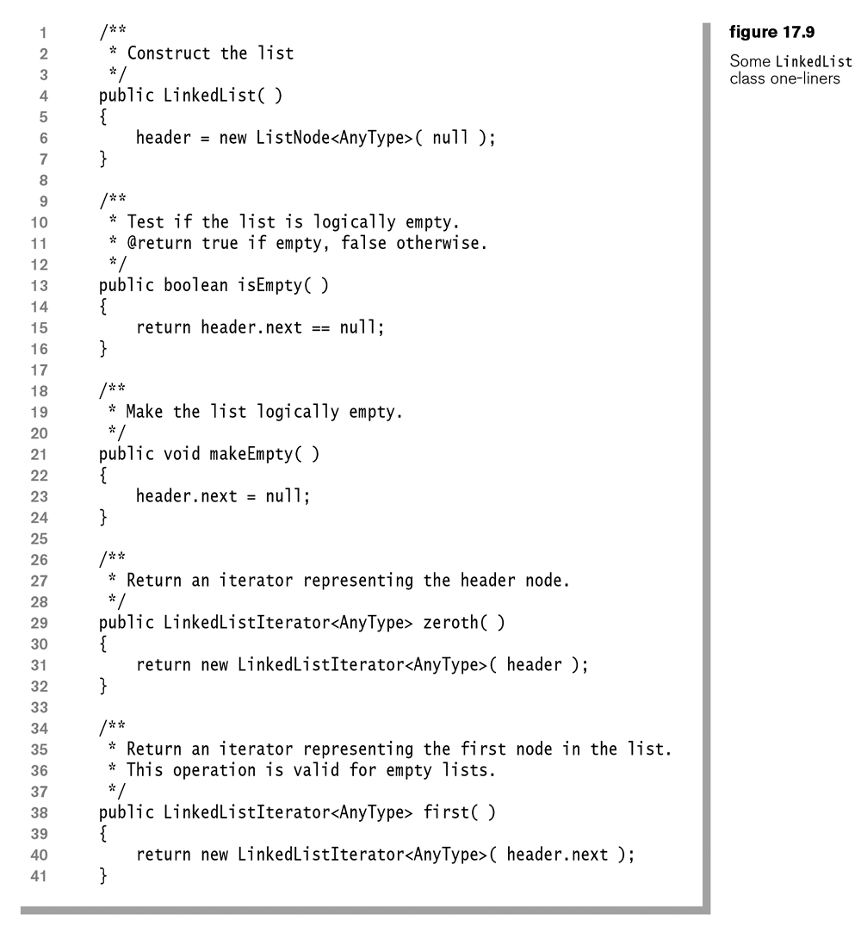

Slide 14
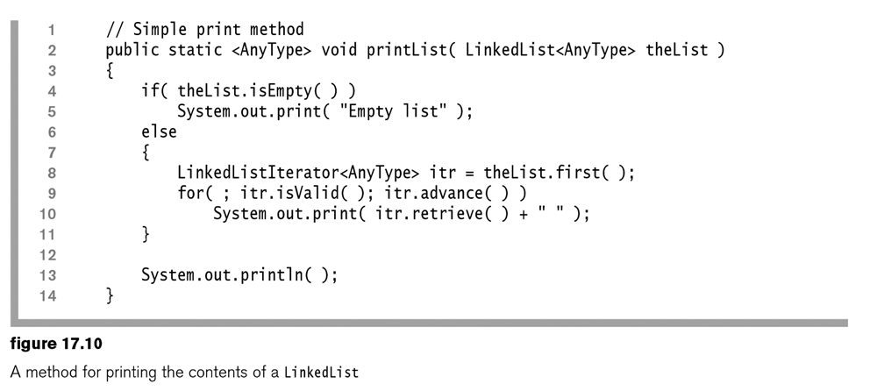
printList method
Before we switch slides, can we code up a find method?

Slide 15
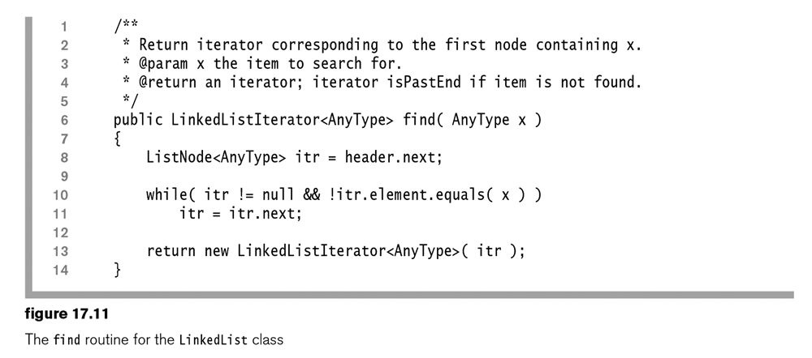
Find Method
Before we move on, can we code up a remove method that takes the item to be removed as a parameter?

Slide 16
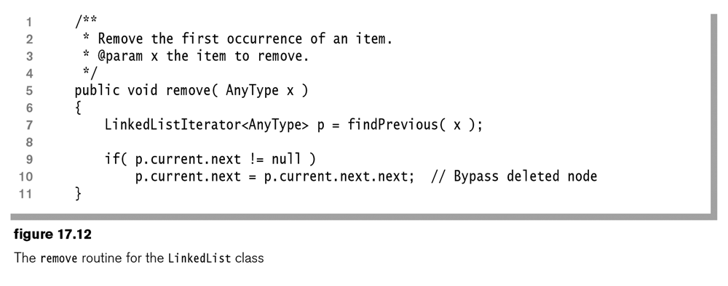
Remove Method
Before we go on, can we code up a method that takes a node and finds the node before it? (findPrevious)

Slide 17
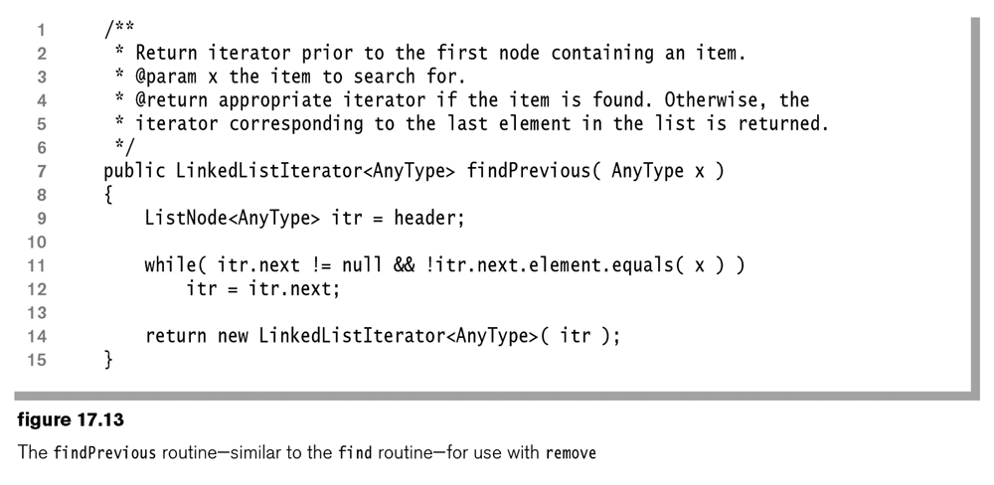
Find Previous Method
Before we move on, can we code up an insert method?

Slide 18
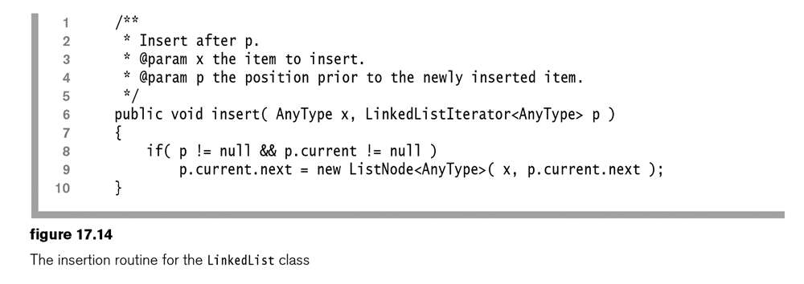
Insert Method

Slide 19
Thoughts
What is the Big-Oh time of the following:
Insert
Delete
Find
FindPrevious
Difficulties
Next is easy, previous/retreat is difficult
Accessing the front of a list is easy, but accessing the end of a list is difficult

Slide 20

Doubly linked lists
Have a Head, and a Tail
Have a next, and a previous

Slide 21

Test for empty
We now can check for head.next == tail instead of null

Slide 22
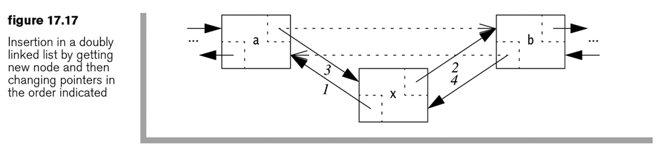
Insertion is changed
We can now have an insertBefore and insertAfter
There is a bit more copying of pointers

Slide 23
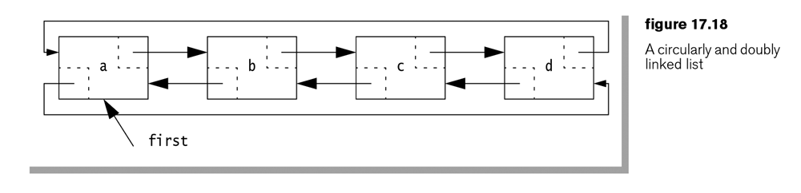
Circularly linked
Some problems might need something like this

Slide 24
Sorted Linked List
Which methods need to change from our linked list?
What is the new Big-Oh time?

Slide 25
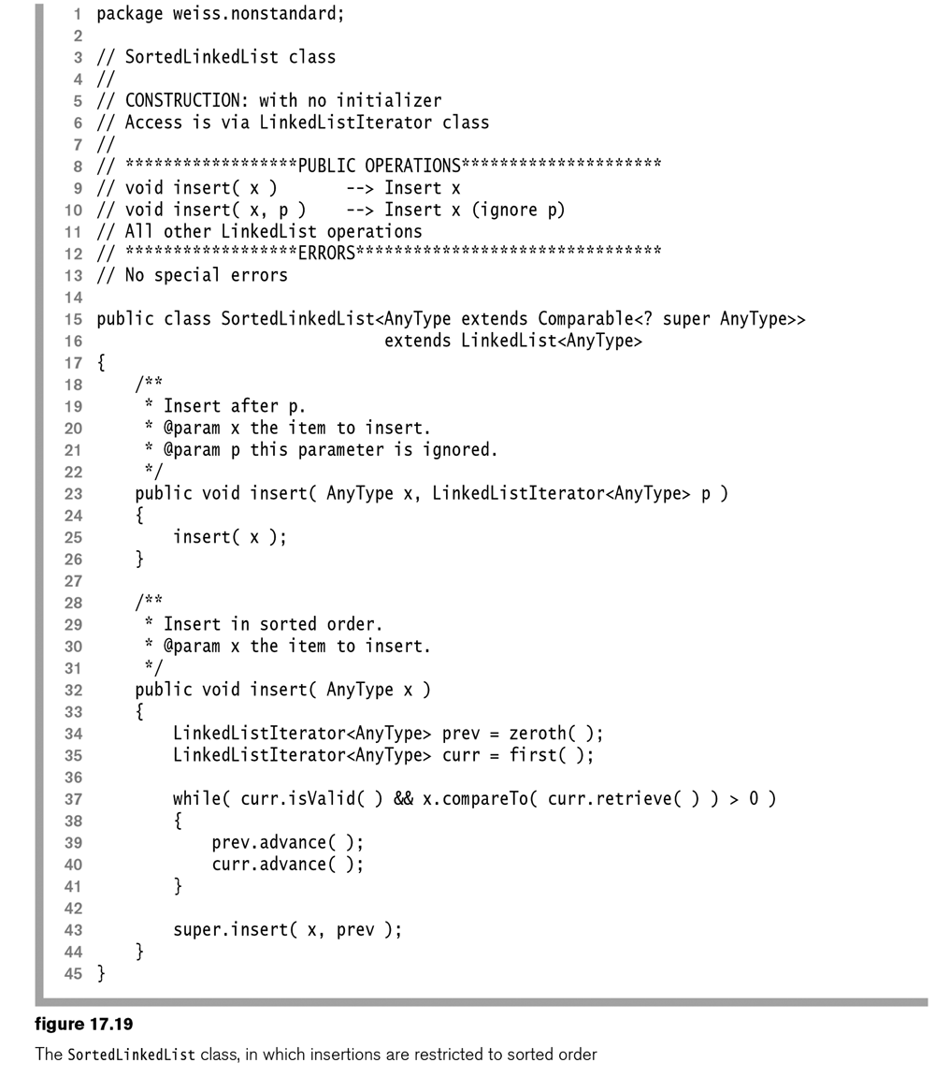

Slide 26
The Full Implementations
The following slides show the full implementations of the LinkedList in the collections class

Slide 27
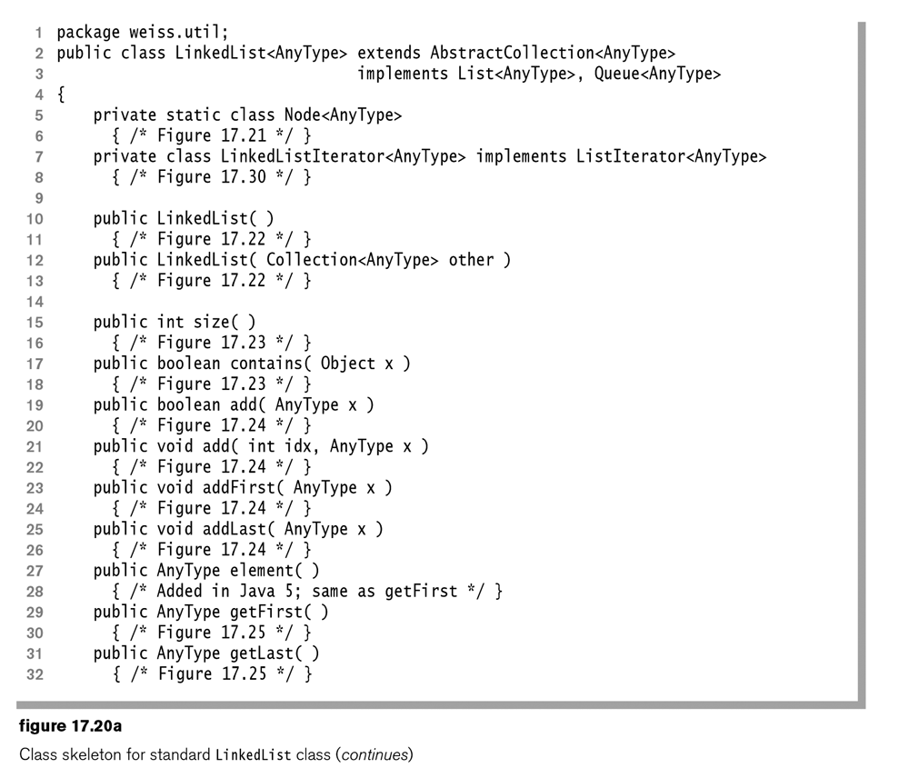

Slide 28
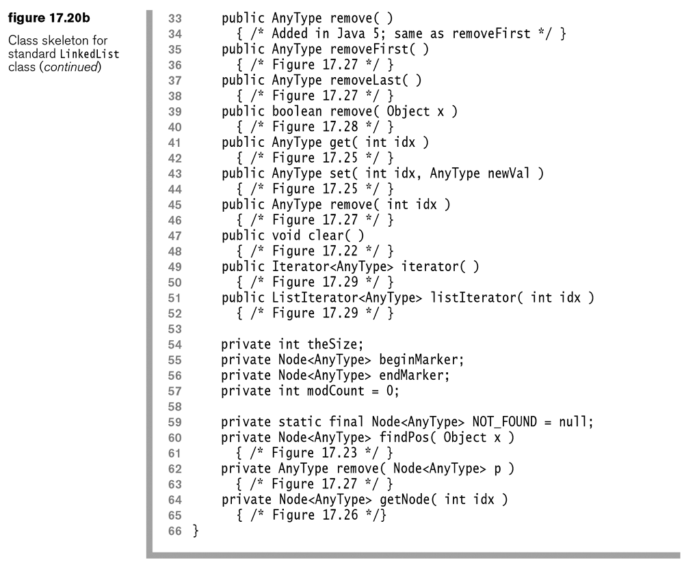

Slide 29
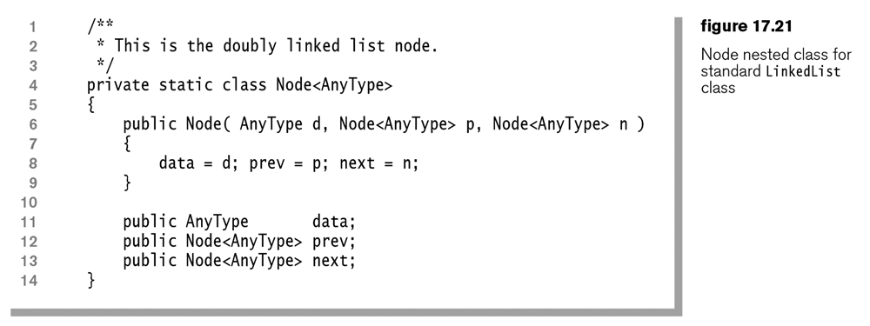

Slide 30
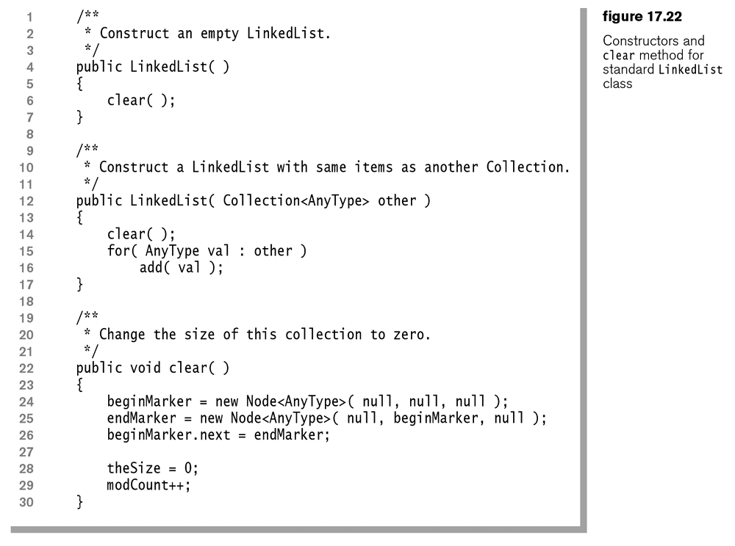

Slide 31
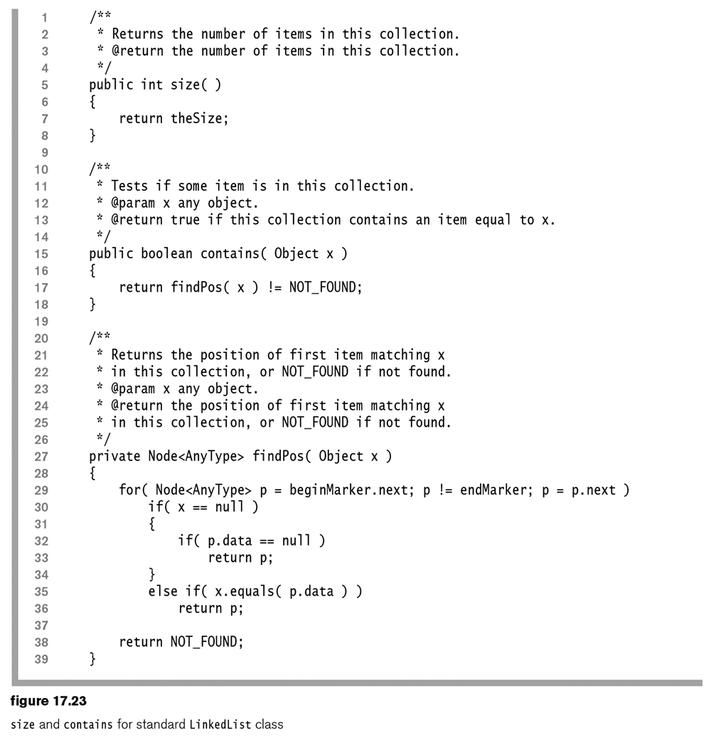

Slide 32
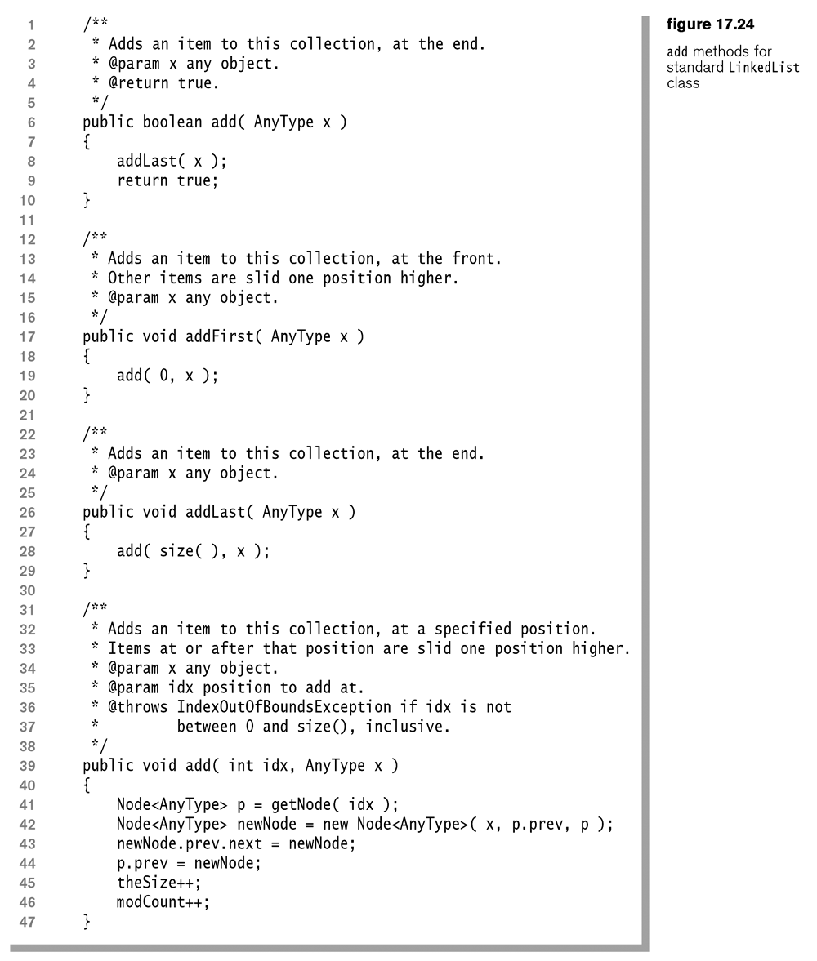

Slide 33
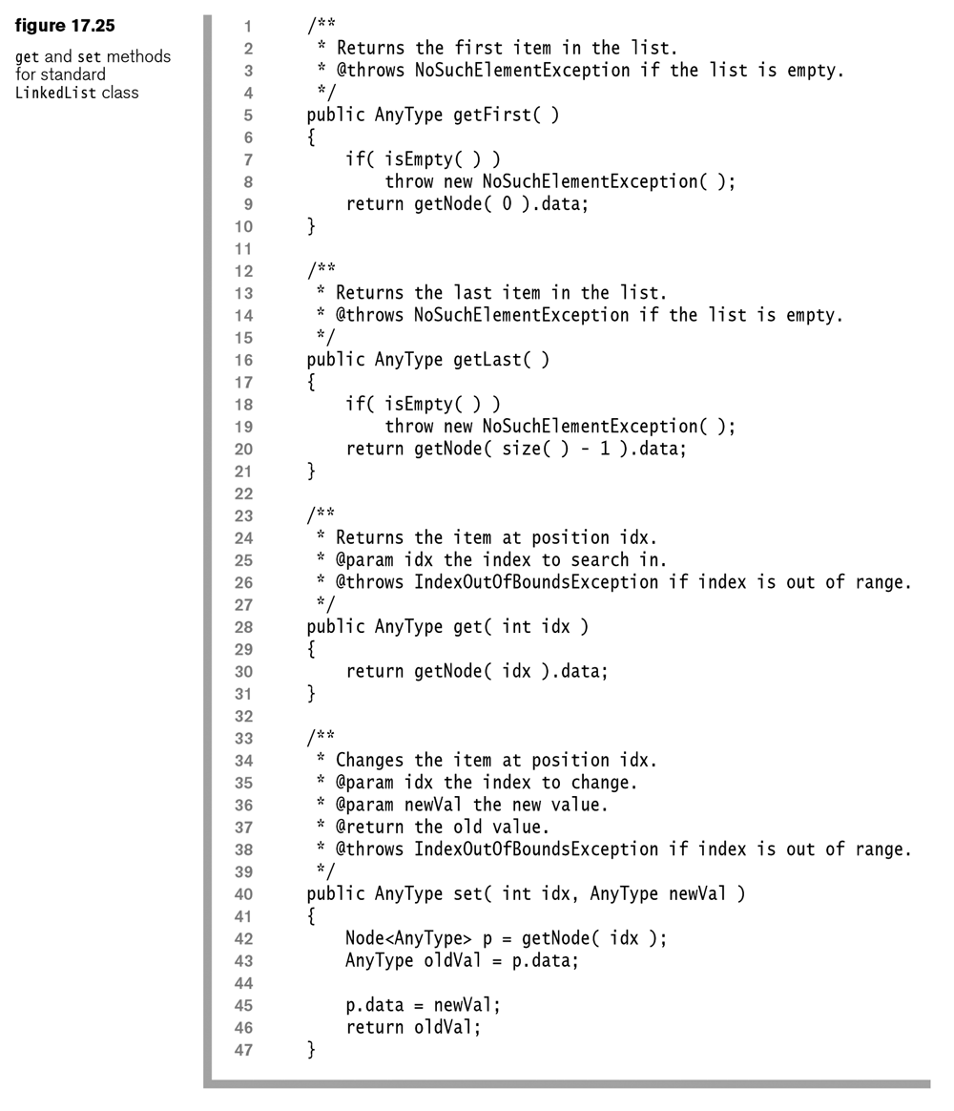

Slide 34
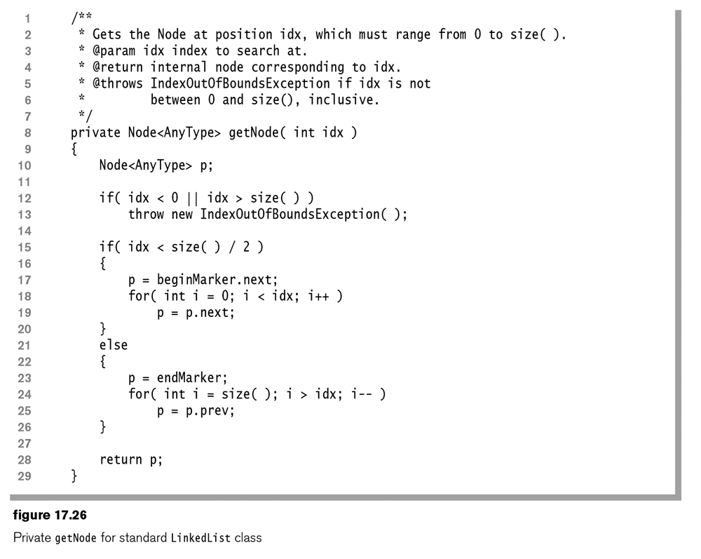

Slide 35
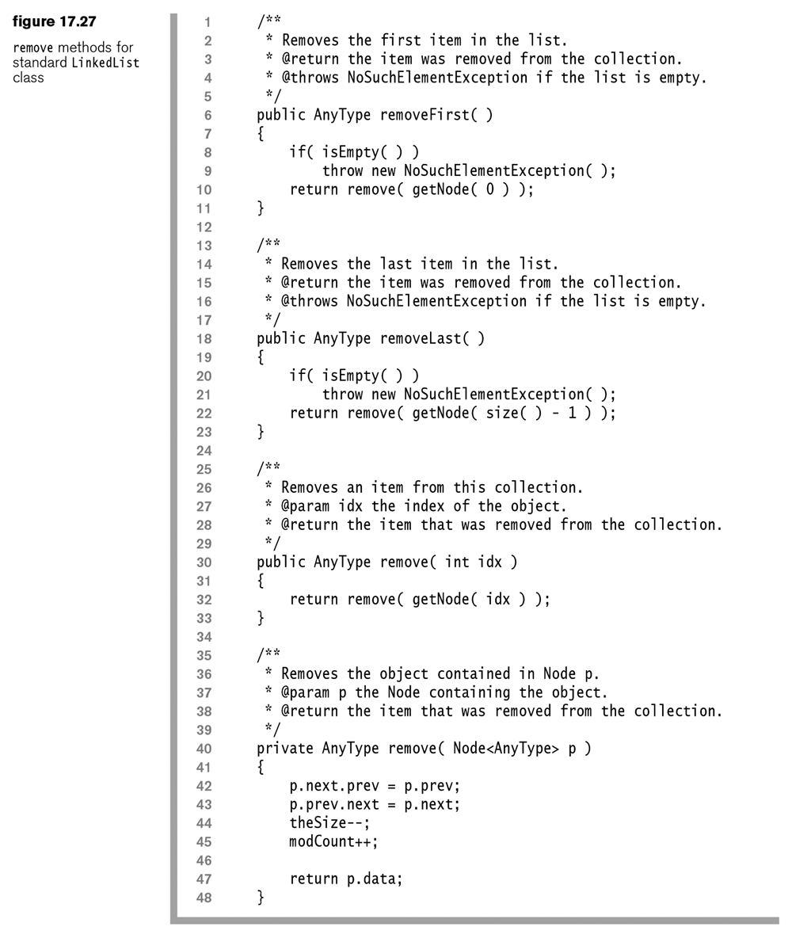

Slide 36
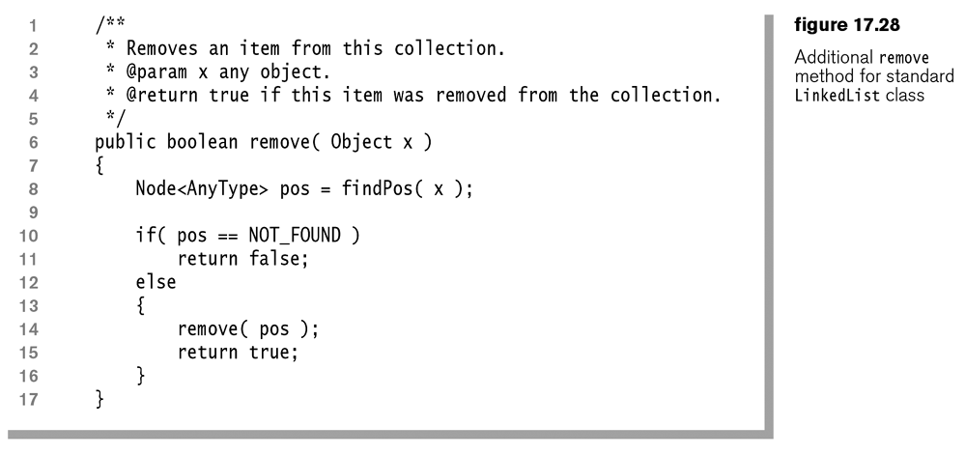

Slide 37
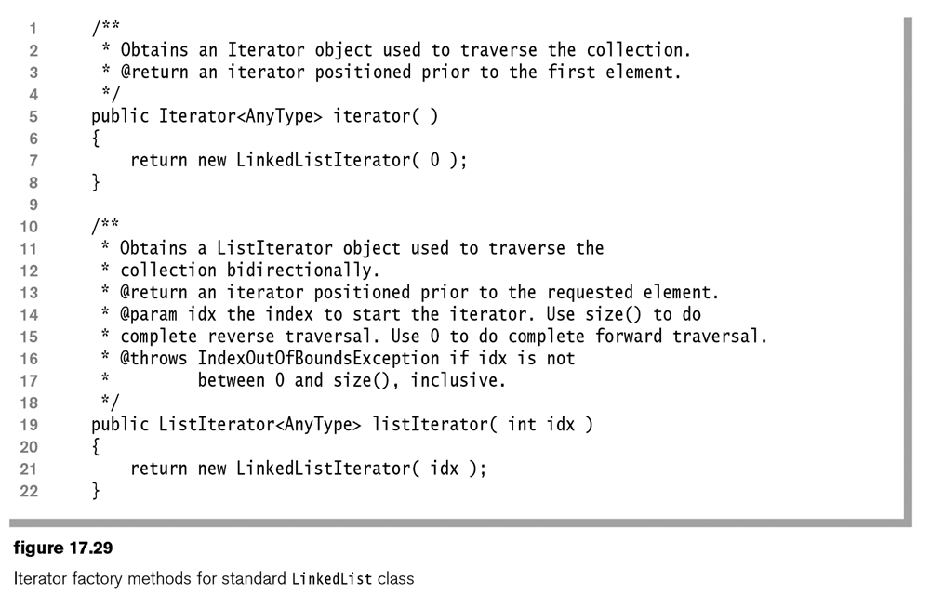

Slide 38
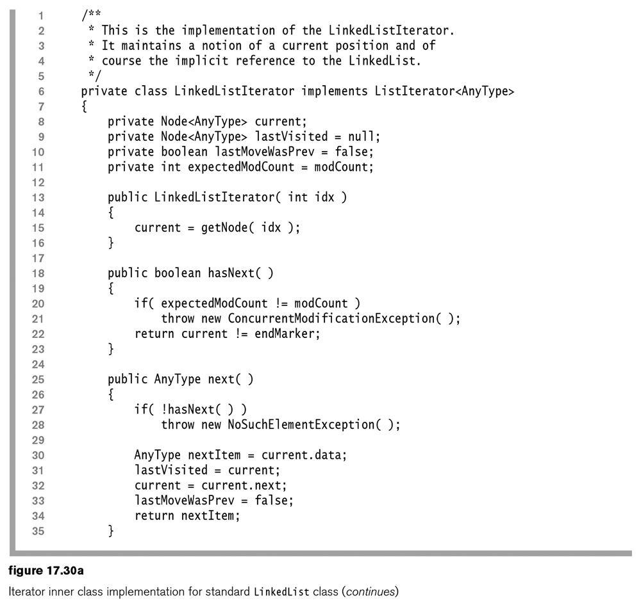

Slide 39
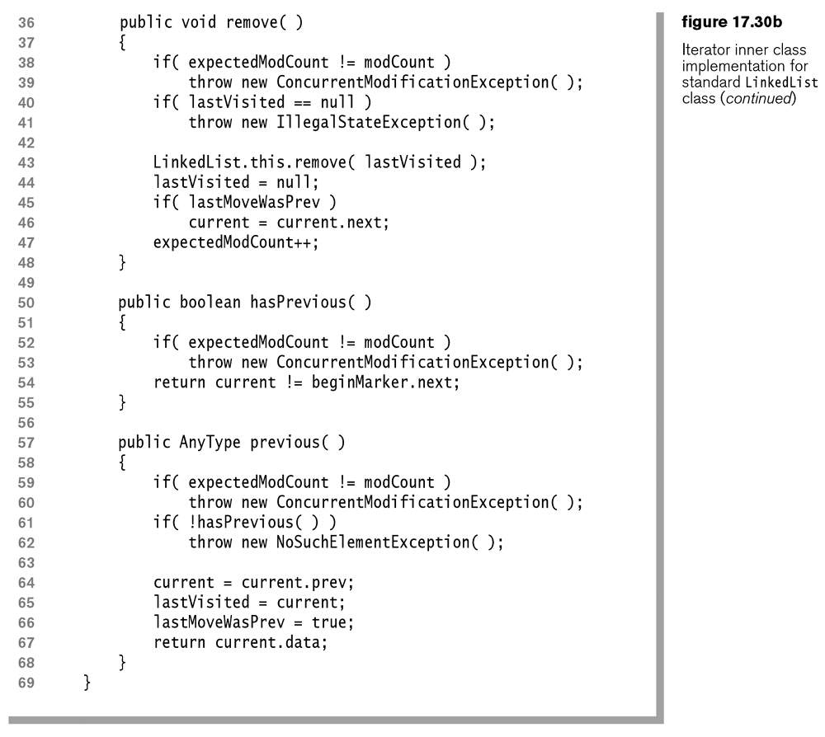

Slide 40
Homework – Written (A)
Answer the following questions from the In Theory portion of the book:
17.1. Draw an empty linked list with header implementation.
Assume that after it was blank, you then added the following integers: 4, 9, 3
17.2. Draw an empty doubly linked list that uses both a header and a tail.
Assume that after it was blank, you then added the following integers: 4, 9, 3

Slide 41
Homework – Written (B)
Answer the following questions from the In Theory portion of the book:
17.4. A linked list contains a cycle if, starting from some node p, following a sufficient number of next links brings us back to node p. Node p does not have to be the first node in the list. Assume that you have a linked list that contains N nodes. However, the value of N is unknown.
A) Design an O(N) algorithm to determine whether the list contains a cycle. You may use O(N) extra space.
NOTES: Only do part A. This should probably be in the programming portion as you will write java code. Your code can run in N*N time if you want
public static boolean listContainsACycle(??). Start with the code from the book, that you can find on the G: drive. Create a file with your own main in it.
17.6. Suppose that you have a reference to a node in a singly linked list that is guaranteed not to be the last node in the list. You do not have references to any other nodes (except by following links). Describe an O(1) algorithm that logically removes the value stored in such a node from the linked list, maintaining the integrity of the linked list. (Hint: Involve the next node.)
You can describe this algorithm in words (sudo-code)

Slide 42
Homework – Programming
Create a java class, or PDF file that answers the following questions:
17.8 Modify the find routine in the nonstandard LinkedList class to return the last occurrence of item x.
17.9 Modify remove in the nonstandard LinkedList class to remove all occurrences of x.
17.14. Implement retreat for singly linked lists. Note that it will take linear time.
Retreat means to go back a node. Start with the code in Figure 17.7. Assume the retreat method takes no arguments and returns no argument just like the advance method. You may need to modify the constructor to complete this problem.
17.17. If the order that items in a list are stored is not important, you can frequently speed searching with the heuristic known as move to front: Whenever an item is accessed, move it to the front of the list. This action usually results in an improvement because frequently accessed items tend to migrate toward the front of the list, whereas less frequently accessed items tend to migrate toward the end of the list. Consequently, the most frequently accessed items tend to require the least searching. Implement the move-to-front heuristic for linked lists.
Create a new method called fasterFind that works like the existing find method, but with the changes mentioned in the problem.

