Slide 1
Chapter 18
Trees

Slide 2
Chapter Summary
The tree is a fundamental structure in computer science. Almost all operating systems store files in trees or treelike structures. Trees are also used in compiler design, text processing, and searching algorithms. We discuss the latter application in Chapter 19.
In this chapter, we show
A definition of a general tree and discuss how it is used in a file system
An examination of the binary tree
Implementation of tree operations, using recursion
Nonrecursive traversal of a tree

Slide 3
Defining a tree: nonrecursively
Nonrecursively, a tree consists of a set of nodes and a set of directed edges that connect pairs of nodes. Throughout this text we consider only rooted trees. A rooted tree has the following properties.
One node is distinguished as the root.
Every node c, except the root, is connected by an edge from exactly one other node p. Node p is c’s parent, and c is one of p’s children.
A unique path traverses from the root to each node. The number of edges that must be followed is the path length.

Slide 4
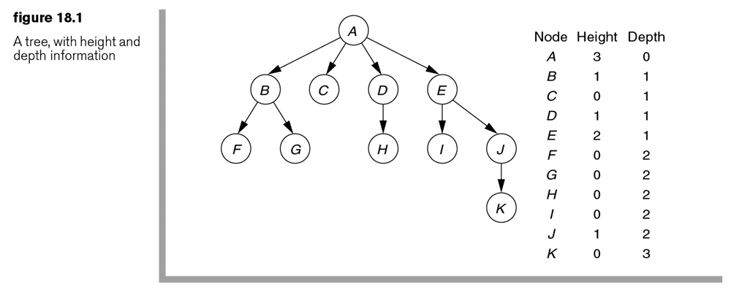
Example
Find the following: Root node, height, leaves, depth of node H, the node with the most branches, siblings,

Slide 5
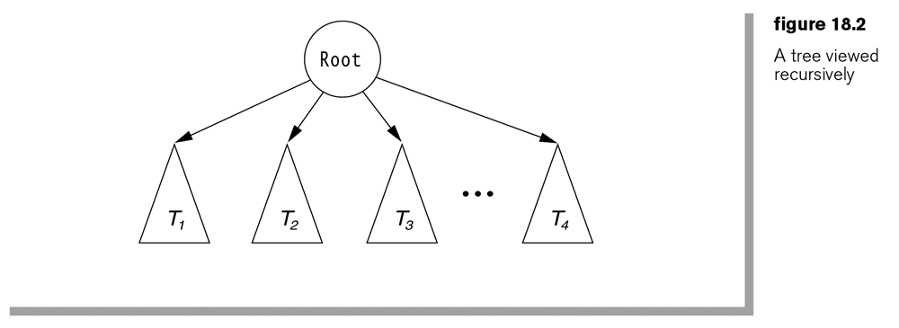
Recursive Definition of a tree

Slide 6
How do you implement a tree structure?
Thoughts?

Slide 7
One idea:
Have a linked list of children in each node
Linked list takes up space. Extremely large trees need to save space
That lead into the next idea

Slide 8
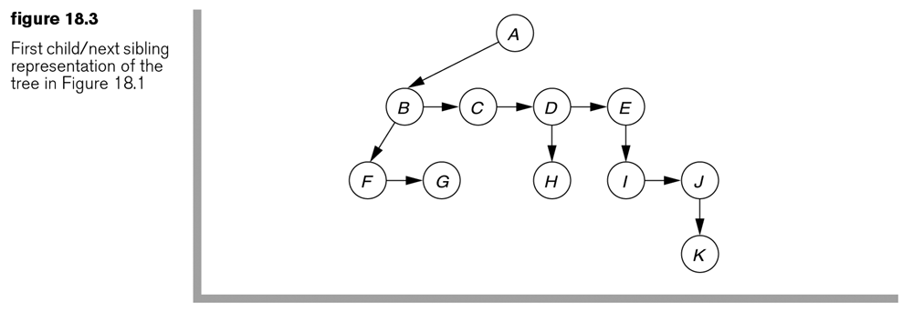
First child/next sibling
2 pointers per node

Slide 9
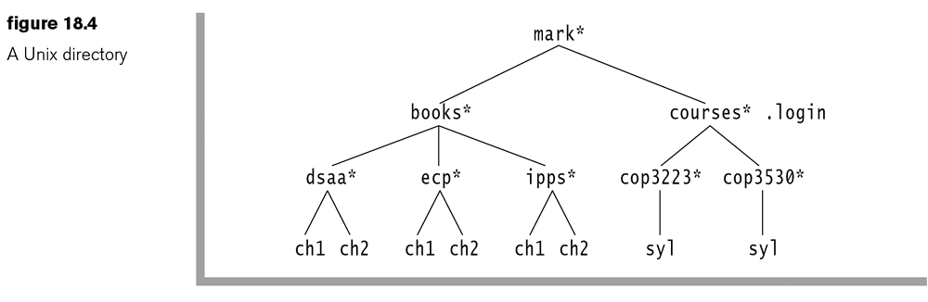
File System uses trees
Mark* is like the C: drive, or in this case, a user’s directory

Slide 10
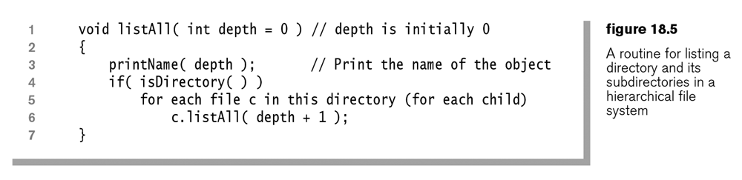
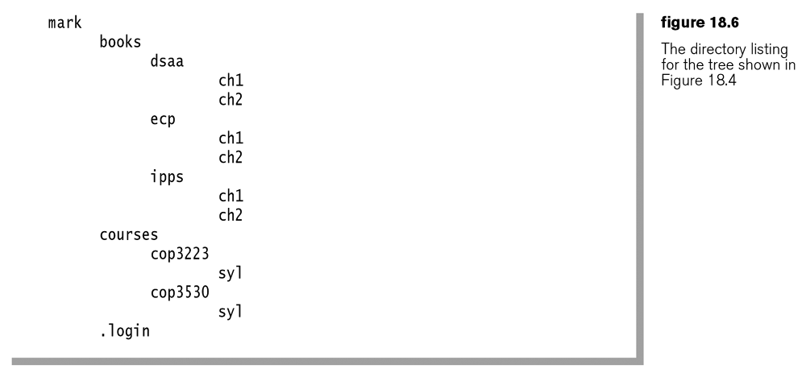
Recursive, preorder tree traversal

Slide 11
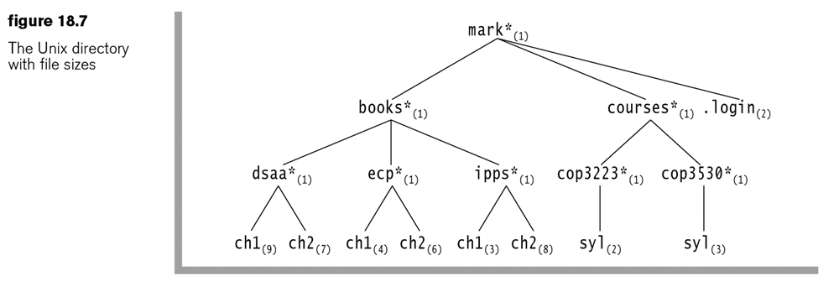
Example with file sizes
What if we wanted to calculate all the file sizes? What would the program look like?

Slide 12
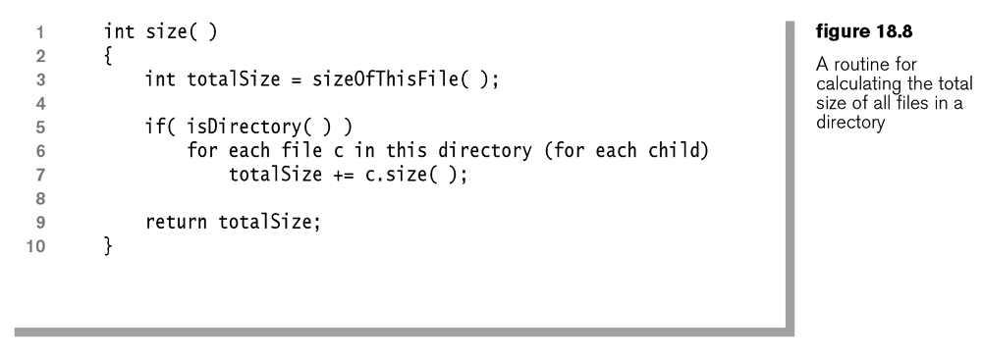
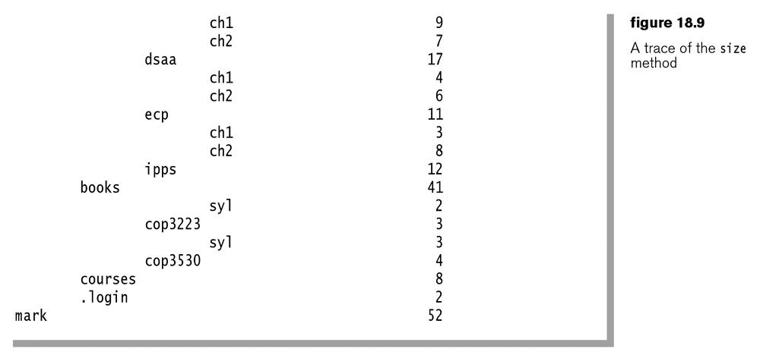
Size – Post Order Traversal

Slide 13
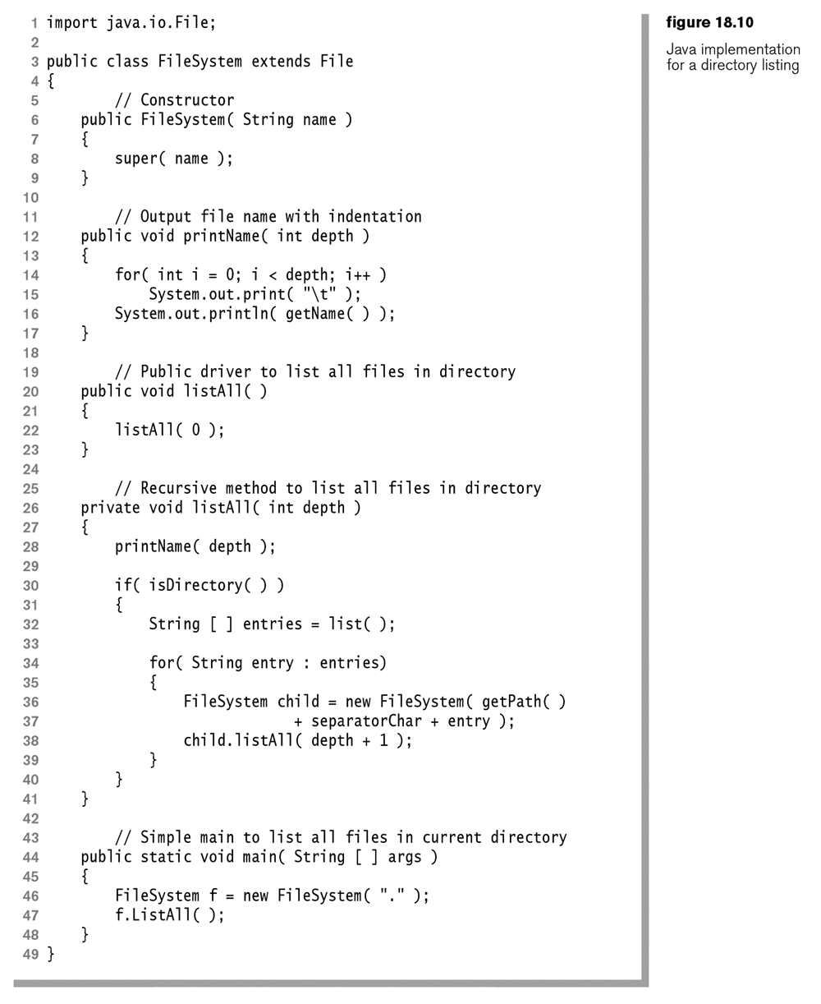
Java implementation

Slide 14
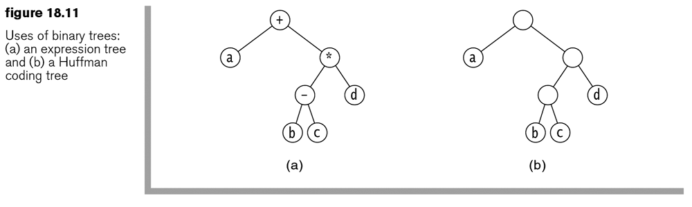
Binary Trees
Trees with only 2 children per node
Left
Right

Slide 15
Let’s Code It Up
Binary Node
Has Data – Use a String, or get fancy with AnyType
Has a Left Child
Has a Right Child
Binary Tree
Has a Binary Node as the root

Slide 16
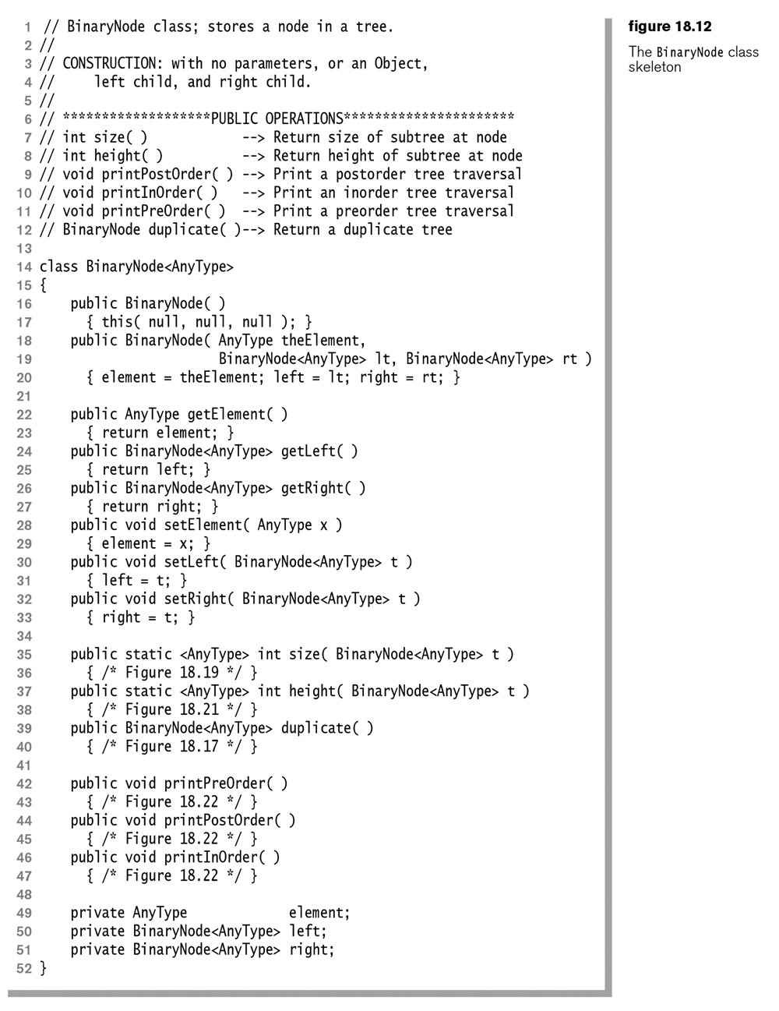
Binary Node Code

Slide 17
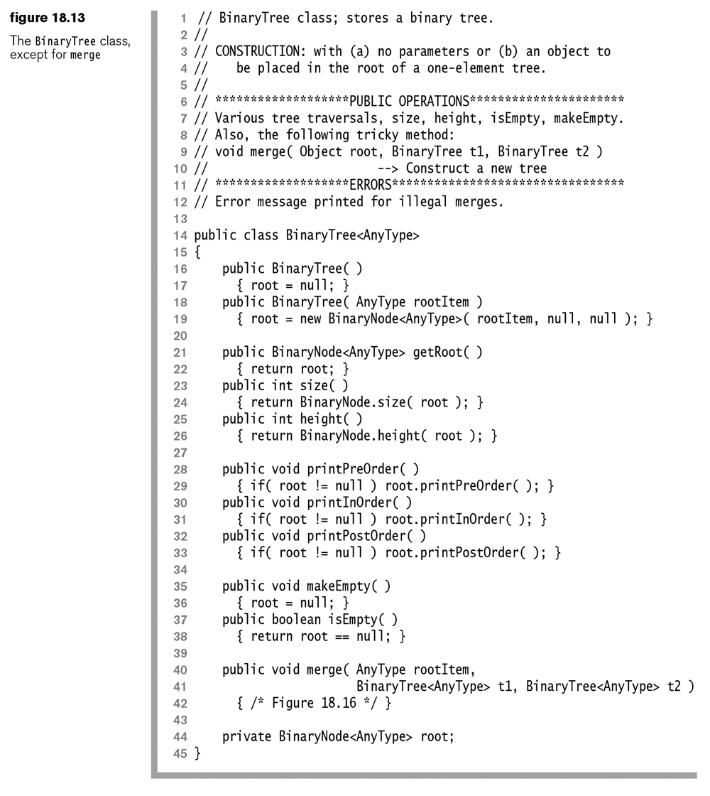
Binary Tree Code

Slide 18
Let’s Code It Up
Binary Tree
Add the following method:
public static BinaryTree merge(AnyType item, BinaryTree b1, BinaryTree b2){
??
}

Slide 19
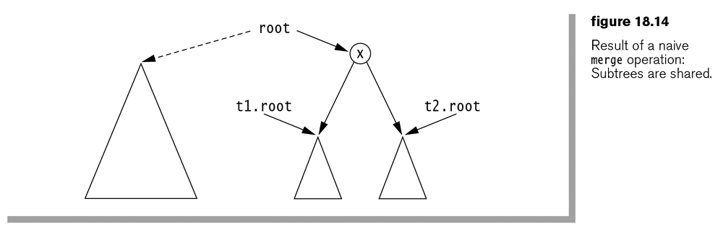
Simple Merge Routine
(Note: in the book’s code, this method isn’t static)
public void merge(rootitem, BinaryTree1, BT2){
root = new BinaryNode<AnyType>( rootItem, t1.root, t2.root );
}
“If things were always this simple, programmers would be unemployed. Fortunately for our careers, there are a host of complications. “

Slide 20
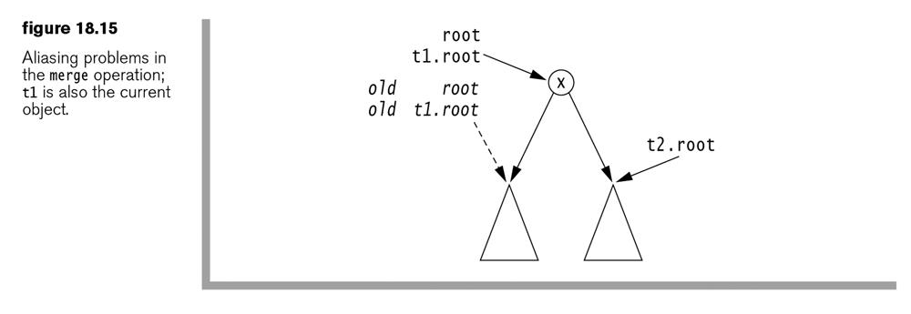
Aliasing problem
What if someone called the previous code with:
t1.merge( x, t1, t2 );
t2.merge( x, t1, t2 );
t1.merge( x, t3, t3 );

Slide 21
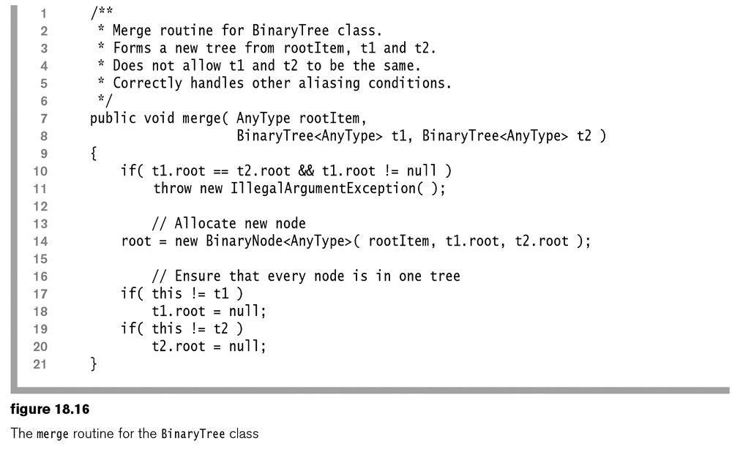

Slide 22
Let’s Code It Up
Can we create a recursive method that can duplicate a tree/BinaryNode?
public BinaryNode<Anytype> duplicate(){ ??? }

Slide 23
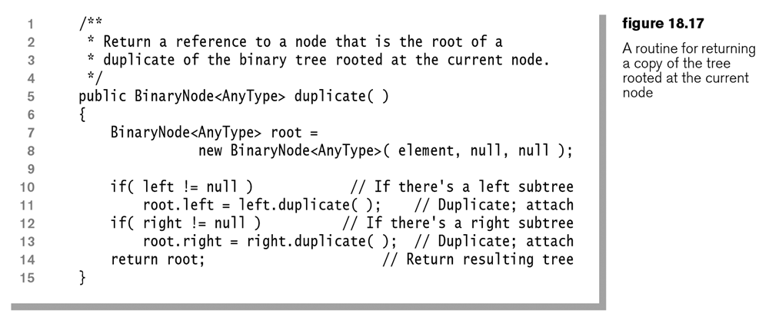
Recursive Duplicate Method on BinaryTree

Slide 24
Let’s Code It Up
Can we code up a Size method?
The size is the size of the left tree + size of the right tree + 1
public static <Anytype> int size (BinaryNode<Anytype> t){ ??? }

Slide 25
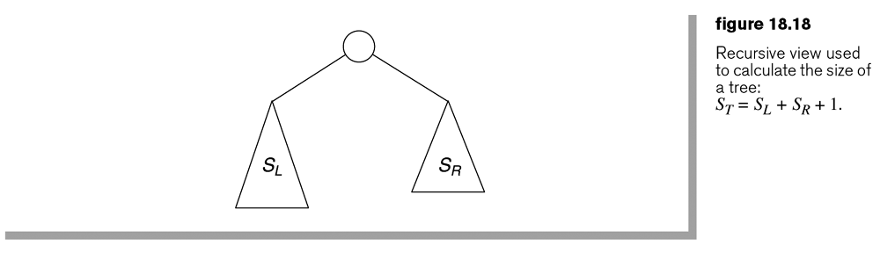
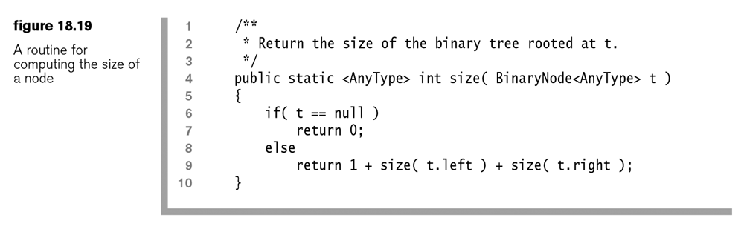
Size method

Slide 26
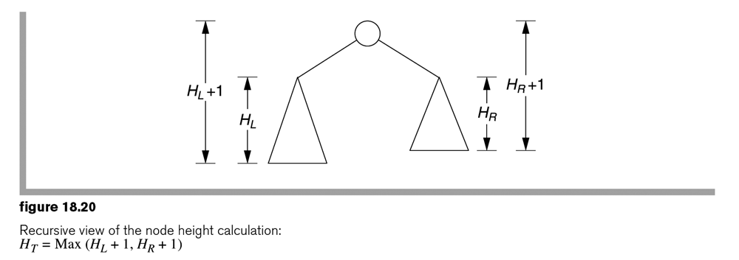
Let’s Code It Up
Can we code up a height method?
Don’t forget that each side might be different heights
Move for a hint

Slide 27
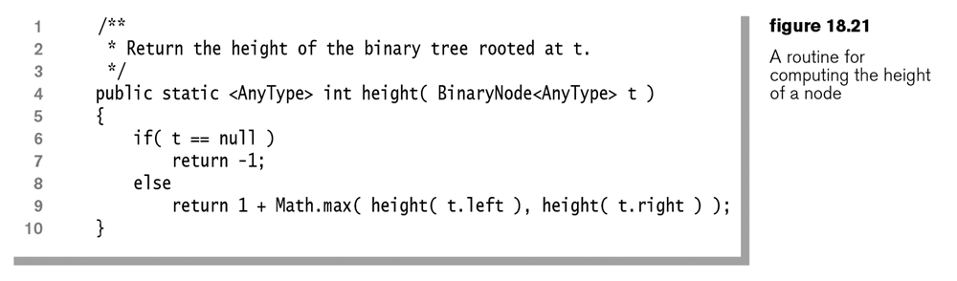
Height Method

Slide 28
Printing the tree
Can you come up with methods that print the tree?
Note: just call the toString method on the item.
Pre-Order, node first then children
Post-Order, children first, then node
In-Order - ???? Can you guess this one

Slide 29
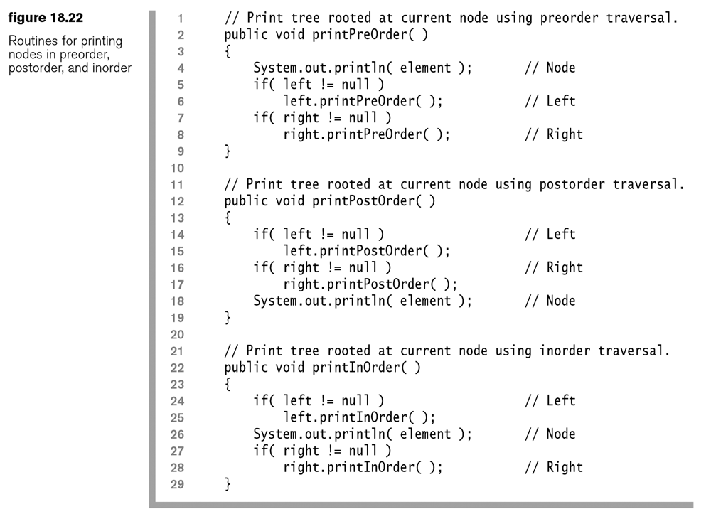

Slide 30
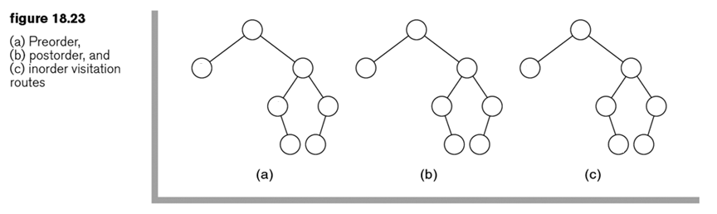
Node Visitation Routes
Add the numbers 1-7 onto the nodes based on the order the algorithms will visit them.
(answers on next slide)

Slide 31
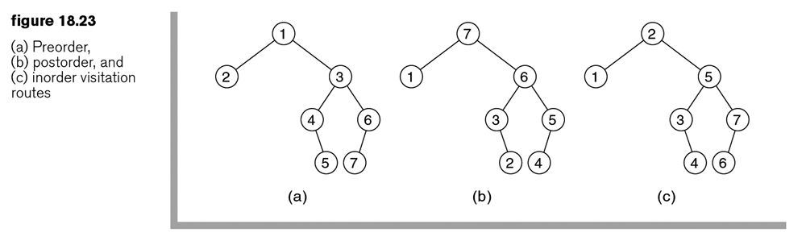
Node Visitation Routes
This picture shows the order you visit the nodes in this tree using the 3 strategies

Slide 32
Iterators
Just like with ArrayList, LinkedList, and the others, you can create an iterator that walks the tree

Slide 33
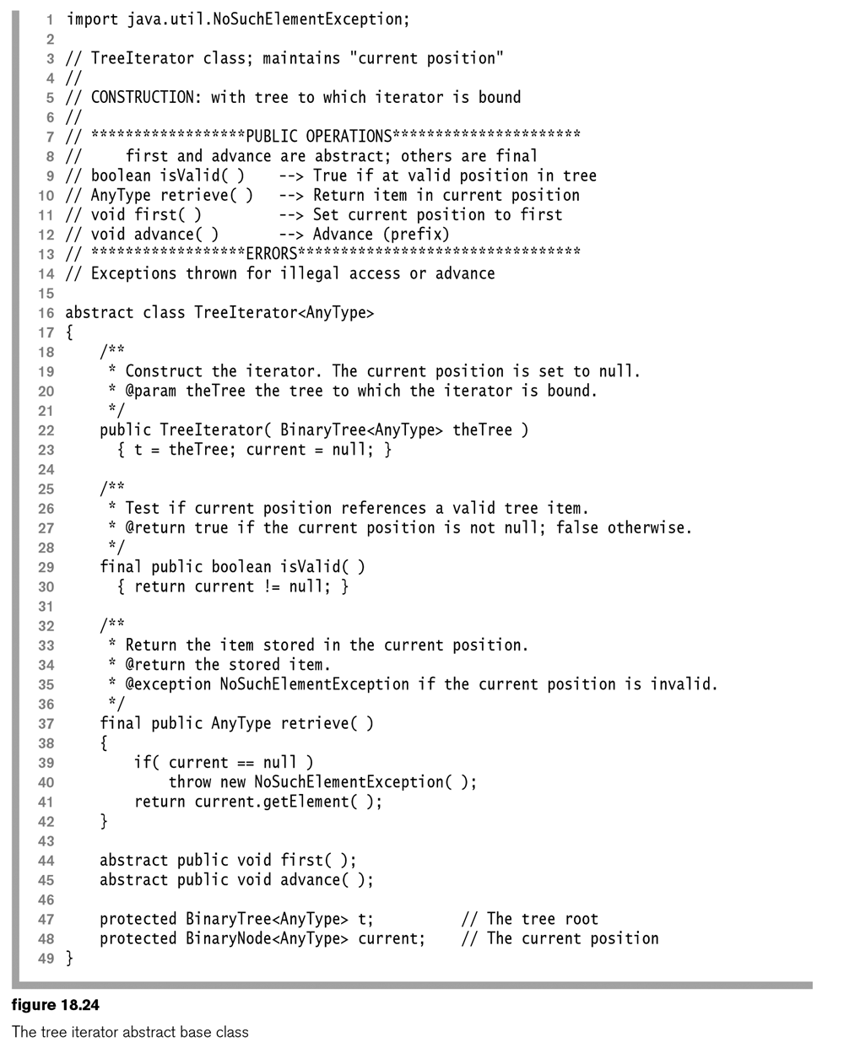

Slide 34
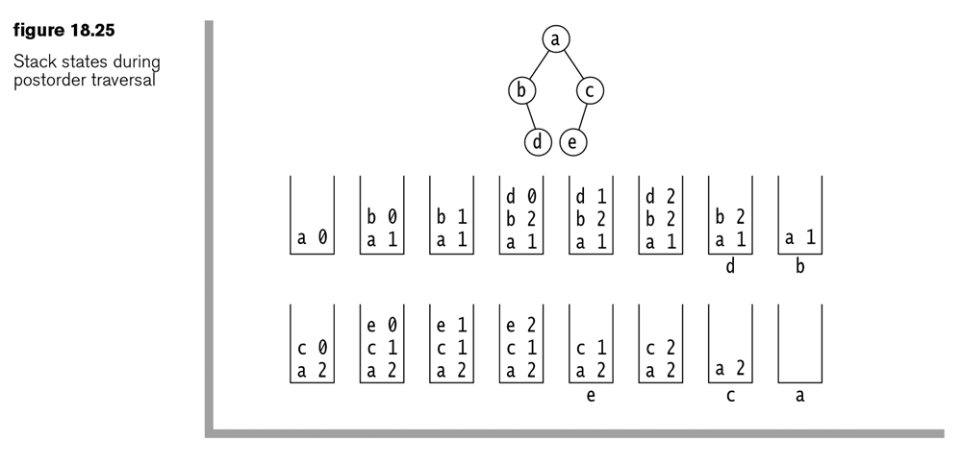
You can use a stack to create a non-recursive solution
Your code must keep track of how many times a node is ‘poped’, and on the third time, process it. This is for post-order traversal

Slide 35
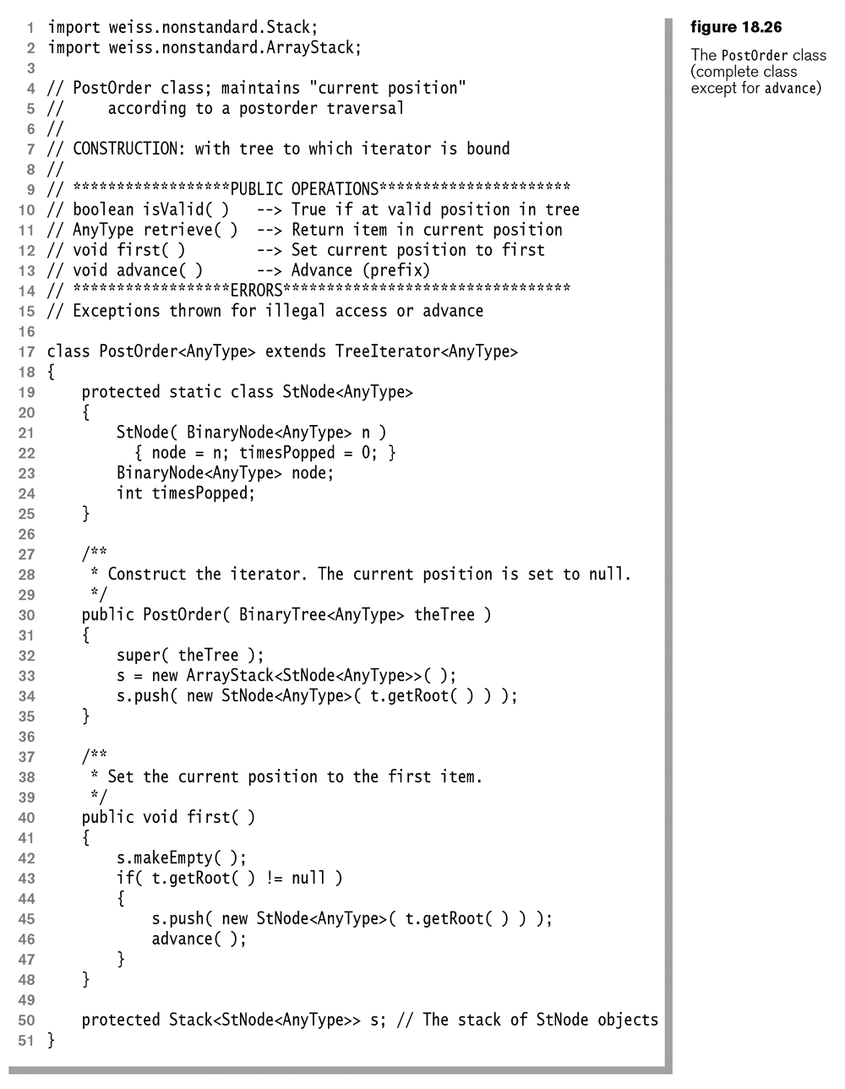

Slide 36
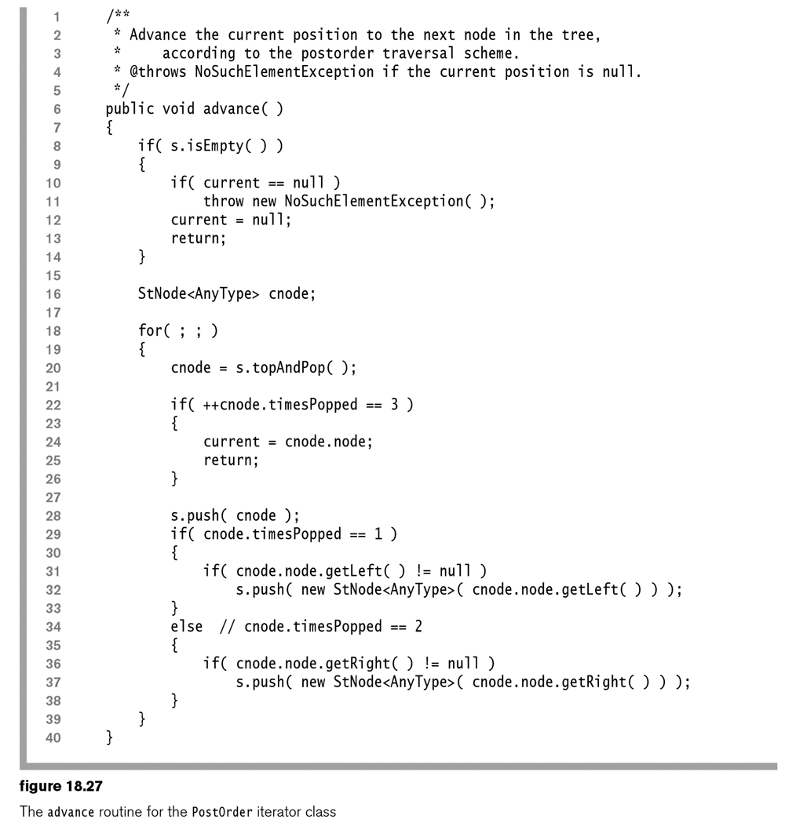

Slide 37
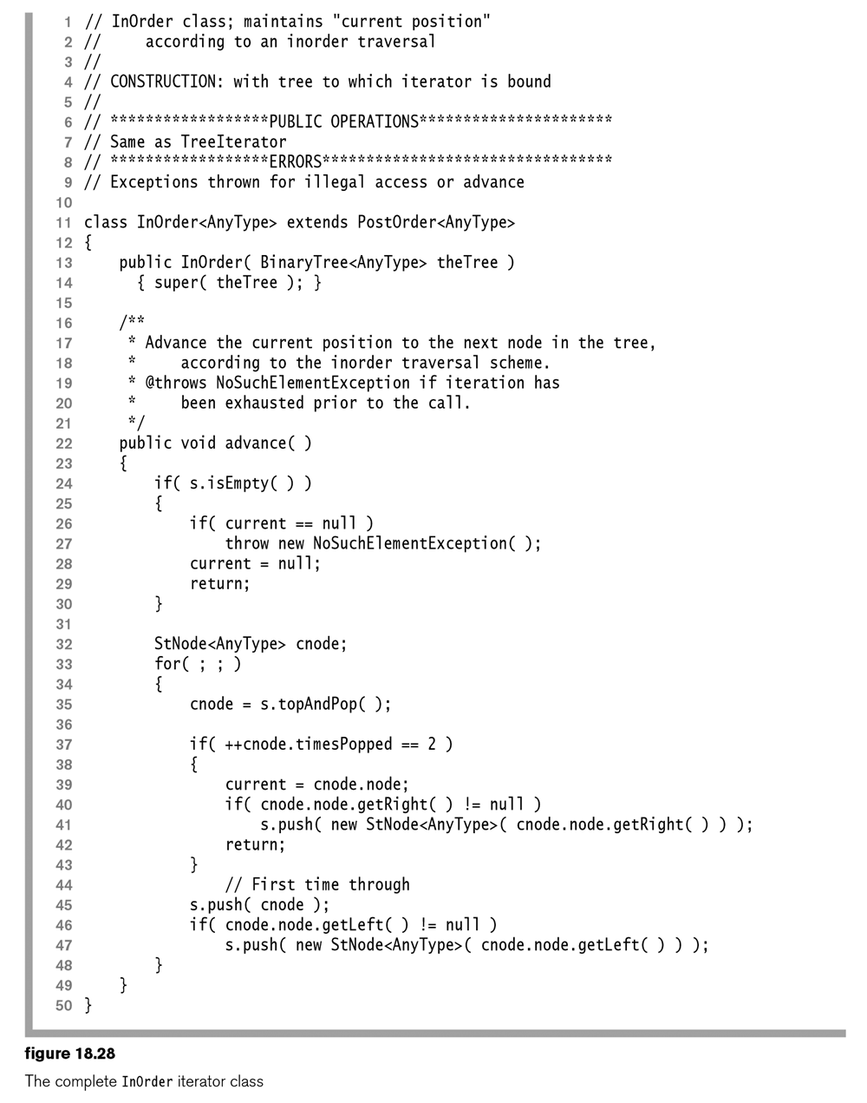

Slide 38
Pre-Order traversal
Code follows:

Slide 39
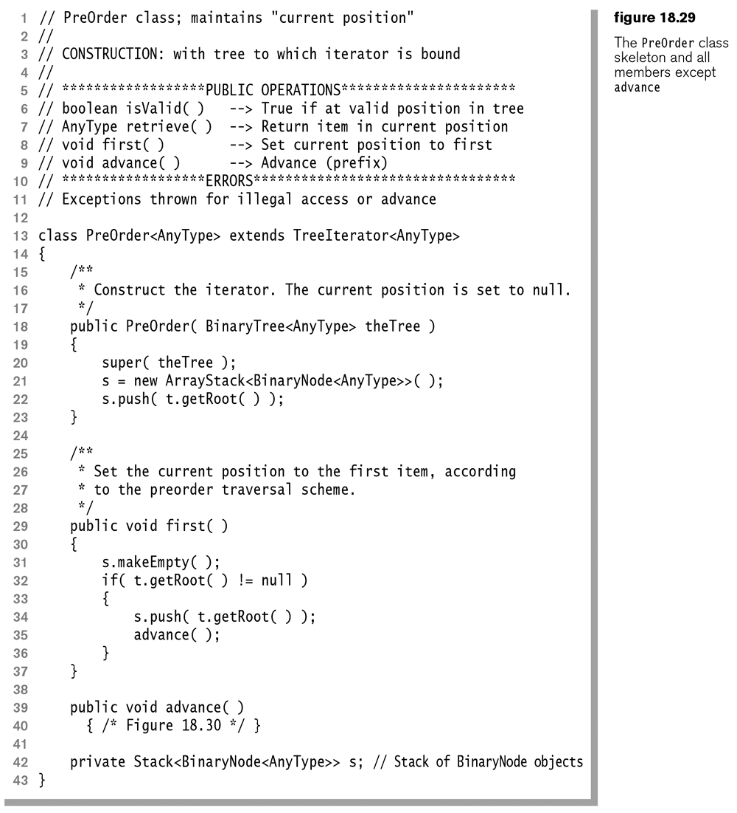

Slide 40
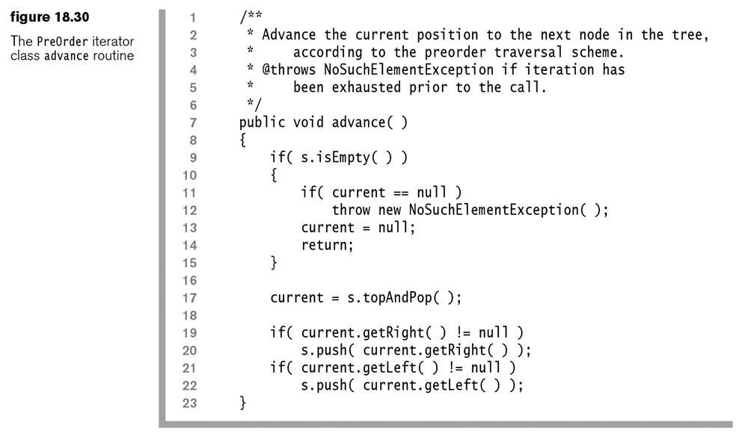

Slide 41
Level Order traversal
level-order traversal processes nodes starting at the root and going from top to bottom, left to right. The name is derived from the fact that we output level 0 nodes (the root), level 1 nodes (root’s children), level 2 nodes (grandchildren of the root), and so on. A level- order traversal is implemented by using a queue instead of a stack.
Worries: Your queue will have lots of nodes in it, especially at the final level!
This is a form of Breadth First Search

Slide 42
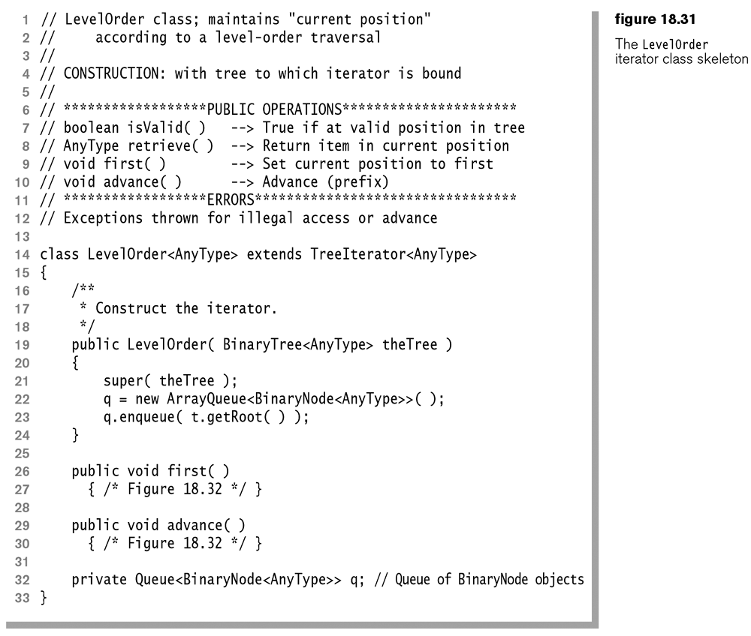

Slide 43
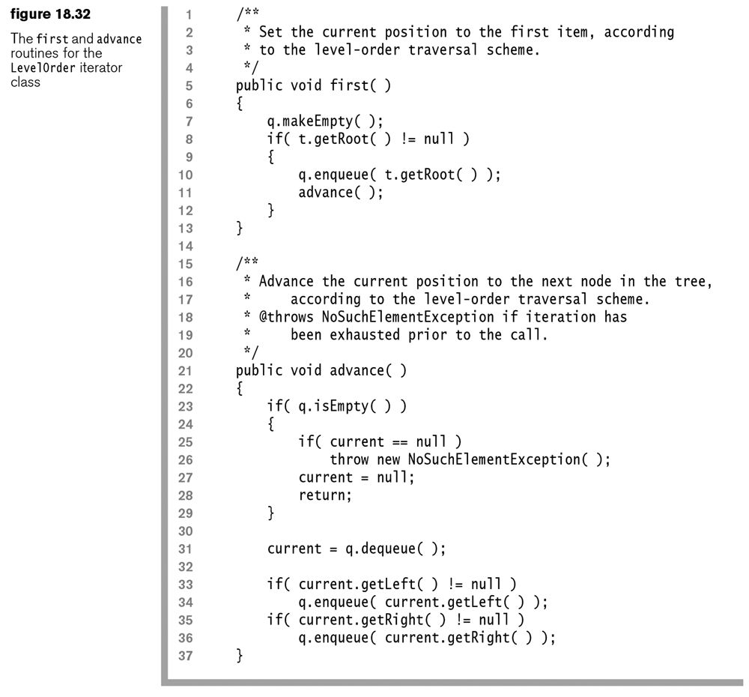

Slide 44
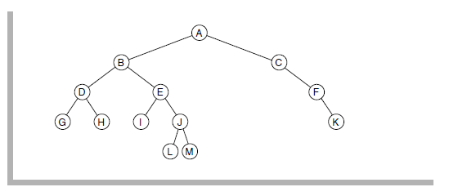
Homework – Written (A)
Answer the following questions from the In Theory portion of the book:
18.1 For the tree shown in Figure 18.33, determine
a. Which node is the root
b. Which nodes are leaves
c. The tree’s depth
d. The result of preorder, postorder, inorder, and level-order traversals

Slide 45

Homework – Written (B)
Answer the following questions from the In Theory portion of the book:
18.2 For each node in the tree shown in Figure 18.33
a. Name the parent node
b. List the children
c. List the siblings
d. Compute the height
e. Compute the depth
f. Compute the size
18.5. Show that the maximum number of nodes in a binary tree of height H is $2^{H+1} – 1$.
Note: Instead of answering this question generally, answer this question using figure 18.33. I would like you to draw a tree of the same height, but having the maximum number of nodes. Count the total number of nodes, and write the formula using this tree as the example. Verify that the math works as described.

Slide 46
Homework – Programming (A)
Create a java class, or PDF file that answers the following questions:
18.9. Write efficient methods (and give their Big-Oh running times) that take a reference to a binary tree root T and compute
a. The number of leaves in T
b. The number of nodes in T that contain one non-null child
c. The number of nodes in T that contain two non-null children
Note: The BinaryTree.java and BinayNode.java are on the G: drive. If you want to test your code, you will need to make your own trees using the merge method (which works a bit strangely), or just hook up the tree links yourself. Please leave a comment above each method stating the Big-Oh runtimes.

Slide 47
Homework – Programming (B)
Create a java class, or PDF file that answers the following questions:
18.10. Suppose a binary tree stores integers. Write efficient methods (and give their Big-Oh running times) that take a reference to a binary tree root T and compute
a. The number of even data items
b. The sum of all the items in the tree
Note: Please leave a comment above each method stating the Big-Oh runtimes.
18.14. Write a method that lists all files in a directory (including its subdirectories) that are larger than a specified size.
Note: Test this method in a main using a folder on your F: drive, or USB device. The length method of a File returns the size of the file in bytes.

