Slide 1
Chapter 20
Hash Tables

Slide 2
Overview
In this chapter we discuss the hash table, which supports only a subset of the operations allowed by binary search trees. The implementation of hash tables is frequently called hashing, and it per- forms insertions, deletions, and finds in constant average time.
This improvement is obtained at the expense of a loss of ordering information among the elements: Operations such as findMin and findMax and the printing of an entire table in sorted order in linear time are not supported
Chapter includes:
Several methods of implementing the hash table
Analytical comparisons of these methods
Some applications of hashing
Comparisons of hash tables and binary search trees

Slide 3
Basic Idea
The hash table supports the retrieval or deletion of any named item. We want to be able to support the basic operations in constant time, as for the stack and queue. Because the accesses are much less restricted, this support seems like an impossible goal. That is, surely when the size of the set increases, searches in the set should take longer. However, that is not necessarily the case.
Suppose that all the items we are dealing with are small nonnegative integers, ranging from 0 to 65,535. We can use a simple array to implement each operation as follows. First, we initialize an array a that is indexed from 0 to 65,535 with all 0s. To perform insert(i), we execute a[i]++. Note that a[i] represents the number of times that i has been inserted. To perform find(i), we verify that a[i] is not 0. To perform remove(i), we make sure that a[i] is positive and then execute a[i]--. The time for each operation is clearly constant; even the overhead of the array initialization is a constant amount of work (65,536 assignments).

Slide 4
Problems?
First, suppose that we have 32- bit integers instead of 16-bit integers. Then the array a must hold 4 billion items, which is impractical.
What if we don’t use integers, but we use strings?
Where is spot[“hello”]?
Can you think of a way we can make this work?

Slide 5
Solving the large array problem
How do we avoid using an absurdly large array?
We do so by using a function that maps large numbers (or strings interpreted as numbers) into smaller, more manageable numbers. A function that maps an item into a small index is known as a hash function.
If x is an arbitrary (nonnegative) integer, then x%tableSize generates a number between 0 and tableSize-1 suitable for indexing into an array of size tableSize.
If s is a string, we can convert s to a large integer x by using the method suggested previously and then apply the mod operator (%) to get a suitable index
The use of the hash function introduces a complication: Two or more different items can hash out to the same position, causing a collision.

Slide 6
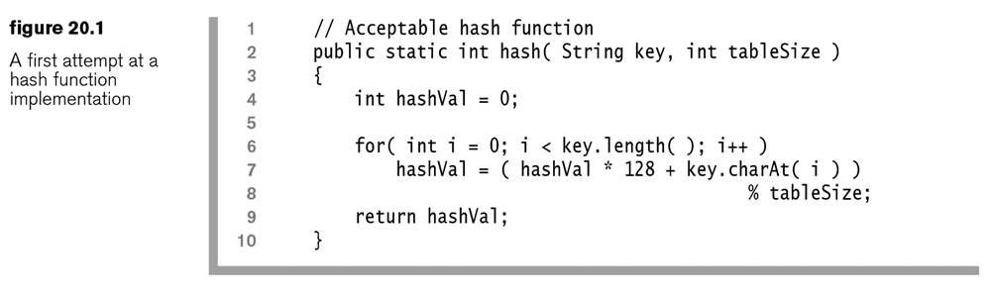
Taking individual characters and adding their int value
1234 can be re-written as
1*10³ + 2*10² + 3*10¹ + 4
“junk” can be rewritten with 128 bit characters as
‘j’*128³+u*128²+n*128¹+k – However this number is too large for an array index
A₃X³ + A₂X² + A₁X¹ + A₀X⁰ can be re-writen as (((A₃)X + A₂)X + A₁)X + A₀
However, % is expensive

Slide 7
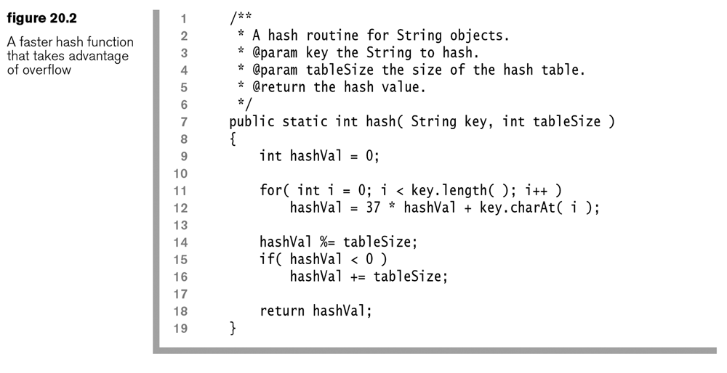
Version 1.1
only do 1 %,
use 37 instead of 128 to avoid massive overflow
fix the number if we still overflow into the negatives at the end because array[-5] is bad

Slide 8
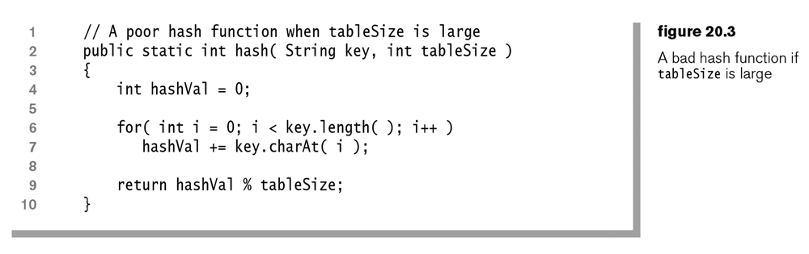
Equal Key Distribution is necessary!
Maybe don’t do the multiplication?
What is the max number you can expect from the following method if a=1, b=2, Z=52, so max 52.
Length 1 strings? Length 15 strings?

Slide 9
HashSet
A Set is a container that contains no duplicates
A HashSet uses a Hash to implement the Set.
A TreeSet uses a tree to keep all the items in the set in sorted order.
See Chapter 6 for code.
Why is one advantage HashSet has over TreeSet?

Slide 10
HashMap
A Map is used to store a collection of entries that consists of keys and their values. So a Map, maps keys to values.
HashMap does not keep keys in sorted order, but TreeMap does.
See chapter 6 for code
What is one advantage HashMap has over TreeMap?

Slide 11
hashCode
Java.lang.String has:
hashCode()
equals()
This makes it great to use as a key for a hash.
Other objects that would do well as “keys” in a HashSet, or HashMap also have these methods
Can you think of some?
For a historical view of the hashCode method of java, see the book, but basically the java people changed it quite a bit, and even back and forth.

Slide 12
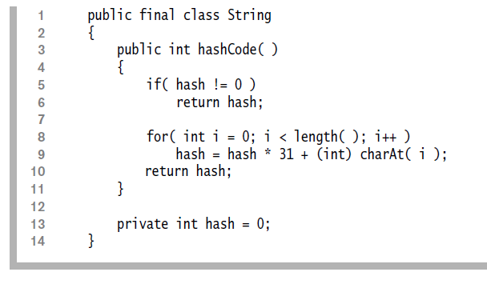
Cashing the Hash Code
Each string remembers it’s hash once it has been computed
Classic time vs space tradeoff
Cashing works here because Strings are immutable

Slide 13
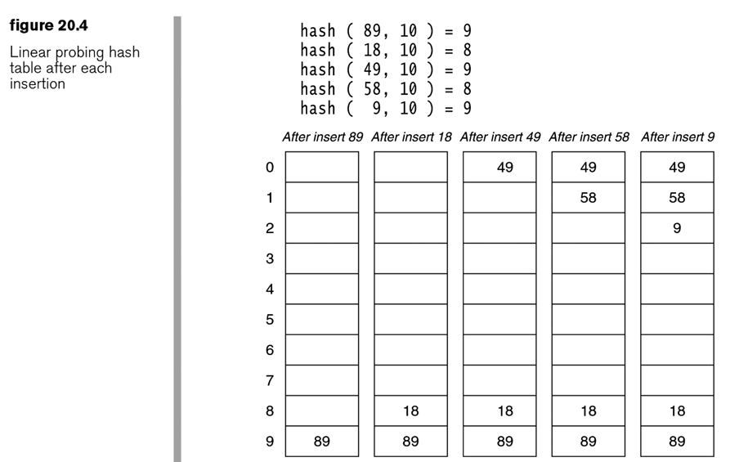
What to do on Collision
Option 1: Linear Probing Just find the next free spot
Problem: How long if there is only 1 free spot?
Problem: What if there are no free spots?

Slide 14
The Find method
Does the previous slide’s hash contain 9
How do you know?
Does the previous slide’s hash contain 129?
How do you know?

Slide 15
Linear Probing naïve analysis
Assume:
The hash table is large
Each probe in the hash is independent of the previous probe
Probes being independent of each other is great, but generally you are searching a hash for something related to what you just looked for

Slide 16
Theorem 20.1
definition: The load factor, λ, of a probing hash table is the fraction of the table that is full. The load factor ranges from 0 (empty) to 1 (completely full).
Theorem
If independence of probes is assumed, the average number of cells examined in an insertion using linear probing is 1/(1 – λ).
Proof
For a table with a load factor of λ, the probability of any cell’s being empty is 1 – λ. Consequently, the expected number of independent trials required to find an empty cell is 1/(1 – λ).

Slide 17
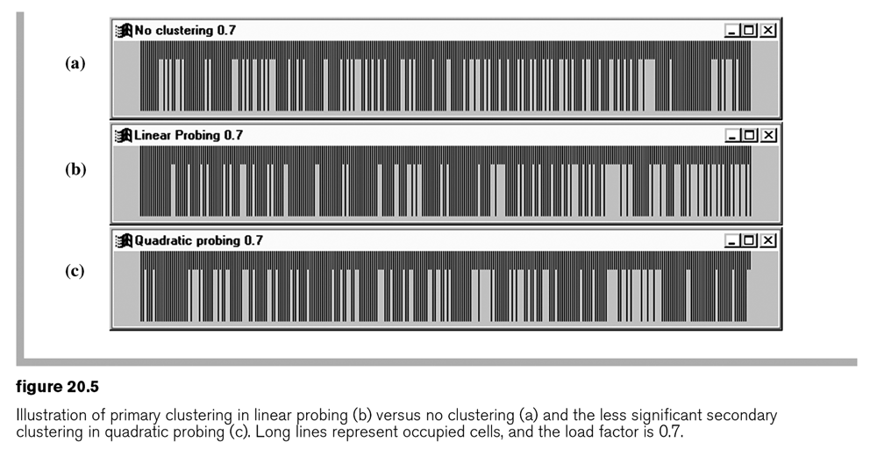
Primary Clustering What really happens in hashes

Slide 18
Theorem 20.2
Theorem 20.2
The average number of cells examined in an insertion using linear probing is roughly (1 + 1 ⁄ (1 – λ)
(Even the book doesn’t care about the math!)
The proof is beyond the scope of this text. See reference [6].
Without clustering if λ is close to 1, then 10 cells would need to be examined, but with clustering 50 cells need to be examined. The goal would be 1 cell
Takeaway
Items that collide cause degenerate performance – so use a hash function that doesn’t collide! (yeah right)

Slide 19
Cost of Find
Two types of find
Successful
Unsuccessful
We can likely agree that find is easier than insert, so for an unsuccessful find we can just assume it takes the same time as insert
Successful finds should be a bit faster, because you don’t have to go down the entire list
The cost of finding X is the same cost of when it was initially inserted. In other words, if X was the fist thing in, then you always find it the fastest – See Theorem 20.3

Slide 20
Quadratic probing
Linear probing is fine if the table is sparse, so don’t think it shouldn’t be used.
Quadratic probing
F(i) = i² (on collisions)
Specifically, if the hash function evaluates to H and a search in cell H is inconclusive, we try cells H+1², H+2², H+3², … , H+i² (employing wraparound) in sequence. This strategy differs from the linear probing strategy of searching H+1, H+2, H+3, … , H+i

Slide 21
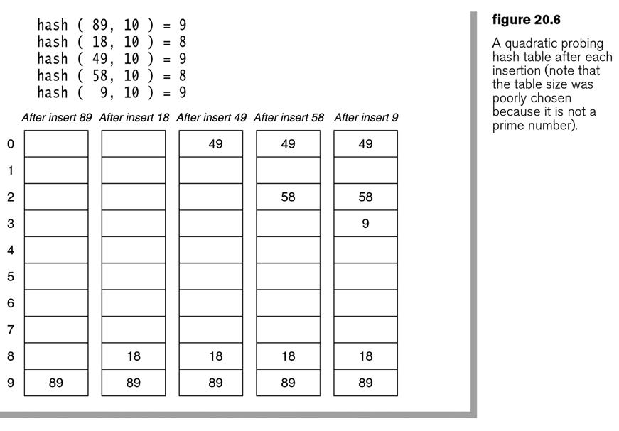
Quadratic probing
When 49 collides with 89, try the next cell (H+1²)
When 58 collides, try the next, cell, then try the cell 4 away
Note: the alternative locations for 8 and 9 are no longer the same!

Slide 22
Quadratic Probing Worries
When a cell is tried after a collision, can we guarantee that we haven’t already tried it?
If there is a single spot in the array, can we get our last item into it?
It seems to require multiplication and mod, does that make it slow?
If the load gets too high, can we dynamically expand the table for either linear or quadratic?

Slide 23
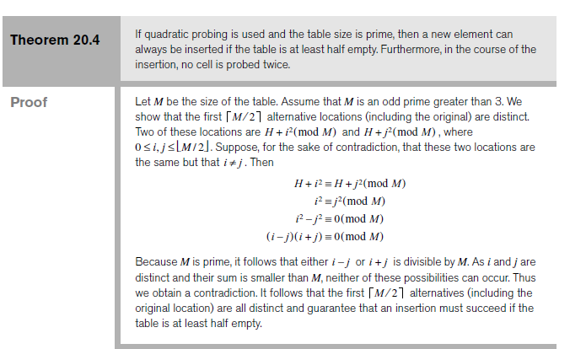
Tablesize Must Be Prime!

Slide 24
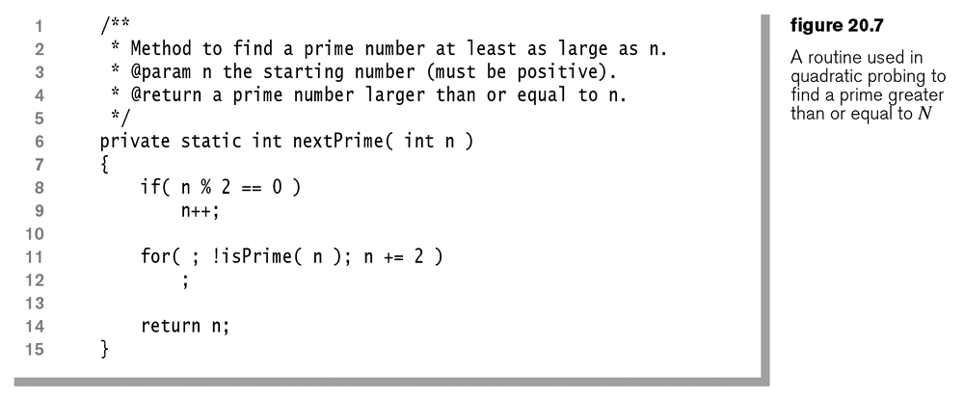
Find a prime, because it is so important

Slide 25
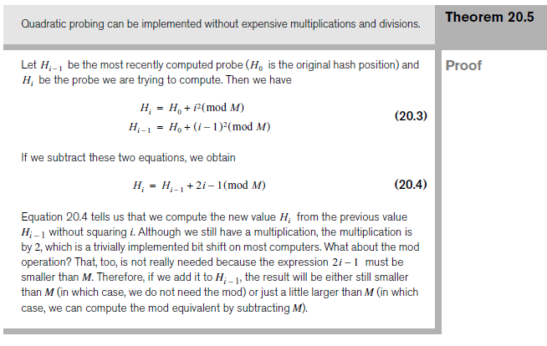
Theorem 20.5
In binary, 1 and 10 and 100 multiply by 2

Slide 26
Final 2 woes
Finding a prime is faster than copying everything over into the new array, so no problem there.
We have to re-hash all the items into the new array. Bummer, but there is no other way.
Java code for HashSet follows.
The one weird thing I found was that they don’t just set spots to null when they go away, but keep track of ‘is active.’

Slide 27
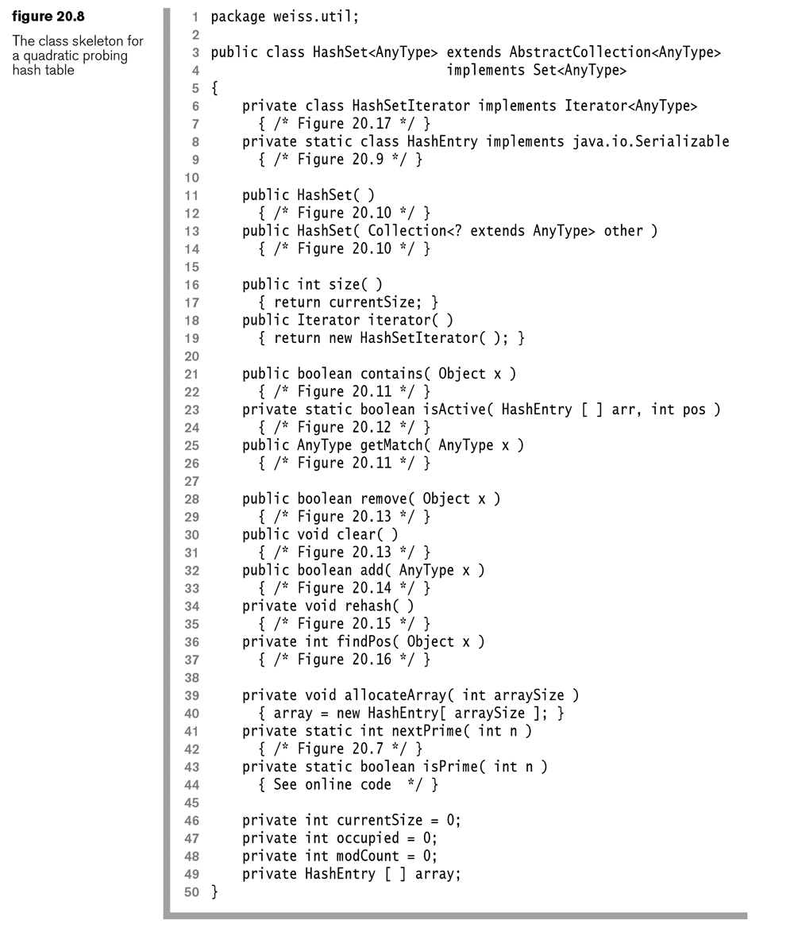

Slide 28
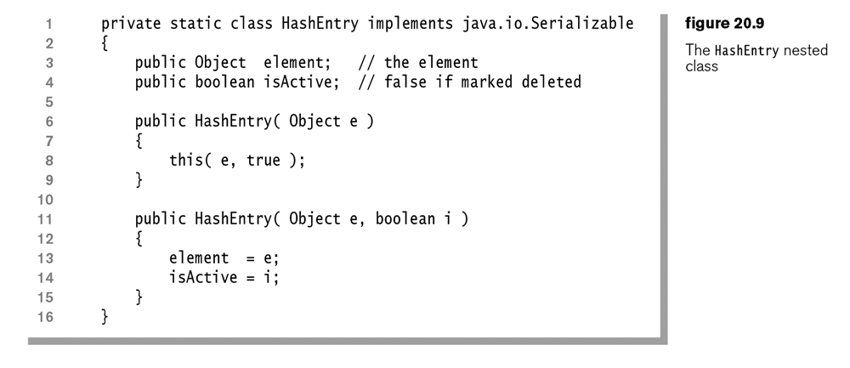

Slide 29
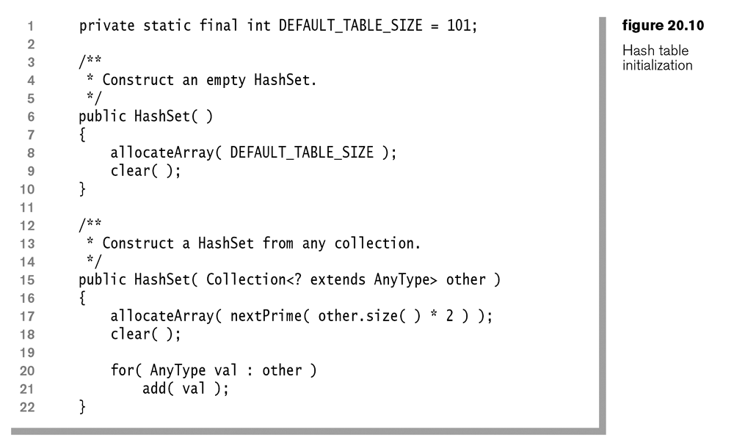

Slide 30
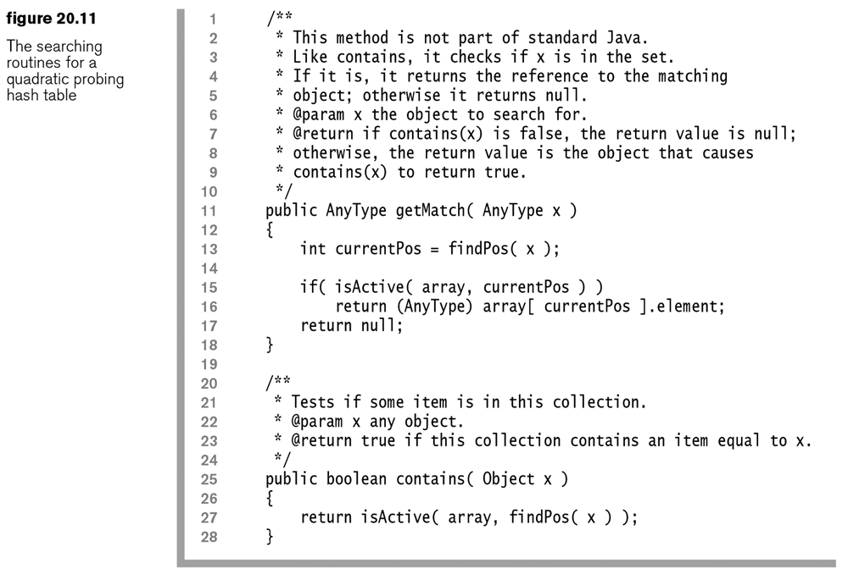

Slide 31
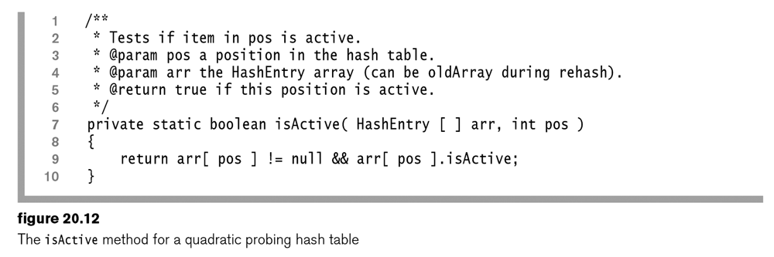

Slide 32
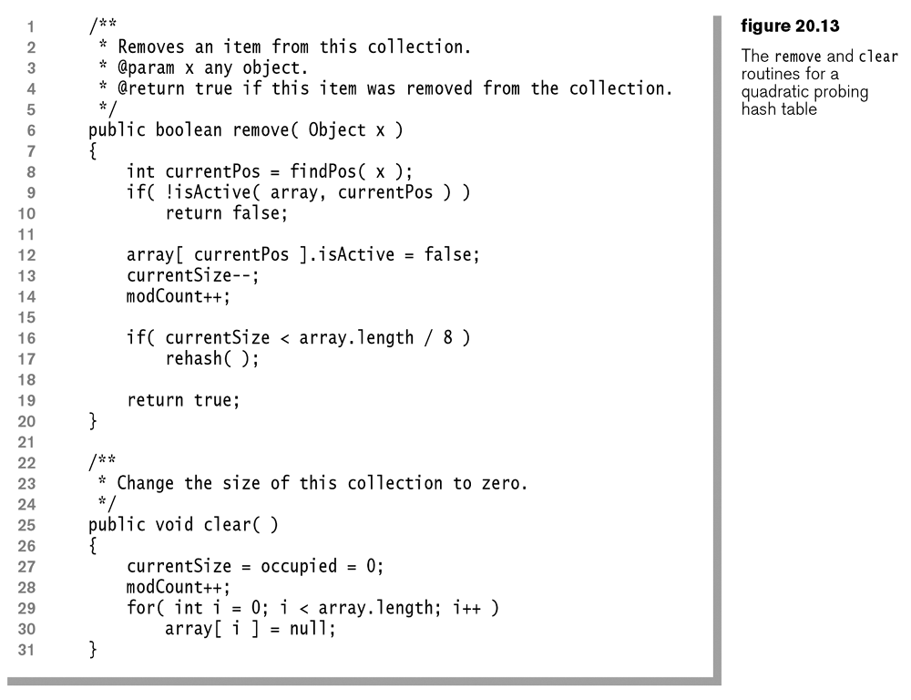

Slide 33
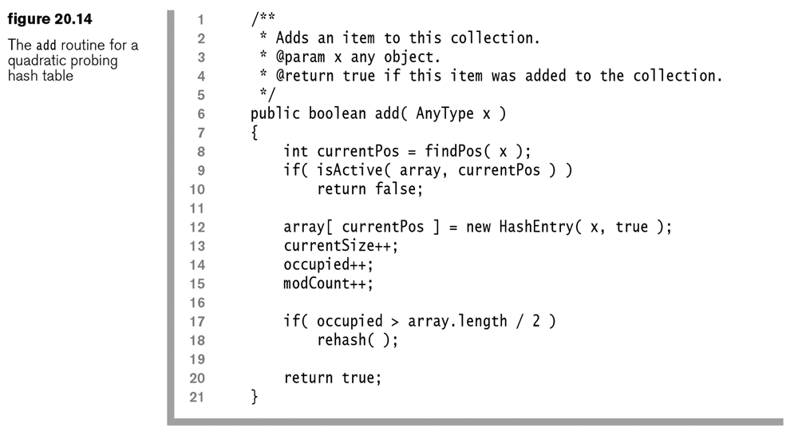

Slide 34
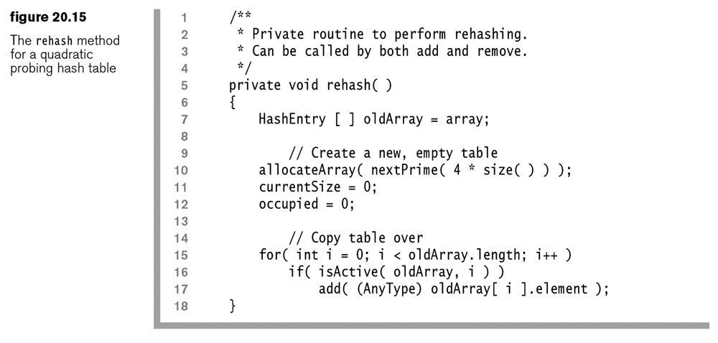
Remember: it is important to use prime numbers for the size!

Slide 35
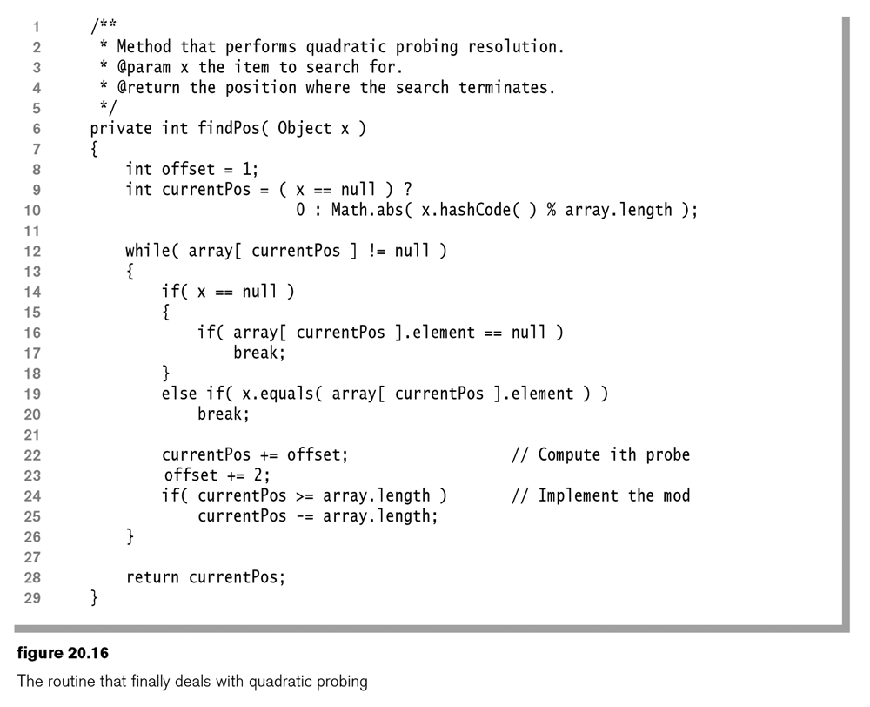
Here is the Quadratic Probing code

Slide 36
Iterator
How do you suggest we iterator over this HashSet?
They don’t use advance, just
Next
Remove

Slide 37
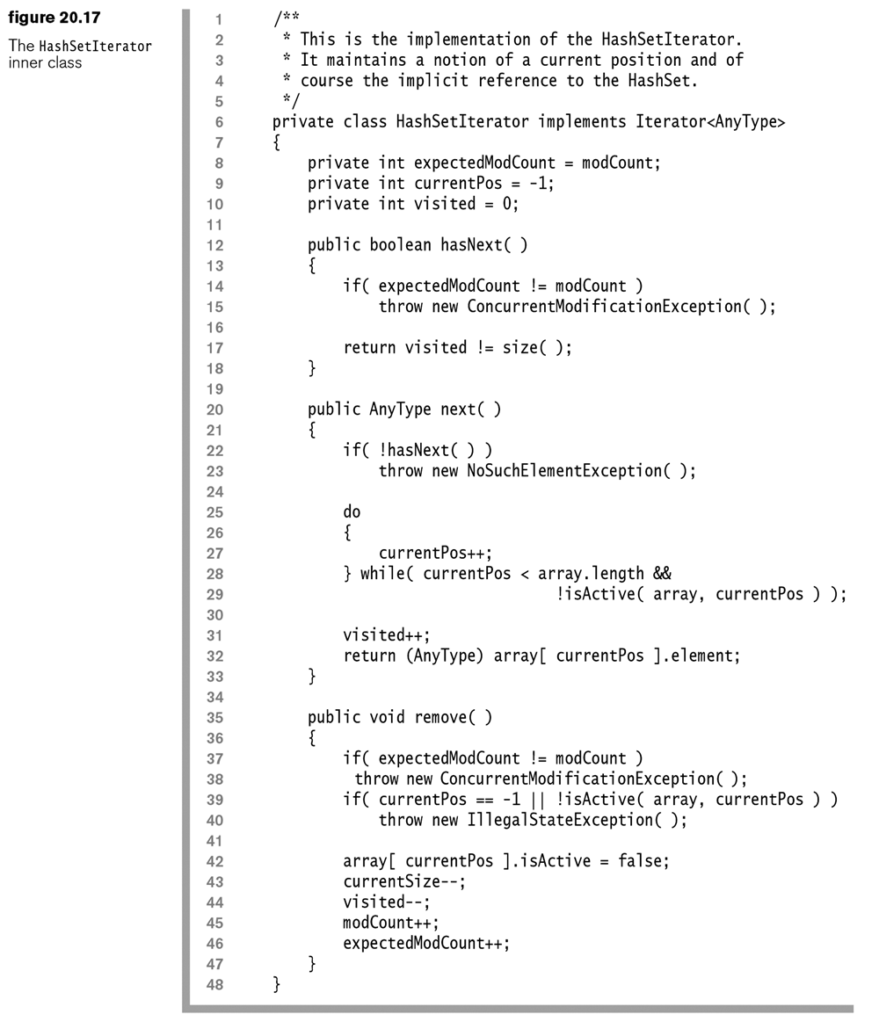

Slide 38
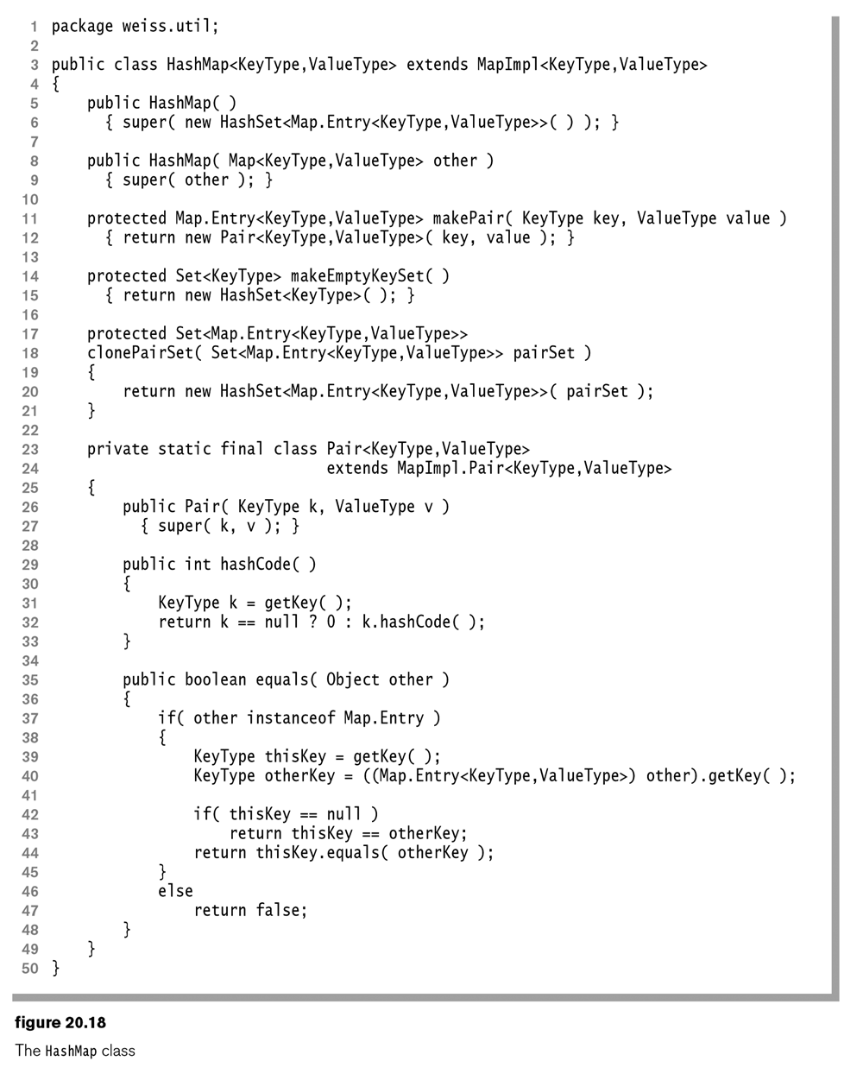

Slide 39
Analysis of Quadratic probing
Sometimes you get a ‘secondary clustering’ effect, but generally this only results in less than an extra one-half probe per search.
If you want to avoid this you can use
Double Hashing – use a different hash function
Really nice, but difficult to implement

Slide 40
Separate Chaining Hashing
Hash into an array of linked lists
Nice way to go, especially since it avoids
Thing 1 - You guess (Something with hashing)
Thing 2 – You guess (Something with arrays/hashing)
Fairly simple – see next slide

Slide 41
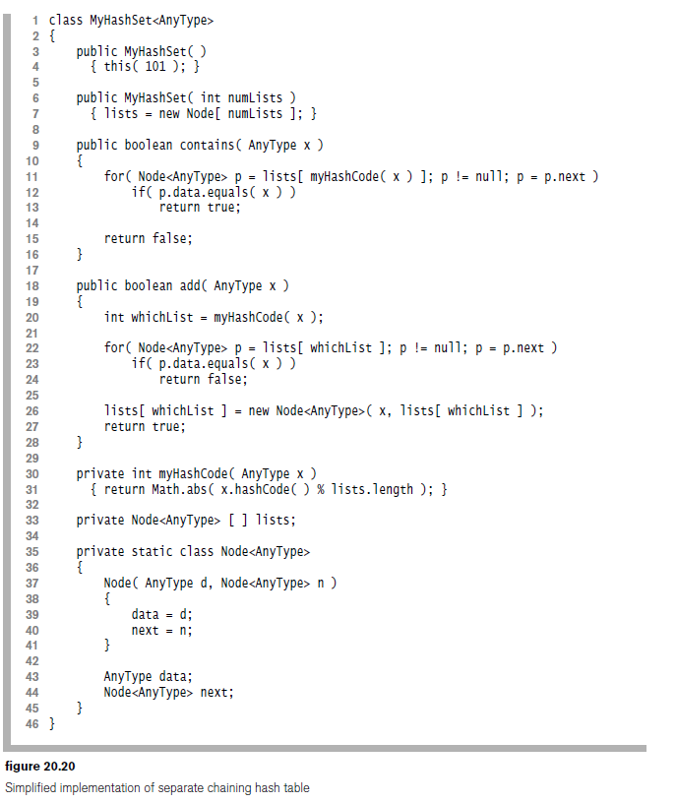

Slide 42
Uses of hashing
Tons
Compilers, to keep track of variable names
Games, to keep track of seen states
Dictionaries. If you put all the correctly spelled words into a hash, you can check for correct spelling in constant time
Hash tables are awesome because
Insert – constant time
Find – constant time

Slide 43
Homework – Written
Answer the following questions from the In Theory portion of the book:
20.1 What are the array indices for a hash table of size 11?
20.2 What is the appropriate probing table size if the number of items in the hash table is 10?
20.3 Explain how deletion is performed in both probing and separate chaining hash tables.
20.5. Given the input {4371, 1323, 6173, 4199, 4344, 9679, 1989}, a fixed table size of 10, and a hash function H(X) = X mod 10, show the resulting
a. Linear probing hash table
b. Quadratic probing hash table
c. Separate chaining hash table
Note: We didn't talk much about separate chaining, so only do A and B
20.6, Show the result of rehashing the probing tables in Exercise 20.5. Rehash to a prime table size.
Note: but just pick either a, or b from the 20.5 tables. Also, use the table size you calculated in problem 20.2

Slide 44
Homework – Programming
Create a java class, or PDF file that answers the following questions:
Nothing assigned since we likely ran out of time

