Slide 1

Chapter 7
Recursion

Slide 2
Chapter Summary
In this chapter, we show
The four basic rules of recursion
Numerical applications of recursion, leading to implementation of an encryption algorithm
A general technique called divide and conquer
A general technique called dynamic programming, which is similar to recursion but uses tables instead of recursive method calls
A general technique called backtracking, which amounts to a careful exhaustive search

Slide 3

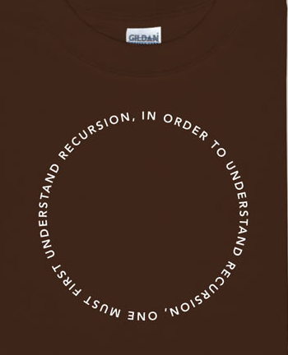
Courtesy of www.wikipedia.com
Courtesy of www.ThinkGeek.com

Slide 4
What is recursion
A method that calls itself
Recursion
See "Recursion".

Slide 5
Example
Dictionary:
Look up a word
It uses other words to explain it
We might have to look up those other words
Dictionaries are finite, so we will eventually know all the words and be able to stop
However, watch out for circular definitions!
Infinite recursion!

Slide 6

Sum of the first N integers
For loop:
$1+2+3+ …+n$
or recursive:
$Sum(1) = 1$
$Sum\left(n\right)=n+Sum\left(n−1\right)$
Let’s code this up recursively and try it out!

Slide 7
Requirements
Base Case
Recursion must bottom out
Try the previous example with a negative number
Make Progress
Each recursive call must be a smaller version of the original problem
Method stack must be able to fit in memory
How many recursive calls were able to be made when using a negative number? That would be the max positive int that we could use
“You gotta believe!” – Always assume the recursive call works. We assume other method calls work, so although this feels different, it isn’t?

Slide 8
Try one yourself
Print out a number recursively – one digit at a time
n %10 give you the last digit
But we need to print that after we print every other digit
Use a long as a parameter – so we can have larger numbers
The book suggests a “Driver routine” so that we can avoid checking for wrong or strange inputs in each recursive case.
This is just a method that someone would call, and this method would check validity (>0) and then call the recursive case

Slide 9
Let’s code this one up
Fibonacci
Fib(0) = 1
Fib(1) = 1
Fib(n) = Fib(n-1)+Fib(N-2)
How high can we go?

Slide 10
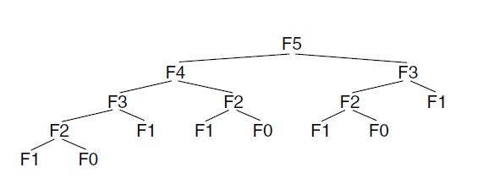
Why is that bad?
How many F1’s are there
This is solved by Dynamic Programming – A topic in CS 3000
Compound interest rule: never duplicate work by solving the same instance of a problem

Slide 11
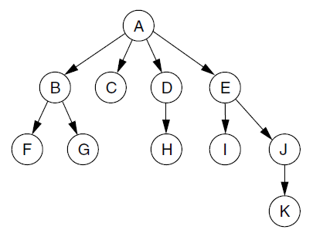
Tree Structure - Preview
How many?
Roots
Nodes
Leaves
Branches

Slide 12
Mystery 1
Open the RecursionForLecture.java file
Let’s try to figure out the following by calling it in the main, then printing the results
public static int mystery1( int a, int b ){
if (b == 1){
return a;
}
else{
return a + mystery1(a, b-1);
}
}

Slide 13
Mystery 2
Open the RecursionForLecture.java file
Let’s try to figure out the following by calling it in the main, then printing the results
public static int mystery2 (int array[], int size){
if (size == 1){
return array[0];
}
else{
return array[size-1] + mystery2(array, size-1);
}
}

Slide 14
Mystery 3
Open the RecursionForLecture.java file
Let’s try to figure out the following by calling it in the main, then printing the results
public static String mystery3 (int array[], int x){
if (x < array.length){
return mystery3(array, x+1) + "" + array[x] + " ";
}
else{
return "";
}
}

Slide 15
testPalindrome
Code This One Up On Your Own
Perhaps we will do it together after you have had a go at it

Slide 16
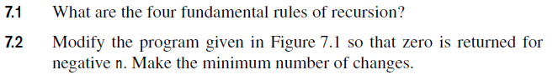
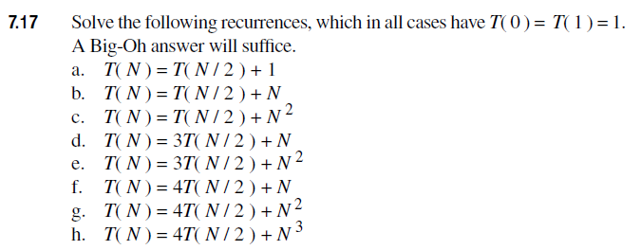
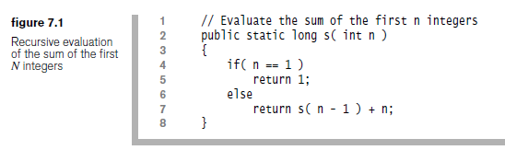
Homework - Written

Slide 17
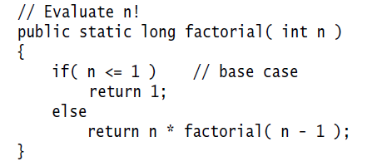
Factorial
N! is the product of the first N integers
What does this look like?
Move for books answer

Slide 18
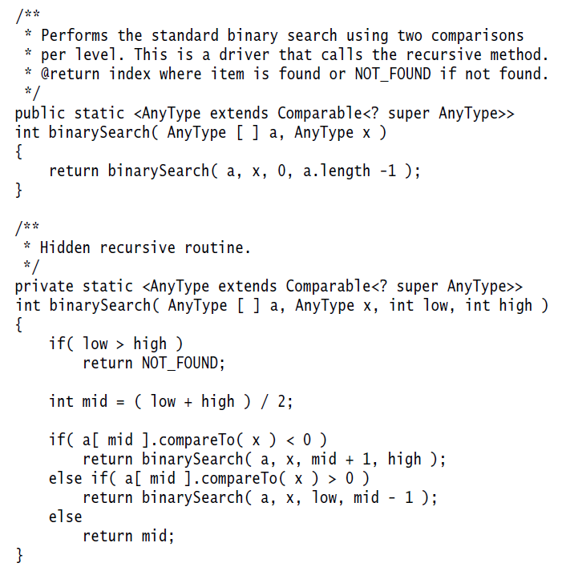
Binary Search
Move for books answer
What does this look like?
The book uses a “driver”

Slide 19

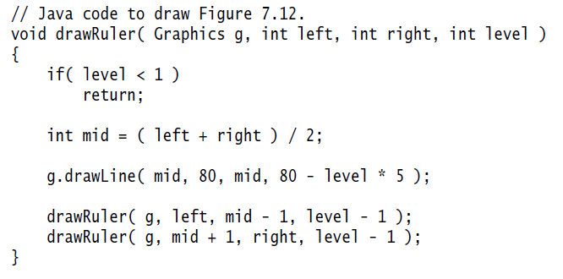
Drawing a ruler

Slide 20
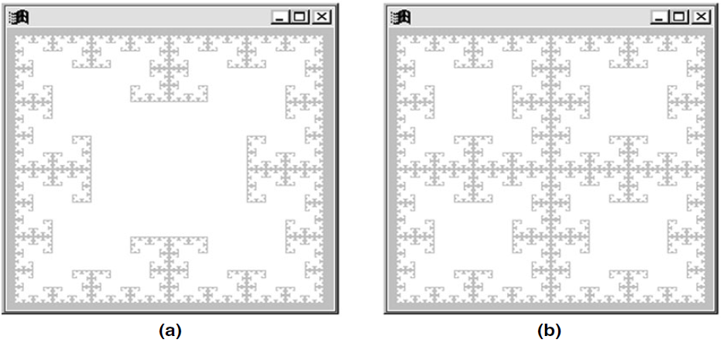
Fractal Star
Code in book

Slide 21
Koch Curve
We will see this on the next slide, but I have a file for you to code this up called KochCurve.java
Give it a try after we talk about the next slide

Slide 22
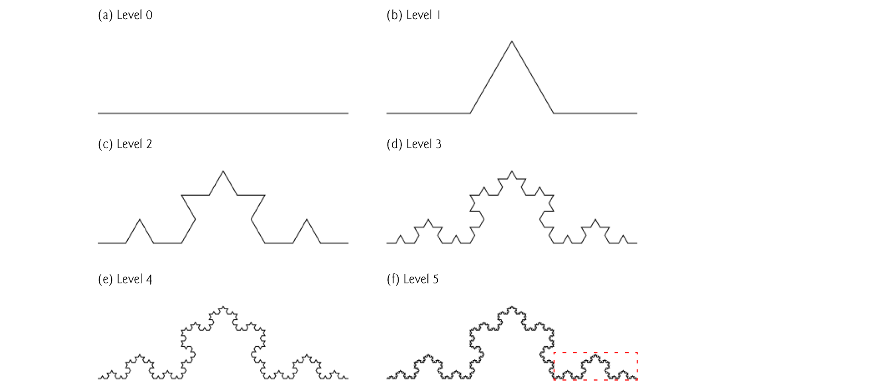
Koch Curve
From 1410 book and Wikipedia
Courtesy of www.wikipedia.org

Slide 23
7.4 – Numerical Applications 7.5 – Divide and Conquer 7.6 – Dynamic Programming
1. Modular exponentiation: Compute XN(mod P).
2. Greatest common divisor: Compute gcd(A, B).
3. Multiplicative inverse: Solve AX ≡ 1(mod P) for X.
4. Primality testing: Determine whether N is prime (deferred to Chapter 9).
Maximum Contiguous Subsequence sum
But recursively!
We will go through these in CS 3000

Slide 24
7.7 - Backtracking
Use Recursion to Try All Possible Moves
Basically, if you reach a “dead end” you just give up and let the recursion take you to a different “move”

Slide 25

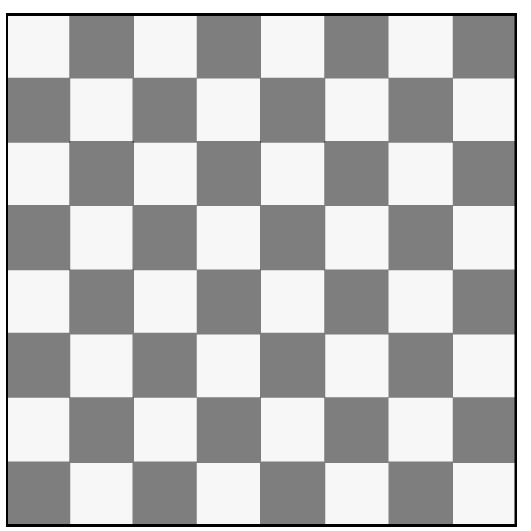
Eight Queens
The eight queens puzzle is the problem of placing eight chess queens on an 8×8 chessboard such that … no two queens attack each other. Thus, a solution requires that no two queens share the same row, column, or diagonal.
(www.wikipedia.com)
eightQueens(???)
Base Case(???)
RecursiveCase(???)

Slide 26
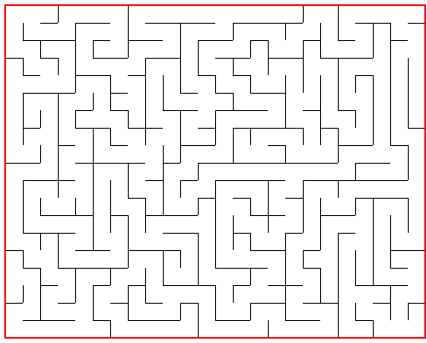
Maze Problem
What is the return type? ?? maze(what parameters do we need)
What are the base cases?
What are the recursive cases

Slide 27
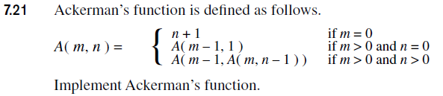
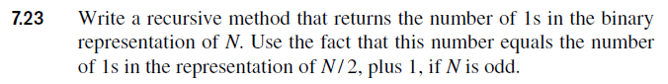
Homework - Programming
7.23. Just for clarity, N is an int (in decimal, not binary)

Slide 28
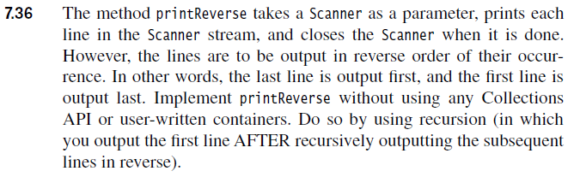
Homework - Programming
7.36 - use the nextLine() method of the Scanner class. Test your method in the main by providing a Scanner to your method that is setup to read a .txt file you have created. Please upload your .txt file as well.

Slide 29
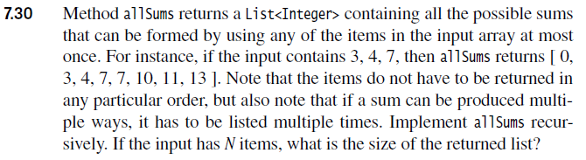
5 Bonus Points
7.30. Note: the list should probably be [ 0, 3, ..., 14 ] instead of [ 0, 3, ..., 13 ] as 3+4+7=14. Please do list the size of a list with N items, as that will help ensure you did it correctly. Also, you can use ArrayList instead of List.

