Slide 1
Chapter 8
Sorting Algorithms

Slide 2
Chapter Summary
In this chapter, we show
That simple sorts run in quadratic time
How to code Shellsort, which is a simple and efficient algorithm that runs in subquadratic time
How to write the slightly more complicated O(N log N) mergesort and quicksort algorithms
That Ω(N log N) comparisons are required for any general-purpose sorting algorithm
How is Ω different than Big Oh?

Slide 3
Why is sorting important?
Words in a dictionary are sorted (and case distinctions are ignored).
Files in a directory are often listed in sorted order.
The index of a book is sorted (and case distinctions are ignored).
The card catalog in a library is sorted by both author and title.
A listing of course offerings at a university is sorted, first by department and then by course number.
Many banks provide statements that list checks in increasing order by check number.
In a newspaper, the calendar of events in a schedule is generally sorted by date.
Musical compact disks in a record store are generally sorted by recording artist.
In the programs printed for graduation ceremonies, departments are listed in sorted order and then students in those departments are listed in sorted order.

Slide 4
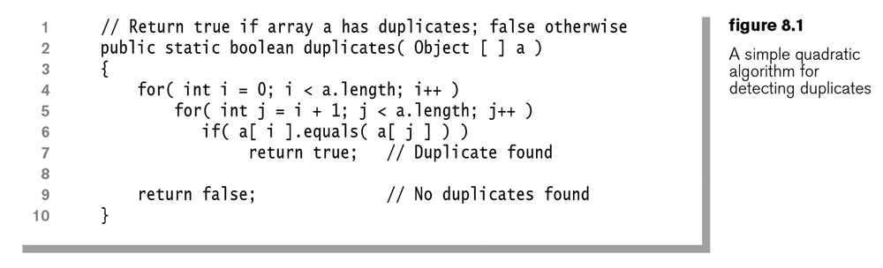
Practical Application
How is this algorithm improved if the array is sorted?
What if we first had to sort the array? Is sorting, then searching faster that this current method?

Slide 5
Insertion Sort
Start with an array of 1 – it is sorted
Get an item
Run it down the list until you find its place
Let’s try it with 5 volunteers
Hopefully I brought papers, but if not, then everyone needs to think of a word or number

Slide 6
Eclipse Demo: Insertion Sort
I have an eclipse project called Sorting that has some demo’s – so we can also see it in action using code
These examples were created by the students in the CS department at UBC in the 90’s using java applets which have since gone out of style
Hopefully I copied that to the G: drive
Use the SortItem.java file

Slide 7
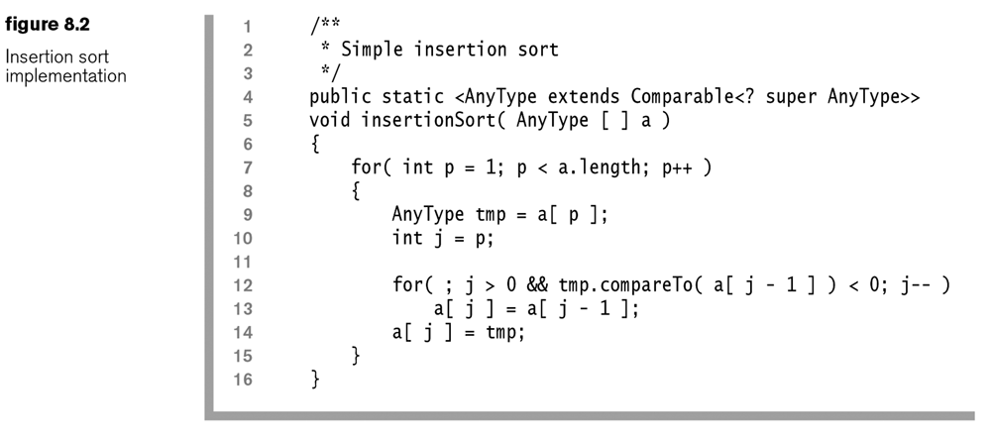
Insertion Sort
What is the worst and average case runtime?
What is the runtime if the array is already sorted?
Give it a try with the papers?

Slide 8
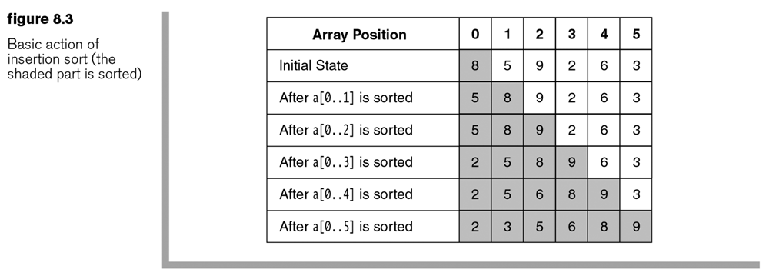
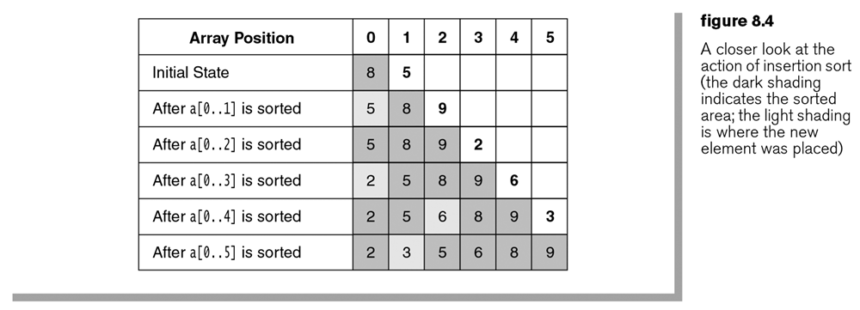

Slide 9
Inversions
An inversion is a pair of elements that are out of order in an array. In other words, it is any ordered pair (i, j) having the property that i < j but A_{i} > A_{j}.
For example, the sequence {8, 5, 9, 2, 6, 3} has 10 inversions that correspond to the pairs (8, 5), (8, 2), (8, 6), (8, 3), (5, 2), (5, 3), (9, 2), (9, 6), (9, 3), and (6, 3).
The number of inversions can tell us how many swaps we might need to perform, and thus the runtime.

Slide 10
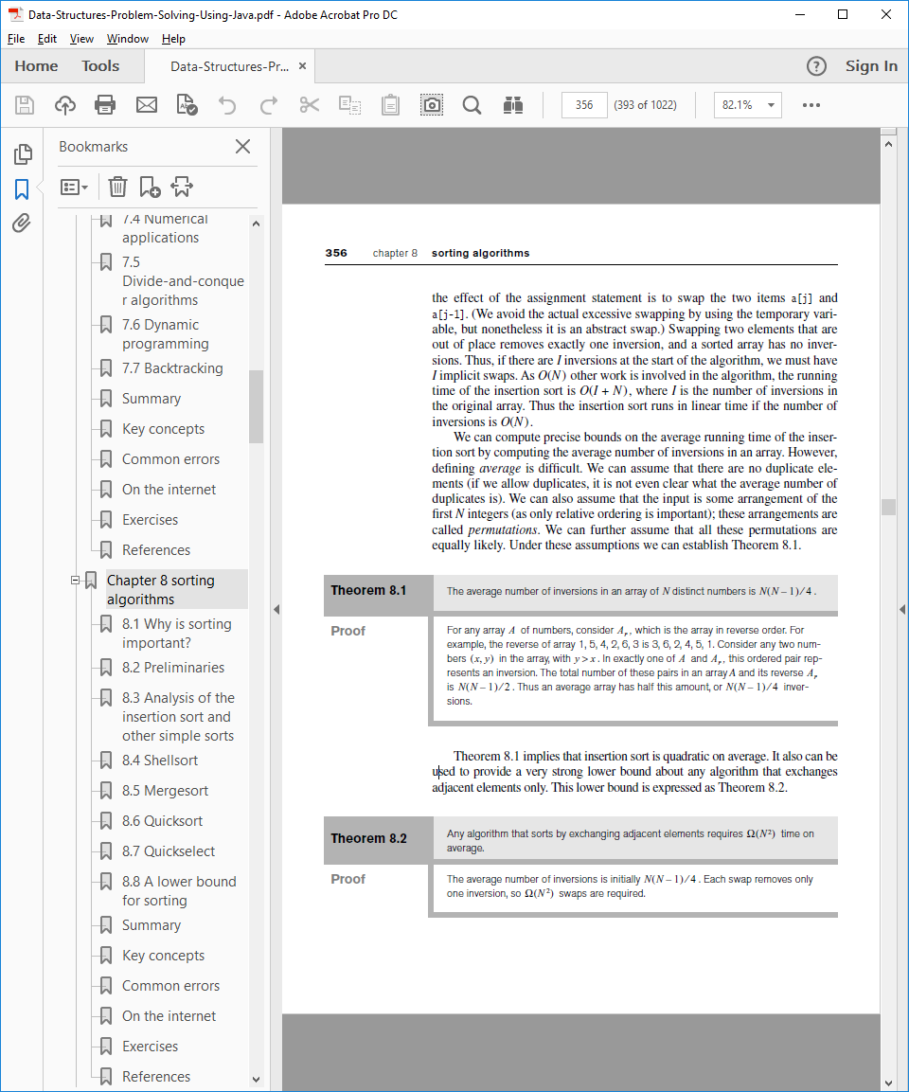
Theorem 8.1, 8.2

Slide 11
What does that mean?
This lower bound shows us that, for a sorting algorithm to run in subquadratic or O(N2) time, it must make comparisons and, in particular, exchanges between elements that are far apart. A sorting algorithm progresses by eliminating inversions. To run efficiently, it must eliminate more than just one inversion per exchange.

Slide 12
Shell Sort (Dr. Donald Shell)
Shell’s idea was to avoid the large amount of data movement, first by comparing elements that were far apart and then by comparing elements that were less far apart, and so on, gradually shrinking toward the basic insertion sort.
This gradually shrinking is called the increment sequence. You can start with as large a number as you want, as long as you end with sorting every 1.
Basically, you are sorting a subset of the array, based on the increment sequence

Slide 13
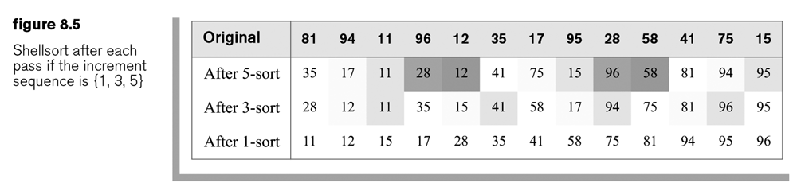
Example
After a 5 sort, elements spaced five apart (identically shaded) are sorted relative to each other.
After a 3 sort, elements spaced three apart are guaranteed to be in sorted order, relative to each other.

Slide 14
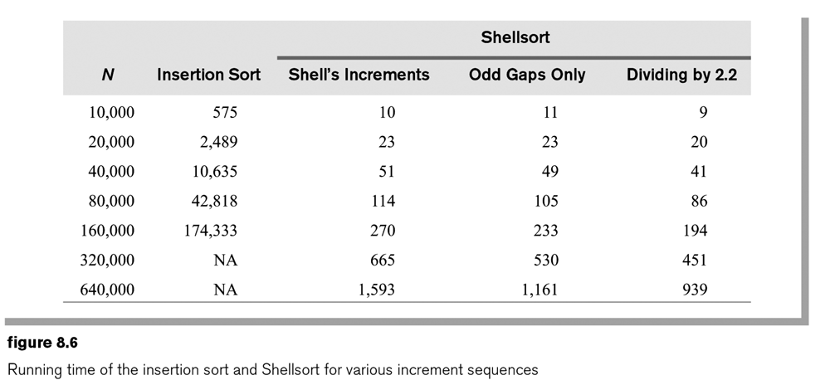

Slide 15
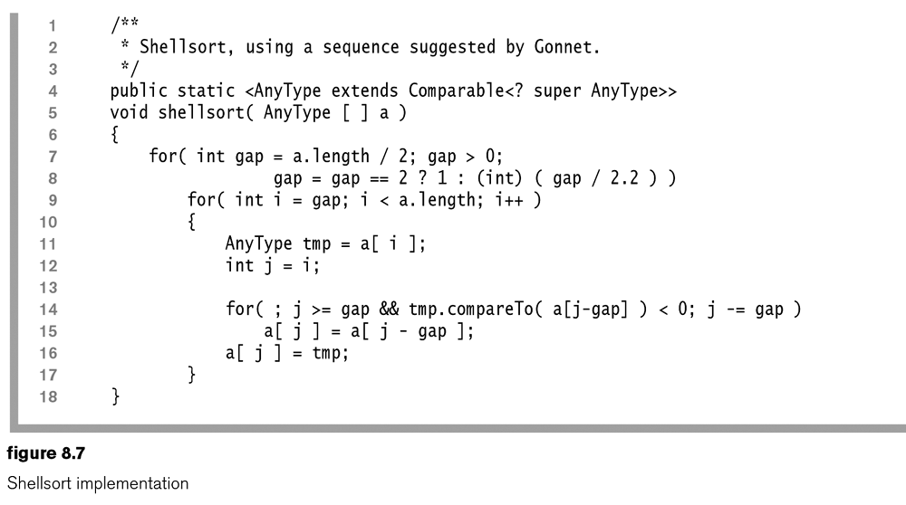
Let’s try it with the papers
10 Volunteers - so we can have a gap of ??????
Hopefully I brought them, but if not, everyone needs to think of their own word
Like insertion sort, assume first one is sorted and start at second one. Compare it with the one before. First time is:
gap-gap = 0

Slide 16
Eclipse Demo: Shell Sort
Comment out the InsertionSort line
Uncomment out ShellSort line
No extra learning allowed! ☺
Try hard not to be tempted to look at the others!

Slide 17
Merge Sort
Uses recursion to break the problem into 2 identically sized sub-problems
The recursion chapter said this was O(N log N)
Algorithm:
If the number it sorts is 0 or 1, return – it is sorted
Recursively sort the first and second halves separately
Merge the sorted halves into a sorted group. This must be done in linear time!

Slide 18
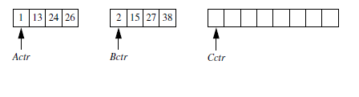
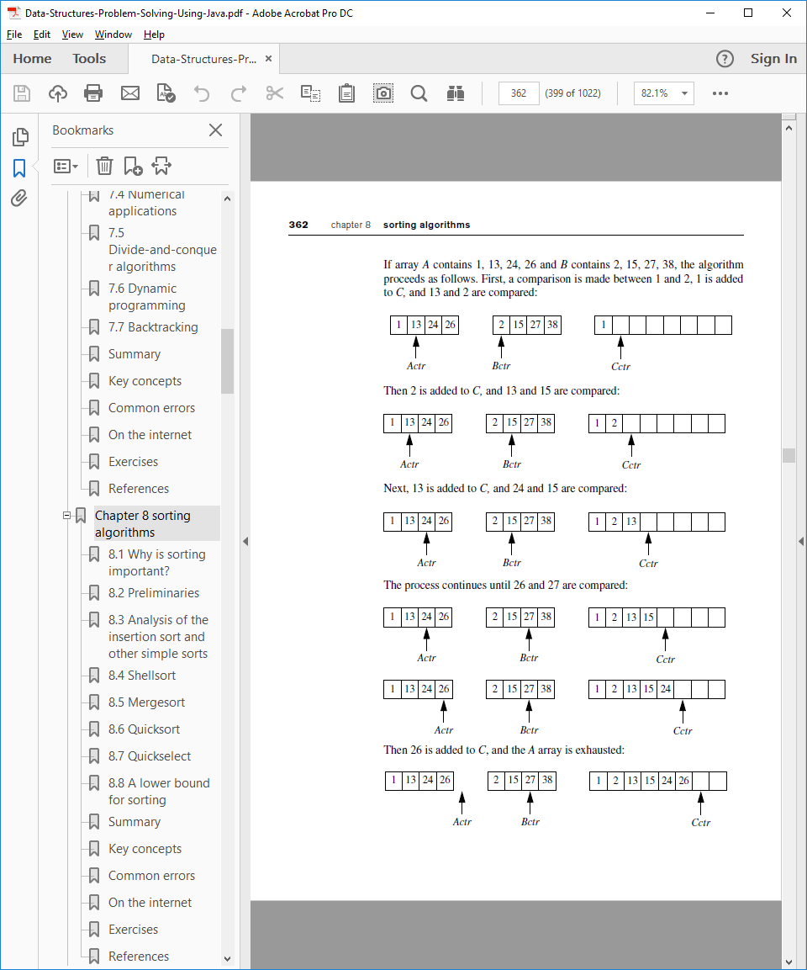
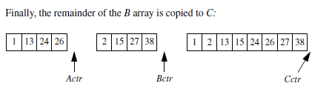
Merge Routine
You need linear memory, but if you smartly switch where you store the numbers you can do better

Slide 19
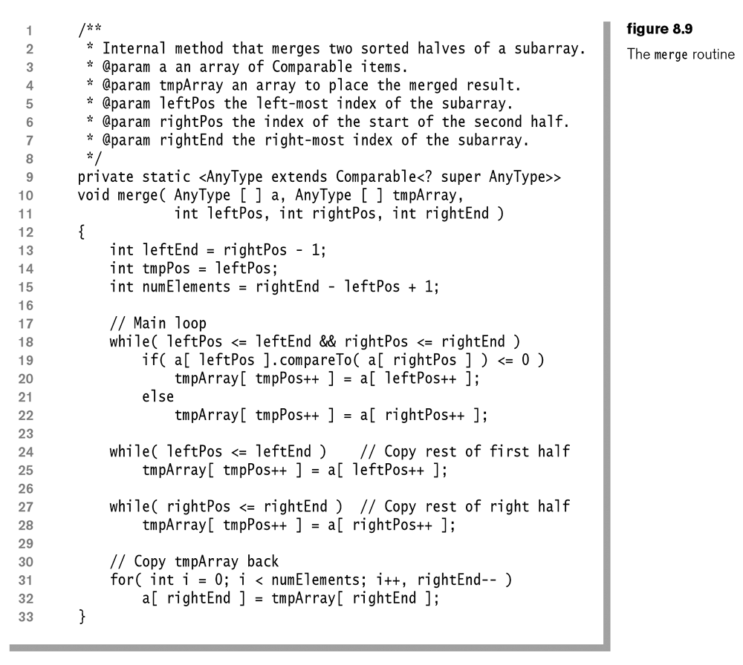

Slide 20
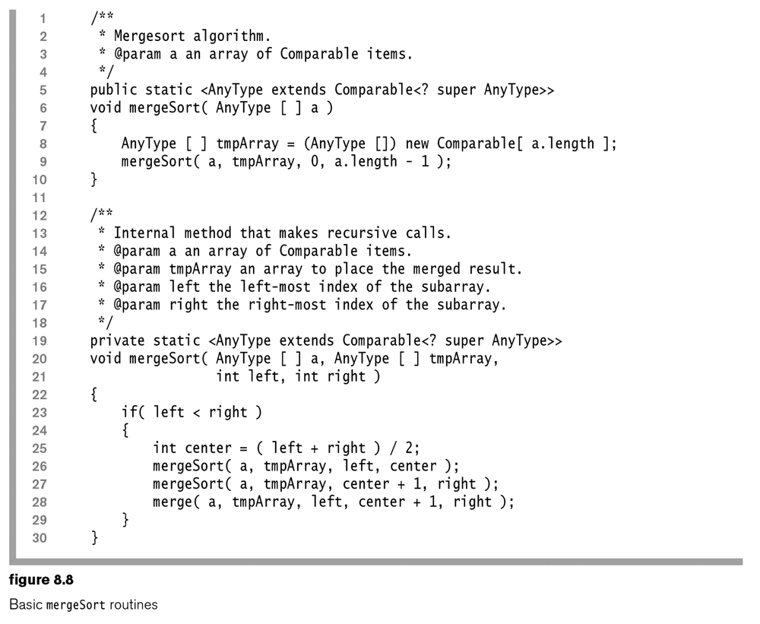
Let’s try with the papers?
10 Volunteers to be sorted
More volunteers as needed due to recursion in second method

Slide 21
Eclipse Demo: Merge Sort
Uncomment out MergeSort line
If you want to see a slow version where you have to essentially shift every element to keep using only the memory you have, try the MergeSortNoExtraSpace one

Slide 22
A Step Towards Quick Sort
O(N log N)
Worst case is O(N²) but you can make the worst case statistically unlikely to occur
Arbitrarily choose any item, and then form three groups:
those smaller than the chosen item,
those equal to the chosen item,
and those larger than the chosen item.
Recursively sort the first and third groups, and then concatenate the three groups.

Slide 23
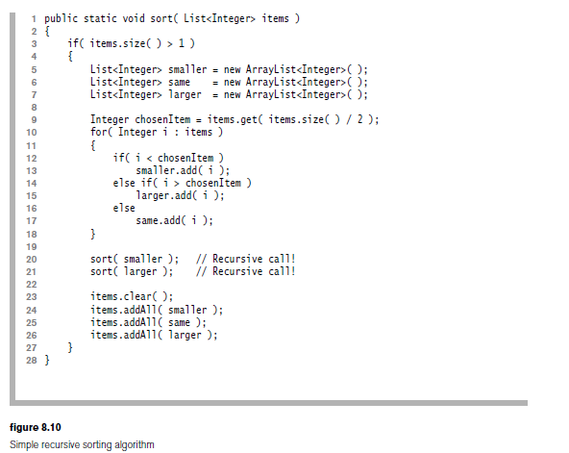
Almost to Quick Sort
In this implementation, the item you pick might be a bad choice
Also, we still create extra memory with those lists

Slide 24
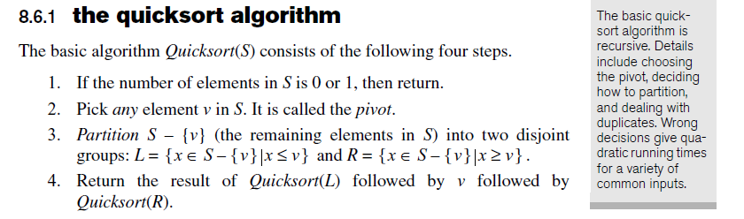
The Basic Quick Sort Algorithm

Slide 25
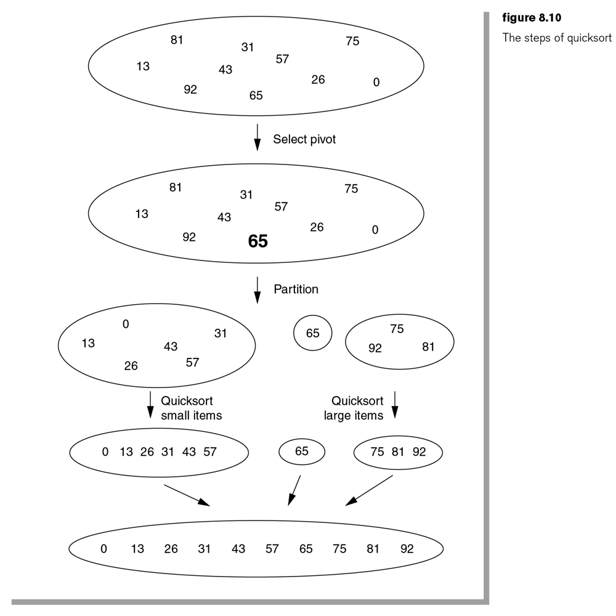
Let’s try with the papers?
10 volunteers?

Slide 26
Eclipse Demo: Quick Sort
Uncomment out QuickSort line
Maybe get a few running at a time to see the difference

Slide 27
Why is Quicksort Faster than Merge Sort?
Quicksort doesn’t guaranty that each sub-problem is of equal size, but merge sort breaks it exactly in half which is better
Also, if we pick a bad pivot in Quicksort– like the smallest number, over and over again, we have an O(N²) runtime.
Quicksort’s partitioning step can be performed significantly faster than the merging step in merge sort, so that is where the gain in speed comes in.
There are some math proofs in the book if you want to read up on it.

Slide 28
Picking the pivot
Bad:
Pick the first element?
Nothing is wrong with this if the array is random.
What if the array is already sorted?
Safe:
Pick the middle element
What if the array is already sorted?
Median of three partitioning
Try to guess what that means

Slide 29
Partitioning Strategy
The first step in the partitioning algorithm is to get the pivot element out of the way by swapping it with the last element
move all the small elements (relative to the pivot) to the left in the array and all the large elements to the right.
“i” at the left and “j” at the right, move them in gradually
In Figures 8.12–8.17, white cells are those that we know are correctly placed. The lightly shaded cells are not necessarily correctly placed

Slide 30
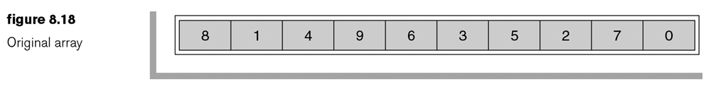
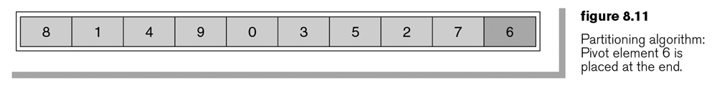
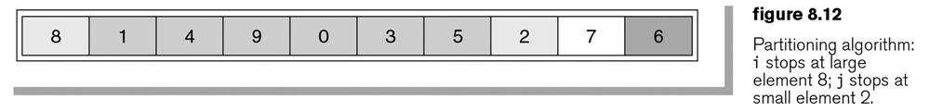
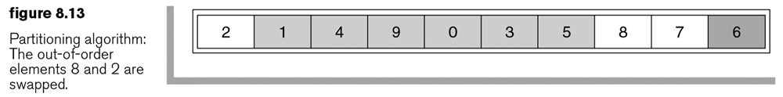
Example with

Slide 31
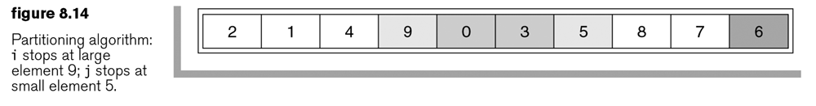
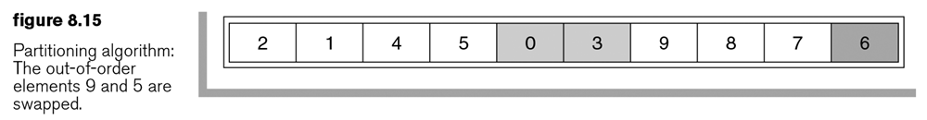
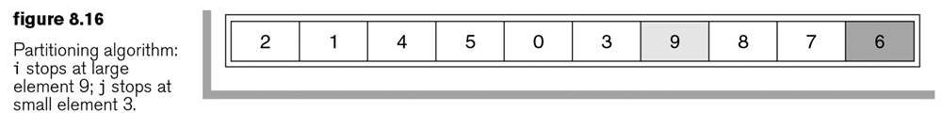
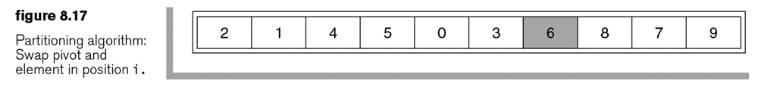

Slide 32
Note
The partitioning algorithm requires no extra memory and that each element is compared exactly once with the pivot. When the code is written, this approach translates to a very tight inner loop.

Slide 33
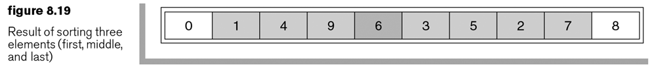
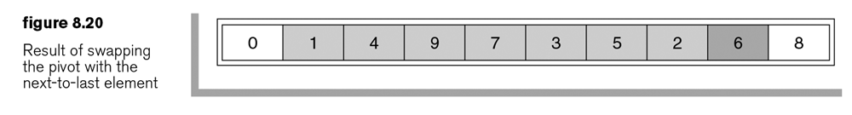
Median of 3 Partitioning
We should not swap the pivot with the element in the last position. Instead, we should swap it with the element in the next-to-last position, as shown in Figure 8.21.
We can start i at low+1 and j at high-2.
We are guaranteed that, whenever i searches for a large element, it will stop because in the worst case it will encounter the pivot (and we stop on equality).
We are guaranteed that, whenever j searches for a small element, it will stop because in the worst case it will encounter the first element (and we stop on equality).

Slide 34
Final thing
For small arrays, insertion sort is great, so when we are using quick sort, we can switch to insertion sort if there are less than 10 elements.

Slide 35
Eclipse Demo: Quick Sort and Buble Sort
Uncomment out QuickSortAndBubbleSort line
Bubble sort is similar to the insertion sort mentioned in the book.
There might not be a noticeable speedup, but it should be faster!

Slide 36
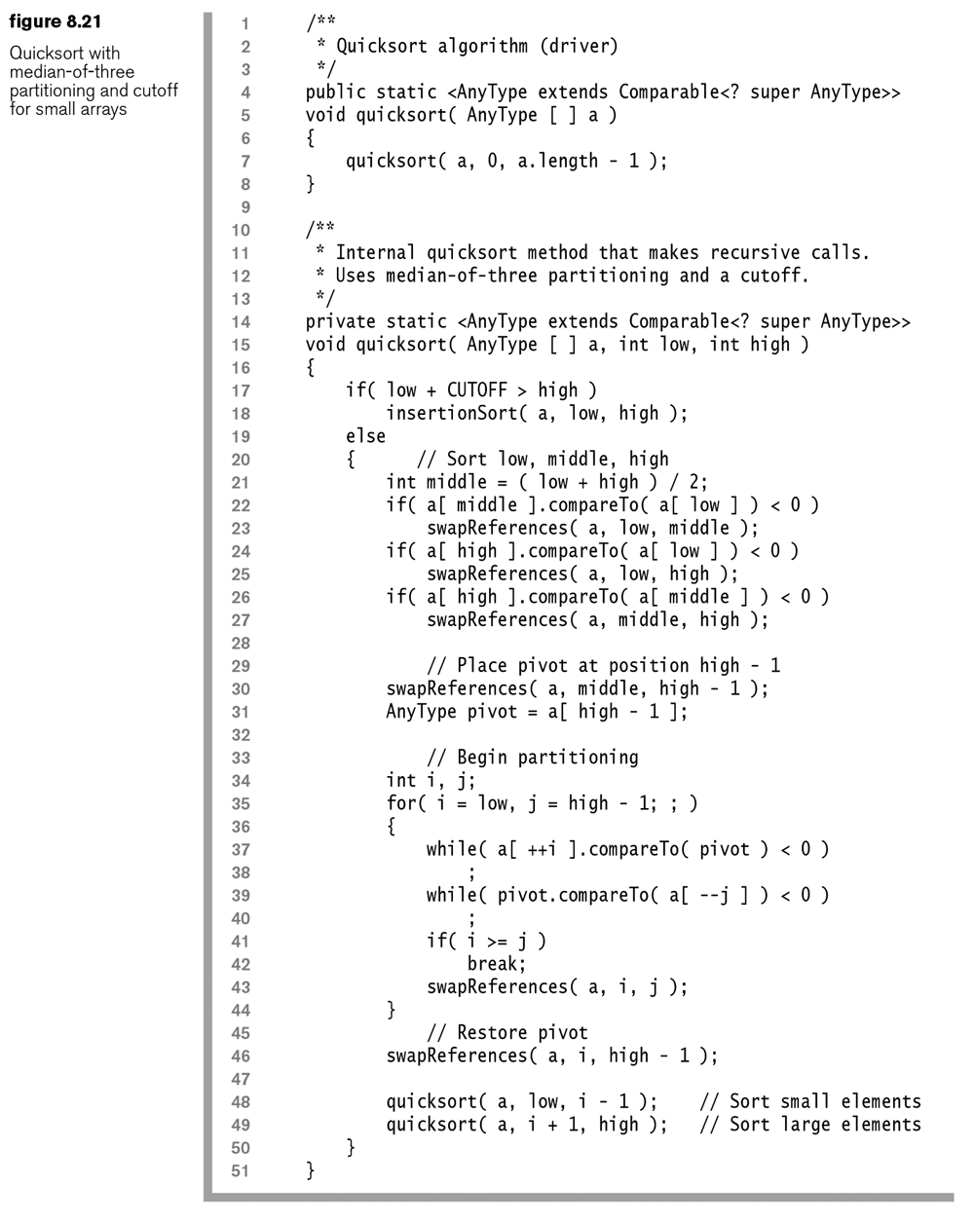

Slide 37
Quick Select
Find the kth smallest element in an array of N items
If we don’t sort, we can slightly change quicksort and then select in linear time
If the number of elements in S is 1, presumably k is also 1, so we can return the single element in S.
Pick any element v in S. It is the pivot.
Partition S – {v} into L and R, exactly as was done for quicksort.
If k is less than or equal to the number of elements in L, the item we are searching for must be in L. Call Quickselect( L, k ) recursively. Otherwise, if k is exactly equal to 1 more than the number of items in L, the pivot is the kth smallest element, and we can return it as the answer. Otherwise, the kth smallest element lies in R, and it is the (k – |L| – 1)th smallest element in R. Again, we can make a recursive call and return the result.

Slide 38
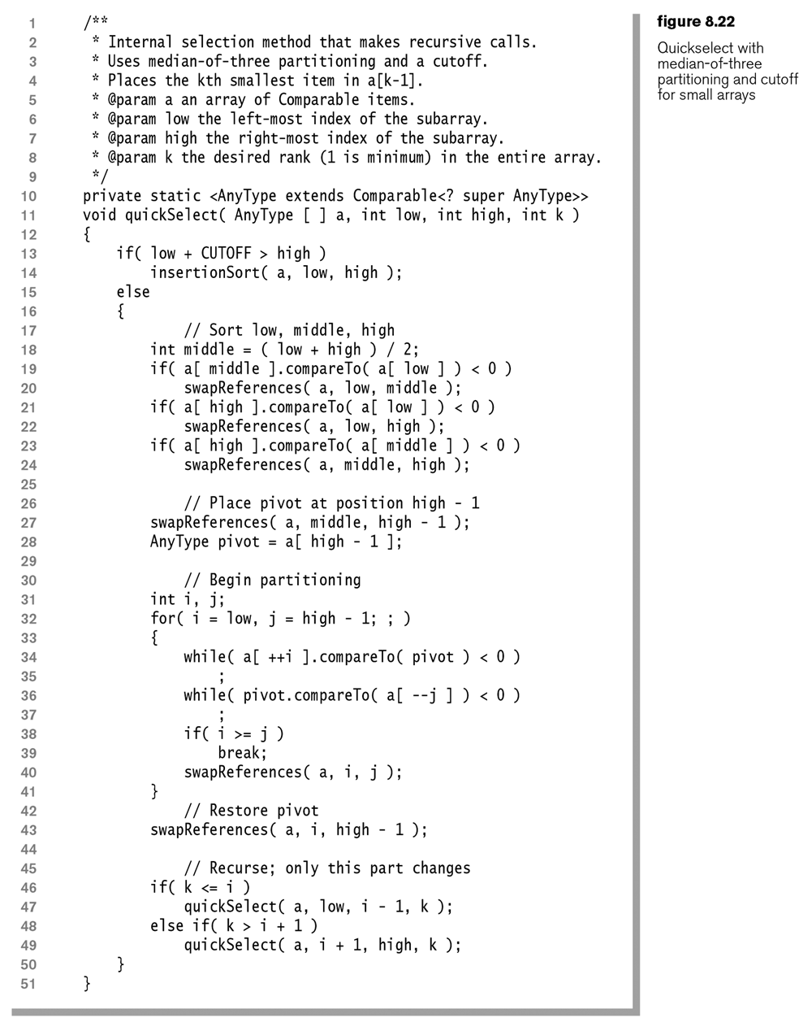

Slide 39
Homework – Written
Answer the following questions from the In Theory portion of the book:
8.4 - When all keys are equal, what is the running time of: a) Insertion sort. (b-d in book)
8.5 - When the input has been sorted, what is the running time of: a) Insertion sort. (b-d in book)
8.6 - When the input has been sorted in reverse order, what is the running time of: a) Insertion sort (b-d in book)
8.8. Construct a worst-case input for quicksort with: a) The middle element as pivot
Just do part a and use an array of size 10

Slide 40
Homework – Programming
Create a java class, or PDF file that answers the following questions:
8.21. An array contains N numbers, and you want to determine whether two of the numbers sum to a given number K. For instance, if the input is 8, 4, 1, 6 and K is 10, the answer is yes (4 and 6). A number may be used twice. Do the following.
a. Give an O(N*N) algorithm to solve this problem
B. Give an O(N log N) algorithm to solve this problem. (Hint: Sort the items first. After doing so, you can solve the problem in linear time.)
For part B, the book says that you can sort it, then do something in linear time. Do the sorting part, but if it is too hard to figure out something in linear time, anything that runs in N lg(N) time is fine. Maybe something like: pick a number and then see if there is a match in the array that adds up correctly, but find that match in a faster way than just looking at every element.
C. Code both solutions and compare the running times of your algorithms.
For part C it asks you to compare the runtime of your algorithms. Make sure you test your code using at least 2 different size arrays, probably 1,000 and 100,000. This means you will have to create a method that creates an array and fills it with random data. You will also need code that can calculate runtime.
8.27 Write a method that removes all duplicates in an array A of N items. Return the number of items that remain in A. Your method must run in O(N log N) average time (use quicksort as a preprocessing step), and should make no use of the Collections API.
I would love it if you could get this working using AnyType, but I will accept an implementation using Integer. The Sort.java file on the G: drive contains some of the sorting algorithms we spoke about in this chapter. Feel free to use that.
8.33 Two words are anagrams if they contain the same letters in the same frequency. For instance, stale and least are anagrams of each other. A simple way to check this is to sort the characters in each word; if you get the same answer (in the example, we get aelst), the words are anagrams of each other. Write a method that tests if two words are anagrams of each other.
I want your main to test your method at least 6 different times and print the results in an easy to read manner.

