Slide 1
A Balanced Introduction to Computer Science, 3/E
David Reed, Creighton University
©2011 Pearson Prentice Hall
ISBN 978-0-13-216675-1
Chapter 6
The History of Computers

Slide 2
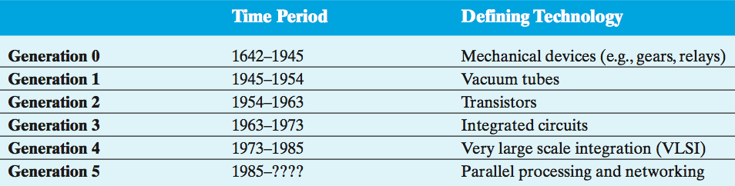
History of computing
calculating devices have been around for millennia (e.g., abacus ~3,000 B.C.)
modern "computing technology" traces its roots to the 16-17th centuries
  as part of the "Scientific Revolution", people like Kepler, Galileo, and Newton viewed the natural world as mechanistic and understandable
  this led to technological advances & innovation
from simple mechanical calculating devices to powerful modern computers, computing technology has evolved through technological breakthroughs

Slide 3
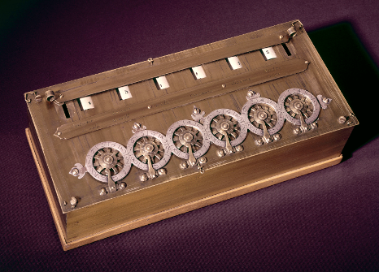
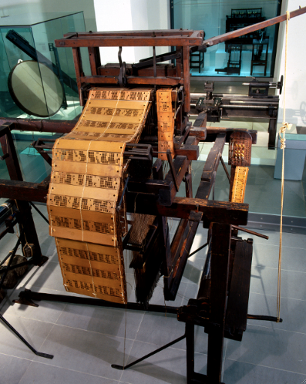
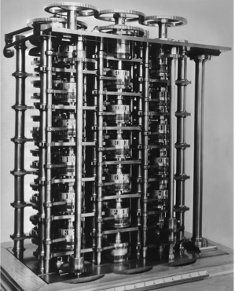
Generation 0: Mechanical Computers
1642 – Pascal built a mechanical calculating machine
  used mechanical gears, a hand-crank, dials and knobs
  other similar machines followed
1805 – the first programmable device was Jacquard's loom
  the loom wove tapestries with elaborate, programmable patterns
  a pattern was represented by metal punch-cards, fed into the loom
  using the loom, it became possible to mass-produce tapestries, and even reprogram it to produce different patterns simply by changing the cards
mid 1800's – Babbage designed his "analytical engine"
  its design expanded upon mechanical calculators, but was programmable via punch-cards (similar to Jacquard's loom)
  Babbage's vision described the general layout of modern computers
  he never completed a functional machine – his design was beyond the technology of the day

Slide 4
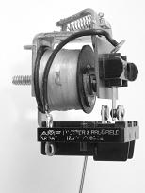
Generation 0 (cont.)
1930's – several engineers independently built "computers" using electromagnetic relays
  an electromagnetic relay is physical switch, which can be opened/closed via electrical current
  relays were used extensively in early telephone exchanges
  Zuse (Nazi Germany) – his machines were destroyed in WWII
  Atanasoff (Iowa State) – built a partially-working machine with his grad student
  Stibitz (Bell Labs) – built the MARK I computer that followed the designs of Babbage
    limited capabilities by modern standards: could store only 72 numbers, required 1/10 sec to add, 6 sec to multiply
    still, 100 times faster than previous technology

Slide 5
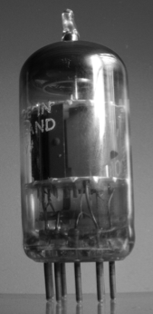
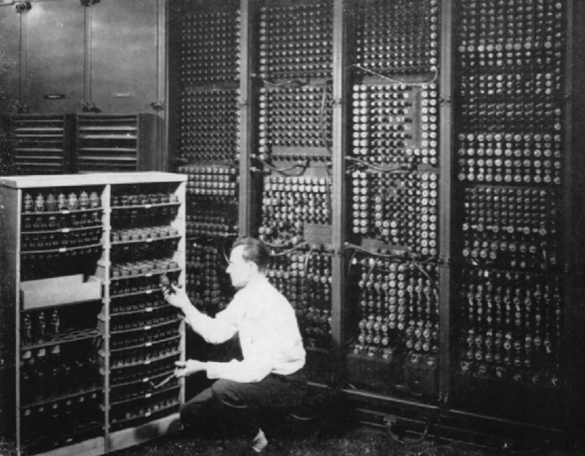
Generation 1: Vacuum Tubes
mid 1940's – vacuum tubes replaced relays
  a vacuum tube is a light bulb containing a partial vacuum to speed electron flow
  vacuum tubes could control the flow of electricity faster than relays since they had no moving parts
  invented by Lee de Forest in 1906
1940's – hybrid computers using vacuum tubes and relays were built
  COLOSSUS (1943)
    first "electronic computer", built by the British govt. (based on designs by Alan Turing)
    used to decode Nazi communications during the war
    the computer was top-secret, so did not influence other researchers
  ENIAC (1946)
    first publicly-acknowledged "electronic computer", built by Eckert & Mauchly (UPenn)
    contained 18,000 vacuum tubes and 1,500 relays
    weighed 30 tons, consumed 140 kwatts

Slide 6
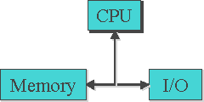
Generation 1 (cont.)
COLOSSUS and ENIAC were not general purpose computers
  could enter input using dials & knobs, paper tape
  but to perform a different computation, needed to reconfigure
von Neumann popularized the idea of a "stored program" computer
  Memory stores both data and programs
  Central Processing Unit (CPU) executes by loading program instructions from memory and executing them in sequence
  Input/Output devices allow for interaction with the user
  virtually all modern machines follow this
  von Neumann Architecture
    (note: same basic design as Babbage)
programming was still difficult and tedious
  each machine had its own machine language, 0's & 1's corresponding to the settings of physical components
  in 1950's, assembly languages replaced 0's & 1's with mnemonic names
  e.g., ADD instead of 00101110

Slide 7
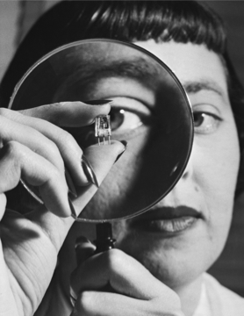
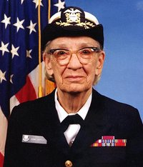
Generation 2: Transistors
mid 1950's – transistors began to replace tubes
  a transistor is a piece of silicon whose conductivity can be turned on and off using an electric current
  they performed the same switching function of vacuum tubes, but were smaller, faster, more reliable, and cheaper to mass produce
  invented by Bardeen, Brattain, & Shockley in 1948 (earning them the 1956 Nobel Prize in physics)
  some historians claim the transistor was the most important invention of the 20th century
computers became commercial as cost dropped
  high-level languages were designed to make programming more natural
  FORTRAN (1957, Backus at IBM)
  LISP (1959, McCarthy at MIT)
  BASIC (1959, Kemeny at Dartmouth)
  COBOL (1960, Murray-Hopper at DOD)
  the computer industry grew as businesses could afford to
  buy and use computers
    Eckert-Mauchly (1951), DEC (1957)
    IBM became market force in 1960's

Slide 8
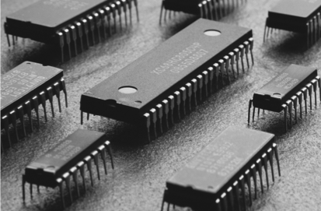
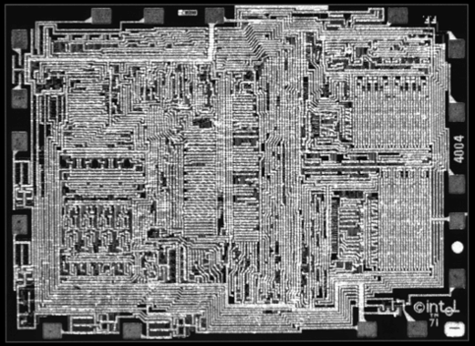
Generation 3: Integrated Circuits
mid 1960's - integrated circuits (IC) were produced
  Noyce and Kilby independently developed techniques for packaging transistors and circuitry on a silicon chip (Kilby won the 2000 Nobel Prize in physics)
  this advance was made possible by miniaturization & improved manufacturing
  allowed for mass-producing useful circuitry
  1971 – Intel marketed the first microprocessor, the 4004, a chip with all the circuitry for a calculator
1960's saw the rise of Operating Systems
  recall: an operating system is a collection of programs that manage peripheral devices and other resources
  in the 60's, operating systems enabled time-sharing, where users share a computer by swapping jobs in and out
  as computers became affordable to small businesses, specialized programming languages were developed
      Pascal (1971, Wirth), C (1972, Ritchie)

Slide 9
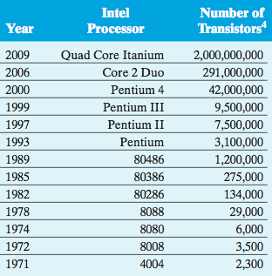
Generation 4: VLSI
late 1970's - Very Large Scale Integration (VLSI)
  by the late 1970's, manufacturing advances allowed placing hundreds of thousands of transistors w/ circuitry on a chip
  this "very large scale integration" resulted in mass-produced microprocessors and other useful IC's
  since computers could be constructed by simply connecting powerful IC's and peripheral devices, they were easier to make and more affordable

Slide 10
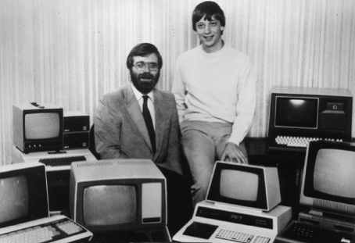
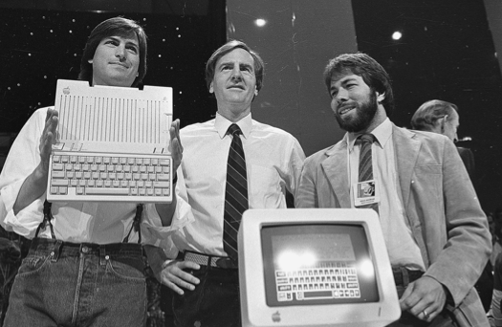
Generation 4: VLSI (cont.)
with VLSI came the rise of personal computing
  1975 - Bill Gates & Paul Allen founded Microsoft
    Gates wrote a BASIC interpreter for the first PC (Altair)
  1977 - Steve Wozniak & Steve Jobs founded Apple
    went from Jobs' garage to $120 million in sales by 1980
  1980 - IBM introduced PC
    Microsoft licensed the DOS operating system to IBM
  1984 - Apple countered with Macintosh
    introduced the modern GUI-based OS (which was mostly developed at Xerox)
  1985 - Microsoft countered with Windows
1980's - object-oriented programming began
  represented a new approach to program design which views a program as a collection of interacting software objects that model real-world entities
  Smalltalk (Kay, 1980), C++ (Stroustrup, 1985), Java (Sun, 1995)

Slide 11
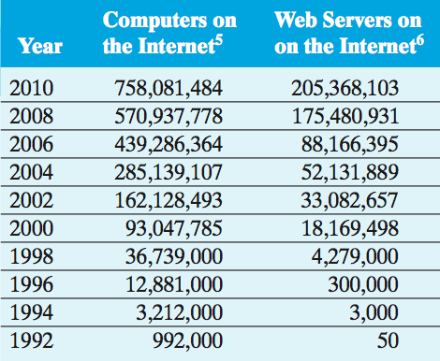
Generation 5: Parallelism/Networks
the latest generation of computers is still hotly debated
  no new switching technologies, but changes in usage have occurred
parallel processing has become widespread
  multi-core processors provide simple parallelism, can spread jobs across cores
  similarly, high-end machines (e.g. Web servers) can have multiple CPU's
  in 1997, highly parallel Deep Blue beat Kasparov in a chess match
most computers today are networked
  the Internet traces its roots to the 1969 ARPANet
    mainly used by government & universities until the late 80s/early 90s
  the Web was invented by Tim Berners-Lee in 1989, to allow physics researchers to share data
    1993: Marc Andreessen & Eric Bina developed Mosaic
    1994: Andreesen & Netscape released Navigator
    1995: Microsoft released Internet Explorer
  in 2009, 55% of American adults connected to Internet wirelessly, >30% using a smart phone
(Internet Software Consortium & Netcraft, April 2010.)

Slide 12
Computing entrepreneurs
Richest People in the World (Forbes, 3/10/10)
1. Carlos Slim Helu $53.5 billion Age: 70
2. Bill Gates $53.0 billion Age: 54
3. Warren Buffet $47.0 billion Age: 79
4. Mukesh Ambani $29.0 billion Age: 52
5. Lakshmi Mittal $28.7 billion Age: 59
6. Larry Ellison $28.0 billion Age: 65
…
24. Sergey Brin $17.5 billion Age: 36
24. Larry Page $17.5 billion Age: 37
…
33. Steve Ballmer $14.5 billion Age: 54
…
37. Paul Allen $13.5 billion Age: 57
37. Michael Dell $13.5 billion Age: 45
…
43. Jeff Bezos $12.3 billion Age: 46

