Slide 1
A Balanced Introduction to Computer Science, 3/E
David Reed, Creighton University
©2011 Pearson Prentice Hall
ISBN 978-0-13-216675-1
Chapter 13
Conditional Repetition

Slide 2
Conditional Repetition
an if statement is known as a control statement
  it is used to control the execution of other JavaScript statements
  provides for conditional execution
  is useful for solving problems that involve choices
    either do this or don't, based on some condition (if)
    either do this or do that, based on some condition (if-else)
closely related to the concept of conditional execution is conditional repetition
  many problems involve repeating some task over and over until a specific condition is met
  e.g., rolling dice until a 7 is obtained
  e.g., repeatedly prompting the user for a valid input
  in JavaScript, while loops provide for conditional repetition

Slide 3
While Loops
a while loop resembles an if statement in that its behavior is dependent on a Boolean condition.
  however, the statements inside a while loop’s curly braces (a.k.a. the loop body) are executed repeatedly as long as the condition remains true
  general form:
      while (BOOLEAN_TEST) {
      STATEMENTS_EXECUTED_AS_LONG_AS_TRUE
      }
when the browser encounters a while loop, it first evaluates the Boolean test
  if the test succeeds, then the statements inside the loop are executed in order, just like an if statement
  once all the statements have been executed, program control returns to the beginning of the loop
  the loop test is evaluated again, and if it succeeds, the loop body statements are executed again
  this process repeats until the Boolean test fails

Slide 4
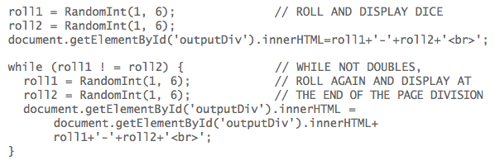
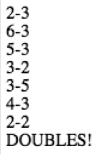
While Loop Example
example: roll two dice repeatedly until doubles are obtained
note: even though while loops and if statements look similar, they are very different control statements
  an if statement may execute its code once or not at all
  a while loop may execute its code an arbitrary number of times (including not at all)
sample output:

Slide 5
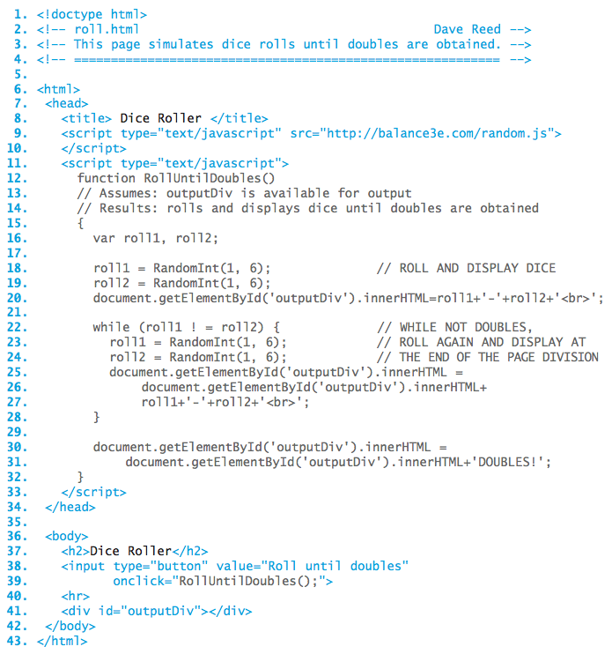
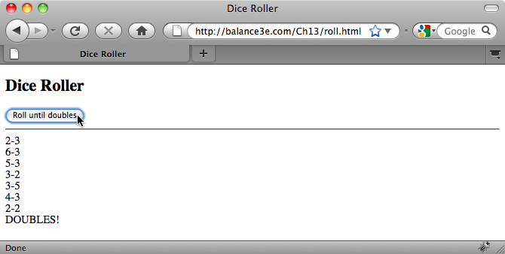
Dice Roller Page

Slide 6
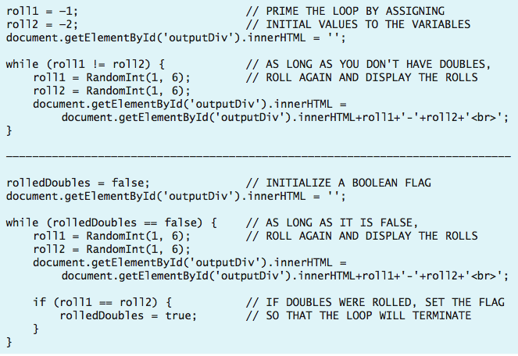
Avoiding redundancy
note the redundancy in the code
  must perform the initial dice roll before the loop begins
  then, have to repeatedly re-roll inside the loop
can avoid this by either:
  "priming the loop" with default values that allow the loop to execute
  defining a Boolean "flag" to determine when the loop should continue

Slide 7
Loop Tests
note: the loop test defines the condition under which the loop continues
  this is often backwards from the way we think about loops
  e.g., read input until you get a positive number (i.e., until input > 0)
    while (input <= 0) { . . . }
  e.g., keep rolling dice until you get doubles (i.e., until roll1 == roll2)
    while (roll1 != roll2) { . . . }
  e.g., keep rolling dice until you get double fours (i.e., until roll1 == 4 && roll2 = 4)
    while (roll1 != 4 || roll2 != 4) { . . . }
DeMorgan's Law: !(X && Y) == (!X || !Y)
!(X || Y) == (!X && !Y)

Slide 8
Counter-Driven Loops
since a while loop is controlled by a condition, it is usually impossible to predict the number of repetitions that will occur
  e.g., how many dice rolls will it take to get doubles?
a while loop can also be used to repeat a task some fixed number of times
  implemented by using a while loop whose test is based on a counter
  general form of counter-driven while loop:
    repCount = 0;
    while (repCount < DESIRED_NUMBER_OF_REPETITIONS) {
    STATEMENTS_FOR_CARRYING_OUT_DESIRED_TASK
    repCount = repCount + 1;
    }
  the counter is initially set to 0 before the loop begins, and is incremented at the end of the loop body
    the counter keeps track of how many times the statements in the loop body have executed
    when the number of repetitions reaches the desired number, the loop test fails and the loop terminates

Slide 9
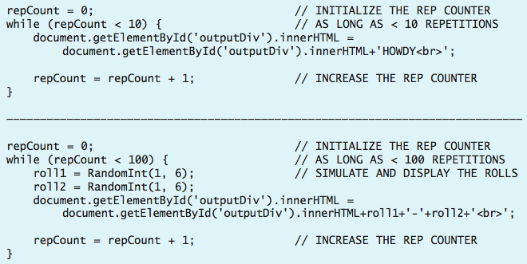
Counter-Driven Loops
examples:

Slide 10
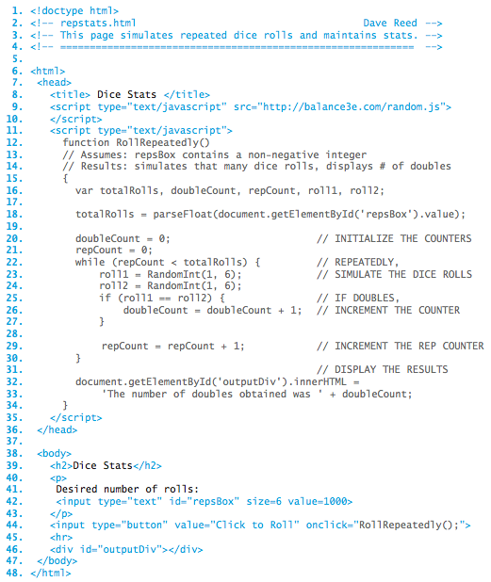
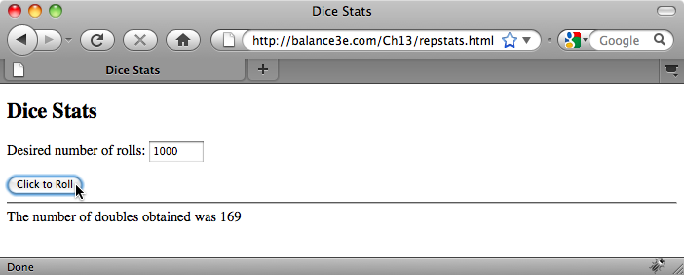
Counter-driven Dice Roller
while loop executes totalRolls times
each time, the dice are rolled and checked for doubles

Slide 11
Infinite Loops
the browser will repeatedly execute statements in the body of a while loop
as long as the loop test succeeds (evaluates to true)
  it is possible that the test will always succeed and the loop will run forever
    repCount = 0;
    while (repCount < 10) {
    document.getElementById('outputDiv').inerHTML =
    document.getElementById('outputDiv').inerHTML + 'HOWDY<br>';
    }
  a loop that runs forever is known as an infinite loop (or a black hole loop)
  to guard against infinite loops, make sure that some part of the loop test changes inside the loop
    in the above example, repCount is not updated in the loop so there is no chance of terminating once the loop starts
  an infinite loop may freeze up the browser
    sometimes, clicking the Stop button will suffice to interrupt the browser
    other times, you may need to restart the browser

Slide 12
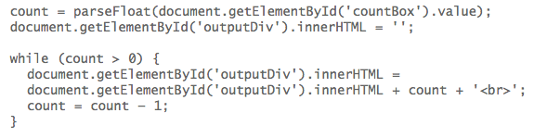
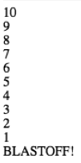
Variables and Repetition
any variable can be employed to control the number of loop repetitions and the variable can be updated in various ways
example: countdown

Slide 13
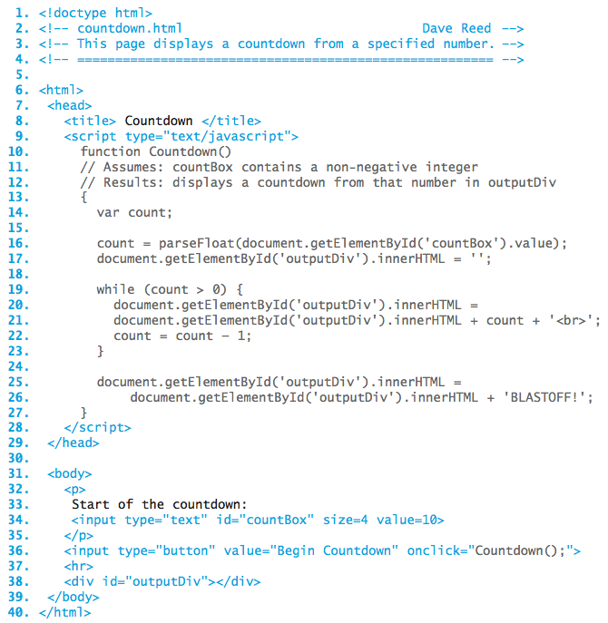
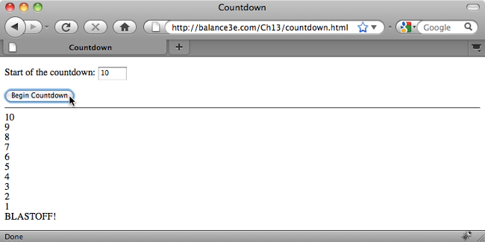
Countdown Page

Slide 14
Example: Hailstone Sequences
an interesting unsolved problem in mathematics: hailstone sequence
  start with any positive integer
  if the number is odd, then multiply the number by three and add one; otherwise, divide it by two
  repeat as many times as desired
  for example: 5, 16, 8, 4, 2, 1, 4, 2, 1, 4, 2, 1, …
it is conjectured that, no matter what positive integer you start with, you will always end up in the 4-2-1 loop
  this has been verified for all starting number up to 5,764,607,523,034,234,880
  but, it still has not been proven to hold for ALL starting numbers

