Slide 1
Department of Computing Technology
Prof. Stephen Buerle
Introduction to Programming
(CMPT 120 & CMSC 120)

Slide 2
Context of this Class
Introduction to Programming
  First class in a series of (3) Classes for CS/ITS Major
    Introduction to Programming – (HTML, CSS, JavaScript, DOM)
    Software Development I - Java
    Software Development II – PHP, MYSQL, Apache
  Required for Chemistry and Biology majors
  Sets the conceptual and practical foundations for CS/ITS major
  Helps to introduce and explore some of the fundamental technological transformations that are affecting our Global Society the areas of:
    Economics,Engineering and Science
    Banking and Finance
    Telecommunications
    Healthcare, Pharmaceuticals and Biotechnology
    Defense, Fire, Emergency Services and Law Enforcement
    Transportation, Energy and the Environment

Slide 3
Why do I Enjoy Teaching this Class?
This course allows me to launch you into the field of computation and teach you analysis and computation techniques which can have a significant impact on your academic and profession career
  Essential to all Scientific and Engineering discipline
    Physics | Biology | Chemistry | Mathematics | Geology
  Introduce fundamental concepts that you will use your entire career
    What is a bit? What is a byte? Why is it relevant?
    What is a data type? How do we use them?
    What is a variable? Why is it important?
    What is a function? Where do we use them?
    What is a control structures? Why are they essential to decision making?
    What is an array?Why are they so essential to problem solving in all Science and Engineering discipline?

Slide 4
A Little about You
How was your Summer?
  Where did you go and what did you do? and...
  Are you excited to be here?
On the cards just handed out, please provide your:
  Name
  Major/Minor
  Preferred email contact
  Previous programming experience (list and describe)
    HTML/CSS
    Javascript
    Java
    C/C++
    Perl
    Python
    Networking
    Systems/HW

Slide 5


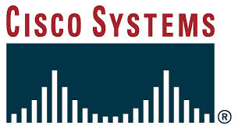
A Little about Me
Former Role & Responsibilities
  Clever Devices - Chief Scientist/Security Officer
  Unisys – Security Engineer/consultant
  IAEA - Network Security Officer – IAEA
  Total Network Solutions – Dir of Security - Cisco Start-up
  Network Developer/Systems Programmer/Database Developer
Previous Courses Taught
  Internet Security/Advanced Seminar in Internet Security
  Systems Analysis and Design (UML)
  Software Design and Development
  Independent Studies (Risk Analysis/VA, Cryptography, Access Control)
  Introduction to Programming (HTML/CSS/Javascript)
  Software Development I (Java)
  Web Programming I (HTML4/5, CSS, JavaScript)
  Web Programming II (PHP, Apache, MYSQL, XML , DOM)
  Data Communications and Networking
Academic background
  PhD ABD – State university of NY Albany
  (2) Masters Degrees – RPI & Harvard University

Slide 6
Some Logistics
Course Syllabus
  This is your “roadmap” for this course
  My office hours
  Course Overview
  Course Objectives
  Texts and Other Instructional Materials
  Online Resources
  Attendance and Evaluation
  Course Schedule
  Outcomes & Assessment
  Instructional Sequence and Assignments
  Academic Integrity
ACM Code of Ethics - Read

Slide 7
Chapter 1
Computer Basics

Slide 8
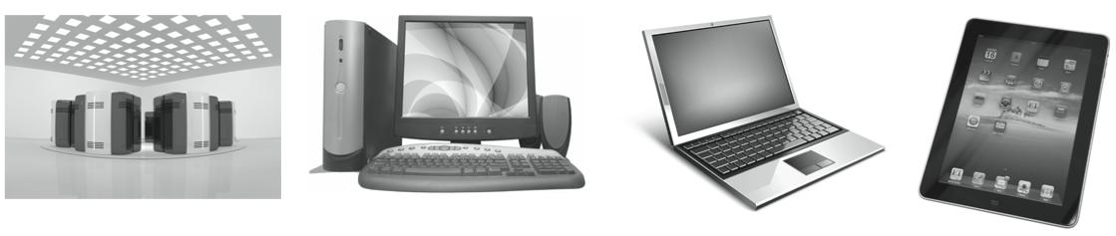
What is a Computer?
a computer is a device that receives, stores, and processes information
different types of computers have different characteristics
  supercomputers: powerful but expensive; used for complex computations (e.g., weather forecasting, engineering design and modeling)
  desktop computers: less powerful but affordable; used for a variety of user applications (e.g., email, Web browsing, document processing)
  laptop computers: similar functionality to desktops, but mobile
  palmtop computers: portable, but limited applications and screen size

Slide 9
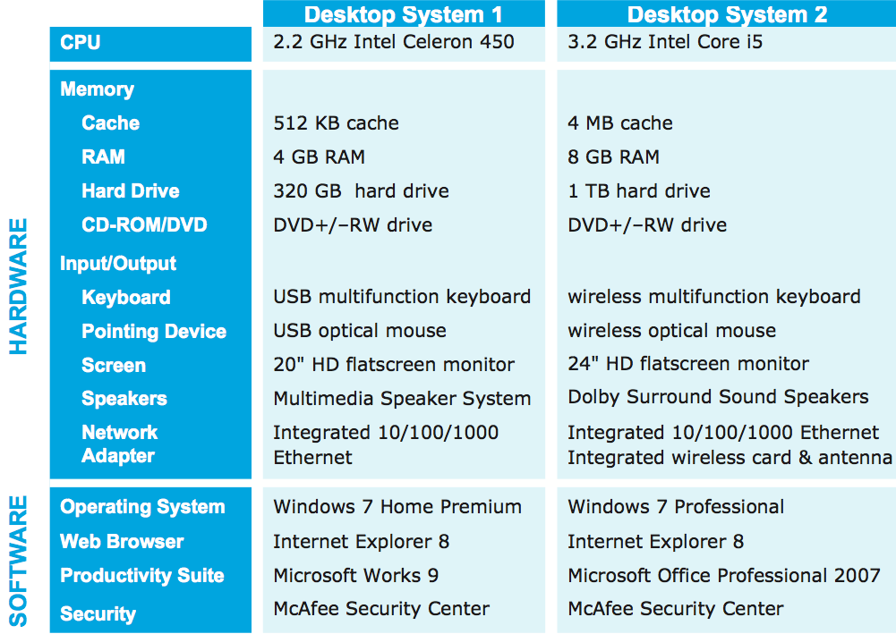
Desktop Specifications
purchasing a computer can be confusing
  sales materials contain highly technical information and computer jargon
the following specs describe two computer systems for sale in May, 2010
  Desktop 1 is a low-end system, inexpensive but with limited features
  Desktop 2 is a high-end system, uses the latest technology so expensive

Slide 10
Hardware vs. Software
the term hardware refers to the physical components of a computer system
  e.g., monitor, keyboard, mouse, hard drive
the term software refers to the programs that execute on the computer
  e.g., word processing program, Web browser

Slide 11
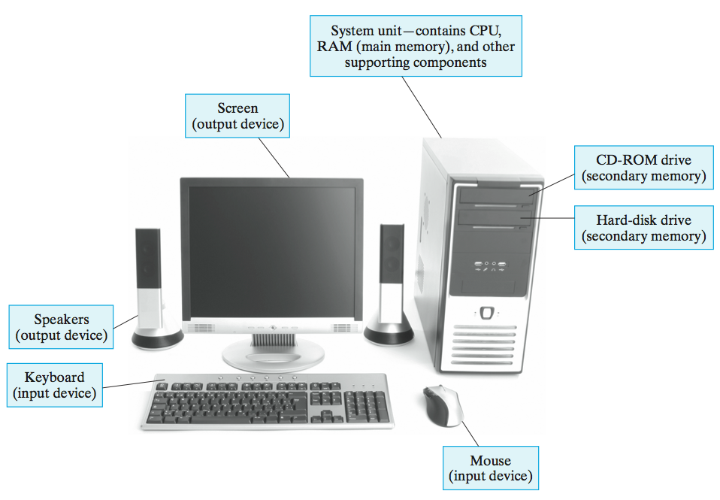
Common Desktop Hardware

Slide 12
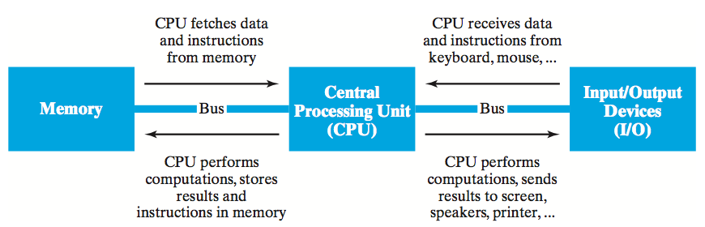
von Neumann Architecture
although specific components may vary, virtually all modern computers have the same underlying structure
  known as the von Neumann architecture
  named after computer pioneer, John von Neumann, who popularized the design in the early 1950's
the von Neumann architecture identifies 3 essential components
  Input/Output Devices (I/O) allow the user to interact with the computer
  Memory stores information to be processed as well as programs (instructions specifying the steps necessary to complete specific tasks)
  Central Processing Unit (CPU) carries out the instructions to process information

Slide 13
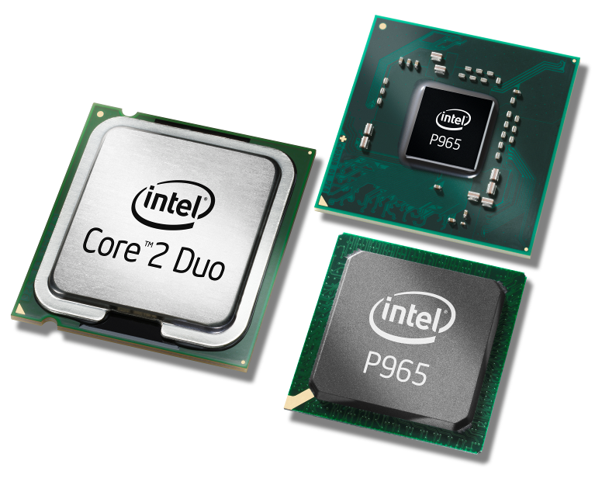
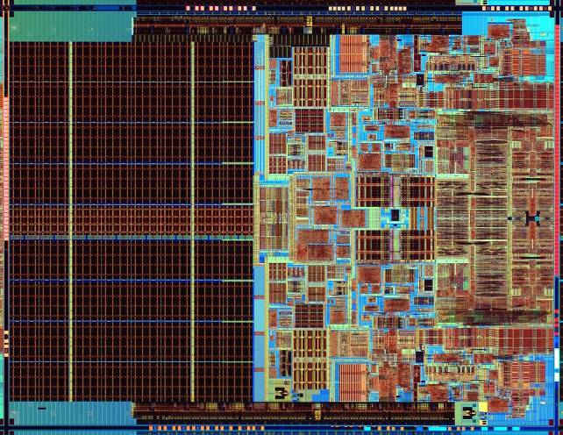
Central Processing Unit (CPU)
the CPU is the "brains" of the computer, responsible for controlling its inner workings
  made of circuitry – electronic components wired together to control the flow of electrical signals
  the circuitry is embedded in a small silicon chip, 1-2 inches square
  despite its small size, the CPU is the most complex part of a computer
    (CPU circuitry can have 100's of millions of individual components)
  commercial examples: Intel Core 2 Duo, Intel i5, AMD Sempron, AMD Athlon

Slide 14
CPU (cont.)
the CPU works by repeatedly fetching a program instruction from memory and executing that instruction
  individual instructions are very simple (e.g., add two numbers, or copy this data)
  complex behavior results from incredible speed
    a 2.2 GHz Celeron 450 processor can execute 2.2 billion instructions per second
    a 3.2 GHz Core i5 processor can execute 3.2 billion instructions per second
i5 is a multi-core processor
contains the circuitry of 4 separate processors, packaged on one chip
in theory, i5 can execute 4 instructions simultaneously
→ much faster than single-core Celeron

Slide 15
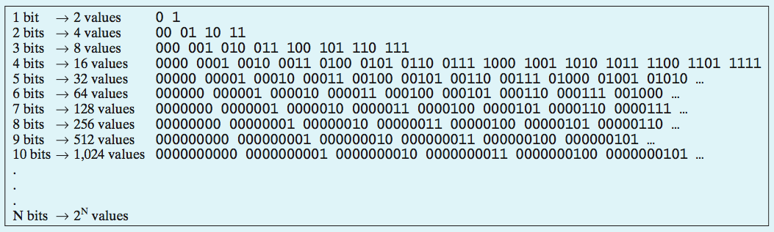
Memory
memory is the part of the computer that stores data and programs
modern computers are digital devices, meaning they store and process information as binary digits (bits)
  bits are commonly represented as either 0 or 1
  bits are the building block of digital memory
    by grouping bits together, large ranges of values can be represented

Slide 16
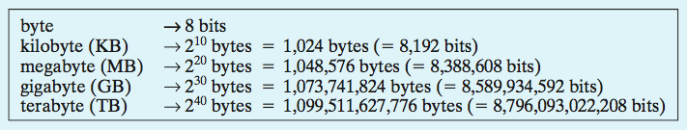
Memory (cont.)
memory capacity is usually specified in bytes
  a byte is a collection of 8 bits – so can represent a range of 2⁸ = 256 values
  large collections of bytes can be specified using prefixes
since a byte is sufficient to represent a single character, can think of memory in terms of text
  a kilobyte can store a few paragraphs (roughly 1 thousand characters)
  a megabyte can store a book (roughly 1 million characters)
  a gigabyte can store a small library (roughly 1 billion characters)
  a terabyte can store a book repository (roughly 1 trillion characters)

Slide 17
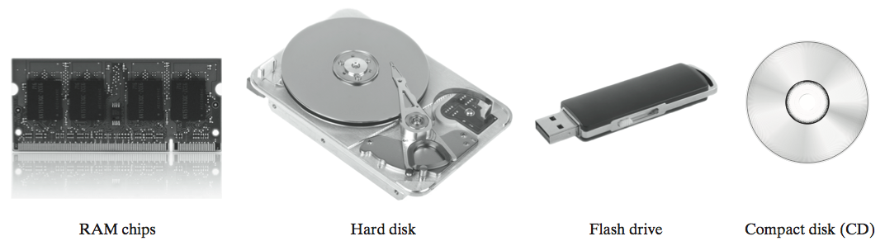
Memory (cont.)
modern computers use a combination of memory types, each with its own performance and cost characteristics
main memory (or primary memory) is fast and expensive
  data is stored as electric signals in circuitry, used to store active data
  memory is volatile – data is lost when the computer is turned off
  examples: Random Access Memory (RAM), cache
secondary memory or storage is slower but cheaper
  use different technologies (magnetic signals on hard disk, reflective spots on CD)
  memory is permanent – useful for storing long-term data
  examples: hard disk, flash drive, compact disk (CD)

Slide 18
Memory (cont.)
higher-end computers tend to have
  more main memory to allow for quick access to more data and programs
  more secondary memory to allow for storing more long-term data

Slide 19
Input/Output (I/O)
input devices allow the computer to receive data and instructions from external sources
  examples: keyboard, mouse, track pad, microphone, scanner
output devices allow the computer to display or broadcast its results
  examples: monitor, speaker, printer

Slide 20
Software
recall: hardware refers to the physical components of computers
software refers to the programs that execute on the hardware
a software program is a sequence of instructions for the computer (more specifically, for the CPU) to carry out in order to complete some task
  e.g., word processing (Microsoft Word, Corel WordPerfect)
  e.g., image processing (Adobe Photoshop, Flash)
  e.g., Web browsing (Internet Explorer, Mozilla Firefox)

Slide 21
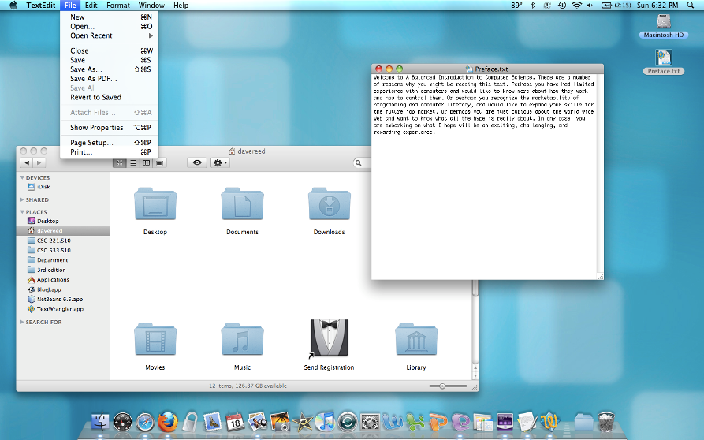
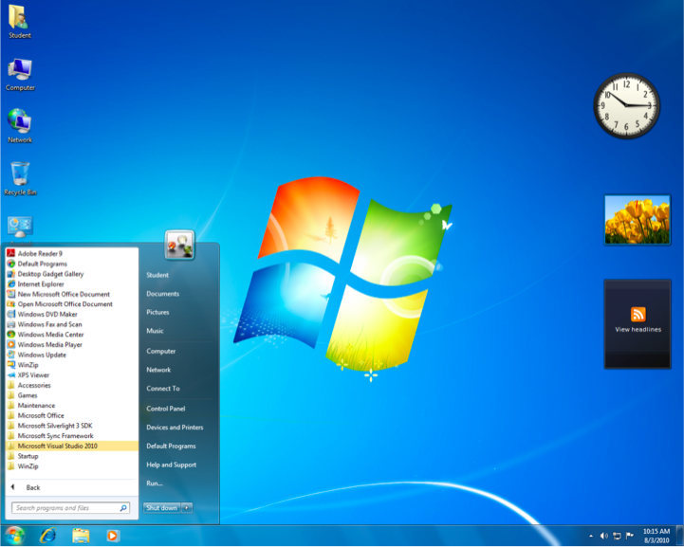
Operating Systems
the Operating System (OS) is a collection of programs that controls how the CPU, memory, and I/O devices work together
  kernel: manages the CPU's operations, controls how data and instructions are loaded and executed by the CPU, coordinates other hardware components
  file system: organizes and manages files and directories
  graphical user interface (GUI): provides intuitive, visual elements for interacting with the computer
    GUI's utilize windows, icons, menus, and pointers

Slide 22
Quick Net & Web Overview
the Internet is a vast, international network of computers
  the physical connections between computers vary, but the overall effect is that computers around the world can communicate and share resources
  the Internet traces its roots back to 1969, when the U.S. government sponsored the first long-distance computer network
  starting with only 4 computers, the network would eventually evolve into today's Internet
the World Wide Web is a collection of software that spans the Internet and enables the interlinking of documents and resources
  the basic idea for the Web was proposed by Tim Berners-Lee in 1989
  his system interlinked documents (including multimedia elements such as images and sound clips) over the Internet
  through the use of well-defined rules, or protocols, that define how they are formatted, documents could be shared across networks on various types of computers

Slide 23
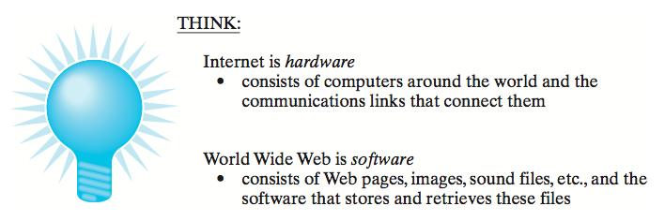
Internet ≠ World Wide Web
the Internet could exist without the Web
  and did, in fact, for many years (applications included email and news groups)
the Web couldn't exist without the Internet
  the Internet is the hardware that stores and executes the Web software

Slide 24
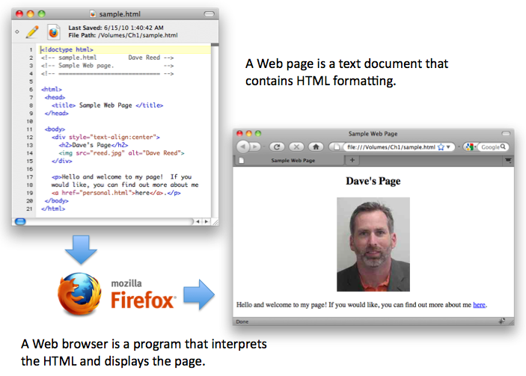
Viewing a Web Page
a Web page is a text document that contains additional formatting information in a language called HTML (HyperText Markup Language)
a Web browser is a program that accesses a Web page, interprets its content, and displays the page

Slide 25
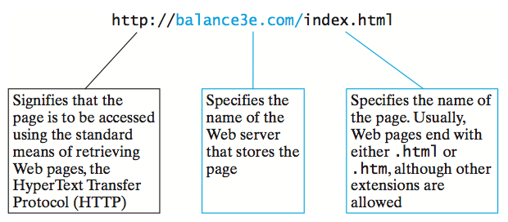
Web Addresses
a Web server is an Internet-enabled computer that stores Web pages and executes software for providing access to the pages
  when you request a Web page, the browser sends a request over the Internet to the appropriate server
  the server locates the specified page and sends it back to your computer
Web pages require uniform names to locate and identify them uniquely
  each page is assigned a Uniform Resource Locator (URL)
  URL's are commonly referred to as Web addresses
  the different parts of the Web address provide information for locating the page

Slide 26
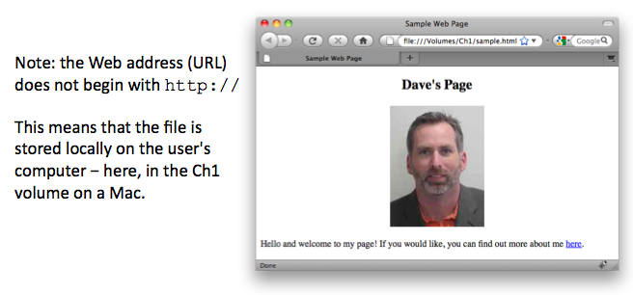
Viewing Local Web Pages
a Web browser can be used to view pages stored on the same computer
  can go through the File menu to select the local page, or
  can enter the File location in the address box (without the http prefix)
this feature is handy when developing Web pages
  can create a Web page and view it in the browser before uploading to a server

