Slide 1
A Balanced Introduction to Computer Science, 3/E
David Reed, Creighton University
©2011 Pearson Prentice Hall
ISBN 978-0-13-216675-1
Chapter 4
JavaScript and Dynamic Web Pages

Slide 2
Static vs. Dynamic Pages
recall: a Web page uses HTML tags to identify page content and formatting information
HTML can produce only static pages
  static pages look the same and behave in the same manner each time they are loaded into a browser
in 1995, researchers at Netscape developed JavaScript, a language for creating dynamic pages
  Web pages with JavaScript can change their appearance:
    over time (e.g., a different image each time that a page is loaded), or
    in response to a user’s actions (e.g., typing, mouse clicks, and other input methods)

Slide 3
Programming Languages
JavaScript is a programming language
  a programming language is a language for specifying instructions that a computer can execute
  each statement in a programming language specifies a particular action that the computer is to carry out
    (e.g., changing an image or opening a window when a button is clicked)
some programming languages are general-purpose
  popular languages include C++, Java, J#
JavaScript was defined for a specific purpose: adding dynamic content to Web pages
  can associate JavaScript statements with certain HTML elements so that they react to actions taken by the user (e.g., a button click)

Slide 4
Event Handlers
JavaScript code is associated with HTML element using event handler attributes
  the ONMOUSEOVER attribute specifies the statement(s) that are to be executed when the mouse is moved over the element
  the ONMOUSEOUT attribute specifies the statement(s) that are to be executed when the mouse is moved off the element
  for example, can have an image that reacts to mouse movements:
    <img src="ADDRESS_OF_IMAGE" alt="DESCRIPTIVE_TEXT"
    onmouseover="CODE_TO_EXECUTE_WHEN_MOUSE_GOES_OVER_IMAGE"
    onmouseout="CODE_TO_EXECUTE_WHEN_MOUSE_LEAVES_IMAGE">
the simplest type of action is to change the value of one of the other attributes of the element
  this is accomplished via a JavaScript assignment statement
    this.ATTRIBUTE_NAME = NEW_ATTRIBUTE_VALUE;

Slide 5
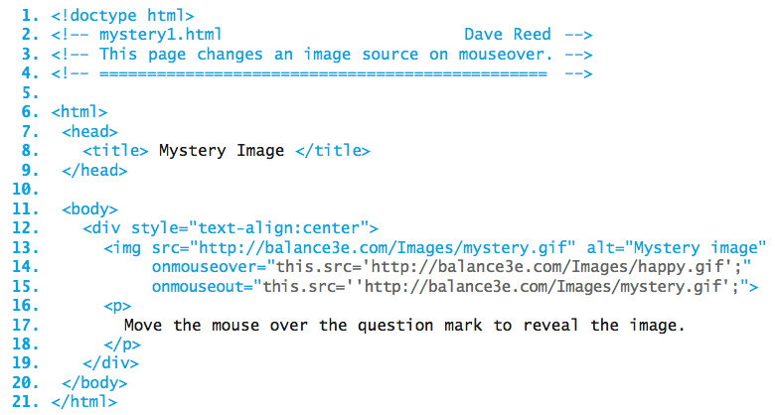
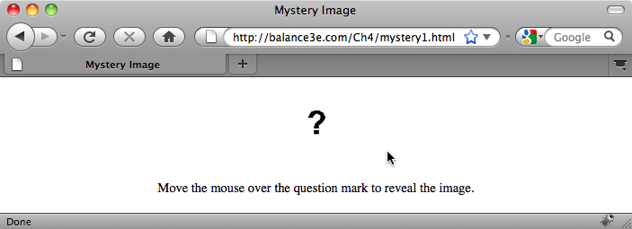
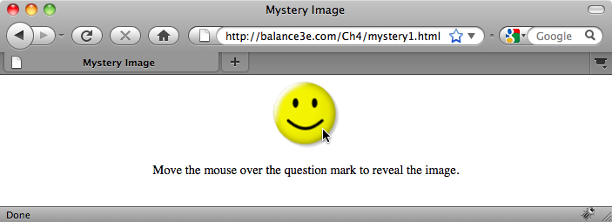
Mystery Image Page
initially, the image displays a '?'
when mouse moves over, SRC attribute is assigned to happy face
when mouse leaves, SRC attribute is assigned back to '?'

Slide 6
HTML/JavaScript Strings
a string is a sequence of characters enclosed in quotes
  strings appear in HTML attribute assignments (e.g., file name for SRC attribute)
  strings also appear in JavaScript assignments (e.g., attribute assignment within ONMOUSEOVER
    <img src="mystery.gif" alt="Mystery image"
    onmouseover="this.src='happy.gif';"
    onmouseout="this.src='mystery.gif';">
here, JavaScript assignments (gray text) are nested inside the HTML strings assigned to the event handlers
technically, strings can be represented using either single or double quotes
  to avoid confusion, we will always use double quotes for HTML strings; single quotes for JavaScript strings

Slide 7
Other Dynamic Attributes
can similarly change other element attributes using JavaScript assignments
  HEIGHT attribute of an IMG sets the height of the image (in number of pixels)
  WIDTH attribute of an IMG sets the width of the image (in number of pixels)
    <img src="mystery.gif" alt="Mystery image" height=85 width=85
    onmouseover="this.height=200; this.width=200;"
    onmouseout="this.height=85; this.width=85;">
here, moving the mouse over the image expands it from 85x85 pixels to 200x200 pixels
similarly, moving the mouse away reduces it back to 85x85 pixels
an event handler attribute can be assigned a series of attribute assignments (separated by semicolons)
  multiple assignments are executed in the order they appear

Slide 8
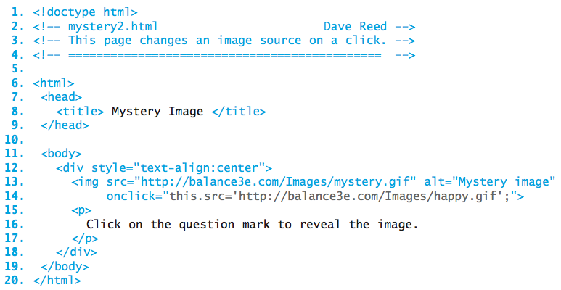
onclick Event Handler
another common event handler is the ONCLICK attribute
  specifies JavaScript statement(s) to be executed when the mouse is clicked on the element
    <img src="ADDRESS_OF_IMAGE" alt="DESCRIPTIVE_TEXT"
    onclick="CODE_TO_BE_EXECUTED_WHEN_MOUSE_CLICKS_ON_IMAGE">

Slide 9

Input buttons
the onclick attribute is often associated with buttons
  a button is an HTML element that appears as a labeled rectangle/oval
a button is a specific type of input element
  <input type="button" value="BUTTON_LABEL"
  onclick="CODE_TO_BE_EXECUTED_WHEN_MOUSE_CLICKS_ON_BUTTON">
typically, buttons are used to initiate actions on other elements
  e.g., click on a button to change the SRC or HEIGHT/WIDTH of an IMG
  need to be able to identify the element (as opposed to this.)
  document.getElementById('ELEMENT_ID')

Slide 10
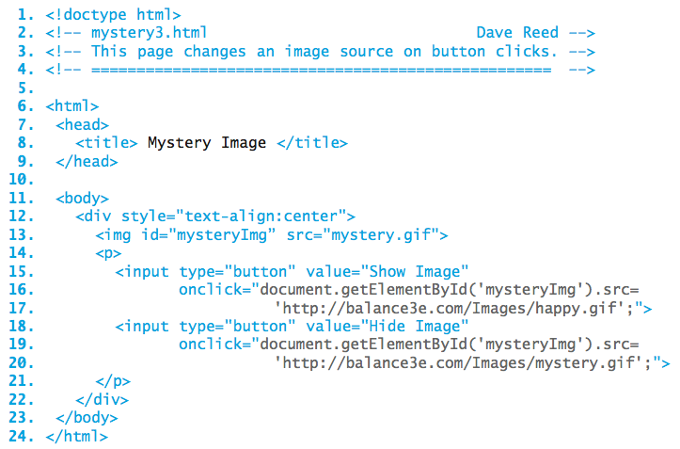
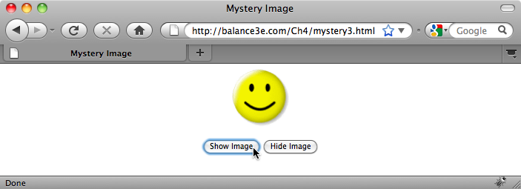
Button Version
each button click changes the SRC attribute of the element with ID mysteryImg
note: the IDs must match exactly, including the same capitalization

Slide 11
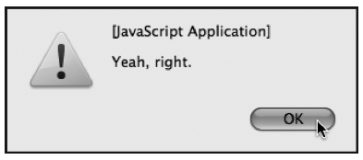
Dynamic Text
to display text within a page, there are 2 main options:
  alert statement: will display a text message in a separate alert window
    <input type="button" value="Click for free money!"
    onclick="alert('Yeah, right.');">
    alert windows are useful when you want to display
    a short (1-line) message
    can be annoying to the user since the pop-up
    window must be closed by clicking the OK button
  INNERHTML attribute: text elements (DIV, P, SPAN) have an attribute that specifies their text content
    you can change the text displayed in one of these elements by assigning a new string to its INNERHTML attribute
    advantages:
      the text is integrated into the page (not in a separate window)
      it can accommodate long messages
      it can incorporate HTML formatting (e.g., paragraphs using P, bold using B, …)

Slide 12
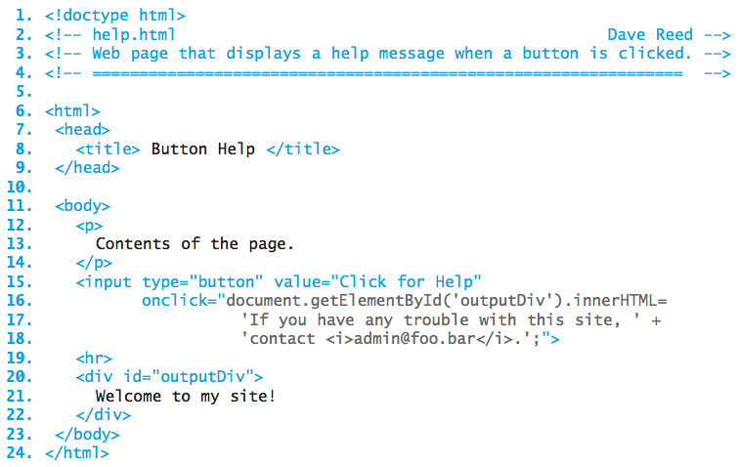
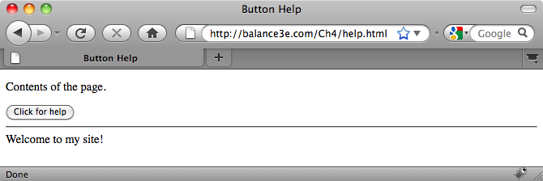
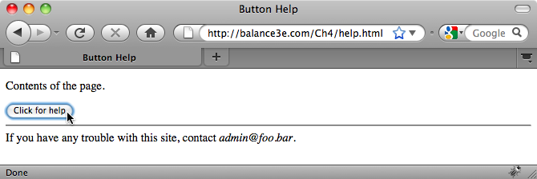
Help Page
initially, outputDiv displays a welcome message
when the button is clicked, that message is replaced with different text

Slide 13
Error Messages
an error in the format of an HTML or JavaScript statements is known as a syntax error
  some syntax errors are ignored by the browser
    e.g., misspelling an HTML tag name
  most JavaScript syntax errors will generate an error message
    Internet Explorer: must configure the settings to pop up error messages
    Firefox: must view the Error Console to see error messages
  recognizing common errors allows you to avoid them in the future
    Error: unterminated string literal
    alert('This example is illegal because the string is broken
    across lines');
    Error: missing ) after argument list OR
    Error: missing ; after statement
    alert('This example is illegal because '
    'there is not a + connecting the pieces');

Slide 14
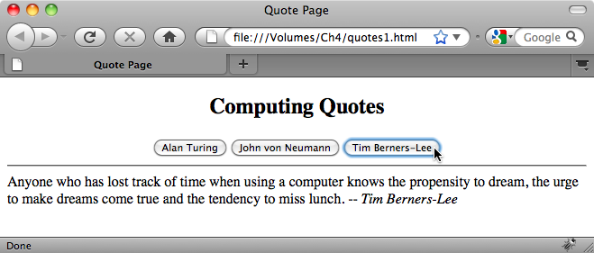
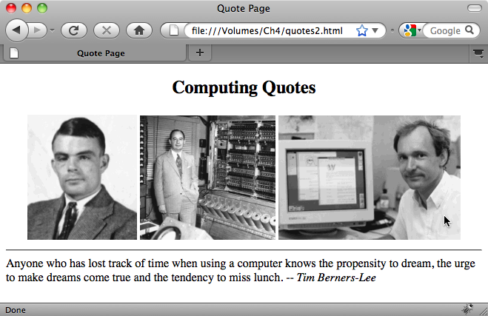
Example: Quotations Page
suppose we want to develop a page that displays favorite quotations in a page division
could use:
  a button for each quote, clicking the button displays the quote
  an image for each quote, moving the mouse over the image displays the quote

Slide 15
Apostrophes in Strings
if you want to display text that contains apostrophes, must be careful
  <input type="button" value="Welcome"
  onclick="document.getElementById('outputDiv').innerHTML=
  'Welcome to my page. I'm glad you're here.';">
  will cause an error, since the apostrophe in I'm will be interpreted as the closing quote in the string
to display an apostrophe in text, must precede it with an escape character (i.e., a backslash)
  <input type="button" value="Welcome"
  onclick="document.getElementById('outputDiv').innerHTML=
  'Welcome to my page. I\'m glad you\'re here.';">
  the escape character tells the browser that the apostrophe that follows is part of the string, not the closing quote

