Slide 1
A Balanced Introduction to Computer Science, 3/E
David Reed, Creighton University
©2011 Pearson Prentice Hall
ISBN 978-0-13-216675-1
Chapter 9
Abstraction and Libraries

Slide 2
Abstraction
abstraction is the process of ignoring minutiae and focusing on the big picture
  in modern life, we are constantly confronted with complexity
  we don't necessarily know how it works, but we know how to use it
  e.g., how does a TV work? a car? a computer?
we survive in the face of complexity by abstracting away details
  to use a TV/car/computer, it's not important to understand the inner workings
  we ignore unimportant details and focus on those features relevant to using it
  e.g., TV has power switch, volume control, channel changer, …
JavaScript functions (like Math.sqrt) provide computational abstraction
  a function encapsulates some computation & hides the details from the user
  the user only needs to know how to call the function, not how it works
  Chapter 7 introduced simple user-defined functions
    could encapsulate the statements associated with a button, call the function as needed

Slide 3
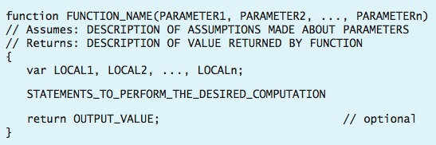
General Function Form
to write general-purpose functions, we can extend definitions to include:
1) parameters, 2) local variables, and 3) return statements
  parameters are variables that correspond to the function’s inputs (if any)
    parameters appear in the parentheses, separated by commas
  local variables are temporary variables that are limited to that function only
    if require some temporary storage in performing calculations, then declare local variables using the keyword var, separated by commas
    a local variable exists only while the function executes, so no potential conflicts with other functions
  a return statement is a statement that specifies an output value
    consists of the keyword return followed by a variable or expression

Slide 4
Declaring Local Variables
we have seen that variables are useful for storing intermediate steps in a complex computation
  within a user-defined function, the programmer is free to create new variables and use them in specifying the function’s computation
  however, by default, new variables used in a function are global (i.e., exist and are accessible anywhere in the page)
    but what if the same variable name is already used elsewhere?
to avoid name conflicts, the programmer should declare temporary variables to be local
  a variable declaration is a statement that lists all local variables to be used in a function (usually the first statement in a function)
  general form:
    var LOCAL_1, LOCAL_2, . . ., LOCAL_n;

Slide 5
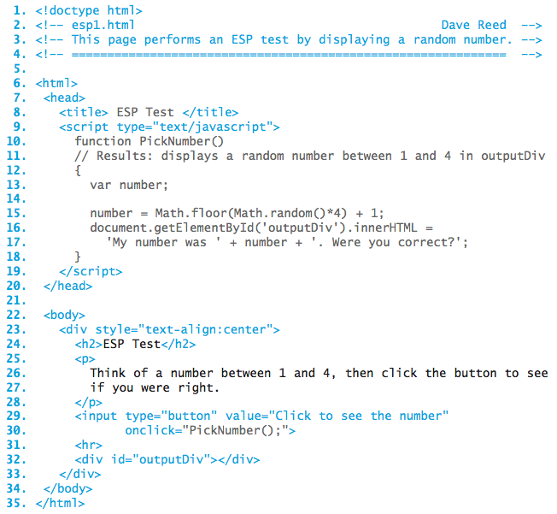
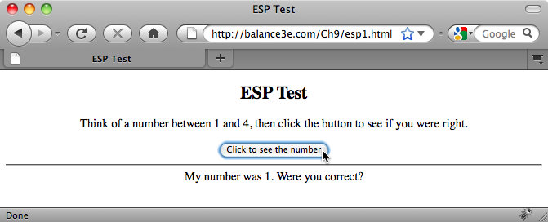
ESP Test Page
consider a simple ESP test
user thinks of a number between 1-4
clicks on the button to see the computer's pick
number is declared local to _x0010_pickNumber
only exists while the function executes

Slide 6
Functions with Inputs
most of the predefined function we have considered expect at least one input
  e.g., Math.sqrt takes a number as input, and returns its square root as output
      Math.sqrt(9) → 3
  e.g., Math.max takes two numbers as inputs, and returns the maximum as output
      Math.max(7, 3) → 7
in English, the word parameter refers to some aspect of a system that can be varied in order to control its behavior
  in JavaScript, a parameter is a variable (declared inside the function's parentheses) whose value is automatically initialized to the corresponding input value when the function is called
  parameters allow the same function to perform different (but related) tasks when called with different input values

Slide 7
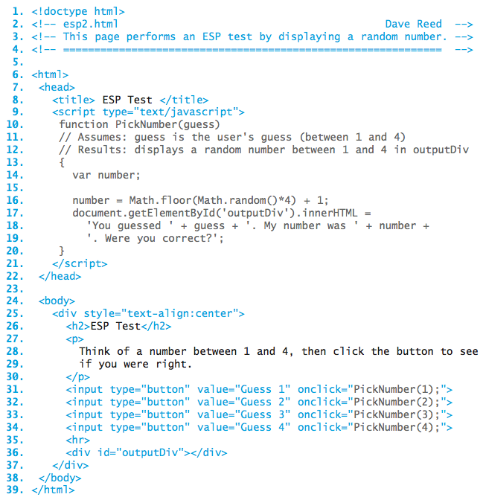
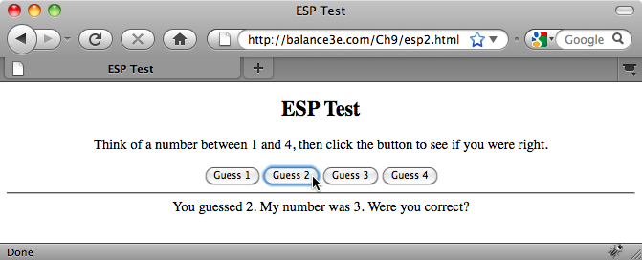
ESP Test Page Revisited
better design: have a button for each guess
  to guess 1, the user clicks the 'Guess 1' button
  instead of 4 different functions (that behave similarly), have 1 function with a parameter
  the number corresponding to the guess is passed in as an input, displayed as the guess

Slide 8
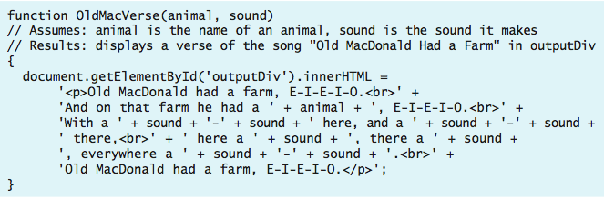
Multiple Inputs
if a function has more than one input,
  parameters in the function definition are separated by commas
  input values in the function call are separated by commas
  values are matched to parameters by order
    1st input value in the function call is assigned to the 1st parameter in the function
    2nd input value in the function call is assigned to the 2nd parameter in the function
    . . .
<input type="button" value="Cow Verse"
onclick="OldMacVerse('cow', 'moo');">

Slide 9
Parameters and Locals
parameters play an important role in functions
  they facilitate the creation of generalized computations
  i.e., the function defines a formula, but certain values within the formula can differ each time the function is called
parameters are special instances of local variables
  when the function is called, memory cells are allocated for the parameters and each input from the call is assigned to its corresponding parameter
  once a parameter has been assigned a value, you can refer to that parameter within the function just as you would any other variable
  when the function terminates, the parameters “go away,” and their associated memory cells are freed
parameters are declared and initialized automatically
  do not declare them as local variables

Slide 10
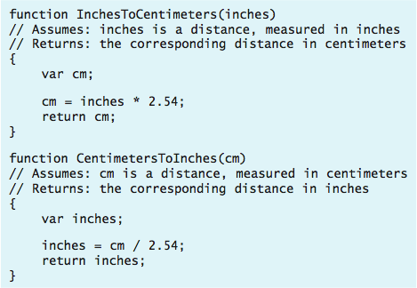
Functions with Return
displaying results using an INNERHTML assignment or alert is OK for some functions
  for full generality, we need to be able to return an output value, which can then be used in other computations
    e.g., number = Math.sqrt(9);
    cm = InchesToCentimeters(in);
a return statement can be added to a function to specify its output value
  when the return statement is reached, the variable or expression is evaluated and its value is returned as the function's output
  general form:
  return OUTPUT_VALUE;

Slide 11
Function Libraries
functions such as InchesToCentimeters can be added to the HEAD of a page
  tedious if the function is to be used in many pages
  involves creating lots of copies that all must be maintained for consistency
the alternative for general purpose functions is to place them in a library file
  a library file is a separate text file that contains the definitions of one or more JavaScript functions
  it can be loaded into any page by adding an HTML element to the HEAD
    <script type="text/javascript" src="LIBRARY_FILENAME"><script>
advantages of library files:
  avoids duplication (only one copy of the function definition)
  makes it easy to reuse functions (simply load the library file into any page)
  makes it easy to modify functions (a single change to the library file automatically affects all pages that load the library

Slide 12
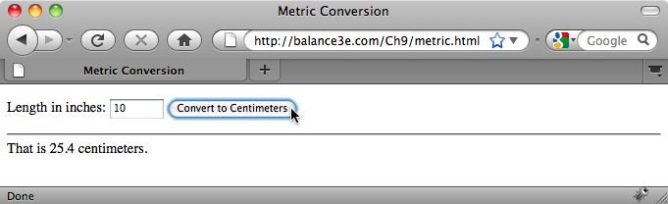
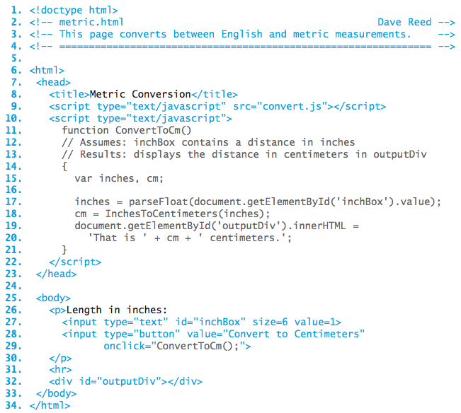
Conversion Page
  the convert.js library file is loaded into the page
  this makes the InchesToCentimeters function accessible within the page
  since ConvertToCm is specific to this page, it directly in the HEAD (as opposed to a library file)

Slide 13
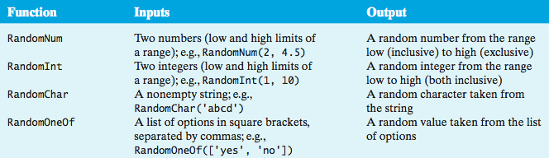
random.js Library
the random.js library contains useful functions for generating random values
any page can utilize the functions by first loading the random.js library
<script type="text/javascript" src="http://balance3e.com/random.js">
</script>
for example, could revise the ESP Test page to use RandomInt:
number = RandomInt(1, 4);

Slide 14
Errors to Avoid
When beginning programmers attempt to load a JavaScript code library, errors of two types commonly occur:
if the SCRIPT tags are malformed or the name/address of the library is incorrect, the library will fail to load
  this will not cause an error in itself, but any subsequent attempt to call a function from the library will produce
    Error: Object Expected (using Internet Explorer)
    or
    Error: XXX is not a function (using Firefox), where XXX is the entered name
when you use the SRC attribute in a pair of SCRIPT tags to load a code library, you cannot place additional JavaScript code between the tags
  think of the SRC attribute as causing the contents of the library to be inserted between the tags, overwriting any other code that was erroneously placed there
  <script type="text/javascript" src="FILENAME">
  ANYTHING PLACED IN HERE WILL BE IGNORED
  </script>
  if you want additional JavaScript code or another library, you must use another pair of SCRIPT tags

Slide 15
Designing Functions
functions do not add any computational power to the language
  a function definition simply encapsulates other statements
still, the capacity to define and use functions is key to solving complex problems, as well as to developing reusable code
  encapsulating repetitive tasks can shorten and simplify code
  functions provide units of computational abstraction – user can ignore details
  functions are self-contained, so can easily be reused in different applications
when is it worthwhile to define a function?
  if a particular computation is complex—meaning that it requires extra variables and/or multiple lines to define
  if you have to perform a particular computation repeatedly
when defining a function, you must identify
  the inputs
  the computation to be performed using those inputs
  the output

Slide 16
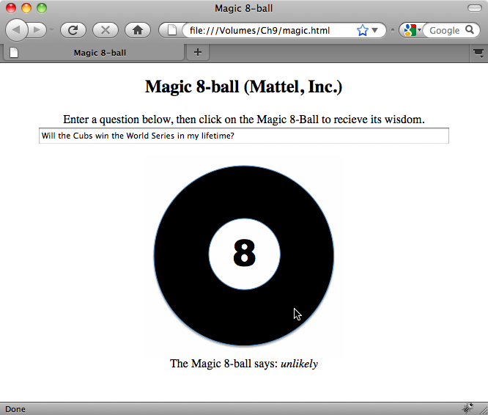
Design Example
consider the task of designing an online Magic 8-ball® (Mattell, Inc.)
  must be able to ask a yes/no type question
  receive an answer (presumably, at random)
could use:
  a text box for entering the question
  a DIV element for displaying the answer
  a clickable image for initiating the action – which involves calling a function to process the question, select an answer, and display it in the DIV

