Slide 1
A Balanced Introduction to Computer Science, 3/E
David Reed, Creighton University
©2011 Pearson Prentice Hall
ISBN 978-0-13-216675-1
Chapter 12
Data Representation

Slide 2
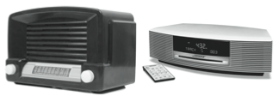
Analog vs. Digital
there are two ways data can be stored electronically
  analog signals represent data in a way that is analogous to real life
    signals can vary continuously across an infinite range of values
    e.g., frequencies on an old-fashioned radio
    with a dial
  digital signals utilize only a finite set of values
    e.g., frequencies on a modern radio with
    digital display
the major tradeoff between analog and digital is variability vs. reproducibility
  analog allows for a (potentially) infinite number of unique signals, but they are harder to reproduce
    good for storing data that is highly variable but does not need to be reproduced exactly
  digital signals limit the number of representable signals, but they are easily remembered and reproduced
    good for storing data when reproducibility is paramount

Slide 3
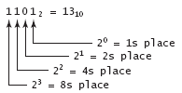
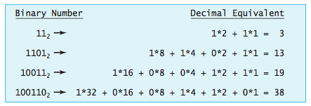
Binary Numbers
modern computers save and manipulate data as discrete (digital) values
  the most effective systems use two distinct binary states for data representation
  in essence, all data is stored as binary numbers
in the binary number system, all values are represented using only the two binary digits 0 and 1, which are called bits
binary representation
converting binary to decimal

Slide 4

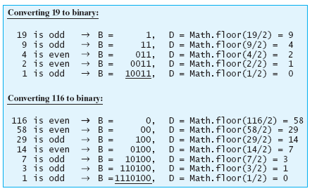
Decimal → Binary
algorithm for converting from decimal (D) to binary (B):

Slide 5
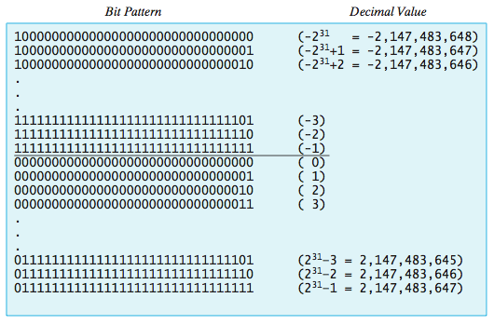
Representing Integers
when an integer value must be saved on a computer, its binary equivalent can be encoded as a bit pattern and stored digitally
usually, a fixed size (e.g., 32 bits) is used for each integer so that the computer knows where one integer ends and another begins
  the initial bit in each pattern acts as the sign bit (0=positive, 1=negative)
  negative numbers are represented in two’s complement notation
    the "largest" bit pattern corresponds to the smallest absolute value (-1)

Slide 6
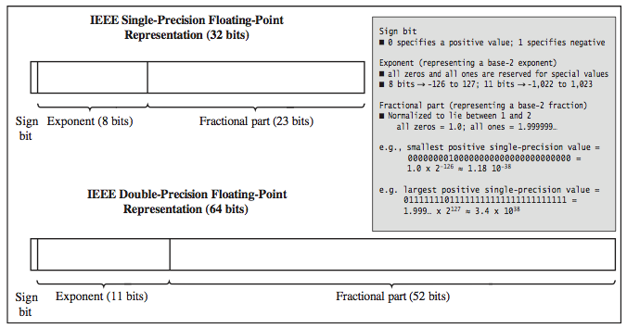
Representing Real Numbers
a real number can be uniquely identified by the two components of its scientific notation (fractional part and the exponent)
  123.45 = 12345 x 10⁻² .000042 = 42 x 10⁻⁶
thus, any real number can be stored as a pair of integers
  real numbers stored in this format are known as floating point numbers, since the decimal point moves (floats) to normalize the fraction
  standard formats exist for storing real numbers, using either 32 or 64bits
most programming languages represent integers and reals differently
JavaScript simplifies things by using IEEE double-precision floating point for all numbers

Slide 7
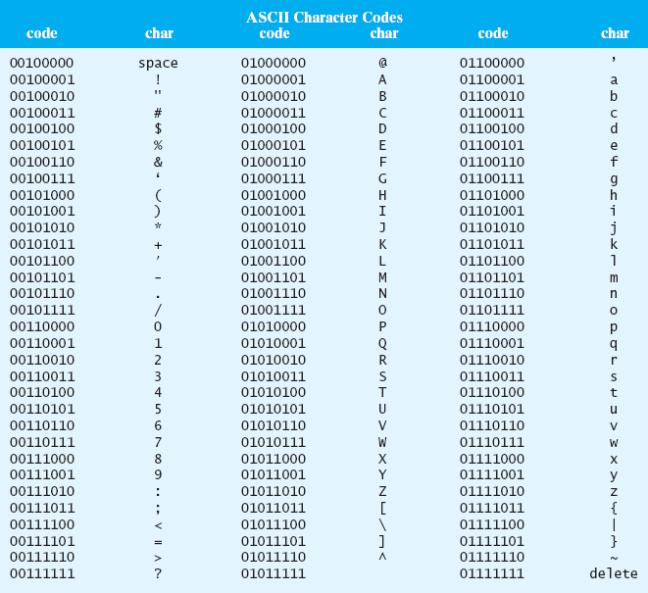
Representing Characters
characters have no natural correspondence to binary numbers
  computer scientists devised an arbitrary system for representing characters as bit patterns
  ASCII (American Standard Code for Information Interchange)
    maps each character to a specific 8-bit pattern
    note that all digits are contiguous, as are lower- and upper-case letters
    '0' < '1' < … < '9'
    'A' < 'B' < … < 'Z'
    'a' < 'b' < … < 'z'
  Unicode is a 16-bit extension to ASCII that supports other languages

Slide 8

Representing Text
strings can be represented as sequences of ASCII codes, one for each character in the string
specific programs may store additional information along with the ASCII codes
  e.g. programming languages will often store the number of characters along with the ASCII codes
  e.g., word processing programs will insert special character symbols to denote formatting (analogous to HTML tags in a Web page)

Slide 9
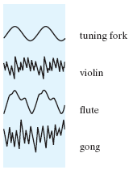
Representing Sounds
computers are capable of representing much more than numbers and text
  complex data requires additional techniques and algorithms
EXAMPLE: representing sounds
  sounds are inherently analog signals with a specific amplitudes and frequencies
  when sound waves reach your ear, they cause
  your eardrum to vibrate, and your brain
  interprets the vibration as sound
  e.g. telephones translate a waveform into
  electrical signals, which are then sent over
  a wire and converted back to sound
  e.g. phonographs interpret waveforms stored on
  on grooves of a disk (similar to audio cassettes)
  analog signals cannot be reproduced exactly,
  but this is not usually a problem since the
  human ear is unlikely to notice small
  inconsistencies

Slide 10
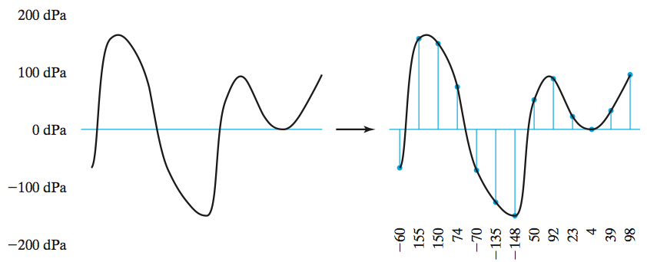
Representing Sounds (cont.)
when analog recordings are repeatedly duplicated, small errors that were originally unnoticed begin to propagate
digital recordings can be reproduced exactly without any deterioration
in sound quality
  analog waveforms must be converted to a sequence of discrete values
  digital sampling is the process in which the amplitude of a wave is measured at regular intervals, and stored as discrete measurements
  frequent measurements must be taken to ensure high quality (e.g., 44,100 readings per second for a CD)
    this results in massive amounts of storage
    techniques are used to compress the data and reduce file sizes (e.g., MP3, WAV)

Slide 11
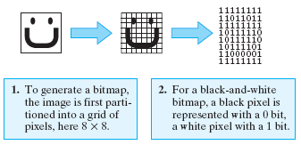
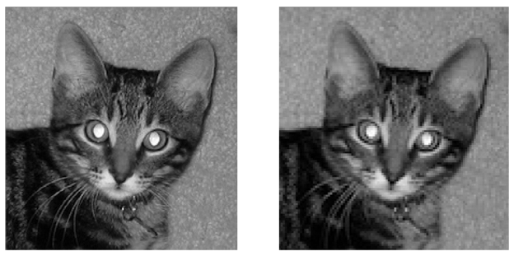
Representing Images
EXAMPLE: representing images
  images are stored using a variety of formats and compression techniques
  the simplest representation is a bitmap
  bitmaps partition an image into a grid of picture elements, called pixels, and then convert each pixel into a bit pattern
resolution refers to the sharpness or clarity of an image
  bitmaps that are divided into smaller pixels will yield higher resolution images
  the left image is stored using 72pixels per square inch, and the right image is stored using 36pixels per square inch
    the left image appears sharp, but has twice the storage requirements

Slide 12
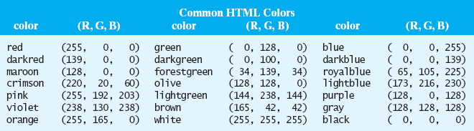
Representing Images (cont.)
when creating a bitmap of a color image, more than one bit is required to represent each pixel
  the most common system is to translate each pixel into a 24 bit code, known as its RGB value: 8 bits to represent the intensity of each red/green/blue component
common image formats implement various compression techniques to reduce storage size
  GIF (Graphics Interchange Format)
    a lossless format, meaning no information is lost in the compression
    commonly used for precise pictures, such as line drawings
  PNG(Portable Network Graphics)
    more modern alternative to GIF - more colors, 10-50% more compact
  JPEG (Joint Photographic Experts Group)
    a lossy format, so the compression is not fully reversible (but more efficient)
    commonly used for photographs

Slide 13
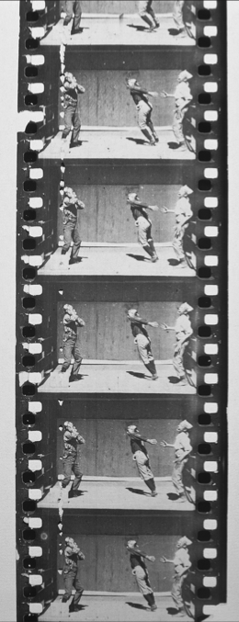
Representing movies
in principle, a movie is a sequence of images (frames) that are displayed in sequence to produce the effect of motion
  typically, 24 frames/sec
MPEG or MP4 format uses a variety of techniques to compress video
  individual frames use techniques similar to JPEG
  since much of successive frames are same, need only store changes from frame to frame
elements of MPEG are included in the ATSC (Advanced Television Systems Committee) standard for digital TV
  individual frames use techniques similar to JPEG
other related formats are DVD & Blu-Ray

Slide 14
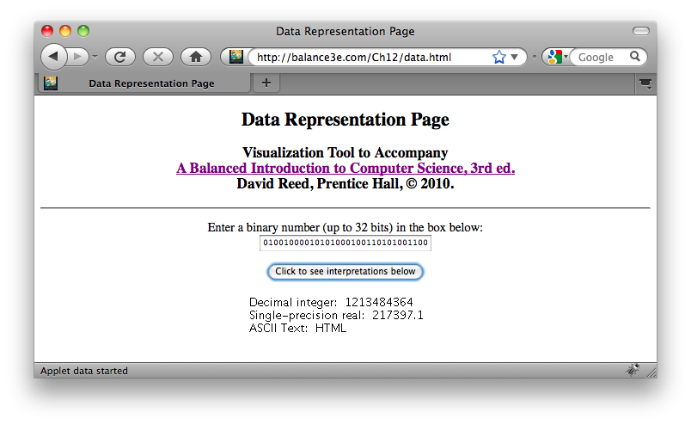
Distinguishing Data Types
how does a computer know what type of value is stored in a particular piece of memory?
  short answer: it doesn't
  when a program stores data in memory, it must store additional information as to what type of data the bit pattern represents
  thus, the same bit pattern might represent different values in different contexts

