Slide 1
A Balanced Introduction to Computer Science, 3/E
David Reed, Creighton University
©2011 Pearson Prentice Hall
ISBN 978-0-13-216675-1
Chapter 15
JavaScript Strings

Slide 2
Strings as Objects
so far, your interactive Web pages have manipulated strings in simple ways
  use text box to input a word or phrase
  store that text in a (string) variable
  incorporate the text in a message, possibly using + to concatenate
strings are different from numbers and Booleans in that they are objects
  a software object is a unit of code that encapsulates both data and operations that can be performed on that data
  a string is a software object that models words and phrases
    data: a sequence of characters, enclosed in quotes
    operations include: make upper case, make lower case,
  determine the number of characters,
  access a particular character,
  search for a particular character, …

Slide 3
Object-Oriented Programming
objects are fundamental in the dominant approach to developing software systems: object-oriented programming (OOP)
  OOP encourages programmers to design programs around software objects
    the programmer identifies the real-world objects involved in a system
      (e.g., for a banking program: bank account, customer, teller, …)
    then designs and builds software objects to model these real-world objects
  OOP is effective for managing large systems, since individual objects can be assigned to different teams and developed independently
  OOP also supports code reuse, since the same or similar objects can be combined in different ways to solve different kinds of problems
example: a doorbell button
  has physical components/properties: color, shape, label, …
  has functionality: when you press the button, the bell rings
an HTML button is a software object that models a real-world button
  has physical components/properties: color, shape, label, …
  has functionality: when you click on the button, JavaScript code is executed

Slide 4
Properties and Methods
using object-oriented terminology,
  the characteristics of an object are called properties
    e.g., a string object has a length property that identifies the number of characters in the string
  the operations that can be performed on the string are called methods
    e.g., the toLowerCase method makes a copy of the string with all upper-case letters converted to lower-case
properties and methods are not new concepts
  a property is a special kind of a variable (it stores a value)
  a method is a special kind of function (it performs some action)
what is special is that they are associated with (or "belong to") an object
  e.g., each string object will have its own variable to stores it length
to access an object property, specify: object name, a period, property name
  str1 = 'foo'; str2 = 'Hi there';
  len1 = str1.length; len2 = str2.length;

Slide 5
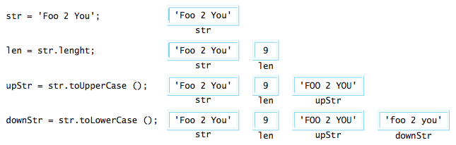
Properties and Methods
similarly, to call a method: object name, period, method call
  e.g., str.toLowerCase() calls the toLowerCase method on str
    (which returns a lowercase copy of the string)
  e.g., str.toUpperCase() calls the toUpperCase method on str
    (which returns an uppercase copy of the string)
note: the toLowerCase and toUpperCase methods do not change the string object they are called on (only an assignment can do that!)
  instead, they return modified copies of the string

Slide 6
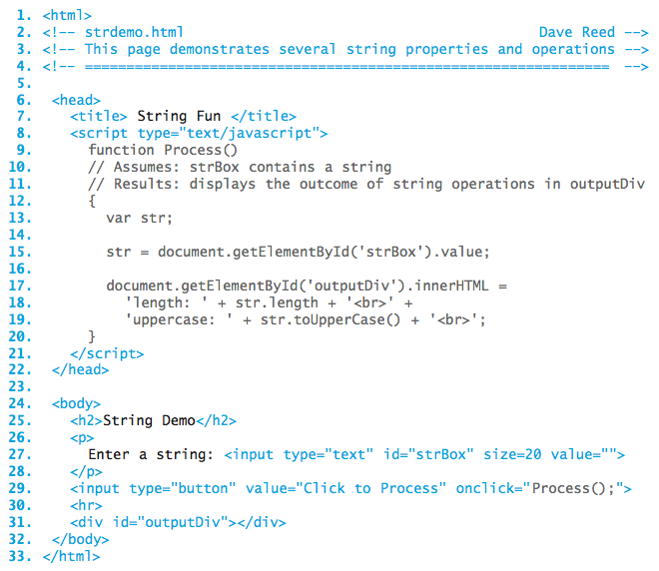
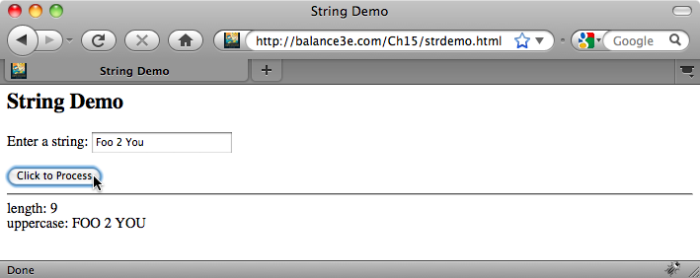
String Manipulation Page

Slide 7
Common String Methods
useful methods exist that allow programmers to access and manipulate individual components of a string
  components are identifiable via indices, or numbers that correspond to the order in which individual characters occur in a string
  indices are assigned in ascending order from left to right, so that the first character in the string is at index 0
the charAt method provides access to a single character within the string
  it takes an index as an input and returns the character at that particular index
    word = 'foo';
    ch = word.charAt(0); // ASSIGNS ch = 'f'
the substring method provides access to an entire sequence of characters within the string
  it takes two numbers as inputs, representing the starting (inclusive) and ending (exclusive) indices of the substring, and returns the substring
    word = 'foo';
    sub = word.substring(1, 3); // ASSIGNS sub = 'oo'

Slide 8
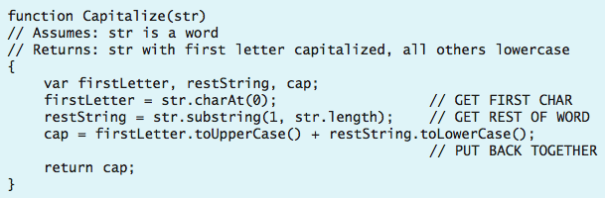
String Access/Concatenation
recall: the concatenation operator (+) can join strings together
assuming the variable word stores a string value, what affect would the following assignment have?
    word = word.charAt(0) + word.substring(1, word.length);
the following function takes a string as input and uses string method calls to create (and return) a capitalized version of that string

Slide 9
Searching Strings
the search method traverses a string in order to locate a given character or substring
  it takes a character or string as input and returns the index at which the character or string first occurs (or -1 if not found)
    str = 'banana';
    num1 = str.search('n'); // ASSIGNS num1 = 2 since the character
    // 'n' first occurs at index 2
    num2 = str.search('ana'); // ASSIGNS num2 = 1 since the string
    // 'ana' first occurs at index 1
    num3 = str.search('z'); // ASSIGNS num3 = -1 since the character
    // 'z' does not occur anywhere
simple application: determine whether a string is a single word or a phrase
  if the string contains no spaces, the call str.search(' ') will return -1, indicating that the string value consists of a single word
  if str.search(' ') returns a nonnegative value, then the presence of spaces signifies a phrase containing multiple words

Slide 10
General Searches
there are times when you want to search for a type of character, rather than a specific value
example: converting a word into Pig Latin
  if a word contains no vowels or begins with a vowel, the characters 'way' are appended to the end of the word
    nth → nthway apple → appleway
  if a word begins with a consonant, its initial sequence of consonants is shifted to the end of the word followed by 'ay'
    banana → ananabay cherry → errychay
  in order to distinguish between these two cases, must search for the first vowel
    then, use the substring method to break the string into parts and the + operator to put the pieces back together (with 'ay')
    cherry → erry + ch + ay = errychay

Slide 11
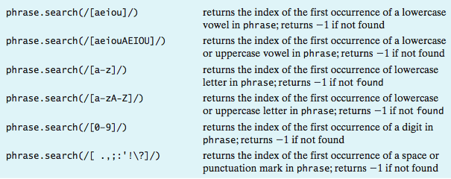
General Searches
rather than having to search for vowels individually, an entire class of characters can be specified using /[ . . . ]/

Slide 12
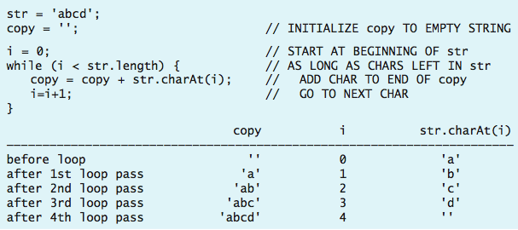
Strings and Repetition
some tasks involve repeatedly performing the same operations
  to accomplish such tasks, we can combine while loops with string methods such as charAt and search
example: a while loop used to access and process each character in a string
  the characters that comprise the string are concatenated one-by-one onto another string, resulting in an exact copy

Slide 13
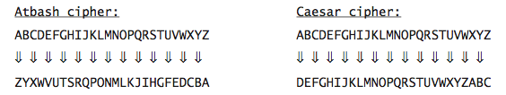
Example: Substitution Ciphers
a substitution cipher is a code for encrypting/decrypting messages
  one letter of the alphabet is substituted for another in the message
  Atbash cipher (500 B.C.) was used by Hebrew scribes
  Caesar cipher (50-60 B.C.) was used by Julius Caesar
  ABC → ZYX ABC → DEF
  HELLO → SVOOL HELLO → KHOOR
substitution ciphers are easy to understand and use
  26! ≈ 4 x 10²⁶ possible substitution keys

Slide 14
Text Areas
a text area is similar to a text box but it can contain any number of text lines
general form of a text area element:
  <textarea id='AREA_ID' rows=NUM_ROWS cols=NUM_COLS>
  INITIAL_TEXT
  </textarea>
  the ID attribute gives the element an identifier so that it can be referenced
  the ROWS attribute specifies the height (number of text lines) of the area
  the COLS attribute specifies the width (number of characters) of the area
unlike a text box, opening and closing tags are used to define a text area
  any text appearing between the tags will be the initial text in the text area
  otherwise, the contents of a text area are accessed/assigned in the same way
  document.getElementById('AREA_ID').value

Slide 15
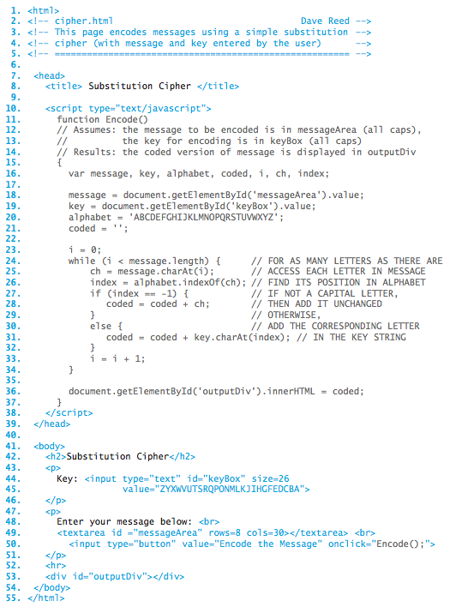
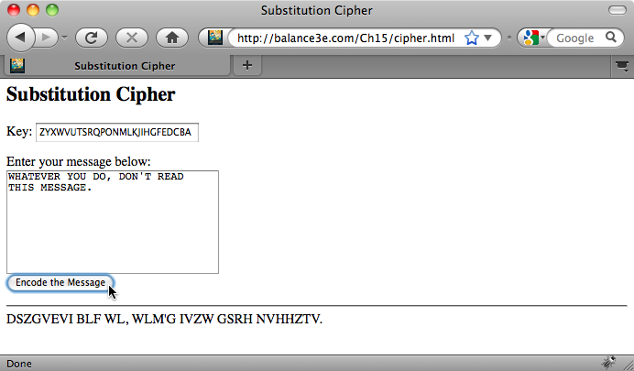
Encoding a message
pseudocode:
  for as many letters as there are in the message
    get the next character in the message
    find its position in the alphabet
    find the corresponding letter in the key
    use that letter to encode the current letter in the message

