Slide 1
A Balanced Introduction to Computer Science, 3/E
David Reed, Creighton University
©2011 Pearson Prentice Hall
ISBN 978-0-13-216675-1
Chapter 17
JavaScript Arrays

Slide 2

Arrays as Objects
earlier, we introduced the concept of software objects: programming structures that encompass both data (properties) and operations (methods)
  e.g., a string object has properties (e.g., length) and methods (e.g., charAt) that enable the programmer to easily store and manipulate text
like strings, JavaScript arrays are objects that encapsulate multiple values and their associated properties and methods
  unlike strings (which store only text characters), the items in an array can be of any data type
  an array consists of a sequence of items, enclosed in square brackets and separated by commas
  when assigning values to arrays:
    an item can appear in an array more than once
    array items can be specified as expressions
    arrays can be empty

Slide 3
Accessing Items in an Array
since an array stores a series of values, its associated memory cell can be envisioned as divided into components, each containing an individual value
array items are assigned sequential indices, allowing programmers to identify an item by its corresponding index
array access is accomplished by specifying the name of the array object, followed by the index of the desired item in brackets
  the first item is misc[0], the second is misc[1], …, the last is misc[length-1]
  if an index is specified beyond the scope of an array, the access yields undefined

Slide 4
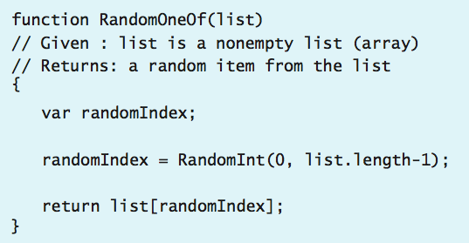
Array Access Example
we now can understand how the RandomOneOf function from random.js works
  the input to the function is a nonempty array of arbitrary items
  the RandomInt function is called to pick a random index from the array (between 0 and the last index, list.length-1)
  the bracket notation is used to access the item at that index, which is then returned by the function

Slide 5

Assigning Items in an Array
array items can be assigned values just like any variable
  suppose the array misc has been assigned to store the following
  the assignment misc[0] = 1000; would store the value 1000 as the first item in the array, overwriting the value that was previously there
if the index in an assignment statement is beyond the array’s current length, the array will automatically expand to accommodate the new item
  the assignment misc[8] = 'oops'; would store 'oops' at index 8

Slide 6
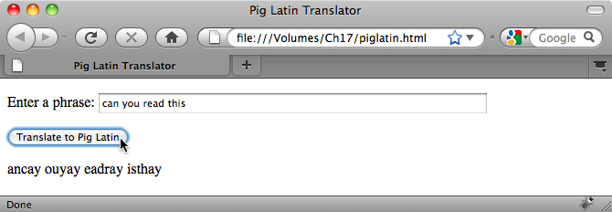
From Strings to Arrays
so far, our Web pages have handled each input from the user as a single string
  this approach is limiting since many programming tasks involve separately processing an arbitrary number of words or numbers entered by the user
  recall the Pig Latin page
  we might want to generalize the page so that it translates entire phrases instead of just words
  that is, the user would enter an arbitrary sequence of words and each word would be translated
  this task would be very difficult using our current set of programming tools

Slide 7
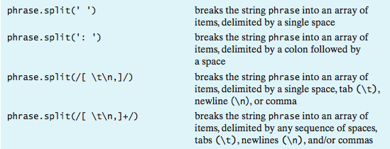
String split Method
JavaScript strings provide a method, split, for easily accessing the components of a string
  the only input required by the split method is a character (or sequence of characters) that serves as a delimiter for breaking apart the string
  the split method separates the string into component substrings at each occurrence of the delimiter, and returns an array consisting of those substrings
    user = 'Grace Murray Hopper';
    arr1 = user.split(' '); // ASSIGNS arr1 to be the array
    // ['Grace', 'Murray', 'Hopper']
  as was the case with strings, /[ … ]/ can be used to specify groups of characters

Slide 8
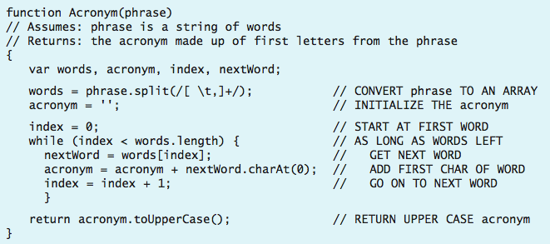
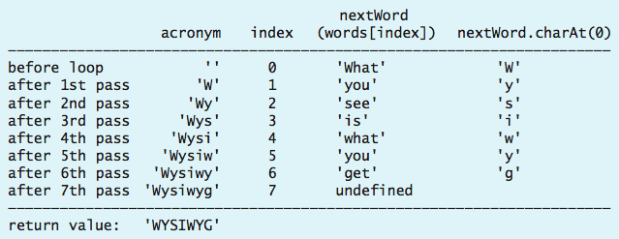
Example: Generating Acronyms
one interesting application of the split method is in deriving acronyms
  acronyms (terms made from the first letters of words in a phrase) are especially popular in the computing field
    RAM – Random Access Memory
    GUI – Graphical User Interface
    WWW – World Wide Web
the Acronym function in arrays.js takes a phrase, such as "What you see is what you get", splits it into an array of individual words, then extracts the first letters to construct the acronym

Slide 9
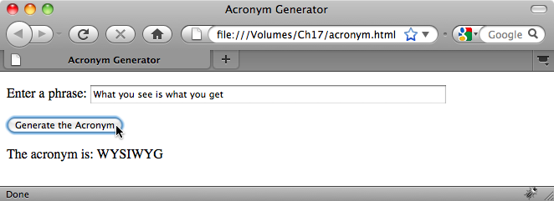
Acronym Page
the Acronym function can be integrated into a Web page
  the user enters a phrase in a text area
  a button is defined to call the Acronym function with the text box contents as input
  the result returned by the function call is displayed in another text box

Slide 10
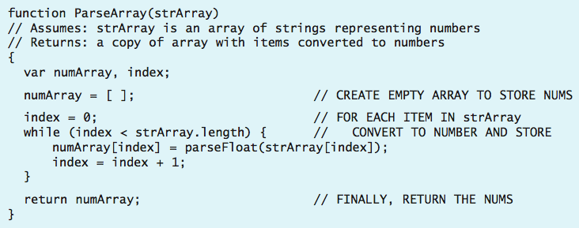
Arrays of Numbers
some applications involve reading and manipulating sequences of numbers
  e.g., suppose we wanted to calculate the average of some number of grades
  we could enter the numbers in one big string, separated by spaces, then
    use the split function to separate out the individual numbers
    then, traverse the resulting array and calculate the sum and average of the numbers
note: even if the input string contains numerical digits, split returns each array item as a string (similar to text box/area access)
  arrays.js contains a function that traverses an array and converts each item to a number

Slide 11
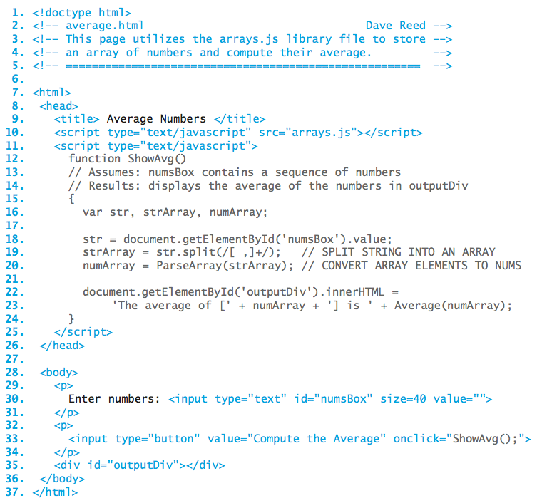
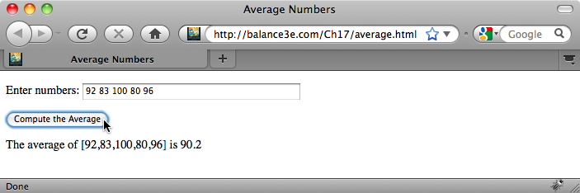
Average Page
this page averages an arbitrary number of grades (entered as a string in a text box)
utilizes split to split the string into an array of strings
utilizes ParseArray to convert into an array of numbers

Slide 12
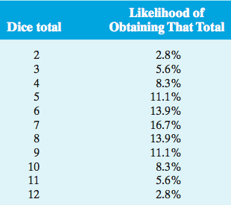
Example: Dice Stats
recall our web page for simulating repeated dice rolls and recording the number of times that a specific total was obtained
  statistical analysis predicts that, given a large number of dice rolls, the distribution of totals will closely mirror the percentages listed below

Slide 13
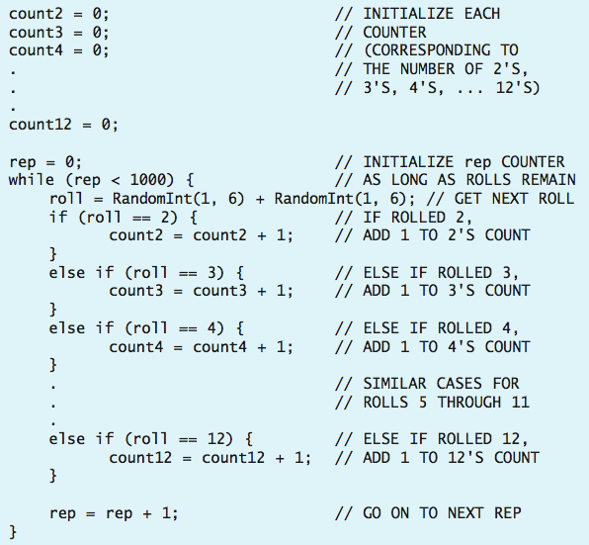
Approach 1: Separate Counters
to obtain a valid distribution of dice totals, we would need to simulate a large number of rolls and simultaneously count the occurrences of every total
  this can be accomplished by defining 11 counters, each corresponding to a particular total
  however, this would be extremely tedious
  requires separate assignment statements for all 11 counters
  requires a cascading if-else statement with 11 cases
  not easily generalized – what if we wanted to use 8-sided dice?

Slide 14
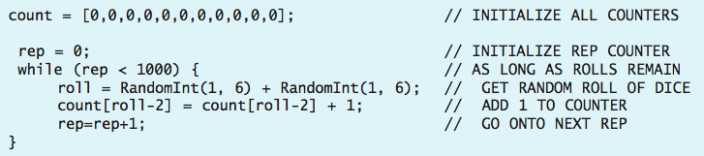
Approach 2: Array of Counters
instead of representing each counter as a separate variable, we can define the counters as items in an array
  all 11 counters can be stored in an array and initialized via a single assignment statement
  any individual counter can be accessed and updated via its corresponding index
    since the first possible total is 2, its count is stored in index 0
    the next possible total, 3, has its count stored in index 1
    …
    for an arbitrary roll, its count is stored in index roll-2
  the resulting code is shorter, simpler, and easier to generalize

Slide 15
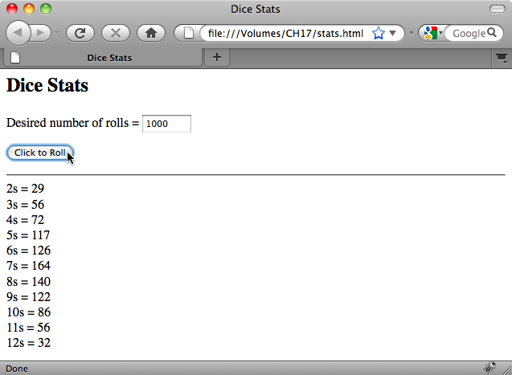
Dice Stats Page
code for maintaining statistics on repeated dice rolls can be integrated into a Web page
  the number of rolls to be simulated is entered by the user into a text box
  a button is defined to call the code for repeatedly simulating the roll and maintaining stats, with the text box contents as input
  the numbers of rolls for each total are then displayed in a page division

Slide 16

Example: ASCII Animations
ASCII art (pictures made of keyboard characters) was popular in the 70s-80s
  can generalize still pictures to moving animations
  recall: a movie is a sequence of frames (individual images) that are displayed in rapid succession
  can build an animation out of a sequence of ASCII art frames
when played in succession, these ASCII art frames would appear as a stick person doing jumping jacks

Slide 17
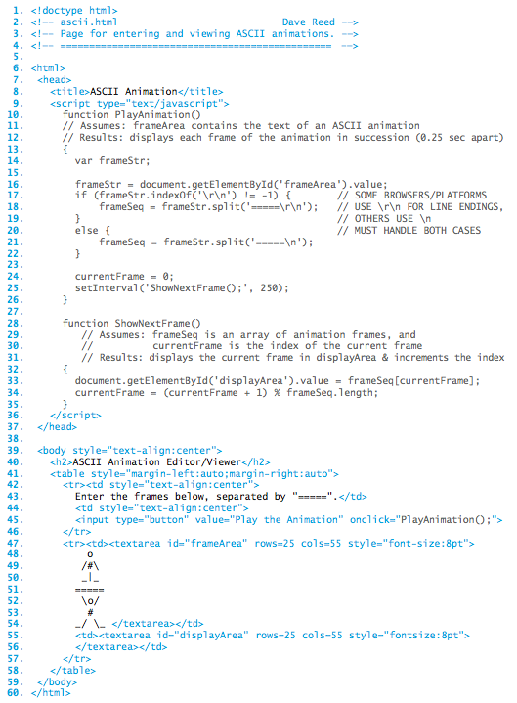
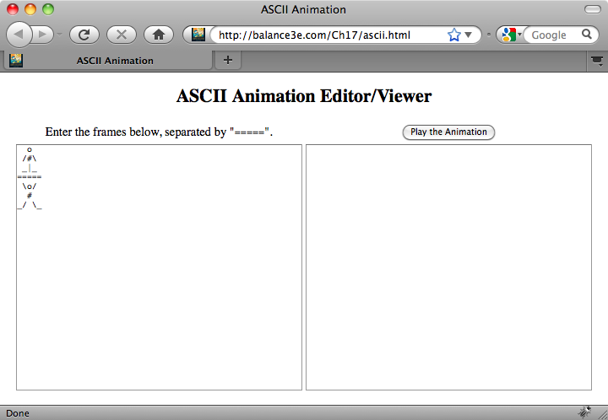
ASCII Animation
Page
the user enters the frames in a text area, separated by '====='
frames are extracted using split
setInterval is used to display successive frames every ¼ second

