Slide 1
A Balanced Introduction to Computer Science, 3/E
David Reed, Creighton University
©2011 Pearson Prentice Hall
ISBN 978-0-13-216675-1
Chapter 2
HTML and Web Pages

Slide 2
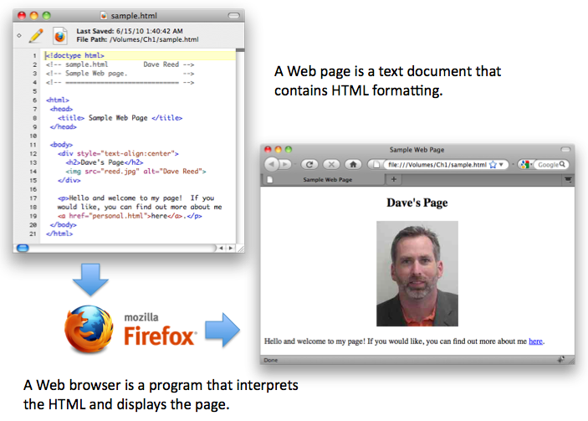
HTML & Web Pages
recall: a Web page is a text document that contains additional formatting information in the HyperText Markup Language (HTML)
  HTML specifies formatting within a page using tags
  in its simplest form, a tag is a word or symbol surrounded by brackets (<>)

Slide 3
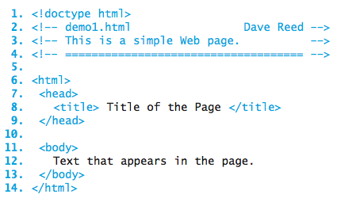
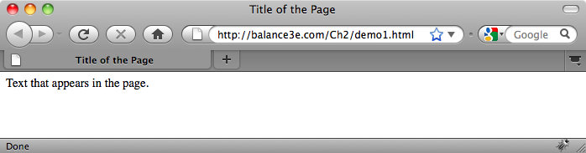
HTML Tags
required tags in a Web page:
  <html> and </html> enclose the entire HTML document
  the HEAD section (enclosed between <head> and </head>) contains information that the browser uses to control the look of the page
    the HEAD can contain a title for the browser window, enclosed between <title> and </title>
  the BODY section (enclosed between <body> and </body>) contains the text that will appear in the page

Slide 4
HTML Elements
tags and the text they enclose form an HTML element
  <title> Title of the Page </title> is a TITLE element
  <head>
  <title> Title of the Page </title>
  </head>
  is a HEAD element (which contains a nested TITLE element)
most HTML elements have opening and closing tags, but not all
  <!-- demo1.html Dave Reed --> is a COMMENT element
  a comment is ignored by the browser (it does not appear in the rendered page)
  comments are used by the page developer to document page features

Slide 5
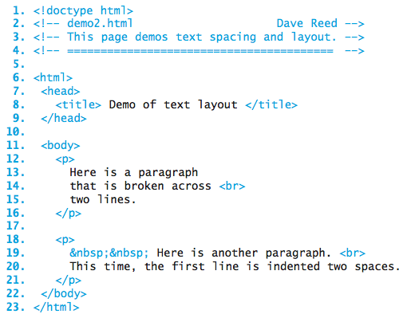
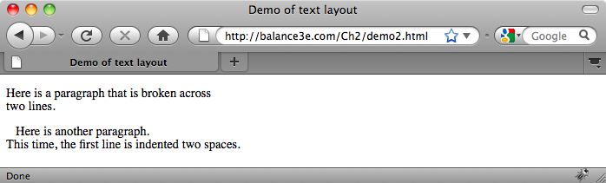
Text Layout
extra white space (spaces, tabs and blank lines) is ignored by the browser
  this allows the browser to adjust the text to the window size
you can control some of the text layout using HTML elements
  a PARAGRAPH element (<p>…</p>) specifies text surrounded by blank lines
  a BREAK element (<br>) causes text to be displayed on a new line
  the &nbsp; symbol forces a space to appear in the text

Slide 6
Headings & Alignment
in a large document, it is useful to divide the text into sections and then provide each with a heading describing the content that follows
  <h1> … </h1> enclose a top-level heading (large and bold)
  <h2> … </h2> enclose a sub-heading (slightly smaller and bold)
  . . .
  <h6> … </h6> enclose the smallest sub-heading
the HORIZONTAL-RULE element <hr> draws a dividing line in the page
by default, headings and other elements are left-justified in the page
  can change the alignment of an element by adding a style attribute that qualifies the appearance of the element
    <h1 style="text-align:center"> Centered Heading </h1>
    <p style="text-align:right">
    This paragraph is right justified. Each line will be shifted
    to line up at the right margin.
    </p>

Slide 7
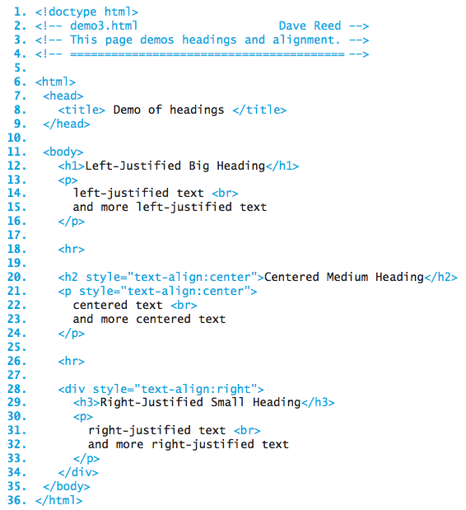
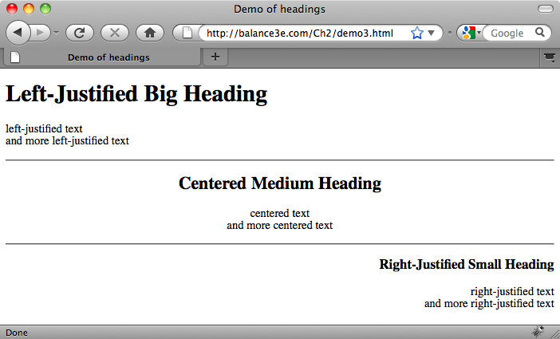
Headings & Alignment (cont.)
the DIV element groups multiple elements, so they can be formatted together

Slide 8
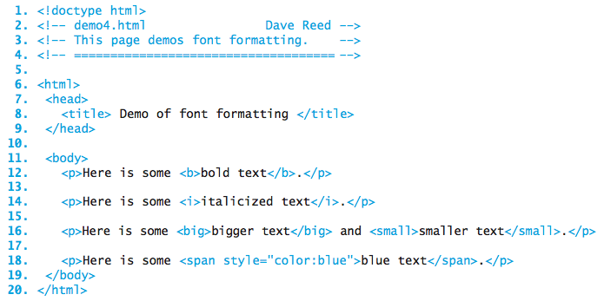
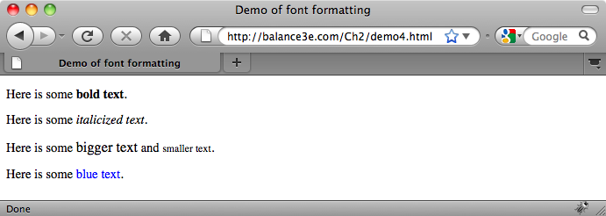
Font Formatting
text can be formatted in a variety of ways
  bold (<b> … </b>), italics (<i> … </i>), underlined (<u> … </u>)
colored text is enclosed in <span style="color:????"> … </span>
  common colors can be used (e.g., red, green, orange, lightblue, darkblue)

Slide 9
Hyperlinks
a hyperlink, or just link, is a connection to another Web page
  by default, a link appears as underlined text in the page
  when the user clicks on the link, the corresponding page is retrieved and displayed
a link is specified using ANCHOR tags <a> and </a>
  text that appears within the tags is displayed as the link in the page
  must have an HREF attribute that specifies the associated Web address
  <a href="http://www.creighton.edu">Creighton University</a>
  <a href="personal.html">Local Page</a>
note: the browser displays links underlined and in color
  by default, links whose pages have not yet been visited are blue
  by default, links whose pages have previously been visited are purple

Slide 10
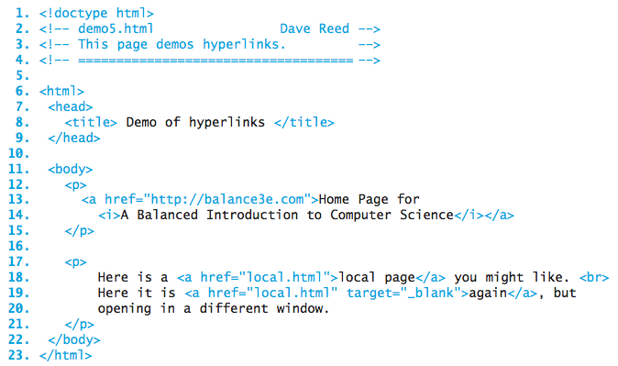
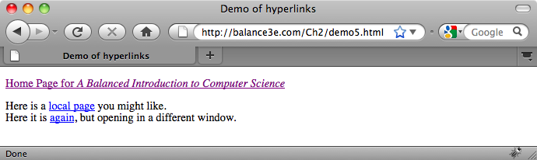
Hyperlinks (cont.)

Slide 11
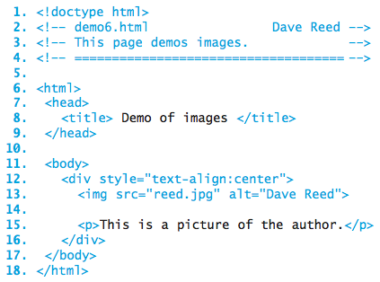
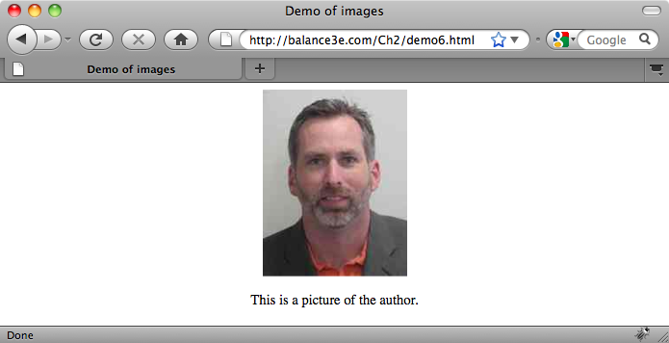
Images
Web pages can contain other types of media besides text and links
  images are embedded in a page using an IMG tag ( <img> )
IMG attributes
  SRC specifies the location of the image file
  ALT specifies alternate text that is displayed if the image fails to load

Slide 12
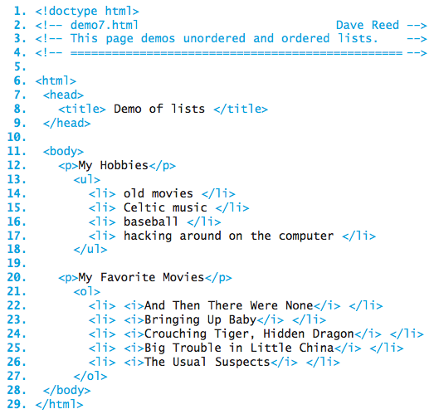
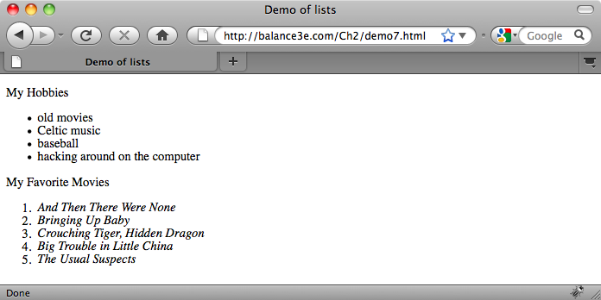
Lists
HTML lists organize items in sequence
  <ul>…</ul> enclose an unordered list; <ol>…</ol> enclose an ordered list
  <li>…</li> enclose a list item

Slide 13
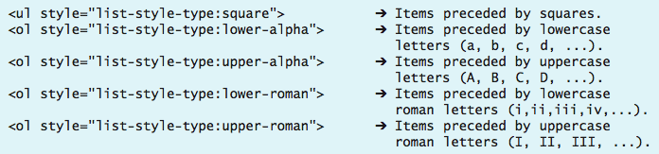
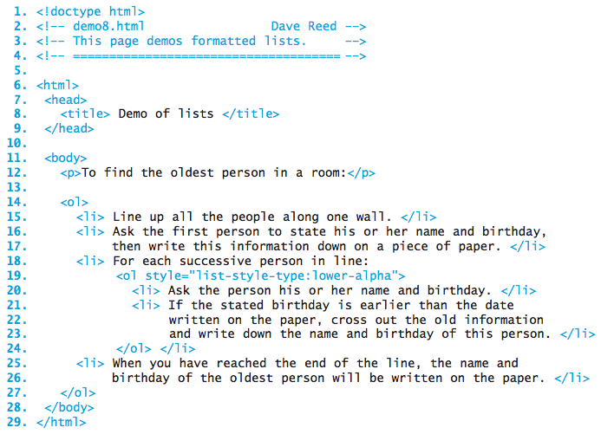
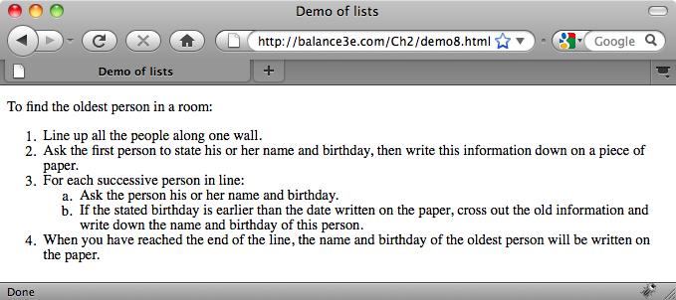
Lists (cont.)
a style attribute can be used to format the list elements

Slide 14
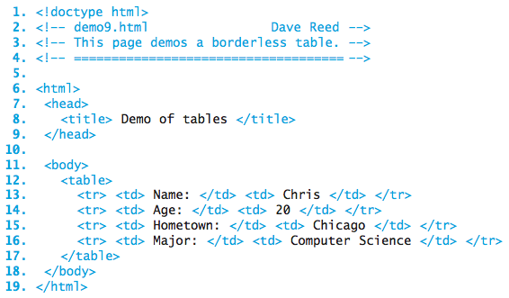
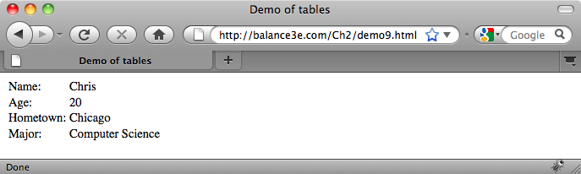
Tables
text can be aligned into rows and columns using a TABLE element
  <table> and </table> encapsulate the table data
  <tr> and </tr> encapsulate a row within the table
  <td> and </td> encapsulate table data within a row (i.e., a column entry)

Slide 15
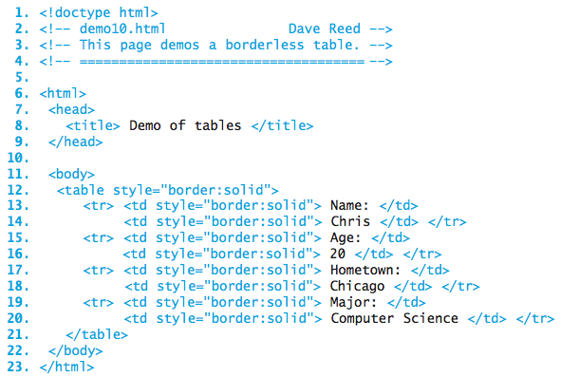
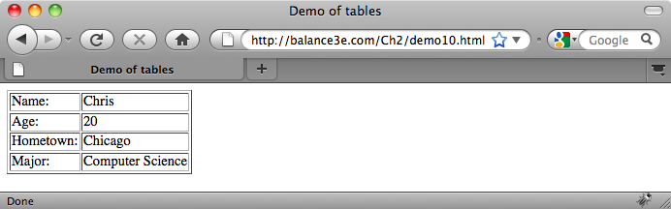
Tables with Borders
borders can be added to tables using a style attribute
  style="border:solid" adds a border to the table or table data items

Slide 16
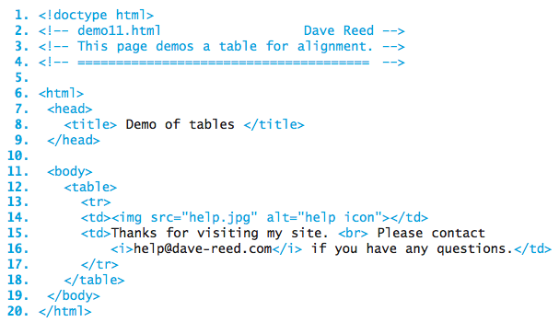
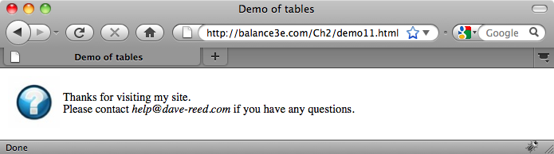
Tables for Alignment
tables can be used to align elements in the page
  here, an image is aligned to the left of some text

