Slide 1
A Balanced Introduction to Computer Science, 3/E
David Reed, Creighton University
©2011 Pearson Prentice Hall
ISBN 978-0-13-216675-1
Chapter 5
JavaScript and User Interaction

Slide 2
Text Boxes
HTML event handlers enable the user to interact with the page
  e.g., move the mouse over an image to change it
  e.g., click on a button to display a text message in a page division
for greater control, the user must be able to enter information into the page
  e.g., enter words to complete a fill-in-the-blank story
  e.g., enter grades to calculate a course average
a text box is an HTML element that is embedded in the page
<input type="text" id="BOX_ID" size=NUM_CHARS value="INITIAL_CONTENTS">
  the user can enter text directly in the box
  a JavaScript statement can then access the contents of the text box by accessing its VALUE attribute
document.getElementById('BOX_ID').value

Slide 3
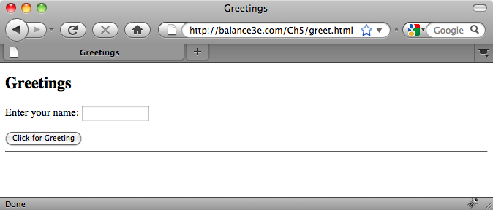
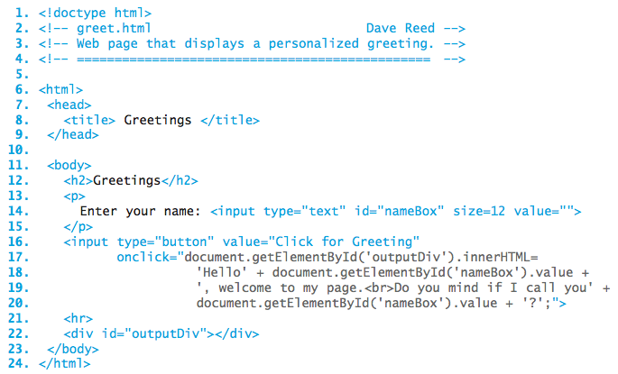
Greetings Page
since value="", the text box is initially empty
the user can enter his/her name in the text box

Slide 4
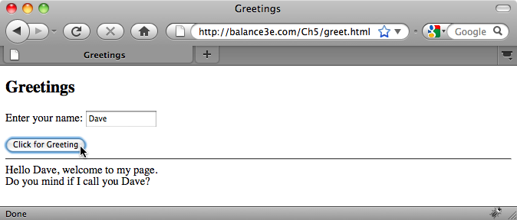
Greetings Page
when the button is clicked, the text in the box is accessed and incorporated into the message

Slide 5
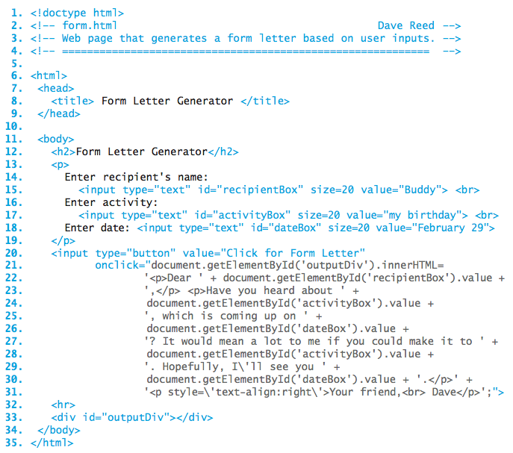
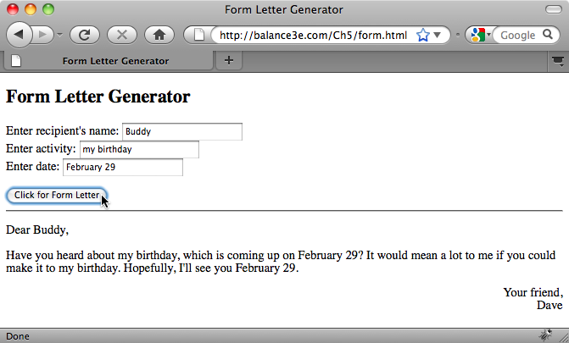
Form Letter Page
a Web page can have numerous text boxes
  each must have a unique ID
  text assigned to the VALUE attribute is automatically displayed
  useful whenever a default value is natural

Slide 6
Mixing Text & Expressions
when displaying a complex message involving text and box contents, special care must be taken
  <input type="button" value="Click for Form Letter"
  onclick="document.getElementById('outputDiv').innerHTML=
  '<p>Dear ' + document.getElementById('recipientBox').value +
  ',</p> <p>Have you heard about ' +
  document.getElementById('activityBox').value +
  ', which is coming up on' +
  document.getElementById('dateBox').value +
  '? It would mean a lot to me if you could make it to' +
  document.getElementById('activityBox').value +
  '. Hopefully, I\'ll see you ' +
  document.getElementById('dateBox').value + '.</p>' +
  '<p style=\'text-align:right\'>Your friend,<br> Dave</p>';">
  any part of the message enclosed in quotes is treated as plain text (including formatting tags)
  expressions that access the contents of a text box must be evaluated by the browser → cannot be enclosed in quotes
  all of the pieces of the message are concatenated together using '+'

Slide 7
JavaScript Variables
JavaScript assignments have been used to directly assign values to attributes
document.getElementById('mysteryImg').width = 100;
assignments can also be used for indirect actions via variables
a variable is a name used to symbolize a dynamic (changeable) value
  each variable is associated with a memory cell
  when a value is assigned to a variable, that value is stored in the corresponding memory cell
userName = 'Dave';
  any subsequent reference to a variable evaluates to the value stored in its memory cell
    document.getElementById('outputDiv').innerHTML = 'Hi ' + userName;
'Dave'
userName

Slide 8
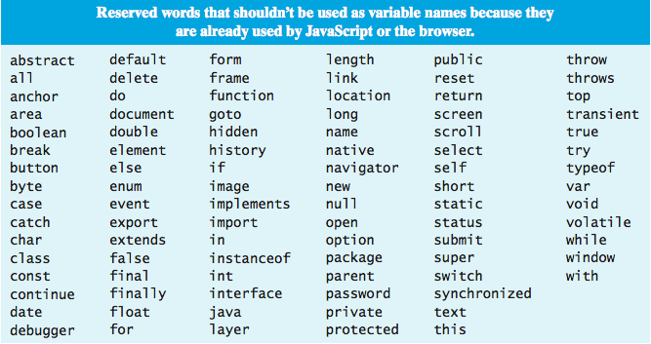
Variable Names
a variable name can be any sequence of letters, digits and underscores, as long as it starts with a letter
  variable names should be chosen to be descriptive of its purpose

Slide 9
Variables for Reuse
variables can simplify code by giving a short name to a complex expression
  e.g., in greetings page, can assign the text box contents to a variable
  then, can use the variable repeatedly in the message
  <input type="button" value="Click for Greeting"
  onclick="userName=document.getElementById('nameBox').value;
  document.getElementById('outputDiv').innerHTML =
  'Hello ' + userName + ', welcome to my page.<br>' +
  'Do you mind if I call you ' + userName + '?';">
example application: a fill-in-the-blank story page
  page contains text boxes with label such as Name, Color, Animal, Place
  the user enters word/phrase choices in these boxes
  those choices are inserted into a story and displayed in a page division
  because the words/phrases may be used several times in the story, it will make the code shorter (and less error prone) to first assign box contents to variables, then use the variables in the story

Slide 10
Common Pattern
many pages will follow the same basic pattern
  text boxes allow the user to enter words/phrases
  at the click of a button, the text box contents are accessed & stored in variables
  a message incorporating the variable values is displayed
the JavaScript code executed at the button click similarly follows a pattern
  VAR1 = document.getElementById('BOX_ID1').value;
  VAR2 = document.getElementById('BOX_ID2').value;
  ...
  VARn = document.getElementById('BOX_IDn').value;
  document.getElementById('outputDiv').innerHTML =
  MESSAGE_INTEGRATING_STRING_LITERALS_AND_VARIABLES;"

Slide 11
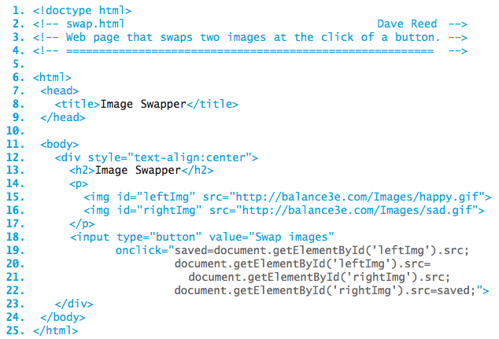
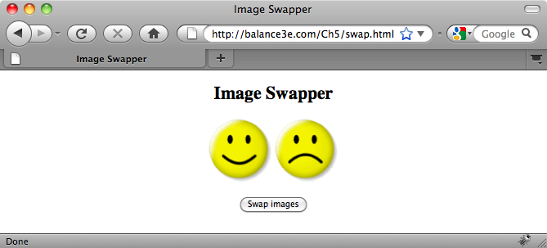
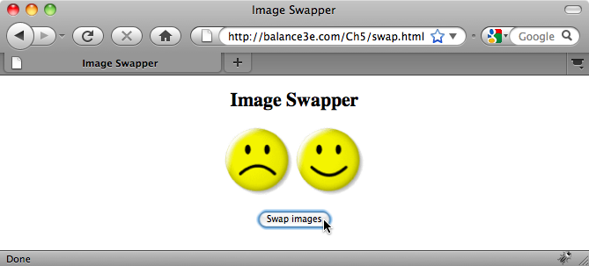
Variables for Temps
sometimes, a variable is needed to store a value so it is not lost
when the button is clicked, the IMG sources are swapped
  the leftImg source is saved in a variable
  then, can overwrite leftImg source with rightImg source
  finally, can assign stored value to rightImg

Slide 12
Data Types
each unit of information processed by a computer belongs to a general category or data type
  e.g., string, number, Boolean (either true or false)
each data type is associated with a specific set of predefined operators that may be used by programmers to manipulate values of that type
  e.g., we have seen string concatenation via +
  similarly, standard operators are predefined for numbers
    addition (+), subtraction (-), multiplication (*), division (/)
variables can be assigned various kinds of numerical values, including mathematical expressions formed by applying operators to numbers
  when an expression appears on the right-hand side, the expression is evaluated and the resulting value is assigned to the variable on the left-hand side
    phrase = 'howdy' + ' doo'; 'howdy doo'
    phrase
    x = 50/4; 12.5
    x

Slide 13
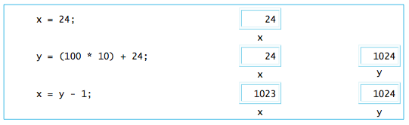
Variables and Expressions
if a variable appears in an expression, the value currently assigned to that variable is substituted
when you read an assignment statement, refrain from using equals for '='
  '=' does not represent equality, it represents assignment
  read it as gets
    x = x + 1; → x gets x + 1;

Slide 14
Number Representation
useful facts about JavaScript numbers
  to improve readability, very large or very small number are displayed in scientific notation: XeY represents the value X  10^{Y}
    e.g., 1e24 → 1  10²⁴ → 1000000000000000000000000
  JavaScript stores all numbers in memory cells of a fixed size (64 bits)
    as a result, only a finite number of values can be represented
    e.g., 1e308 can be represented, but 1e309 is treated as Infinity
      1e-323 can be represented, but 1e-324 is treated as 0
  even within the range 1e-323 . . . 1e309, not all numbers can be represented
    note that between any two numbers lie infinitely more numbers!
    JavaScript can represent approximately 17 significant digits
    e.g.., 0.9999999999999999 can be represented exactly
    0.99999999999999999 is rounded up to 1

Slide 15
Text Boxes and Numbers
special care must be taken when accessing numbers from a text box
  the content of a text box is always accessed as a string (sequence of characters)
  e.g., if the user enters 500 in a box, then the value '500' is accessed
    myNumber = document.getElementById('numBox').value;
    alert('One more is ' + (myNumber + 1));
  if the user entered 12 in the box, what would be displayed?
  the alert message would be One more is 121 WHY?
    the box content is accessed as '12' which is stored in myNumber
    the parenthesized sub-expression (myNumber + 1) is evaluated first
    since this is a mixed expression, the number 1 is converted to '1' then concatenated
    the result, '121', is then concatenated to the end of 'One more is '
what is needed is a mechanism for converting strings of digits into numbers
  e.g., '500' → 500, '1.314' → 1.314, …

Slide 16
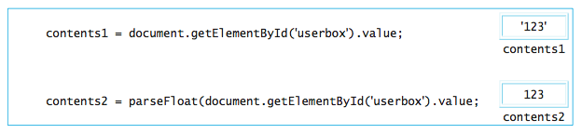
parseFloat Function
in mathematics, a function is a mapping from inputs to a single output
  e.g., the absolute value function: |-5| → 5, |17.3| → 17.3
from a programmer's view, a function is a "unit of computational abstraction"
  there is some computation required to calculate the output given the input(s)
  a JavaScript function encapsulates that computation and hides the details
    applying a function to inputs is known as calling the function
    the output of a function call is known as the return value

Slide 17
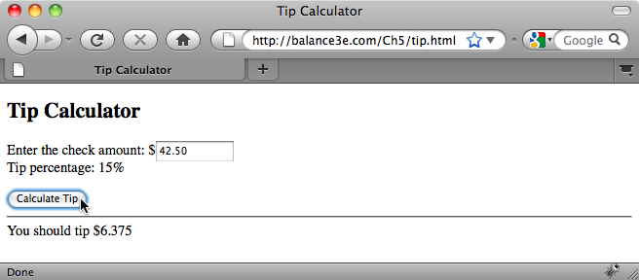
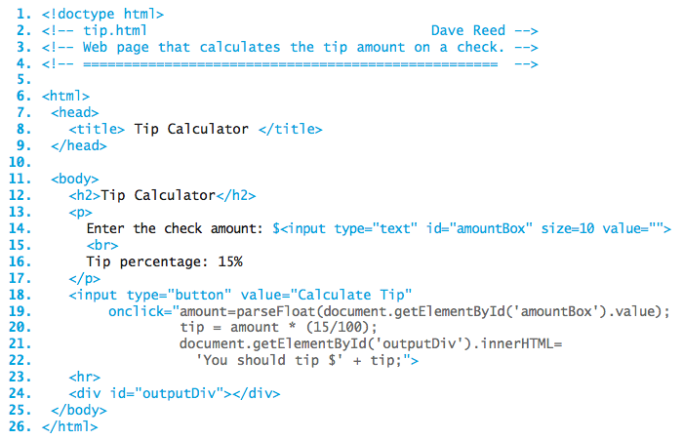
Tip Calculator Page
calling the parseFloat function on the text in the box converts it to a number
this number is then assigned to amount

Slide 18
Common Pattern
similarly, Web pages that compute a value will follow the same basic pattern
  text boxes allow the user to enter numbers
  at the click of a button, the text box contents are accessed, parseFloat is applied to convert to numbers, and the numbers are stored in variables
  a computation involving those numbers is performed
  the result of the computation is displayed in the page
the JavaScript code executed at the button click similarly follows a pattern
  VAR1 = parseFloat(document.getElementById('BOX_ID1').value);
  VAR2 = parseFloat(document.getElementById('BOX_ID2').value);
  ...
  VARn = parseFloat(document.getElementById('BOX_IDn').value);
  RESULT = EXPRESSION_INVOLVING_VARIABLES;
  document.getElementById('outputDiv').innerHTML =
  MESSAGE_INTEGRATING_STRING_LITERALS_AND_RESULT;

Slide 19
Errors and Debugging
in computer jargon, the term bug refers to an error in a program
  the process of systematically locating and fixing errors is debugging
three types of errors can occur
  syntax errors: typographic errors
    e.g., omitting a quote or misspelling a function name
    since the browser catches these, they are usually "easy" to identify and fix
  run-time errors: occur when operations are applied to illegal values
    e.g., attempting to multiply a string or divide by zero
    also caught by the browser, which either produces an error message or else returns a special value (string multiplication produces NaN, for "Not a Number"; division by zero produces Infinity)
  logic errors: flaws in the design or implementation of a program
    whenever your program produces the wrong result
    since they are not caught by the browser (the program is legal, just not what you wanted), logic errors are hardest to identify
useful technique for identifying bugs: diagnostic alert statements
  at various intervals in the code, display the values of key variables using alert
  you can then isolate at what point the program is going wrong

