Slide 1
A Balanced Introduction to Computer Science, 3/E
David Reed, Creighton University
©2011 Pearson Prentice Hall
ISBN 978-0-13-216675-1
Chapter 7
Functions and Randomness

Slide 2
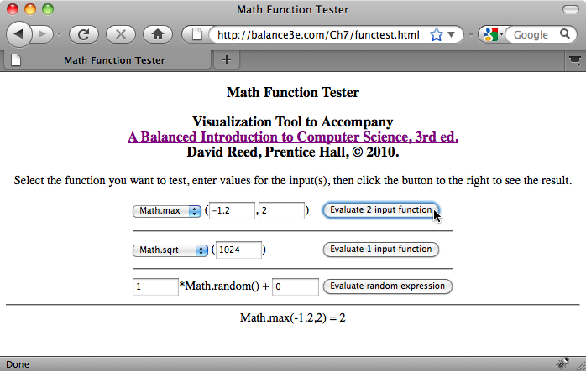
Predefined Functions
recall: in mathematics, a function is a mapping from inputs to a single output
  e.g., the absolute value function: |-5| → 5, |17.3| → 17.3
in JavaScript, a function is applied to inputs via a function call
  specify the function name, followed by inputs in parentheses
  num = parseFloat(document.getElementById('numBox').value);
in addition to parseFloat, JavaScript has numerous predefined mathematical functions
the functest.html page allows you to explore these

Slide 3
Math Functions
Math.sqrt determines the square root
  Math.sqrt(9) → √9 = 3
  Math.sqrt(12.25) → √12.25 = 3.5
Math.max determines the maximum of two values
  Math.max(12, 8.5) → 12
  Math.max(-3, -8) → -3
Math.pow raises a number to a power
  Math.pow(2, 10) → 2¹⁰ = 1024
  Math.pow(2, -1) → 2⁻¹ = 0.5
  Math.pow(9, 0.5) → 9^{0.5} = 3
Math.min, Math.abs, Math.round, Math.ceil, Math.floor, …

Slide 4
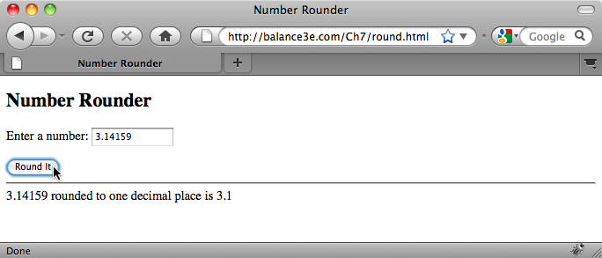
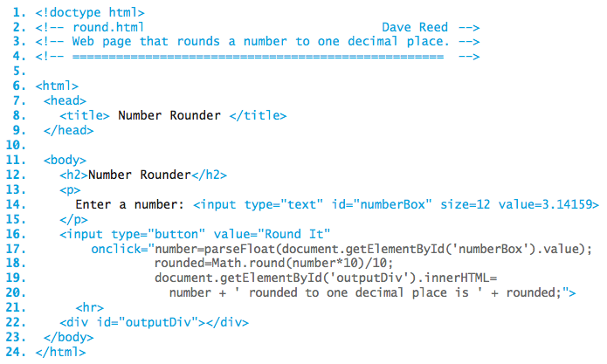
Rounding Page
uses the Math.round function to round a number to 1 digit
Math.round(3.14159*10)/10 → Math.round(31.4159)/10 → 31/10 → 3.1

Slide 5
Math.random
Math.random generates a pseudo-random number in the range [0…1)
  pseudo-random refers to the fact that the numbers appear randomly distributed, but are in fact generated by a complex algorithm
  note: this function has no inputs; it returns a different number each call
  Math.random() → 0.33008525626748814
  Math.random() → 0.213335955823927
  Math.random() → 0.8975001737758223
a call to Math.random can be placed in an expression to affect the range
  2*Math.random() → [0…2)
  Math.random() + 1 → [1…2)
  9*Math.random() + 1 → [1…10)
  Math.floor(9*Math.random() + 1) → 1, 2, 3, …, 9

Slide 6
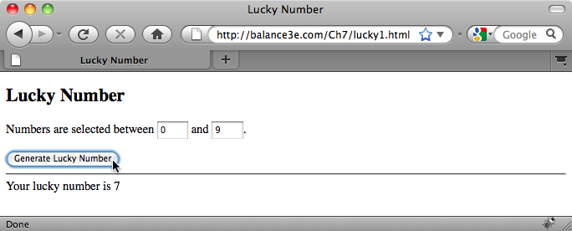
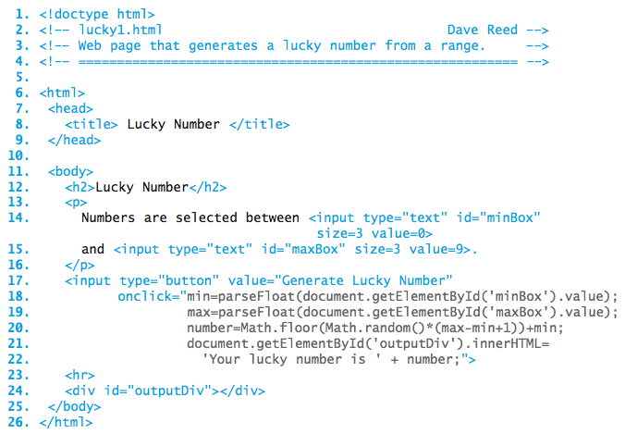
Lucky Number Page
displays a random number from the range specified by the text boxes

Slide 7

Simplifying buttons
consider the button from lucky1.html:
  the size of ONCLICK attribute makes the button complex and difficult to read
  plus, must be careful with nested quotes ("…" vs. '…')
functions provide a mechanism for simplifying complex buttons such as this
recall:
  functions minimize the amount of detail that has to be considered
    e.g., can use Math.sqrt without worrying about how it works
  functions reduce the length and complexity of code
    e.g., a single call to Math.sqrt replaces the underlying complex algorithm

Slide 8
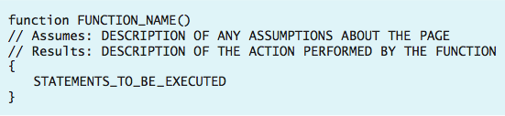
Simple user-defined functions
in addition to JavaScript's predefined functions, the user can define new functions in the HEAD section and call them within the page
we will explore user-defined functions fully in Chapter 9
  for now, the following simple form suffices for simplifying buttons
  a function definition begins with the word function followed by its name and ()
    a function name should be descriptive of the task being performed
  lines beginning with // are comments that describe the function's behavior
    comments are ignored by the interpreter, but make code more user-readable
  the statements to be executed when the function is called are placed between the curly braces

Slide 9
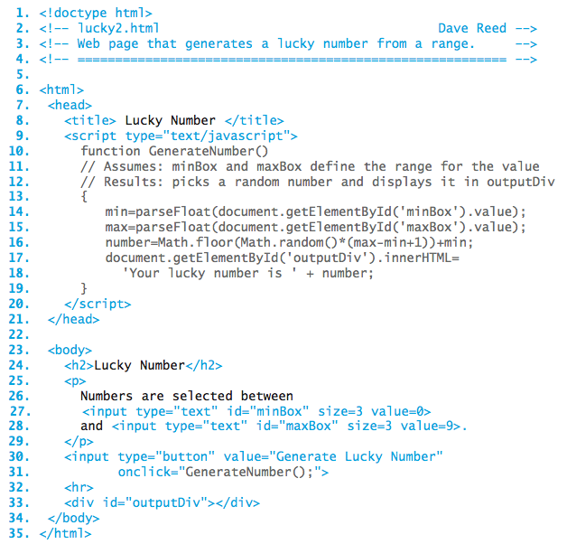
Lucky Number Revisited
the code from the button is moved to the user-defined GenerateNumber function
SCRIPT tags enclose the function definition in the HEAD
as a result, the button is greatly simplified
GENERAL ADVICE: if more than one statement is to be associated with a button, define a separate function

Slide 10
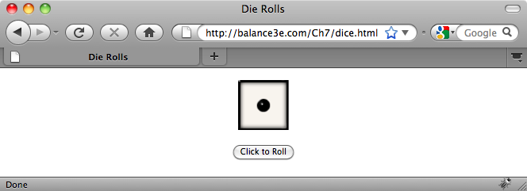
Example: Dice Simulation
suppose we wanted to simulate the roll of a 6-sided die
  at the click of a button, see a randomly selected roll of a die
can use Math.random and Math.floor to generate a random roll between 1 & 6
  roll = Math.floor(Math.random()*6) + 1;
die images are stored as http://balance3e.com/Images/die1.gif,
http://balance3e.com/Images/die2.gif, …,
http://balance3e.com/Images/die6.gif

Slide 11
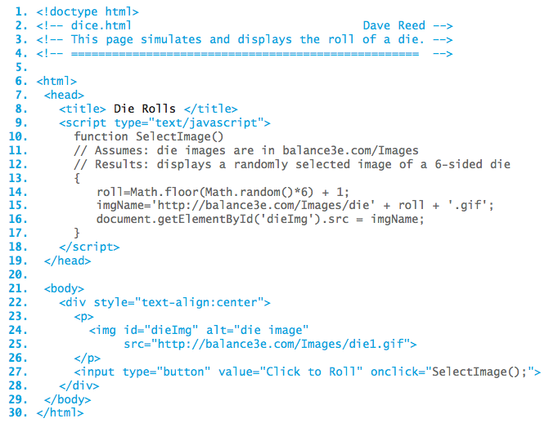
Example: Dice Simulation
the desired die image can be selected using the roll variable
'…/die' +
roll +
'.gif'

Slide 12
Example: Slide Show
the dice simulation page can be generalized into a random slide show
  name the slide images using a consistent naming scheme
  slide1.jpg, slide2.jpg, slide3.jpg, …
each time the button is clicked, the SelectImage function is called to randomly change the image
to select a random slide at the start, make use of the ONLOAD attribute of the BODY tag
<body onload="CODE_TO_EXECUTE_AFTER_PAGE_LOADS">
here, call SelectImage after the page loads in order to start with a random image
<body onload="SelectImage();">

Slide 13
Example: Banner Ads
the random slide show page can be generalized into random banner ads
  name the ad images using a consistent naming scheme
  ad0.jpg, ad1.jpg, ad2.jpg, …
the SelectAd function changes the ad to a random image
instead of calling the function at the click of a button, can automate using the predefined setInterval function
setInterval('JAVASCRIPT_FUNCTION_CALL', INTERVAL_IN_MSEC)
sets a timer and repeatedly executes the specified function at set intervals
<body onload="setInterval('SelectAd()', 5000);">
will call the function to change the ad image every half second

Slide 14
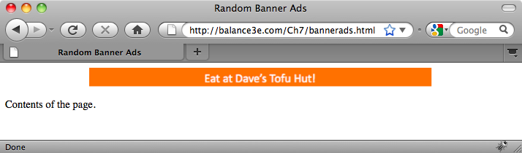
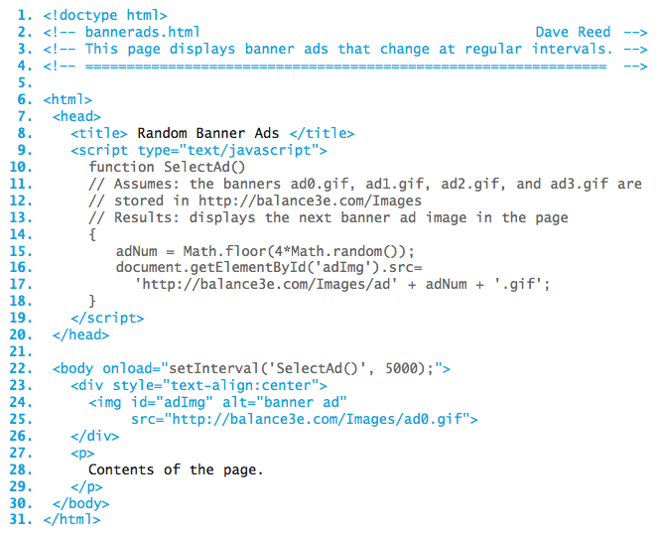
Example: Banner Ads

