Slide 1
A Balanced Introduction to Computer Science, 3/E
David Reed, Creighton University
©2011 Pearson Prentice Hall
ISBN 978-0-13-216675-1
Chapter 11
Conditional Execution

Slide 2
Conditional Execution
so far, all of the code you have written has been unconditionally executed
  the browser carried out statements in the same set order
in contrast, many programming tasks require code that reacts differently under varying circumstances or conditions
  e.g., a student's course grade depends upon his/her average
  e.g., an ESP test requires recognizing when a subject guessed right
  e.g., the outcome of a game depends upon die rolls or player moves
conditional execution refers to a program’s ability to execute a statement or sequence of statements only if some condition holds true

Slide 3
If Statements
in JavaScript, the simplest form of conditional statement is the if statement
  one action is taken if some condition is true, but a different action is taken if the condition is not true (called the else case)
  the else case is optional
general form of the if statement:
      if (BOOLEAN_TEST) {
      STATEMENTS_EXECUTED_IF_TRUE
      }
      else {
      STATEMENTS_EXECUTED_IF_FALSE
      }

Slide 4
Braces in If Statements
some people prefer braces on separate lines formatted like this:
  if (BOOLEAN_TEST)
  {
  STATEMENTS_EXECUTED_IF_TRUE
  }
  else
  {
  STATEMENTS_EXECUTED_IF_FALSE
  }
either style is acceptable, but be consistent!
  properly aligning the code (with if-else lining up and statements indented) is central in producing code that is easy to read and modify
technically, you can omit the braces if there is only one statement
  however, THIS IS STRONGLY DISCOURAGED!
  can lead to tricky errors if the code is ever modified

Slide 5
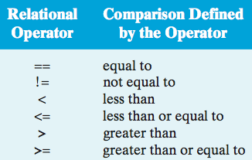
Boolean Tests
the test that controls an if statement can be any Boolean expression (i.e., an expression that evaluates to either true or false)
  Boolean tests are formed using relational operators because they test the relationships between values
NOTE:
== is for comparisons
= is for assignments
the Boolean test in an if statement determines the code that will be executed
  if the test is true, then the code inside the subsequent curly braces will execute
  if the test is false, then the code inside the curly braces following the else will execute
  note that if the test is false and there is no else case, the program moves on to the statement directly after the if

Slide 6
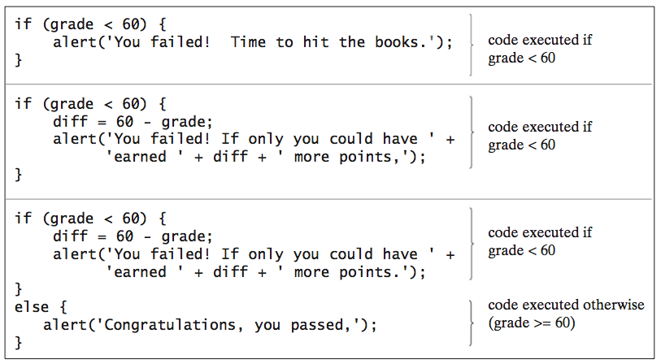
If Statement Examples
an if statement is known as a control statement, since its purpose is to control the execution of other statements

Slide 7
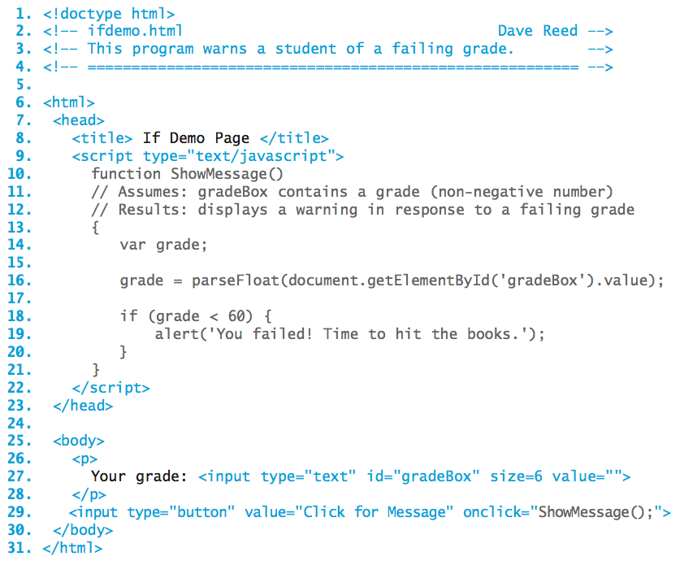
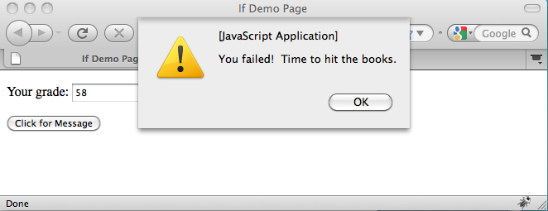
Example within a Page
here, the if statement is executed when the button is clicked
  what happens if the text box contains a number ≥ 60?

Slide 8
Accessing Text Fields
recall that values entered via text boxes/areas are always returned as strings
if (document.getElementById('age').value >= 18) {
alert('You are old enough to vote.');
}
else {
alert('Sorry. You are too young to vote.');
}
will say that a 2-year old can vote, but a 102-year old can't!
WHY?
if you wish to treat a value obtained from a text box or text area as a number, you must use the parseFloat function to convert it
age = parseFloat(document.getElementById('age').value);
if (age >= 18) {
alert('You are old enough to vote.');
}
else {
alert('Sorry. You are too young to vote.');
}
will behave as expected

Slide 9
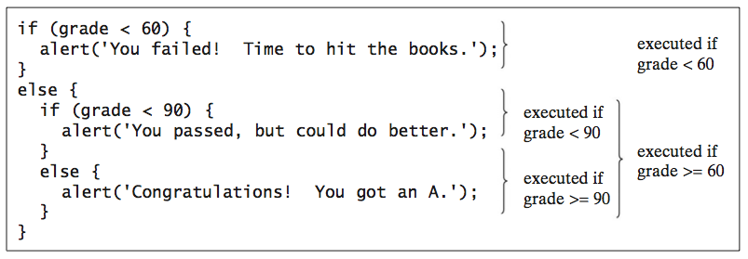
Nested If Statements
programming tasks often require code that responds to more than one condition
  this can be accomplished by nesting one if statement inside of another
example: three different grade levels
  failing (grade < 60), acceptable (60 ≤ grade < 90), A-level (grade ≥ 90)
  the outer if-else distinguishes failing from passing grades
  the nested if-else further separates passing grades into acceptable and A-level

Slide 10
Cascading If-else Statements
nested if-else structures are known as cascading if-else statements because control cascades down the branches
  the topmost level is evaluated first
  if the test succeeds, then the corresponding statements are executed and control moves to the next statement following the cascading if
  if the test fails, then control cascades down to the next if test
  in general, control cascades down the statement from one test to another until one succeeds or the end of the statement is reached

Slide 11
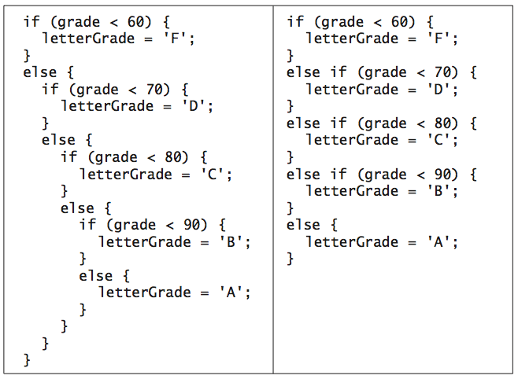
A Cleaner Notation
when it is necessary to handle a large number of alternatives, nested if-else statements can become cumbersome and unwieldy
  multiple levels of indentation and curly braces cause the code to look cluttered make it harder to read/understand
  can simplify by removing some unnecessary curly braces & aligning each case to the left
  nested if statements vs. more readable else-if
  example:

Slide 12
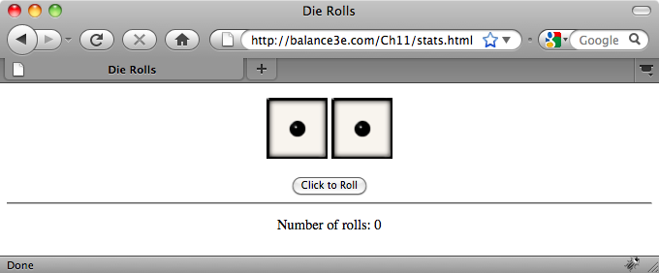
Dice Stats Example
consider a Web page that simulates the roll of two dice
  will use image to display the dice
  will use a button to initiate the die rolls
  will keep track and display the number of rolls
  when the user clicks the button, two random die rolls are selected, the corresponding images are displayed, and the number of rolls incremented

Slide 13
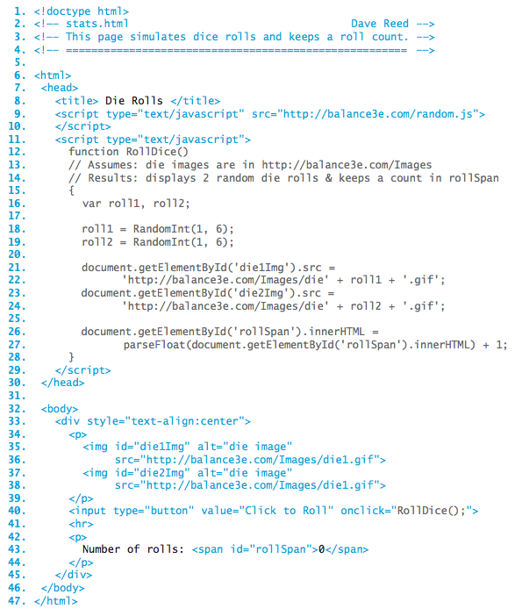
Stats Page
the RandomInt function from random.js is used to select the random roll
since each die image is stored as die#.gif, can assign each image source with one assignment
the number of rolls appears in a span
  initially 0
  incremented in RollDice each time the button is clicked

Slide 14
Counters
any variable that is used to record occurrences of an event is known as a counter
  initially, the counter is set to zero
  each time the specified action occurs, the counter is incremented
  after a given time period, the value stored in the counter will tell you the number of times the desired event took place
  document.getElementById('rollSpan').innerHTML =
  parseFloat(document.getElementById('rollSpan').innerHTML)+1;
in software applications, counters are often conditional
  e.g., count the number of times dice rolls come up doubles
  e.g., count the number of times the user guesses a number correctly
conditional counters must be controlled by if statements
  if the desired event occurs, then you increment the counter
  if (roll1 == roll2) {
  // CODE TO BE EXECUTED WHEN DOUBLES ARE ROLLED
  }

Slide 15
Boolean Expressions
sometimes, simple comparisons between two values may not be adequate to express the conditions under which code should execute
JavaScript provides operators for expressing multipart tests
  logical AND (&&): represents the conjunction of two things
    (TEST1 && TEST2) is true if both TEST1 and TEST2 are true
    if (roll1 == 4 && roll2 == 4) {
    // CODE TO BE EXECUTED WHEN DOUBE FOURS ARE ROLLED
    }
  logical OR (||): represents the disjunction of two things
    (TEST1 || TEST2) is true if either TEST1 or TEST2 are true
    if (roll1 == 4 || roll2 == 4) {
    // CODE TO BE EXECUTED WHEN AT LEAST ONE FOUR IS ROLLED
    }
  logical NOT (!): represents negation
    (!TEST1) is true only if TEST1 is false
    if (!(roll1 == 4 || roll2 == 4)) {
    // CODE TO BE EXECUTED WHEN NEITHER ROLL IS A FOUR
    }

Slide 16
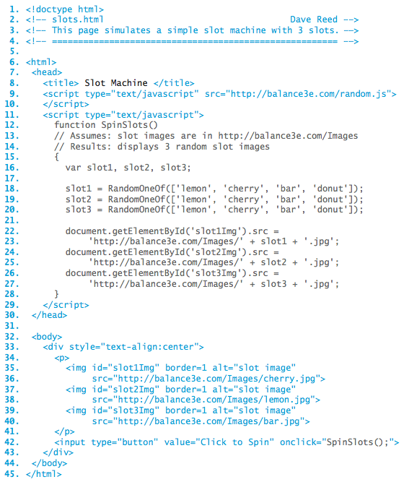
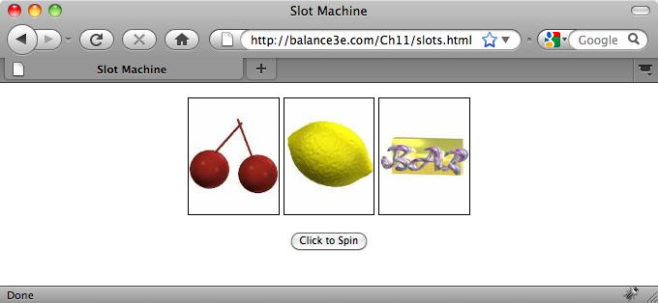
Slot Machine
initially, displays three random slot images at the click of a button
need to display player's credits
  player starts with 20 credits
  each spin costs 1 credit, three matching slots earns 13 credits
  disallow play if no credits
  possibly give a loan when broke

