Slide 1


The Scrum-Agile Approach
Elijah Thomas

Slide 2
Contents
Scrum Overview
Waterfall Vs Scrum
Roles
Work phases
Benefits
Limitations
Citations

Slide 3
Overview
The Scrum framework is an agile approach based on the modular implementation of complex work called “sprints” which focus primarily on consistent collaboration, flow of work, and self-organizing teams. Scrum has three overarching principles transparency, inspection, and adaptation.
Each scrum team consist of a product owner, scrum master, and a team of developers who all share collective ownership of a particular product but have different responsibilities within the scrum framework.
The Scrum development life cycle starts in the initial planning phases in which the product owner identifies value that can be provided to business owners, customers, or users of an applications. After which the sprint phase begins with the sprint planning, sprint, and sprint retrospection. After this the work is not completed however and the deployment phase of the Scrum phase begins with developers working to ensure that a quality product is delivered to end users.

Slide 4
 | Waterfall | Scrum
Planning | Most planning is done up front and extensive documentation is required. | Planning is limited and done at the “last responsible moment” this keeps workflow steady.
Execution | Project managers directly control how a project is done | Development teams are enabled to quickly produce value for customers based on modular development
Direction | Objective is to fulfill a contractual obligation to users or customers. | Objective is to provide quality solutions that provide direct value to users.
Information | Information is usually withheld on a need to know. | Information is freely disseminated to ensure cooperation between parties.
Ownership | Project managers and leadership take ownership of project | All parties take shared ownership of project though the product owner provides direction

Slide 5
Roles

Slide 6

Product Owner
The product owner in the scrum framework is an individual whose primary directive is to provide the vision and direction of a scrum team. Scrum projects often have a certain amount of uncertainty and it is the product owner’s job to communicate with customers and find the best value to be provided. The product owner often does this job by creating user stories and managing the product backlog and backlog debt.

Slide 7

Scrum Master
The scrum master stands as the primary “facilitator” of the scrum team both within the scrum team and to external entities. The Scrum master’s responsibilities include but are not limited to;
Serve as the “Owner of an agile process”
Facilitate Daily standups
Facilitates Sprint Reviews/Retrospectives
Internal coaching of agile principles and implementation

Slide 8

Developers
The development team members in the scrum framework are a group of technical experts whose primary focus is to provide direct value to the customers/users by producing quality solutions.
Teams deliver “done” iterations of a product during sprints.
Determine the amount of work a given user story will take.
Take private ownership of a scrum project

Slide 9


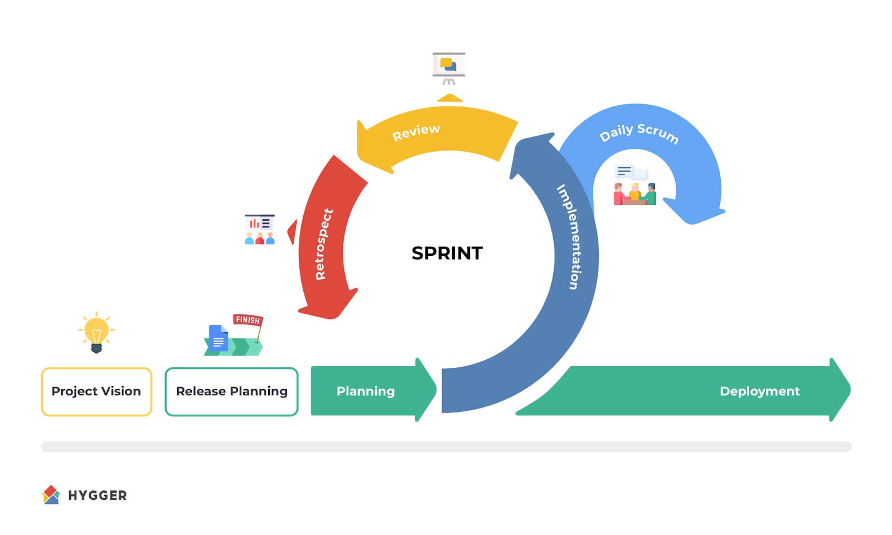
Scrum Phases

Slide 10
Sprint Planning
According to Dave West CEO of Scrum.org, “the purpose of sprint planning is to define what can and should be delivered during a sprint” It serves as a dialog between the scrum team, product owner, and end user to find out what value can be provided though a sprint iteration.

Slide 11
The Sprint
The sprint is largely performed by the development team by creating solutions to user stories defined by the product backlog. During the sprint, the development team holds daily standup meetings facilitated by the scrum master to ensure that the flow of the project is fluid and potential issues are addressed.

Slide 12
Sprint Review
The review and retrospective phase of scrum serves as an opportunity for the scrum team to reflect on what worked and what didn’t work during a sprint. The sprint review is an informal meeting that allows stakeholders and team members to evaluate the value provided by the development team. Usually these meetings involve the entire scrum team and are facilitated by the product owner and scrum master.

Slide 13
Benefits
Scrum is a flexible development based development method which ensures flexibility
When implemented correctly scrum works well for projects with high levels of uncertainty.
Modular development enables strategic unit testing which leads to quality solutions being provided to end users.
Scrum allows for faster deployment of solutions

Slide 14
Limitations
Difficulty to implement when scaling
Requires dedicated training
Hard to integrate with waterfall method approach
Requires ideological shift of the entire organization to be integrated correctly.

Slide 15
Citations
What is Scrum? (n.d.). Scrum.org. https://www.scrum.org/resources/what-scrum-module
Atlassian. (n.d.). What is Scrum? [Video]. Atlassian. https://www.atlassian.com/agile/scrum
Donato, H., & Donato, H. (2023, June 12). What Are The Phases Of Scrum? Workamajig. https://www.workamajig.com/blog/scrum-methodology-guide/scrum-phases#:~:text=Scrum%20is%20an%20Agile%20project,and%20retrospective%2C%20and%20release%20phase.
Vasiliauskas, V. (2023, September 28). 14 Scrum advantages and disadvantages in 2023. Teamhood. https://teamhood.com/agile/scrum-advantages-disadvantages/

