Slide 1
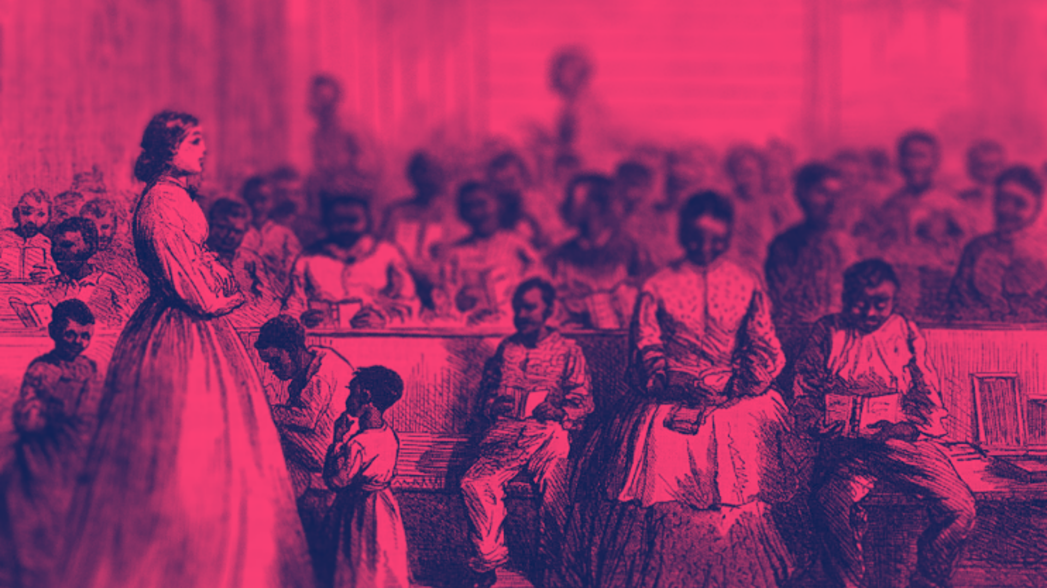
10.2
REALITIES OF
RECONSTRUCTION

Slide 2
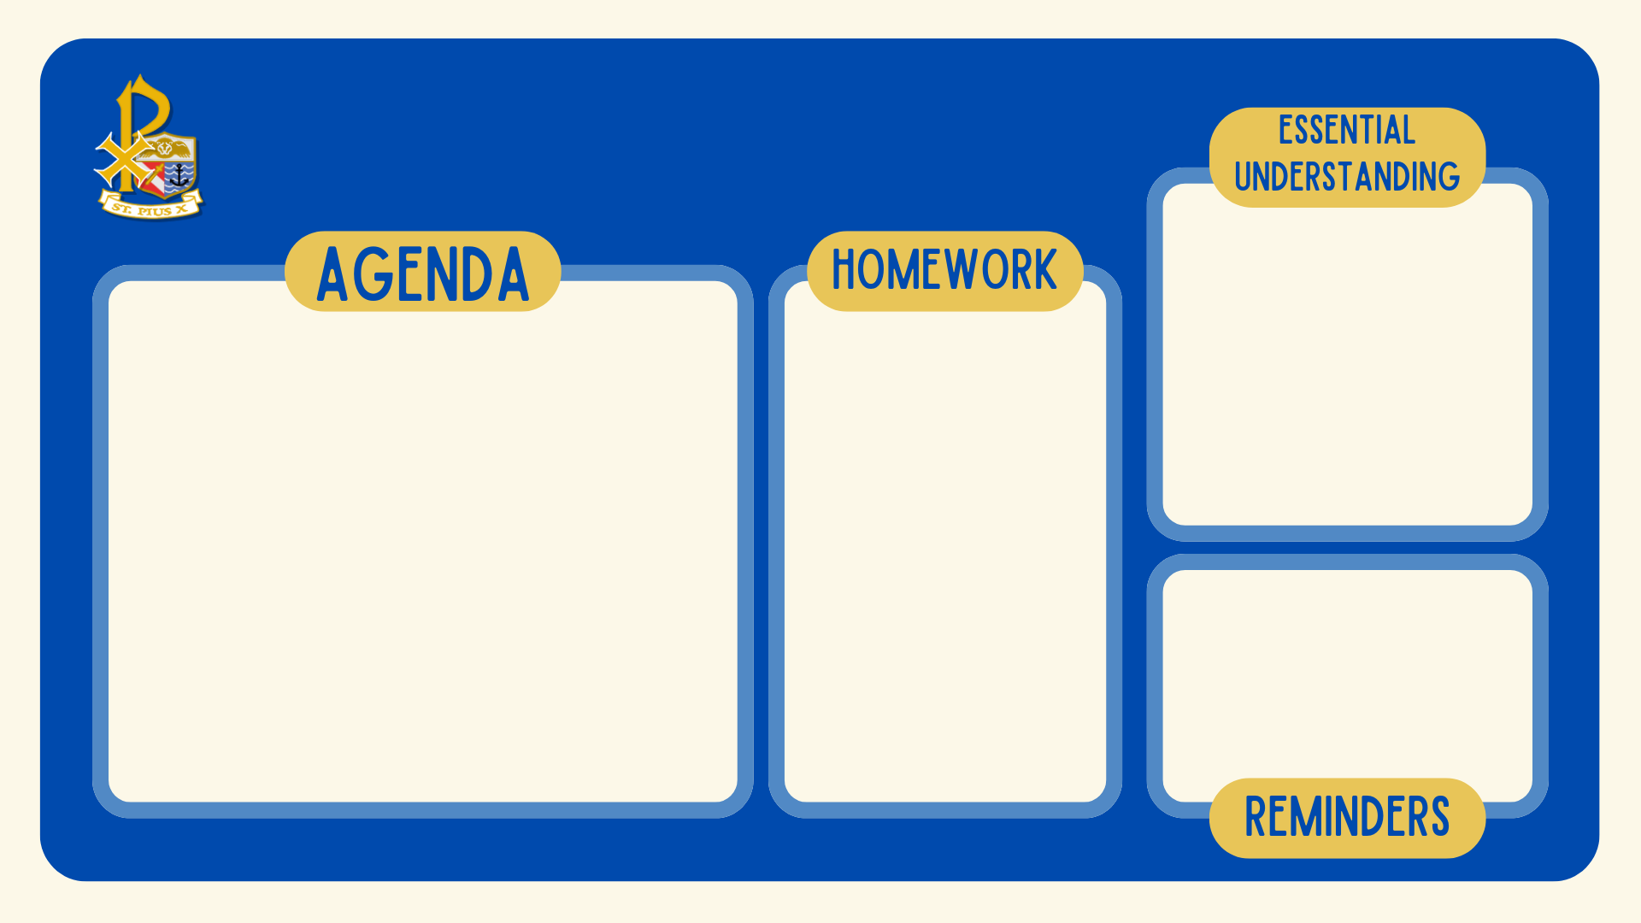
WED NOV 13 2024
Reconstruction aimed to change the South by promoting political and social reforms, but many white Southerners resisted through black codes and other laws that limited the freedom of African-Americans. This period showed the struggle between the government's push for equality and the efforts to keep old systems of control in place after the Civil War.
Reconstruction for African Americans in the South
  Notes
  Videos
  Check for Understanding
None
Test on Civil War Tuesday!
Notes:
Student Sheet:

Slide 3
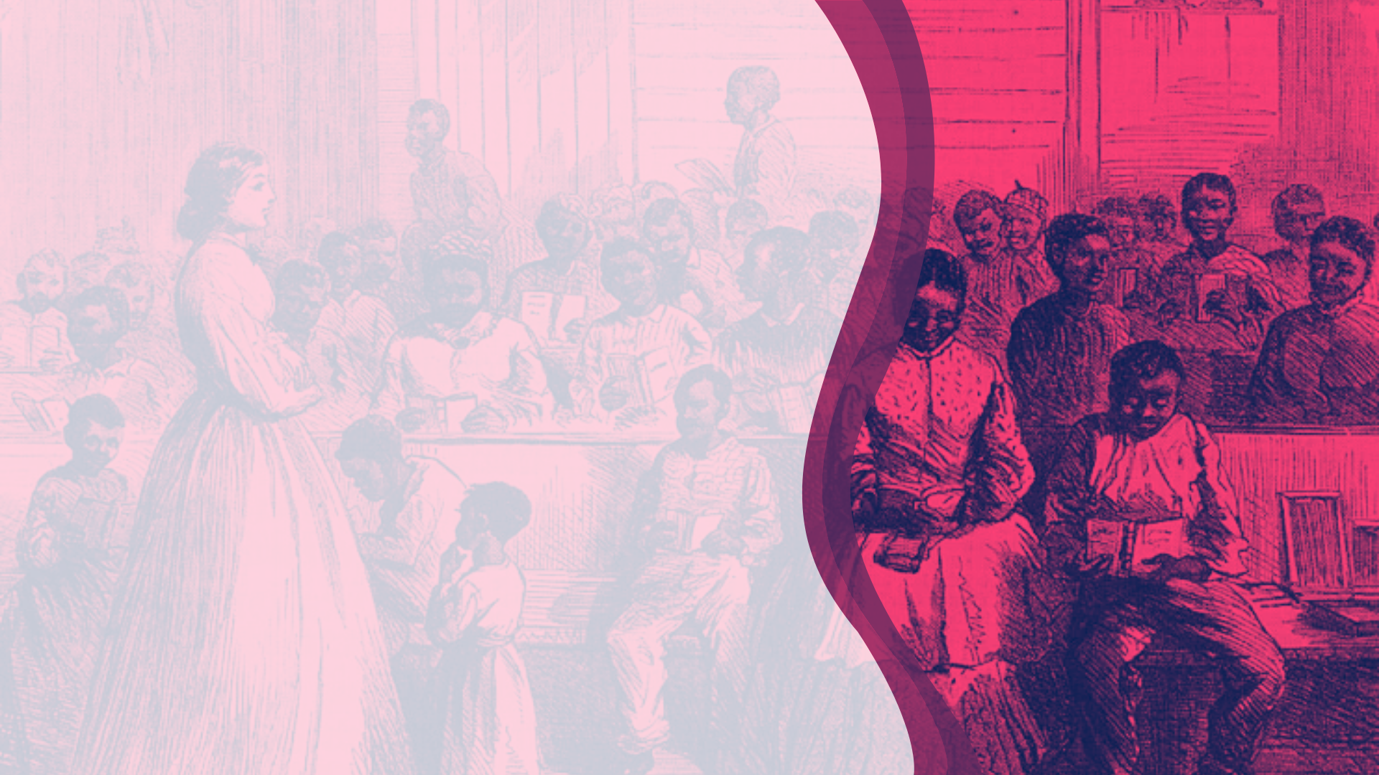
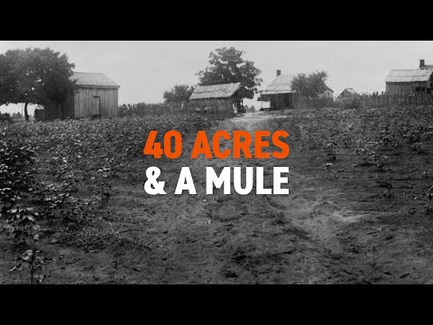
HOPES AND DREAMS
Reconstruction brought with it hope for African-Americans who finally had freedom to control their own destinies.
“40 Acres and a Mule” symbolized it...

Slide 4
What did "40 Acres and a Mule" symbolize for newly freed African-Americans during Reconstruction?
Notes:
🍐This is a Pear Deck Multiple Choice Slide.
🍐🍐Your current options are: A: Guaranteed employment working for people in agriculture, B: Access to public education, C: Economic independence and self-sufficiency, D: A new form of government assistance for the poor,
🍐🍐Correct options are C: Economic independence and self-sufficiency
🍐🍐Students will earn 1 points for this response.
🍐 To edit the type of question or choices, go back to the "Make Your Lessons Interactive" in the Pear Deck sidebar.

Slide 5
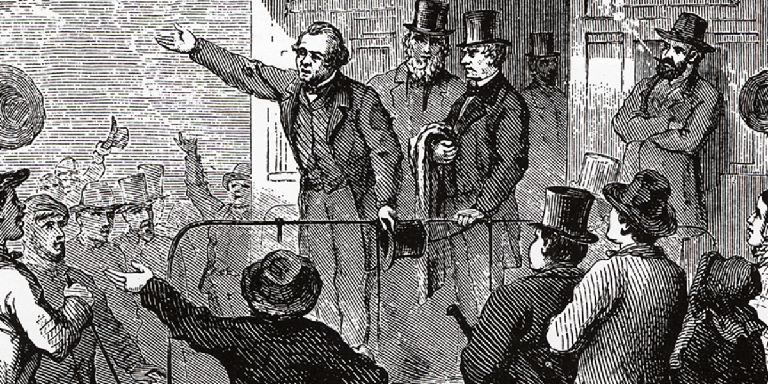
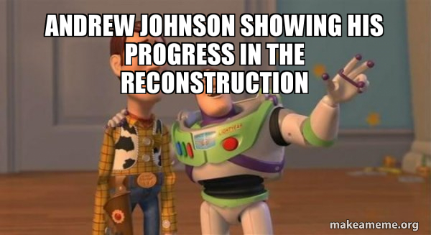
SWING AROUND THE CIRCLE
An even more radical republican majority is elected to congress in 1866
Johnson goes on a speaking tour to try to convince voters and congressmen to be more moderate
  Ended up getting in fights and convincing no one
By 1867, no party would claim him as their own...

Slide 6
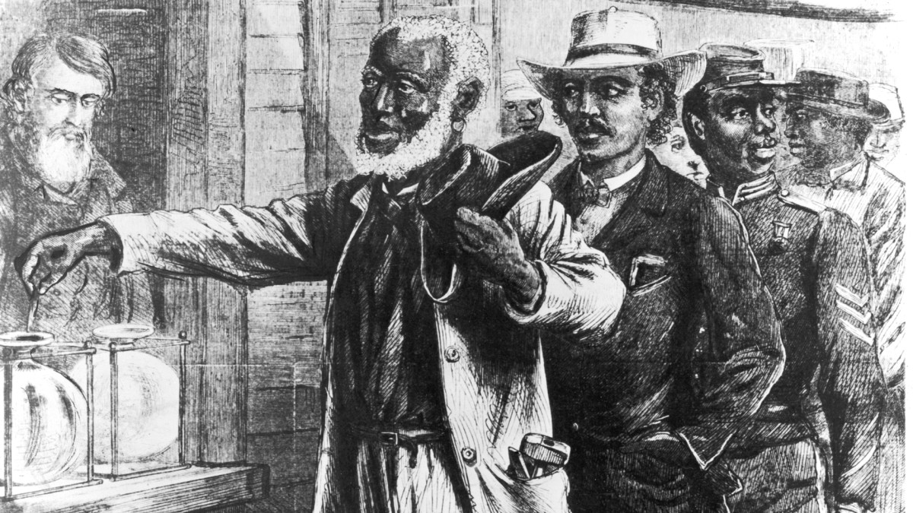
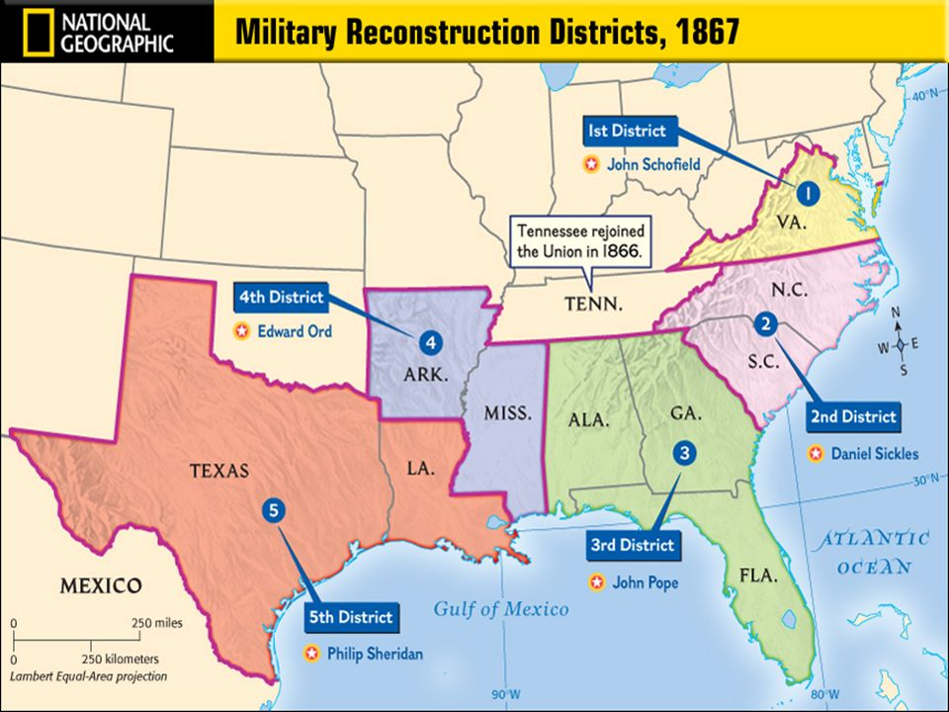
CONGRESSIONAL RECONSTRUCTION
Reconstruction Act of 1867= creates 7 military zones for south under martial law
  Black males could enroll to vote
  No ex-confederate could vote or hold office
  Required 14th Amendment to be in new constitutions for states to have representation
Johnson and southerners did as little as possible to enforce all of this

Slide 7
How did Congressional Reconstruction under the Radical Republicans differ from Lincoln's and Johnson's plans?
Notes:
🍐This is a Pear Deck Multiple Choice Slide.
🍐🍐Your current options are: A: It included full amnesty for all former Confederates, B: It was more lenient toward the Southern states, C: It imposed stricter conditions, including military oversight and the exclusion of ex-Confederates from voting and holding office, D: It focused solely on rebuilding Southern infrastructure,
🍐🍐Correct options are C: It imposed stricter conditions, including military oversight and the exclusion of ex-Confederates from voting and holding office
🍐🍐Students will earn 1 points for this response.
🍐 To edit the type of question or choices, go back to the "Make Your Lessons Interactive" in the Pear Deck sidebar.

Slide 8
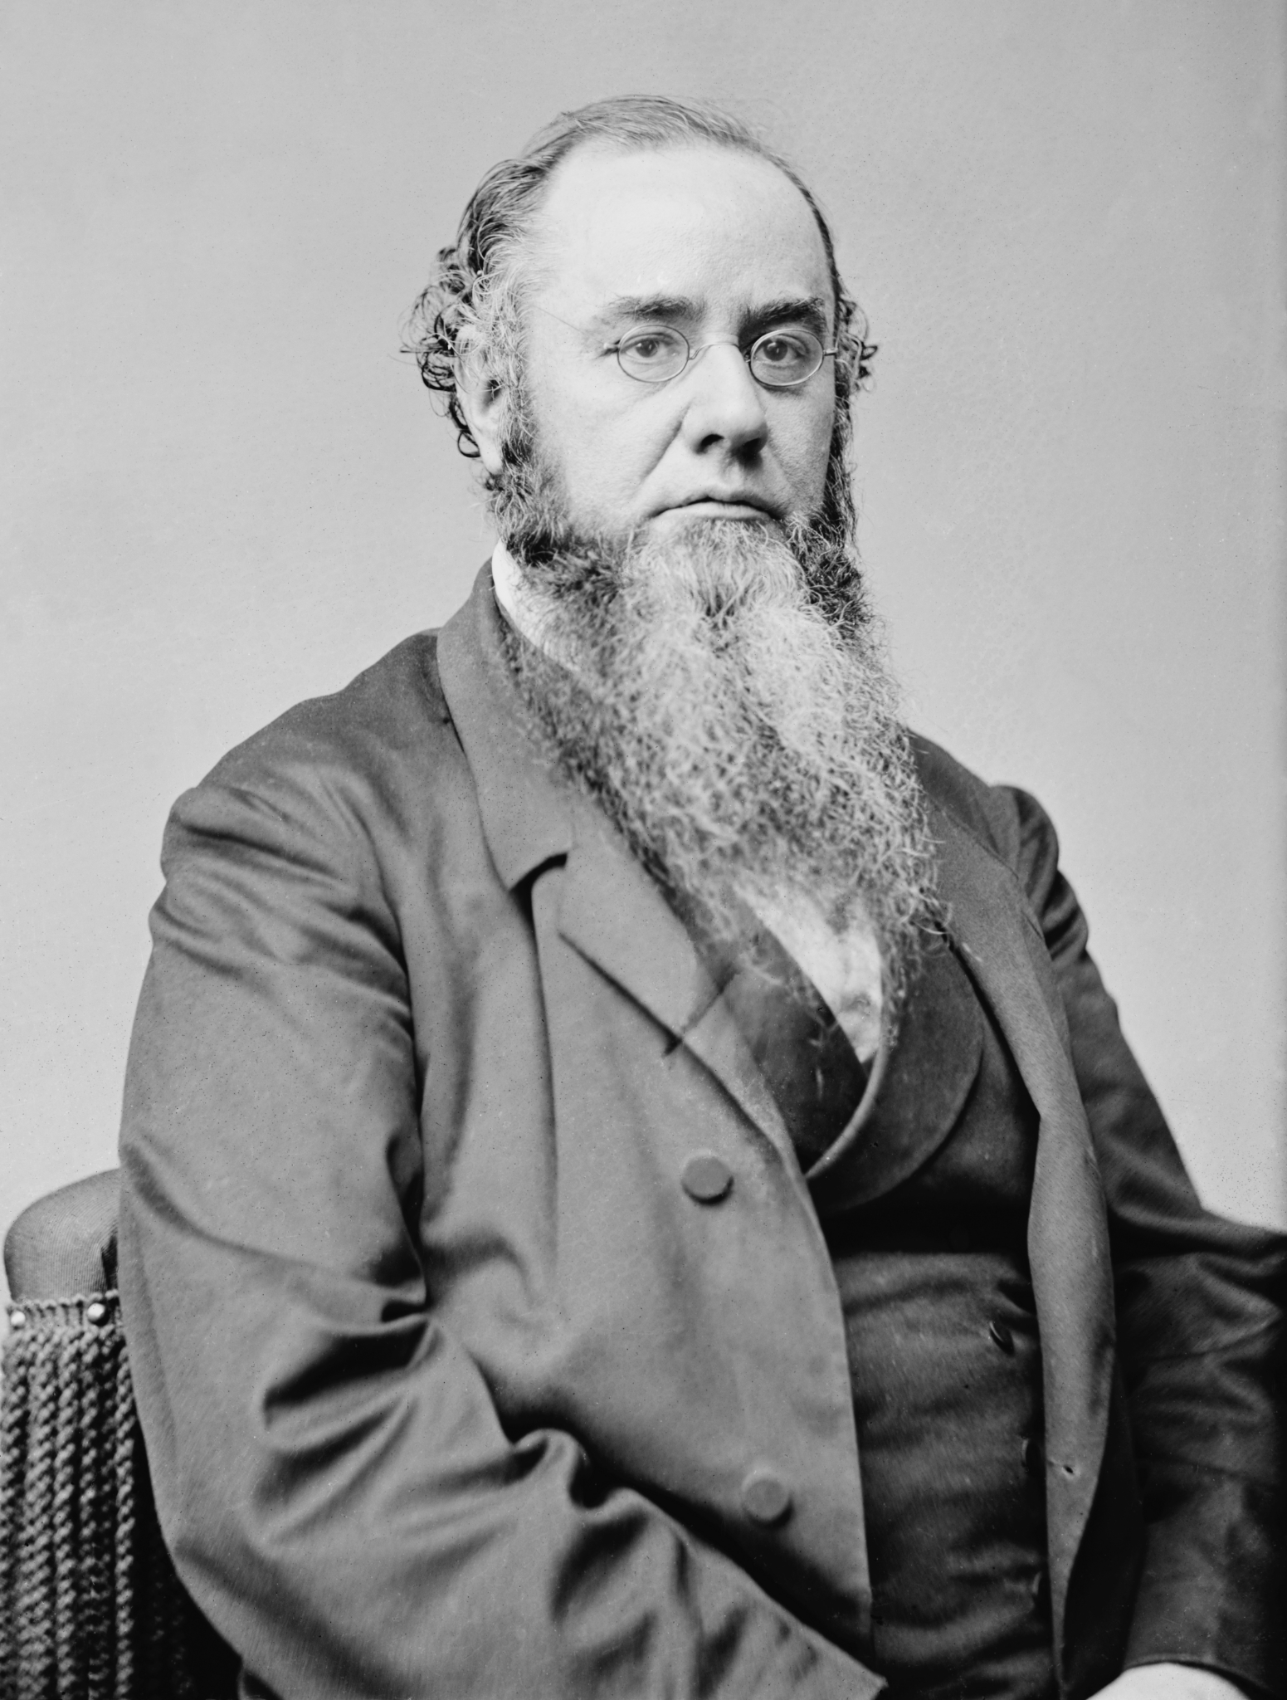
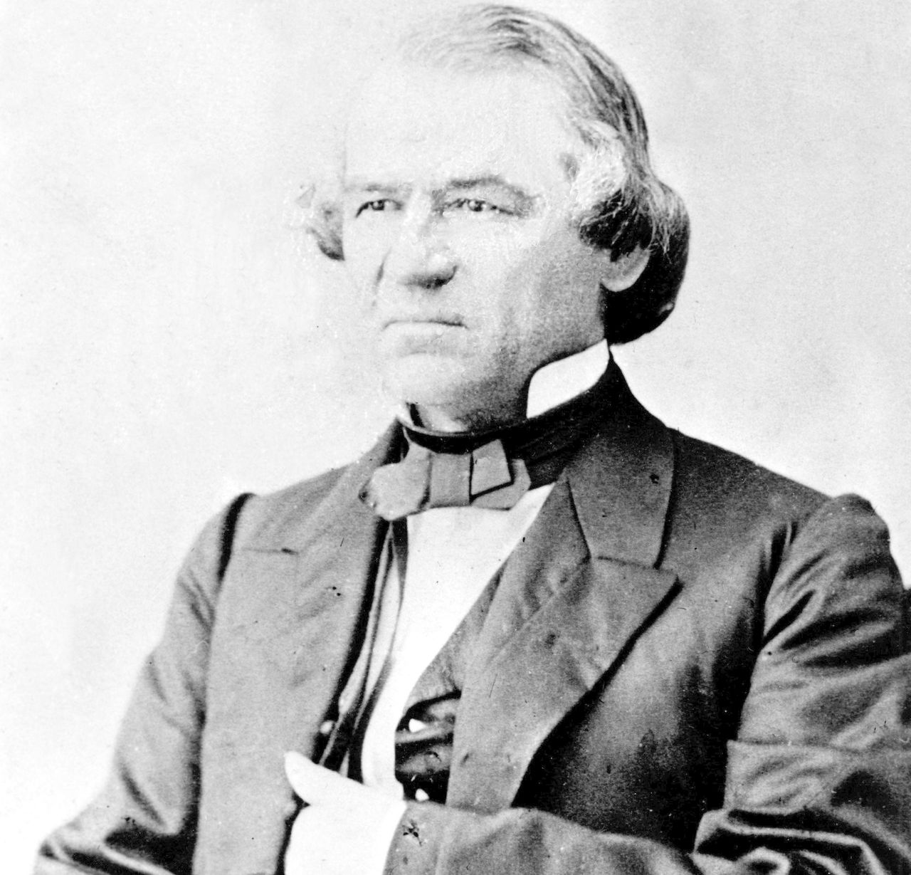


JOHNSON IMPEACHED
Radical Republicans were over Johnson and his vetoes
He had actually been removing generals and officials who had been enforcing the laws in the south
Radicals pass the Tenure of Office Act to prevent him from firing Sec. of War, Ed Stanton, who was last radical in cabinet → Johnson does it anyway

Slide 9
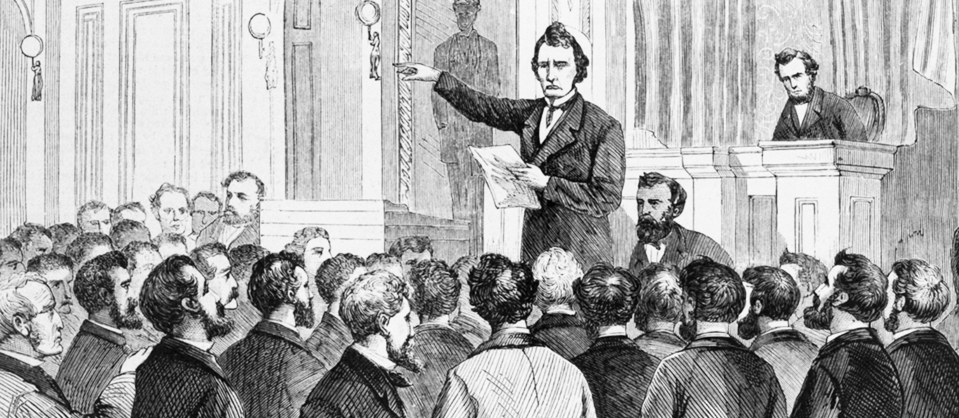
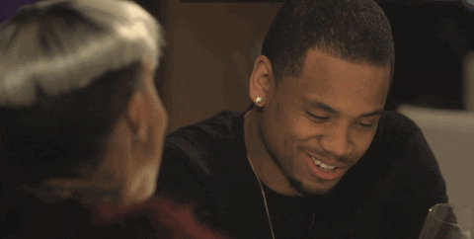
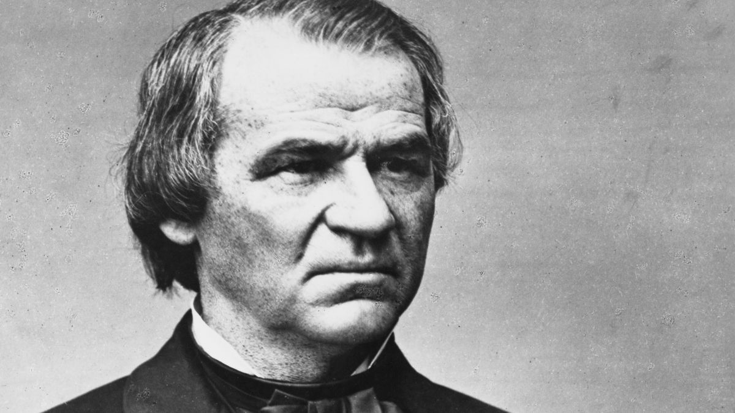
JOHNSON IMPEACHED
Johnson fires Stanton anyways
House impeaches Johnson and puts him on trial
Many congressmen believe President can only be removed for criminal acts → this was a political crime
Radicals fall 1 vote shy of removing Johnson from office

Slide 10
What was the main reason why President Andrew Johnson was impeached?
Notes:
🍐This is a Pear Deck Multiple Choice Slide.
🍐🍐Your current options are: A: He encouraged the creation of black codes, B: He refused to enforce the 15th Amendment, C: He vetoed the Reconstruction Act of 1867, D: He violated the Tenure of Office Act by firing Secretary of War Edwin Stanton,
🍐🍐Correct options are D: He violated the Tenure of Office Act by firing Secretary of War Edwin Stanton
🍐🍐Students will earn 1 points for this response.
🍐 To edit the type of question or choices, go back to the "Make Your Lessons Interactive" in the Pear Deck sidebar.

Slide 11
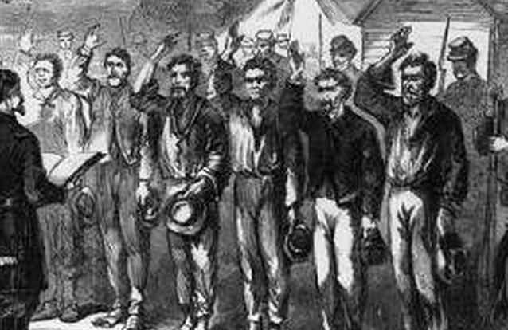
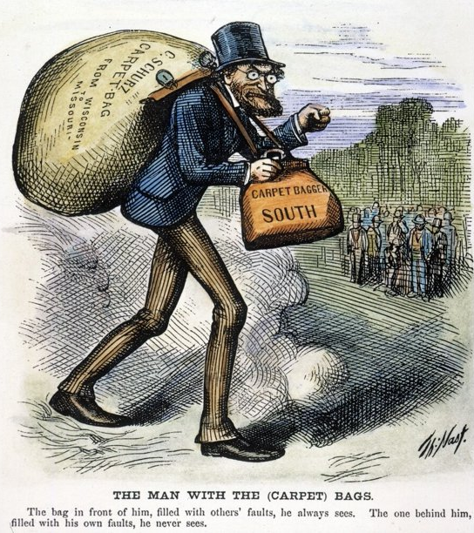
WHITE REPUBLICANS IN SOUTH
Scalawags= white southerners who vote for republicans b/c of promises of economic growth and education for all
  Still cared about racism though
Carpetbaggers= northerners who moved south during Reconstruction
  Accused of coming to take advantage of wrecked economy
  Held ⅓ of all offices

Slide 12
Who were the "Carpetbaggers" during Reconstruction?
Notes:
🍐This is a Pear Deck Multiple Choice Slide.
🍐🍐Your current options are: A: White Southerners who supported the Republican Party for economic reasons, B: Northerners who moved to the South, often accused of taking advantage of the region's economic troubles, but also helped rebuild the region and helped freedmen, C: Southern politicians who opposed Radical Republican policies, D: African-Americans who gained political power after the Civil War,
🍐🍐Correct options are B: Northerners who moved to the South, often accused of taking advantage of the region's economic troubles, but also helped rebuild the region and helped freedmen
🍐🍐Students will earn 1 points for this response.
🍐 To edit the type of question or choices, go back to the "Make Your Lessons Interactive" in the Pear Deck sidebar.

Slide 13
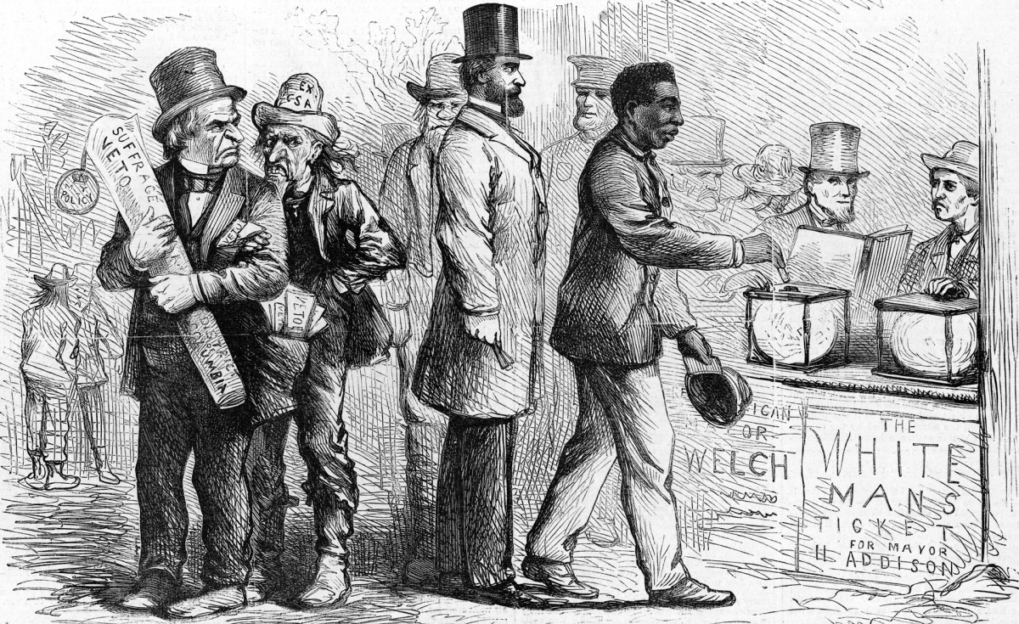
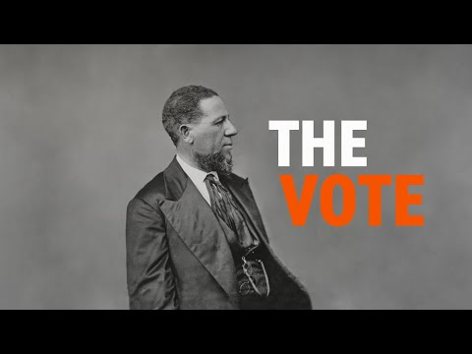
AFRICAN-AMERICANS IN GOVT
15 Amendment (1870)= gives African-Americans the right to vote
Despite whites finding loopholes to prevent many blacks from voting, thousands do
  Majority of voters in 5 states
1870-1876: 2000 black office holders are elected including 7 senators and representatives to DC

Slide 14
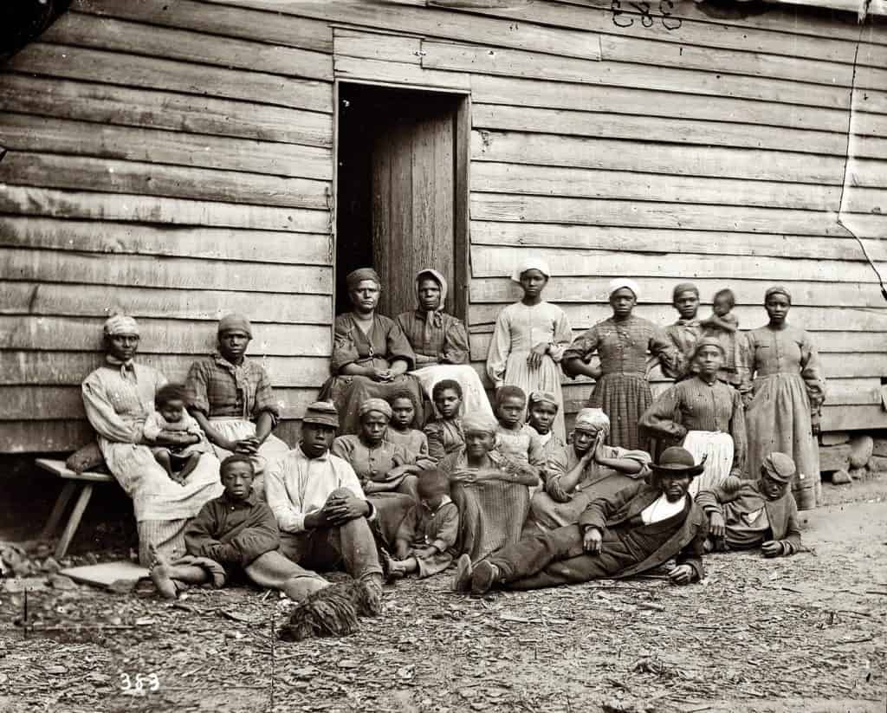
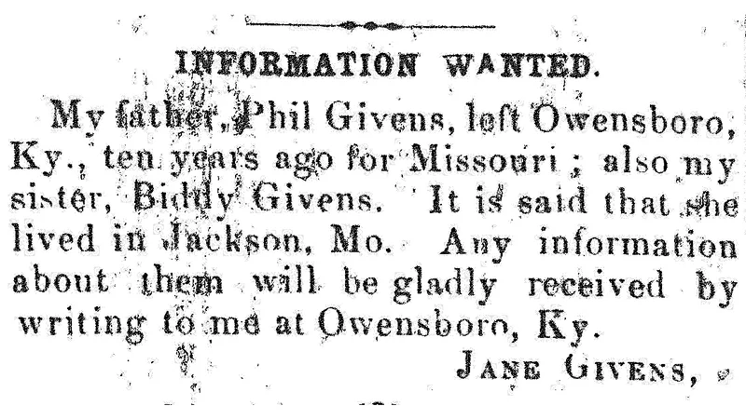
EXPERIENCING FREEDOM
For newly freed African-Americans, freedom meant mobility and control over their own labor
They adopted full names, including last names which usually came from former owners
Marriages were legalized and families often united
Black newspapers published ads taken out by family members in hopes of finding lost loved ones.

Slide 15
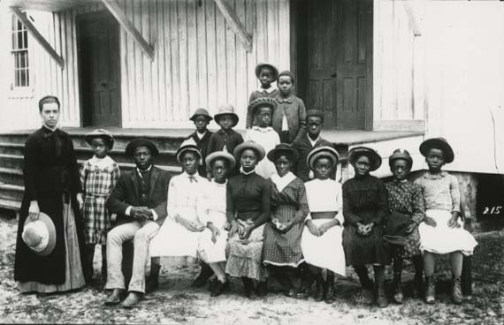
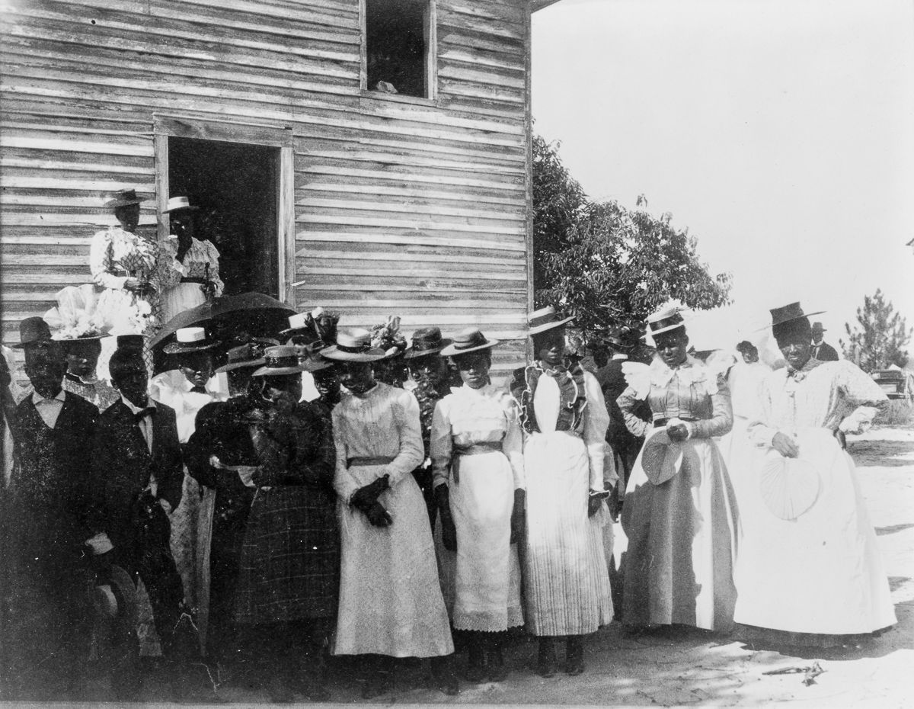
SCHOOL & CHURCH
Both school and church became essential elements of black life
At first, northern missionaries and the Freedmen’s Bureau set up schools → later, the black community set up their own
  Nearly ½ of kids were enrolled
  Adults also attended
They also founded their own Methodist and Baptist churches
  Churches offered a place of refuge in a hostile while world → hope, comfort and voice

Slide 16
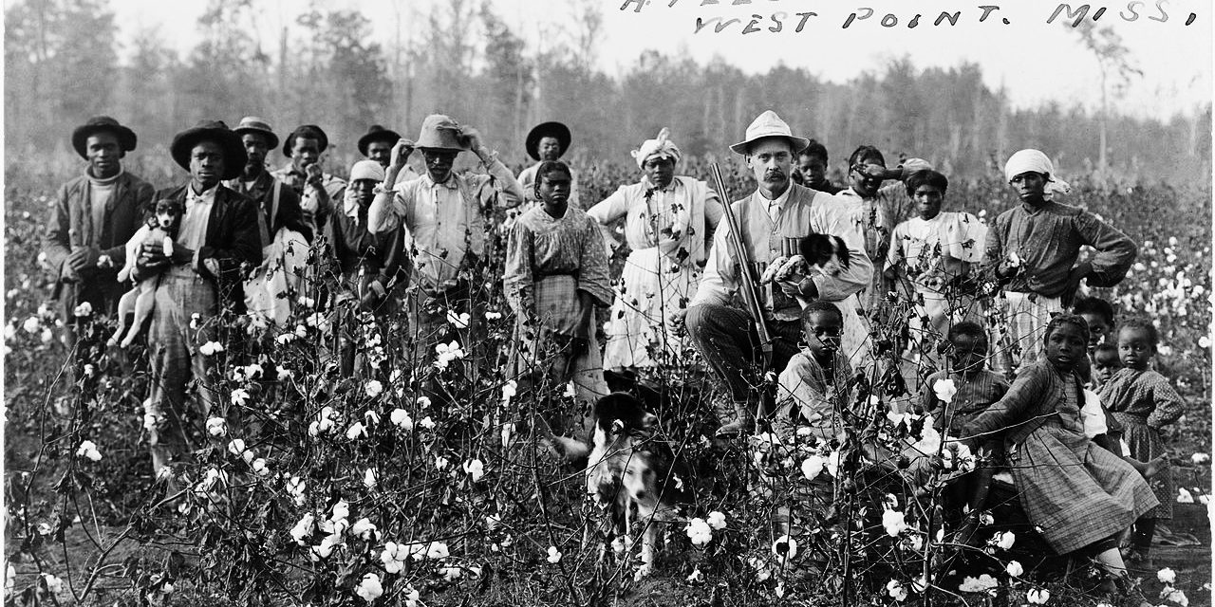
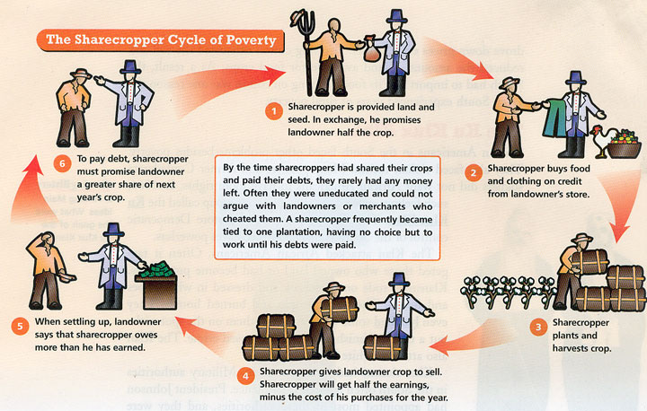
NEW WORKING CONDITIONS
Sharecropping= black families farmed plots on white-owned land and divided the crop @ end of season
  Ownership of a crop was hugely symbolic
Many whites required tenants to purchase seeds and tools from them for marked up prices → often went into debt
Had to stay and work for free until “debt” was paid down; slavery by another name?
  Those who tried to leave could be arrested by Freedmen’s Bureau

Slide 17
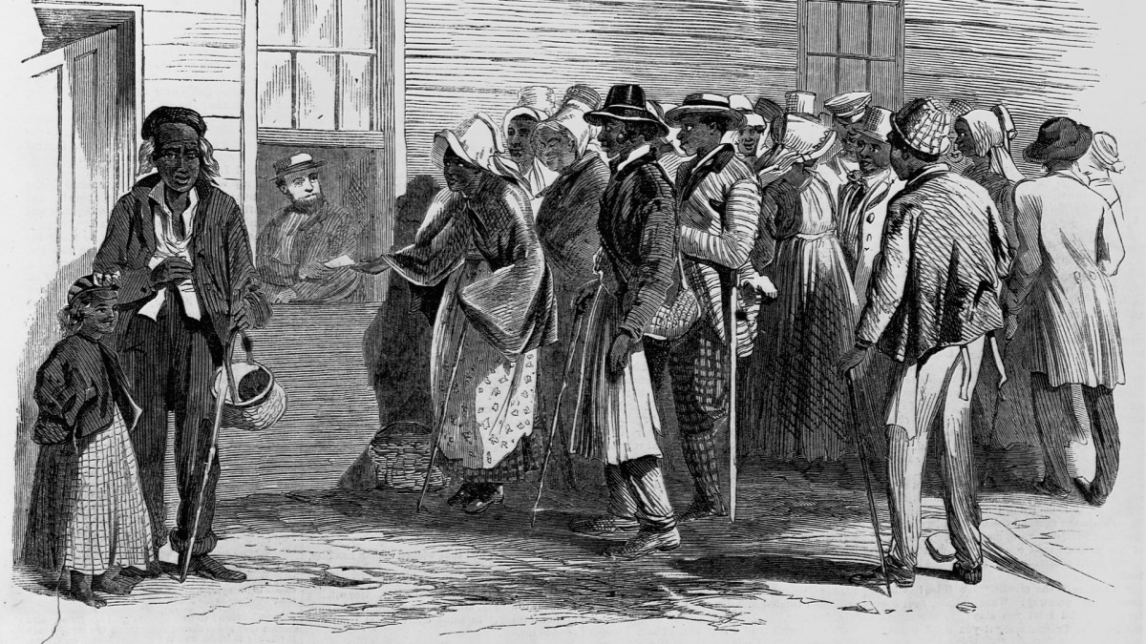
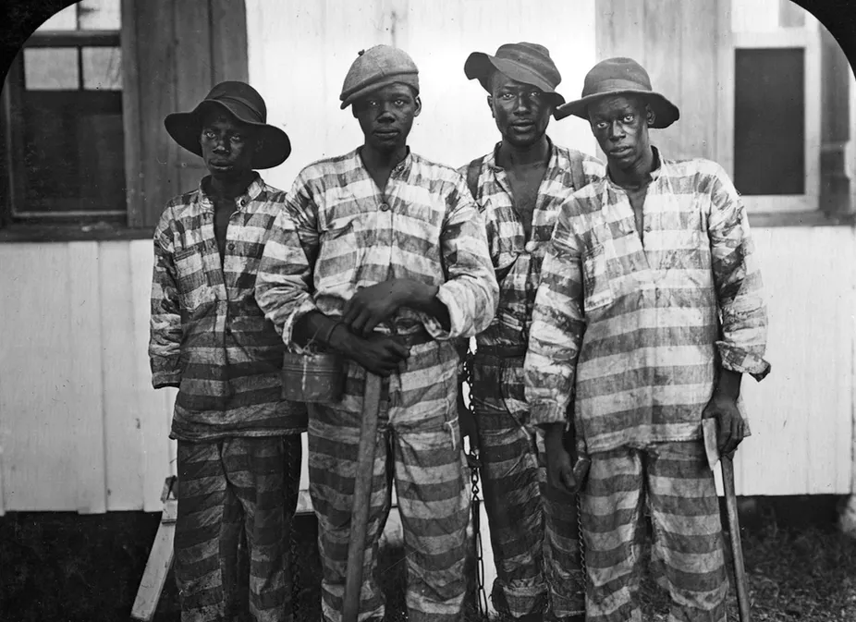
NEW WORKING CONDITIONS
White landowners often chased sharecroppers off land when it was time to pay for their portion of the crop
Black codes included vagrancy laws that allowed police to arrest any African-American found not to have a job
  Those prisoners often found themselves contracted out as labor by the police to local white farmers

Slide 18
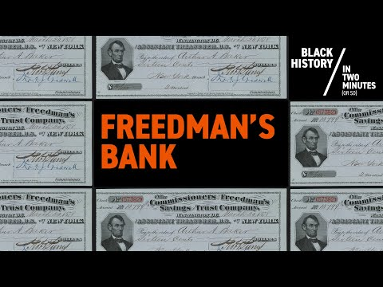
THE FREEDMAN’S BANK
The Freedman’s Bank, initially introduced hope to the Black community, but over time, and with an economic depression in 1873, it showed that any progress African-Americans had seen from 1865- 1873, was in serious jeopardy as Reconstruction came to a close.

Slide 19
What was one effect of the black codes and vagrancy laws during Reconstruction?
Notes:
🍐This is a Pear Deck Multiple Choice Slide.
🍐🍐Your current options are: A: They allowed police to arrest African-Americans without jobs and forced them into labor for local white farmers, B: They protected African-Americans from unfair labor practices, C: They encouraged African-Americans to purchase land for farming, D: They led to more educational opportunities for African-American children,
🍐🍐Correct options are A: They allowed police to arrest African-Americans without jobs and forced them into labor for local white farmers
🍐🍐Students will earn 1 points for this response.
🍐 To edit the type of question or choices, go back to the "Make Your Lessons Interactive" in the Pear Deck sidebar.

