Slide 1
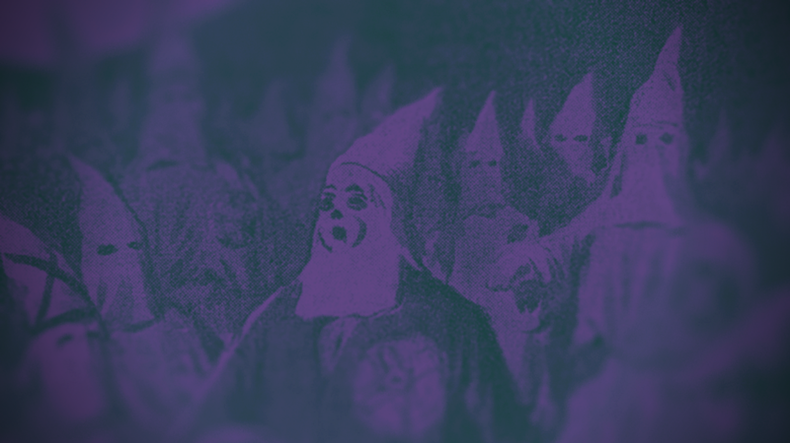
10.3
THE END OF RECONSTRUCTION

Slide 2
MONDAY DEC 11 2023
WHAT YOU NEED
AGENDA
HOMEWORK
Charged computer, but not out yet.
Active Mind
Finish Sharecropping Sim
What led to the end of Reconstruction in the South?
START STUDYING FOR EXAM!

Slide 3

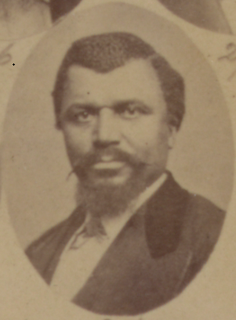
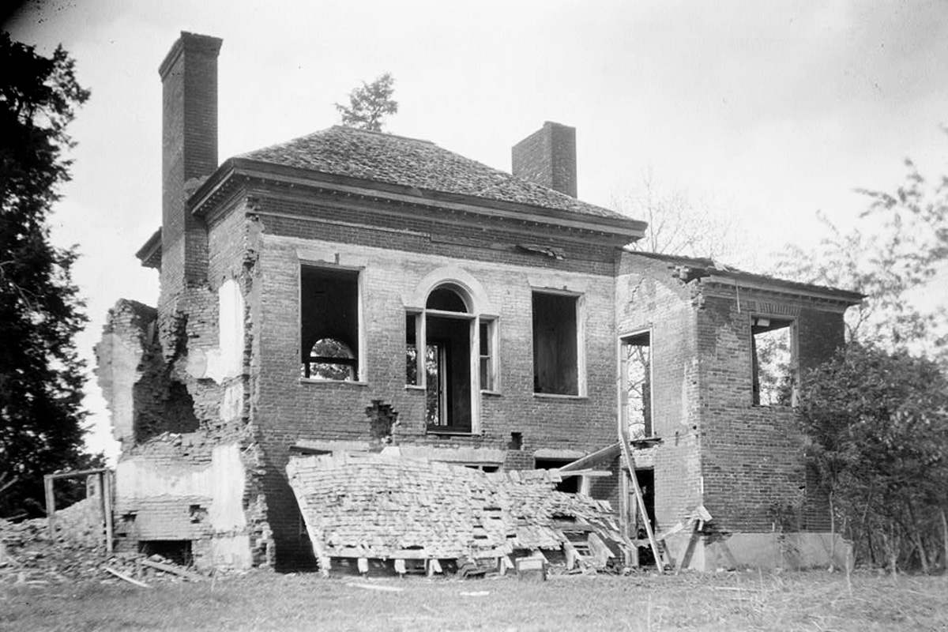
CHARLES CALDWELL
On Christmas Day 1875, Charles Caldwell, a state senator, was having dinner at the home of a friend. He had recently returned to home to Mississippi after fleeing an angry white mob 2 months earlier. As he was giving a toast, a gunshot exploded through the window and Caldwell collapsed. Men entered the home, dragged out his body, and continued to shoot it for fun. He died alone in the street as the home was destroyed….

Slide 4
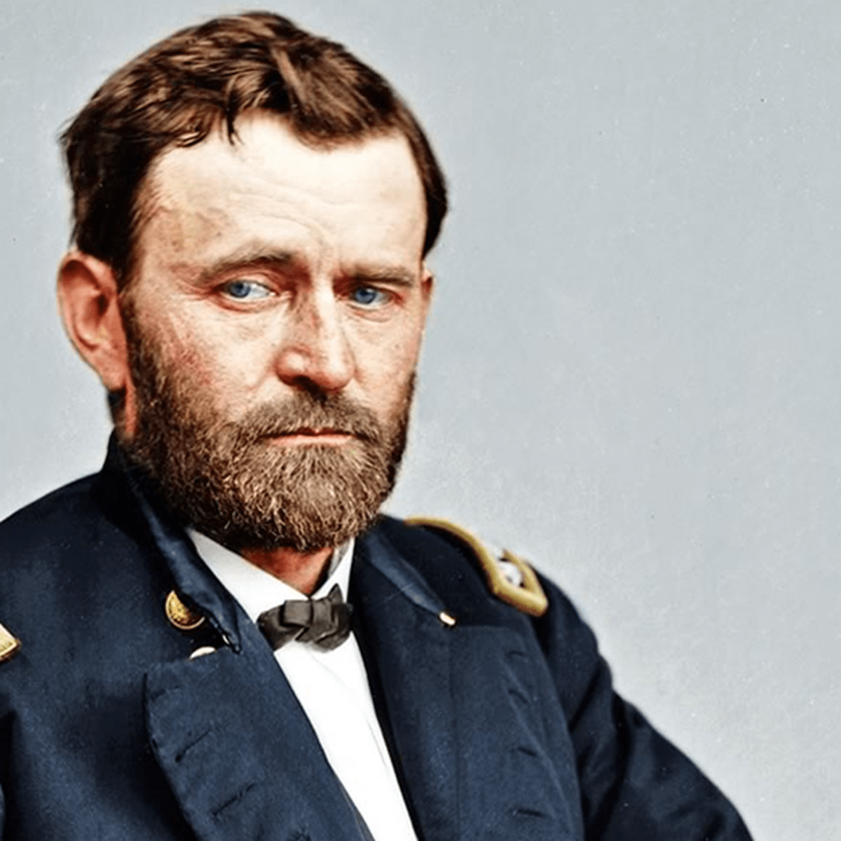
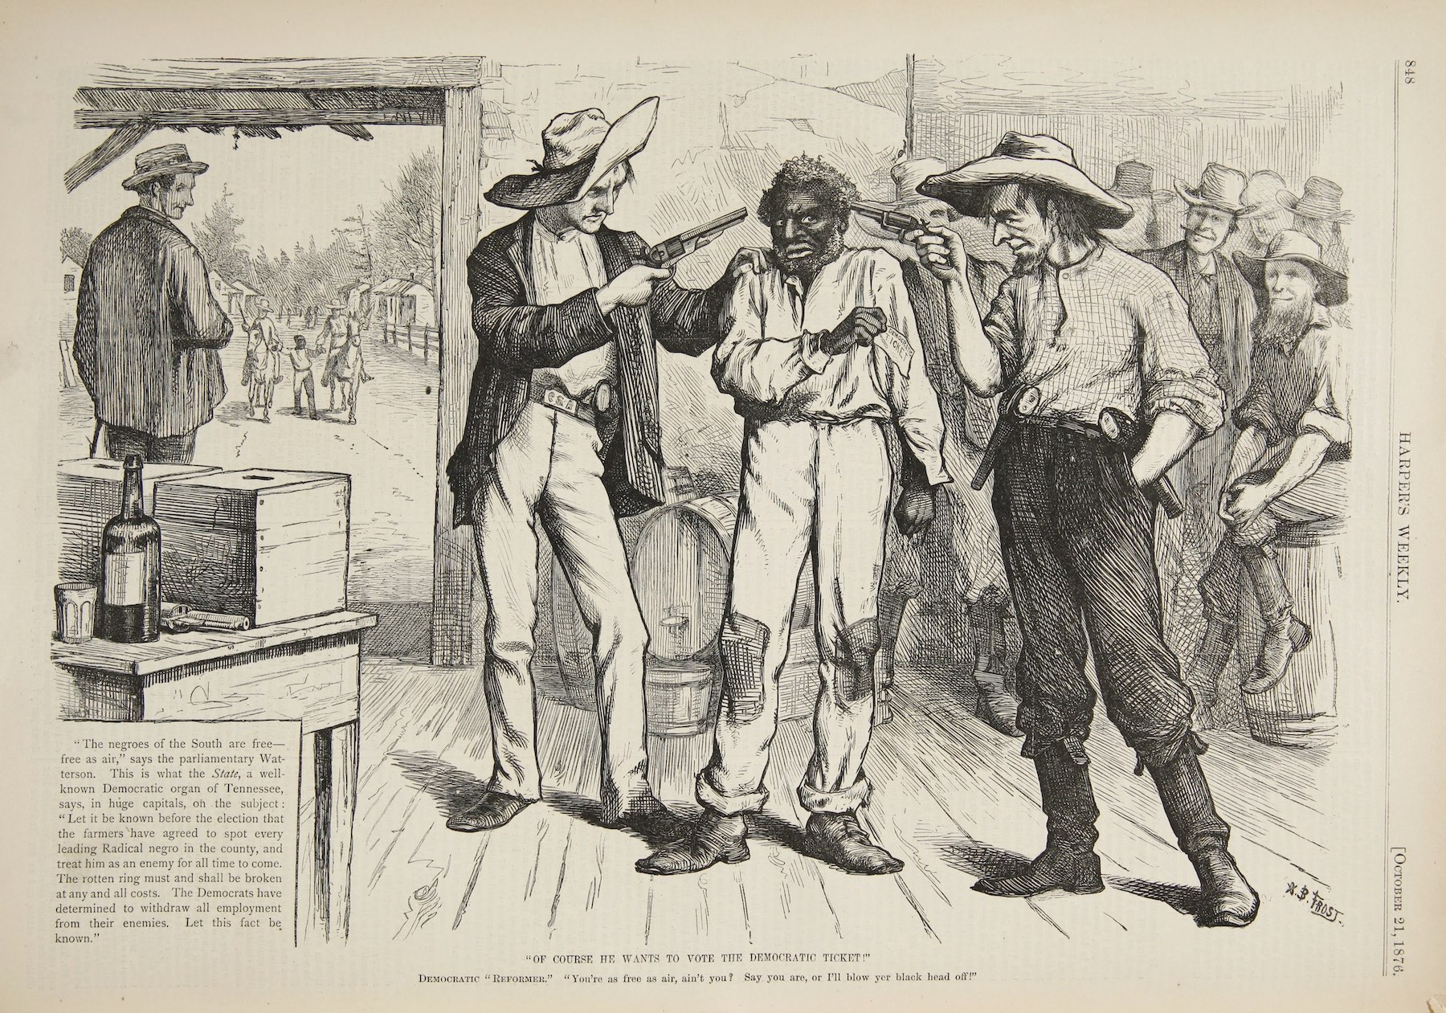
ELECTION OF 1868
US Grant, a republican, was elected as President but only by a small margin in the south
It was clear that many African-Americans were being disenfranchised, or denied the right to vote → often through intimidation, literacy tests, and taxes
1870- Congress passed the 15th Amendment to guarantee right to vote, but loopholes still remained

Slide 5
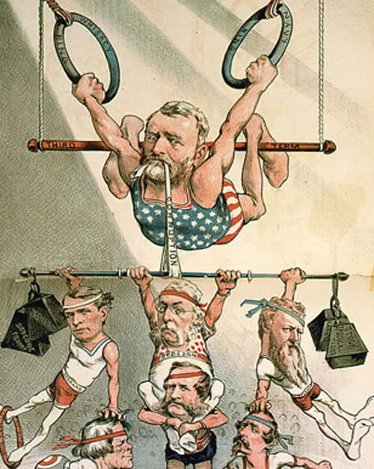
GRANT’S PRESIDENCY
Corruption and scandal was common in the Grant administration
  Grant himself was not involved, but he failed to remove those who were
Whiskey Ring Scandal= tax officials allowed whiskey distillers to get away with not paying taxes in return for kickback payments
Reformers lose interest in black rights and move on to cleaning up government corruption.

Slide 6
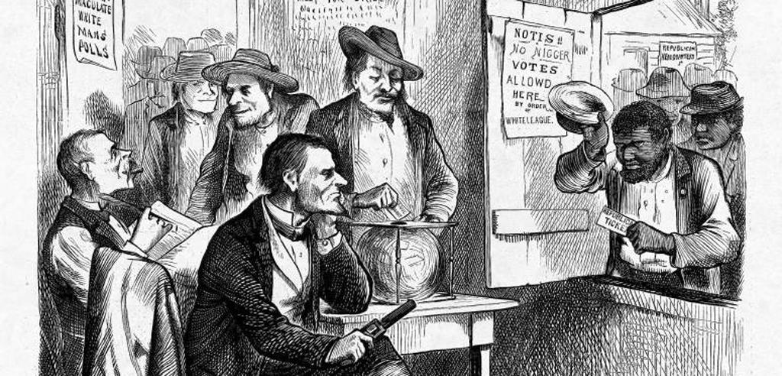

NORTHERN DISILLUSIONMENT
Civil Rights Act of 1875= bans segregation in most public places except schools → no one actually enforces it
Northern whites began to see reconstruction as a “chore” and too much trouble
  Elections were growing violent
Panic of 1873 leads Radical Republicans to lose seats in Congress
  Becomes politically unpopular to support Reconstruction

Slide 7
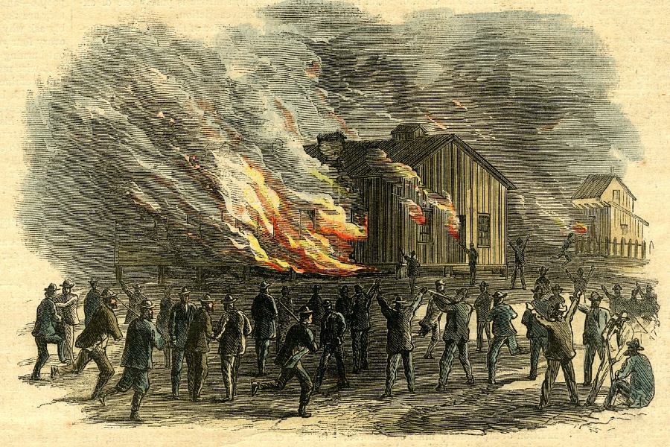
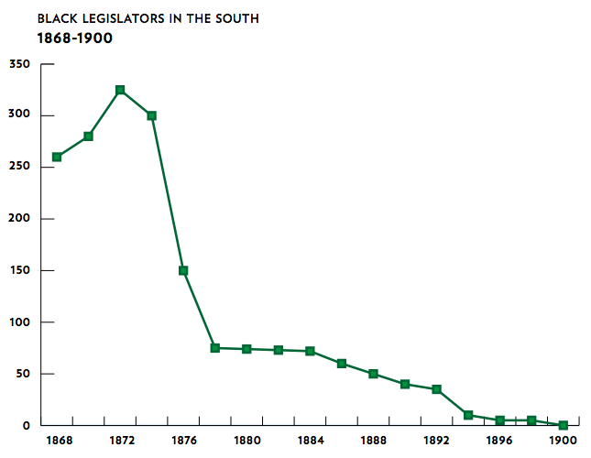
WHITE SUPREMACY
By 1875, public outrage by southerners over African-Americans voting had grown
  Some papers even published names of black voters in order to intimidate
Domestic Terror groups began routinely disrupting elections and assassinating black officials like Charles Caldwell

Slide 8
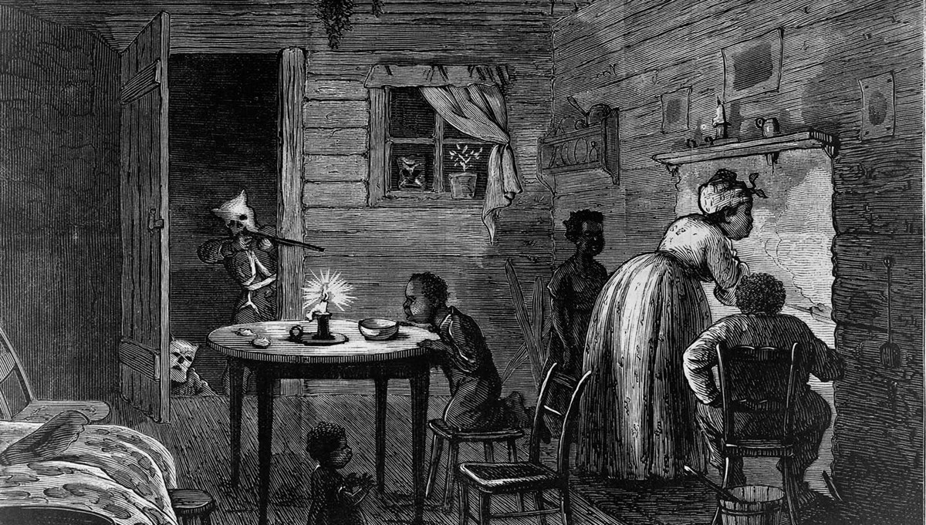
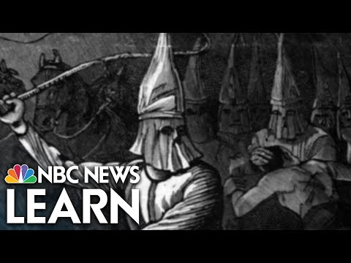
THE KU KLUX KLAN
The Ku Klux Klan sought to “reclaim the night”
  It has originally been controlled by whites who banned any sort of black activity at night on plantations
  Since emancipation, African-Americans had help church, parades, and meetings at night

Slide 9
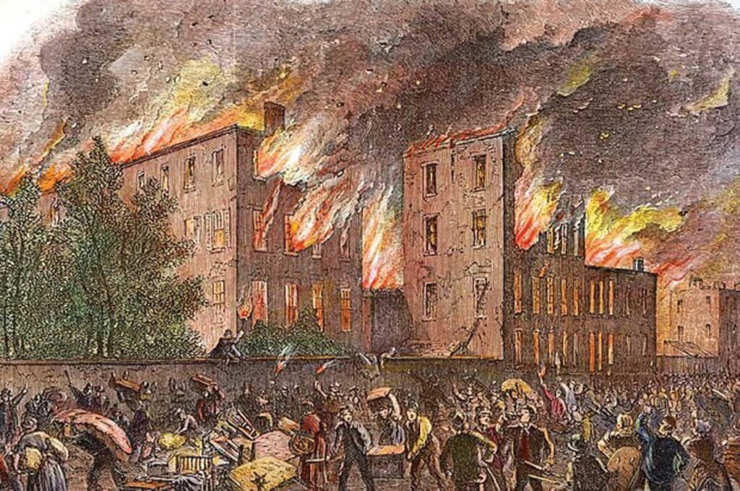
“REDEMPTION”
In 1875, Mississippi whites carry out a plan to cause as much violence as possible to tilt state elections for white democrats
As many as 60,000 African-Americans and whites were prevented from voting through violence and murder
Grant refuses to send in military for help → northern public had no appetite
Newly elected white officials become known as “redeemers”

Slide 10
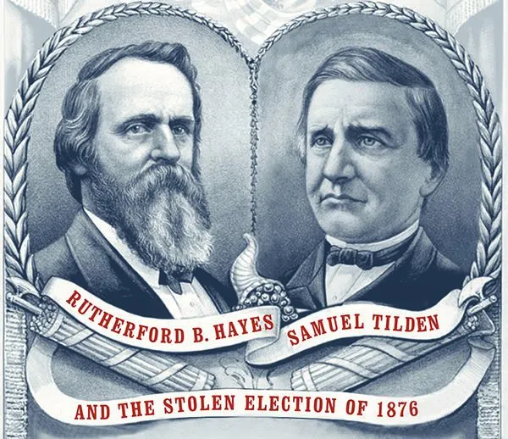
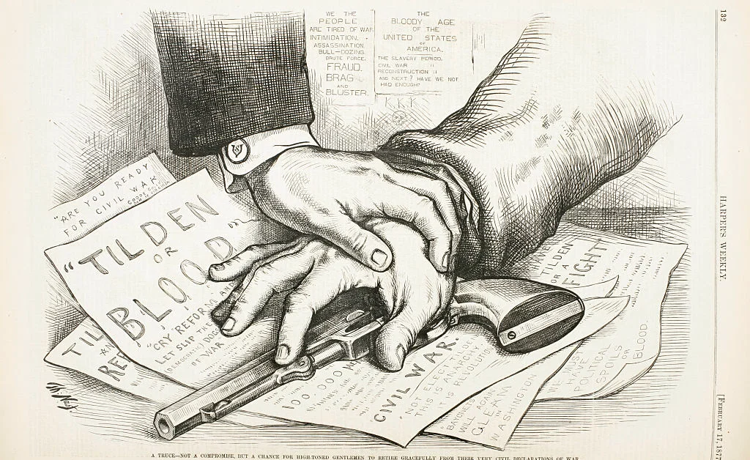
ELECTION OF 1876
Rutherford B Hayes ® runs against Sam Tilden (D)
Widespread violence throws results into chaos and confusion → both parties claim they won SC, FL, and LA
Hayes’ people make a secret deal with the states to remove the military and end Reconstruction if they certify Hayes as the winner, making him President
Republican party collapses and Redeemers take full control; Reconstruction Over

