Slide 1

Machine Learning Final Project
Evann Thompson

Slide 2
Movie Recommender
I decided to do make a movie recommender, where you can type in a movie in an IMDb data set and it returns the top 10 recommendations based on the similarity.
I used Python Pandas, Matplotlib and Flask for this this project

Slide 3

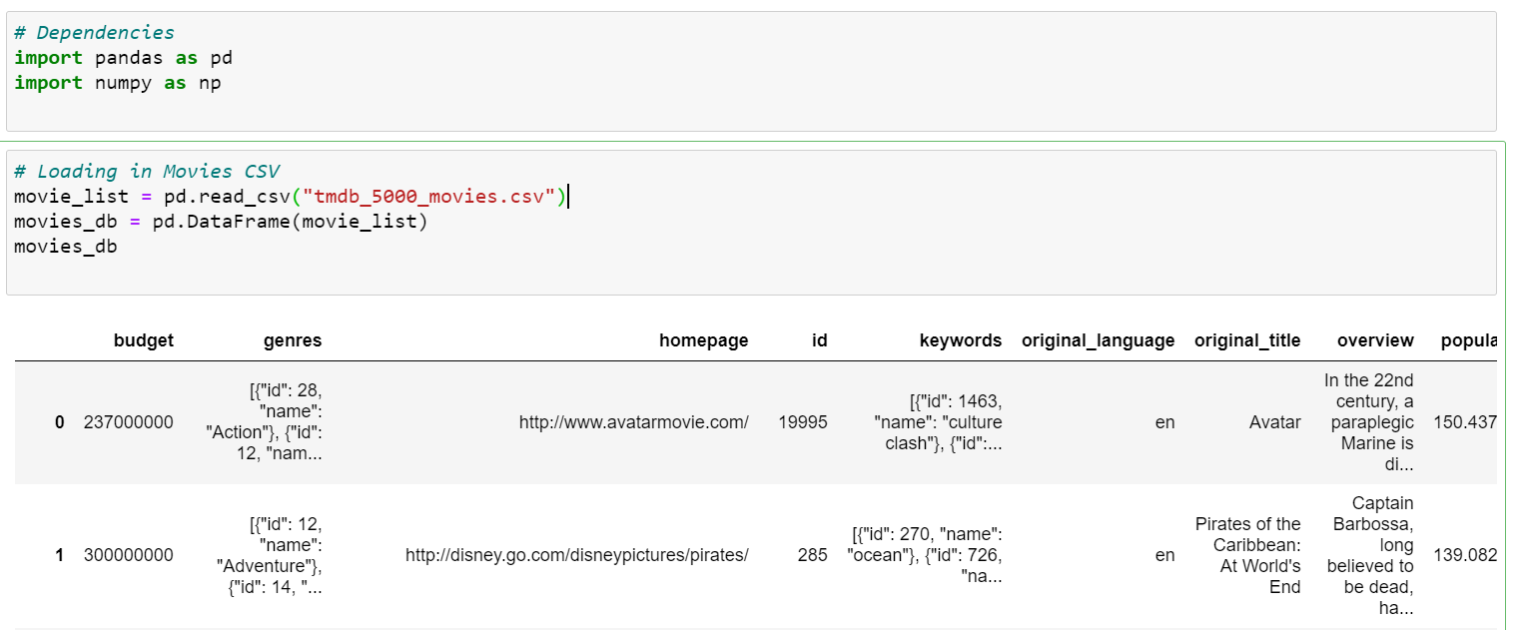
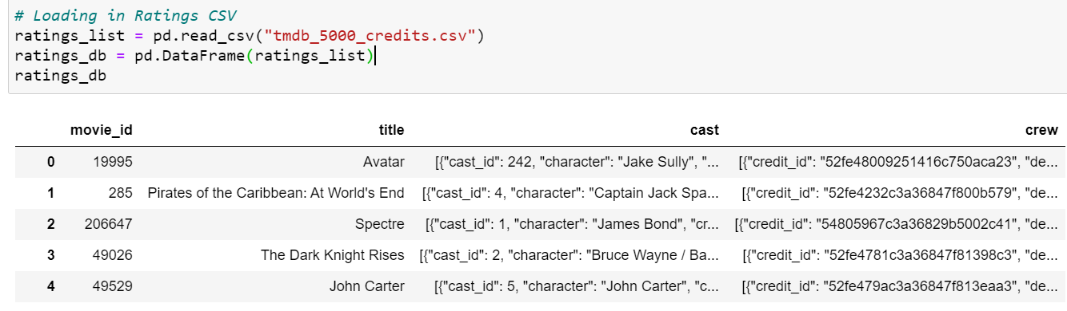
Data used

Slide 4
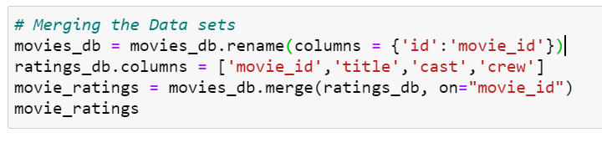
ETL Process

Slide 5
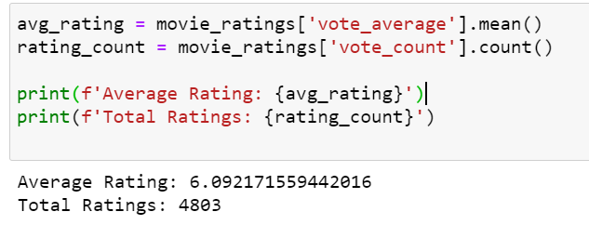
ETL Process

Slide 6
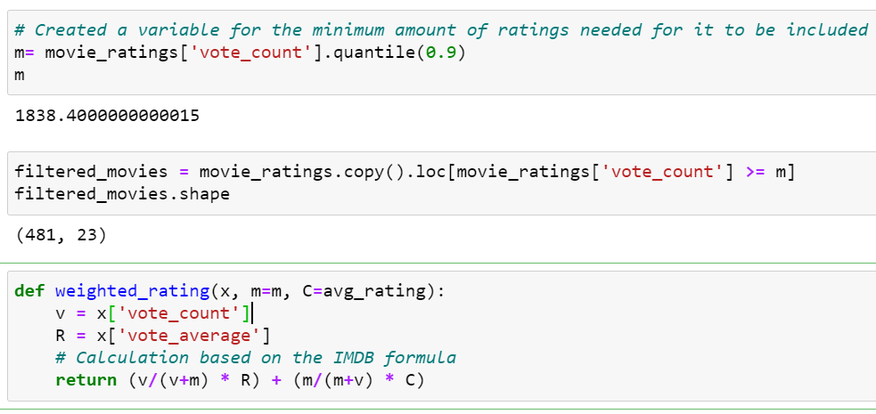
ETL Process

Slide 7
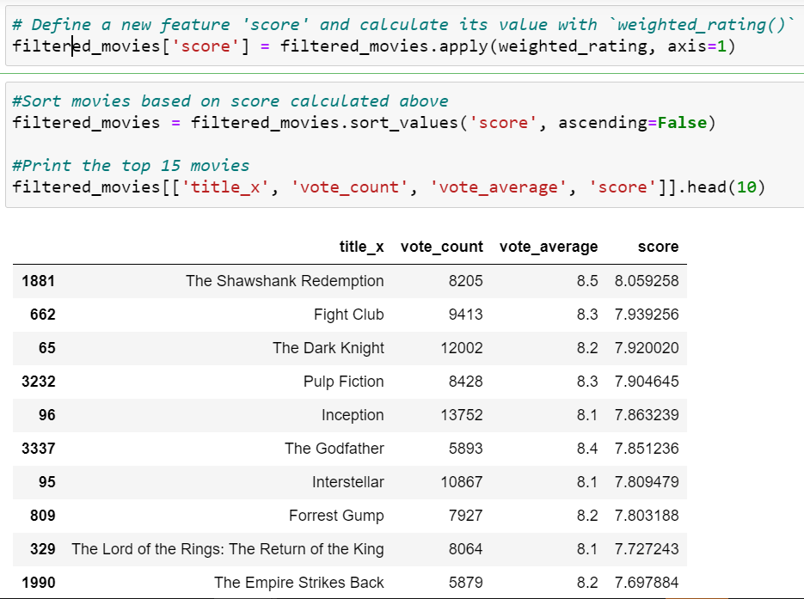
ETL Process

Slide 8
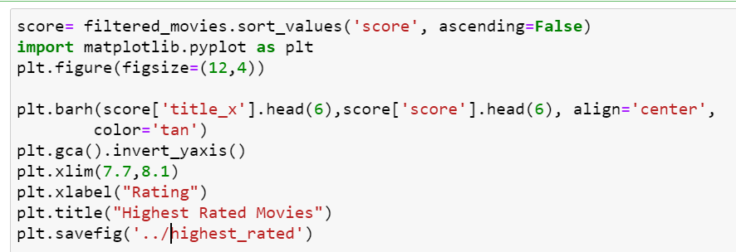
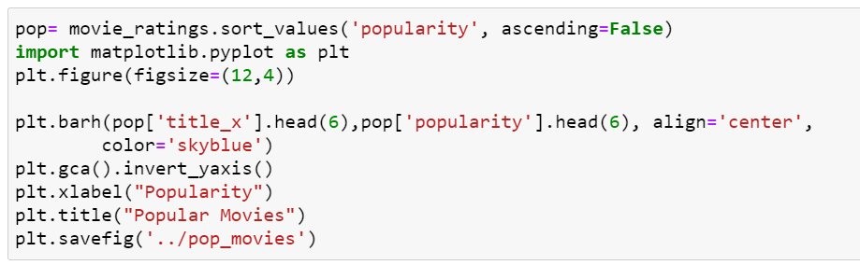
ETL Process

Slide 9
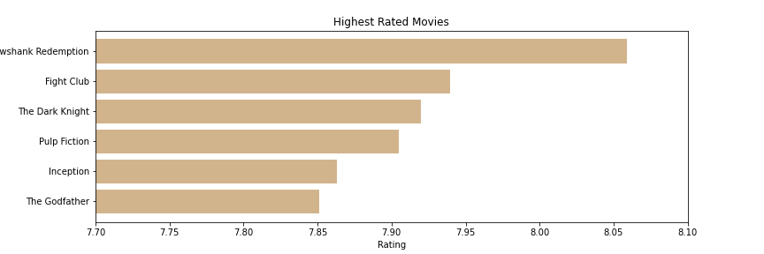
Highest Rated movies

Slide 10
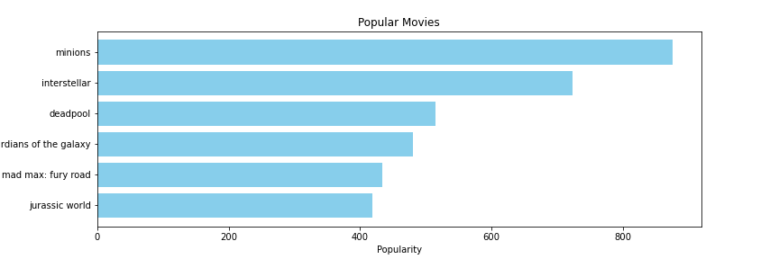
Most popular movies

Slide 11
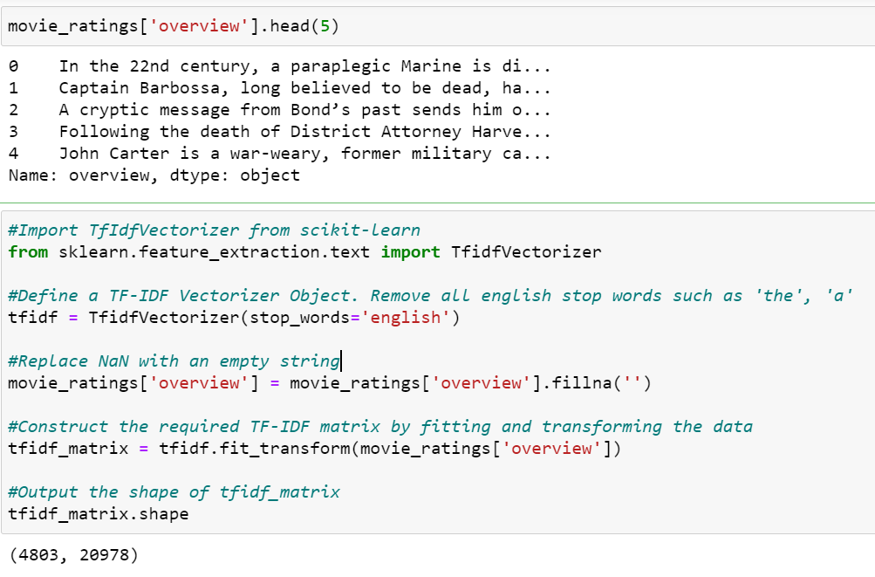
TF-IDF Vectorizer
TF-IDF stands for Term Frequency-Inverse Document Frequency, and the TF-IDF weight is a weight often used in information retrieval and text mining
The first computes the normalized Term Frequency (TF), aka. the number of times a word appears in a document, divided by the total number of words in that document.
The second term is the Inverse Document Frequency (IDF), computed as the logarithm of the number of the documents in the corpus divided by the number of documents where the specific term appears.

Slide 12
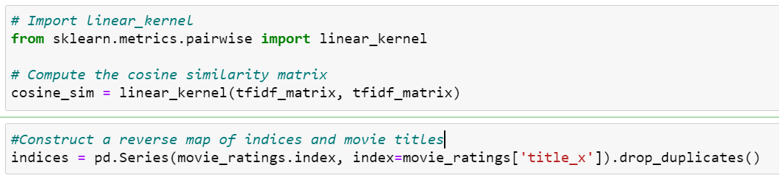
Linear-Kernal
Cosine similarity to calculate a numeric quantity that denotes the similarity between two movies
Mechanism to identify the index of a movie in our metadata DataFrame, given its title.

Slide 13
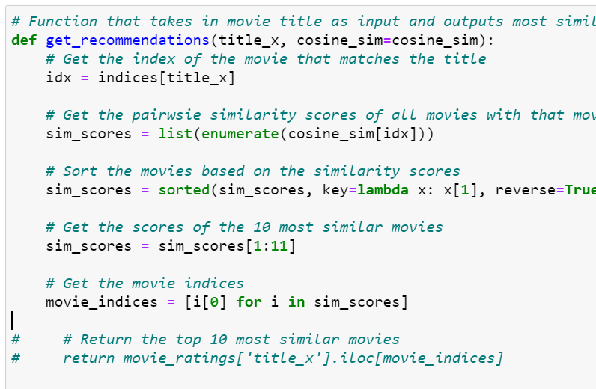
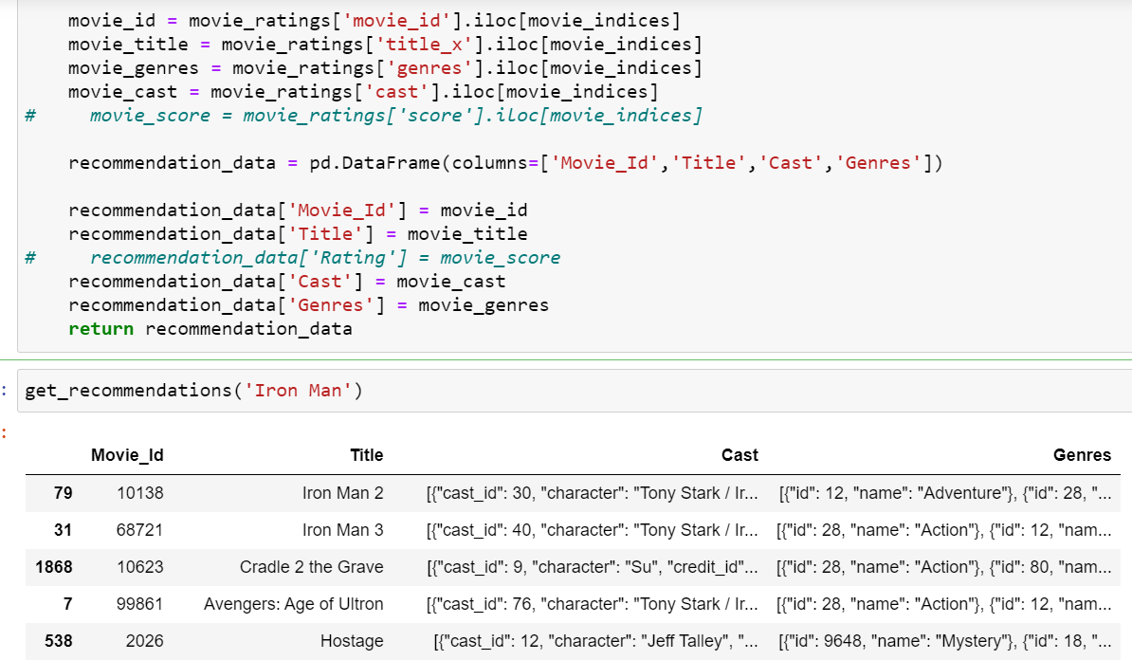
Building the recommender

Slide 14
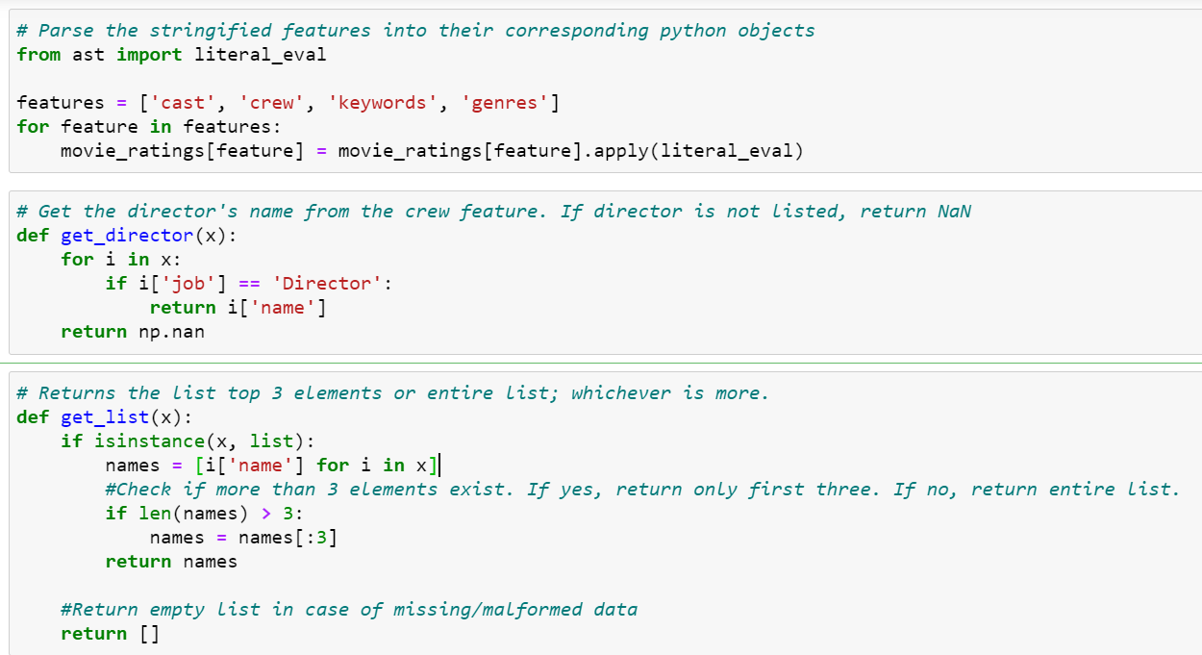
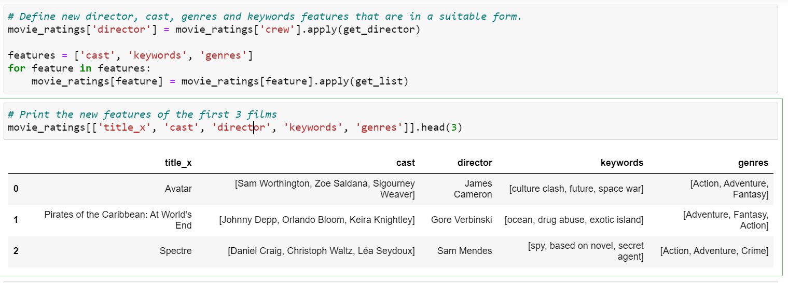
Increasing the quality of recommender

Slide 15
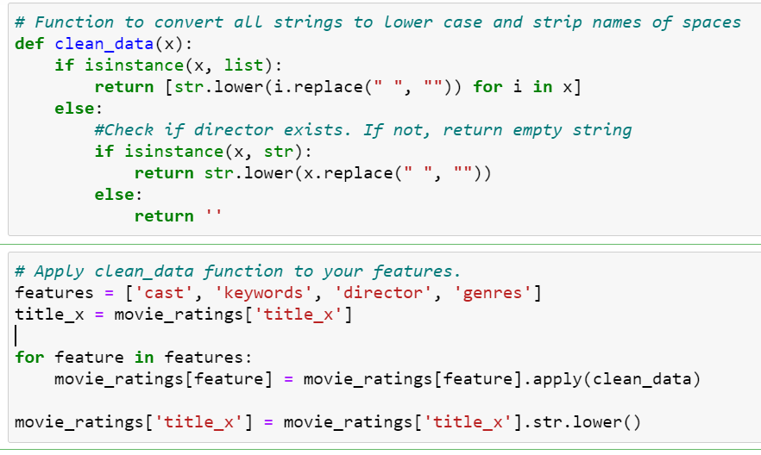
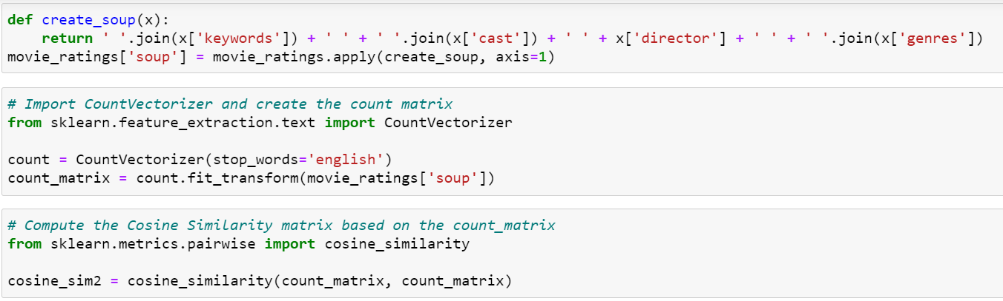
Changing to lowercase & Removing spaces

Slide 16
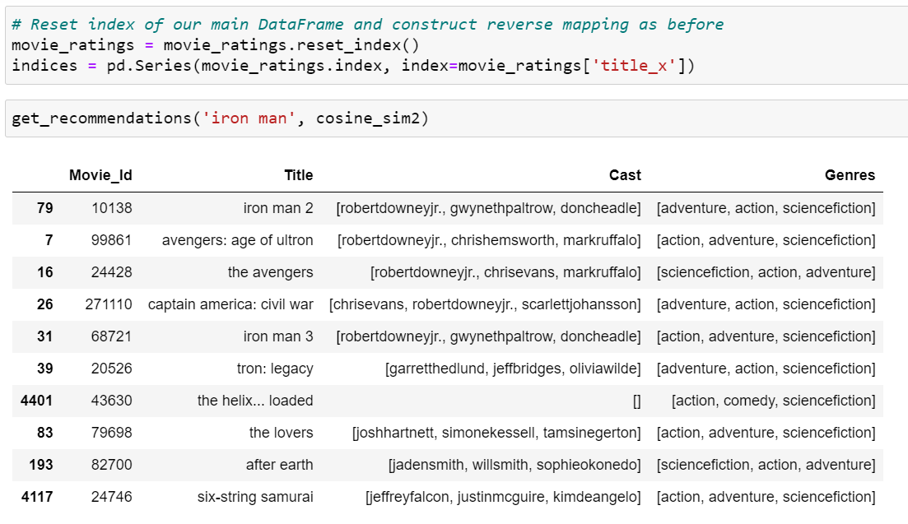
Final recommender

Slide 17
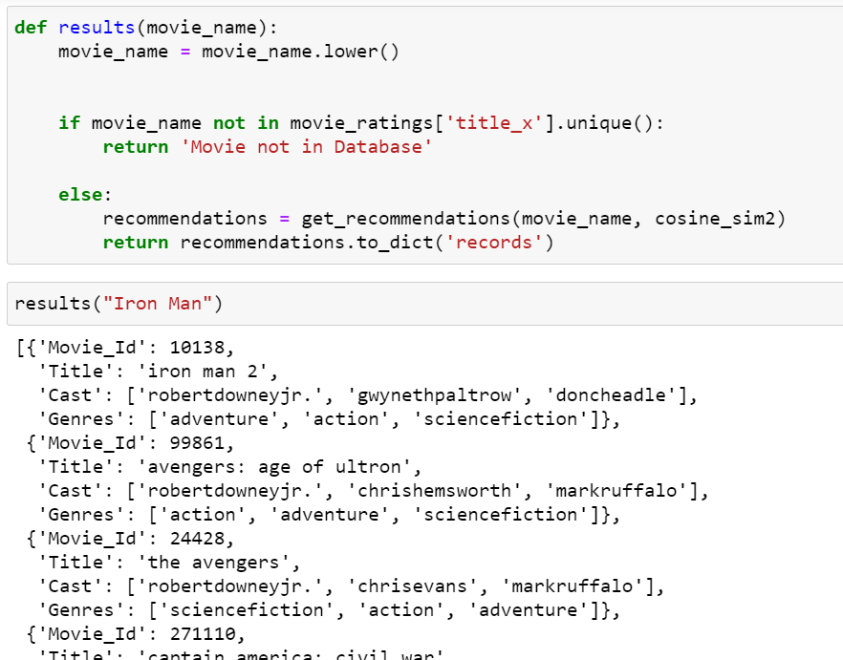
Results

Slide 18
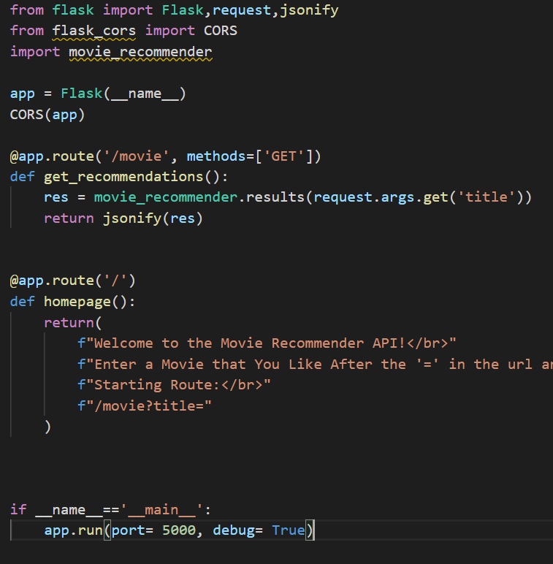
Flask

