Slide 1

Securing Resources
Managed Identities
Hybrid Identities
Identity Providers
Data Security
RBAC

Slide 2
Secure resources
1. Secure resources by using managed identities
Describe the differences between Active Directory on-premises and Azure Active Directory (Azure AD),
Programmatically access Azure AD using Graph API,
Secure access to resources from Azure AD applications using OAuth and OpenID Connect
2. Secure resources by using hybrid identities
Use SAML claims to authenticate to on-premises resources, describe AD Connect synchronization, implement federated identities using Active Directory Federation Services (ADFS)
3. Secure resources by using identity providers
Provide access to resources using identity providers, such as Microsoft account, Facebook, Google, and Yahoo!;
Manage identity and access by using Azure AD B2C
Implement Azure AD B2B
4. Identify an appropriate data security solution
Identify security requirements for data in transit and data at rest;
Identify security requirements using Azure services, including Azure Storage Encryption, Azure Disk Encryption, and Azure SQL Database TDE
5. Design a role-based access control (RBAC) strategy
Secure resource scopes, such as the ability to create VMs and Azure Web Apps;
Implement Azure RBAC standard roles
Design Azure RBAC custom roles
6. Manage security risks by using an appropriate security solution
Identify, assess, and mitigate security risks by using Azure Security Center, Operations Management Suite, and other services

Slide 3
Secure resources by using managed identities
Notes:
How do we identify, authenticate, and authorize users within Azure?
How do we manage who may access to our Azure resources?

Slide 4
On-Premise Active Directory vs Azure AD
Active Directory On-Premise | Azure AD
Authentication Provider | Authentication Provider
Internal single customer directory service | Multi-customer public directory service
Hierarchical structure of: Users, Computers, Ous, Groups, Services | Flat structure of: Users and Groups
Group Policy and DNS data | NA
Can be accessed using LDAP | Can be accessed using Graph API
Primarily uses Kerberos for authentication | Authentication can use SAML, WS-Federation and Oauth
Can Join VM and computer to domain | Can’t join VMs and computer(Except Windows 10)
AD DS Forest, Trees, Domains e.g cloudapp.net | Azure AD Tenants eg. Contoso.onmicrosoft.com
Notes:
In MS Marketing Speak: “Azure Active Directory (Azure AD) is a comprehensive identity and access management cloud solution that gives you a robust set of capabilities to manage users and groups. It helps secure access to on-premises and cloud applications, including Microsoft web services like Office 365, and many non-Microsoft software as a service (SaaS) applications.”
Azure AD is not the same as AD Directory Services – ADDS (a.k.a. On-Prem AD)
Azure AD does not…
Support Group Policy
Support Organizational Units or Computer objects
Support forests or trusts
Flat structure of users and groups
serves as the foundation of Azure’s authentication and authorization functionality
Think UNIX /etc/passwd and /etc/group files
Azure ADDS does exist but is outside the scope of this presentation

Slide 5
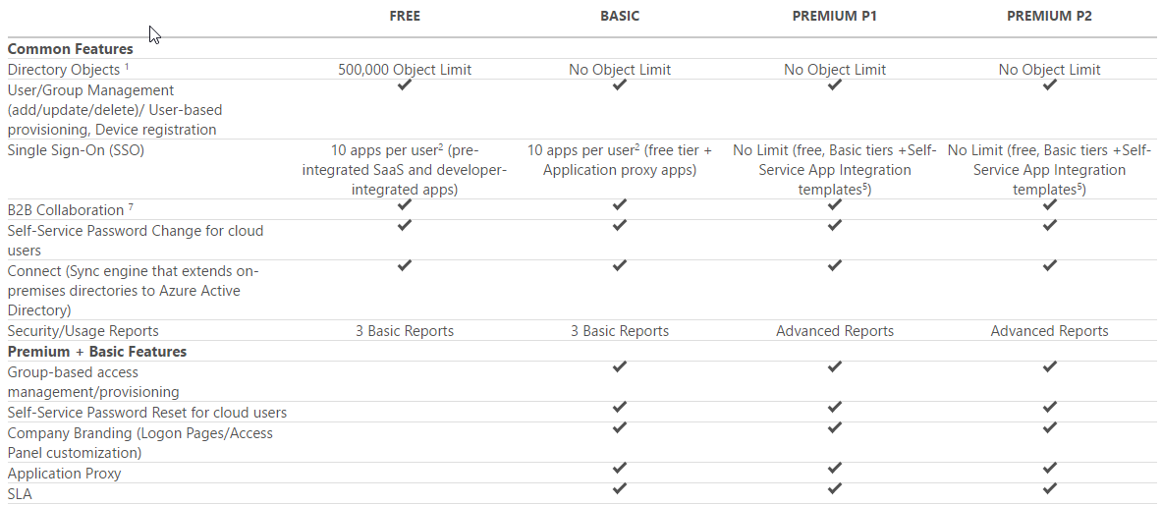
Azure AD Edition Features
https://azure.microsoft.com/en-us/pricing/details/active-directory/
Notes:
4 ”editions” of AzureAD
Test focuses on what is available in the different offerings/SKUs.
As an architect it’s important to know the application/solution requirements and select the proper edition
Know what features/functionality is included by specific levels/editions
https://azure.microsoft.com/en-us/pricing/details/active-directory/

Slide 6
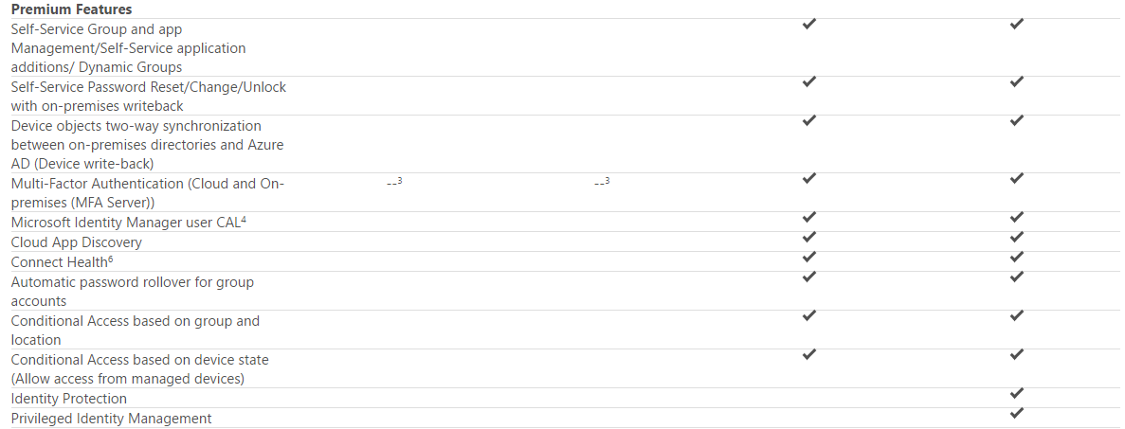
Azure AD Premium Features
https://azure.microsoft.com/en-us/pricing/details/active-directory/
Notes:
https://azure.microsoft.com/en-us/pricing/details/active-directory/
Biggest difference between the Premium offerings is the inclusion of Identity Protection and Privileged Identity Management in P2

Slide 7
Secure resources by using hybrid identities
Notes:
How do we integrate our on-prem AD infrastructure with Azure?
How do we manage our on-prem users and our Azure users?

Slide 8
Azure AD Connect
Connects your on-premises AD infrastructure to Azure
Composed of 3 components
Sync Services
Replicates user/group information between On-Prem and Azure
ADFS (optional)
Addresses complex deployments, such as domain join SSO, enforcement of AD sign-in policy, and smart card or 3rd party MFA.
Health
Robust monitoring and provide a central location to view activity
Notes:
Azure AD Connect is the umbrella technology/name for the components that connect your on-prem AD infrastructure to Azure.
Basically it integrates your on-premises directories with Azure Active Directory, thus providing a common identity for users of Office 365, Azure, and 3rd party SaaS applications with Azure AD Integration.
3 Components:
Synchronization - This component is responsible for creating users, groups, and other objects. It is also responsible for making sure identity information for your on-premises users and groups is matching the cloud.
ADFS (optional) - ADFS stands for Active Directory Federation Services and is an optional part of Azure AD Connect. Federating Azure with an on-prem ADFS environment allows organizations to address complex deployments and provides more granular security controls such as password policies, scheduled login times, or smart card/3rd party MFA.
Health Monitoring - Azure AD Connect Health can provide robust monitoring and provide a central location in the Azure portal to view this activity. For additional information, see Azure Active Directory Connect Health.
Reference(s):
https://docs.microsoft.com/en-us/azure/active-directory/connect/active-directory-aadconnect
https://docs.microsoft.com/en-us/azure/active-directory/connect/active-directory-aadconnectsync-whatis
https://docs.microsoft.com/en-us/azure/active-directory/connect/active-directory-aadconnect-topologies
https://docs.microsoft.com/en-us/azure/active-directory/active-directory-hybrid-identity-design-considerations-tools-comparison
https://docs.microsoft.com/en-us/azure/active-directory/connect/active-directory-aadconnectsync-feature-scheduler

Slide 9
Azure AD Connect w/ADFS
Simplicity and consistency
Use the same set of APIs to enable sign on
Use the same set of libraries you already use to authenticate users against Azure AD
Flexibility
In addition to standard user authorization, enable more complex scenarios
Industry support
OAuth 2.0 and OpenID Connect enjoy wide utilization across the industry, so knowledge of these patterns will help you enable authentication and authorization outside of an Active Directory environment as well
Notes:
ADFS is an extension/add-on to ADDS allowing you to use your on-prem AD as a standards-compliant identity provider. Thus your on-prem AD would serve as the source of truth for user identity.
Simplicity and consistency
Use the same set of APIs and patterns to enable sign on for:
multiple types of applications (server, desktop, mobile, browser)
multiple platforms (android, iOS, Windows)
applications inside the corporate network or hosted in the cloud
Use the same set of libraries you can already use to authenticate users against Azure AD
Flexibility
In addition to standard user authorization, enable more complex scenarios such as:
3-legged sign on flows in which a user authorizes one web application or service to access resources that reside with another web app or service.
Server-to-server flows in which a mid-tier service accesses a back end API
JavaScript based single-page applications (SPA)
Improved security controls
password policies
login time enforcement
However because it’s on-prem, it moves the management burden to your IT Staff. They must provision hardware, software, and consider Availability/DR.
Of course, you could deploy ADFS in Azure itself as long as there aren’t any network or security policies preventing it.
Reference(s):
https://docs.microsoft.com/en-us/azure/active-directory/connect/active-directory-aadconnectfed-whatis

Slide 10
AD Connect SSO - Requirements
Your user is signing in on a corporate desktop.
The desktop has been previously joined to your Active Directory (AD) domain.
The desktop has a direct connection to your Domain Controller (DC), either on the corporate wired or wireless network or via a remote access connection, such as a VPN connection.
Our service endpoints have been included to the browser's Intranet zone.
Notes:
For this feature to work for a specific user, the following conditions need to be met:
Your user is signing in on a corporate desktop.
The desktop has been previously joined to your Active Directory (AD) domain.
The desktop has a direct connection to your Domain Controller (DC), either on the corporate wired or wireless network or via a remote access connection, such as a VPN connection.
Our service endpoints have been included to the browser's Intranet zone.
If any of the above conditions are not met, then the user will be prompted to enter their username and password as before.

Slide 11
Secure resources by using identity providers
Notes:
How do we share our Azure resources with external people?
How do we manage access to Azure resources by people not in our Azure AD Directory?

Slide 12
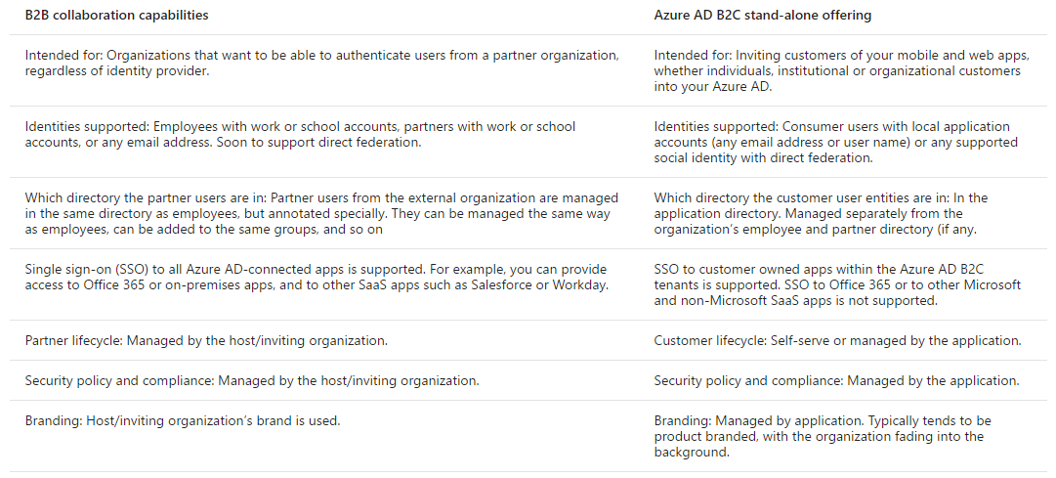
Azure AD B2B vs Azure AD B2C
Notes:
Azure AD B2B is a feature of Azure AD called Azure AD B2B collaboration
Allows external users access to documents, resources, and applications, while owner retains complete control over their own corporate data.
Work with any user from any partner
Partners use their own credentials
No requirement for partners to use Azure AD
No external directories or complex set-up required
Simple and secure collaboration
Provide access to any corporate app or data, while applying sophisticated, Azure AD-powered authorization policies
Easy for users
Enterprise-grade security for apps and data
No management overhead
No external account or password management
No sync or manual account lifecycle management
No external administrative overhead
https://docs.microsoft.com/en-us/azure/active-directory/active-directory-b2b-what-is-azure-ad-b2b

Slide 13
Implement Azure AD B2B Collaboration
B2B collaboration allows you to invite users outside of your organization and manage access to applications and resources.
Can add invited users to:
Enterprise applications
Directory Users
Groups
If the user doesn’t have a Microsoft account or an Azure AD account – one is created for them seamlessly at the time for offer redemption.
Can utilize API to build custom application using B2B
Notes:
Implement Azure AD B2B
What is Azure AD B2B collaboration?
https://docs.microsoft.com/en-us/azure/active-directory/active-directory-b2b-what-is-azure-ad-b2b
Properties of an Azure Active Directory B2B collaboration user
https://docs.microsoft.com/en-us/azure/active-directory/active-directory-b2b-user-properties
Azure Active Directory B2B collaboration API and customization
https://docs.microsoft.com/en-us/azure/active-directory/active-directory-b2b-api
Demonstration/prototype of B2B self-service signup, signup approvals, and profile editing.
https://github.com/Azure/active-directory-dotnet-graphapi-b2bportal-web

Slide 14
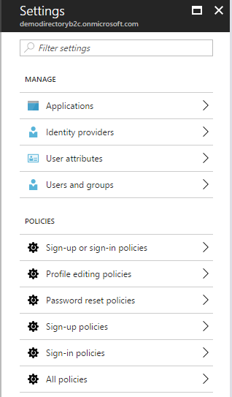
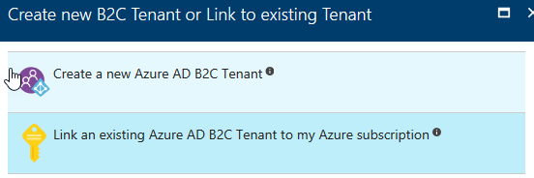
Manage Identity and access by using Azure AD B2C
Once you create Azure AD B2C, you need to link it
Allows you to add users from
Social accounts
Enterprise Accounts
Local Accounts
Can set policies
Can Brand login experience
Notes:
Manage Identity and access by using Azure AD B2C
Azure Active Directory B2C: Enable Multi-Factor Authentication in your consumer-facing applications
https://docs.microsoft.com/en-us/azure/active-directory-b2c/active-directory-b2c-reference-mfa
Azure Active Directory B2C: Create an Azure AD B2C tenant
https://docs.microsoft.com/en-us/azure/active-directory-b2c/active-directory-b2c-get-started
Azure AD B2C: Focus on your app, let us worry about sign-up and sign-in
https://docs.microsoft.com/en-us/azure/active-directory-b2c/active-directory-b2c-overview

Slide 15
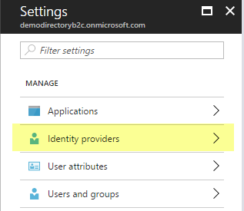
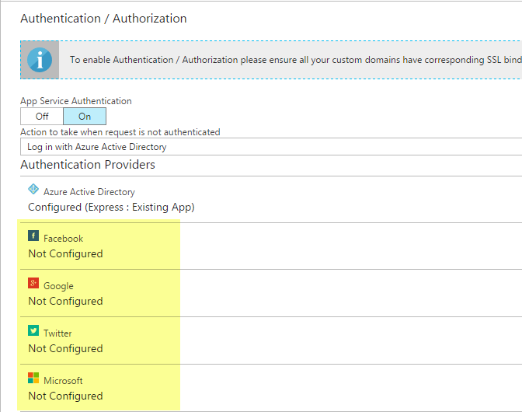
Provide access to resources using identity providers
Configure Identity Providers in Azure AD B2C
Configure in App Service Authentication blade
Notes:
Provide access to resources using identity providers, such as Microsoft Account, Facebook, Google and Yahoo!
Azure AD B2C: Focus on your app, let us worry about sign-up and sign-in
https://docs.microsoft.com/en-us/azure/active-directory-b2c/active-directory-b2c-overview
Azure Active Directory B2C: Provide sign-up and sign-in to consumers with Microsoft accounts
https://docs.microsoft.com/en-us/azure/active-directory-b2c/active-directory-b2c-setup-msa-app

Slide 16
Identify an appropriate data security solution
Notes:
My data is in the cloud but how do I protect it?

Slide 17
Data Security and Encryption
Where is your data?
In Transit
At Rest
Security Method
Multi-Factor Authentication
RBAC
Encryption
In transit (SSL)
At Rest (Disk, File, SQL Database)
Notes:
One of the keys to data protection in the cloud is accounting for the possible states in which your data may occur, and what controls are available for that state.
At-rest: This includes all information storage objects, containers, and types that exist statically on physical media, be it magnetic or optical disk.
In-Transit: When data is being transferred between components, locations or programs, such as over the network, across a service bus (from on-premises to cloud and vice-versa, including hybrid connections such as ExpressRoute), or during an input/output process, it is thought of as being in-motion.
There are many aspects to implementing a secure environment
Enforce multi-factor authentication
Use role based access control (RBAC)
Encrypt Azure virtual machines
Use hardware security models
Manage with Secure Workstations
Enable SQL data encryption
Protect data in transit
Enforce file level data encryption
Reference(s):
https://docs.microsoft.com/en-us/azure/security/azure-security-data-encryption-best-practices

Slide 18
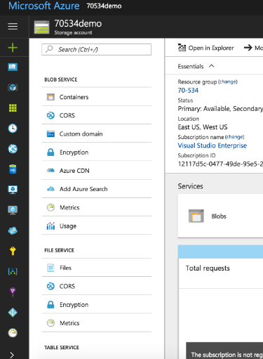
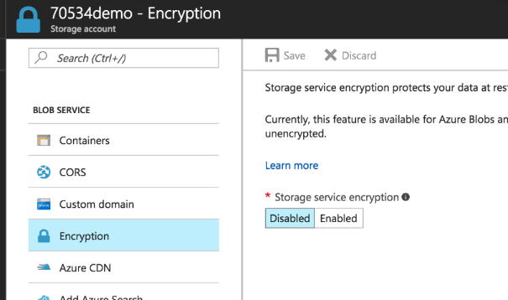
Storage Services Encryption
Notes:
Azure Storage Service Encryption (SSE) for Data at Rest helps you protect and safeguard your data to meet your organizational security and compliance commitments. With this feature, Azure Storage automatically encrypts your data prior to persisting to storage and decrypts prior to retrieval. The encryption, decryption, and key management are totally transparent to users.
SSE works by encrypting the data when it is written to Azure Storage, and can be used for Azure Blob Storage and File Storage. It works for the following:
Standard Storage: General purpose storage accounts for Blobs and File storage and Blob storage accounts
Premium storage
All redundancy levels (LRS, ZRS, GRS, RA-GRS)
Azure Resource Manager storage accounts (but not classic)
All regions.

Slide 19
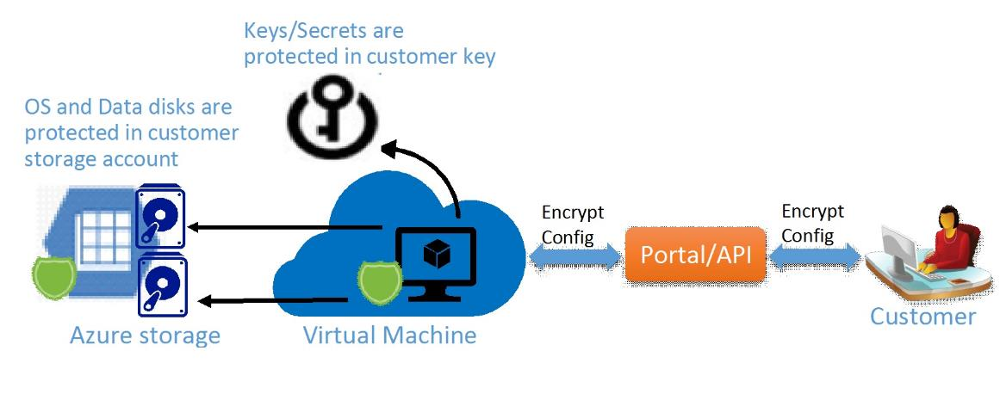
Azure Disk Encryption
Notes:
Azure Disk Encryption is a new capability that helps you encrypt your Windows and Linux IaaS virtual machine disks. Azure Disk Encryption leverages the industry standard BitLocker feature of Windows and the DM-Crypt feature of Linux to provide volume encryption for the OS and the data disks. The solution is integrated with Azure Key Vault to help you control and manage the disk-encryption keys and secrets in your key vault subscription. The solution also ensures that all data on the virtual machine disks are encrypted at rest in your Azure storage.
Azure disk encryption for Windows and Linux IaaS VMs is now in General Availability in all Azure public regions and AzureGov regions for Standard VMs and VMs with premium storage.
When you apply the Azure Disk Encryption-management solution, you can satisfy the following business needs:
IaaS VMs are secured at rest, because you can use industry-standard encryption technology to address organizational security and compliance requirements.
IaaS VMs boot under customer-controlled keys and policies, and you can audit their usage in your key vault.

Slide 20
Azure Disk Encryption Scenarios
Enable encryption on new IaaS VMs created from pre-encrypted VHD and encryption keys
Enable encryption on new IaaS VMs created from the Azure Gallery images
Enable encryption on existing IaaS VMs running in Azure
Disable encryption on Windows IaaS VMs
Disable encryption on data drives for Linux IaaS VMs
Enable encryption of managed disk VMs
Update encryption settings of an existing encrypted non-premium storage VM
Backup and restore of encrypted VMs, encrypted with key encryption key
Notes:
For the test, you should be able to know how (and why) you would want to implement each of these scenarios.

Slide 21
SQL Server TDE
Transparent Data Encryption
Applies to both PAAS and IAAS offerings
Covers both “in transit” and “at rest” encryption requirements
Notes:
So to facilitate that, SQL Server has a feature called Transparent Data Encryption abbreviated TDE. What it does is it encrypts the database, associated backups and transaction log files behind the scenes and allows us as developers to query the database without any changes to our code. So TDE is going to cover data at rest for SQL and for in transit, you'll want to use SSL with whatever libraries the developers are actually using.
When it comes to hosting SQL Server, you can go the platform as a service route and use Azure SQL and in that case, it's going to easily allow you to enable TDE via the portal, PowerShell or T-SQL or you could host it yourself either on-prem or with IaaS VMs and in that case, you can enable TDE. However, you also have more responsibility for securing the server, backups and everything else.

Slide 22
Design a role-based access control (RBAC) strategy
Notes:
How do I control access to my Azure resources?

Slide 23
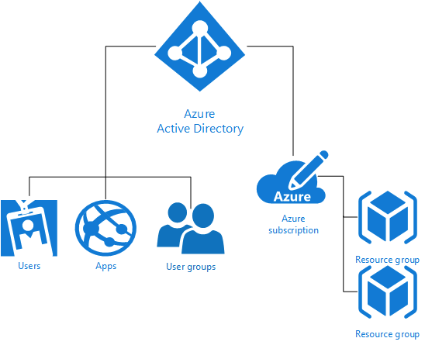
RBAC Overview
Notes:
Each Azure subscription is associated with one Azure Active Directory (AD) directory. Users, groups, and applications from that directory can manage resources in the Azure subscription. Assign these access rights using the Azure portal, Azure command-line tools, and Azure Management APIs. Multiple subscriptions can trust the same directory, but each subscription trusts only one directory.
Grant access by assigning the appropriate RBAC role to users, groups, and applications at a certain scope. The scope of a role assignment can be a subscription, a resource group, or a single resource. A role assigned at a parent scope also grants access to the children contained within it. For example, a user with access to a resource group can manage all the resources it contains, like websites, virtual machines, and subnets.
Using RBAC, you can segregate duties within your team and grant only the amount of access to users that they need to perform their jobs. Instead of giving everybody unrestricted permissions in your Azure subscription or resources, you can allow only certain actions. For example, use RBAC to let one employee manage virtual machines in a subscription, while another can manage SQL databases within the same subscription.
The trust relationship that a subscription has with a directory is unlike the relationship that it has with other resources in Azure (websites, databases, and so on). If a subscription expires, access to the other resources associated with the subscription also stops. But an Azure AD directory remains in Azure, and you can associate a different subscription with that directory and manage the directory using the new subscription.
Reference(s):
https://docs.microsoft.com/en-us/azure/active-directory/active-directory-how-subscriptions-associated-directory
https://docs.microsoft.com/en-us/azure/active-directory/role-based-access-control-configure

Slide 24
Role Management
Levels at which may be managed/assigned
Subscription Level
Resource Group Level
Resource Level
Built-In roles
Custom Roles
Access that you grant at parent scopes is inherited at child scopes
Notes:
Azure allows us to manage where a role is assigned, and there are three locations. At the subscription level, at a resource group level, or on a resource directly.
Now, the word resource tells us that this is all handled from the new portal or from PowerShell, the command line interface, or the REST API. Since the classic Portal is about services, and the new Portal is all about resources. Azure gives us a set of common built-in roles that we can use.
The list is fairly long, you can find it at https://docs.microsoft.com/en-us/azure/active-directory/role-based-access-built-in-roles
You assign the Reader role to an Azure AD group at the subscription scope. The members of that group can view every resource group and resource in the subscription.
You assign the Contributor role to an application at the resource group scope. It can manage resources of all types in that resource group, but not other resource groups in the subscription.
Becoming less of an issue, but worth pointing out for the exam:
Only the Azure portal and the new Azure Resource Manager APIs support Azure RBAC. Users and applications that are assigned RBAC roles cannot use the classic management portal and the Azure classic deployment model.
Reference(s):
https://docs.microsoft.com/en-us/azure/active-directory/role-based-access-control-what-is

Slide 25
Custom Roles
Use when none of the built-in roles meet your needs
Each tenant can create up to 2000 custom roles.
Shared across all subscriptions that use a tenant
Comprised of Actions, NotActions, and AvailableScopes
Managed via Portal, PowerShell, Azure CLI, or the REST API
Notes:
Azure allows us to manage where a role is assigned, and there are three locations. At the subscription level, at a resource group level, or on a resource directly.
Azure RBAC has three basic roles that apply to all resource types:
Owner has full access to all resources including the right to delegate access to others.
Contributor can create and manage all types of Azure resources but can’t grant access to others.
Reader can view existing Azure resources.
Now, the word resource tells us that this is all handled from the new portal or from PowerShell, the command line interface, or the REST API. Azure gives us a set of common built-in roles that we can use.
The list is fairly long, you can find it at https://docs.microsoft.com/en-us/azure/active-directory/role-based-access-built-in-roles
Any time someone grants or revokes access within your subscriptions, the changes get logged in Azure events. You can create access change history reports to see all changes for the past 90 days.

Slide 26
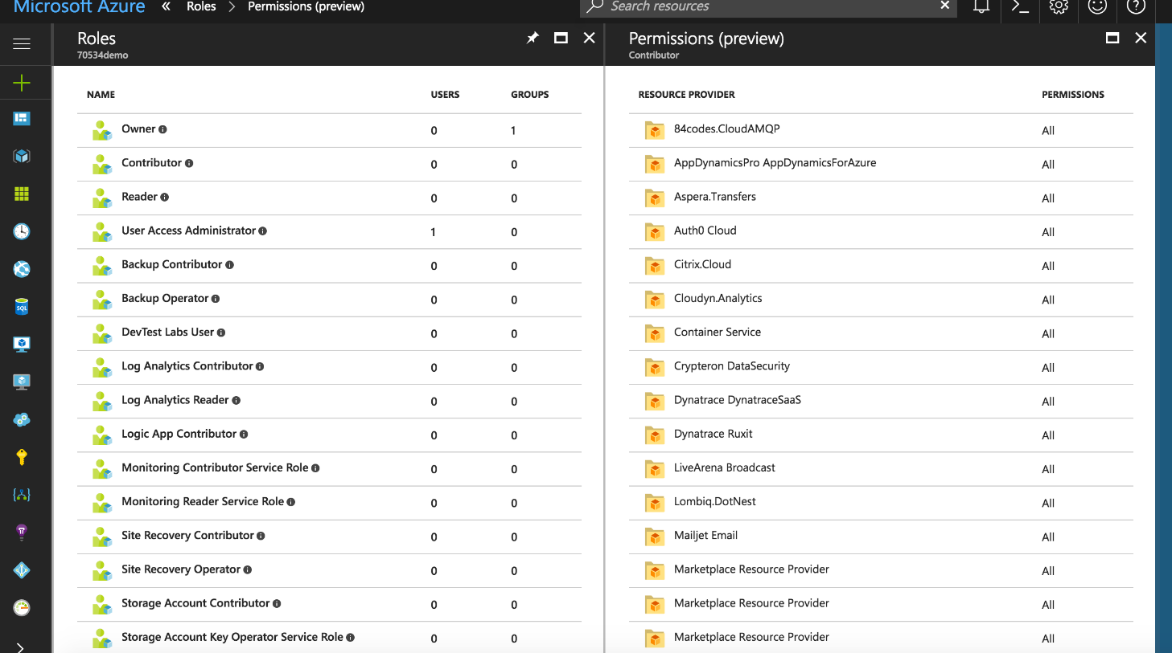
RBAC in the Azure Portal

Slide 27
Azure Security Tools
3 main security tools/services within Azure
Operations Management Suite (OMS)
Azure Security Center (ASC)
Activity Log
Using these tools is critical to ensuring we’re using Azure securely
Notes:
3 main security related/relevant services within azure
OMS
Azure Security Center
Activity Log

Slide 28
Operations Management Suite
Single integration/control point for Azure Services
Integrates with 3rd party services from marketplace
Anything with an agent
Provides operational intelligence across hybrid environments
Process automation and monitoring of resources
Cloud-based SaaS (thus highly available)
Protects privacy and security of data, while delivering software and services to manage the IT infrastructure.
Notes:
What is it?
Cloud-based Single pane of glass
Directly integrates with Azure services
Integrates with 3rd party services (Barracuda Firewall, Sophos, WAF, etc..) from Azure marketplace
Also includes an agent
Cross platform
Provides enterprise-class, real-time operational intelligence across hybrid environments
View and monitor your on-prem and cloud resources within a single portal
Simplifies cloud management with process automation and monitoring of resources
Cloud Based, thus ensures preparedness in the event of a disaster with cloud-based availability
Protects privacy and security of data, while delivering software and services to manage the IT infrastructure.
Reference(s):
https://docs.microsoft.com/en-us/azure/operations-management-suite/operations-management-suite-overview

Slide 29
Operations Management Suite
Log Analytics
Central monitoring and analysis of logs from multiple sources
Automation
Process automation
Configuration enforcement
Backup
Backup and restore critical data
Site Recovery
High availability for critical applications
Notes:
The core functionality of OMS is provided by a set of services that run in Azure.
Log Analytics
Push your logs into a central repository
Data could be service events, performance data, or custom data
Data is then available for consumption by multiple endpoints
Alerts – Which could then trigger a runbook
Dashboards
Export
APIs
Automation
Automate manual processes (runbooks) via PowerShell scripts and workflows
Easily manage resources running in the cloud
Use Hybrid Runbook workers for on-prem
Enforce the configuration of physical/virtual machines via PowerShell DSC
Works in cloud
Works on-prem via PS DSC Agents
Backups
OMS utilizes Azure Backup for backup and restore services (wont get into all the scenarios)
Site Recovery
Azure Site Recovery orchestrates the replication of on-prem virtual/physical machines to Azure or a secondary DR site
Again, won’t go into details but know that it exists and you should review its contribution to the OMS ecosystem
Management solutions
Utilizes one or more OMS service to provide a pre-packaged management scenario
Example: Update management (scan update logs to identify resources with missing updates)
Reference(s):
https://docs.microsoft.com/en-us/azure/operations-management-suite/operations-management-suite-overview\
http://azure.microsoft.com/documentation/services/log-analytics
https://docs.microsoft.com/en-us/azure/automation/automation-intro
http://azure.microsoft.com/documentation/services/backup
http://azure.microsoft.com/documentation/services/site-recovery

Slide 30
Operations Management Suite
Integrating OMS
Workspace in Azure
Multiple Connection Methods
OMS agent installed directly on Windows/Linux host
SCOM
Azure diagnostic VM extension storage account
Notes:
Internals – How does it work – What’s needed
OMS Workspace: A workspace is a logical container where your management data is stored. It provides you a way to partition data between different teams in your organization, as the data is exclusive to its workspace.
Connection Method: Define the connection method OMS will use for data collection
Agent installed on a server
SCOM
Azure storage account configured with the Windows or Linux Azure diagnostic VM extension (option when provisioning new VM) or under Diagnostics settings of the VM blade
References:
http://download.microsoft.com/download/3/7/E/37E21FFE-7E3B-4EB3-A0FE-A07E66ECB9F9/Microsoft_Operations_Management_Suite_Resources.pdf

Slide 31
Activity Log
Provides visibility into subscription-level activity (control-plane)
Information about operations performed ON resources not WITHIN
Answers the question: “What, Who, and When?”
Azure Resource Manager operational data
Service Health events/updates
Limited to Azure Infrastructure and Services
Cannot provide information about OS or custom application events
Differ from resource-level diagnostic logs
Notes:
Answers the question: Who turned off the SQL server!?
Does not answer the question “What caused the SQL server to restart?”
Activity Logs can then feed into a number of downstream entities
OMS Log Analytics
EventHub
PowerBI
Azure Storage
Reference(s):
https://docs.microsoft.com/en-us/azure/monitoring-and-diagnostics/monitoring-overview-activity-logs

Slide 32
Azure Security Center
Provides a central view of security state
Azure resources
On-Premises
Other clouds
Unified Visibility and Control
Define security configuration policies
Monitor policy adherance
Adaptive Threat Prevention
Continuous security assessment
Threat detection
Notes:
As we all know, security in any environment is a challenge and to some extent because the cloud removes the physicality of our infrastructure, it becomes even more so.
Azure Security Center provides unified security management and advanced threat protection for workloads running in Azure, on-premises, and in other clouds. It delivers visibility and control over hybrid cloud workloads, active defenses that reduce your exposure to threats, and intelligent detection to help you keep pace with rapidly evolving cyberattacks.
Azure security center enables you to stay ahead of threats by tapping into Microsoft’s own security apparatus.
Reference(s):
https://docs.microsoft.com/en-us/azure/security-center/security-center-intro
https://docs.microsoft.com/en-us/azure/security-center/security-center-get-started
https://docs.microsoft.com/en-us/azure/monitoring-and-diagnostics/monitoring-overview-of-diagnostic-logs

Slide 33
Demonstration: Tour of Azure Security Center
Notes:
Additional Reading: Deploy a new Windows VM named 20533D03DemoVM1 into a new resource group named 20533D03-DemoRG01 by following the steps listed on “Create a Windows virtual machine with the Azure portal” at: https://aka.ms/pzxh13
Additional Reading: Deploy a Linux VM named 20533D03DemoVM2 into a new resource group named 20533D03-DemoRG02 by following the steps listed on “Create a Linux virtual machine with the Azure portal” at: https://aka.ms/ajqf8q
Note: Do not wait for the deployment to complete. Continue with the next topic.
Preparation Steps
Before starting this demonstration, ensure that you have performed the “Preparing the lab environment” demonstration in this module’s first lesson. Also, ensure that the setup script has completed and that you completed the previous demonstration in this module.
Demonstration Steps
In Microsoft Edge, navigate to the Azure portal.
Sign in by using the Microsoft account that is the Service Administrator of your subscription.
From the hub menu, create a new Windows Server 2016 Datacenter Azure VM in the Azure region that is closest to the classroom location and that is available in your subscription. Specify the following settings (accept all other settings with their default values):
Name: 20533D03LabVM1
User name: Instructor
Password: Pa55w.rd1234
Resource Group: The existing resource group that you created in the previous demonstration, named 20533D0301-DemoRG
Size: Standard_D1_v2
20533D
3: Implementing virtual machines
(More notes on the next slide)

