Slide 1
Design Application Storage and Data Access Strategy
Design Data Storage Options
Design Data Storage Security
Security Options For Performance
Storage for Cloud & Hybrid

Slide 2
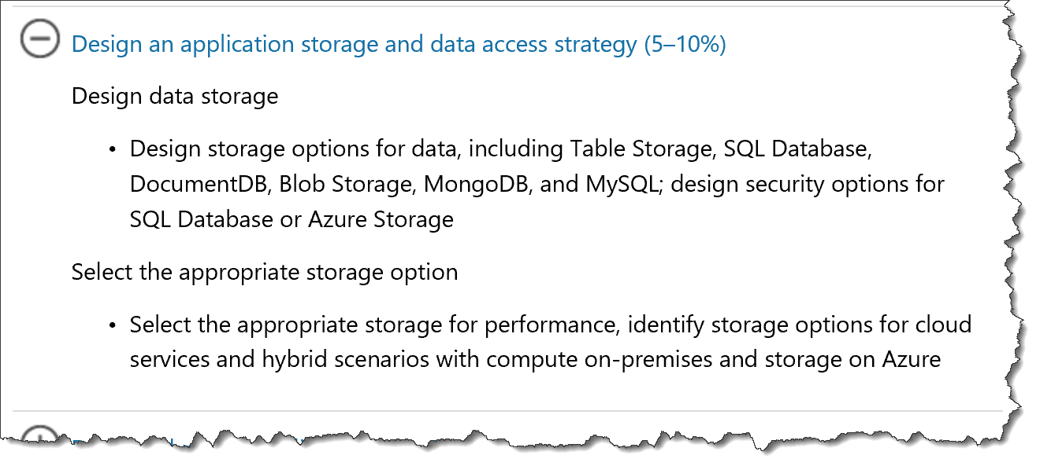
Storage in 70-535
https://www.microsoft.com/en-us/learning/exam-70-535.aspx

Slide 3
Design Data Storage Options
Table Storage
NoSQL
Azure SQL Database
Relational
Tables
MySQL
Relational
Fast DB
Key/attribute
Schemaless
Fast Data Access
Relatively inexpensive
FK, PK, Indexes, etc.
Open Source
CosmosDB
NoSQL
JSON / JavaScript
Blob Storage
Unstructured data
Disks, Images, Logs
MongoDB
NoSQL
JSON-like
Dynamic schemas
High performance
Data Security Options
Azure Storage | Share Access Signature - SAS
Azure SQL Database – same model as on-premises
See aka.ms/azure/storage for a complete introduction
Microsoft Azure Storage Explorer is a standalone app from Microsoft that allows you to easily work with Azure Storage data on Windows, macOS and Linux. http://storageexplorer.com/
Source: Mark Grimes https://mva.microsoft.com/en-US/training-courses/certification-exam-overview-70534-architecting-microsoft-azure-solutions-17406?l=olgrYVmjD_6006218965
Notes:
Design an application storage and data access strategy (15–20%)
Design data storage
Table Storage
With a schemaless data store, it's easy to adapt your data as the needs of your application evolve. Table storage is easy to use, so developers can create applications quickly. Access to data is fast and cost-effective for all kinds of applications.
Table storage is typically significantly lower in cost than traditional SQL for similar volumes of data.
SQL Database, DocumentDB, Blob Storage, MongoDB, and MySQL
design security options for SQL Database or Azure Storage; identify the appropriate VM type and size for a solution
MySQL” is “My Ess Que Ell” (not “my sequel”),
http://azure.microsoft.com/en-us/documentation/articles/storage-introduction/
http://azure.microsoft.com/en-us/marketplace/partners/mongodb/mongodb-inc/
DocumentDB Azure DocumentDB is a NoSQL document database service designed from the ground up to natively support JSON and JavaScript directly inside the database engine. It’s the right solution for web and mobile applications when predictable throughput, low latency, and flexible query are key. Microsoft consumer applications like OneNote already use DocumentDB in production to support millions of users. http://azure.microsoft.com/en-us/services/documentdb/
4 NoSQL options…
Graph Database
Cp;umn-Family?????????
Document
Key/Value
http://www.asp.net/aspnet/overview/developing-apps-with-windows-azure/building-real-world-cloud-apps-with-windows-azure/data-storage-options
Compared to relational databases, the NoSQL options offer far greater scalability and cost-effectiveness for storage and analysis of unstructured data. The tradeoff is that they don't provide the rich queryability and robust data integrity capabilities of relational databases. NoSQL would work well for IIS log data, which
h involves high volume with no need for join queries. NoSQL would not work so well for banking transactions, which requires absolute data integrity and involves many relationships to other account-related data.
There is also a newer category of database platform called NewSQL that combines the scalability of a NoSQL database with the queryability and transactional integrity of a relational database. NewSQL databases are designed for distributed storage and query processing, which is often hard to implement in "OldSQL" databases. NuoDB is an example of a NewSQL database that can be used on Azure.
A shared access signature provides delegated access to resources in your storage account. This means that you can grant a client limited permissions to your blobs, queues, or tables for a specified period of time and with a specified set of permissions, without having to share your account access keys. The SAS is a URI that encompasses in its query parameters all of the information necessary for authenticated access to a storage resource. To access storage resources with the SAS, the client only needs to pass in the SAS to the appropriate constructor or method.
You can use a SAS when you want to provide access to resources in your storage account to a client that can't be trusted with the account key. Your storage account keys include both a primary and secondary key, both of which grant administrative access to your account and all of the resources in it. Exposing either of your account keys opens your account to the possibility of malicious or negligent use. Shared access signatures provide a safe alternative that allows other clients to read, write, and delete
Security administration in Microsoft Azure SQL Database is similar to security administration for an on-premises instance of SQL Server. Managing security at the database-level is almost identical, with differences only in the parameters available. Because Azure SQL Databases can scale to one or more physical computers, Microsoft Azure SQL Database uses a different strategy for server-level administration.

Slide 4
3.1.1
Know the various storage types and their uses. For example, many times you can use Queues to decouple components of a system.
aka.ms/azure/storage, how they are alike & how they are different

Slide 5
Azure Storage Account

Slide 6
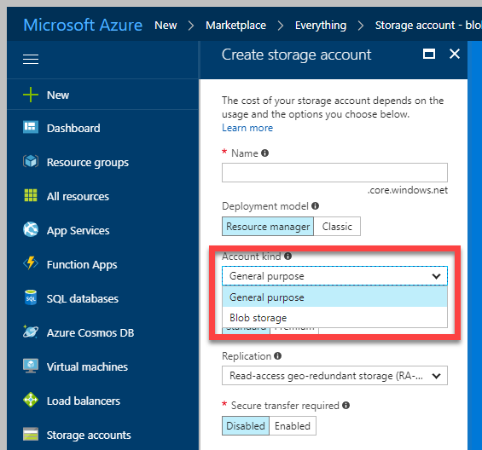
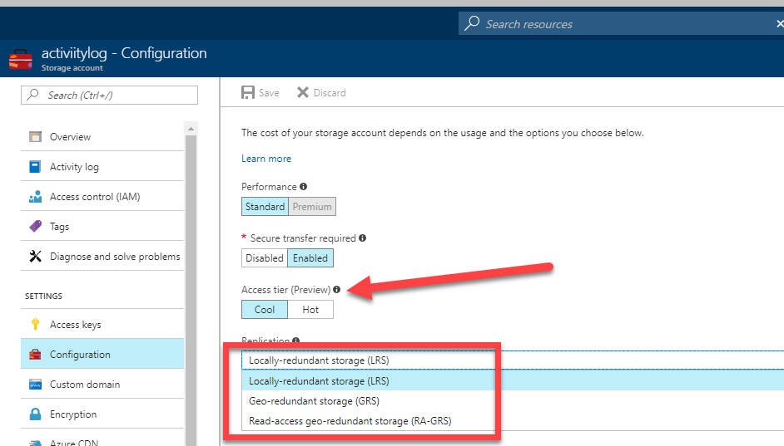
Azure Storage Account
Two Kinds of Storage Account
General Purpose Storage Account
Blobs
Files
Queues
Tables
VHD Disks(Page Blob)
Blob Storage Account
Block Blob
Append Blob
Page Blob
Performance Tier
General Purpose: Standard(HDD based), Premium(SSD based) for VM
Blob Account: Hot, Cool, Archival( Preview)

Slide 7
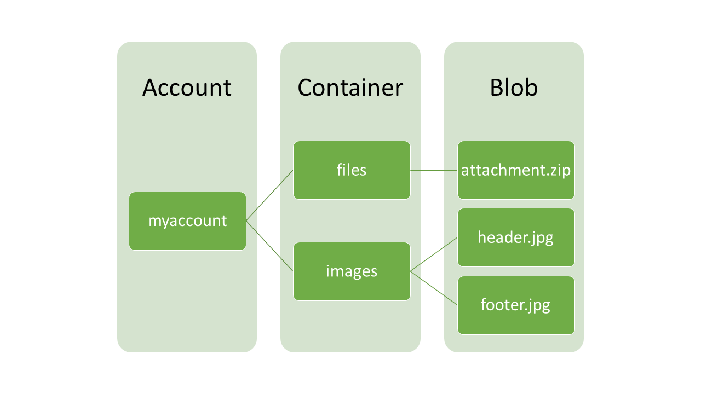
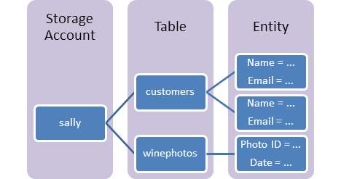
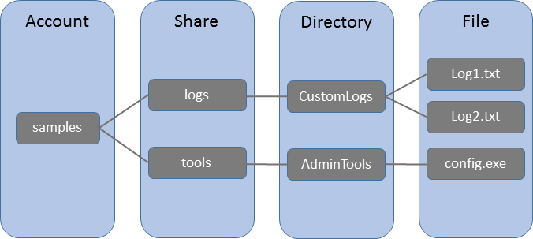
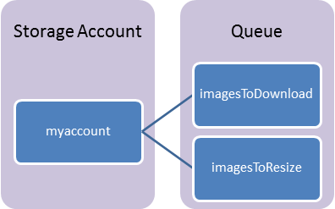
Azure Storage Account Schematic
Blob Storage
Azure Table
File Storage
Azure Queue

Slide 8
Creating a Storage Account
Notes:
The main tasks for this exercise are as follows:
Create virtual networks by using Azure Portal
Task 1: Create a virtual network by using the Azure portal
From MIA-CL1, start Microsoft Edge, go to http://portal.azure.com, and then, if prompted, sign in to the Azure portal as the Service Administrator of your Azure subscription.
From the Azure portal, create a new virtual network by using the following settings:
Name: labVNet1
Address space: 10.0.0.0/16
Subnet name: Subnet1
Subnet address range: 10.0.0.0/24
Subscription: Your Azure subscription
Resource group: Create new
New resource group name: 10979D05-LabRG01
Location: Azure data center where you can deploy Azure VMs, closest to the location of your classroom
Pin to dashboard: Select the checkbox
From the Azure portal, create a new virtual network by using the following settings:
Name: labVNet2
Address space: 10.1.0.0/16
Subnet name: Subnet1
Subnet address range: 10.1.0.0/24
Subscription: Your Azure subscription
Resource group: Use existing 10979D05-LabRG01
Location: Azure data center where you can deploy Azure VMs, closest to the location of your classroom
Pin to dashboard: Select the checkbox
Task 2: Configure VNet peering by using the Azure portal
In the Azure portal, navigate to the labVNet1 blade.
From the labVNet1 blade, create a VNet peering with the following settings:
Name: labVNet1-labVNet2
Deployment model: Resource manager
Subscription: Your Azure subscription
Virtual network: labVNet2
Allow virtual network access: Enabled.
Allow forwarded traffic: Disabled
Allow gateway transit: Disabled
Use remote gateways: Disabled
In the Azure portal, navigate to the labVNet2 blade.
From the labVNet2 blade, create a VNet peering with the following settings:
Name: labVNet2-labVNet1
Deployment model: Resource manager
Subscription: Your Azure subscription
Virtual network: labVNet1
Allow virtual network access: Enabled.
Allow forwarded traffic: Disabled
Allow gateway transit: Disabled
Use remote gateways: Disabled

Slide 9
Azure Table Storage
Azure File Storage
Stores structured NoSQL
Key-value pair
Structured, non relational
Schemaless
Access data using the Odata & LINQ .
Quickly query data using a clustered index
Data is consistent for other client reads after insert/update
Fully managed file shares in the cloud
Supports SMB /CIFS protocol
Can be mounted concurrently
Azure File Sync(Preview)
Suitable for Lift & Shift
LRS, GRS replication

Slide 10
Azure Queue
Provides reliable, persistent messaging.
REST-based GET/PUT/PEEK
Maximum Message Size 64 KB. If larger message size needed use Service Bus
Maximum message TTL 7 days

Slide 11
Storage Options
Standard
Max total request rate of 20k IOPS
Billed for actual usage*
Premium
Designed for Azure VMs
High performance
Low latency
Azure VM disks are implemented as “Page Blobs”
Billed for Provisioned space and not for actual usage.

Slide 12
Azure Blob Storage
Also called Object Storage
Storing large amounts of unstructured object data
Can be accessed from anywhere via HTTP or HTTPS
Three kinds of Blobs:
Block Blob
Append Blob
Page Blob
Common uses of Blob storage include:
Serving images or documents directly to a browser
Storing files for distributed access
Streaming video and audio
Storing data for backup and restore, disaster recovery, and archiving

Slide 13
Block Blobs
Blob is broken into pieces
Block Id for each piece
Max block size = 100MB
Up to 50k blocks per blob
The maximum size of a block blob is ~4.75 TB
Blocks upload can be multithreaded
Streaming , Storing documents, media files, backups

Slide 14
Append Blobs
Similar to Block Blobs
Optimized for append operations
Only can add to the end
The maximum size of an append blob is ~195 GB
Updating or deleting of existing blocks is not supported
Unlike a block blob, an append blob does not expose its block IDs.

Slide 15
Page Blob
Optimized for IaaS disks
Supports random read/writes
Collection of 512 byte pages
Max size = 8TB/4TB(VHD)
Storage Options
Premium Storage(SSD based)
Standard Storage(HDD based)

Slide 16
Replication for Table & Blob Storage
You can switch from LRS to GRS or RA-GRS but ZRS can’t be converted.
ZRS is only available for General Purpose Account type
Replication Option | Number of copies | Strategy
Locally redundant storage (LRS) | Maintains three copies of your data. | Data is replicated three time within a single facility in a single region.
Zone-redundant storage (ZRS) | Maintains three copies of your data. | Data is replicated three times across two to three facilities, either within a single region or across two regions.
Geo-redundant storage (GRS) | Maintains six copies of your data. | Data is replicated three times within the primary region, and is also replicated three times in a secondary region hundreds of miles away from the primary region.
Read access geo-redundant storage (RA-GRS) (Default) | Maintains six copies of your data. | Data is replicated to a secondary geographic location, and also provides read access to your data in the secondary location.

Slide 17
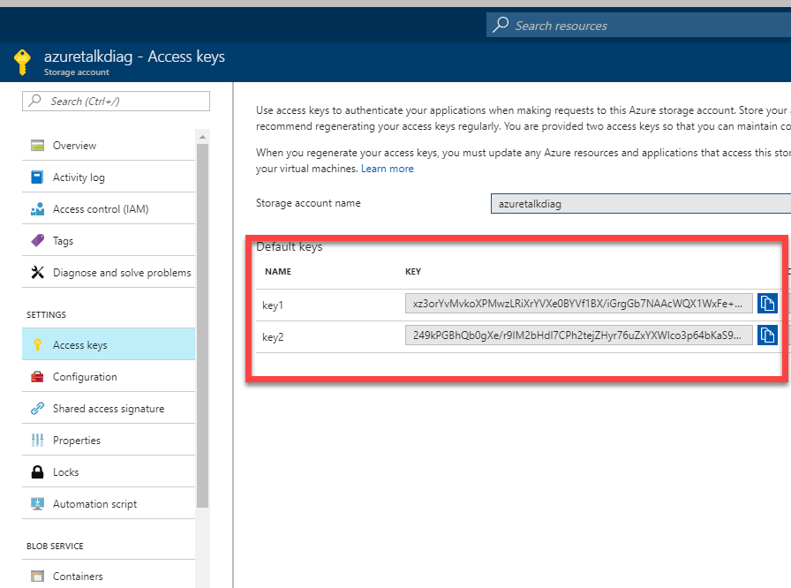
Blob Access
Anonymous Access: Public access for containers or individual blobs
Storage Access Key
Shared Access Signatures (SAS)
Delegated access without sharing account key
Containers & blobs
File shares & files
Queues
Tables & ranges of table entities

Slide 18
Azure Disk
Two ways to create VM disks
Unmanaged Disk
In an unmanaged disk, you manage the storage accounts
VHDs are stored in Page blob
99.99% SLA.
Can be converted to Managed.
Managed Disk
Azure manages the storage accounts that you use for your VM disks
Available in Standard & premium tier.
Standard can be converted in to Premium and vice-versa
99.999% SLA
Recommended storage for VMs.
Allow you to create up to 10,000 VM disks in a subscription
Billing for managed disks depends on the provisioned size of the disk.
Managed disk Overview

Slide 19
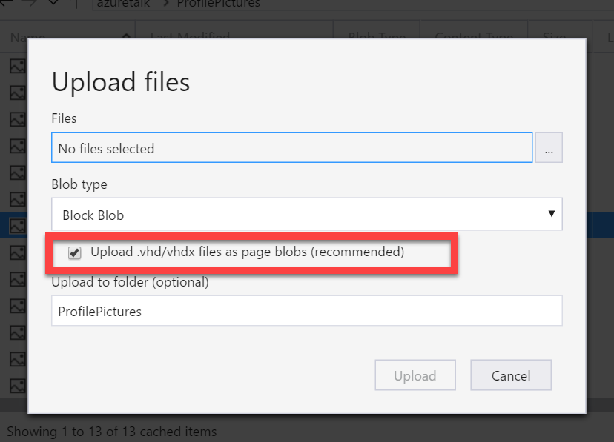
Choose appropriate blob type for uploading VHD. If VHD files are uploaded in block blob you can’t use those.

Slide 20
Table & Blob: Performance, Storage Limits, etc.
https://docs.microsoft.com/en-us/azure/storage/storage-scalability-targets

Slide 21
Resource | Default Limit
Number of storage accounts per subscription | 200
TB per storage account | 500 TB
Max number of blob containers, blobs, file shares, tables, queues, entities, or messages per storage account | Only limit is the 500 TB storage account capacity
Max size of a single blob container, table, or queue | 500 TB
Max number of blocks in a block blob or append blob | 50,000
Max size of a block in a block blob | 100 MB
Max size of a block blob | 50,000 X 100 MB (approx. 4.75 TB)
Max size of a block in an append blob | 4 MB
Max size of an append blob | 50,000 X 4 MB (approx. 195 GB)
Max size of a page blob | 4 TB
Max size of a table entity | 1 MB

Slide 22
Creating a File Share
Notes:
The main tasks for this exercise are as follows:
Create virtual networks by using Azure Portal
Task 1: Create a virtual network by using the Azure portal
From MIA-CL1, start Microsoft Edge, go to http://portal.azure.com, and then, if prompted, sign in to the Azure portal as the Service Administrator of your Azure subscription.
From the Azure portal, create a new virtual network by using the following settings:
Name: labVNet1
Address space: 10.0.0.0/16
Subnet name: Subnet1
Subnet address range: 10.0.0.0/24
Subscription: Your Azure subscription
Resource group: Create new
New resource group name: 10979D05-LabRG01
Location: Azure data center where you can deploy Azure VMs, closest to the location of your classroom
Pin to dashboard: Select the checkbox
From the Azure portal, create a new virtual network by using the following settings:
Name: labVNet2
Address space: 10.1.0.0/16
Subnet name: Subnet1
Subnet address range: 10.1.0.0/24
Subscription: Your Azure subscription
Resource group: Use existing 10979D05-LabRG01
Location: Azure data center where you can deploy Azure VMs, closest to the location of your classroom
Pin to dashboard: Select the checkbox
Task 2: Configure VNet peering by using the Azure portal
In the Azure portal, navigate to the labVNet1 blade.
From the labVNet1 blade, create a VNet peering with the following settings:
Name: labVNet1-labVNet2
Deployment model: Resource manager
Subscription: Your Azure subscription
Virtual network: labVNet2
Allow virtual network access: Enabled.
Allow forwarded traffic: Disabled
Allow gateway transit: Disabled
Use remote gateways: Disabled
In the Azure portal, navigate to the labVNet2 blade.
From the labVNet2 blade, create a VNet peering with the following settings:
Name: labVNet2-labVNet1
Deployment model: Resource manager
Subscription: Your Azure subscription
Virtual network: labVNet1
Allow virtual network access: Enabled.
Allow forwarded traffic: Disabled
Allow gateway transit: Disabled
Use remote gateways: Disabled

Slide 23
Sufficient bandwidth on VM
Make sure sufficient bandwidth is available on your VM to drive disk traffic, as described in Premium Storage-supported VMs. Otherwise, your disk throughput and IOPS is constrained to lower values. Maximum throughput and IOPS are based on the VM limits, not on the disk limits described in the preceding table.
https://docs.microsoft.com/en-us/azure/storage/storage-premium-storage#scalability-and-performance-targets

Slide 24
SQL Database

Slide 25
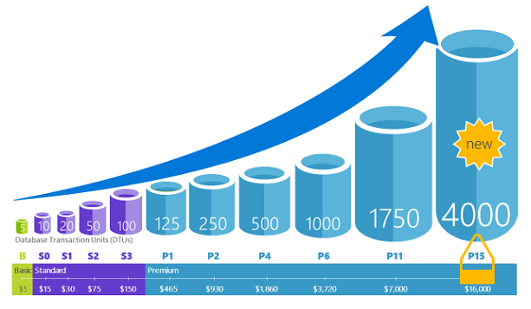
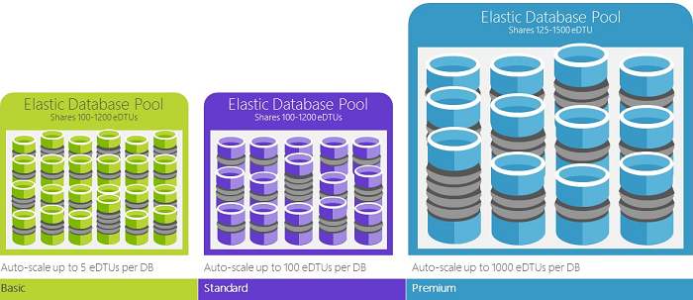
Azure SQL Database
PaaS Offering. Database-as-a-Service
Relational database.
Service tiers:
Basic
Standard
Premium
Premium RS
Elastic Pools. Pooled databases delivers performance
Source: Microsoft

Slide 26
Service Tiers
Basic
Small size
Low traffic
Single active operation
Standard
Low to medium IO performance requirements
Multiple current queries
Premium
High transaction volume
High IO performance requirements
Many concurrent users
High availability
For mission critical apps
Premium RS
IO-intensive apps
Does not require high availability
Analytical workloads

Slide 27
Service Tier Attributes
Service tier features | Basic | Standard | Premium | Premium RS
Maximum single database size | 2 GB | 250 GB | 4 TB* | 1 TB
Maximum elastic pool size | 156 GB | 4 TB | 4 TB* | 1 TB
Maximum database size in an elastic pool | 2 GB | 250 GB | 500 GB | 500 GB
Maximum number of databases per pool | 500 | 500 | 100 | 100
Maximum single database DTUs | 5 | 100 | 4000 | 1000
Maximum DTUs per database in an elastic pool | 5 | 3000 | 4000 | 1000
Database backup retention period | 7 days | 35 days | 35 days | 35 days
SKUs | Basic | S0-S12 | P1-P6, P11, P15 | PRS1, PRS2, PRS4, PRS6
https://docs.microsoft.com/en-us/azure/sql-database/sql-database-service-tiers

Slide 28
CosmosDB

Slide 29
Cosmos DB
Azure Cosmos DB is a globally distributed database service
“one of the supported APIs and data models”
Distribute data to any number of regions easily
NoSQL, Schema free database
99.99% availability within a single region.
It is a good choice for new web, mobile, gaming, and IoT applications
HIPAA-compliant
PaaS

Slide 30
MySQL

Slide 31
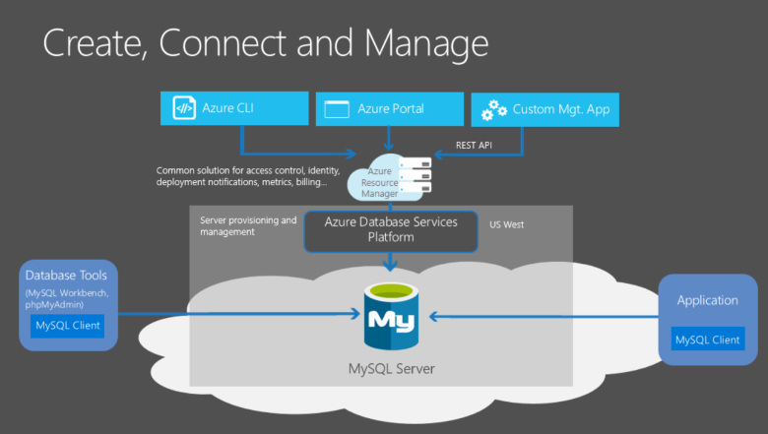
MySQL
Relational database
~3 Azure Options
Run it in a IaaS VM
Hosted by ClearDb
Azure Database for MySQL
Based on the MySQL Community Edition database engine
Dynamic scalability with no application downtime.
Built-in high availability.
https://azure.microsoft.com/en-us/services/mysql/
Source: Microsoft

Slide 32
MongoDB

Slide 33
MongoDB
“humongous"
NoSQL
JSON-like(Binary JSON) documents with schemas
Two options:
One of the offerings under Cosmos DB
Install on VM
MongoDB supports ‘sharding’
MongoDB is free to use from a software licensing perspective
https://docs.microsoft.com/en-us/azure/virtual-machines/windows/classic/install-mongodb

Slide 34
3.1.2
Azure might update to change feature availability. The exam is updated over time, as well, to reflect these changes. However, because of the way Azure is steadily being updated, the newest features might not be on the exams.

Slide 35
3.1.3
Performance levels of the database are important to a company, and the ability to change this at times is equally important. For example, the limits of each level of SQL Database can help the architect to determine the minimum level needed to satisfy those needs.

