Slide 1
70-535 Objective 4
Security and Identity
20-25% of Exam
2-1
Notes:
Presentation: 60 minutes
Lab: 90 minutes
After completing this module, students will be able to:
Create a resource group.
Add resources to a resource group.
Deploy an ARM template to a resource group.
Filter resources using tags.
Author a complex deployment using the Azure Building Blocks tools.
Required materials
To teach this module, you need the Microsoft PowerPoint file: 20535A_02.pptx.
Preparation tasks
To prepare for this module, you should:
Read all of this module’s materials.
Practice performing the demonstrations and labs.
Work through the Module Review and Takeaways section to determine how you will use the information to reinforce student learning and promote knowledge transfer to on-the-job performance.
As you prepare for this class, it is imperative that you complete the labs yourself. This gives you an understanding of how the labs work and the concepts that each covers, so that you can provide meaningful hints to students who might have issues. Furthermore, it will help guide your lecture to ensure that you discuss the concepts that the lab covers.
The Azure portal is continually being improved, and the user interface might have updated since this module was written. Therefore, before teaching this module, familiarize yourself with the latest version of the Azure portal.
20535A
2: Deploying Resources with Azure Resource Manager

Slide 2
Module Overview
ARM Templates Role-Based Access Control (RBAC) Resource Policies Security
2-1
Notes:
20535A
2: Deploying Resources with Azure Resource Manager

Slide 3
Lesson 1: ARM Templates
Azure Resource Manager JSON
2-2
Notes:
20535A
2: Deploying Resources with Azure Resource Manager

Slide 4
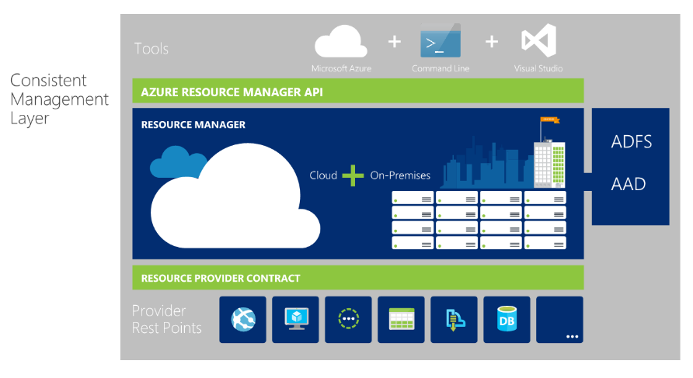
Azure Resource Manager
2-2
Notes:
You use a template -- a resource model of the service -- to create a resource group with the resources you specified above. After you author the template, you can manage and deploy that entire resource group as a single logical unit. There are three primary concepts in Resource Manager:
Resource: A resource is merely a single service instance in Azure. Most services in Azure have a direct representation as a resource. For example, a Web App instance is a resource. An App Service Plan is also a resource. Even a SQL Database instance is a resource.
Resource Group: A resource group is a group of resources in the logical sense. For example, a Resource Group composed of a Network Interface Card (NIC), a Virtual Machine compute allocation, a Virtual Network, and a Public IP Address creates what we would logically consider a “Virtual Machine.”
20535A
2: Deploying Resources with Azure Resource Manager

Slide 5
Azure Resource Manager Templates
Provide a scalable, repeatable method for deploying Azure resources
All resources in the ARM model are built using JSON templates
https://github.com/Azure/azure-quickstart-templates
2-2
Notes:
Resource Group Template: Every resource group deployment is completed using a JSON file known as the resource group template. This JSON file declaratively describes a set of resources. The deployment adds the new resources to a new or existing resource group. For example, a template could contain the configuration necessary to create 2 API App instances, a Mobile App instance and a Cosmos DB instance.
20535A
2: Deploying Resources with Azure Resource Manager

Slide 6
Deploying Resources
PowerShell
Cross Platform Command-Line Interface
Client Libraries
Visual Studio
Portal template deployment
All use the REST API: The REST API is available here: https://docs.microsoft.com/rest/api/resources
2-3
Notes:
Interacting with Resource Manager
You can use Resource Manager in a variety of different ways including:
PowerShell: There are PowerShell CmdLets already available to allow you to manage your services in the context of resources and resource groups.
Cross-Platform Command-Line Interface: This CLI allows you to manage your Azure resources from many different operating systems.
Client Libraries: There are client libraries already available for various programming frameworks/languages to create resources and resource groups in Azure.
Visual Studio: Visual Studio 2015 ships with a Resource Manager project type that allows you to create a resource group template by either manually modifying JSON (with schema intellisense) or use scaffolding to update your JSON template automatically.
Portal template deployment: In the portal, you can use the Template Deployment option in the Marketplace to deploy a Resource Group from a template.
REST API: All the above options use the REST API to create your resources and resource groups. If you prefer to create resources without a library, you can always use the REST API directly. The REST API is available here: https://docs.microsoft.com/rest/api/resources/
20535A
2: Deploying Resources with Azure Resource Manager

Slide 7
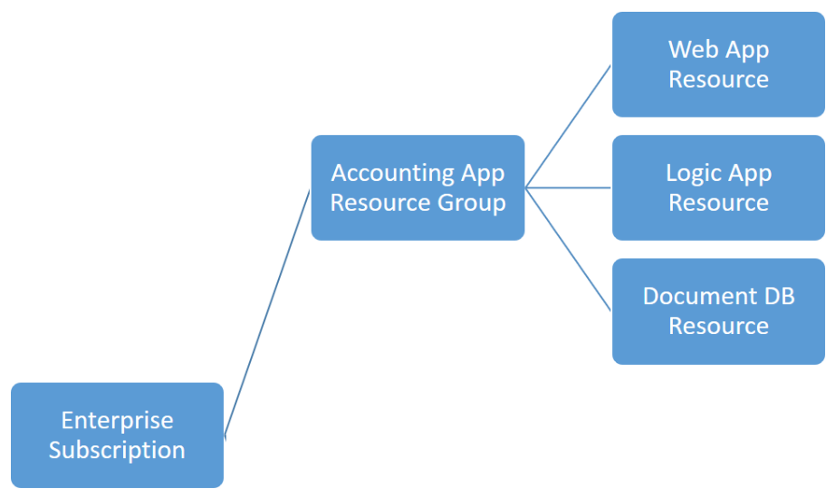
Resource Group Deployment
2-3
Notes:
Resource Groups
Resource Groups are at their simplest a container for multiple resources. There are some rules for resource groups.
Resources can only exist in one resource group
Resource Groups cannot be renamed
Resource Groups can have resources of many different types (services)
Resource Groups can have resources from many different regions.
Resource Group Deployments
Resources can be deployed to any new or existing resource group
Deployment of resources to a resource group becomes a job where you can track the template execution.
If deployment fails, the output of the job can describe why the deployment failed.
Whether the deployment is a single resource to a group or a template to a group, you can use the information to fix any errors and redeploy.
Deployments are incremental; if a resource group contains 2 web apps and you decide to deploy a third, the existing web apps will not be removed.
Currently, immutable deployments are not supported in a resource group. To implement an immutable deployment, you must create a new resource group.
20535A
2: Deploying Resources with Azure Resource Manager

Slide 8
JSON
What is JSON?
JavaScript Object Notification (JSON) is a method for passing data and objects in a formatted style
Similar to XML but “lightweight”
2-4
Notes:
JSON is a, text-based data exchange format (see RFC 4627).
JSON is human-readable, platform independent, and enjoys a wide availability of implementations, similar to XML
Data formatted according to the JSON standard is lightweight and can be parsed by JavaScript implementations with ease. This makes it a perfect choice for data exchange.
JSON can be used in virtually any situation where applications need to exchange or store structured information as text.
Formatting of JSON is below:
Curly brackets act as 'containers’
Square brackets holds arrays or data
Names and values are separated by colons
Array elements are separated by a comma
20535A
2: Deploying Resources with Azure Resource Manager

Slide 9
What Is a JSON Template?
{
"$schema": "http://schema.management.azure.com/schemas/2015-01-01/deploymentTemplate.json#",
"contentVersion": "1.0.0.0",
"parameters": {
},
"variables": {
},
"resources": [
],
"outputs": {
}
}
2-4
Notes:
A JSON template is based on a SCHEMA.
This and the Content version sections are mandatory.
The Parameters and Variables sections are optional as is the output.
A JSON template with no resources section, would not deploy anything.
20535A
2: Deploying Resources with Azure Resource Manager

Slide 10
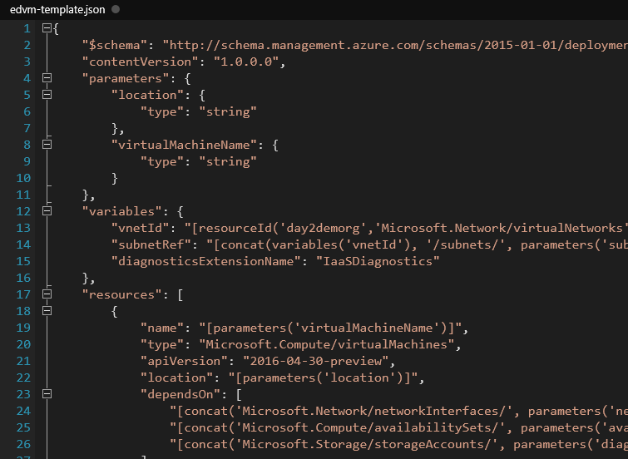
Template Complexity
2-4
Notes:
There are many complexities in a detailed resource template.
To be able to architect solutions and applications within the Azure ecosystem a through understanding of JSON and the template structure as well as methods of manipulation and deployment are required.
As an example, you can see in this slide the Virtual Machine resource using the Microsoft.Compute /VirtualMachines resource provider has several items on which it depends (line 23 onwards).
Nesting is quite common also.
Building a robust and detailed template is quite a skill.
Azure helps with this by providing an Automation Script item on each resource blade to allow examination and redeployment of current resources.
The rest of this module digs deeper into the Azure Resource Manager and how to maximize its use.
20535A
2: Deploying Resources with Azure Resource Manager

Slide 11
Template Driven Resources
Parameters
Resources
Output
Variables
2-4
Notes:
Advantages Of Using Templates
Templates are generally preferred to manually deploying resources for quite a few reasons:
A template can ensure idempotency. If you deploy an identical template to multiple resource groups, they would functionally be the same.
A template can simplify orchestration as you only need to deploy the template to deploy all of your resources. Normally this would take multiple operations.
A template allows you to configure multiple resources simultaneously and use variables/parameters /functions to create dependencies between resources. For example you can require that a VM is created before a Web App because you need the VM's public IP address for one of the Web App's settings. Another example is to require a Storage account is created before a VM so that you can place the VHDs in that storage account.
Templates can parameterize input and output values so they can be reused across many different scenarios. Templates can also be nested so you can reuse smaller templates as part of a larger orchestration.
20535A
2: Deploying Resources with Azure Resource Manager

Slide 12
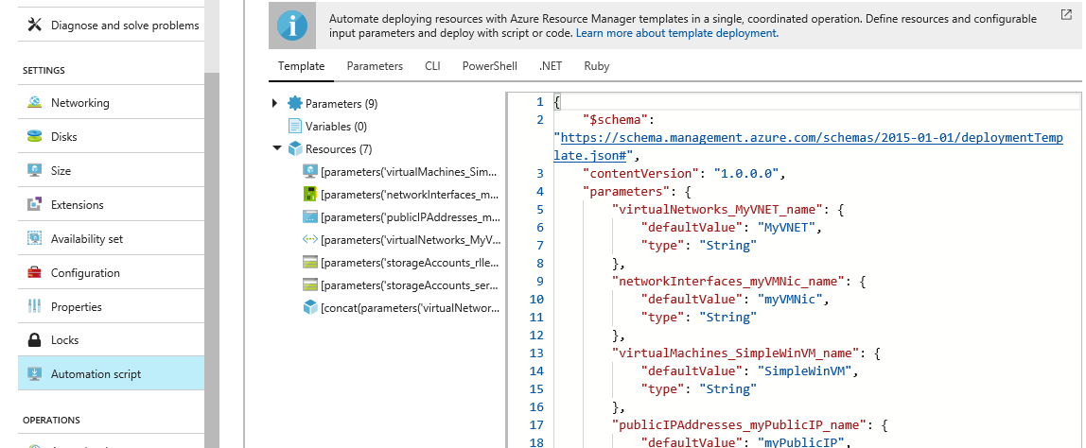
Template Driven Resources
2-4
Notes:
Building a robust and detailed template is quite a skill.
Azure helps with this by providing an Automation Script item on each resource blade to allow examination and redeployment of current resources.
The rest of this module digs deeper into the Azure Resource Manager and how to maximize its use.
20535A
2: Deploying Resources with Azure Resource Manager

Slide 13

Discussion
How could your organization best author, deploy and work with JSON templates?
Notes:
Mention:
Azure resource explorer
ArmVIZ.io
ARM Template References
When authoring ARM Templates, there are three incredible resources available on http://azure.microsoft.com that can help you master the art of declarative templating:
https://docs.microsoft.com/azure/azure-resource-manager/resource-group-authoring-templates
This article introduces some of the major concepts associated with authoring templates for ARM.
https://docs.microsoft.com/azure/azure-resource-manager/resource-group-template-functions
This article lists many of the special functions available in ARM templates that you can use to make templates more useful and easier to author.
https://docs.microsoft.com/azure/azure-resource-manager/best-practices-resource-manager-design-templates
This article goes through some proven design practices when authoring ARM templates.
20535A
2: Deploying Resources with Azure Resource Manager

Slide 14
Lesson 2: Role-Based Access Control (RBAC)
Role-Based Access Control Role Assignment Resource Scope
2-5
Notes:
20535A
2: Deploying Resources with Azure Resource Manager

Slide 15
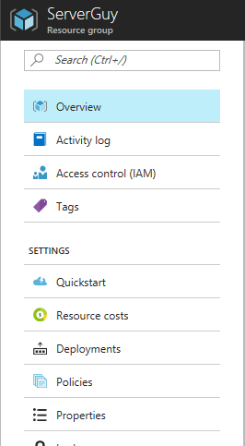
Role-Based Access Control
Azure role-based access control allows granular access by users, groups and applications to resources
Available through Portal.azure.com, each resource has an Access Control (IAM) blade
2-5
Notes:
Role-Based Access Control (RBAC)
Azure role-based access control allows you to grant appropriate access to Azure AD users, groups, and services, by assigning roles to them on a subscription or resource group or individual resource level. The assigned role defines the level of access that the users, groups, or services have on the Azure resource.
20535A
2: Deploying Resources with Azure Resource Manager

Slide 16
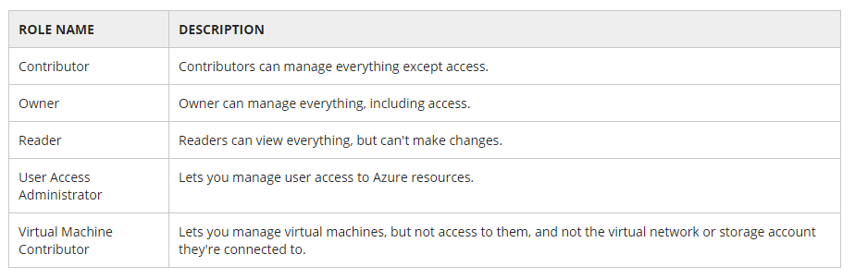
Roles
Many roles available; if not suitable for the purpose,
custom roles can be created
2-5
Notes:
A role is a collection of actions that can be performed on Azure resources. A user or a service is allowed to perform an action on an Azure resource if they have been assigned a role that contains that action. There are built-in roles that include (but is not limited to):
Role Name Description:
Contributors can manage everything except access.
Owners can manage everything, including access.
Readers can view everything, but can't make changes.
User Access Administrator lets you manage user access to Azure resources.
Virtual Machine Contributor lets you manage virtual machines, but not access to them, and not the virtual network or storage account they're connected to.
20535A
2: Deploying Resources with Azure Resource Manager

Slide 17
Role Assignment
Users: From the same Azure AD and same subscription
Groups: If a role is assigned to a group, a user receives the rights of the role when added to the group. The user also automatically loses access to the resource after getting removed from the group
Service principals: Services can be granted access to Azure resources by assigning roles via the Azure module for Windows PowerShell to the Azure AD service principal representing that service
2-6
Notes:
A role assignment can be created that associates a security principal to a role. The role is further used to grant access to a resource scope. This decoupling allows you to specify that a specific role has access to a resource in your subscription and add/remove security principals from that role in a loosely connected manner. Roles can be assigned to the following types of Azure AD security principals:
Users: roles can be assigned to organizational users that are in the Azure AD with which the Azure subscription is associated. Roles can also be assigned to external Microsoft accounts that exist in the same directory.
Groups: roles can be assigned to Azure AD security groups. A user is automatically granted access to a resource if the user becomes a member of a group that has access. The user also automatically loses access to the resource after getting removed from the group. Managing access via groups by assigning roles to groups and adding users to those groups is the best practice, instead of assigning roles directly to users.
Service principals: service identities are represented as service principals in the directory. They authenticate with Azure AD and securely communicate with one another. Services can be granted access to Azure resources by assigning roles via the Azure module for Windows PowerShell to the Azure AD service principal representing that service.
20535A
2: Deploying Resources with Azure Resource Manager

Slide 18
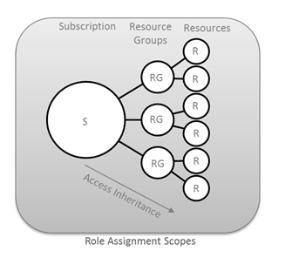
Resource Scope
2-6
Notes:
Access does not need to be granted to the entire subscription. Roles can also be assigned for resource groups as well as for individual resources. In Azure RBAC, a resource inherits role assignments from its parent resources. So if a user, group, or service is granted access to only a resource group within a subscription, they will be able to access only that resource group and resources within it, and not the other resources groups within the subscription. As another example, a security group can be added to the Reader role for a resource group, but be added to the Contributor role for a database within that resource group.
Scoping to Resource Groups
While RBAC can easily be used to grant access to an individual resource, it is preferable to grant access to an entire Resource Group as opposed to individual resources. By scoping to a resource group, you can add/remove and modify resources easily without having to recreate assignments and scopes. You can also give an individual owner or contributor access to a resource group so that they can create, recreate or destroy resources on their own without requiring involvement from the account administrator.
In this example, there is a resource group for an Accounting application. This resource group contains multiple resources that are used in the application. By granting an individual owner or contributor access to the resource group, they can configure resources, create new deployments, add new resources or create automation scripts at will without requiring additional administrator assistance or having access to resources in other resource groups.
20535A
2: Deploying Resources with Azure Resource Manager

Slide 19
Discussion
At what scope is it best to allocate RBAC, resources, resource groups, subscription? To whom should you allocate? Users or User Groups?
Notes:
20535A
2: Deploying Resources with Azure Resource Manager

Slide 20
Lesson 3: Resource Policies
Azure Resource Policies Policy vs RBAC Built-In Policies Policy Definition Policy Assignment Policies for Naming Conventions
2-9
Notes:
20535A
2: Deploying Resources with Azure Resource Manager

Slide 21
Azure Resource Policies
Provides resource conventions in an organization and consists of:
policy definition - describe when and what action to take
policy assignment - apply the policy definition to a scope
2-9
Notes:
Resource policies establish conventions for resources in an organization.
Once these conventions are defined, it is possible to control costs and easily manage Azure resources.
Examples are:
Specify only certain types of virtual machines are created.
Require that all resources have a particular tag applied.
If a policy applies to a parent resource the child resource will inherit the policy. (Resource Group – Resource sin the group):
policy definition - describe when and what action to take
policy assignment - apply the policy definition to a scope
20535A
2: Deploying Resources with Azure Resource Manager

Slide 22
Policy vs RBAC
RBAC controls user access (need RBAC to create resources)
Policies control resources (need RBAC to use policies)
The Contributor role cannot create or apply policies
Permissions
To define requires:
Microsoft.Authorization/policydefinitions/write
To apply requires:
Microsoft.Authorization/policyassignments/write
2-9
Notes:
There are key differences between policy and (RBAC):
RBAC controls user actions.
Policy controls resource properties during deployment.
Examples are:
RBAC allows permissions to create resources
Policies define what resources can be created (among other things)
To use policies, you must use RBAC.
Microsoft.Authorization/policydefinitions/write permission to define a policy.
Microsoft.Authorization/policyassignments/write permission to assign a policy.
These permissions are not included in the Contributor role.
20535A
2: Deploying Resources with Azure Resource Manager

Slide 23
Built-In Policies
Azure provides built-in policy definition limiting the number users need to define; some examples are:
Allowed locations
Allowed resource types
Allowed storage account SKUs
Allowed virtual machine SKUs
Not allowed resource types
Definitions are stored in JSON
2-10
Notes:
Azure provides built-in policy definition limiting the number users need to define, these are:
Allowed locations
Allowed resource types
Allowed storage account SKUs
Allowed virtual machine SKUs
Apply tag and default value
Enforce tag and value
Not allowed resource types
Require SQL Server version 12.0
Require storage account encryption
Policy definition structure is JSON and contains the following elements:
mode
parameters
display name
description
policy rule:
logical evaluation
effect
20535A
2: Deploying Resources with Azure Resource Manager

Slide 24
Policy Definition
How to define:
Use All Mode
Use Parameters
Policy Rule contains simple if and then blocks
{
"if": {
<condition> | <logical operator>
},
"then": {
"effect": "deny | audit | append"
}
}
2-10
Notes:
Mode = all or indexed – only required when scripting recommends All as Indexed is legacy and can be applied only to resources that support location and tags.
Parameters are defined within the definition.
The policy rule is also defined in the JSON and uses If and Then blocks to define what happens when the if conditions apply (Effect).
The definition supports:
Logical operators, conditions and fields
Effects are:
Deny, Audit ,Append ,AuditIfNotExists , DeployIfNotExists
20535A
2: Deploying Resources with Azure Resource Manager

Slide 25
Policy Assignment
Using PowerShell
GUI through Azure Portal
2-11
Notes:
The next slides will introduce each method.
20535A
2: Deploying Resources with Azure Resource Manager

Slide 26
Policy Assignment
Using PowerShell:
$rg = Get-AzureRmResourceGroup -Name “ContosoVMS"
$definition = Get-AzureRmPolicyDefinition -Id /providers/Microsoft.Authorization/policyDefinitions/a57364a-7474-ed43-c564-bf8b9038c4c
New-AzureRMPolicyAssignment -Name VM Sizes Assignment -Scope $rg.ResourceId -PolicyDefinition $definition
2-11
Notes:
Several steps to build the assignment from a policy definition:
$rg = Get-AzureRmResourceGroup -Name “ContosoVMS“
populates rg variable with metadata about a Resource Group.
$definition = Get-AzureRmPolicyDefinition -Id /providers/Microsoft.Authorization/policyDefinitions/a57364a-7474-ed43-c564-bf8b9038c4c
populates the correct definition.
New-AzureRMPolicyAssignment -Name VM Sizes Assignment -Scope $rg.ResourceId -PolicyDefinition $definition
applies the definition to the correct Resource Group.
20535A
2: Deploying Resources with Azure Resource Manager

Slide 27
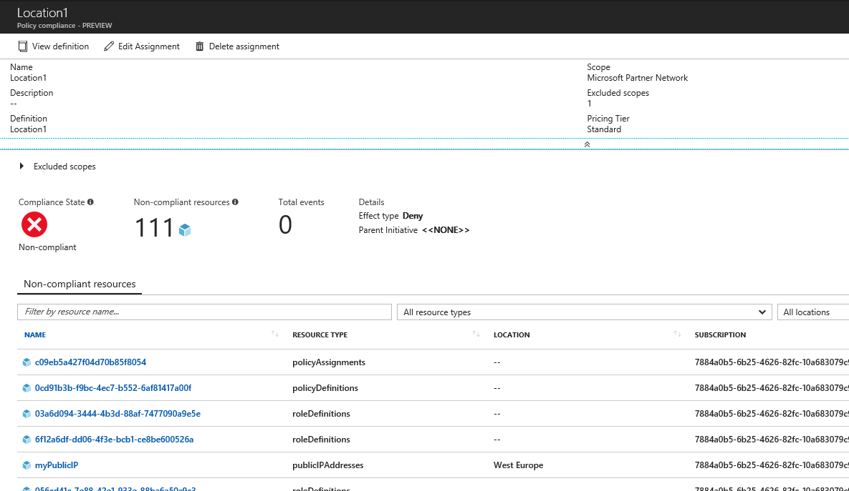
Policy Assignment
Using the Portal
2-11
Notes:
20535A
2: Deploying Resources with Azure Resource Manager

Slide 28
Policies for Naming Conventions
Prescribe how organization resources are named:
Wildcard
Pattern
Tags
Multiple patterns
2-12
Notes:
Ensure naming consistency across organizational resources.
Set naming convention with wildcard
Set naming convention with pattern
Set date pattern for tag value
Set multiple naming patterns
20535A
2: Deploying Resources with Azure Resource Manager

Slide 29
Policies for Naming Conventions
Pattern:
{
"if": {
"not": {
"field": "name",
"match": "contoso??????"
}
},
"then": {
"effect": "deny"
}
}
2-12
Notes:
To specify that resource names match a pattern, use the match condition.
The wildcard uses Like condition.
20535A
2: Deploying Resources with Azure Resource Manager

Slide 30
Discussion
In what situations could you use Azure Policy and RBAC, Azure Policy alone or RBAC alone?
Notes:
20535A
2: Deploying Resources with Azure Resource Manager

Slide 31
Lesson 4: Security
Azure Key Vault Key Vault Use in ARM Templates
2-13
Notes:
20535A
2: Deploying Resources with Azure Resource Manager

Slide 32
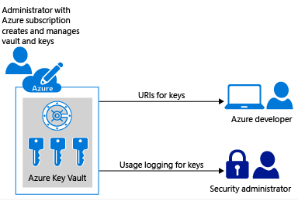
Azure Key Vault
When deploying resources, often secrets are required. These should not be passed but stored in the Azure Key Vault.
2-13
Notes:
Key vault is a two tier Azure service that stores secrets, keys and certificates for access by individuals and applications.
To use this with Arm Templates, a service principal is recommended to prevent administrative credentials being used or stored in templates or vaults.
The premium tier of Key Vault uses a Hard Ware security module for all secrets.
20535A
2: Deploying Resources with Azure Resource Manager

Slide 33
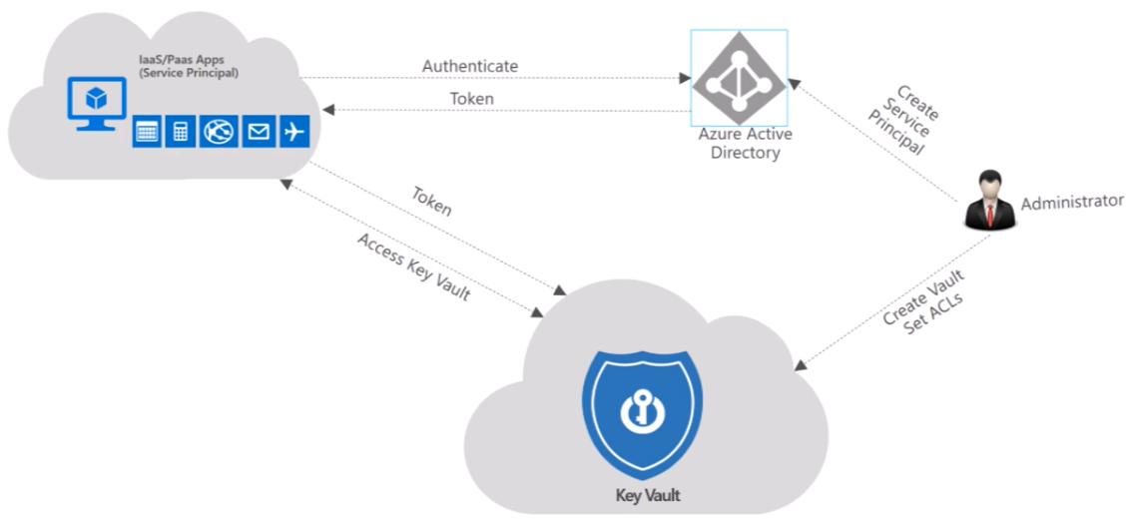
Key Vault Use in Azure
Application access without passing credentials
2-13
Notes:
Azure Key Vault helps safeguard cryptographic keys and secrets used by cloud applications and services.
By using Key Vault, you can encrypt keys and secrets (such as authentication keys, storage account keys, data encryption keys, .PFX files, and passwords).
Developers can create development keys, and then migrate them easily for production use.
Security admins can control access and key permissions at will.
20535A
2: Deploying Resources with Azure Resource Manager

Slide 34
Key Vault Use in ARM Templates
Several steps to allow Key Vault use in template deployment:
Deploy a Key vault and Secret
Enable access to the secret
Either:
Reference the secret with a static ID
Reference the secret with a dynamic ID
Top Tip: set Key Vault enabledForTemplateDeployment property to true at creation.
This will permit access from Resource Manager templates during deployment.
2-14
Notes:
It is not best practice to deploy templates with user credentials either as variables or templates.
Azure allows Arm to utilise Key Vault secrets provided the processes are followed to allow access.
Create a Key Vault and then set the enabledForTemplateDeployment property to true.
Deploy a key vault and secret—you can use Azure CLI, PowerShell, or the Azure Portal.
Enable access to the secret — the user or template carrying out a deployment should have the Microsoft.KeyVault/vaults/deploy/action permission for the key vault.
Reference a secret with static ID — you reference the key vault in the parameter file, not the template. The password parameter is set to a secure string. The template does not specify where that value comes from. Now, create a parameter file for the template.
Reference a secret with dynamic ID — sometimes you need to reference a key vault secret that changes in each deployment. You cannot hard-code the resource ID in the parameters file.
This scenario requires a nested template, it cannot be achieved in the parameter file.
20535A
2: Deploying Resources with Azure Resource Manager

Slide 35
Discussion
How could you use Key Vault to deploy secrets along with your ARM templates?
Notes:
20535A
2: Deploying Resources with Azure Resource Manager

Slide 36
Lab: Getting Started with Azure Resource Manager
Exercise 1: Creating Resource Groups Exercise 2: Deploying an Empty Template Exercise 3: Deploying a Simple Template Exercise 4: Cleanup Subscription
Logon Information
Virtual machine: 20535A-SEA-ARCH
User name: Admin
Password: Pa55w.rd
Estimated Time: 90 minutes
Notes:
This lab assumes that students have their own Azure subscriptions that do not contain any existing cloud services, storage accounts, or Azure SQL Database servers.
Azure is continually improving, so the user interface might have been updated since this lab was written. Before students start the lab, make them aware of any differences between the steps described in the lab and the current user interface.
Exercise 1: Creating Resource Groups
Exercise 2: Deploying an Empty Template
Exercise 3: Deploying a Simple Template
Exercise 4: Cleanup Subscription
20535A
2: Deploying Resources with Azure Resource Manager

Slide 37
Lab Scenario
As part of your onboarding as a Fabrikam consultant, your team has asked you to become familiar with the Azure Resource Manager features and to deploy your first ARM templates.
Notes:
20535A
2: Deploying Resources with Azure Resource Manager

Slide 38
Lab Review
In this lab, you created your first ARM templates and resource groups. How could you use resource groups to organize your Azure resources in your subscription?
Notes:
Question
In this lab, you created your first ARM templates and resource groups. How could you use resource groups to organize your Azure resources in your subscription?
Answer
Answers can include:
Group projects into resource groups.
Use resource groups to split-up clients for consulting firms.
Use resource groups to organize cost centers.
20535A
2: Deploying Resources with Azure Resource Manager

Slide 39
Module Review and Takeaways
Review Questions
Notes:
Review Questions
Question
Which of the following JSON properties are required in an Azure Resource Manager JSON template document?
( ) Option 1: variables, parameters and resources
( ) Option 2: schema, resources and parameters
( ) Option 3: resources, contentVersion and parameters
( ) Option 4: schema, contentVersion and resources
Answer
( ) Option 1: variables, parameters and resources
( ) Option 2: schema, resources and parameters
( ) Option 3: resources, contentVersion and parameters
(√ ) Option 4: schema, contentVersion and resources
20535A
2: Deploying Resources with Azure Resource Manager
(More notes on the next slide)

Slide 40
Notes:
Question
Which of the following built-in roles allows an Azure user to add additional users and resources to an existing resource group?
( ) Option 1: User Access Administrator
( ) Option 2: Owner
( ) Option 3: Security Manager
( ) Option 4: Contributor
( ) Option 5: Reader
Answer
( ) Option 1: User Access Administrator
( √) Option 2: Owner
( ) Option 3: Security Manager
( ) Option 4: Contributor
( ) Option 5: Reader
(More notes on the next slide)
20535A
2: Deploying Resources with Azure Resource Manager

Slide 41
Notes:
Question
Once defined, which of the following are valid scopes for assignment of policy?
( ) Option 1: Subscription
( ) Option 2: Virtual Machine
( ) Option 3: Virtual Network
( ) Option 4: Region
( ) Option 5: Resource
Answer
( √) Option 1: Subscription
( ) Option 2: Virtual Machine
( ) Option 3: Virtual Network
( ) Option 4: Region
( ) Option 5: Resource
20535A
2: Deploying Resources with Azure Resource Manager
(More notes on the next slide)

Slide 42
Notes:
Question
When deploying an ARM template using Key Vault secrets, what format would you use to create and store the password, using PowerShell, in an Azure Key Vault instance?
( ) Option 1: PlainText
( ) Option 2: SecureString
( ) Option 3: ASCII Text
( ) Option 4: JSON
( ) Option 5: Hexadecimal
Answer
( ) Option 1: PlainText
( √) Option 2: SecureString
( ) Option 3: ASCII Text
( ) Option 4: JSON
( ) Option 5: Hexadecimal
20535A
2: Deploying Resources with Azure Resource Manager
(More notes on the next slide)

Slide 43
Notes:
Question
Which of the following files is required by the azbb command-line tool to deploy resources to your subscription?
( ) Option 1: .cloudsettings file
( ) Option 2: ARM Templates
( ) Option 3: Parameters file
( ) Option 4: project.json file
( ) Option 5: Publish Settings File
Answer
( ) Option 1: .cloudsettings file
( ) Option 2: ARM Templates
( √) Option 3: Parameters file
( ) Option 4: project.json file
( ) Option 5: Publish Settings File
20535A
2: Deploying Resources with Azure Resource Manager

Slide 44
Module Overview
Security Identity
9-1
Notes:
20535A
9: Managing Security & Identity for Azure Solutions

Slide 45
Lesson 1: Security
Platform Security Securing the Azure Platform
9-2
Notes:
20535A
9: Managing Security & Identity for Azure Solutions

Slide 46

Platform Security
Security Responsibility is SHARED
Microsoft Azure is built with end-to-end security in mind, besides trust. Microsoft gives you a secure foundation, as well as the tooling to control your environment
Customers own responsibility of their subscription governance, data, identities, and how to protect those. In IAAS, customer owns more control than in PAAS or SAAS
9-2
Notes:
20535A
9: Managing Security & Identity for Azure Solutions

Slide 47
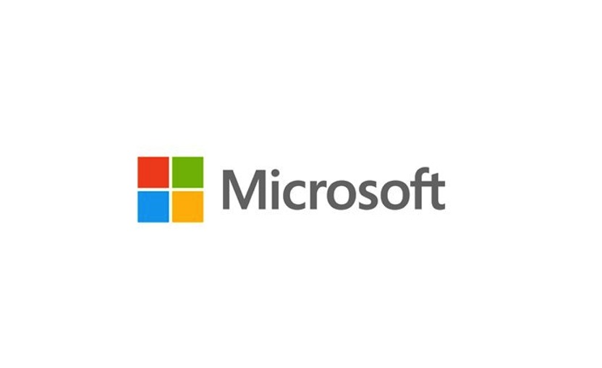

Public Cloud Security
Customer’s PAAS Workloads (Azure Apps, ML, SQL, Functions, Data,…)
Customer’s IAAS Workloads (Networking, Storage, VMs, Backup, ASR,…)
Physical Hypervisor layer
Physical Datacenter Access Security (=the buildings)
9-2
Notes:
20535A
9: Managing Security & Identity for Azure Solutions

Slide 48
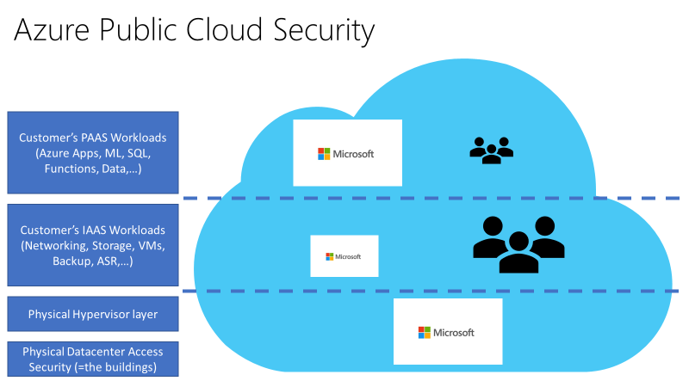
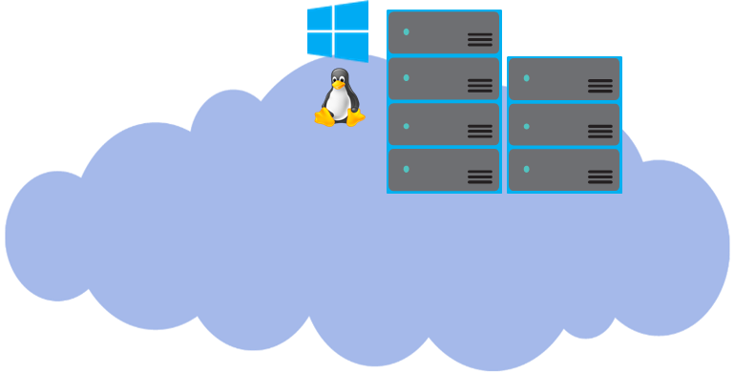
Cloud Platform Security
- Each Azure Tenant is isolated from all other tenants, using “Azure Fabric Controller”
- Azure datacenters are mainly based on Microsoft proprietary hardware, running an Azure-host-specific version of Hyper-V
Customer A
Customer B
9-2
Notes:
20535A
9: Managing Security & Identity for Azure Solutions

Slide 49







Platform Encryption Scenarios
Microsoft Azure
Admin operational sessions to the Azure platform are encrypted
All communication between Azure Regions is encrypted
Hybrid connectivity (Site-to-Site VPN or ExpressRoute) is encrypted
Microsoft Azure
9-2
Notes:
This is a basic diagram, detailing the Architecture and required Azure Backup components, when you want to backup Files & Folders only:
Deploy the Azure Backup Agent (Azure Recovery Services Agent) on the VM guests running on-premises Hyper-V / SCVMM / Vmware / Physical infrastructure
Configure Azure Backup from within the VM guest
Configure the integration with Azure Backup Vault
Run the Backup job from within the VM guest
Files & Folders backup will be stored in Azure Backup Vault, and can be restored from there.
20535A
9: Managing Security & Identity for Azure Solutions

Slide 50
Data Encryption Scenarios
On top of the Azure Platform provided encryption, customers have additional levels of encryption techniques available, depending on the Azure Resource or Data type:
Offline disk shipment: only encrypted disks are accepted
SQL Azure provides database content encryption (SQL DB TDE)
Azure Storage Accounts can be encrypted
Azure VMs (guests) allow Bitlocker encryption
Azure Backup, Azure Recovery Vault data is stored encrypted
Archive Data (data at rest) allows encryption
9-2
Notes:
20535A
9: Managing Security & Identity for Azure Solutions

Slide 51

Compliance & Certifications
Security
Services are built from the ground up, to help safeguard customer data
Privacy
Compliance
Policies and processes help keep customer data private and in their control
Industry-verified compliance conformity and certifications
Transparency
Azure practices, policies and guidelines are public, clear and accessible
9-2
Notes:
Broad set of international and industry-specific compliance standards, such as ISO 27001, HIPAA, FedRAMP, SOC 1 and SOC 2, as well as country/region-specific standards like Australia IRAP, UK G-Cloud, and Singapore MTCS. Rigorous third-party audits, such as by the British Standards Institute, verify Azure’s adherence to the strict security controls these standards mandate.
20535A
9: Managing Security & Identity for Azure Solutions

Slide 52
Securing the Azure Platform
Azure Subscription Governance
Limit Admin Access using RBAC (Role Based Access Control)
Limit VM Admin Access using JIT (Just in Time) Access
Enable (force) Multi-factor Authentication for Azure Admin Accounts
Customize RBAC roles where needed for your organizational compliance
9-3
Notes:
20535A
9: Managing Security & Identity for Azure Solutions

Slide 53
Securing the Azure Platform
Azure Storage Accounts:
Enable Storage Account Encryption:
using your encryption keys
Access Keys:
key1/key2 -> regenerate periodically
Shared Access Signatures (SAS) to narrow Application service access to the storage object and data
Storage Access Policies:
timestamp
permissions
9-3
Notes:
20535A
9: Managing Security & Identity for Azure Solutions

Slide 54
Securing the Azure Platform
Azure SQL-as-a-Service:
Apply RBAC to limit SQL Resources Admin-level access
Be cautious with the “Allow Azure Services” access
Features:
SQL Database Encryption At Rest (TDE)
SQL Database Encryption In Transit
SQL Auditing & Threat Detection
SQL Dynamic Data Masking
SQL Row Level Security
SQL Vulnerability Assessment
9-3
Notes:
20535A
9: Managing Security & Identity for Azure Solutions

Slide 55
Securing the Azure Platform
Azure Networking:
Isolate VM traffic by deploying multiple VNETs and separate Subnets within
Use Network Security Groups to limit traffic allow/deny
Integrate Forced Tunneling, User Defined Routing to control traffic outside from the default Azure Routes
Explore Azure Marketplace Virtual Appliances:
Load Balancers
Firewalls
9-3
Notes:
20535A
9: Managing Security & Identity for Azure Solutions

Slide 56
Securing the Azure Platform
Azure Key Vault:
Security Keys are stored in a vault and invoked by URI when needed
Keys are safeguarded by Azure, using industry-standard algorithms, key lengths, and hardware security modules (HSMs)
Keys are processed in HSMs that reside in the same Azure datacenters as the applications.
9-3
Notes:
20535A
9: Managing Security & Identity for Azure Solutions

Slide 57





Azure Key Vault
Developer accesses the Keys using URI request
Microsoft Azure
Azure Admin manages Azure Key Vault and generates keys
Keys are securely stored in Azure Key Vault
Security Officer inspects where Keys are being used
9-3
Notes:
20535A
9: Managing Security & Identity for Azure Solutions

Slide 58
Lesson 2: Identity
Azure Active Directory Azure AD Authentication Strategies Azure AD B2B & B2C Azure AD Identity Protection Azure AD Domain Services
9-5
Notes:
20535A
9: Managing Security & Identity for Azure Solutions

Slide 59
Azure Active Directory
Long gone is the time where all/most applications were “only” AD integrated
Microsoft Azure
Active Directory
=>
Windows Server Active Directory
User identities from multiple repositories
Hybrid
identity
LOB App Servers
On-Premises ADDS
LDAP v3
Windows PowerShell
Windows Server Active Directory
LOB Web Servers
File Shares, Printers,…
Web services
(SOAP, Java, REST)
Generic SQL via ODBC
9-5
Notes:
Get STS Token from Azure AD.
Return STS Token to Client/Application.
Request resource using trusted STS Token.
SSO Can be implemented in your custom applications too.
20535A
9: Managing Security & Identity for Azure Solutions

Slide 60
Cloud Authentication
The “cloud way of authenticating:
Azure ADConnect using Password Hash Sync
Azure ADConnect using Federation (ADFS)
Azure ADConnect using Azure AD Passthrough Authentication Agent
9-6
Notes:
20535A
9: Managing Security & Identity for Azure Solutions

Slide 61



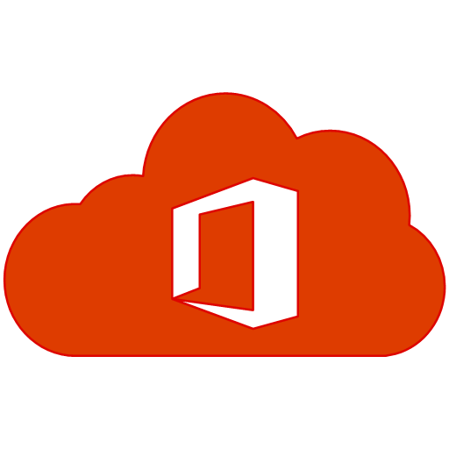



Single Sign-On
3rd Party Web Applications
Implement SSO Everywhere
Intranet Applications
Windows 10 Desktop
IoT Devices
Mobile Applications
Cloud Applications
Azure AD
Directory Sync
STS (Trust)
Security Token
9-6
Notes:
20535A
9: Managing Security & Identity for Azure Solutions

Slide 62



Azure AD Application Proxy
Microsoft Azure
Active Directory
Application
Proxy
https://appX-mydomain.msappproxy.net/
connector
Azure or 3rd Party IaaS
DMZ
connector
connector
connector
app
app
app
app
9-6
Notes:
Azure AD app proxy is a cloud service that allows users to access on-premises apps securely.
Users connect to the cloud service that routes traffic to the applications via “connectors.”
Connectors are usually deployed inside the corporate network, next to the applications.
Users connect to the cloud service that routes their traffic to application resources via the connectors.
20535A
9: Managing Security & Identity for Azure Solutions

Slide 63
Azure AD Authentication Strategies
In any of the “cloud” scenarios, AD Connect User/Group object sync is required
Replaces legacy tools:
DirSync, ADSync, FIM with AD Connector
Benefits:
Allows for write-back (passwords, devices, groups) to on-premises AD
Built-in deployment wizard for on-premises ADFS infrastructure
Azure AD Connect Synchronization Services dashboard
Managed user sign-in options
9-6
Notes:
In any of the “cloud” scenarios, ADConnect User/Group object sync is required.
Replaces legacy tools (DirSync, ADSync, FIM with AD Connector).
Additional benefits:
• Allows for Write-Back (passwords, devices, groups) to on-premises AD.
• Built-in deployment wizard for on-premises ADFS infrastructure (custom deploy).
• Azure ADConnect Synchronization Services dashboard for logging & troubleshooting.
• Manages User Sign-in options.
20535A
9: Managing Security & Identity for Azure Solutions

Slide 64
Azure AD Connect
1st option: Identity + Password (Hash) synchronization
Microsoft Azure
Active Directory
User
Identity +
Password Hash synchronization
Azure Active Directory authenticates user
9-6
Notes:
20535A
9: Managing Security & Identity for Azure Solutions

Slide 65
Azure AD Connect
2nd option: Identity synchronization + ADFS
Microsoft Azure
Active Directory
User
Identity synchronization
Authentication passed to Windows Server Active Directory via ADFS
ADFS
9-6
Notes:
20535A
9: Managing Security & Identity for Azure Solutions

Slide 66
Azure AD Connect
New option: Identity synchronization + Pass-through authentication with Seamless SSO
Microsoft Azure
Active Directory
User
Identity synchronization
Pass-through
authentication
Seamless SSO
Authentication passed to Windows Server Active Directory via Pass-through authentication
Pass-through authentication agent
9-6
Notes:
20535A
9: Managing Security & Identity for Azure Solutions

Slide 67
Azure AD Connect
Seamless SSO is now enabled for the 1st option, too: Identity + Password (Hash) synchronization
Microsoft Azure
Active Directory
User
Identity +
Password Hash synchronization
Azure Active Directory authenticates user
Seamless SSO
9-6
Notes:
20535A
9: Managing Security & Identity for Azure Solutions

Slide 68
Azure AD Connect
More options than ever!
Identity Synchronization + Password Hash Synchronization+
Seamless SSO
Identity Synchronization + ADFS
Identity Synchronization + Pass-through Authentication + Seamless SSO
Microsoft Azure
Active Directory
User
Seamless SSO
ADFS
Seamless SSO
Identity synchronization
Identity +
Password Hash synchronization
Identity synchronization
Pass-through
Authentication
9-6
Notes:
20535A
9: Managing Security & Identity for Azure Solutions

Slide 69

Hybrid Identity
Consolidated deployment assistant for your identity bridge components
All currently available sync engines will be replaced by the sync engine included in the Connect tool
Assisted deployment of ADFS will be available through Azure Active Directory Connect
ADFS is an optional component for authentication in hybrid implementation. Password sync can replace ADFS for more scenarios
DirSync
Azure Active Directory Connect
Azure Active Directory Sync
Sync engine
FIM+Azure Active Directory Connector
ADFS
ADFS
9-6
Notes:
20535A
9: Managing Security & Identity for Azure Solutions

Slide 70
Azure AD B2B & B2C
B2B (Business to Business):
Collaborate between organizations
Avoid federation and extra servers
B2C (Business to Customer):
Use their existing identities
Avoid creating additional identities
MFA (Multi-Factor Authentication):
Further authenticate users
Avoid compromises due to simple password constraints
9-7
Notes:
20535A
9: Managing Security & Identity for Azure Solutions

Slide 71
Azure AD B2B
Inviting users from other Azure AD Tenants into your own organization tenant
User provisioning is done by the invited party
You as an organization are in control to invite the other side’s user
9-7
Notes:
Your employees need to collaborate with partners:
Easily share data and applications with the right people in the right companies.
Your Partners want simplicity:
No new accounts to manage, no federation to configure, No servers to install.
Admins want security control and oversight:
Granular auditing and monitoring of partner access.
20535A
9: Managing Security & Identity for Azure Solutions

Slide 72



Azure AD B2C
Inviting users from other social media Identity Tenants (e.g. Facebook, Twitter, Google, LinkedIn, Microsoft Account) into your own organization tenant
User provisioning is done by the invited party
You as an organization are in control to invite the other side’s user
9-7
Notes:
20535A
9: Managing Security & Identity for Azure Solutions

Slide 73
Multi-Factor Authentication
What is it?:
An authentication method, which requires an additional validation item, besides your username and password combination:
Text message
Azure Authentication App
How does MFA work?
Requires 2 or more (configurable) account validation options:
Something you know (typically user/password combination)
Something you have (Mobile authenticator app)
9-8
Notes:
20535A
9: Managing Security & Identity for Azure Solutions

Slide 74
Azure AD Identity Protection
Automatic detection of vulnerabilities in your organization’s identity objects (e.g., compromised user accounts)
Define configuration alerts and automatic responses (runbooks), to detected suspicious and malicious actions that occur in your organization’s identity solution
Recognize, audit and inspect suspicious activity, and take appropriate action to resolve them
9-8
Notes:
20535A
9: Managing Security & Identity for Azure Solutions

Slide 75
Azure AD Privileged Identity Management
Detect privileged users in Azure Active Directory
Enable “Just-in-time” administrative level access to Microsoft Cloud Services
Detailed reporting related to who got what administrative access level
Automatically give users permission to have permanent admin-level right access, or allow for self-service group membership
9-9
Notes:
20535A
9: Managing Security & Identity for Azure Solutions

Slide 76
Azure AD Domain Services
Some (non-cloud native) applications don’t “speak” cloud:
The application relies on Active Directory protocols (LDAP, Kerberos,…)
Azure AD doesn’t provide Group Policies
Azure AD doesn’t provide Organizational Units
You cannot “join” servers into an Azure AD Tenant
9-10
Notes:
20535A
9: Managing Security & Identity for Azure Solutions

Slide 77
Azure AD Domain Services
Key Characteristics:
Provides a compatibility layer for Active Directory integrated applications, on top of Azure AD
Takes resources from Azure AD to “emulate” an Active Directory domain (users, groups, memberships, passwords, limited GPOs)
One AAD DS per Azure AD
High Availability built-in
9-10
Notes:
20535A
9: Managing Security & Identity for Azure Solutions

Slide 78

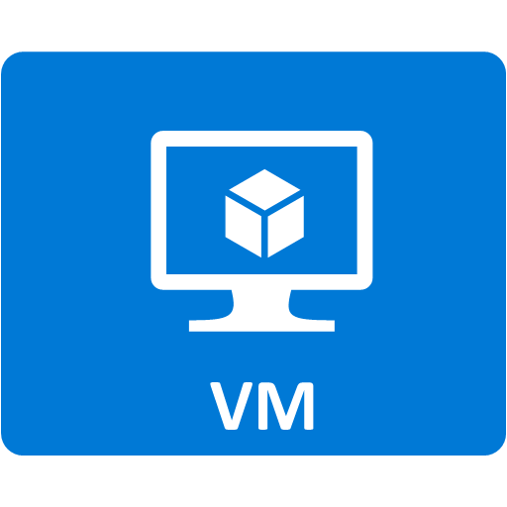

Azure AD Domain Services
Azure
Azure AD Domain Services
Azure AD
Azure AD Connect
Azure ADDS domain joined
9-10
Notes:
On the left side, we have our typical, trusted On-Premises Active Directory Domain Controllers.
These DCs sync user/group objects to Azure AD, using Azure AD Connect sync tool .
Within Azure, we define a specific VNet in Classic Azure; here, we also configure AAD Domain Services, and link it to this Classic Vnet.
AAD Domain Services user/group objects can be created manually, but preferably synced from Azure AD.
VMs in Azure can be “domain joined” to the AAD Domain Services domain, in the exact same way as it occurs on-premises.
20535A
9: Managing Security & Identity for Azure Solutions

Slide 79
Lab: Deploying Services to Secure Secrets in Azure
Exercise 1: Deploying Key Vault using ARM Template Exercise 2: Deploying Virtual Machine using Key Vault Secret Exercise 3: Cleanup Subscription
Logon Information
Virtual machine: 20535A-SEA-ARCH
User name: Admin
Password: Pa55w.rd
Estimated Time: 60 minutes
Notes:
This lab assumes that students have their own Azure subscriptions that do not contain any existing cloud services, storage accounts, or Azure SQL Database servers.
Azure is continually improving, so the user interface might have been updated since this lab was written. Before students start the lab, make them aware of any differences between the steps described in the lab and the current user interface.
Exercise 1: Deploying Key Vault using ARM Template
Exercise 2: Deploying Virtual Machine using Key Vault Secret
Exercise 3: Cleanup Subscription
20535A
9: Managing Security & Identity for Azure Solutions

Slide 80
Lab Scenario
A local credit union client has been excitedly using Azure Resource Manager to deploy virtual machines to the cloud with ARM templates. Unfortunately, they quickly discovered that sending virtual machine passwords as part of the JSON object in an HTTP request body violates some of their industry’s best practices. While they already use SSL for in-flight request security, they would like to use the Azure Key Vault to store their virtual machine passwords moving forward. The client has hired you to put together a prototype showing them how to accomplish this task.
Notes:
20535A
9: Managing Security & Identity for Azure Solutions

Slide 81
Lab Review
What type of secrets could you store for container-based VMs in an Azure Key Vault?
Notes:
Question
What type of secrets could you store for container-based VMs in an Azure Key Vault?
Answer
You can store:
Application secrets
Authentication information
Third-party service keys
Azure service connection strings and keys
Many others…
20535A
9: Managing Security & Identity for Azure Solutions

Slide 82
Module Review and Takeaways
Review Question
Notes:
Review Question
Question
What are some scenarios where you would prefer natively authenticating to Azure AD over using federation or hybrid identity?
Answer
Cloud-native applications is typically the example cited most often when discussing native Azure AD authentication.
20535A
9: Managing Security & Identity for Azure Solutions

