Slide 1
Module 12
70-535 Objective 6
Operational Readiness
10-15% of exam
12-1
Notes:
Presentation: 90 minutes
Case Study: 60 minutes
Lab: 90 minutes
After completing this module, students will be able to:
Compare and contrast monitoring services for applications, the Azure platform, and networking.
Design an alert scheme for a solution hosted in Azure.
Select the appropriate backup option for infrastructure and data hosted in Azure.
Automate the deployment of future resources for backup recovery or scaling purposes.
Required materials
To teach this module, you need the Microsoft PowerPoint file: 20535A_12.pptx.
Preparation tasks
To prepare for this module, you should:
Read all of this module’s materials.
Practice performing the demonstrations and labs.
Work through the Module Review and Takeaways section to determine how you will use the information to reinforce student learning and promote knowledge transfer to on-the-job performance.
As you prepare for this class, it is imperative that you complete the labs yourself. This gives you an understanding of how the labs work and the concepts that each covers, so that you can provide meaningful hints to students who might have issues. Furthermore, it will help guide your lecture to ensure that you discuss the concepts that the lab covers.
The Azure portal is continually being improved, and the user interface might have updated since this module was written. Therefore, before teaching this module, familiarize yourself with the latest version of the Azure portal.
20535A
12: Monitoring & Automating Azure Solutions

Slide 2
Module Overview
Monitoring Backup Automation Business Continuity Case Study
12-1
Notes:
20535A
12: Monitoring & Automating Azure Solutions

Slide 3
Lesson 1: Monitoring
Azure Network Watcher Azure Security Center Azure Monitor & Diagnostics Azure Advisors Azure Service Health Operations Management Suite – Log Analytics Application Insights Power BI
12-2
Notes:
20535A
12: Monitoring & Automating Azure Solutions

Slide 4
Azure Network Watcher
Networking feature, providing:
Topology
Variable Packet Capture
IP Flow Verify
Next Hop
Diagnostics Logging
Security Group View
NSG Flow Logging
VPN Gateway Troubleshooting
Network Subscription Limits
Role Based Access Control
Connectivity
12-2
Notes:
20535A
12: Monitoring & Automating Azure Solutions

Slide 5
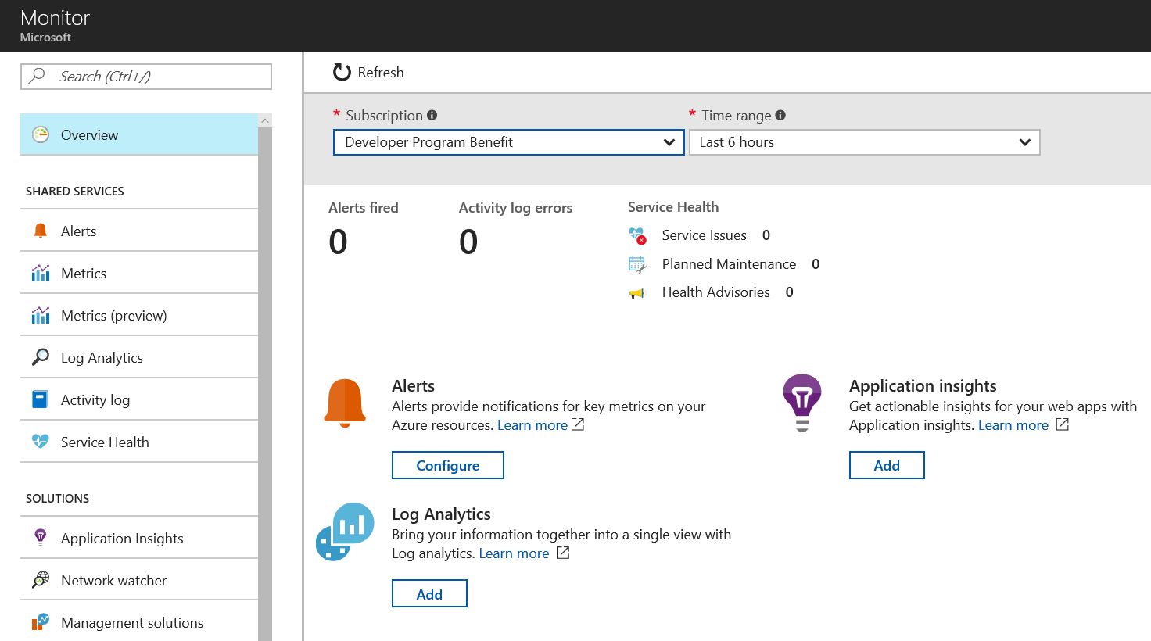
Azure Network Monitor
Centralized hub for different Azure Resources Monitoring aspects:
Alerts
Metrics
Log Analytics
Service Health
Application Insights
Network Watcher
12-3
Notes:
20535A
12: Monitoring & Automating Azure Solutions

Slide 6
Azure Security Center
Centralized Dashboard, focusing on Security posture of Azure and hybrid systems and applications
Active in 3 different areas:
General Security View
Prevention
Detection
Networking Features:
Networking Recommendations
Internet Facing Endpoints security view
Networking Topology security view
12-3
Notes:
20535A
12: Monitoring & Automating Azure Solutions

Slide 7
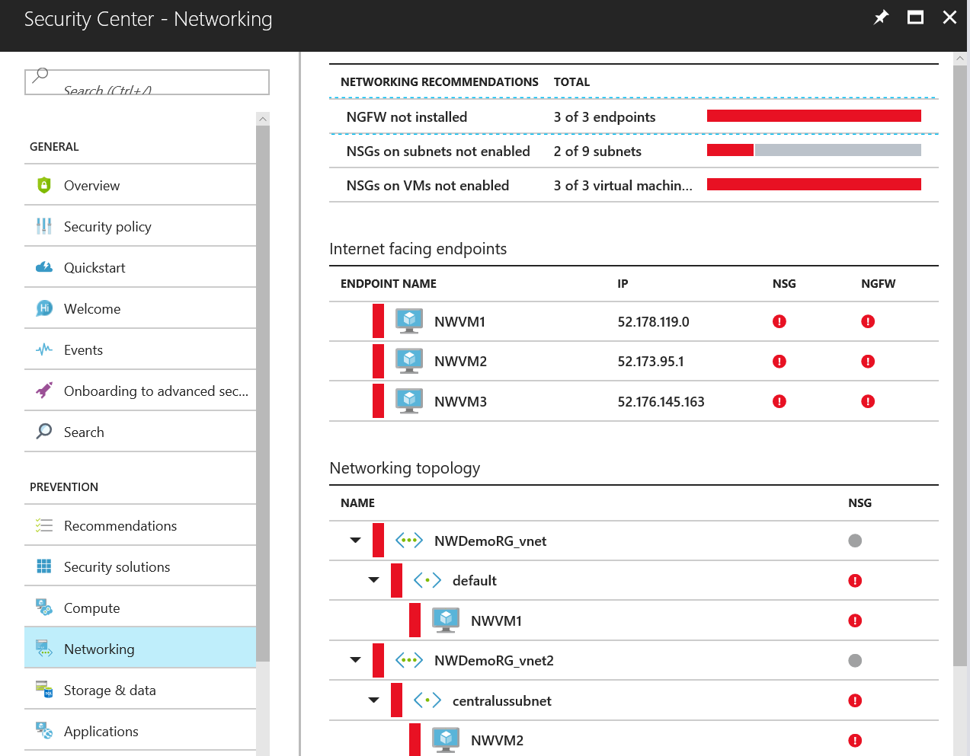
Azure Security Center
12-3
Notes:
20535A
12: Monitoring & Automating Azure Solutions

Slide 8
Azure Monitor & Diagnostics
“Highly granular and real-time monitoring data for any Azure Resource”
View and manage all your monitoring data easily
Set up alerts and take automated actions
Diagnose operational issues quickly
Integrate with your existing tools
Get the granular, up-to-date monitoring data you need—all in one place
12-3
Notes:
20535A
12: Monitoring & Automating Azure Solutions

Slide 9


Azure Monitor & Diagnostics
“Dev: My Application is slow…, Ops guy, can you figure out why”
!
?
User
Azure
Storage
App
12-3
Notes:
20535A
12: Monitoring & Automating Azure Solutions

Slide 10
Azure Advisors
“Optimize your Azure Resources, according to Microsoft Best Practices”
Improve the availability of business-critical applications
Enhance protection from potential security threats
Optimize Performance to run healthy applications
Maximize the ROI of your IT and business budget
Get the granular, up-to-date monitoring data you need—all in one place
12-5
Notes:
20535A
12: Monitoring & Automating Azure Solutions

Slide 11
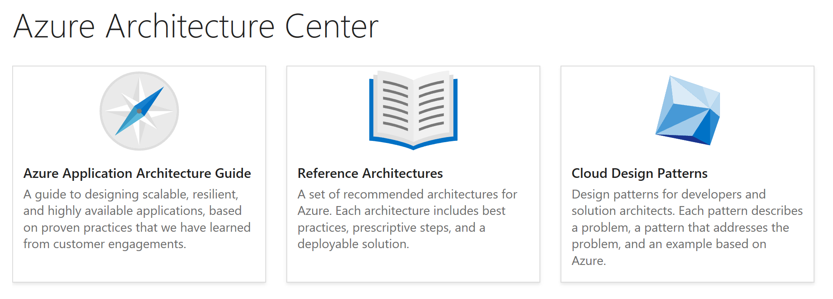
Azure Advisors
Recommendations are sourced from the Azure Architecture Center
12-5
Notes:
20535A
12: Monitoring & Automating Azure Solutions

Slide 12
Azure Service Health
“Provides timely and personalized information when problems in Azure services impact your services.”
Azure Portal
Personalized Service Health Dashboard
Azure Service Health
Service Issues
Maintenance
Advisories
Azure Monitor
Service Health Alerts
http://status.azure.com
General Health Overview of all Azure Services
12-5
Notes:
20535A
12: Monitoring & Automating Azure Solutions

Slide 13
Azure Service Health
Service Issues:
Shows any ongoing problems in the Azure Platform, having impact on YOU
Planned Maintenance:
Provides information on scheduled maintenance of YOUR impacted Azure Resources
Health History:
Shares feedback of past issues with impact on YOUR Azure Resources
12-5
Notes:
20535A
12: Monitoring & Automating Azure Solutions

Slide 14
Operations Management Suite – Log Analytics
“Gain visibility and control across your hybrid cloud with simplified security and operations management”
Gain immediate insights across workloads
Enable consistent control and compliance
Respond immediately to security threats
Ensure availability of apps and data
Monitoring, Management + Business Continuity & Disaster Recovery
12-6
Notes:
20535A
12: Monitoring & Automating Azure Solutions

Slide 15
Operations Management Suite – Log Analytics
Separate the signal from the noise
See the full picture in meaningful detail
Integrating application monitoring
Azure Resources & Hybrid
OMS Agents
Supports “Any” Log File format
12-6
Notes:
20535A
12: Monitoring & Automating Azure Solutions

Slide 16
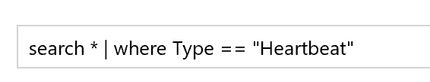
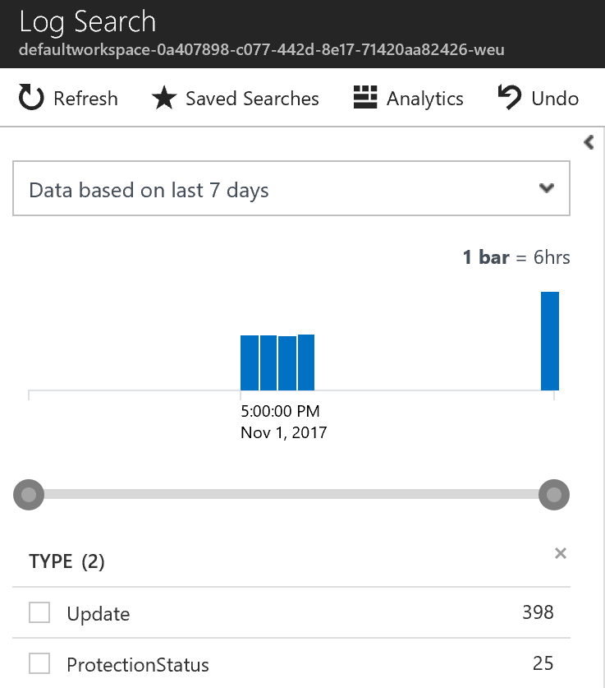
Operations Management Suite – Log Analytics
Powerful Query Language
Click-to-filter scenarios
Saved Search
Export to CSV
Use “Azure Log Analytics” for more advanced querying (portal.loganalytics.io)
12-6
Notes:
20535A
12: Monitoring & Automating Azure Solutions

Slide 17
Application Insights
“Get actionable insights through application performance management and instant analytics”
Web App Performance Management
Integrated in the Web App code, running in Azure or on-premises
Diagnostics, proactively detecting lifecycle issues
DevOps integration from within VS2017, GitHub,…
Monitoring, Management + Business Continuity & Disaster Recovery
12-6
Notes:
20535A
12: Monitoring & Automating Azure Solutions

Slide 18
Application Insights
Application Map:
Diagram of App Components and interactions between all services
Live Metrics:
Real-Time Requests information
Servers:
Detailed Performance per Instance view
Availability:
Run scheduled tests for Uptime
12-6
Notes:
20535A
12: Monitoring & Automating Azure Solutions

Slide 19
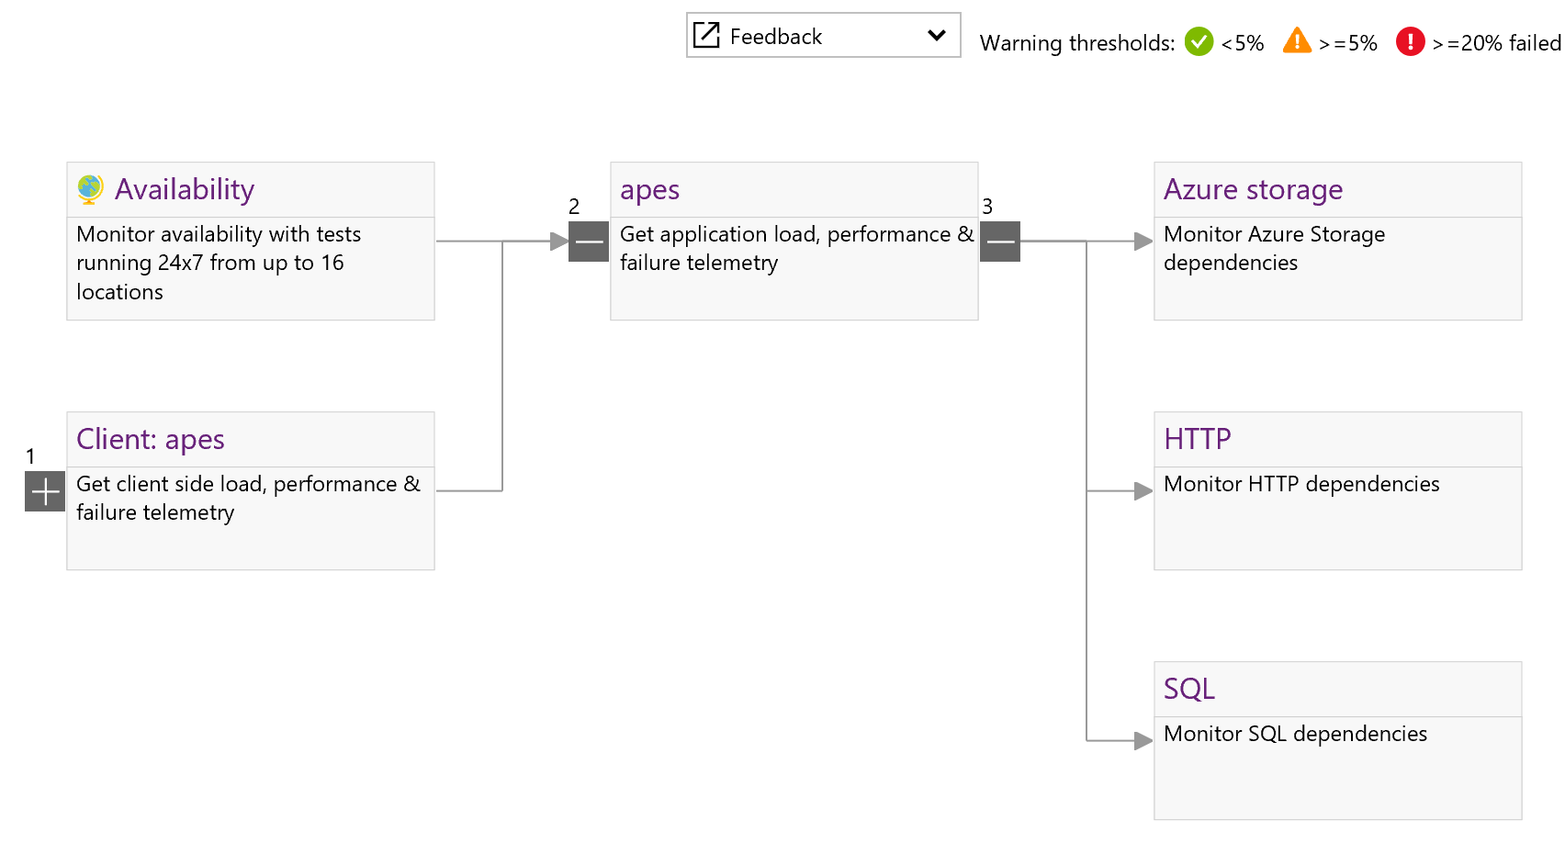
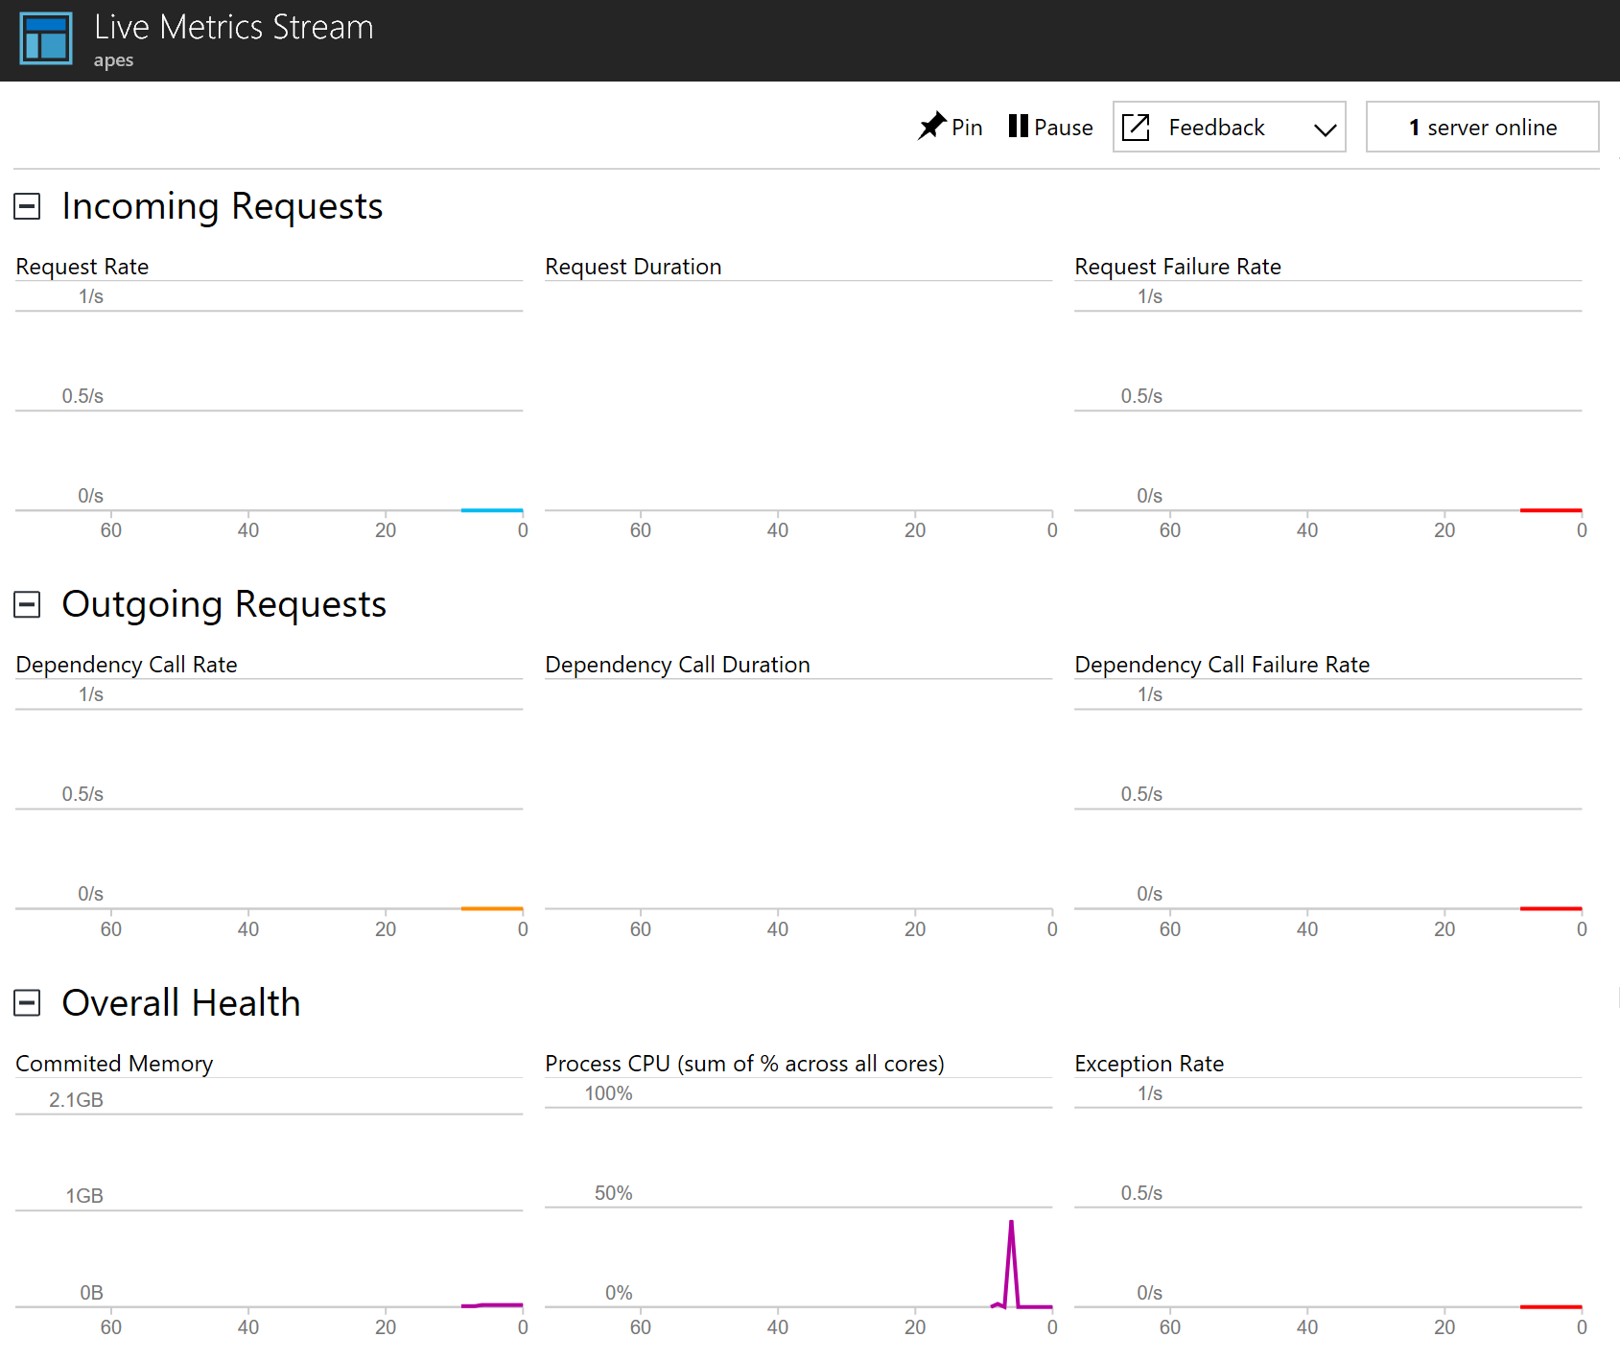
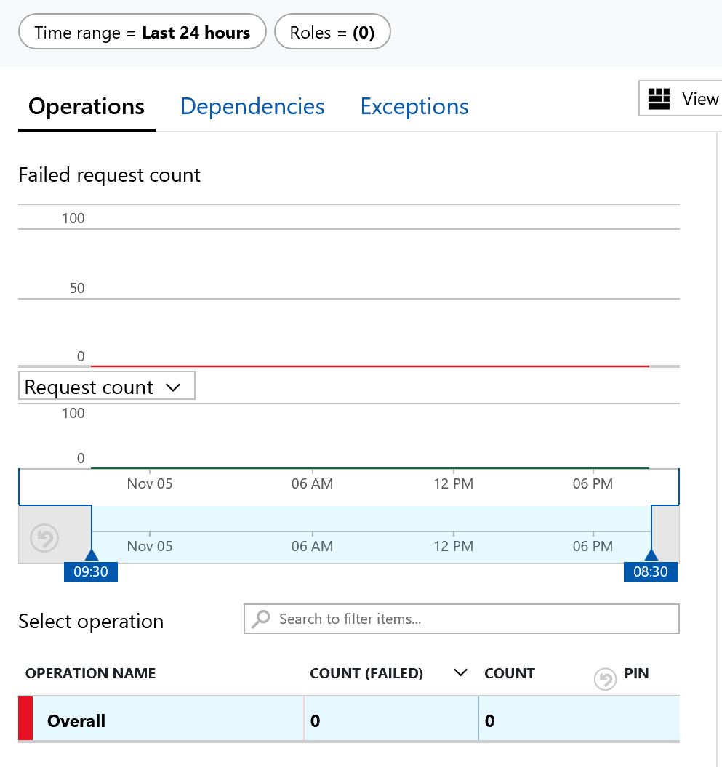
Application Insights
12-6
Notes:
Examples of reports created by Application Insights in the portal.
20535A
12: Monitoring & Automating Azure Solutions

Slide 20
Power BI
“Workspace approach, integrating with Power BI Apps, allowing for detailed reporting and data analytics”
Connect to different data sources, create reports and data charts
Get access to powerful dashboards, alerts and drill down for info
Simplify Mgmt, expose IT data to non-IT teams, achieve compliance
Embed interactive data visuals and reporting features into your apps
Monitoring, Management + Business Continuity & Disaster Recovery
12-7
Notes:
20535A
12: Monitoring & Automating Azure Solutions

Slide 21
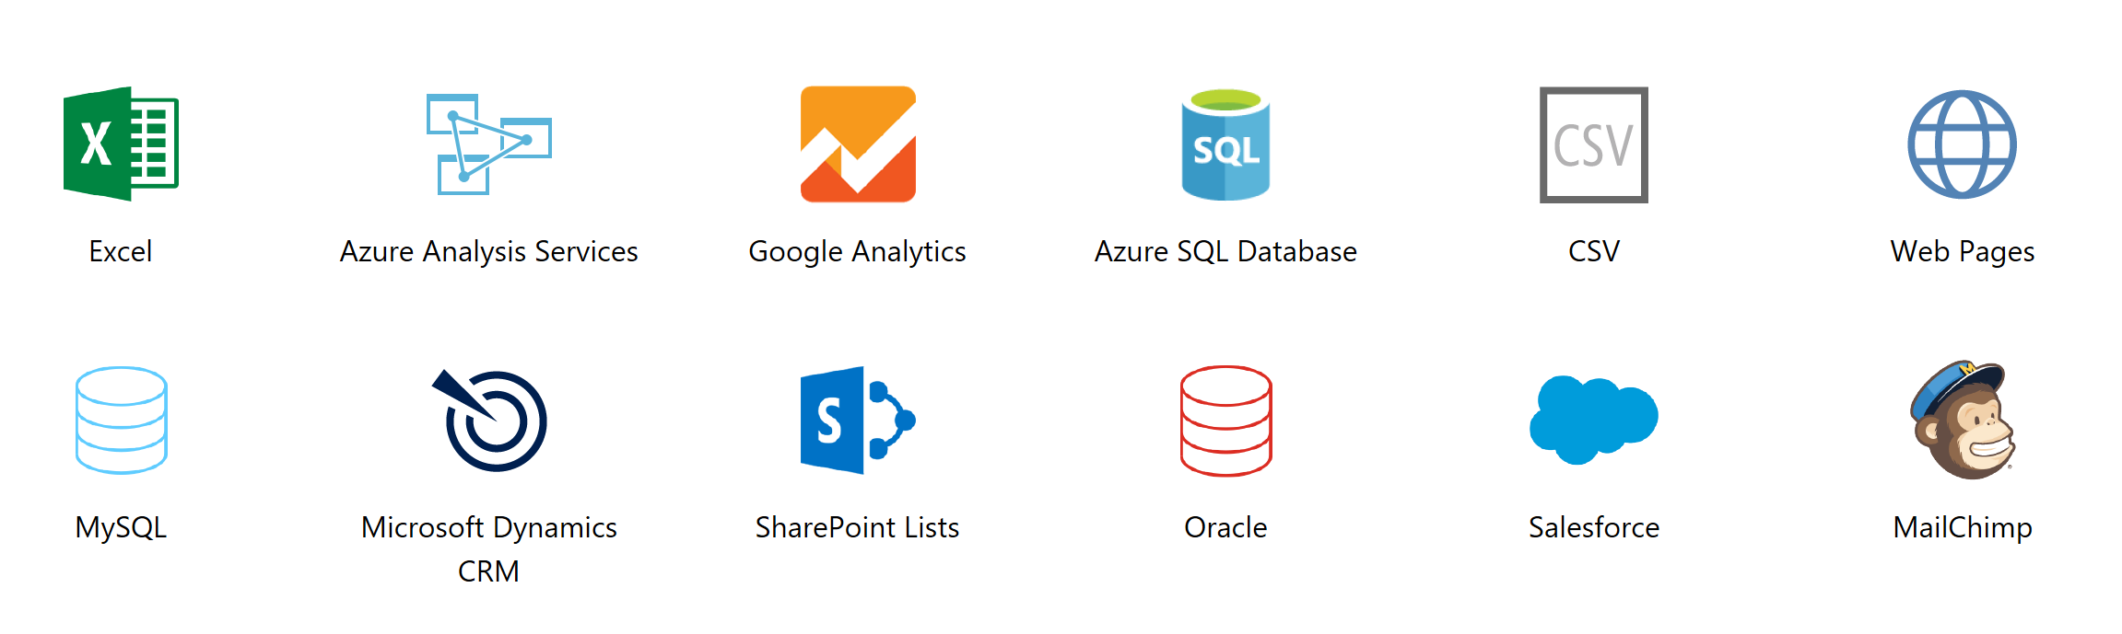
Power BI
Integrating with Industry-Standard Data Sources
12-7
Notes:
20535A
12: Monitoring & Automating Azure Solutions

Slide 22
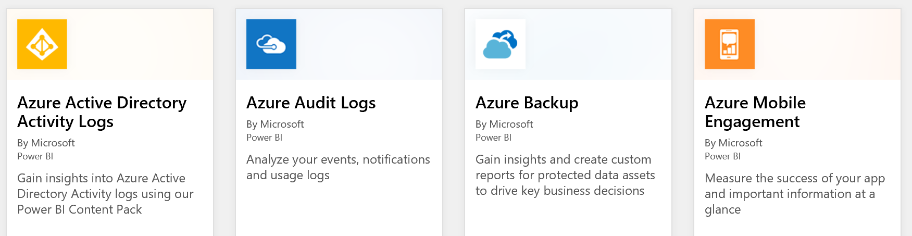
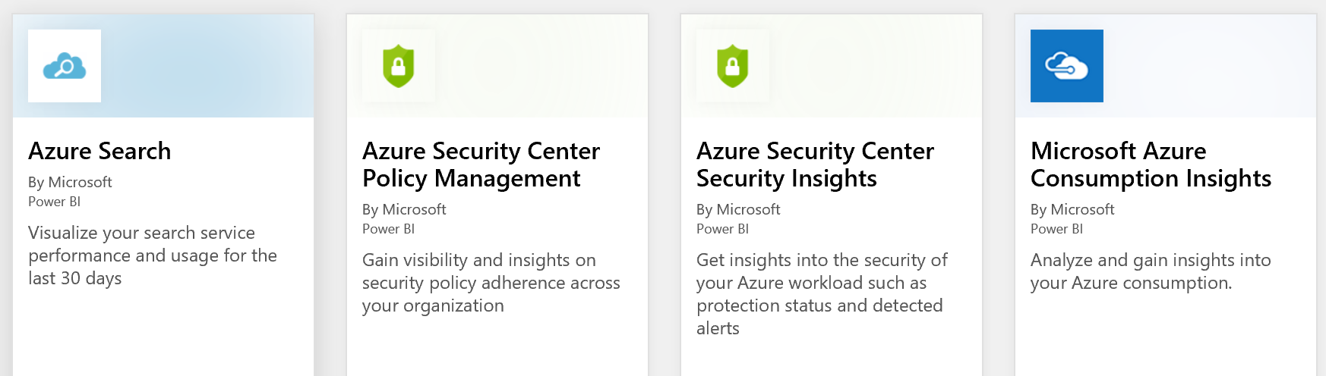
Power BI Integrations
12-7
Notes:
Power BI can be integrated with many of the services listed above.
20535A
12: Monitoring & Automating Azure Solutions

Slide 23
Lesson 2: Backup
Azure Backup Backup Options Specialized Backup Site Recovery
12-8
Notes:
20535A
12: Monitoring & Automating Azure Solutions

Slide 24
Azure Backup
There are three popular scenarios where Azure is selected as the ideal backup target:
On-Premises backups of Files & Folders into Azure Backup Vault
On-Premises backups of full Windows & Linux VMs into Azure Backup Vault
Azure VM backup to Azure Backup Vault
12-8*
Notes:
20535A
12: Monitoring & Automating Azure Solutions

Slide 25




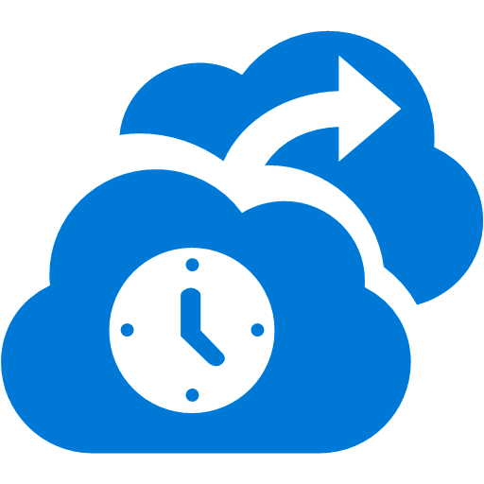
Backup Options
Azure Backup / Restore of On-Premises Files & Folders
Azure Site Recovery
443 (HTTPS)
Microsoft Azure
Backup Vault
Data Channel
Public Internet or ExpressRoute with Public Peering
Source: Windows OS
Microsoft Azure Recovery Services Agent
Replicates data to Azure
12-8
Notes:
20535A
12: Monitoring & Automating Azure Solutions

Slide 26
Backing up OS, Sysvol and Applications
Azure Backup / Restore of On-premises running full workloads (OS, Sysvol, and Applications)
443 (HTTPS)
Azure Backup Server or DPM
Azure Site Recovery
443 (HTTPS)
Microsoft Azure
Backup Vault
Data Channel
Public Internet or ExpressRoute with Public Peering
Source: VMware, AWS & Physical Servers
Azure Backup Server
Used for caching, compression, and encryption
SysCtr DPM
If you already have SC on-premises
Azure Backup Recovery Services Agent
12-9
Notes:
Deploy the Azure Backup Server (or System Center DPM 2012 R2 or 2016) on the on-premises Hyper-V / SCVMM / Vmware / Physical infrastructure.
Configure Azure Backup Server backup policies, backup storage (2-tier) and deploy agents to your workloads.
Configure the integration with Azure Backup Vault.
Run the Backup job from within the Azure Backup Server console.
VM workloads (system state, OS, applications,…) backup will be stored in Azure Backup Vault, and can be restored from there.
20535A
12: Monitoring & Automating Azure Solutions

Slide 27
Backing Up Full VMs
Azure VM Backup / Restore to Azure Backup Vault
Azure VM
Azure Site Recovery
443 (HTTPS)
Microsoft Azure Backup Vault
Data Channel
Azure Backbone
Source: Azure
Microsoft Azure Backup Extension for VMs
12-9
Notes:
Deploy the Azure Backup Extension, or select Azure Backup in the VM configuration.
Configure Azure Backup policies, in the Azure platform.
Configure the integration with Azure Backup Vault.
Run the Backup job from within the Azure Platform.
Azure VMs will be backed up as full VM snapshots, and can be restored from within the Azure Portal.
20535A
12: Monitoring & Automating Azure Solutions

Slide 28
Specialized Backup
You can do more than simply backup VMs or Data using Azure Backup:
Hybrid Backup Encryption
Azure Backup Monitoring with Log Analytics
Azure Backup Reports with Power BI
Linux Application Consistent Azure Backup
12-9
Notes:
20535A
12: Monitoring & Automating Azure Solutions

Slide 29








Hybrid Backup Encryption
KEK is stored
on-prem
+
=
Passphrase
User-provided Passphrase
MARS Agent Algorithm
(SHA256)
Windows Secret-Store (on-prem)
Only the user has KEK and Passphrase
+
=
KEK encrypted DEK
+
DEK encrypted data
MARS uses ACS/AAD to communicate with Service
Key-Encryption Key (KEK)
Transfer over HTTPS Protocol
+
=
Azure Backup Service
Backup Data
Data-Encryption Key (DEK)
from MARS Agent (SHA256)
*All assets are AES256 Encrypted
12-9
Notes:
20535A
12: Monitoring & Automating Azure Solutions

Slide 30
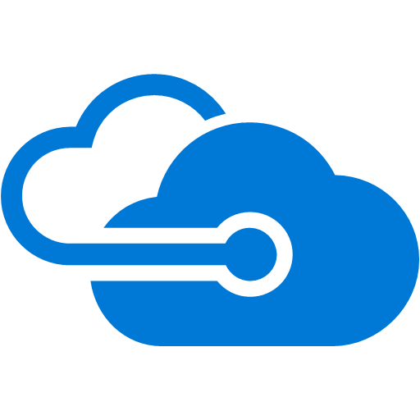

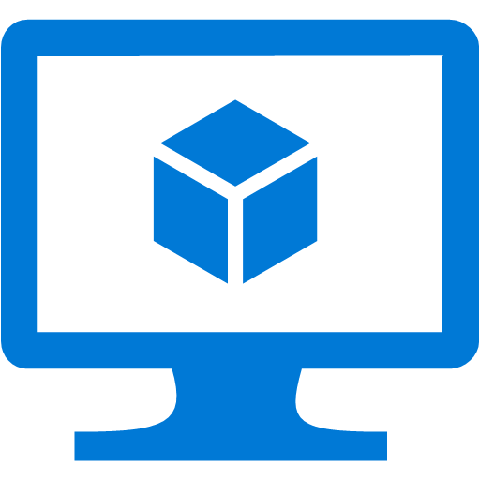
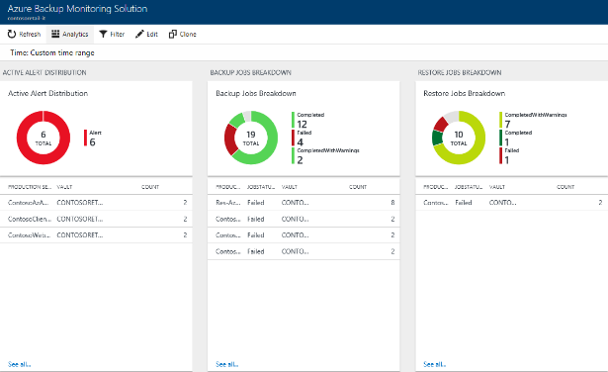

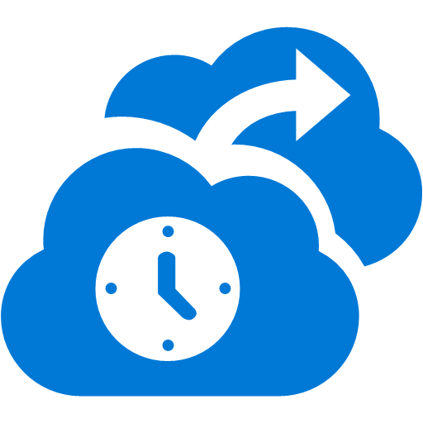
Azure Backup Monitoring with Log Analytics
Log Analytics
Data Model
Azure VM Backup
Azure Backup Agent Backup
No infrastructure
Enterprise Wide
Custom Queries (KQL)
ITSM Integration
12-10
Notes:
20535A
12: Monitoring & Automating Azure Solutions

Slide 31

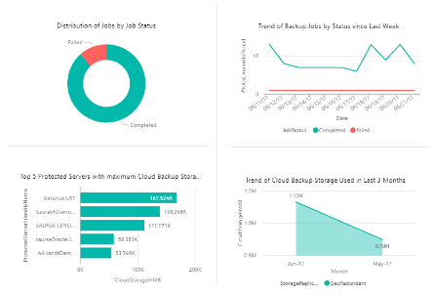
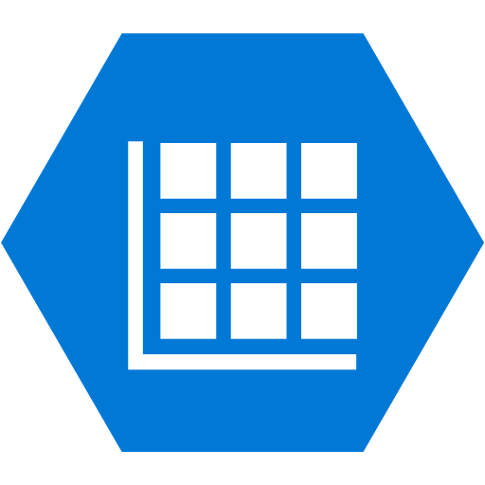
Azure Backup Reports with Power BI
Power BI Reports
Data Model
&
Cubes
Azure VM Backup
Azure Storage
Azure Backup Agent Backup
No infrastructure
Enterprise Wide
Custom Reports
Access Control
12-10
Notes:
20535A
12: Monitoring & Automating Azure Solutions

Slide 32



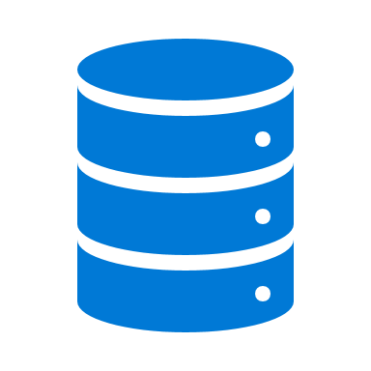
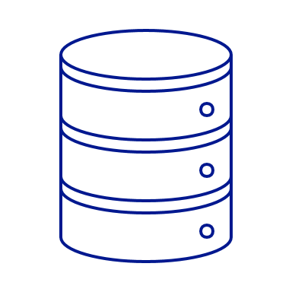
Linux Application Consistent Azure Backup
1
NEW
Configure
Backup
2
3
> _pre-script
4
VM Snapshot
Start Backup
5
> _post-script
6
Incremental Backup saved in vault
App consistent backup
Open support platform
12-10
Notes:
Taking backups of Azure VMs running Linux OS is fully supported, for Azure supported Linux Operating Systems.
To allow for application consistent backups, you need to run a pre- & post- backup script. The VM Snapshot will be your VM Backup, which gets stored in the Backup Vault using an incremental update process.
20535A
12: Monitoring & Automating Azure Solutions

Slide 33


Azure Data Box
Offline Data Shipping
Recovery Services Vault
Ship
Azure Data Box Service
Azure Data Box
Up to 100 TB
Backup data from multiple sources
No procuring of disks
Parallel transfers
Safe and secure
12-10
Notes:
Another Azure capability that somehow relates to Backup (but can be used for offline data shipping in general, not limited to Azure Backup data), is Azure Data Box.
Use the Azure Data Box service when you want to transfer large amounts of data to Azure but are limited by time, network availability or costs.
Transferring terabytes of data to the cloud is hard. The Azure Data Box provides a secure, tamper-resistant method for quick and simple transfer of your data to Azure. You can order the Data Box through the Azure portal. Easily connect it to your existing network, then load your data onto the Data Box using standard NAS protocols (SMB/CIFS). Your data is automatically protected using 256-AES encryption. The Data Box is returned to the Azure Data Center to be uploaded to Azure, then the device is securely erased.
20535A
12: Monitoring & Automating Azure Solutions

Slide 34
Site Recovery
Designed for zero-data loss during migration
Near-zero downtime for their users
Comprehensive coverage for all applications
Ability to test application in the new cloud before migration
12-10
Notes:
20535A
12: Monitoring & Automating Azure Solutions

Slide 35
Site Recovery Advantages
Zero application data loss during migration
Near-zero application downtime during migration
Broad coverage for hypervisors, applications, operating systems, and Azure features
No-impact application testing in Azure
12-10
Notes:
20535A
12: Monitoring & Automating Azure Solutions

Slide 36
Disaster Recovery or Workload Migration from Hyper-V/SCVMM
Hyper-V Server
Azure Site Recovery
443 (HTTPS)
Microsoft Azure
Data Channel
Public Internet or ExpressRoute with Public Peering
Source: Hyper-V/SCVMM
Microsoft Azure Recovery Services Agent
Replicates data to Azure
12-10
Notes:
Deploy the ASR Agent on the on-premises Hyper-V / SCVMM infrastructure.
Select your VMs you want to replicate to Azure.
Replication occurs through public internet or expressroute (https/443).
Azure is your DR Site, containing the offline VMs until failover is executed.
(failback occurs in the same way from Azure back to on-premises VM).
20535A
12: Monitoring & Automating Azure Solutions

Slide 37
Disaster Recovery or Workload Migration from VMware/AWS/physical
443 (HTTPS)
Config Server
Process Server
9443 (HTTPS)
Azure Site Recovery
443 (HTTPS)
Microsoft Azure
Data Channel
Public Internet or ExpressRoute with Public Peering
Source: VMware, AWS & Physical Servers
Process Server
Used for caching, compression, and encryption
Configuration Server
Used for centralized management
Mobility Service Captures all data writes from memory
12-10
Notes:
Deploy the ASR Processing and Configuration Server on the on-premises VMware infrastructure.
Select your VMs you want to replicate to Azure.
Replication occurs through public internet or expressroute (https/443).
Azure is your DR Site, containing the offline VMs until failover is executed.
(failback occurs in the same way from Azure back to on-premises VM).
20535A
12: Monitoring & Automating Azure Solutions

Slide 38
Disaster Recovery or Workload Migration from Azure to Azure
Azure VM
Azure Site Recovery
Microsoft Azure
Same or different Region
443 (HTTPS)
Data Channel
Azure Backbone
Source: Azure
Microsoft Azure Recovery Services Agent
Replicates data to Azure
12-10
Notes:
Select your Azure VMs you want to replicate to another Azure Resource Group or another Azure Region.
Replication occurs through Microsoft Azure Backbone (https/443).
Azure is your DR Site, containing the offline VMs until failover is executed.
(failback occurs in the same way from target Azure VM back to source Azure VM).
20535A
12: Monitoring & Automating Azure Solutions

Slide 39
Lesson 3: Automation
Azure Automation Automation Flow Configuration Management
12-11
Notes:
20535A
12: Monitoring & Automating Azure Solutions

Slide 40
Azure Automation
Configuration and control plane for Azure, on-premise and other cloud providers:
Robust configuration management toolkit built-in
Access governance and control
Serverless execution of management scripts
Integration with existing platforms, systems and OS features
12-11
Notes:
20535A
12: Monitoring & Automating Azure Solutions

Slide 41
Features
Process Automation:
Author runbooks - PowerShell, scripts PowerShell workflow, Graphical, Python2
Hybrid Runbook Workers with Proxy support
Configuration Management:
DSC Configurations, Pull service
Node Management & Reporting
Change tracking & Inventory
Update Management:
Insights across a hybrid Environment
Orchestrated updates and troubleshooting
12-11
Notes:
Microsoft Azure Automation provides a way for users to automate the manual, long-running, error-prone, and frequently repeated tasks that are commonly performed in a cloud and enterprise environment. It saves time and increases the reliability of regular administrative tasks and even schedules them to be automatically performed at regular intervals. You can automate processes using runbooks or automate configuration management using Desired State Configuration.
Configuration Management
DSC Configurations, Pull service
Node Management & Reporting
Change tracking & Inventory
Update Management
Insights across your hybrid Environment
Orchestrated updates and troubleshooting
Integration
Included with Azure SDK
Webhooks to start runbook remotely
Process Automation
Author runbooks - PowerShell, scripts PowerShell workflow, Graphical, Python2
Hybrid Runbook Workers with Proxy support
Onboarding
RunAs account for Azure management
Gallery of runbooks and modules from Microsoft and community
20535A
12: Monitoring & Automating Azure Solutions
(More notes on the next slide)

Slide 42
Notes:
Shared capabilities across features
Role Based Access Control
Secure, global store for variables, credentials, certificates, connections
Schedules, Modules, Auditing, Tags
20535A
12: Monitoring & Automating Azure Solutions

Slide 43

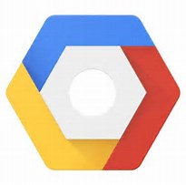



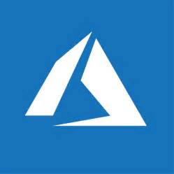
Cross-Cloud
Third party clouds
443 (HTTPS)
Microsoft Azure
Automation
On-premises Datacenters Branch offices datacenters
Secured connection using the Azure Automation Hybrid Worker
Automation tasks are running on-premises, but triggered from Azure Automation
Azure Stack
12-12
Notes:
The core component of Azure Automation is defined and configured in the Azure Platform (cross Regions). From there, you can establish hybrid automation capabilities, by using the Azure Automation Hybrid Worker.
This is similar to running like an Azure Automation agent on your non-Azure cloud platforms, where Amazon Web Services, Google Cloud, your own Private Cloud datacenter, or any third party hosted datacenter if you want, would be a good example.
Latest supportability added to the Azure Automation feature set, is integration with on-premises running Azure Stack.
20535A
12: Monitoring & Automating Azure Solutions

Slide 44
Azure Automation Desired State Configuration
Host DSC Scripts and clients pull their configurations automatically
Support for cloud or on-premises VMs and hosts
Simple onboard process for Azure Virtual Machines
Characteristics & Use Cases:
Import, Authoring, Compiling
Integrated source control,
Controlled Distribution to nodes
Reporting
12-12
Notes:
20535A
12: Monitoring & Automating Azure Solutions

Slide 45
Desired State Configuration
Automation DSC can be used to manage various machines:
Azure virtual machines running Windows or Linux
Amazon Web Services (AWS) virtual machines running Windows or Linux
Physical/virtual Windows computers on-premises, or in a cloud other than Azure or AWS
Physical/virtual Linux computers on-premises, or in a cloud other than Azure or AWS
12-12
Notes:
20535A
12: Monitoring & Automating Azure Solutions

Slide 46
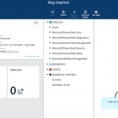
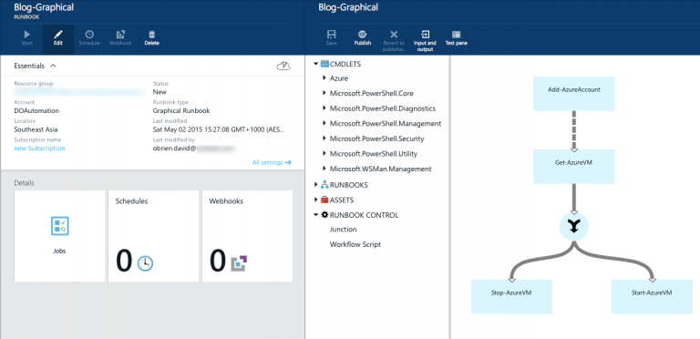
Desired State Configuration
Built-in integration with on-premises systems and PowerShell DSC nodes
Run Azure Automation runbooks on-premises
Automation accessible via new REST API (including GitHub, VSO and ARM)
Graphical workflow-authoring tool
Runbook Management from the new Microsoft Azure portal
12-12
Notes:
20535A
12: Monitoring & Automating Azure Solutions

Slide 47





Hybrid Runbook Worker
An on-prem server running MS Mgmt Agent
Executes runbooks downloaded from AA
Reports results back to AA and OMS
Can be deployed in groups for high availability
Requires no ports (outside-in)
On-premises
Runbook Environment
Azure Automation
Microsoft Mgmt Agent
Operations
Management Suite
Hybrid Runbook Worker
12-12
Notes:
20535A
12: Monitoring & Automating Azure Solutions

Slide 48




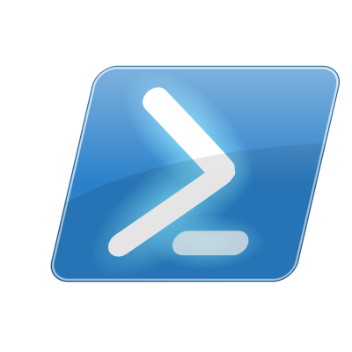

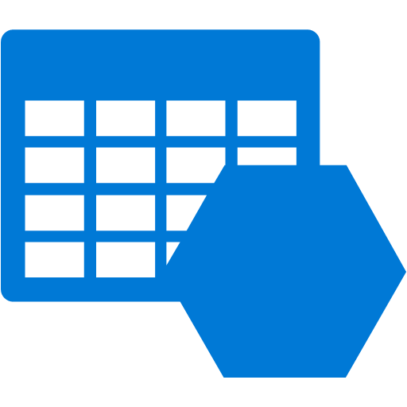
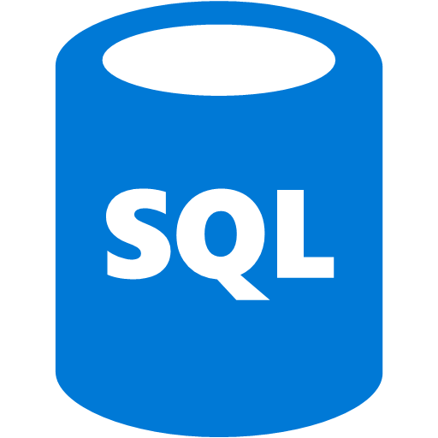

Automation Flow
A
Azure Portal
Azure Automation Runbooks
Webhooks
PowerShell
Alerts
Run actions against Azure Resources
12-12
Notes:
20535A
12: Monitoring & Automating Azure Solutions

Slide 49
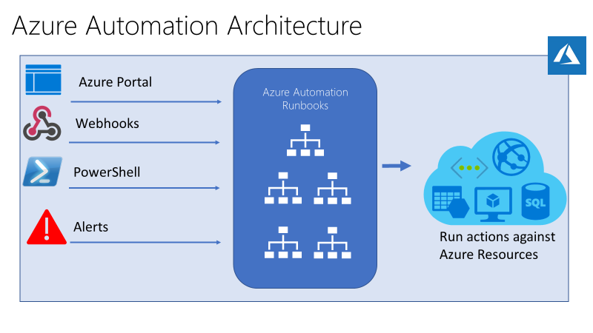
Automation Flow
Run actions against on-premises running Resources, using Hybrid runbook worker group
12-12
Notes:
The following image illustrates detailed step-by-step process in the life cycle of a runbook. It includes different ways a runbook is started in Azure Automation, components required for Hybrid Runbook Worker to execute Azure Automation runbooks and interactions between different components. To learn about executing Automation runbooks in your datacenter, refer to hybrid runbook workers.
Very similar in architecture than the previous one, this design emphasizes once more the flexibility and control you have to manage and run configuration scripts across multiple clouds.
20535A
12: Monitoring & Automating Azure Solutions

Slide 50

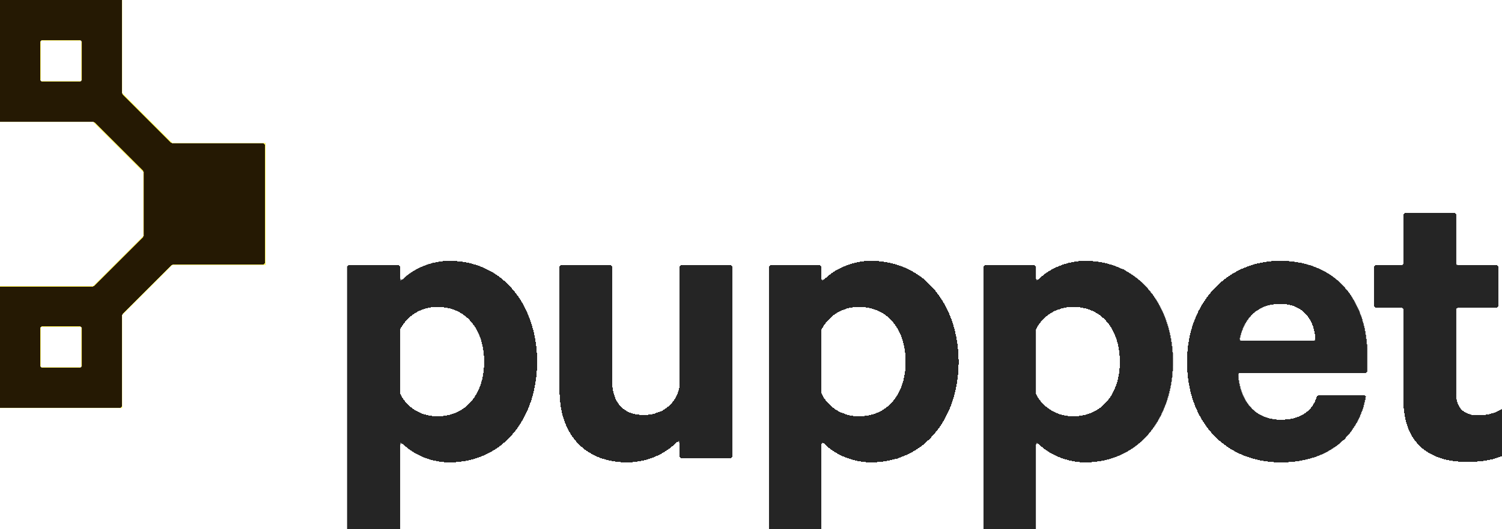
Configuration Management
Provision/ Manage Infrastructure
Bootstrap Agents
Customize VM
12-13
Notes:
20535A
12: Monitoring & Automating Azure Solutions

Slide 51
Chef
Chef is a configuration management tools for deploying & managing infrastructure and applications
Key Capabilities:
Infrastructure as code
Declarative interface to resource
Policy based configuration management
Notes:
20535A
12: Monitoring & Automating Azure Solutions

Slide 52
Puppet
Puppet is a configuration management system that allows you to define the state of your IT infrastructure, then automatically enforces the correct state
Key Capabilities:
Supports easy to read declarative language
Enforces desired state on the system
Puppet Forge supports many ready to use modules
12-13
Notes:
Puppet is a configuration management system that allows you to define the state of your IT infrastructure, then automatically enforces the correct state.
Key Capabilities:
Supports easy to read declarative language.
Enforces desired state on the system.
Puppet Forge supports many ready to use modules.
20535A
12: Monitoring & Automating Azure Solutions

Slide 53
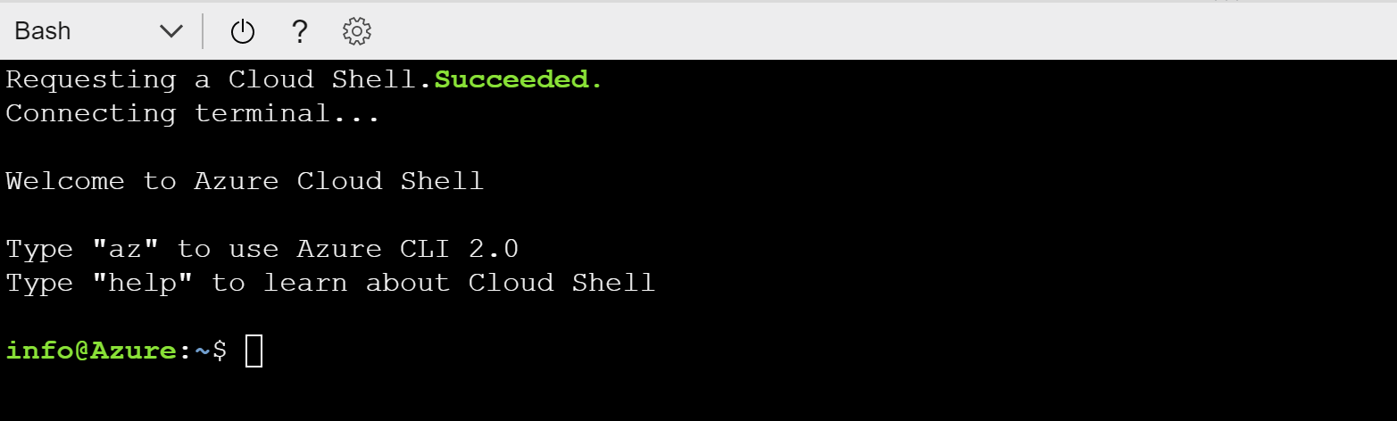
Cloud Shell
Authenticated shell access to Azure from virtually anywhere (browser)
Choice of shell experience that best suits the way you work:
PowerShell or Bash CLI
Common tools and programming languages included that’s updated and maintained by Microsoft
Persist your files across sessions in attached Azure File storage
12-13
Notes:
20535A
12: Monitoring & Automating Azure Solutions

Slide 54
Lab: Deploying Configuration Management Solutions to Azure
Exercise 1: Deploying a Chef Management Server using ARM Exercise 2: Configuring Management Server Exercise 3: Deploying a VM Scale Set using Chef-Configured VMs Exercise 4: Cleanup Subscription
Logon Information
Virtual machine: 20535A-SEA-ARCH
User name: Admin
Password: Pa55w.rd
Estimated Time: 90 minutes
Notes:
This lab assumes that students have their own Azure subscriptions that do not contain any existing cloud services, storage accounts, or Azure SQL Database servers.
Azure is continually improving, so the user interface might have been updated since this lab was written. Before students start the lab, make them aware of any differences between the steps described in the lab and the current user interface.
Exercise 1: Deploying a Chef Management Server using ARM
Exercise 2: Configuring Management Server
Exercise 3: Deploying a VM Scale Set using Chef-Configured VMs
Exercise 4: Cleanup Subscription
20535A
12: Monitoring & Automating Azure Solutions

Slide 55
Lab Scenario
A cutting-edge insurance organization would like to create multiple virtual machines to process insurance claims. Today, those virtual machines are managed in the organization’s datacenter using Chef. The client has reached out to you to create a prototype solution where the machines are created automatically and have the Chef agent and configuration installed as part of the automatic deployment.
Notes:
20535A
12: Monitoring & Automating Azure Solutions

Slide 56
Lab Review
Do you find it easier to use PowerShell DSC or Chef to configure a VM in a VM Scale Set?
Notes:
Question
Do you find it easier to use PowerShell DSC or Chef to configure a VM in a VM Scale Set?
Answer
The answer will depend wildly based on the respondent. If the respondent likes to write code, then the Ruby in Chef recipes will be easier to follow. If the respondent prefers to write scripts, then the PowerShell for DSC will be more familiar.
20535A
12: Monitoring & Automating Azure Solutions

Slide 57
Module Review and Takeaways
Review Question
Notes:
Review Question
Question
What questions would you ask your IT team before you design a backup solution for your organization?
Answer
Answers may include:
How often do you restore from backups?
What data is considered “high priority” for backup?
How long should your data be retained?
What is your service-level agreement (SLA) for restoration from backup after a data or system failure?
Do you have long-term data that requires little to no access?
20535A
12: Monitoring & Automating Azure Solutions

Slide 58
Course Evaluation
Your evaluation of this course will help Microsoft understand the quality of your learning experience.
Please work with your training provider to access the course evaluation form.
Microsoft will keep your answers to this survey private and confidential and will use your responses to improve your future learning experience. Your open and honest feedback is valuable and appreciated.
Notes:
Remind students to complete the course evaluation.

