Slide 1
Java 8 parallel streams
Ethan Williams
Notes:
I’m Ethan and today I’m presenting on parallel streams in Java, which was introduced to make it easy for developers to take advantage of concurrency in their applications.

Slide 2
Topics
How to utilize parallel streams
Overview on how they work
Explanation of Spliterator
Explanation of Collector
Common mistakes

Slide 3
HOW TO UTILIZE THEM it’s easy
Serial Stream
Parallel Stream
Notes:
And they did a really good job at it. The serial stream simply prints off the name off all Person objects who have a job. Making this run in parallel is as easy as adding the parallel method(). After this the developer gives up responsibility for threading to the JVM.

Slide 4

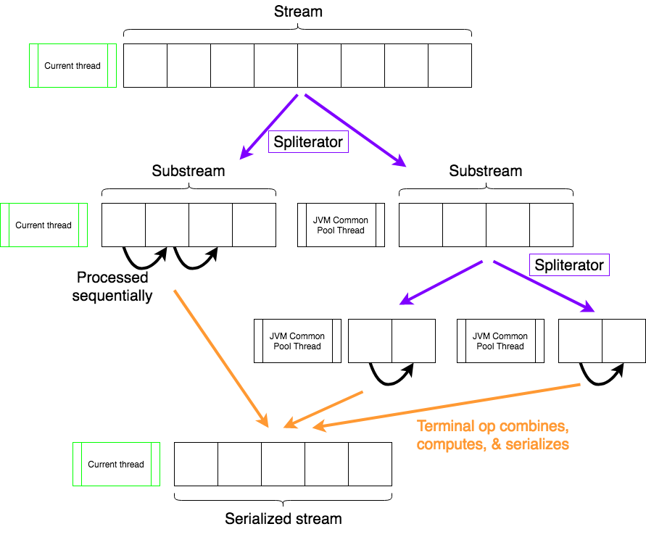
How they work
Stream is broken up by the Spliterator into substreams
Extra substreams are handed to ForkJoinPool.common()
Each substream is processed like a singular serial stream
JVM combines all substreams together to serialize the stream
Notes:
When the JVM gets a parallel stream it uses an object called a Spliterator to break up the full stream into substreams that all assume responsibility for a part of the original stream. Note that a substream is not actually a new Stream object but just references a part of the original Stream, the reason will be explained shortly. Each new substream that is broken off is processed by a different thread from the common fork join pool. The new thread can either split again or start to process elements. Once each substream is finished processing they are assembled together into the final data form.

Slide 5
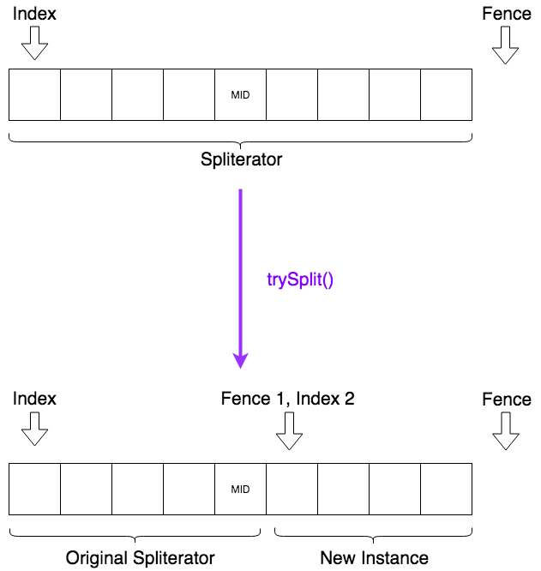
Spliterator
”Split + iterator”- Used to traverse and split substreams
Traverses via tryAdvance() or forEachRemaining()
Can split itself into two spliterators via trySplit()
Contains same characteristics as a Stream

Slide 6
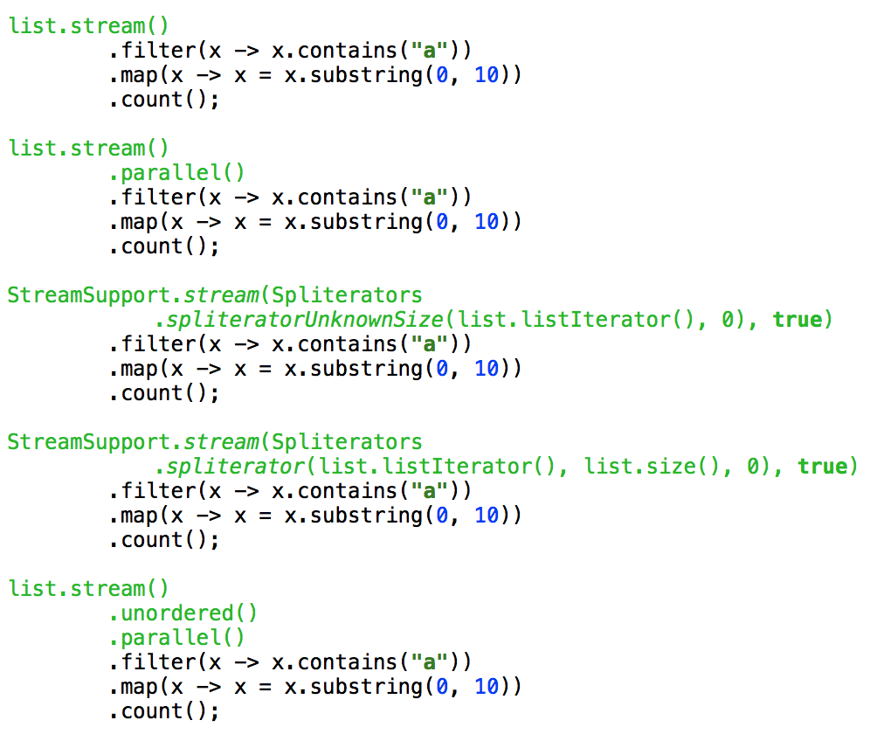
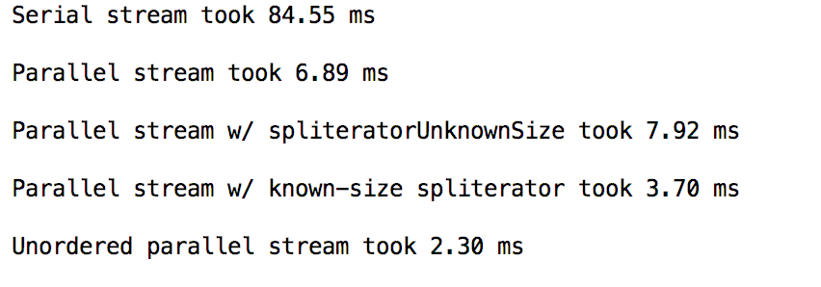
Spliterator Continued
Run on random 10,000 String list

Slide 7
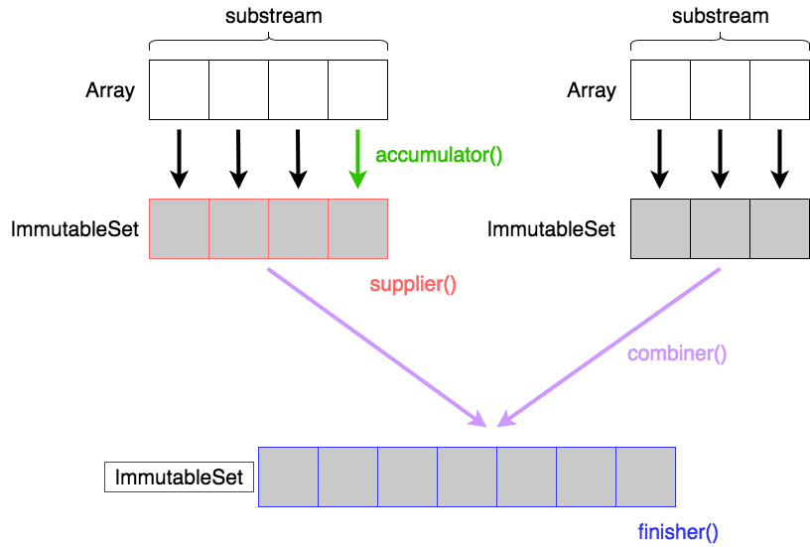
Collector
Defines a mutable reduction operation for a stream
Functionality derived from 4 main functions
Main reduction operation for parallel streams
Contains same characteristics as Spliterator

Slide 8
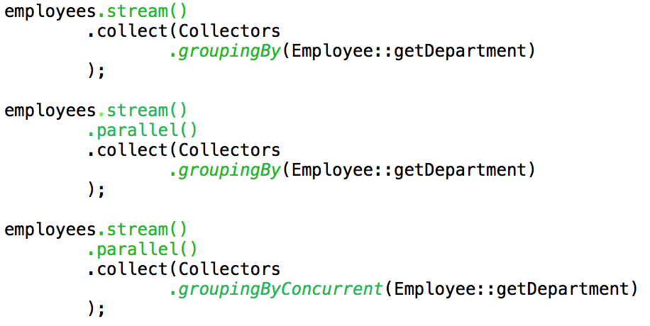
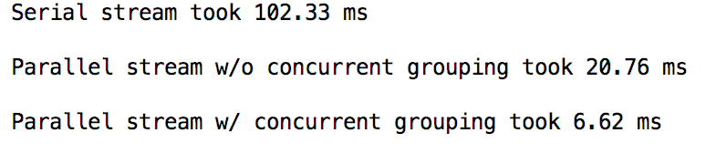
Collector Continued
Run on 26,000 Employee array

Slide 9
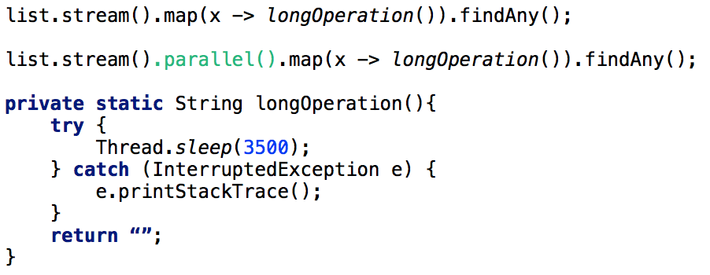

Practical Considerations Long-Running/Blocking operations
Run on random 10,000 String list

Slide 10
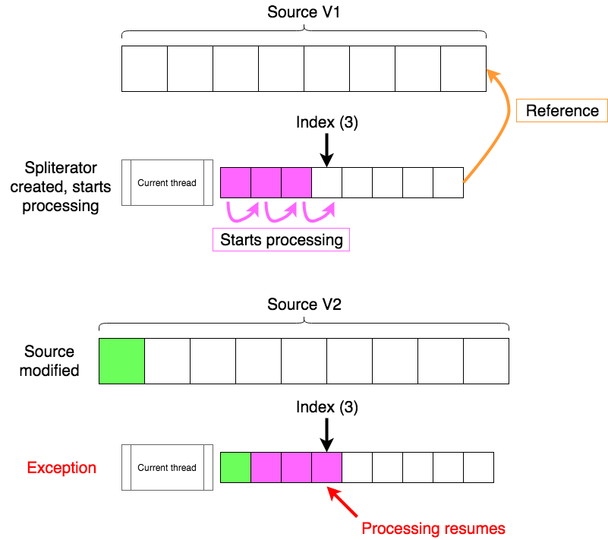
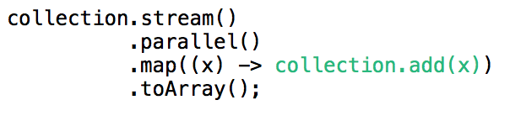
Practical Considerations interference

Slide 11
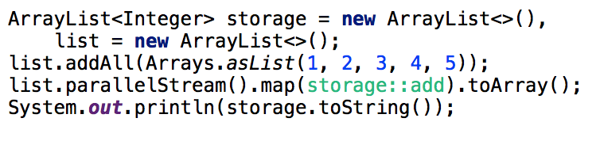
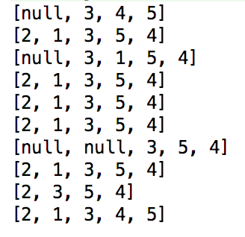
Practical Considerations Stateful Expressions
Run in 10 interation loop

Slide 12
conclusion
Using parallel streams is dope
They’ll also help you improve performance
Don’t make mistakes
Questions?

