Slide 1
Java 8 parallel streams
Ethan Williams

Slide 2

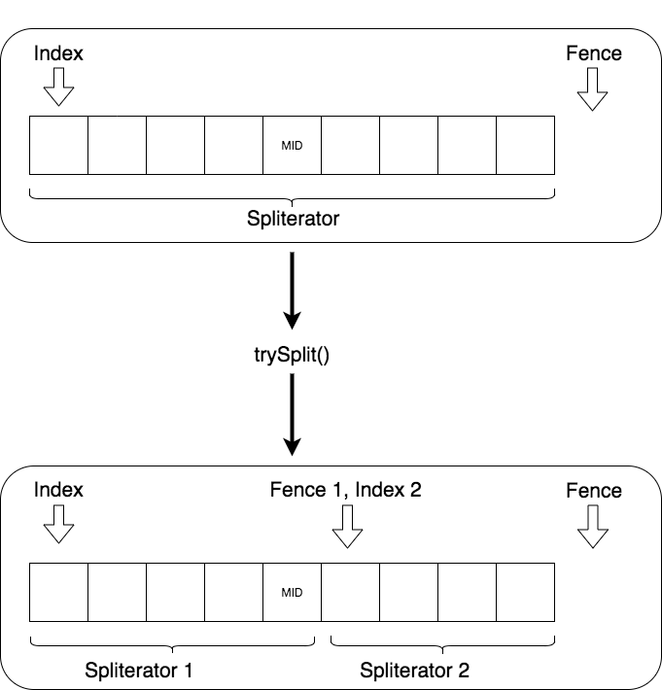
Spliterator
”Split + iterator”
Has backing list, current index in list, fence, and expected mod count
Traverses via tryAdvance() or forEachRemaining()
Can split itself into two spliterators via trySplit
Contains same characteristics as a Stream (ORDERED, DISTINCT, SORTED, SIZED, NONNULL, IMMUTABLE, CONCURRENT, SUBSIZED)

Slide 3
Collector

