Slide 1
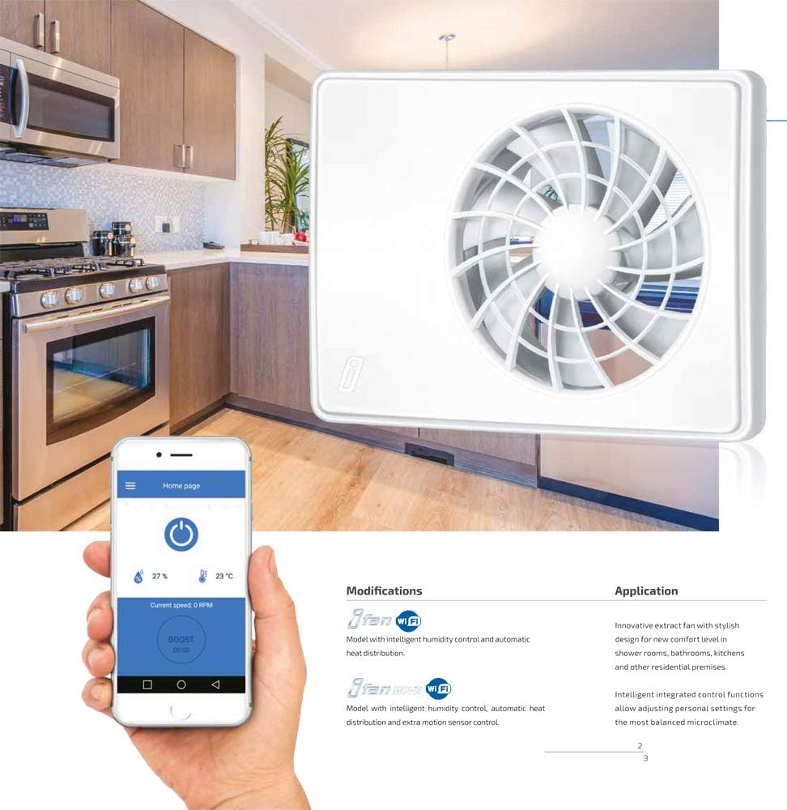
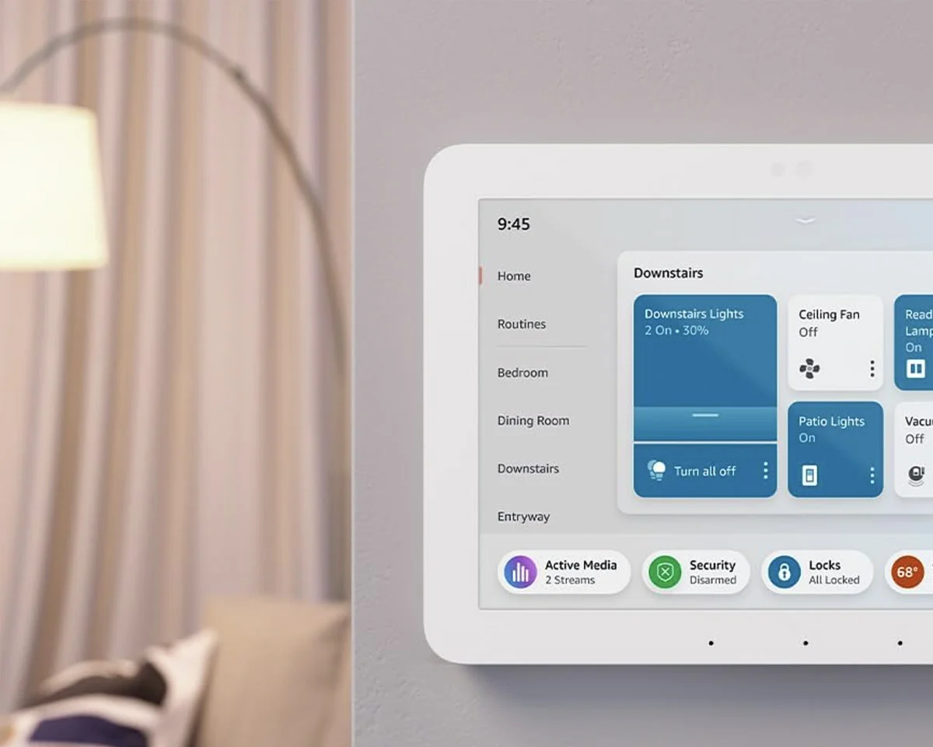
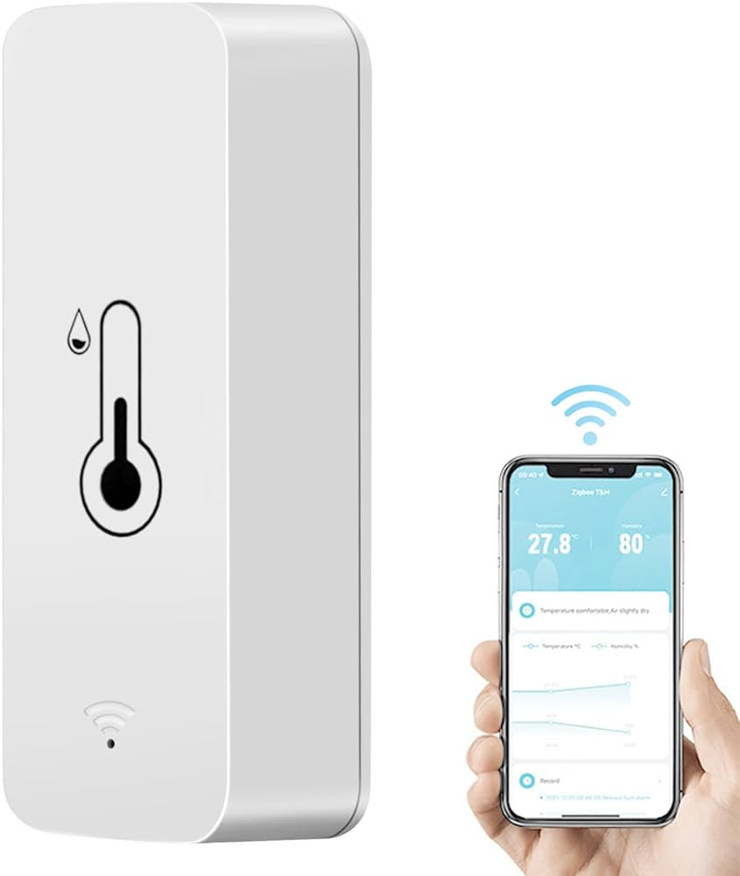
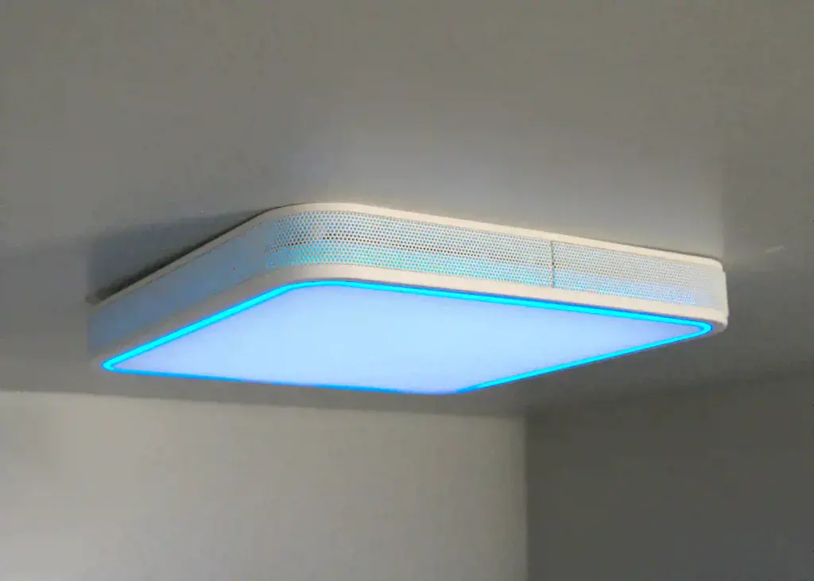
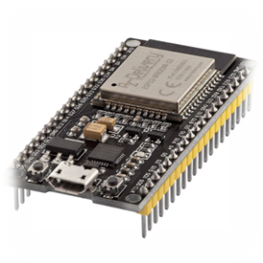
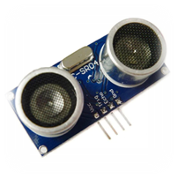
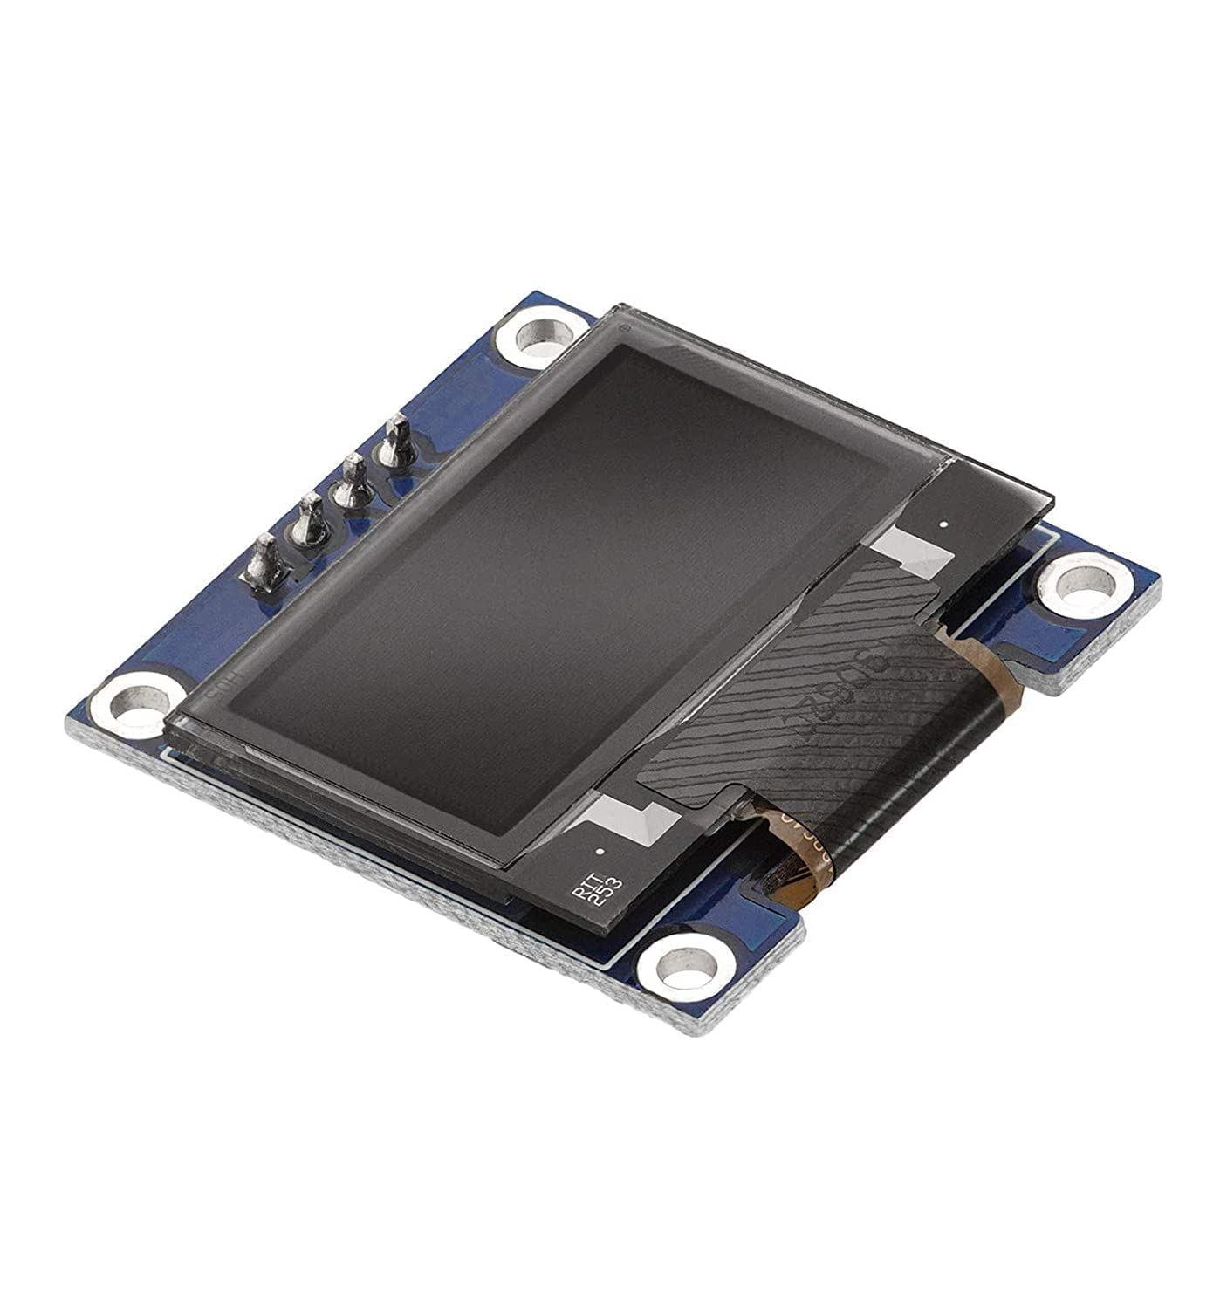
INTERNET OF THINGS COMP 6570: SMART FAN
These smart extractor fans are designed with advanced technology, including features such as wifi, bluetooth, mobile app integration and automatic humidity sensors. Perfect for bathrooms, kitchens, laundry rooms, utility rooms and more. Say goodbye to manual adjustments with a smart bathroom fan.
Using smart humidity detector to track climate in users' home, will be able to monitor conditions from their phone. Humidity and temperature impacts personal health. Features are high-accuracy sensors, instant app alerts.
An ultrasonic motion sensor will be used to detect movement in its sensor so information can be displayed on the mirror. The reason for ultrasonic so it can take a rough measurement and not detect small pets (cats and dogs)
ESP32 will be used for retrieving the data from the internet and passing it onto the OLED display. This will allow the user to see the information displayed on the control panel for smart fan
For the information to be displayed the ESP will connect to the users Wi-Fi and be able to show up to date continuously
An OLED display so the information can be displayed from the Fire Beetle ESP32 - Ev

