Slide 1
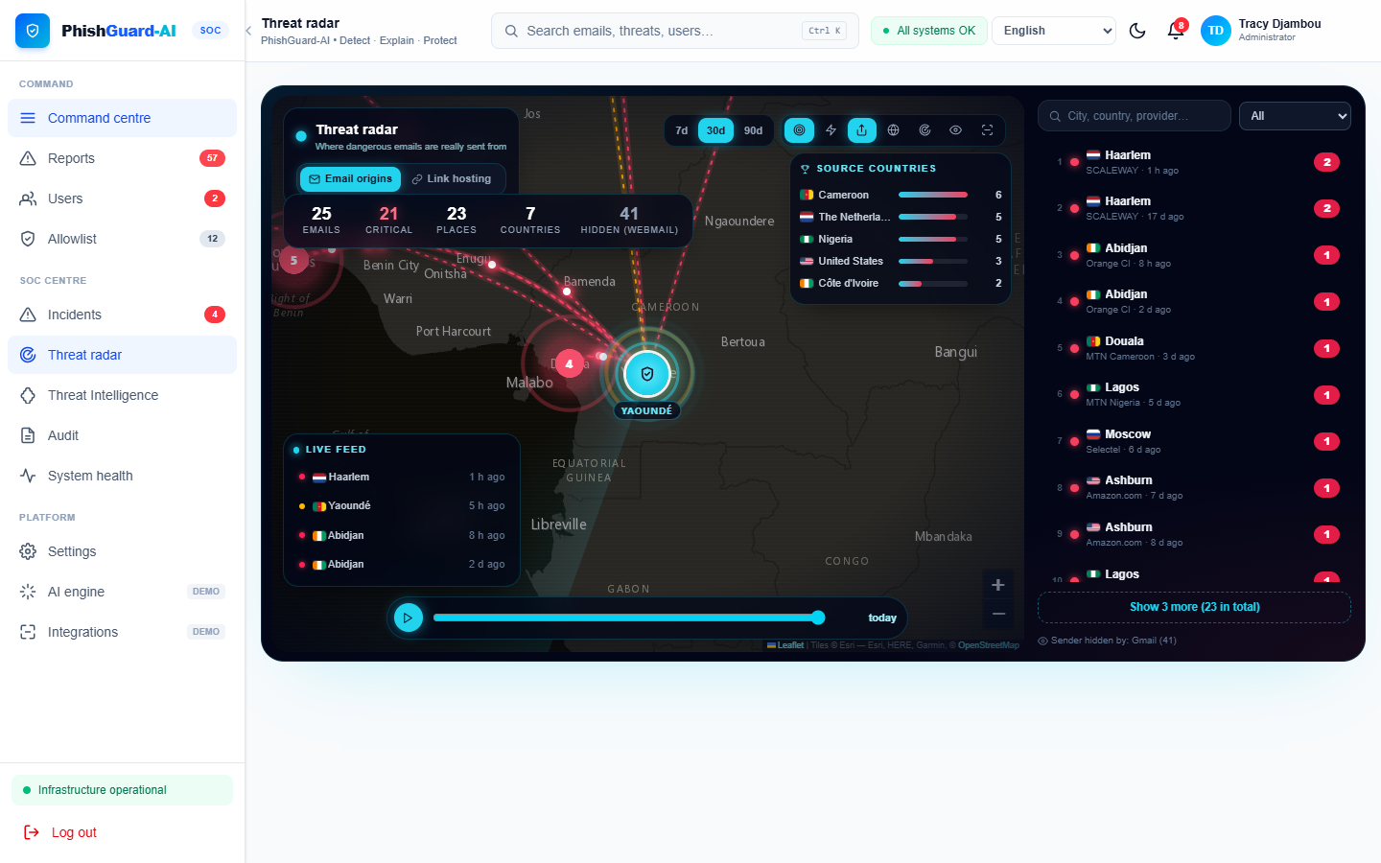
THE ICT UNIVERSITY · Faculty of ICT · BSc Cybersecurity
PhishGuard-AI
Design and Implementation of an AI-Based Platform for Phishing Detection and Cybersecurity Awareness in Cameroon
DJAMBOU NOUBIBOU Lareine Tracy
ICTU20234152
Supervisor: Eng. NEBASI Brayan
Academic year 2025/2026
1
Notes:
Good morning honourable members of the jury. My name is DJAMBOU NOUBIBOU Lareine Tracy, and I present PhishGuard-AI, a platform that detects phishing messages targeting Cameroonians and teaches them to recognise scams, supervised by Eng. NEBASI Brayan.

Slide 2
Outline
1
2
3
4
Context & problem
Objectives & questions
Literature & gap
Methodology
5
6
7
8
Design
Implementation (demo)
Testing & results
Limits & next steps
2
Notes:
The presentation follows the structure of my dissertation: context, objectives, literature, methodology, design, implementation with a demonstration, results, and finally the limits and next steps.

Slide 3
Phishing in Cameroon has a local face
Mobile money, French-language lures, SMS and WhatsApp
!
MoMo suspension
"Your account will be blocked in 24h, confirm your PIN on…"
Why existing tools fail
Built for English corporate e-mail
Blind to messages with no link
Block without explaining
No local view of campaigns
!
Fake relative
"Mum, I changed number, send 25 000 FCFA urgently"
!
ENEO bill
"Unpaid bill, power cut today at 5 p.m."
!
Bank alert
"Afriland: suspicious activity, log in at afriland-secure…"
!
Prize / job
"You won 500 000 FCFA, pay 5 000 FCFA fees"
3
Notes:
Phishing in Cameroon mostly looks like this: fake mobile money suspensions, the fake relative who changed number, fake ENEO bills, fake bank alerts and prizes. Many contain no link at all. The tools that exist were built for English corporate e-mail, they ignore messages without links, and they block without explaining, so the user learns nothing.

Slide 4
Problem and objectives
Problem: no accessible, explainable and context-aware tool lets Cameroonian citizens check a suspicious message and learn from it.
1
2
3
4
Hybrid engine
Multi-channel platform
Awareness
Secured SOC
F1 ≥ 0.85, false alarms < 15 % on held-out local messages
Text, link, screenshot, e-mail, mailbox; median < 10 s
Highlighted cues, actions, quiz
Approval, triage, incidents, radar, audit, sudo
General objective: design, implement and evaluate an AI-based web platform that detects phishing targeting Cameroonians and raises their awareness.
4
Notes:
The problem is the absence of an accessible, explainable and locally adapted tool. My general objective is to design, implement and evaluate such a platform. It has four SMART specific objectives: a hybrid detection engine with F1 of at least 0.85 and fewer than 15 percent false alarms; a multi-channel platform answering in under 10 seconds; an awareness component; and a secured administration and security operations module. Each objective maps to one research question.

Slide 5
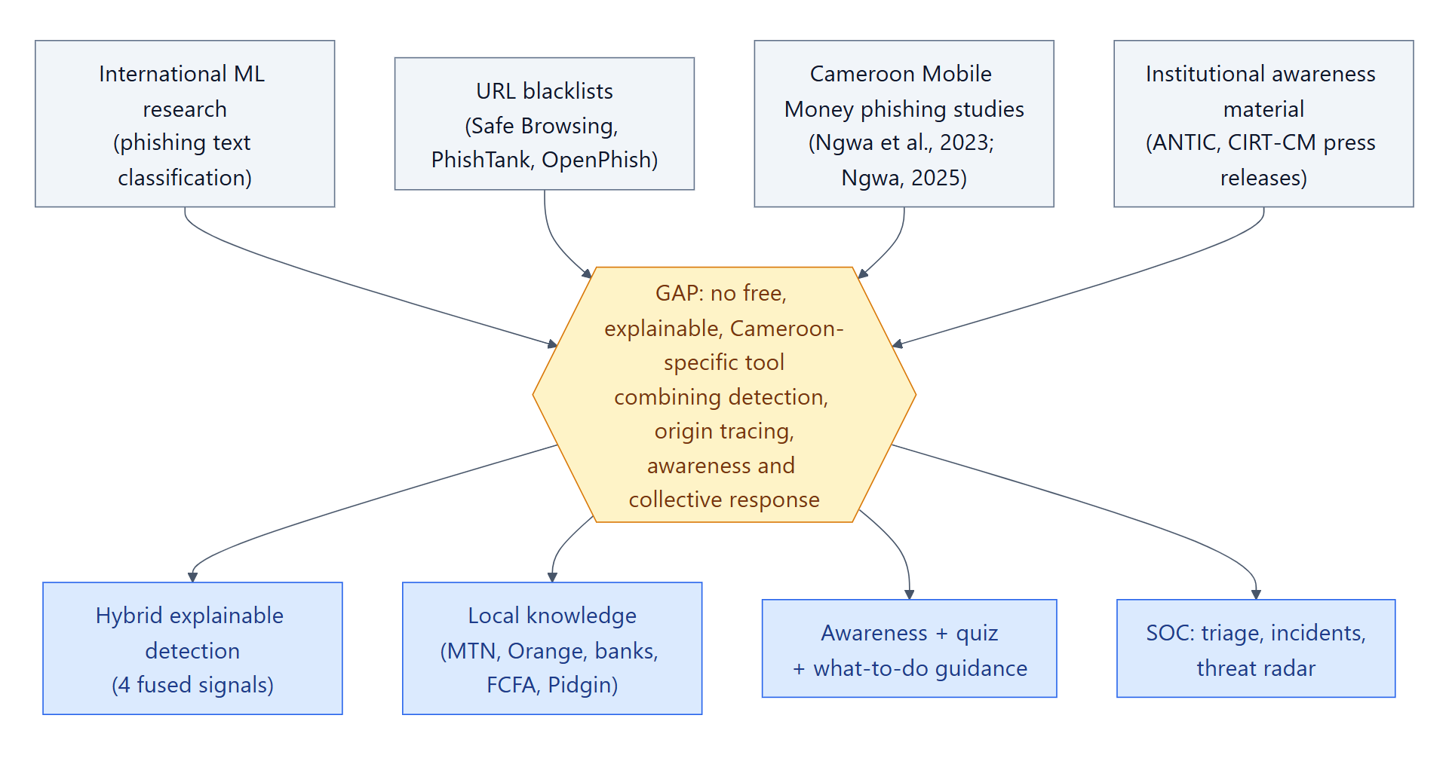
What the literature says
Each technique alone has a blind spot
•
Blocklists
Precise but late; useless without a link
•
Rules
Explainable; recall only 6 % in our tests
•
Machine learning
Fast, high recall; over-reacts (32 % false alarms)
•
LLM (Claude)
Understands intent; slow, external, costly
5
Notes:
The literature shows that blocklists arrive late, rules catch only what their authors foresaw, machine learning depends on its data and raises false alarms, and language models are slow and external. Awareness research, notably Kumaraguru and Sheng, shows that training is most effective when embedded at the moment of decision. The gap is a tool that combines all four signals, explains itself, targets local scams and aggregates reports into intelligence.

Slide 6
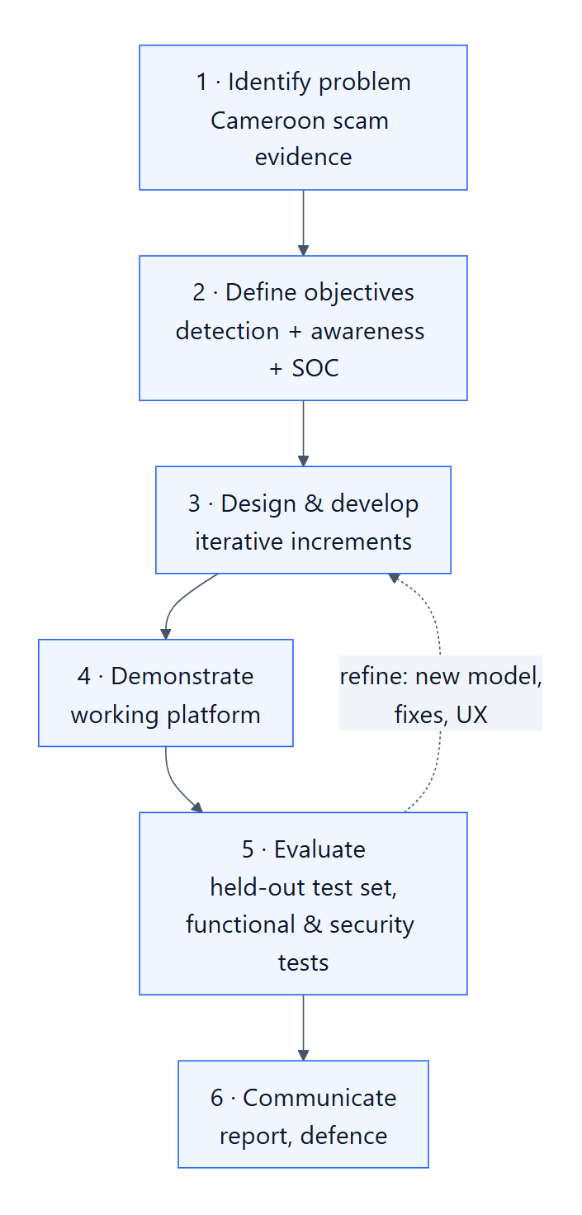
Methodology: Design Science Research
Peffers et al. (2007), four iterations
1 Foundation
API, database, authentication, first model
2 Pipeline
4 signals, fusion, e-mail parser, OCR
3 Platform & SOC
Visitor gate, dashboard, mailboxes, SOC
4 Intelligence
Origin tracing, radar, new corpus, evaluation
Corpus: 6 370 messages
586 Cameroonian train · 178 test (unseen templates) · 24 challenge · 5 574 UCI SMS · 8 admin labels. Grouped hold-out split: no near-duplicates between train and test.
6
Notes:
I used Design Science Research: the contribution is an artefact plus the knowledge from building and evaluating it. Development went in four iterations. Since no public Cameroonian corpus exists, I built one of 6,370 messages. The key choice is the grouped split: every variant of a template is either in training or in test, never both, so the model is not tested on copies of what it learned.

Slide 7
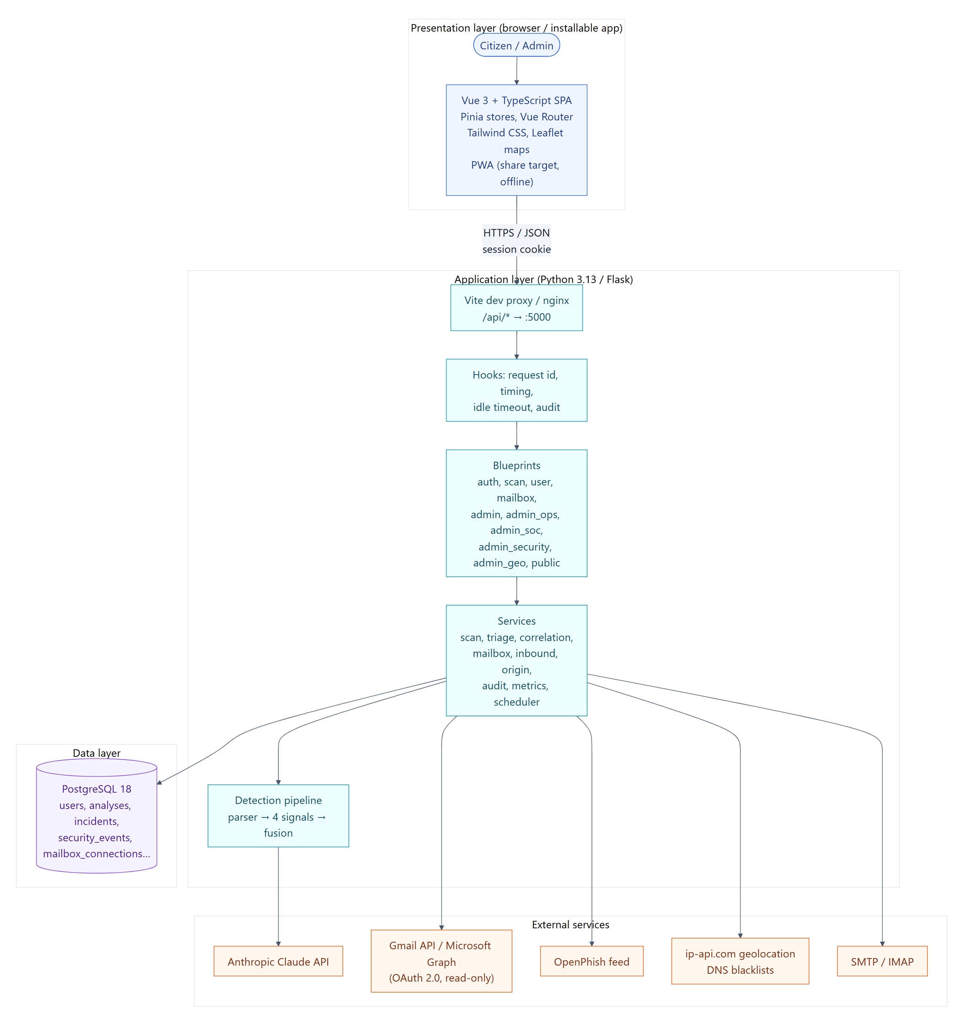
Architecture
Vue 3 + TypeScript single-page app, installable PWA
Flask REST API in blueprints; uniform JSON envelope
Services with one job each: scan, mailbox, triage, correlation, audit, origin
PostgreSQL 18 + model files
External: Claude, Gmail / Outlook, ip-api, DNSBL, OpenPhish
Background scheduler: sync, correlation, feeds, health
7
Notes:
The architecture has three tiers: a Vue 3 front end that is also an installable app, a Flask API organised in blueprints with small services each doing one job, and PostgreSQL. External services are called only by the back end, never by the browser.

Slide 8
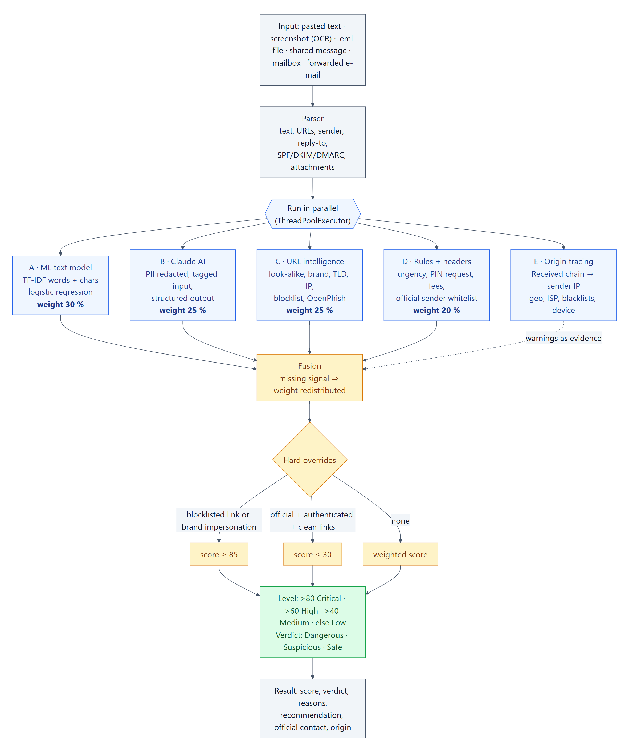
The heart: a four-signal detection pipeline
30 %
Text model
TF-IDF words + characters, logistic regression
25 %
Claude AI
Structured judgement on a redacted copy
25 %
URL intelligence
Look-alikes, TLD, shorteners, blocklist, XGBoost
20 %
Expert rules
PIN requests, fees, cut-off threats, headers
Missing signal → weight redistributed. Blocklist / brand spoof → ≥ 85. Official + authenticated + clean → ≤ 30. Levels: >80 Critical · >60 High · >40 Medium.
8
Notes:
Every input is parsed, then four signals run in parallel. The text model weighs 30 percent, Claude 25, URL intelligence 25 and the rules 20. If a signal is unavailable, for example no link or no AI, its weight is redistributed so the score stays comparable. Two hard overrides apply: a blocklisted link or a brand spoof forces at least 85; an official, authenticated sender with clean links is capped at 30. Every signal returns evidence, which becomes the explanation shown to the user.

Slide 9
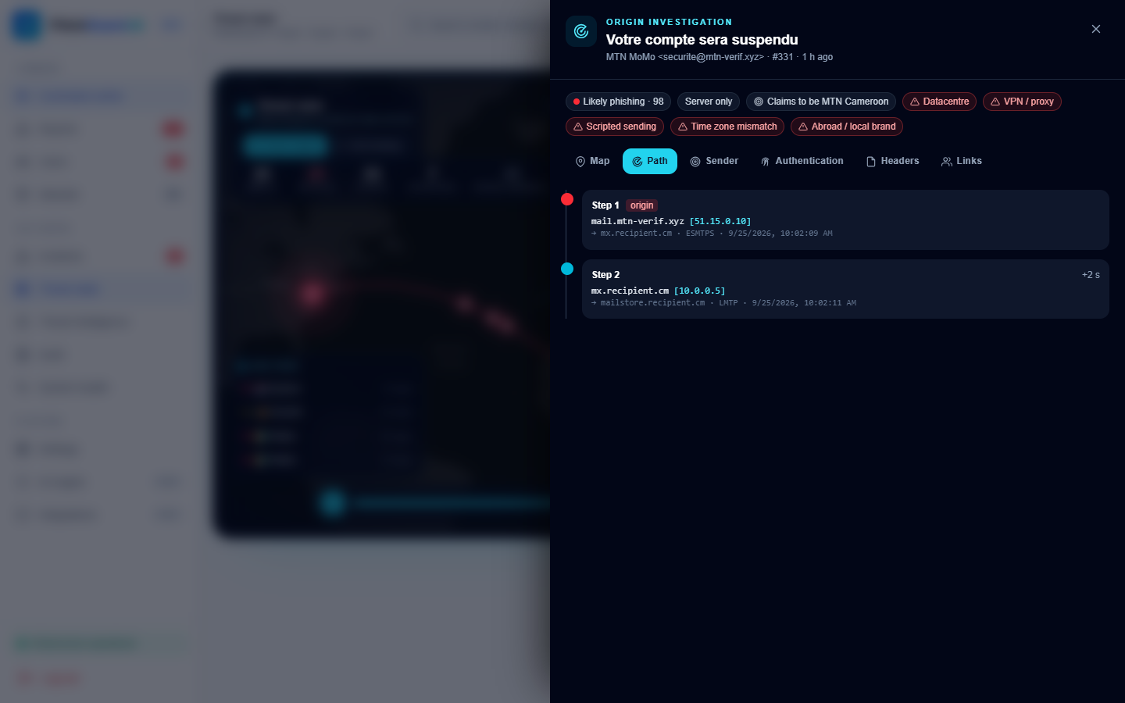
Where did this e-mail really come from?
Sender-origin tracing from the Received headers
Read the Received chain bottom-up → first public IP
Geolocate, reverse DNS, ASN, 3 DNS blacklists
Flags: datacentre, proxy, scripted mailer, foreign sender for a local brand, time-zone mismatch
Gmail hides the sender → reported as hidden, never mis-located
User sees a simple card; admin sees full path (audited)
9
Notes:
For e-mails, the platform reads the Received headers from the bottom to find the first public IP. It geolocates it, checks three blacklists and raises flags such as datacentre sender, scripted mailer, or a message claiming to be a Cameroonian bank but sent from abroad. When the sender used Gmail, the provider hides the IP, so we say "hidden" rather than showing a wrong location. Users see a simple card; administrators see the full path, and each view is audited.

Slide 10
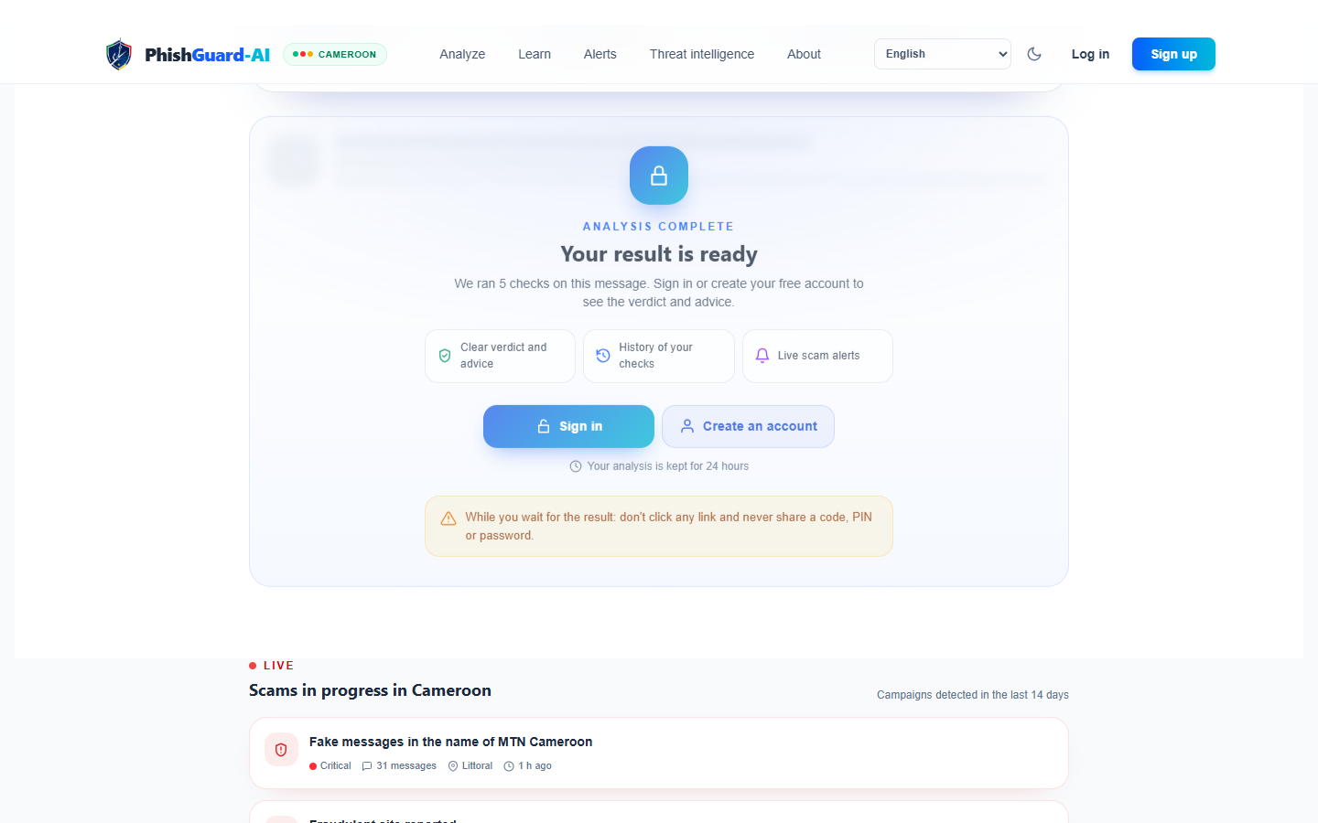
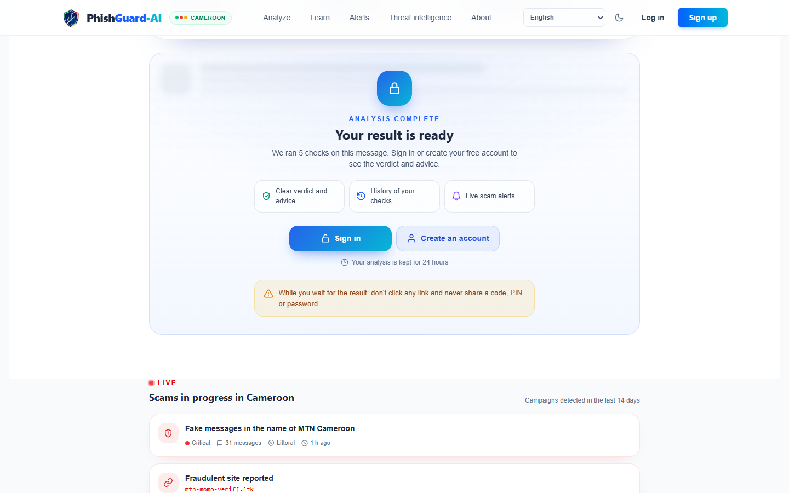
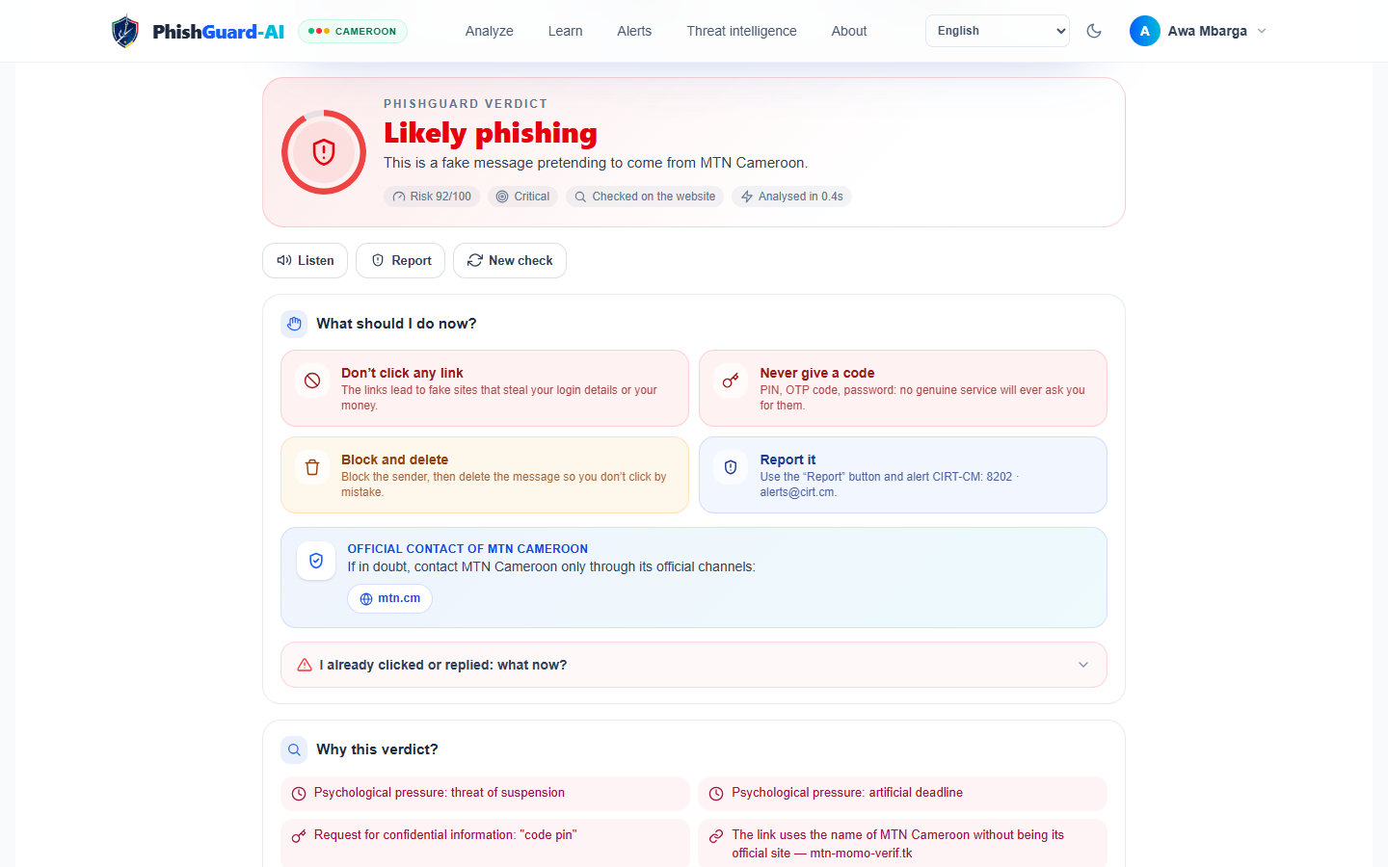
Citizen experience
Analyse first, reveal after sign-in, explain everything
1. Live analysis
2. Result gated
3. Explained verdict
Visitors never receive a verdict: only a single-use claim token (SHA-256 stored, 24 h), so scammers cannot test their messages anonymously.
10
Notes:
Here is the citizen journey. Anyone can paste a message; the four signals run live. A visitor then has to sign in to see the result: the server only returns a single-use token. This drives registration and prevents fraudsters from anonymously testing whether their scam passes. The result card highlights the suspicious words in the message itself and says what to do.

Slide 11
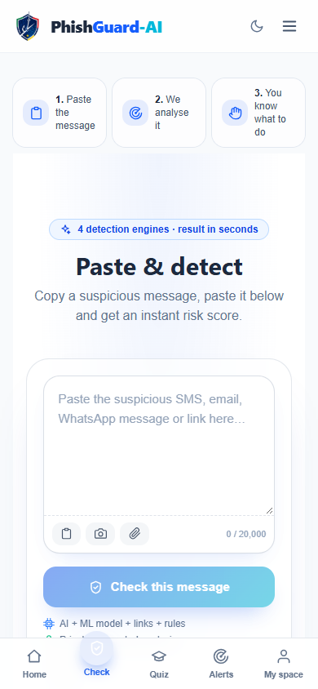
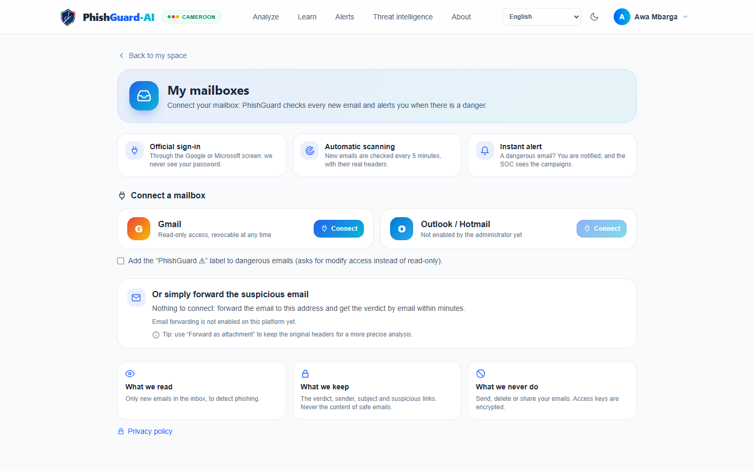
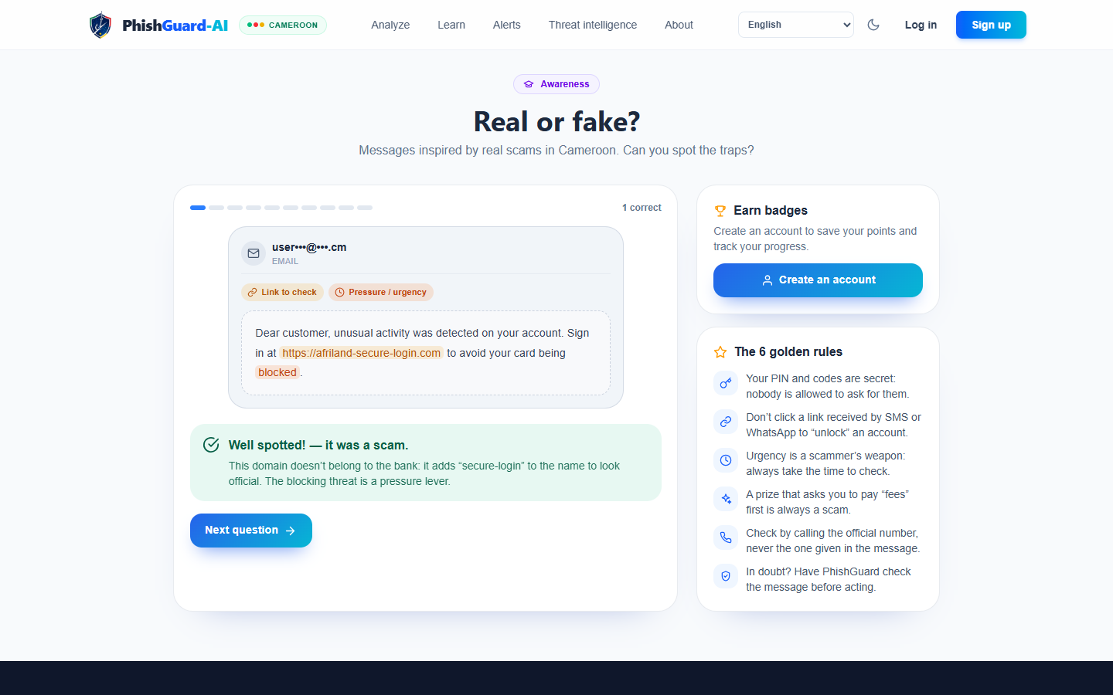
Multi-channel and awareness
Phone-first PWA, Android share target
Screenshot OCR in the browser
Gmail / Outlook read-only (OAuth), encrypted tokens
Forward-to-PhishGuard address
Quiz on local scams, read-aloud, FR / EN
11
Notes:
The platform follows people where scams arrive: a phone-first installable app that appears in the Android share menu, screenshot reading on the device, read-only connection of Gmail or Outlook with encrypted tokens, and a forwarding address. The Learn page offers a quiz built on real Cameroonian scenarios.

Slide 12
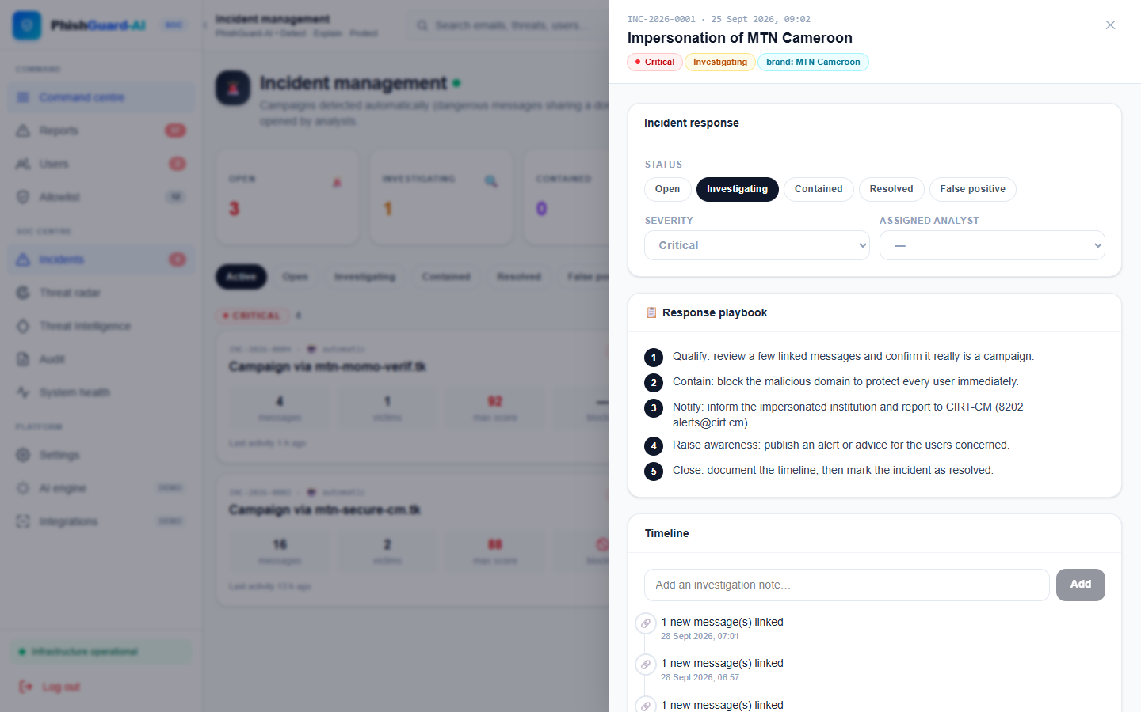
Security operations for administrators
From individual reports to collective intelligence
Risk-scored sign-ups · review queue with AI triage · incident correlation → blocklist · threat radar · system health · audit log · sudo mode
12
Notes:
Administrators get a small security operations centre. Risky sign-ups are held for approval, user reports enter a review queue with a triage suggestion, dangerous messages sharing a domain or brand are correlated into incidents that feed the blocklist, and the threat radar shows where attacks come from. Sensitive actions require sudo mode and everything is audited.

Slide 13
Securing the platform itself
✓
✓
✓
✓
Least privilege
Read-only mail scopes; roles
Fail-safe defaults
No verdict for anonymous callers
Complete mediation
Session re-checked every request
Separation of privilege
Sudo mode for admin actions
✓
✓
✓
✓
Accountability
Every security event audited
Data minimisation
Safe e-mails: subject only
Secrets
bcrypt, Fernet, env-only keys
Revocation
session_version: sign out everywhere
13
Notes:
A platform that stores messages and mailbox access is itself a target, so I applied Saltzer and Schroeder principles and privacy by design: read-only scopes, no verdicts for anonymous users, sessions revalidated at every request, sudo mode, a full audit log, minimal storage, bcrypt and encrypted tokens, and global sign-out. Twelve security test cases including SQL injection, XSS, token replay and privilege escalation all passed.

Slide 14
Results on unseen Cameroonian messages
Flagged = score > 40
0.939
F1 with AI (n = 40)
10.6 %
false alarms, no AI (was 31.9 %)
10 ms / 7.2 s
median latency offline / with AI
14
Notes:
On 204 unseen Cameroonian messages, the text model alone catches 99 percent of scams but raises false alarms on almost one genuine message in three. Rules never raise false alarms but catch only 6 percent. Fusion without AI cuts false alarms to 10.6 percent with F1 0.85; adding Claude raises recall to 0.96 and F1 to 0.94 on a 40-message sample. Median latency is 10 milliseconds offline and 7.2 seconds with AI. All four objectives are met on this technical evaluation.

Slide 15
Honest limits and next steps
Where it still fails
Scams with no link and no brand ("fake relative", "fake agent"): scores 35–40, just under the threshold
Corpus partly synthetic (templates)
AI measured on 40 messages only
No field acceptance study yet; no load test
Gmail senders cannot be located
Next steps
Collect real labelled messages via the review queue, retrain
Rules for money requests from "new numbers"
User study with 30 participants (questionnaire ready)
Partnership with CIRT / operators for feeds and takedowns
WhatsApp bot and USSD channel
15
Notes:
I want to be transparent about the limits. The remaining misses are scams with no link and no brand, like the fake relative, which score just below the threshold; this is exactly where the AI helps. The corpus is partly synthetic, the AI was evaluated on 40 messages, and the user study is designed but not yet run. Next steps: retrain on real reviewed messages, add rules for money requests from new numbers, run the user study, and partner with CIRT and operators.

Slide 16
Thank you
PhishGuard-AI detects, explains and teaches — built for the scams Cameroonians actually receive.
4 / 4
0.939
12 / 12
43
objectives met
F1 with AI
security tests passed
figures in the report
Questions from the jury are welcome.
16
Notes:
To conclude: PhishGuard-AI detects, explains and teaches, and it was built for the scams Cameroonians really receive. The four objectives are met on the technical evaluation, and the next step is to validate it with real users. Thank you for your attention; I am ready for your questions.

