Slide 1
Airframe-linked Systems
April 4-8, 2011
Notes:
I – Principles of straight and steady level flight
Rev 3 –Aug 05
I - <number>

Slide 2
Cabin Atmospheric Control System
By: LIU Yanhong

Slide 3
Summary
GENERAL POINTS
  Introduction
  General Specification
  Standard Atmosphere
AIR GENERATION
AIR CONDITIONING
  Heating System
  Cooling System
  Temperature Regulation
  Cabin Pressurization System
Oxygen System

Slide 4
1.GENERAL POINTS

Slide 5
Introduction
Flight envelope of aircraft covers large conditions:
  Cruise altitude:
    about 40,000 feet (12km) for subsonic commercial aircraft
    about 60,000 feet (18km) for supersonic aircraft
  The temperature (about -50℃) and the pressure (lower than 200 mbar) are too low to allow human life.
  Speeds: subsonic/supersonic
  Atmospheric conditions: from polar climate to tropical climate
(1ft=0.305m)

Slide 6
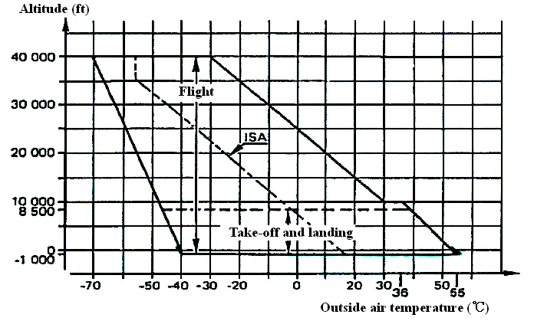
Altitude/temperature Domains
Notes:
I – Principles of straight and steady level flight
Rev 3 –Aug 05
I - <number>

Slide 7
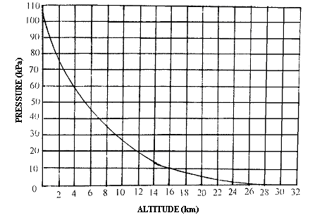
Pressure vs Altitude
101.325kPa

Slide 8
Introduction (cont.)
It’s necessary to condition the aircraft, that means to regulate the temperature and pressure in order to assure:
  for the crew: good working condition
  for passengers: optimal comfort
  for the on board electronics: right operation
  for the freight: preservation of animals and goods
The air conditioning is carried out by some systems including:
  the air bleed: air generation
  the air conditioning: cabin temperature control
  the pressurization: cabin pressure control

Slide 9
General Principle of Air Circuits
Outside Air
Air
bleed
Air
conditioning
Air
distribution
Cockpit
Cabin
Cargo holds
E/E bay
Pressurization
Outside

Slide 10
General Specification:
Certification Rules
For the CS-25 certification of a passenger transport aircraft the following paragraphs are applicable:
  25.831 ventilation:
    the minimum air flow (10 cfm per member of crew)
    the maximum rate of CO and CO₂(CO:one part in 20 000 parts of air, CO₂: 0.5% by volume)
    the means for the control flow/temperature
  25.841 pressurized cabin:
    the maximum cabin altitude (8,000ft for the normal conditions, 15,000ft in the case of failure)
    the equipment, the control means and indicators required
Notes:
I – Principles of straight and steady level flight
Rev 3 –Aug 05
I - <number>

Slide 11
General Specification:
Certification Rules (cont.)
  25.843 Tests for pressurized cabin:
    the strength tests and the functional tests to carry out
  25.1436 and 25.1438 Low pressure and high pressure pneumatic systems:
    the definition rules and pneumatic component tests.
  251461 Equipment containing high-energy rotors:
    the necessary protections in the case of rotor failure

Slide 12
CS 25.843 Tests for pressurized cabins
Strength test. The complete pressurized cabin, including doors, windows, and valves, must be tested as a pressure vessel for the pressure differential specified in CS 25.365 (d).
25.365(d) The aeroplane structure must be strong enough to withstand the pressure differential loads corresponding to the maximum relief valve setting multiplied by a factor of 1.33, omitting other loads.
(b) Functional tests. The following functional tests must be performed:
(1) Tests of the functioning and capacity of the positive and negative pressure differential valves, and of the emergency release valve, to simulate the effects of closed regulator valves.
(2) Tests of the pressurization system to show proper functioning under each possible condition of pressure, temperature, and moisture, up to the maximum altitude for which certification is requested.
(3) Flight tests, to show the performance of the pressure supply, pressure and flow regulators, indicators, and warning signals, in steady and stepped climbs and descents at rates corresponding to the maximum attainable within the operating limitations of the aeroplane, up to the maximum altitude for which certification is requested.
(4) Tests of each door and emergency exit, to show that they operate properly after being subjected to the flight tests prescribed in sub-paragraph (b)(3) of this paragraph.

Slide 13
General Specifications:
Thermal Comfort Rules
The air conditioning role is to maintain the environmental conditions ensuring the thermal comfort in the cabin. But the thermal comfort is an ambiguous notion. It depends on the environmental parameters:
  temperature of surrounding air
  average radiation temperature of the wall
  velocity and humidity of the air
  the physical activity and the clothes of the persons
The values of the optimum temperature are:
  surrounding temperature: between 20℃ and 26℃
  radiation temperature: the closed value of the surrounding temperature
  air velocity: <0.15m/s(heating); <0.25m/s(cooling)

Slide 14
General Specifications:
Thermal Comfort Rules (cont.)
  Humidity: the recommendations ask to keep humidity between 30% and 60%, but this criteria is very difficult to apply in aeronautics (risk of condensation on the cold structures and then corrosion).
  The lack of comfort can be caused also by an local heating or cooling (cold feet, hot head…) in order to reduce this risk it’s necessary to keep the vertical temperature gap lower than 3 ℃ between the feet and the head.

Slide 15
General Specifications:
Pressurization Comfort Rules
The pressurization role is to control the cabin pressure and its variations compatible with human physiology.
The regulation sets the maximum cabin altitude at 8,000ft (2,400m) in order to avoid of effects of oxygen lack. People are also sensitive to a fast variation of the ambient pressure: we can have pain at the sinus, ear infection…
Pressure variations of 500 SLFM (Sea Level feet per minute) (2.54m/s or 30Pa/s) in climb and 300 SLFM (1.5m/s or 18Pa/s) in descent are normally admitted as comfortable for the passengers.
sinus 鼻窦

Slide 16
General Specification:
Noise Comfort Rules
The air conditioning produces noise in the passengers cabin but it’s not the only source of noise. For instance the air flow through the aerator is another source: this noise doesn’t disturb the crew nor the passengers.
The acceptable limit value for an exposure to noise during some hours is 85dB(A).
Notes:
I – Principles of straight and steady level flight
Rev 3 –Aug 05
I - <number>
Aerator 通风机

Slide 17
General Specification:
Avionic Ventilation
The ARINC 600 specification defines the thermal environment conditions for the electronic equipment:
  Ambient temperature
    ground survival temperature: -55℃ up to 85℃; the equipment doesn’t have to operate at this temperature but to stay without damage
    working temperature during 30 min: -40℃ up to 70℃; they are the equipment starting conditions before the blowing becomes effective
    working temperature (ground and flight): -15℃ up to 65℃
    ground normal working temperature: 50℃
Notes:
I – Principles of straight and steady level flight
Rev 3 –Aug 05
I - <number>
Aeronautical Radio, Incorporated (ARINC),

Slide 18
General Specification:
Avionic Ventilation (cont.)
  Blowing air temperature
    operating limited time at 30 min: -40℃ up to 70℃
    continual operating (ground and flight): -15℃ up to 55℃
    normal continual operating: 40℃ (ground); 30℃ (flight)
  Depending on their thermal performances the equipment need a blowing or suction, or both.

Slide 19
Standard Atmosphere
In order to characterize with accuracy the performances of the systems, the specifications define a standard atmosphere: pressure and temperature for altitudes.
ISA DAY: (z:altitude in km)
  On the ground T(0)=15℃ (288.15K)
  (sea level) P(0)=1 013.25 mbar(101 325Pa)
  Rho(0)=1.225kg/m³
  From 0 to 11 km T=T(0)-6.5z
  (troposphere/对流层) p=p(0)(1-6.5z/288) exp 5.255
  Rho=Rho(0)(1-6.5z/288) exp 4.255

Slide 20
Standard Atmosphere (cont.)
From 11 to 25 km (stratosphere/同温层)
T = -56.5℃(216.65K)
Log(p11/p) = Log(Rho(11)/Rho)=(z-11)/14.6
HOT DAY, X-HOT DAY, COLD DAY, X-COLD DAY:
The pressure law is the same but the temperature law is different.
For the humidity there is also a specification which defines the humidity in relation with the altitude.

Slide 21
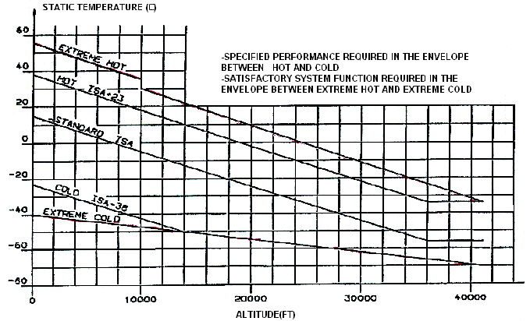
Temperature as a Function of Altitude

Slide 22
AIR CONDITIONING SYSTEM FUNCTIONS
to control flight deck and cabin temperature within a comfortable range, in heating and cooling modes
to provide adequate fresh air supply to occupants
to provide fresh ram air for cabin ventilation in case of loss of both ECS Packs and to ensure smoke evacuation function when required
to exhaust air from cockpit, cabin lavatory and galley areas
to ventilate the cockpit displays and ensure avionics bay ventilation
to provide sufficient air for the pressurization control

Slide 23
AIR CONDITIONING SYSTEM
PACK
CABIN
PRSOV
/
BLEED VALVE
FCV
/
PACK VALVE
TCV
AIR SOURCE
CHAMBER
PRESSURE CONTROLLER
Hc dPc/dt ΔPc
TEMP
CONTROLLER
SELECTOR

Slide 24
2.AIR GENERATION

Slide 25
Air Generation
The air source, for the aircraft conditioning is outside air. The air must be compressed in order to :
  increase the air density (from 0 to 90km air contents remain same: N₂ : 78%; O₂ : 21%; others : 1% - uniform aerosphere)
  produce an expansion in the cooling turbine
  pressurize the cabin
The means used to obtain the air are:
  air bleed from the compressors stage of engine
  air bleed from the APU
  ground power unit (on the ground)
In case of total loss in flight of the air generation an emergency scoop can be used to provide the cabin blowing (lower than 10,000ft).

Slide 26
Engine Air Supply
The airplane engines are the main source of pneumatic system air. On the turbo-jet and turboprop engine, the air is picked-up on the engine high stage compressor. The temperature of this air is about 450℃ up to 650℃ and the pressure can reach up to 35 bar. The values depend on the altitude and the engine rate.
Used primarily as inflight air source, a small amount of air is bled from the engine compressor section. This air is pressure and temperature regulated, and distributed to user systems.

Slide 27
Engine Air Supply (cont.)
Generally speaking, an engine air bleed is composed of:
two suctions on the engine
The IP with a check valve is used in the normal mode, the HP with pressure regulation valve is used when the IP pressure is too low. During low power engine operation, the HP ports supply compressed air. During high power settings, the IP ports do.
pressure regulation unit: with a valve regulating the downstream pressure to about 45psi
temperature regulation unit: precooler, an air/air heat exchanger, whose air is pick-up on the engine fan or dynamic outside.This air flow is regulated by an associated valve to a thermostat in order to obtain an air bleed temperature of about 200℃.
temperature and pressure probes: associated to the computer which ensures the monitoring,warning and safety functions.
Notes:
I – Principles of straight and steady level flight
Rev 3 –Aug 05
I - <number>

Slide 28
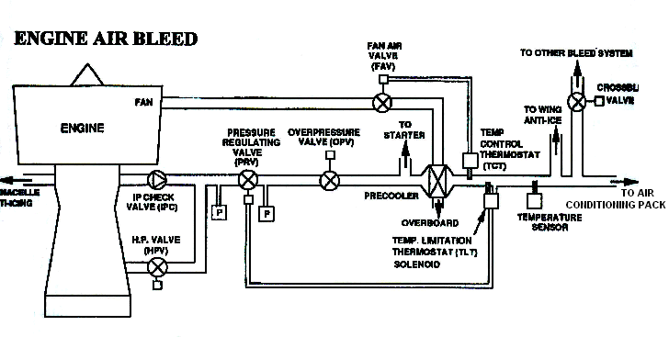
Notes:
I – Principles of straight and steady level flight
Rev 3 –Aug 05
I - <number>
IP(Intermediate Pressure) HP(High Pressure)
The IP check valve will not permit high stage air to be supplied to the intermediate bleed ports

Slide 29
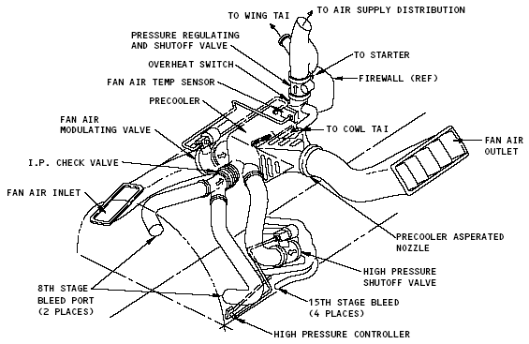
B767 ENGINE AIR SUPPLY SYSTEM

Slide 30
APU Air Bleed
The APU is a small gas turbine engine which allows the aircraft on the ground to be independent when the engines are shut down. It can be used also in flight. It provides:
On the ground:
  compressed air for the air conditioning and the starting of engine,
  electricity for the aircraft network.
In take-off:
  In the cases where the maximum performances are necessary (short runway, high temperature), the APU feeds air conditioning: so, no engine air bleed and no thrust reduction.
In flight:
  The APU constitutes an emergency system for the electricity and the pneumatic, with normally an altitude limitation.
  For B737-3/4/5, the APU can be used as an alternate bleed air source up to airplane altitudes of 17,000 ft.
Notes:
I – Principles of straight and steady level flight
Rev 3 –Aug 05
I - <number>

Slide 31
APU Air Bleed (cont.)
The components of APU bleed air system include:
  APU bleed air valve: shuts the APU bleed.
  APU check valve: protects the APU from engine bleed air flow.
  APU pressure relief valve: Its purpose is to vent off excess pressure in the pneumatic duct to prevent an overpressure condition which can cause the ducting to rupture. (75psi for B737-6/7/8, 80psi for B737-3/4/5)
Notes:
I – Principles of straight and steady level flight
Rev 3 –Aug 05
I - <number>

Slide 32
Ground Power Unit
When the aircraft is on the ground, the pneumatic power can be supplied by a ground power unit. Two types of use are possible:
High pressure power unit (HP):
  The air is used to start the engine or to supply the aircraft air conditioning units. The ground pneumatic connector check valve lets you connect an external source of compressed air to the pneumatic manifold. It prevents flow out of the manifold, and lets flow into the manifold.
Low pressure power unit (LP):
  The ground conditioned air connector lets an external source of conditioned air supply directly the cabin air distribution network. In this case it’s not necessary to use the aircraft air conditioning.

Slide 33
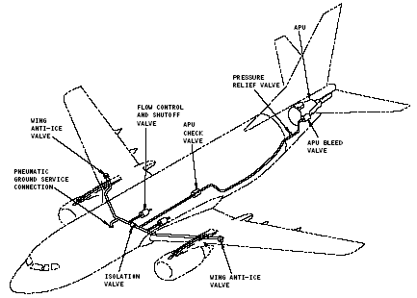
B737-3/4/5
Notes:
I – Principles of straight and steady level flight
Rev 3 –Aug 05
I - <number>

Slide 34
Emergency Ram Air
In case of total loss in flight of the air generation, the pilot can open an emergency scoop. The cabin air distribution circuit is then supplied by outside non-conditioned air.
This procedure requires that the pressure gap between the outside and inside of the cabin be low, that means that the aircraft is non-pressurized: this is only the case for flight altitude lower than 10,000 ft.

Slide 35
Users of Pneumatic System
On B747, the pneumatic or air supply system supplies temperature and pressure regulated air for the user systems. The air is used for:
  Airplane pressurization and environmental control system (ECS)
  Engine cowl and wing thermal anti-icing
  Engine starting
  Hydraulic pump operation (ADP) and reservoir pressurization
  Potable water tank pressurization.
  Wing leading edge flap drives (pneumatic motor)
Notes:
I – Principles of straight and steady level flight
Rev 3 –Aug 05
I - <number>
On B747, system 1 and 4 have air-driven pumps (ADP). The pneumatic system supplies power for the ADPs.
Wing leading edge flap drives by pneumatic motor for primary power.

Slide 36
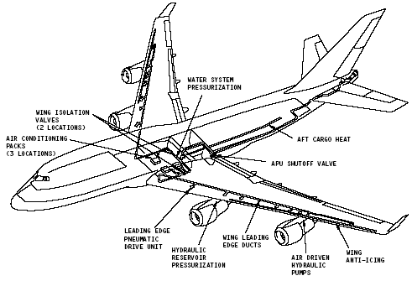
B747-400
Notes:
I – Principles of straight and steady level flight
Rev 3 –Aug 05
I - <number>

Slide 37
Bleed System of CRJ700/900
IPCV
HPV
UPSTREAM NACELLE COWL ANTI-ICE VALVE
PRSOV
ATS
FCV
BTS
PCE
CBV
UPSTREAM ECS COOLING PACKS
HASOV
DOWNSTREAM APU CHECK VALVE
DOWNSTREAM HP GROUND CONNECTION
UPSTREAM WING ANTI-ICE VALVE
AIR TURBINE STARTER
DOWNSTREAM ENGINE FIREWALL
LOW PRESSURE PORT
HIGH PRESSURE PORT
Notes:
I – Principles of straight and steady level flight
Rev 3 –Aug 05
I - <number>
IPCV: immediate pressure check valve BTS: bleed temperature sensor
HPV: high pressure valve CBV: cross bleed valve
ATS: air turbine starter valve (Engine) PCE: precooler
HASOV: hot air shut off valve

Slide 38
3.AIR CONDITIONING

Slide 39
Heating System
Exhaust Heating System
Combustion Heater System
Electric Heating System
Bleed Air Heating System

Slide 40
Exhaust Heating System
Exhaust heating system is the simplest of aircraft heating systems and is used on most light aircraft.
The system’s components include:
  a heater muff around the exhaust stacks
  an air scoop to direct ram air into the heater muff
  ducting to carry the heated air into the cabin
``

Slide 41
Combustion Heating System
Combustion heater or surface combustion heater is often used to heat the cabin of larger, more expensive aircraft.
This type of heater burns the aircraft’s fuel in a combustion chamber or tube to develop required heat.
Air flowing around the tube is heated and ducted to the cabin.

Slide 42
Electric Heating System
This system provides cabin with heat when the aircraft is on the ground and engines are not running.
Electric heaters are often used on small turbo-prop aircraft.
Air is taken from the cabin, passed over electric heater coils, and returned to the cabin.

Slide 43
Electric Heating System (cont.)
On jet aircraft, electric heater is used for supplemental heating.
  On B737-6/7/8, door area heaters supply more heat around the two main entry doors, heater blankets supply more heat around the emergency escape doors.
  Electrical power is also used to heat the flight compartment windows. The windows are of laminate construction. One layer is made of a conductive coating. Electric current from the window heat system flows through the conductive coating. The resistance of the conductive coating produces heat and warms the window.
  The probe anti-icing system supplies heat to these probes with electricity:
    angle of attack sensor
    total air temperature probe
    pitot probes
Notes:
I – Principles of straight and steady level flight
Rev 3 –Aug 05
I - <number>

Slide 44
Bleed Air Heating System
Bleed air heating system is used on unpressurized turbine-engine aircraft.
Extremely hot compressor bleed air is ducted into a chamber where it is mixed with ambient or recirculated air to cool the air to a suitable temperature.
This air mixture is then ducted into the cabin.

Slide 45
Cooling System
Aircraft cooling system is used to cool air inside the aircraft for passenger and crew comfort.
Two types of circuits used for cooling cabin air:
  Freon Vapor-Cycle Cooling
  Air-Cycle Cooling Systems
There are some applications of mixed systems “air/vapor cycles” (DC 8 )

Slide 46
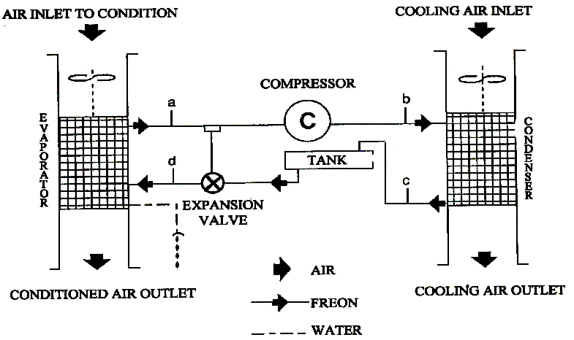
Vapor Cycle

Slide 47
Freon (R12) pressure with related vaporization temperature
P(kgf/cm²) | T(℃)
0.4 | - 50
1.0 | - 30
2.2 | - 10
3.1 | 0
4.3 | 10
7.6 | 30
12.4 | 50

Slide 48
Vapor Cycle
Evolution of the cooling fluid:
  (a-b) compression, (b-c) cooling and condensation,
  (c-d) expansion, (d-a) vaporization,
It’s during the vaporization of fluid that the cooling is obtained.
The expansion valve is connected to a thermostat located in the compressor intake. It regulates the fluid flow in order to assure an over heating at exit evaporator. So, a complete vaporization is assured before the intake in the compressor: because there is a risk of failure of the compressor if the fluid is in liquid phase.
The tank assures a right load of the circuit for the different cases of operating.The air circulation in the evaporator and the condenser is carried out with ventilators.
Notes:
I – Principles of straight and steady level flight
Rev 3 –Aug 05
I - <number>

Slide 49
Air-Cycle Cooling System
Air-cycle cooling systems are used on modern large turbine-powered aircraft.
These systems use the compression and expansion of air to adjust the temperature in passenger and crew compartments.

Slide 50
Air-Cycle System
Three different types of assemblies:
  Turbobrake assembly (turboventilator or turbo-fan): Y-7
This assembly is very easy.
  Bootstrap 2 wheels assembly: B727, B737-300, MD-82.
  This solution increases the cycle efficiency and requires lower bleed pressure.
  Bootstrap 3 wheels assembly: B737-700, B747, A300/A310.
  This assembly allows the ventilation on the ground.
    Bootstrap 3 wheels with high pressure water separator assembly: B757/767, A320/A340.
      allows negative exit temperatures of the unit,
      eliminates the water separator.

Slide 51
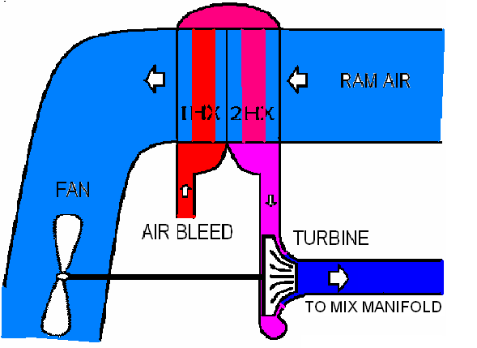
TURBO-FAN
Notes:
I – Principles of straight and steady level flight
Rev 3 –Aug 05
I - <number>

Slide 52
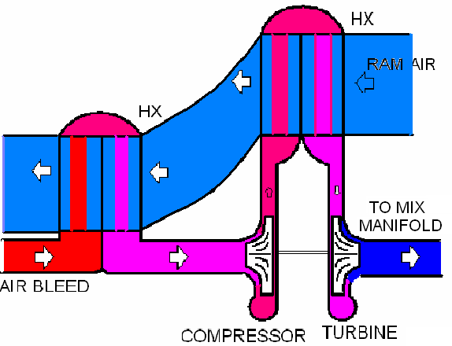
BOOTSTRAP 2 WHEELS

Slide 53
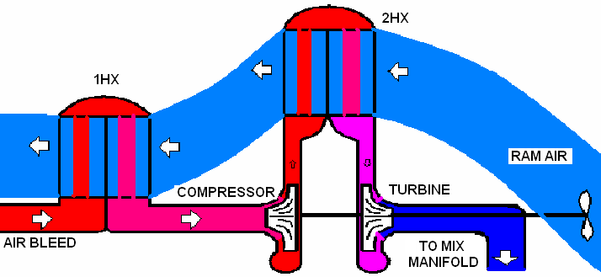
BOOTSTRAP 3 WHEELS

Slide 54
An Example of
High pressure water separation system
FLOW CONTROL
VALVE
FROM BLEED
SYSTEM
TO MIX
MANIFOLD
A320

Slide 55
An Example of
High pressure water separation system
Temperature control function :
FROM BLEED
SYSTEM
TO MIX
MANIFOLD
A320
BYPASS
VALVE

Slide 56
An Example of
High pressure water separation system
Anti-ice function :
FROM BLEED
SYSTEM
TO MIX
MANIFOLD
ANTI-ICE
VALVE
A320
BYPASS
VALVE

Slide 57
AIR CONDITIONING OPERATING CONDITIONS
Airbus A320Family values
34 ℃ (93.2℉)
3480hpa abs.
91℃ (195.8℉)
2530hpa abs.
38 ℃ (100.4℉)
190 ℃ (374℉)
2600hpa abs.
30 ℃ (86℉)
142℃ (287.6℉)
3620hpa abs.
24 ℃ (75.2℉)
FROM BLEED
SYSTEM
TO MIX
MANIFOLD
-6 ℃ (21.2℉)
A320
-30 ℃ (-22℉)
1035hpa abs.

Slide 58
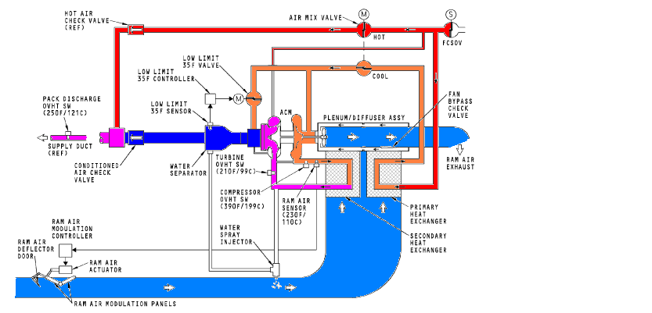
B737-6/7
Low pressure water separation system

Slide 59
Temperature Regulation

Slide 60
Unit Temperature Regulation
The exit temperature of air conditioning unit is realized by a computer which controls the positions of:
  the temperature regulation valve
  the cooling air inlet and exit flaps of the exchangers
This regulation has two optimization criteria:
  a most important opened position of the temperature regulation valve: so the permeability of the unit is minimum and the bleed pressure necessary is minimum.
  a most important closed position of the flaps in order to decrease the aircraft drag; for this function it’s necessary to avoid a compressor exit over-heat and a ventilator surging.
Notes:
I – Principles of straight and steady level flight
Rev 3 –Aug 05
I - <number>

Slide 61
Cabin Temperature Regulation
Depending on its length the cabin is divided into some regulation zones.
The cabin temperature regulation range is 18-30℃. The blowing temperature is regulated in the range of 8℃ to 50℃. In exceptional cases this limit of temperatures can be extended from 2℃ to 70℃.
The air conditioning unit regulates the temperature: the temperature is the lowest necessary temperature of all the zones. To obtain the right temperature in every zone hot air is mixed in the distribution conduit of every zone.
To maintain a constant comfort level, the selected temperature can be corrected in order to compensate the wall temperature reduction and the altitude humidity effects.

Slide 62
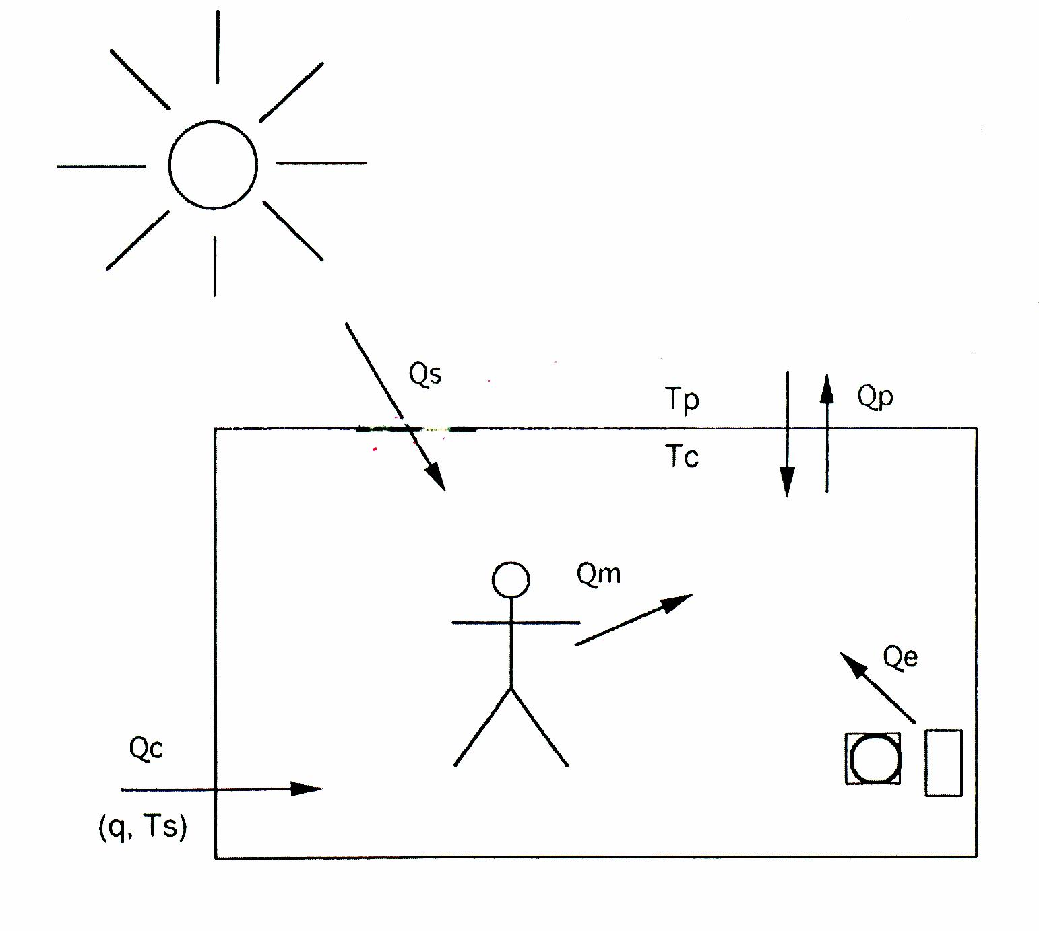
Cabin Thermal Balance

Slide 63
Cabin Thermal Balance
Qm = heat metabolic production; at 21℃ :
Qpassenger= 90 W (quiet person---passenger),
Qcrew = 180 W ( person with medium activity---- pilot)
Qe = electrical power dissipated by the equipment (instruments, computer, lighting…)
Qe= ΣNi (1-ηi) Ni : rated power consumption
ηi: mechanical efficiency
Qs = horizontal projection through the glasses of the solaria radiation (solaria flux = 1 kW/m²)
Qs =τGsFp τ: permeability
Gs: density of radiation
Fp: area vertical to sun line

Slide 64
Qp = heating transmission through walls
Qp = h S (Tp-Tc) h: convection coefficient
S: area
Tp: temperature outside
Tc: temperature of cabin
Qc = air conditioning contribution
Qc = mCp(Ts-Tc) m: air flow
Cp: specific heat of air
Ts: temperature of air blowing
In stabilized state (Tc constant and no leakage considered):
Qm+Qe+Qs+Qp+Qc=0

Slide 65
Cabin Thermal Balance (cont.)
Example of a pre-definition of a training aircraft with two seats:
1-flight condition:
  low altitude flight,
  M = 0.83,
  outside temperature:ISA+30℃ ,
  cockpit temperature:Tc=21℃ ,
  electronic bay temperature:Ta=40℃ .
2-cockpit thermal balance:
  Qm =2×180=360W,
  Qe =500W,
  Qs =1000(W/m²) × 2.1(m²)=2100W,
  Qp =4500W,
  Qcockpit =7460W.

Slide 66
Cabin Thermal Balance (cont.)
3-electronic bay thermal balance:
  Qe =2400 W+25%(allowance for future equipment)=3000 W
  Qp =2000 W
  Qelectronic = 3000+2000=5000 W
4-necessary flow calculation:
The necessary cooling power in this case is not the sum of the Qcockpit and Qelectronic. In fact Tc<Ta: we can use the air extracted from the cockpit to ventilate the electronic bay.
Cockpit necessary flow: m=Qcockpit/Cp(Tc-Ts),
If we use a circuit with low pressure for the water separation:
Ts min = +2℃ (icing protection); m1=7460/(1009 × 19) = 0.39kg/s
The available cooling power for the electronic bay is:
Qa1 = m1 Cp(Ta-Tc)=0.39 × 1009 ×(40-21)=7500 w,
That is sufficient !

Slide 67
Cabin Thermal Balance (cont.)
If we use a circuit with a high pressure water extraction:
  Ts mini = -20℃ , m2 = 7460/(1009x41) = 0.18 kg/s
The available cooling power for the electronic bay is:
  Qa2 = m2 Cp (Ta-Tc) = 0.18x1009x(40-21) = 3500 W,
  This is not sufficient for Qa = 5000 W.
In this case it’s necessary to have a specific air flow for the 1500 W which remains:
  ma = 1500/Cp(Ta-Ts) = 0.025 kg/s,
  then mt = m2+ma = 0.205 kg/s.
5-conclusion:
If we use high pressure extraction water circuit, we need about half less air flow than with a low pressure water extraction.
The weight profit for the system will be about 25%.

Slide 68
Cabin Ventilation and Recirculation
Beside its temperature control role, the air conditioning has to assure the air renewal in the cabin. For this the aeronautical standards provide to deliver 10 cfm of fresh air per person. If we take into account the volume of the cabins, this flow assures a complete air change every 3 or 4 minutes.
To increase the total air flow in the cabin without penalizing the fuel consumption, a part of the cabin air is recirculated. The percentage of recirculated air varies from 30% up to 50% according to the aircraft type. For every passenger the total flow will also be 20 cfm.
1 cfm=1.7 m³/h

Slide 69
The recirculation allows to have a maximum of benefits with the high pressure water extraction unit: these units have the possibility to supply an air outlet at a negative temperature. But to blow frozen air on the passengers is not possible. So this frozen air is mixed with the recirculated air and the result is compatible with the comfort.
This recirculated air is filtrated to avoid the dust, cigarettes smoke, as well as bacteria and virus propagation.
The air ventilation of the galley,toilets and cargo hold is not recirculated but directly extracted to the outside.

Slide 70
Cabin Pressurization System

Slide 71
PRESSURE vs. ALTITUDE
1100
900
700
300mbar
mbar
=
500
30,000ft
300
100
0
100
200
300
400
FL
The ambient pressure is a function of the altitude. This variation is not linear.
Therefore, to a standard atmosphere pressure corresponds an altitude value.

Slide 72
Physiologic Effects of the Altitude Flight
Due to the altitude, the drop of the atmospheric pressure induces a drop of the partial pressure of the different gases of the air and therefore of the oxygen. The effects of oxygen lack are:
  from 10 000 ft (3 000 m): decrease of the reflexes and the intellectual faculties. After a long time (some hours) risk of headaches and vertigo,
  from 15 000 ft (4 500 m): important decrease of the reflexes and the intellectual faculties, up to the loss of consciousness for sensitive persons,
  vertigo 眩晕
Notes:
I – Principles of straight and steady level flight
Rev 3 –Aug 05
I - <number>
reflex :反射 vertigo : 眩晕

Slide 73
Physiologic Effects of the Altitude Flight (Cont.)
  over 20 000 ft (6 000 m): the capacity to produce a constant work is practically non-existent, the useful consciousness time is about 3 up to 10 min,
  at 40 000 ft (12 000 m): the useful consciousness time is some seconds.
These stages are indicative and depend on the person and their physical conditions. The oxygen lack effects are very dangerous and a loss of consciousness can occur after some seconds without preliminary faintness.
Notes:
I – Principles of straight and steady level flight
Rev 3 –Aug 05
I - <number>
insidious: 阴险的

Slide 74
Altitude Effects Protection
To fight against the altitude effects two methods are available:
  to supply oxygen in permanence to the persons (with an oxygen mask)
  to restore in the cabin a compatible pressure with the human physiology
The aircraft can be classified according to one or more employed methods:
 | Max flight altitude | Application
Non pressurized cabin No oxygen mask | 12 000 ft (3 500m) | Light aircraft, helicopter
Non pressurized cabin Oxygen mask | 30 000 ft (9 000m) | Military aircraft
Pressurized cabin Safety oxygen mask | 51 000 ft (15 000 m) | Subsonic commercial aircraft
Non pressurized cabin Oxygen swollen suit | 60 000 ft (18 000 m) | Military aircraft

Slide 75
Pressurization Principle
The cabin pressure variation results from the difference between the air flow coming and going out.
The inlet flow is determined by the air conditioning needs, so it’s the outlet flow variation which controls the variation and the pressure cabin. The outlet flow is controlled by the outflow valve.
AIR CONDITIONING
CABIN
REGULATING VALVE
OUTSIDE EVCUATED AIR
AIRCRAFT PARAMETERS
PC
computer

Slide 76
GOAL OF PRESSURIZATION SYSTEM
The aircraft flight altitude and the rate of change are too severe for the passengers comfort and safety.
Goal
  To increase the passenger comfort by controlling:
    the lowest cabin altitude (Zc)
    the lowest rate of change (VZc) value
  To take the aircraft criteria into account (structure)
  To decrease the crew work load

Slide 77
Pressurization Law
On the ground (parking and roll):
The valves are completely open to guarantee a minimal differential pressure inside/outside in order to allow the opening and the closing of the doors.
During take-off:
During take-off due to the velocity and the nose up attitude an over pressure occurs at the valve outlet. To avoid these overpressurse in the cabin, the pressurization system swells a little the cabin (5 up to 10 mbar) just before take-off.
During the climb:
After take-off the cabin altitude is proportional to the aircraft altitude.
While cruising:
The system regulates the cabin pressure determined during the climb.

Slide 78
Pressurization Law (Cont.)
During the descent:
The cabin pressure decreases toward the ground pressure.The cabin vertical speed indicator (variation of the cabin pressure) is optimized to respect the comfort limits. But two limits have to be respected:
  the overpressure safety: the cabin pressure has to stay under the DP max (maximum differential pressure used to calculate the aircraft structure strength)
  the depression safety: the cabin pressure has to stay under the outside pressure.
At landing:
Like for take-off, the cabin is a little swollen. After landing the system controls the valves opening so that the differential pressure cancels each other out. So the system is in ground mode.

Slide 79
Pressurization Profile
Landing airport
Takeoff airport
GROUND
GROUND
PRESSURIZATION
PREPRESSURIZATION
DEPRESSURIZATION

Slide 80
Cabin Pressurization System
Cabin pressurization system provides a comfortable and safe environment for passengers and crew while allowing the aircraft to fly at higher altitudes.
Flying at high altitudes is more fuel efficient and it allows the aircraft to fly above most undesirable weather conditions.
Functions:
  controls the cabin pressure with the outflow valve;
  limits the rate of change of cabin pressure;
  monitors the cabin-to-ambient pressure differential.

Slide 81
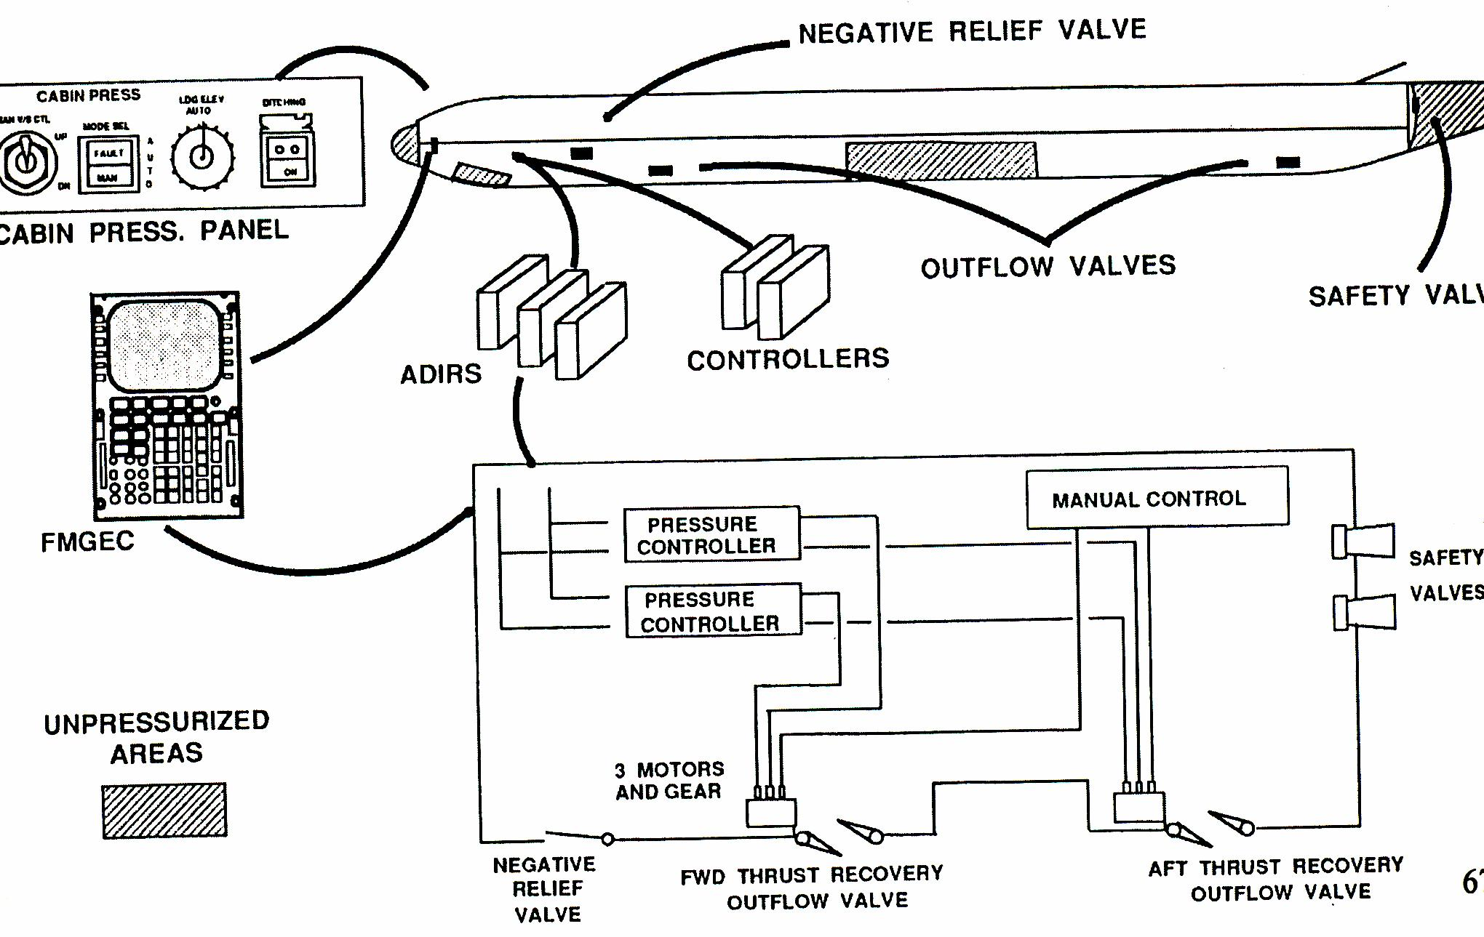
Pressurization System
Notes:
I – Principles of straight and steady level flight
Rev 3 –Aug 05
I - <number>
FMGE

Slide 82
Pressurization System Components
outflow valve
  primary cabin pressure control, regulates the amount of pressurized air that is allowed to exit the cabin
  The outflow valve is driven more open to decrease cabin pressure or more closed to increase cabin pressure.
safety valve (positive pressure relief valve)
  prevents cabin over-pressurization by opening automatically at a predetermined pressure
negative pressure-relief valve
  Prevents cabin pressure from going below that of the ambient air
Notes:
I – Principles of straight and steady level flight
Rev 3 –Aug 05
I - <number>

Slide 83
AIR CONDITIONING SYSTEM
PACK
CABIN
PRSOV
/
BLEED VALVE
FCV
/
PACK VALVE
TCV
AIR SOURCE
CHAMBER
PRESSURE CONTROLLER
Hc dPc/dt ΔPc
TEMP
CONTROLLER
SELECTOR

Slide 84
4. OXYGEN SYSTEM

Slide 85
Oxygen System
Oxygen systems are required on aircraft that operate for extended periods above 10,000 ft.
The two types of oxygen systems are used on private and commercial aircraft are:
  Stored-gas Oxygen Systems
  Chemical or Solid State Oxygen Systems

Slide 86
Stored-Gas Oxygen System
Stored-gas oxygen system uses oxygen cylinders (bottles) to hold the aircraft’s oxygen supply
Oxygen bottles may be:
  high-pressure
  low-pressure

Slide 87
Stored-Gas Oxygen System
High-pressure bottles
  Contain oxygen at 1 800psi
  Green in color
  Labeled Aviator’s Breathing Oxygen
Low-pressure
  Contain oxygen at 450psi
  Yellow in color
  Labeled Aviator’s Breathing Oxygen

Slide 88
Chemical or Solid State Oxygen System
There are many advantages of using solid-state oxygen system
  safe
  lower in cost than stored-gas systems
  comparatively maintenance free

Slide 89
THE END!
Thank You for Your Attention!

