Slide 1





Quantum Algorithms for Graph Analytics
Edoardo Tignone
Machine Learning for Quantum X, July 9th, 2021

Slide 2







IFAB
IFAB’s mission is to promote the development of Big Data and Artificial Intelligence technologies and innovative scientific methods which can be used to drive sustainable human development.
The IFAB project on quantum computing developments is mainly focused on:
optimization
machine learning
IFAB members
founders

Slide 3
Clique Problems
What is a clique?
clique

Slide 4
Clique Problems
What is a clique?
maximum clique
maximal cliques

Slide 5


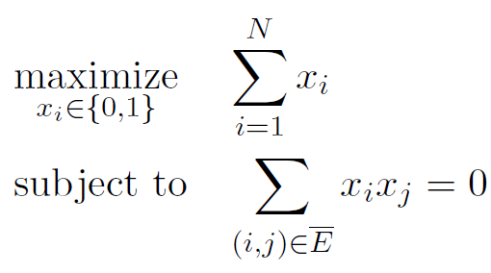
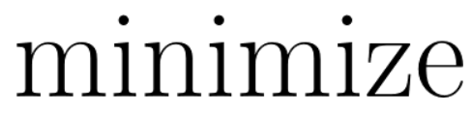
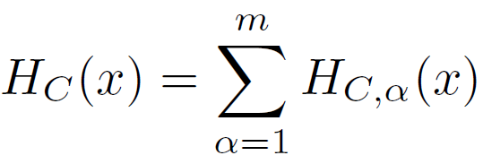

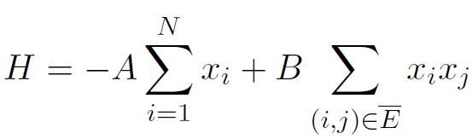

Maximum Clique Problem (MCP)
MCP formulation:

Slide 6
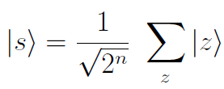
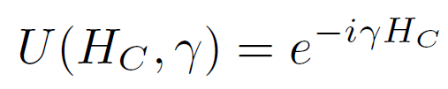
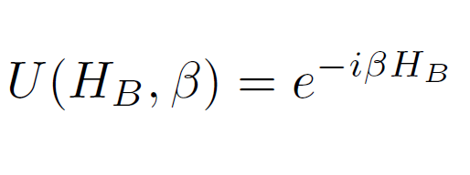
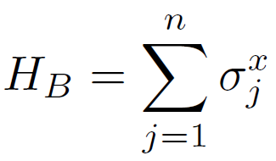
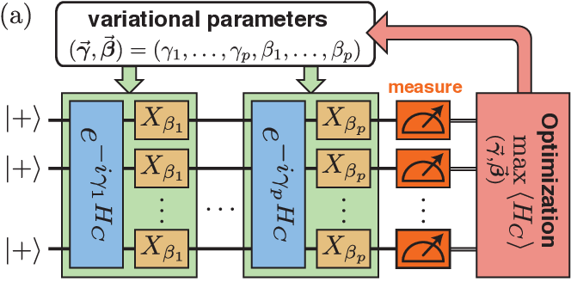



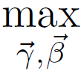

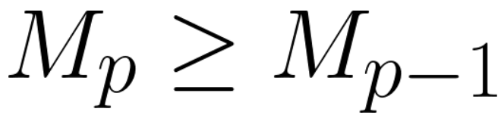
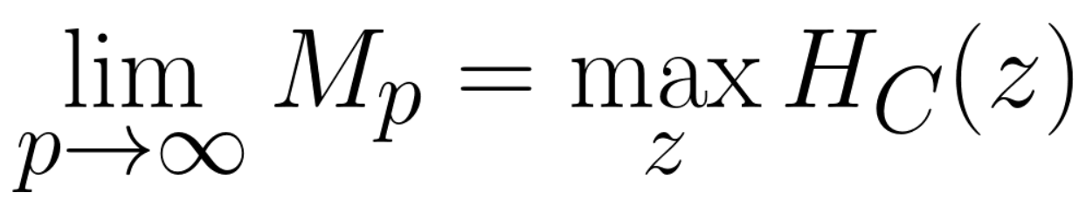
Quantum Approximate Optimization Algorithm (QAOA)
Circuit:
where
with
Measure:
satisfies:
L. Zhou et al., Phys. Rev. X 10, 021067, 2020

Slide 7
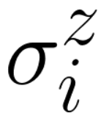
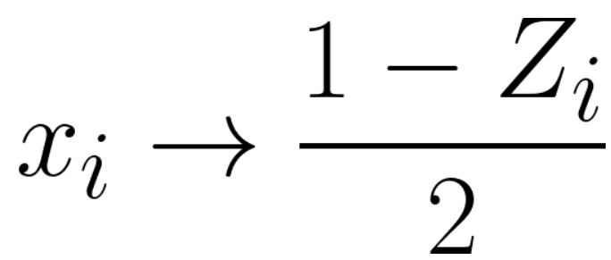
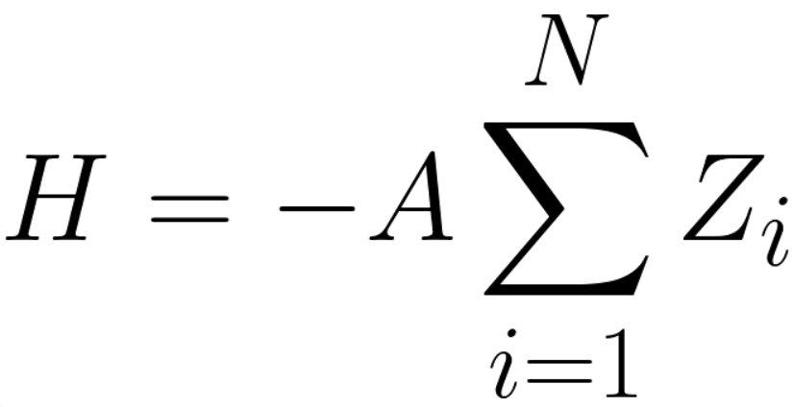
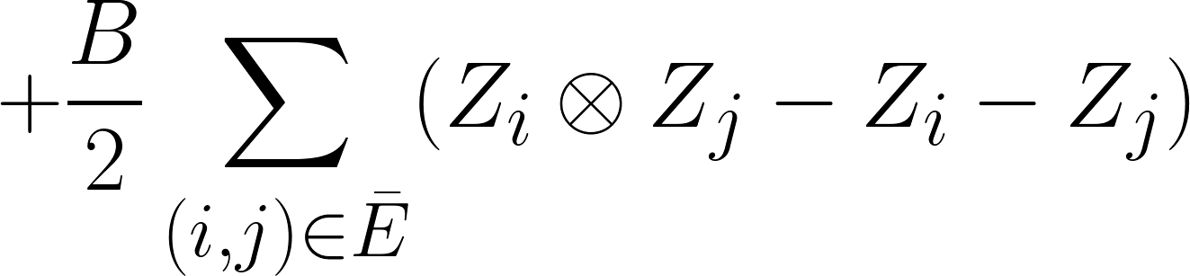
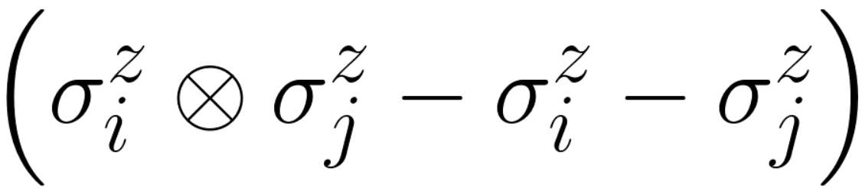
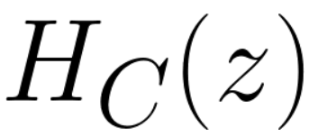
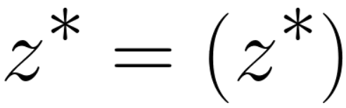
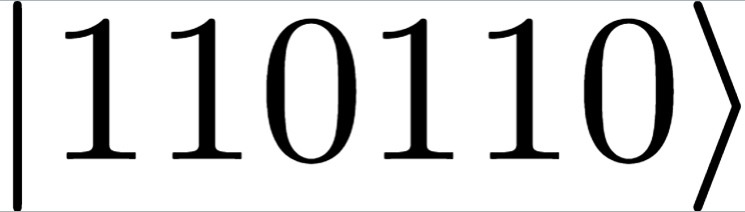



Quantum Approximate Optimization Algorithm (QAOA)
Mapping:
Increase the probability to measure the maximum clique:
6
4
5
$$3$$
$$1$$
$$2$$
L. Zhou et al., Phys. Rev. X 10, 021067, 2020

Slide 8
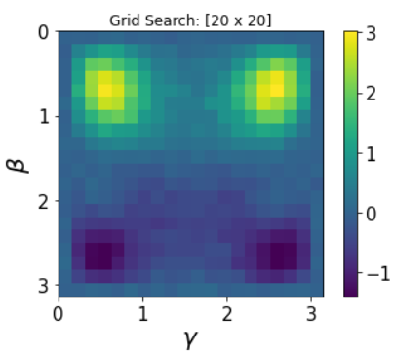
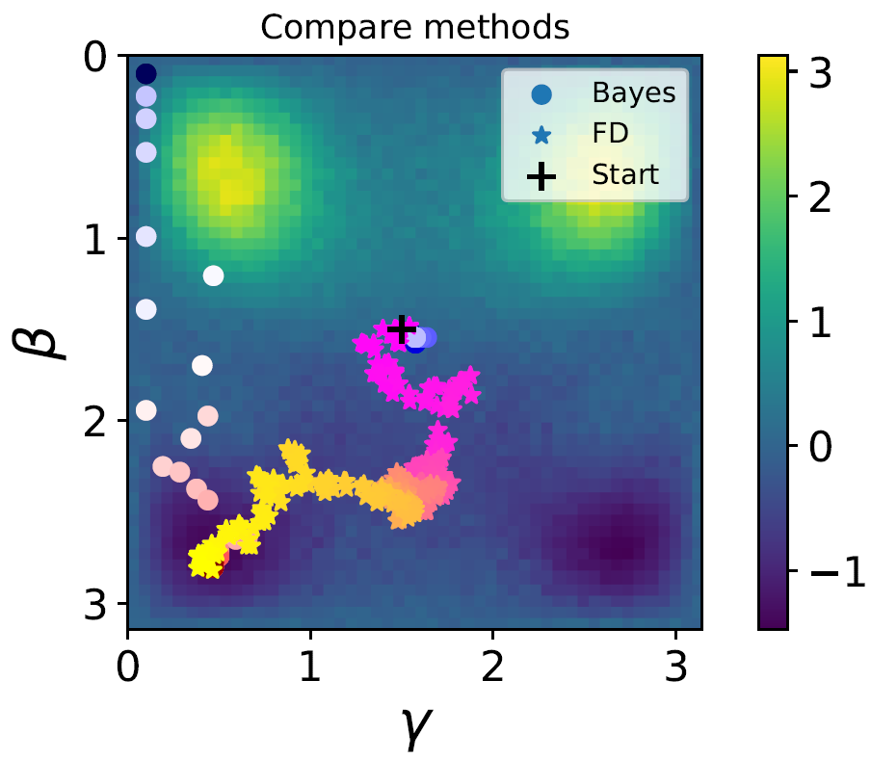
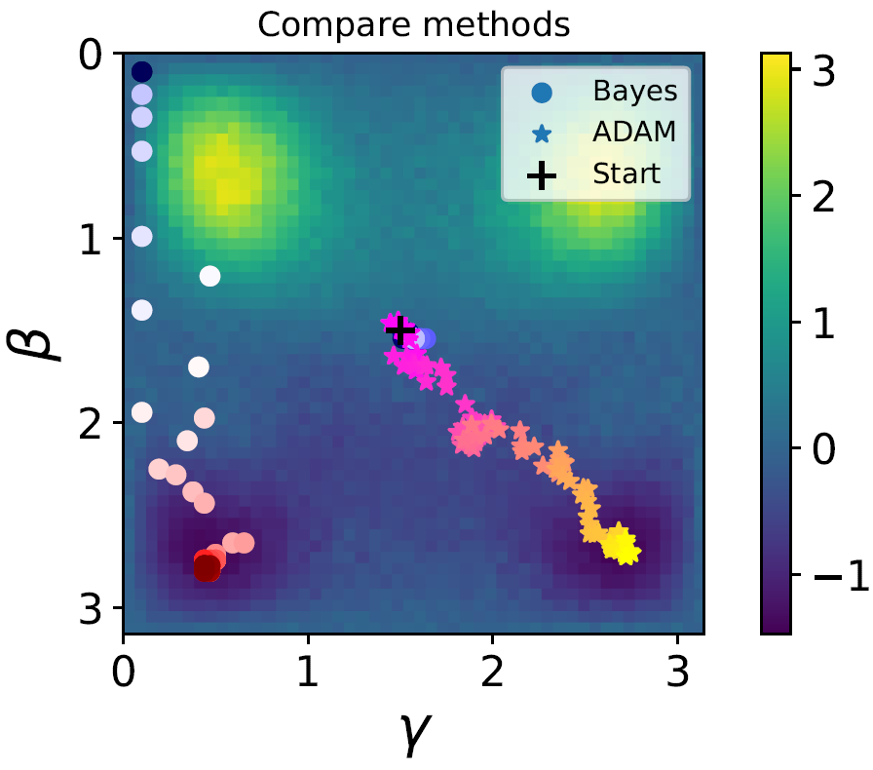



Optimizers
QAOA (p=1): grid search 20x20
There is a plethora of classical optimizers:
grid search
derivative-based methods
natural gradient
bayesian optimization
…
$$5$$
$$3$$
$$4$$
$$1$$
$$2$$

Slide 9
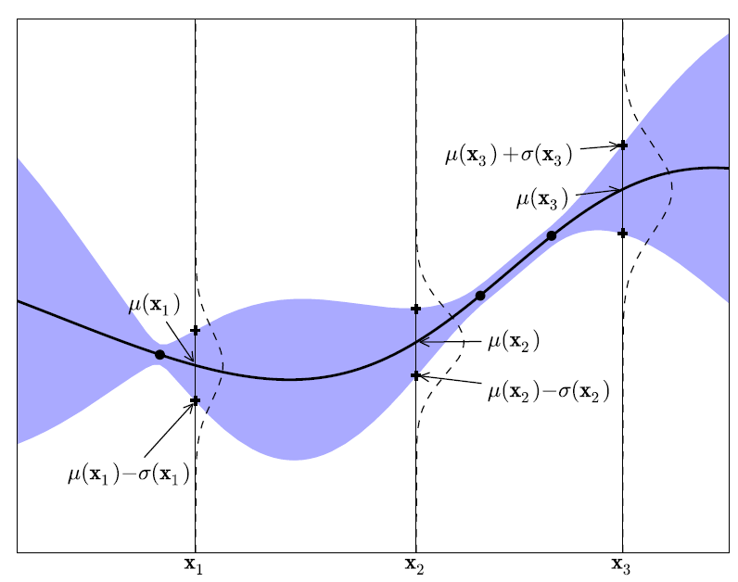
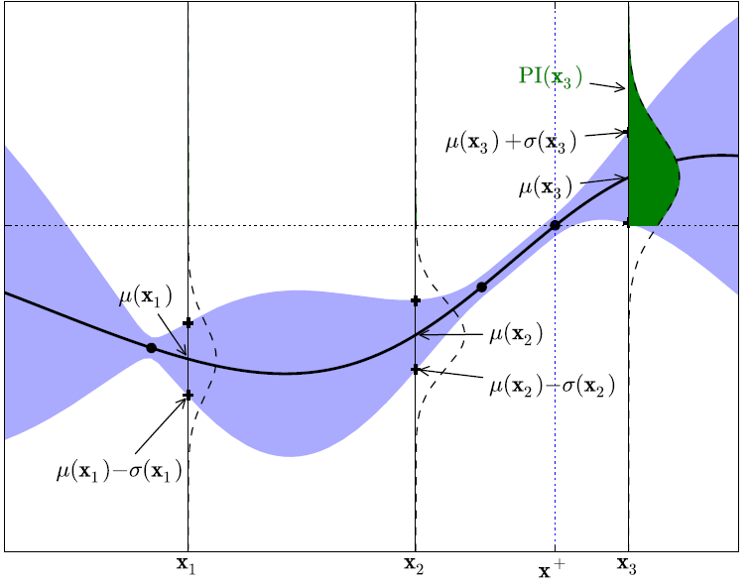
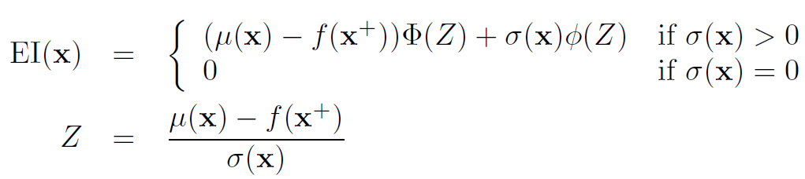
Gaussian Process Bayesian Optimization (GPBO)
E. Brochu et al., arXiv:1012.2599v1, 2010
A possible acquisition function is:

Slide 10
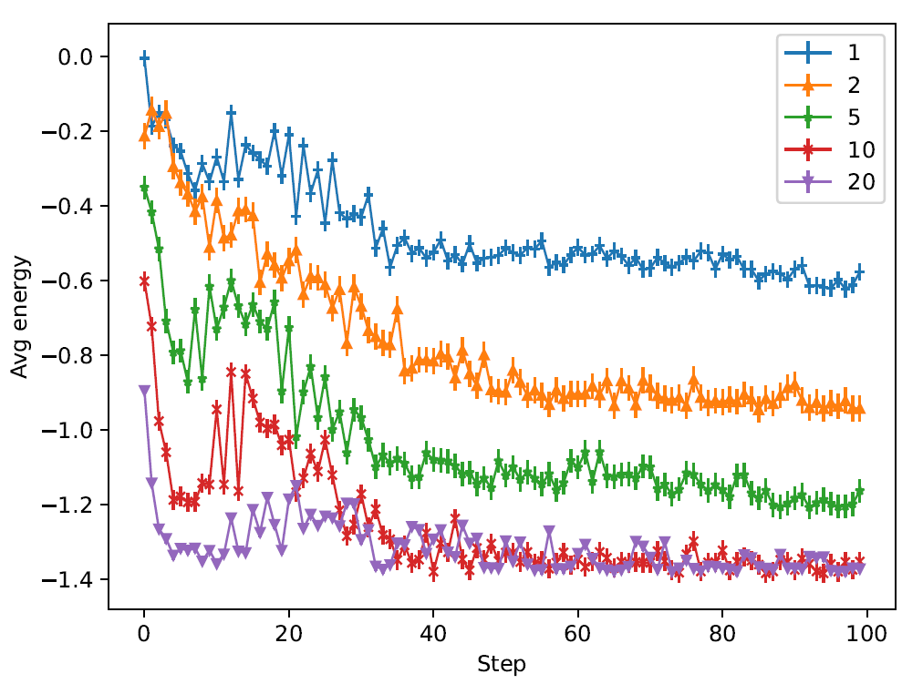
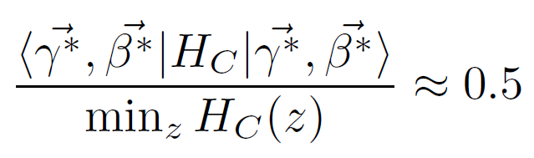
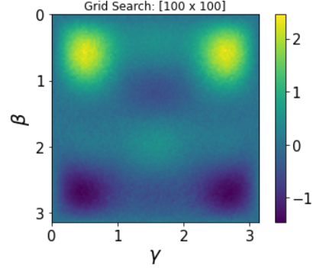
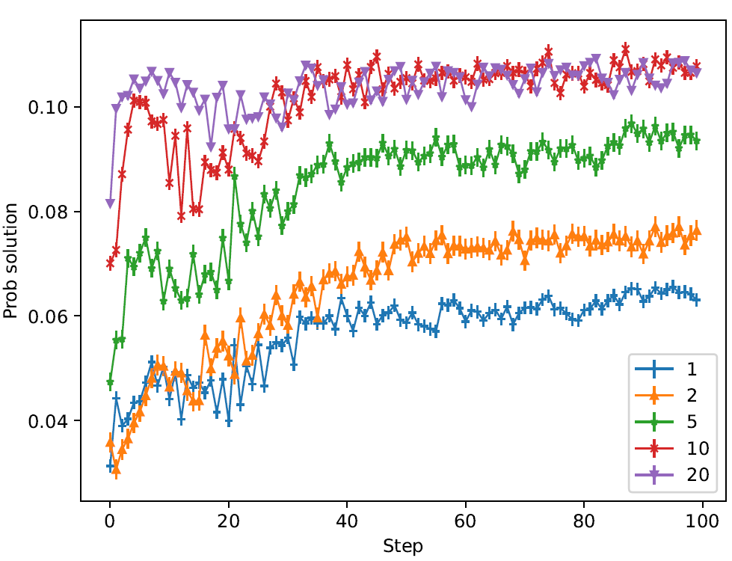

Preliminary results - QAOA with GPBO
Improvement
over random

Slide 11
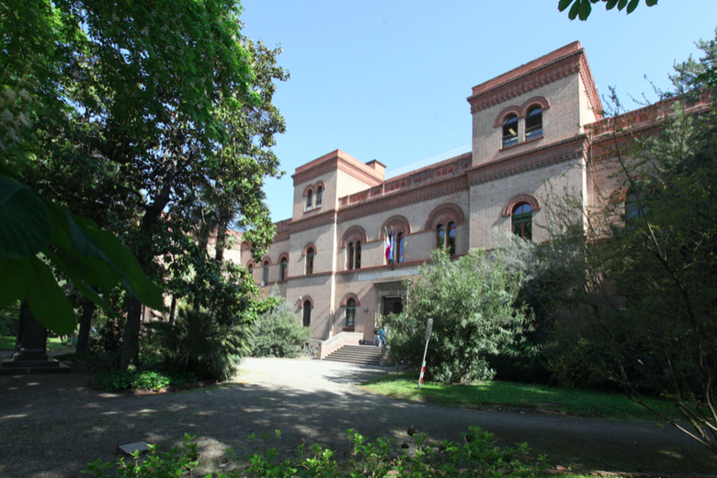
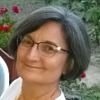
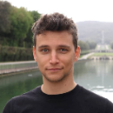
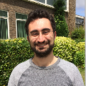
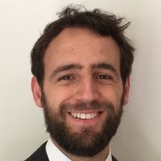
Elisa
Ercolessi
Simone
Tibaldi
Davide Vodola
Edoardo
Tignone
Postdoc position available
Deadline: July 12th, 2021

