Slide 1
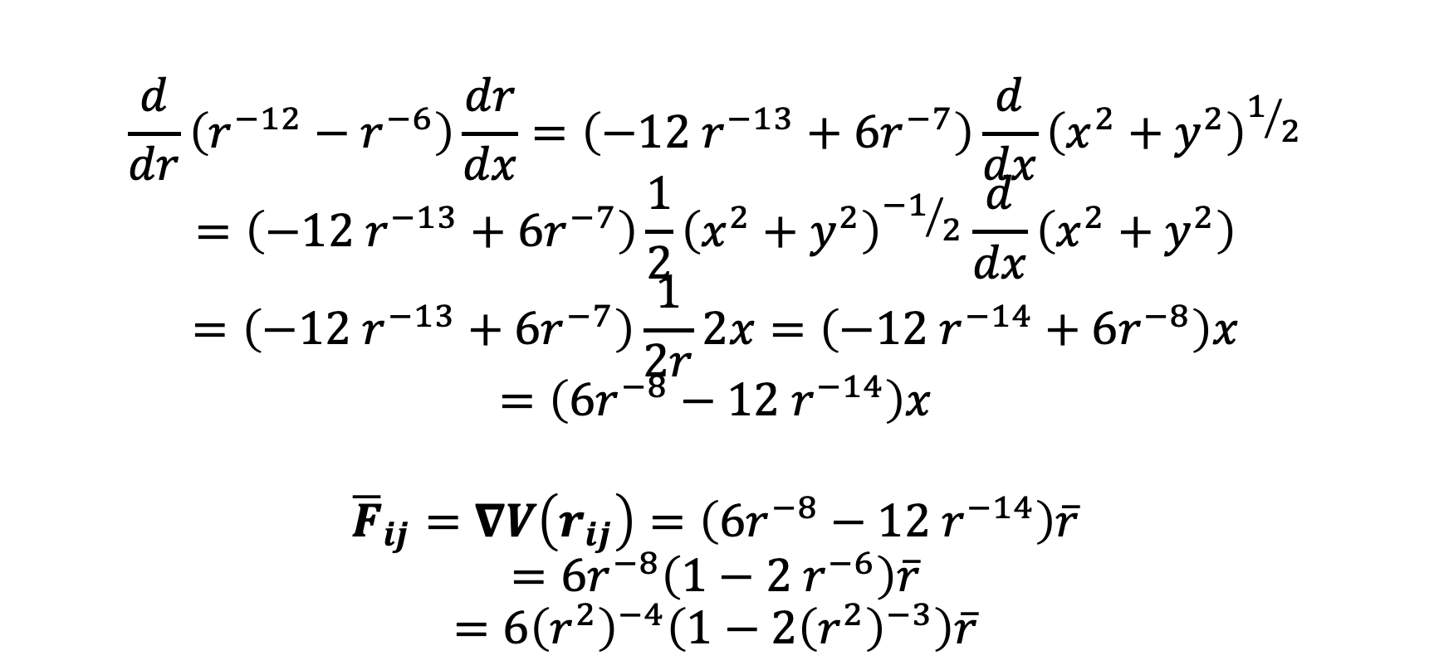
LJ force
$$\frac{d}{dr}\left(r^{−12}−r^{−6}\right)\frac{dr}{dx}=\left({−12 r}^{−13}+6r^{−7}\right)\frac{d}{dx}{\left(x^{2}+y^{2}\right)}^{1/2}$$
$$=\left({−12 r}^{−13}+6r^{−7}\right)\frac{1}{2}{\left(x^{2}+y^{2}\right)}^{{−1}/2}\frac{d}{dx}\left(x^{2}+y^{2}\right)$$
$$=\left({−12 r}^{−13}+6r^{−7}\right)\frac{1}{2r}2x=\left({−12 r}^{−14}+6r^{−8}\right)x$$
$$=\left({6r^{−8}−12 r}^{−14}\right)x$$
$${\overline{F}}_{ij}=∇V\left(r_{ij}\right)=\left({6r^{−8}−12 r}^{−14}\right)\overline{r}$$
$$=6r^{−8}\left({1−2 r}^{−6}\right)\overline{r}$$
$$=6{\left(r^{2}\right)}^{−4}\left(1−2{\left(r^{2}\right)}^{−3}\right)\overline{r}$$

Slide 2

LJ equilibrium distance
$$\frac{d}{dr}\left(r^{−12}−r^{−6}\right)=\left({−12 r}^{−13}+6r^{−7}\right)$$
$$=6\left({1−2 r}^{−6}\right)r^{−7}$$
$$=6\left(1−\frac{2}{r^{6}}\right)r^{−7}=0$$
$$⟺r=2^{\frac{1}{6}}≅1.122462048309373$$

