Slide 1

Create a GitHub account (1)
go to https://github.com, enter your e-mail address and click “Sign up for GitHub”:

Slide 2
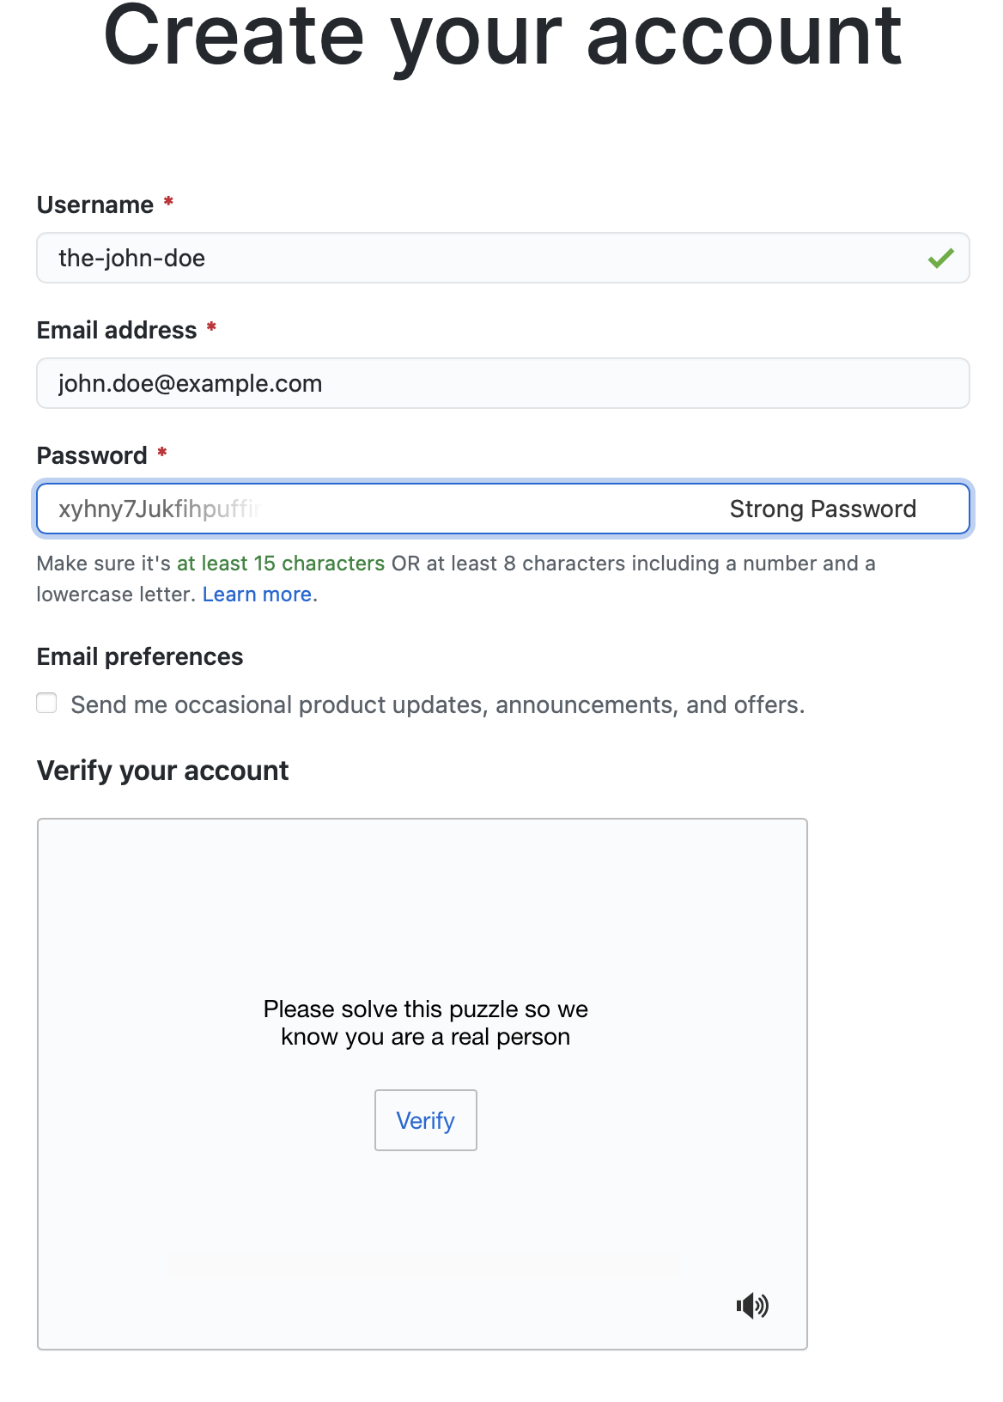
Create GitHub account (2)
Choose your Username
Choose a password (and remember it)
Click “Verify” and solve the puzzle
A button “Create account” will appear, click on it
You will receive an e-mail at the e-mail address you provided to activate your account

Slide 3
Create a personal access token for GitHub
follow this guide: https://docs.github.com/en/github/authenticating-to-github/creating-a-personal-access-token
At point 7 check at least these boxes:
repo
read:org
After point 9 (copying the token), paste it in a text file <your-github-username>.txt in your home directory.
Skip point 10.

Slide 4
Request a VSC account
Follow the guidelines at https://docs.vscentrum.be/en/latest/access/getting_access.html - how-to-request-an-account

