Slide 1
Setting up your personalized micc environment
micc was built for
University of Antwerp course on Parallel Programming
CalcUA Course on High Performance Python – software development for PhD students and Postdocs
by engelbert.tijskens@uantwerpen.be

Slide 2
Development of Python/C++/Fortran projects with micc
This document assumes that all the tools of the development environment have been setup as described in https://micc.readthedocs.io/en/master/devenv.html.
An Ubuntu 20.10 virtual machine for VirtualBox with all tools installed can be downloaded from https://calcua.uantwerpen.be/courses/parallel-programming/ubuntu-20.10.ova. It has a userid user with password calcua@ua
This document describes how to customize the environment for so that micc is able to automatically create GitHub repos for the projects you create.

Slide 3

Create GitHub account (1)
go to https://github.com, enter your e-mail address and click “Sign up for GitHub”:

Slide 4
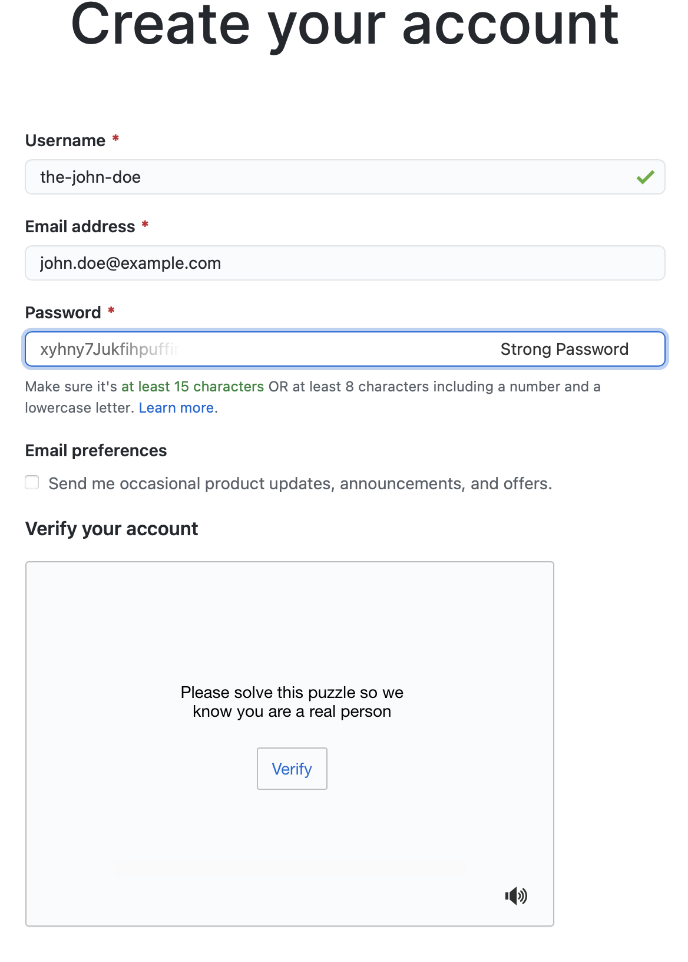
Create GitHub account (2)
Choose your Username
Choose a password (and remember it)
Click “Verify” and solve the puzzle
A button “Create account” will appear, click on it
You will receive an e-mail at the e-mail address you provided to activate your account

Slide 5
Create a personal access token for GitHub
follow this guide: https://docs.github.com/en/github/authenticating-to-github/creating-a-personal-access-token
At point 7 check at least these boxes:
repo
read:org
After point 9 (copying the token), paste it in a text file .pat.txt in your home directory. Type this command in a terminal: $ echo shift+ctrl+V > ~/<your-github-username>.pat
Micc uses this file to automatically create a GitHub repo for your project
Skip point 10.

Slide 6
Setup micc (1)
Before micc can be used it must be set up by typing this command in a terminal. Provide your name, e-mail address and GitHub username:
$ micc setup
your full name [first-name last-name]: John Doe
your e-mail address [your.email@whatev.er]: john.doe@example.com
your github username (leave empty if you do not have one,
or create one at https://github.com/join) [your-github-username]: the-john-doe
After you provided your GitHub username, you may accept the default values of all further questions

Slide 7
Setup micc (2)
Finally, micc will configure your git environment
…
Configuring git:
[ > git config --global user.name John Doe
] done.
[ > git config --global user.email john.doe@example.com
] done.
[ > git config --global credential.helper cache
] done.
…
Micc is now configured and ready to be used

Slide 8
Setup micc (3)
If you want to change your preferences, you can edit the default entries in file
/Users/etijskens/.et_micc/micc.json
Note that these changes will only affect NEW projects. Existing projects will be unaffected.
Alternatively, you can start all over again typing
$ micc setup --force
The first time you push a local repo to GitHub, git will ask the password for your GitHub account. After that it will remember the password.

Slide 9
Things I forgot to install …
openmpi:
Open terminal and execute these commands (sudo password is calcua@ua)
sudo apt-get install openmpi-bin libopenmpi-dev

Slide 10
you’re good to go
browse the micc tutorials
at https://micc.readthedocs.io/en/master/devenv.html
or in the course’s git repository
$ cd workspace
$ git clone https://github.com/etijskens/pp
$ xdg-open pp/course-material/micc-documentation/index.html

