Slide 1
setting up your personal environment
Parallel Programming 2020-2021
Bert Tijskens

Slide 2
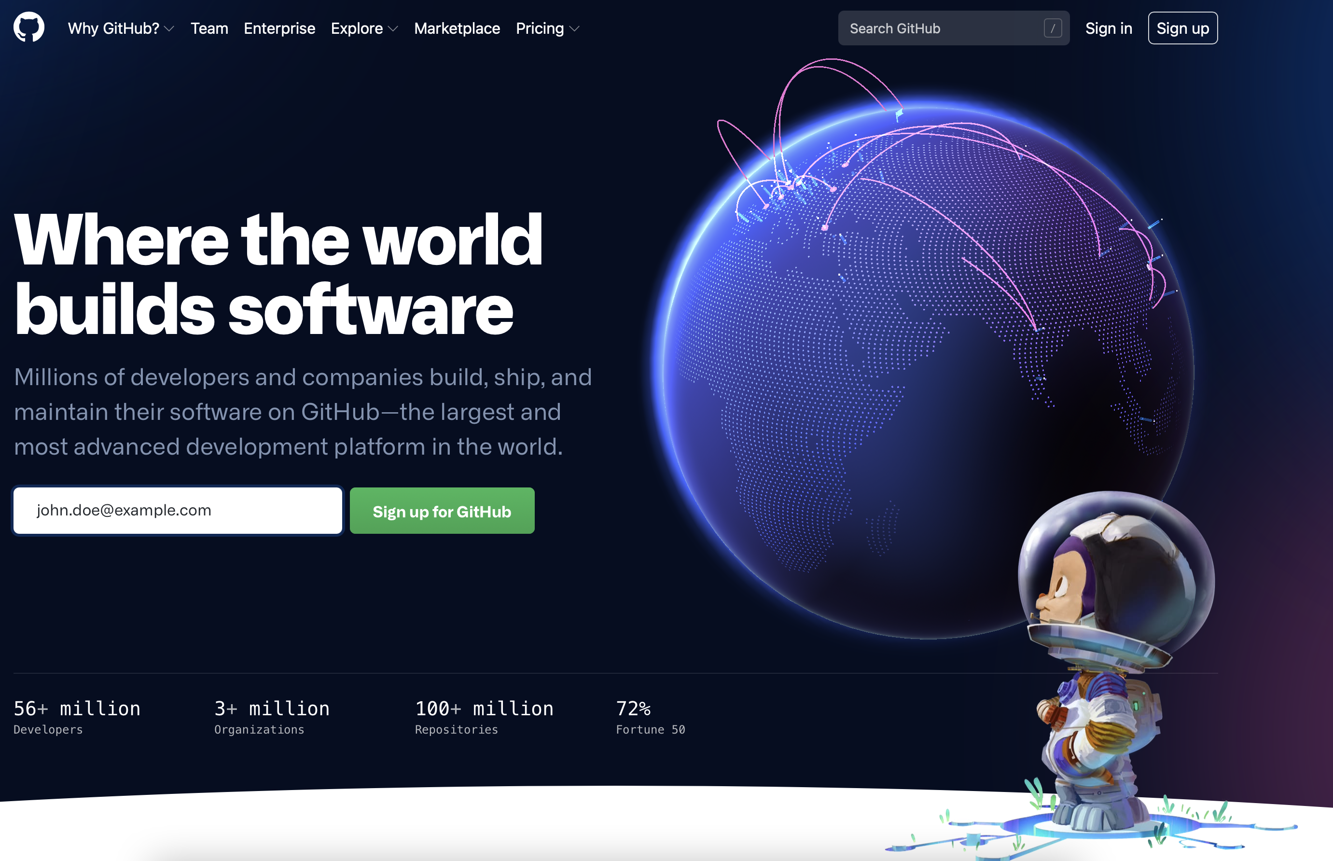
Create GitHub account (1)
go to https://github.com, enter your e-mail address and click “Sign up for GitHub”:

Slide 3
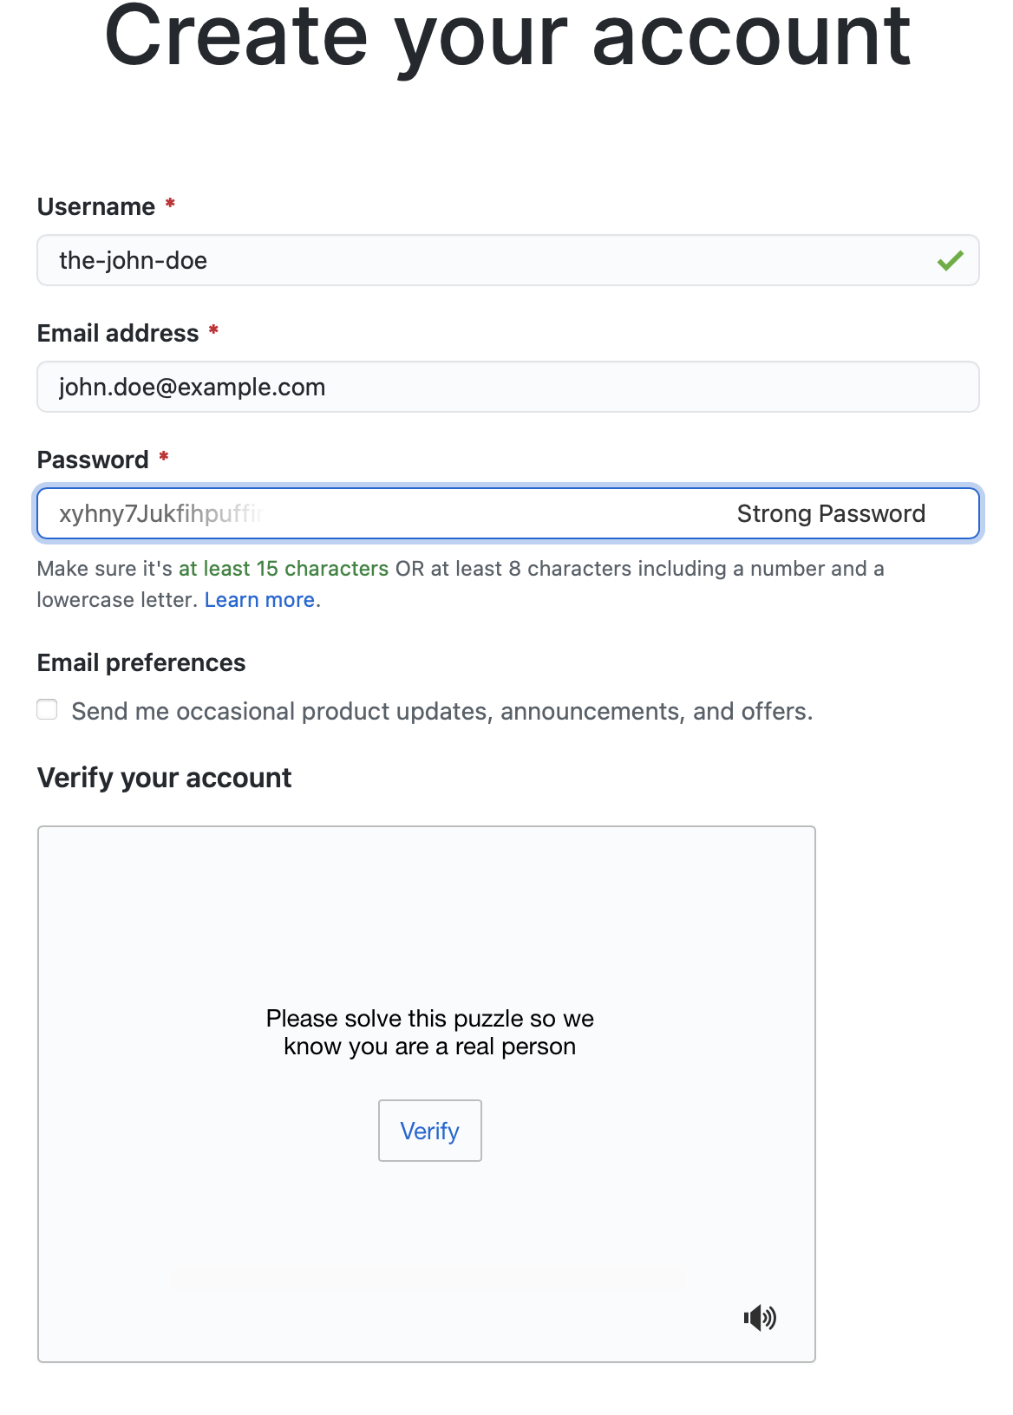
Create GitHub account (2)
Choose your Username
Choose a password (and remember it)
Click “Verify” and solve the puzzle
A button “Create account” will appear, click on it
You will receive an e-mail at the e-mail address you provided to activate your account

Slide 4
Create a personal access token (PAT)
follow this guide: https://docs.github.com/en/github/authenticating-to-github/creating-a-personal-access-token
At point 7 check at least these boxes:
repo
read:org
After point 9 (copying the token), paste it in a text file .pat.txt in your home directory. Type this command in a terminal: $ echo shift+ctrl+V > ~/.pat.txt
micc uses this file to automatically create a GitHub repo for your project

Slide 5
Setup micc
Type this command in a terminal and provide your name, e-mail address and GitHub username:
$ micc setup
your full name [first-name last-name]: John Doe
your e-mail address [your.email@whatev.er]: john.doe@example.com
your github username (leave empty if you do not have one,
or create one at https://github.com/join) [your-github-username]: the-john-doe
After your GitHub username, you may accept the default values
Finally, micc will configure your git environment
I you made a mistake, you can edit the micc configuration file ~/.et-micc/micc.json or start all over again as micc setup --force
The first time you push a local repo to GitHub, git will ask the password for your GitHub account

Slide 6
you’re good to go
browse the micc tutorials
at https://micc.readthedocs.io/en/master/devenv.html
or in the git repo ~/workspace/pp
$ cd workspace
$ git clone https://github.com/etijskens/pp
$ xdg-open pp/course-material/micc-documentation/index.html

