Slide 1
Parallel Programming
Project assignment
Domain decomposition for Molecular Dynamics

Slide 2
phase 1
sequential code

Slide 3
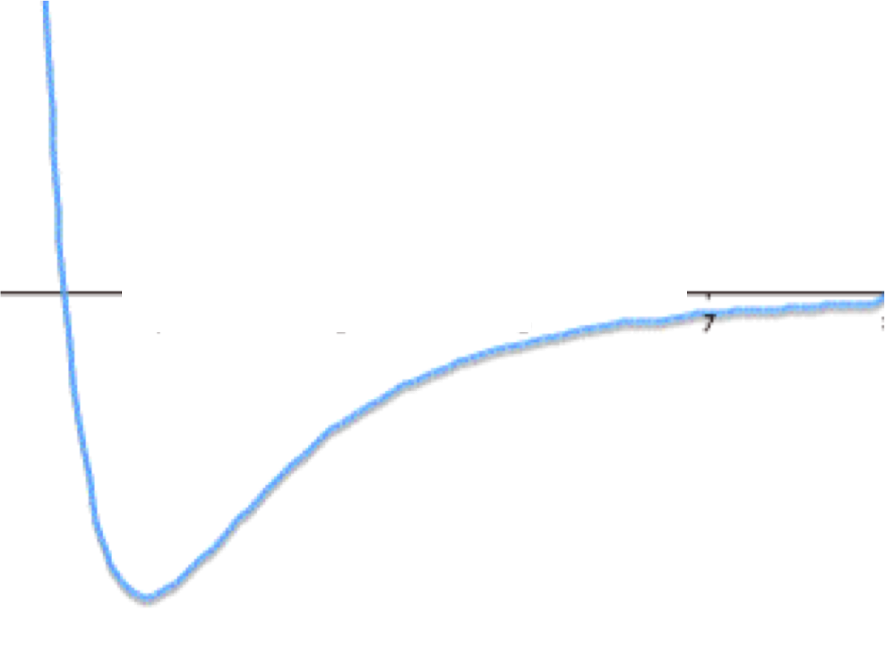


Molecular Dynamics – LJ potential
interaction = Lennard-Jones potential (without coefficients)
cut-off distance: $r_{c}=3r_{0}$
avoid sqrt when computing the distance: $V\left(r^{2}\right)=\frac{1}{{\left(r^{2}\right)}^{6}}−\frac{1}{{\left(r^{2}\right)}^{3}}$
$$r_{0}$$

Slide 4
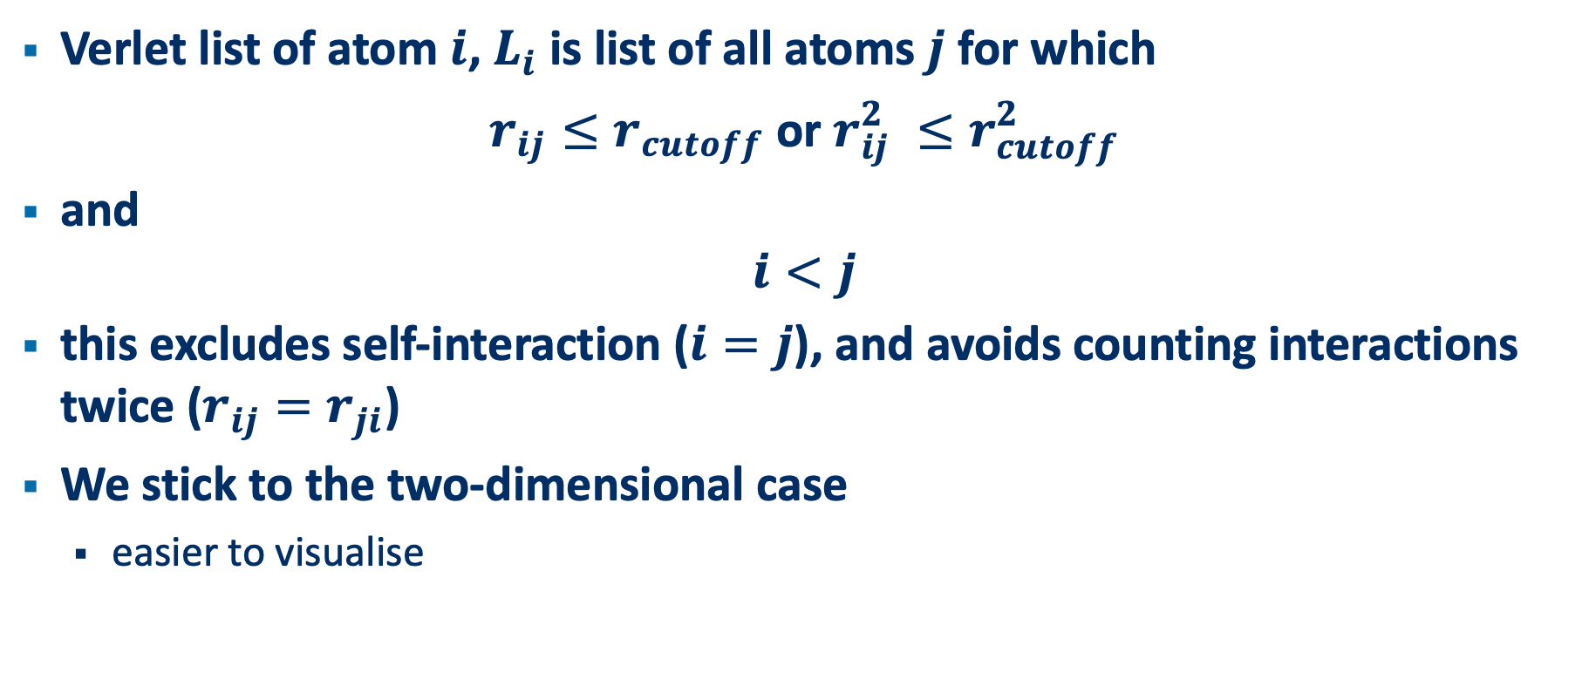
Molecular Dynamics – Verlet list
Verlet list of atom $i$, $L_{i}$ is list of all atoms $j$ for which
$r_{ij}≤r_{cutoff}$ or $r_{ij}^{2} ≤r_{cutoff}^{2}$
and
$$i<j$$
this excludes self-interaction ($i=j$), and avoids counting interactions twice ($r_{ij}=r_{ji}$)
We stick to the two-dimensional case
easier to visualise

Slide 5
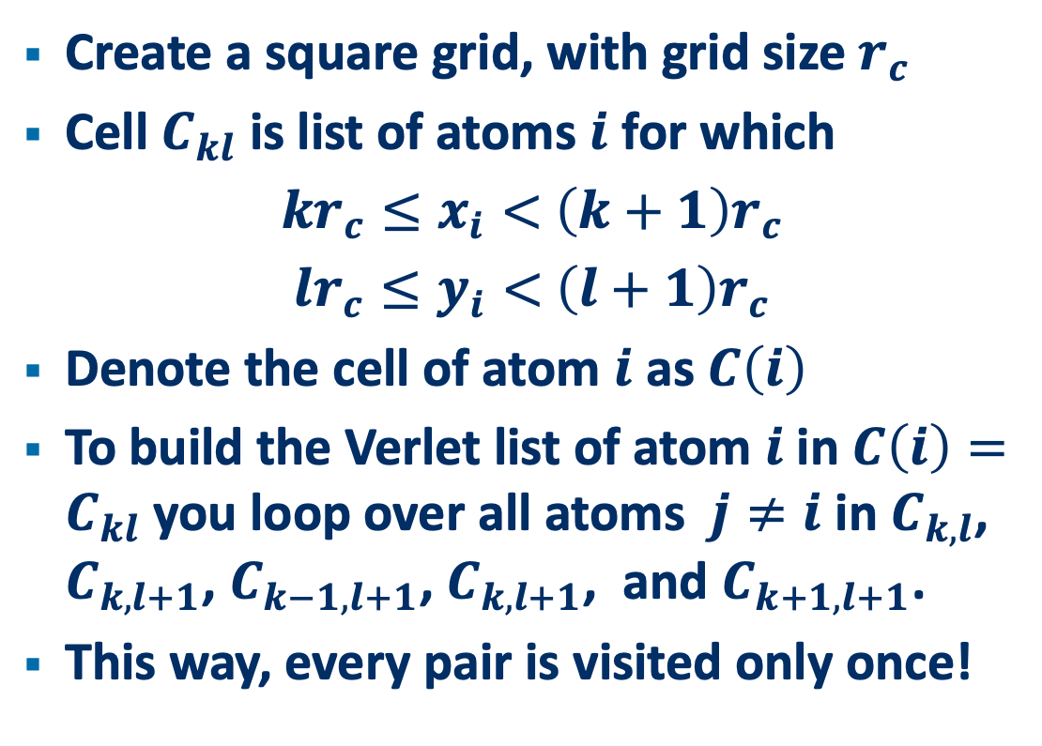
Molecular Dynamics
Create a square grid, with grid size $r_{c}$
Cell $C_{kl}$ is list of atoms $i$ for which
$kr_{c}≤x_{i}<$ $\left(k+1\right)r_{c}$
$lr_{c}≤y_{i}<$ $\left(l+1\right)r_{c}$
Denote the cell of atom $i$ as $C\left(i\right)$
To build the Verlet list of atom $i$ in $C\left(i\right)=$ $C_{kl}$ you loop over all atoms $j≠i$ in $C_{k,l}$, $C_{k,l+1}$, $C_{k−1,l+1}$, $C_{k,l+1}$, and $C_{k+1,l+1}$.
This way, every pair is visited only once!

Slide 6
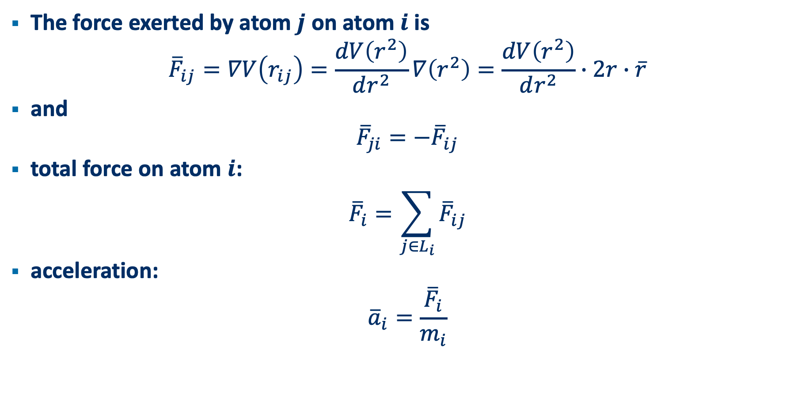
Molecular dynamics – force and acceleration
The force exerted by atom $j$ on atom $i$ is
$${\overline{F}}_{ij}=∇V\left(r_{ij}\right)=\frac{dV\left(r^{2}\right)}{dr^{2}}∇\left(r^{2}\right)=\frac{dV\left(r^{2}\right)}{dr^{2}}∙2r∙\overline{r}$$
and
$${\overline{F}}_{ji}={−\overline{F}}_{ij}$$
total force on atom $i$:
$${\overline{F}}_{i}=\sum_{j∈L_{i}}{{\overline{F}}_{ij}}$$
acceleration:
$${\overline{a}}_{i}=\frac{{\overline{F}}_{i}}{m_{i}}$$

Slide 7
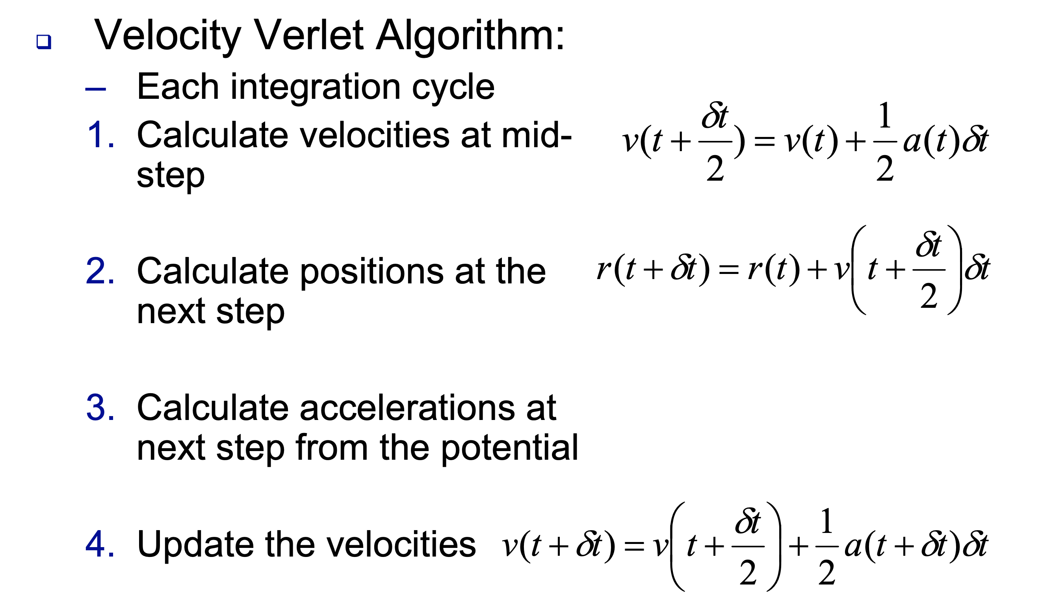

Molecular dynamics – time evolution
time integration scheme
time step = $δt$

Slide 8
Molecular dynamics – time evolution
Atoms may move from one cell to another. One must update the grid cells every time the Verlet list must be updated.

Slide 9
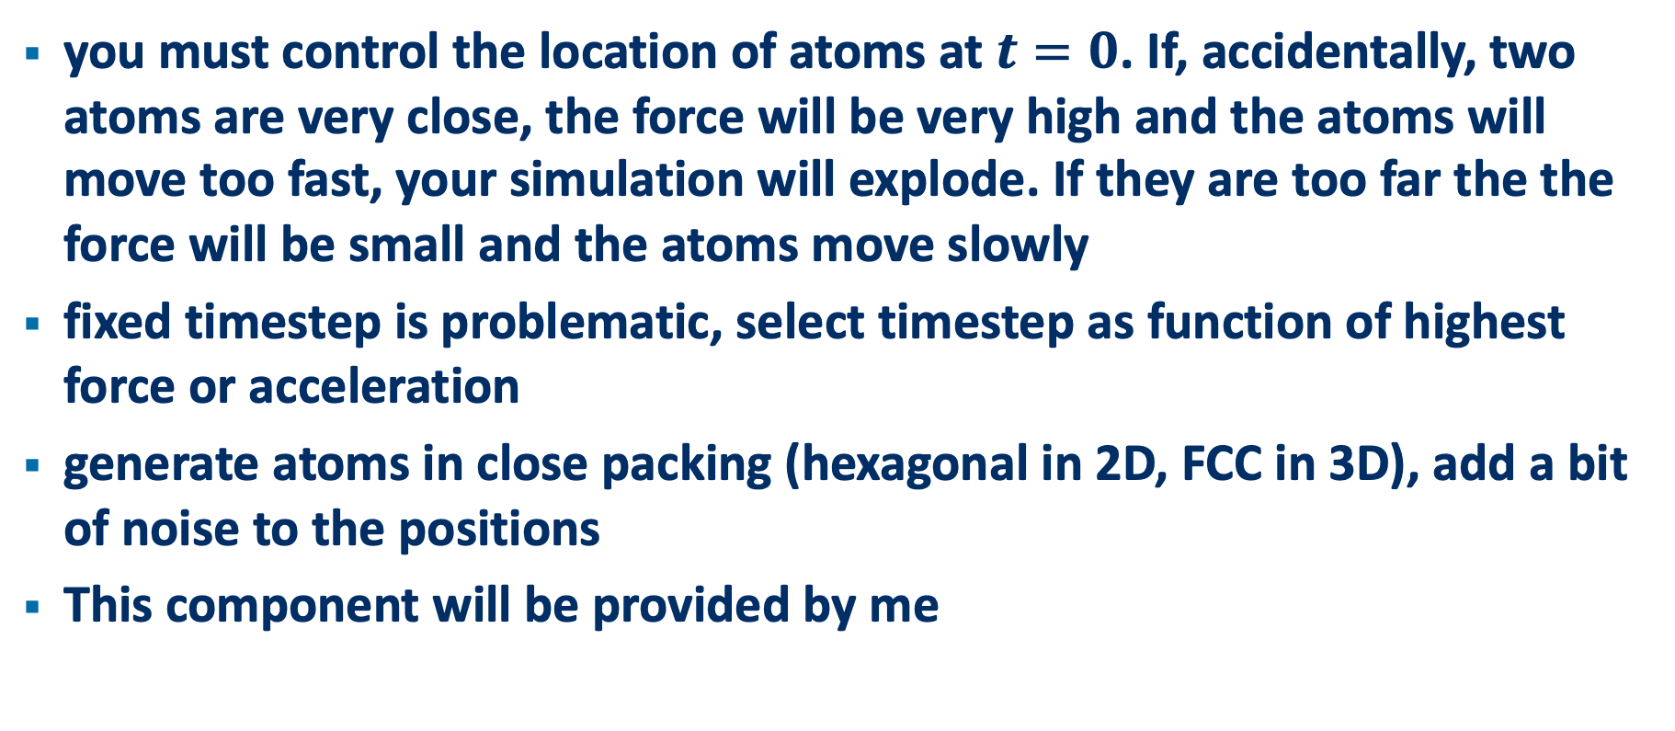
Molecular Dynamics - initialization
you must control the location of atoms at $t=0$. If, accidentally, two atoms are very close, the force will be very high and the atoms will move too fast, your simulation will explode. If they are too far the the force will be small and the atoms move slowly
fixed timestep is problematic, select timestep as function of highest force or acceleration
generate atoms in close packing (hexagonal in 2D, FCC in 3D), add a bit of noise to the positions
This component will be provided by me

Slide 10
Strategy
make sure you have carried out personal-setup.pdf
github account!
mpi installation (was forgotten in the VM)
see principles in first talk
use micc
put your code in a private github repository and give me access
you have a backup at any time (commit and push regularly)
I can check your code and investigate your problems to help you
the code is a deliverable for the evaluation

Slide 11
Strategy
start in Python
write tests for every component
LJ potential and force
grid construction
verlet list construction
total forces
time evolution
replace Python version with a C++ or Fortran version for
LJ potential and forces
time evolution
(other components may remain in Python even if they are slow)
provide timings for both versions (e.g. using the et_stopwatch package, see micc tutorials)

Slide 12
phase 2
Parallellisation

Slide 13
Molecular Dynamics - Parallelization
Divide the work across several processes, using mpi4py. Every core runs a separate process that does part of the work. E.g.
mpirun –np 2 python md.py
runs 2 processes. If the tasks are independent, they must not exchange information. This is not always possible.
Check the (api) documentation of mpi4py at https://mpi4py.readthedocs.io/en/stable/
For a tutorial on MPI check https://folk.idi.ntnu.no/elster/tdt4200-f09/gropp-mpi-tutorial.pdf

Slide 14
Molecular Dynamics - Parallelization
domain composition
Divide the space in domains, one per process. Each domain has its own atoms.
Let domain boundaries coincide with cell boundaries.
Domain needs information from neighbouring domains. Cells on the boundary must be known to each domain touching that boundary in order to compute the Verlet list. This is the halo concept, also known as ghost cells.
Atoms may move from one cell to another and from one domain to another.
Think carefully about which information must be communicated and when
The amount of communication is proportional to the area of the boundaries
The amount of work (load) is proportional to the volume of the domains

Slide 15
Molecular Dynamics - Parallelization
Communication is slow and is not useful work on its own
In general we want to minimize the amount of data communicated.
Try to overlap computation and communication. While waiting for the communication to finish, do some other useful computation.
check the tutorial by Gropp and make sure you understand these concepts:
one-sided vs two-sided communication
blocking vs non-blocking communication

Slide 16
Molecular Dynamics - Parallelization
if the atom density is uniform across domains, each process has approximately the same amount of work and the processes will finish their timestep more or less simultaneously.
If not, some processed will finish their timestep well before others and will have to wait for the last process before the next timestep can be started. Load balancing needed
Dynamical domain decomposition. E.g. using only boundaries perpendicular to the x-axis, letting the boundaries move along the x-axis so they have approximately the same atom density.
Much more domains (= small tasks) than processes. The tasks are moved around to waiting processes.
We won’t go there…

Slide 17
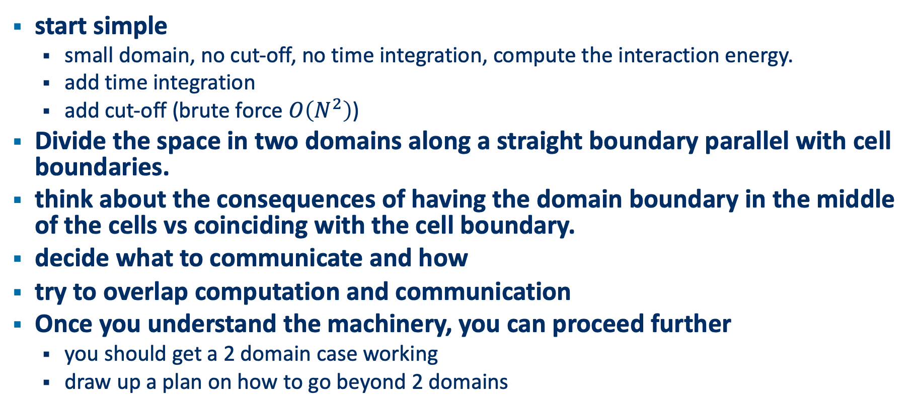
Molecular Dynamics - Parallelization
start simple
small domain, no cut-off, no time integration, compute the interaction energy.
add time integration
add cut-off (brute force $O\left(N^{2}\right)$)
Divide the space in two domains along a straight boundary parallel with cell boundaries.
think about the consequences of having the domain boundary in the middle of the cells vs coinciding with the cell boundary.
decide what to communicate and how
try to overlap computation and communication
Once you understand the machinery, you can proceed further
you should get a 2 domain case working
draw up a plan on how to go beyond 2 domains

Slide 18
phase 3
Evaluation

Slide 19
Evaluation
presentation of your work (probably via ms teams)
explain your approach
evaluate the performance of your approach (measurements)
(I will give you some tools later)
I will ask questions to see if you understand what you did, and to challenge your approach
deliverables
the presentation (.pptx or .pdf)
the code
both should be in your github repository

Slide 20
Getting started

Slide 21
Getting started
# create project
> cd workspace
> micc create LeonMD --package --remote=‘private’
> cd LeonMD
# add common tools for atom generation and plotting
> poetry add et_ppMDcommon
> source .venv/bin/activate
(.venv)>

Slide 22
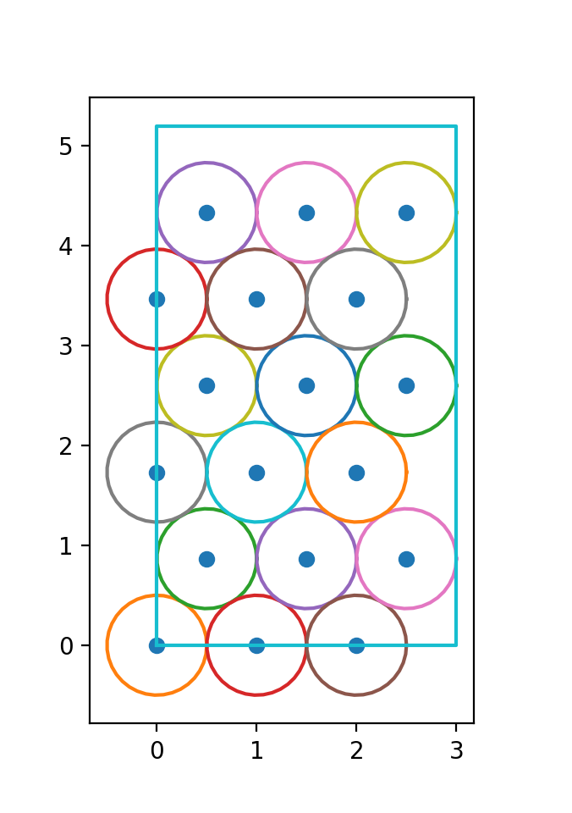
Getting started
import numpy as np
import et_ppmdcommon as cmn
# make box containing 3x3 rectangular unit cells
box = cmn.Box(0, 0, 3, 3*np.sqrt(3))
x,y = box.generateAtoms(r=1.0)
md.figure() md.plotAtoms(x, y) # dots md.plotAtoms(x, y, r=r0/2) # circles with atom radius md.plotBox(box) # containing box md.plt.show()

Slide 23
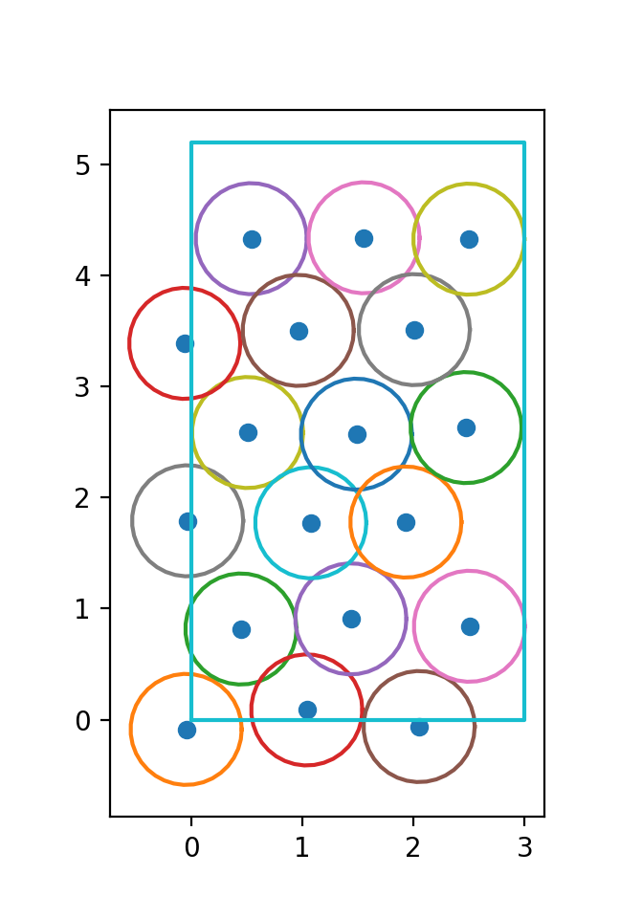
Getting started
x,y = box.generateAtoms(box, r=1.0, noise=.1)
md.figure() md.plotAtoms(x, y) # dots md.plotAtoms(x, y, r=r0/2) # circles with atom radius md.plotBox(box) # containing box md.plt.show()

Slide 24
equations

Slide 25
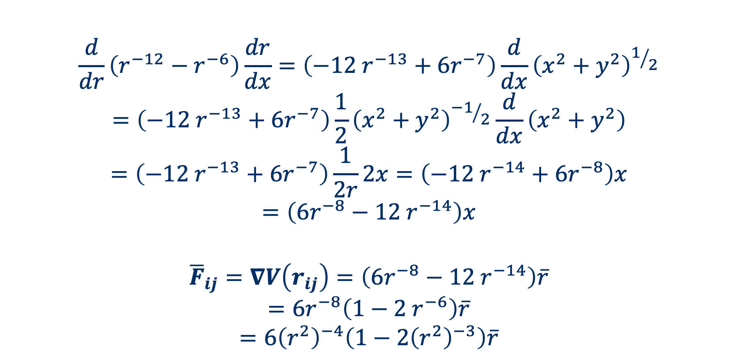
LJ force
$$\frac{d}{dr}\left(r^{−12}−r^{−6}\right)\frac{dr}{dx}=\left({−12 r}^{−13}+6r^{−7}\right)\frac{d}{dx}{\left(x^{2}+y^{2}\right)}^{1/2}$$
$$=\left({−12 r}^{−13}+6r^{−7}\right)\frac{1}{2}{\left(x^{2}+y^{2}\right)}^{{−1}/2}\frac{d}{dx}\left(x^{2}+y^{2}\right)$$
$$=\left({−12 r}^{−13}+6r^{−7}\right)\frac{1}{2r}2x=\left({−12 r}^{−14}+6r^{−8}\right)x$$
$$=\left({6r^{−8}−12 r}^{−14}\right)x$$
$${\overline{F}}_{ij}=∇V\left(r_{ij}\right)=\left({6r^{−8}−12 r}^{−14}\right)\overline{r}$$
$$=6r^{−8}\left({1−2 r}^{−6}\right)\overline{r}$$
$$=6{\left(r^{2}\right)}^{−4}\left(1−2{\left(r^{2}\right)}^{−3}\right)\overline{r}$$

Slide 26
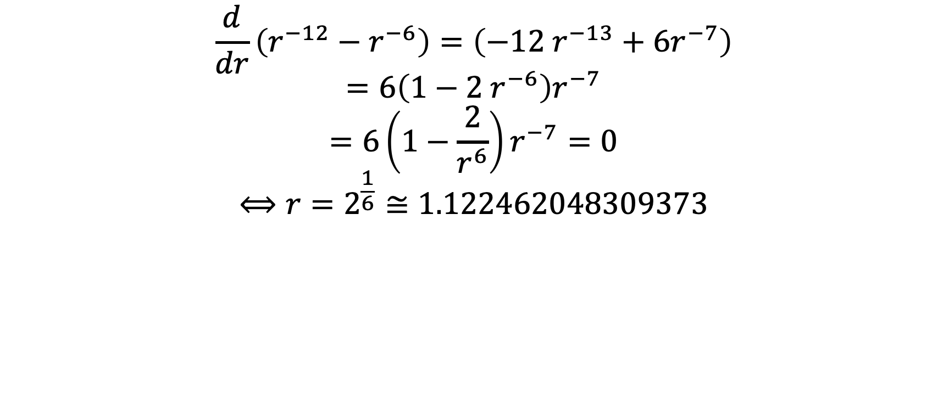
LJ equilibrium distance
$$\frac{d}{dr}\left(r^{−12}−r^{−6}\right)=\left({−12 r}^{−13}+6r^{−7}\right)$$
$$=6\left({1−2 r}^{−6}\right)r^{−7}$$
$$=6\left(1−\frac{2}{r^{6}}\right)r^{−7}=0$$
$$⟺r=2^{\frac{1}{6}}≅1.122462048309373$$

Slide 27
Verlet Lists

Slide 28
Verlist list
is a mathematical concept: the set of neighbours of an atom which are within the cutoff distance
in a program you need a representation for each mathematical concept:
a data structure
the data structure is not important for correctness
the data structure is important for
performance
practical considerations (ease of programming, debugging, …)

Slide 29
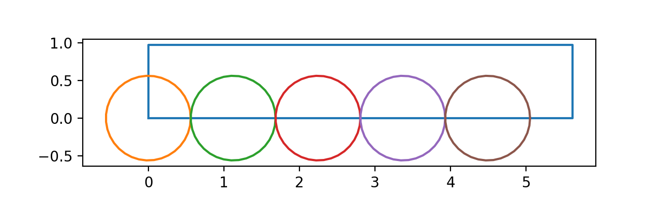
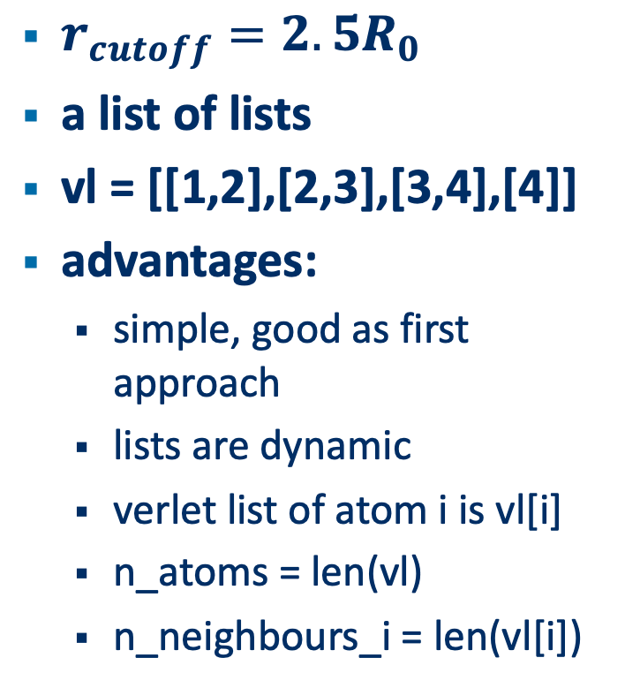
Pure Python approach
$r_{cutoff}=2.5R_{0}$
a list of lists
vl = [[1,2],[2,3],[3,4],[4]]
advantages:
simple, good as first approach
lists are dynamic
verlet list of atom i is vl[i]
n_atoms = len(vl)
n_neighbours_i = len(vl[i])
vl = []
[]
vl0 = []
[]
vl0.append(1)
[1]
vl0.append(2)
[1,2]
vl.append(vl0)
[[1,2]]
vl1 = []
[]
vl1.append(2)
[2]
vl0.append(3)
[2,3]
vl.append(vl1)
[[1,2],[2,3]]
…

Slide 30
mixed programming approach
disadvantages
double loop in Python = slow
Python list is non-contiguous data structure = slow
replace with contiguous data-structure: numpy array
pass this to C++ or Fortran and make the loops in C++/Fortran
Atom | #neigbours | Neighbour 1 | Neighbour 2 | Neighbour 3
0 | 2 | 1 | 2 | -
1 | 2 | 2 | 3 | -
2 | 2 | 3 | 4 | -
3 | 1 | 4 | - | -
4 | 0 | - | - | -

Slide 31
Atom | #neigbours | Neighbour 1 | Neighbour 2 | Neighbour 3
0 | 2 | 1 | 2 | -
1 | 2 | 2 | 3 | -
2 | 2 | 3 | 4 | -
3 | 1 | 4 | - | -
4 | 0 | - | - | -
if storage is row major (rows are stored contiguously)
Python, C, C++
outer loop = loop over atoms (loop over rows
inner loop = loop over neighbours (loop in a row) => contiguous data access
if storage is column major (columns are stored contiguously)
transpose the data structure
outer loop = loop over atoms (loop over columns)
inner loop = loop over neighbours (loop in a column) => contiguous data acces

Slide 32
Atom | #neigbours | Neighbour 1 | Neighbour 2 | Neighbour 3
0 | 2 | 1 | 2 | -
1 | 2 | 2 | 3 | -
2 | 2 | 3 | 4 | -
3 | 1 | 4 | - | -
4 | 0 | - | - | -
disadvantages
memory space wasted
cache misses
need to transpose to switch between Fortran and C++
Fortran requires multi-dimensional numpy arrays to be created with ‘Fortran’ storage order
vl = numpy.zeros((max_neighours, n_atoms), dtype=float, order=‘Fortran’)
if not, the array will be copied and transposed, which is expensive
consequently, our Python coded will be different depending on whether we want to use Fortran or C++
that may complicate things later

Slide 33
Atom | #neigbours | Neighbour 1 | Neighbour 2 | Neighbour 3
0 | 2 | 1 | 2 | -
1 | 2 | 2 | 3 | -
2 | 2 | 3 | 4 | -
3 | 1 | 4 | - | -
4 | 0 | - | - | -
Linearize the numpy array
length = n_atoms (5) + total number of neighbours (7). = 12
alternative: use 2 arrays:
Verlet list is reused often before it is rebuilt, so it is a good thing to optimize.
1D data arrays can be passed to Fortran and C++ regardless of the storage order, because they are contiguous anyway.
2 | 1 | 2 | 2 | 2 | 3 | 2 | 3 | 4 | 1 | 4 | 0
2 | 2 | 2 | 1 | 0
1 | 2 | 2 | 3 | 3 | 4 | 4

Slide 34
Reflection
This is an example of how software development for research is like “shooting at a moving target”
The goal is stated in vague terms, no clear specifications of how to achieve it, many open questions, …
The data structure that we originally proposed poses problems:
For Fortran to accept 2D numpy arrays, they must be created with ‘Fortran’ storage order. That makes the code dependent on the language that is used for the binary extension. If only Fortran is used, that is not really a problem, but if we also want C++, it may be the source of subtle bugs.
The linearisation of the Verlet list solves that problem, but we need to adjust the code to take into account the new data structure.

Slide 35
parallel processes
mpi4py

Slide 36
basic principle
start multiple versions of a program with mpirun:
python my_script.py
becomes:
mpirun –np <number-of-processes> python my_script.py
if you ask for more processes than your machine has cores available, the cores will alternate between the processes until they are finished.
For the project work 2 processes is sufficient, but make sure your VM has at least 2 cores available.
MPI is distributed memory parallelisation: each process has its own memory, which is not shared with the other processes.

Slide 37
basic principle
Obviously, the goal is that each process does its part of the work
But mpirun –np N … runs N copies of the same program
How can we make each copy (= each process) do something different

Slide 38
basic principle
Each process has an id, in MPI speak, its rank.
from mpi4py import MPI
comm = MPI.COMM_WORLD
mpi_rank = comm.Get_rank() # rank of this MPI process (this is different in # every process.
mpi_size = comm. Get_size() # number of MPI processes in this mpirun group
# mpi_rank = 0, 1, 2, …, mpi_size-2
# rank 0 is sometimes called the master, and the # other ranks slaves

Slide 39
basic principle
The code can test for a specific rank and execute actions
if mpi_rank == 0:
# divide the work in parts and send the parts for the other rank
…
else:
# receive work from rank 0
…
# now, each process has a different part of the work.
# Thus, do the work, and send the result back to rank 0.

Slide 40
example code
see
et_ppmd/et_ppmd/mpi_example.py
et_ppmd/tests/test_mpi_example.py
documentation
mpi4py docs: https://mpi4py.readthedocs.io/en/stable/
mpi4py tutorials:
https://mpi4py.readthedocs.io/en/stable/tutorial.html
https://rabernat.github.io/research_computing/parallel-programming-with-mpi-for-python.html
pytest-ing of mpi4py code: https://pytest-mpi.readthedocs.io/en/latest/

Slide 41
expectations
for 19/4

Slide 42
code
for building a Verlet list – python
for time evolution (velocity Verlet algorithm)
for a simple MD simulation
setup: generate a set of atoms in a box
chose a timestep dt and a number of timesteps nv that the Verlet list is kept unmodified before it is rebuild.
run 10*nv timesteps
plan domain decomposition
make a small presentation (<=5 slides) to
explain how you want to decompose the domain of the above MD simulation in 2 sub-domains.
describe the communication that is needed.

