Slide 1
CPU
P1
P2
L1
L1
L2
l2
L3
memory channels
I/O
DRAM

Slide 2

your local machine
internet
the remote machine (supercomputer)
interconnect
login node
master node
compute nodes

Slide 3
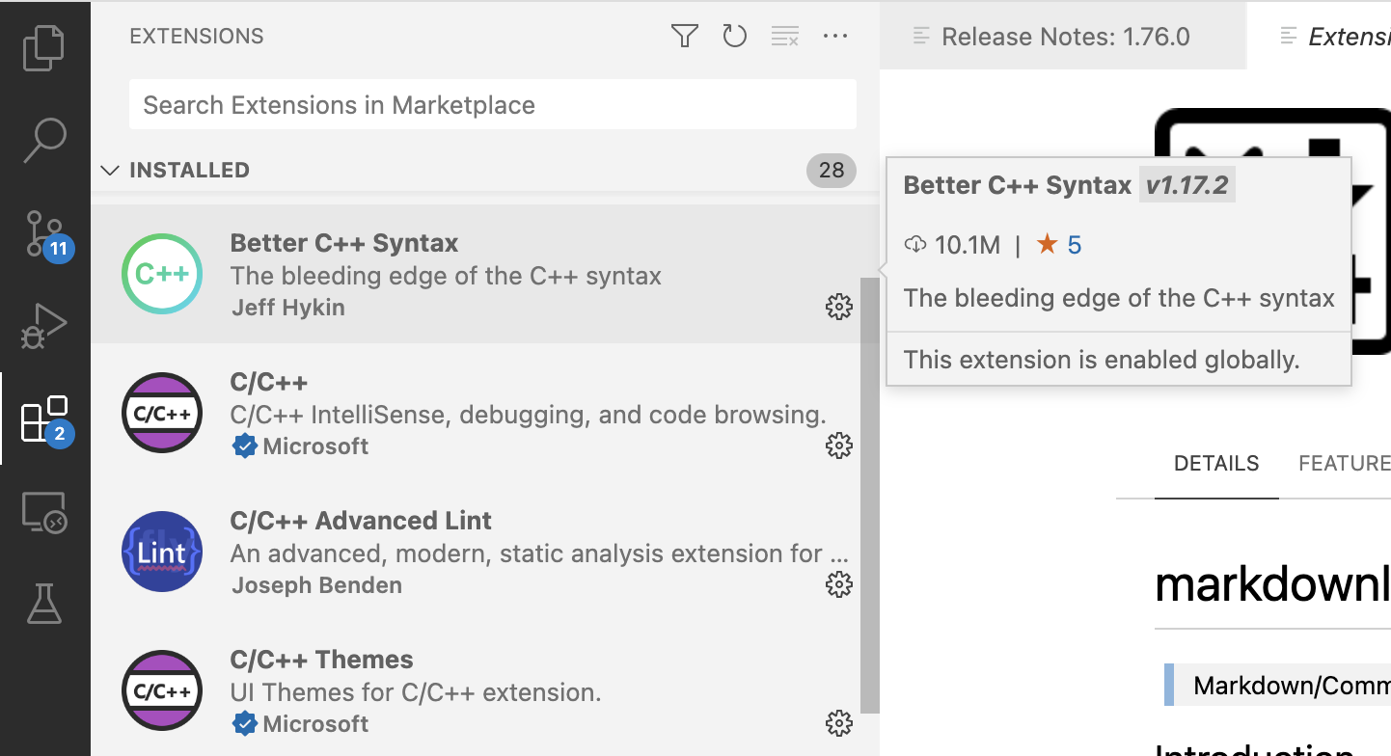

Slide 4
compute
node
CPU0
P1
P2
CPU1
P1
P2
L1
L1
L1
L1
L2
l2
L2
l2
L3
L3
memory channels
I/O
memory channels
DRAM0
DRAM1
Interconnect

Slide 5



Bandwidth limited <-|-> peak performance limited
$$P_{p}$$
3
4
Performance [F/s]
$$B I_{c}$$
2
1
Computational intensity ($i_{c}$) [F/B]

Slide 6
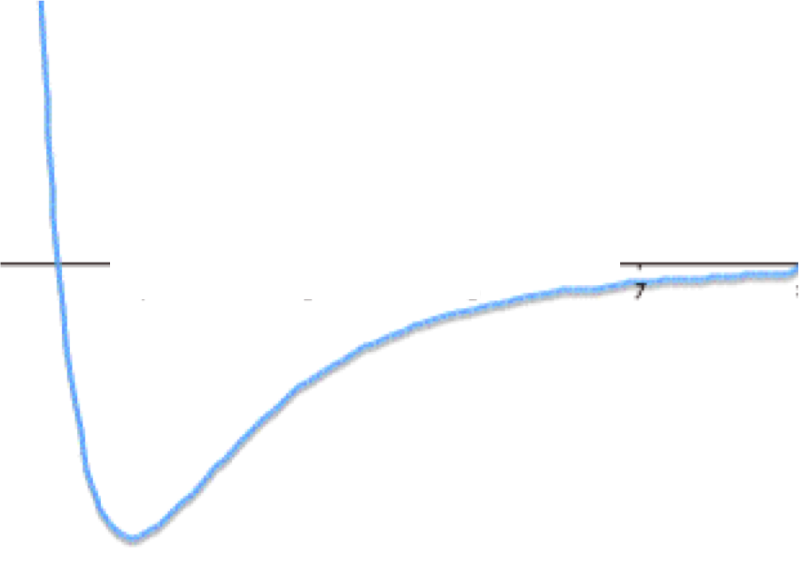

Slide 7
Store r_{ij}
r_{ij} | 0 | 1 | 2 | 3 | 4 | 5 | 6
0
1 | 0
2 | 1 | 2
3 | 3 | 4 | 5
4 | 6 | 7 | 8 | 9
5 | 10 | 11 | 12 | 13 | 14
6 | 15 | 16 | 17 | 18 | 19 | 20
Linear array containing r10, r20, r21, r30, r31, r32, r40, r41, r42, r43, …

Slide 8
E_{ij} | 0 | 1 | 2 | 3 | 4 | 5 | 6 | E_{row}
0
1 | 0 |  |  |  |  |  |  | E₀
2 | 1 | 2 |  |  |  |  |  | E₁+E₂
3 | 3 | 4 | 5 |  |  |  |  | E₃+E₄+E₅
4 | 6 | 7 | 8 | 9 |  |  |  | E₆+…+E₉
5 | 10 | 11 | 12 | 13 | 14 |  |  | E₁₀+…+E₁₄
6 | 15 | 16 | 17 | 18 | 19 | 20 |  | E₁₅+…+E₂₀
 |  |  |  |  |  |  |  | E_{0+ … +} E₂₀

Slide 9
E_{ij} | 0 | 1 | 2 | 3 | 4 | 5 | 6 | E_{row}
0
1 | 0 |  |  |  |  |  |  | E₀
2 | 1 | 2 |  |  |  |  |  | E₁+E₂
3 | 3 | 4 | 5 |  |  |  |  | E₃+E₄+E₅
4 | 6 | 7 | 8 | 9 |  |  |  | E₆+…+E₉
5 | 10 | 11 | 12 | 13 | 14 |  |  | E₁₀+…+E₁₄
6 | 15 | 16 | 17 | 18 | 19 | 20 |  | E₁₅+…+E₁₉+E₂₀
 |  |  |  |  |  |  |  | E₀+ … + +E₆+…+E₉ +E₁₀+…+E₁₄ +E₁₅+…+E₁₉ + E₂₀

Slide 10
E_{ij} | 0 | 1 | 2 | 3 | 4 | 5 | 6 | E_{row}
0
1 | 0 |  |  |  |  |  |  | E₀
2 | 1 | 2 |  |  |  |  |  | E₁+E₂
3 | 3 | 4 | 5 |  |  |  |  | E₃+E₄+E₅
4 | 6 | 7 | 8 | 9 |  |  |  | E₆+…+E₉
5 | 10 | 11 | 12 | 13 | 14 |  |  | E₁₀+…+E₁₄-E₁₄-E₁₄
6 | 15 | 16 | 17 | 18 | 19 | 20 |  | E₁₅+…+E₂₀-E₁₉+E₁₉
 |  |  |  |  |  |  |  | E₀+ … +E₅ +E₆+ … +E₉ -(E₆+ … +E₉) +E₆+ … +E₉ +E₁₀+…+E₁₄-E₁₄-E₁₄ +E₁₅+…+E₂₀-E₁₉+E₁₉ + E₂₀

Slide 12
Register 1
A_{i}
+
Register 2
B_{i}
=
Register 3
C_{i}
Load 2 operands in register
Execute 1 add instruction
Store 1 result
Single Instruction Multiple Data
(SIMD)

Slide 13
Register 1
A_{i}
A_{j}
A_{k}
A_{l}
Potentially 4x faster
[if the loads and stores can be executed fast enough]
+_{vector}
Register 2
B_{i}
B_{j}
B_{k}
B_{l}
=_{vector}
Register 3
C_{i}
C_{j}
C_{k}
C_{l}
Load 2x4 operands in register
Execute 1 vadd instruction
Store 1x4 results
Single Instruction Multiple Data
(SIMD)

