Slide 1
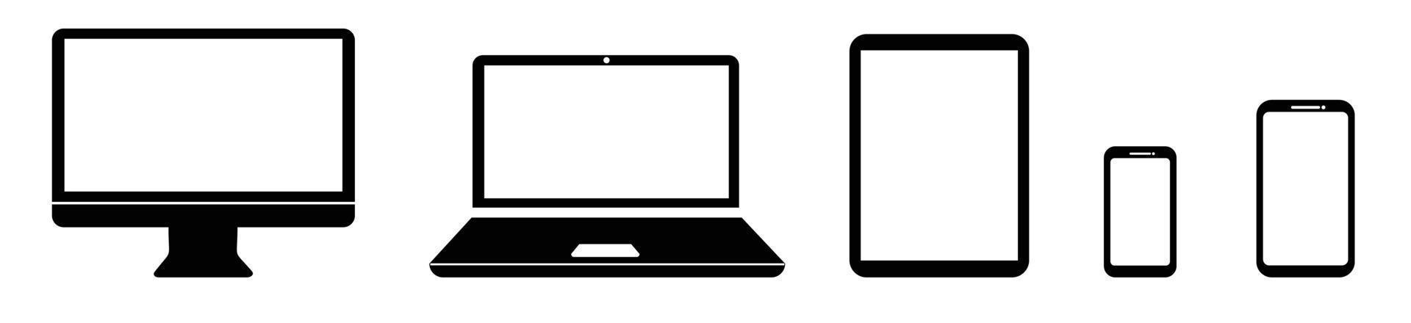
local machine
internet
remote (supercomputer)
interconnect
login node
master node
compute nodes

