Slide 1
study of
zero halo layer domain decomposition and RMA (MPI-2, MPI-3)
E. Tijskens - fall 2022

Slide 2
zero halo layer approach
Traditionally, FVM parallelisation uses the halo layer approach: data for cells next to a processor boundary is duplicated. Halo layer covers all processor boundaries and is explicitly updated through parallel communications calls: prescribed communication pattern, at predefined points
OpenFOAM operates in zero halo layer approach: flexibility in communication pattern, separate setup for FVM and FEM solvers
FVM and FEM operations “look parallel” without data dependency: perfect scaling
What zero halo layer approach actually means is that the connection with neighbouring processes is handled through a boundary condition – Obviously, this is only possible in CFD!
Hence, this does not provide a clue for handling domain decomposition in MD or GD
source:
H Jasak, HPC Deployment of OpenFOAM in an Industrial setting. PRACE Seminar: Industrial Usage of HPC, Stockholm, 3/2011 (IndSem2011_Jasak.pdf)
PETSc4FOAM: A Library to plug-in PETSc into the OpenFOAM Framework. 6/2022. https://prace-ri.eu/wp-content/uploads/WP294-PETSc4FOAM-A-Library-to-plug-in-PETSc-into-the-OpenFOAM-Framework.pdf

Slide 3
MPI-2, MPI-3
MPI_get = origin reads sth from a remote process (target). This supposes that the origin knows the memory location of the data in the target.
MPI_put = origin writes sth to a remote process (target). This supposes that the origin knows the memory location of where the data must be put.
How to handle requests like ”get all particles within distance d from my domain boundary with process p”.
BVH looks interesting, since natural…
Fluid dynamics is much simpler: only boundary information needs to be communicated

Slide 4
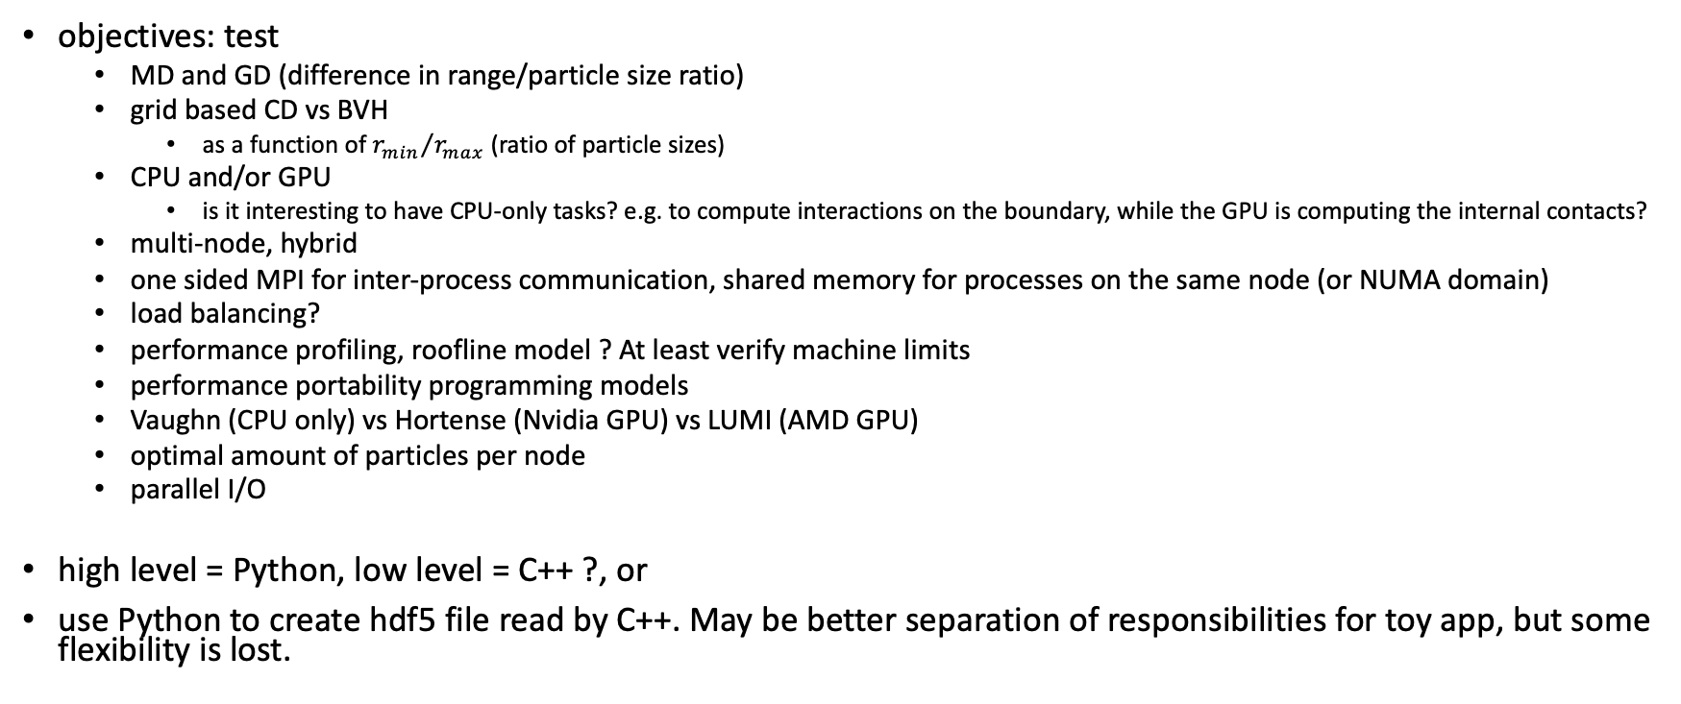
preliminary plan RMA for particle based simulation (MD, GD)
objectives: test
MD and GD (difference in range/particle size ratio)
grid based CD vs BVH
as a function of ${r_{min}}/{r_{max}}$ (ratio of particle sizes)
CPU and/or GPU
is it interesting to have CPU-only tasks? e.g. to compute interactions on the boundary, while the GPU is computing the internal contacts?
multi-node, hybrid
one sided MPI for inter-process communication, shared memory for processes on the same node (or NUMA domain)
load balancing?
performance profiling, roofline model ? At least verify machine limits
performance portability programming models
Vaughn (CPU only) vs Hortense (Nvidia GPU) vs LUMI (AMD GPU)
optimal amount of particles per node
parallel I/O
high level = Python, low level = C++ ?, or
use Python to create hdf5 file read by C++. May be better separation of responsibilities for toy app, but some flexibility is lost.

Slide 5
plan
single thread – CPU-only application

Slide 6
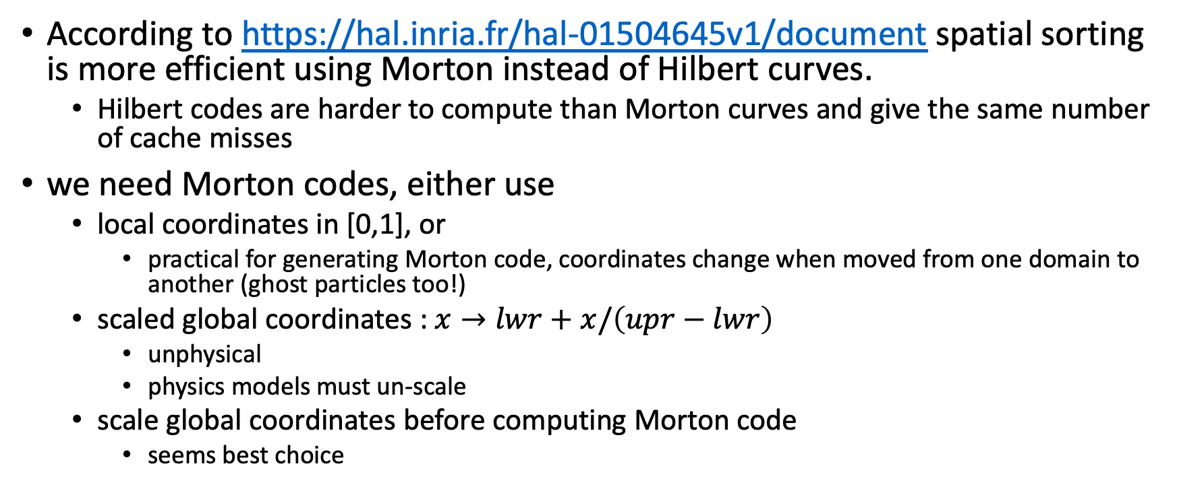
issues and design decisions spatial sorting
According to https://hal.inria.fr/hal-01504645v1/document spatial sorting is more efficient using Morton instead of Hilbert curves.
Hilbert codes are harder to compute than Morton curves and give the same number of cache misses
we need Morton codes, either use
local coordinates in [0,1], or
practical for generating Morton code, coordinates change when moved from one domain to another (ghost particles too!)
scaled global coordinates : $x→lwr+x/\left(upr−lwr\right)$
unphysical
physics models must un-scale
scale global coordinates before computing Morton code
seems best choice

Slide 7
issues and design decisions spatial sorting – cont’d
In [17], two algorithms for the Morton layout are proposed: one that takes 12 operations and one that takes 5 operations plus two loads from a lookup table. We implemented the same idea for the L4D layout. In both cases, the lookup table creates an indirection which is not vectorizable and therefore this approach has to be discarded.

Slide 8
issues and design decisions Performance portability programming models
Kokkos
RAJA
the paper https://arxiv.org/pdf/1911.08394.pdf provides some arguments in favor of kokkos

Slide 9
issues and design decisions data structures
array of structures vs structure of arrays
https://hal.inria.fr/hal-01504645v1/document

Slide 10
issues and design decisions collision detection
(multi-)grid
BVH
CPU/GPU algorithms

Slide 11
issues and design decisions collision detection – cont’d
Collision Detection on the GPU
https://developer.nvidia.com/blog/thinking-parallel-part-i-collision-detection-gpu/
sort and sweep
launch one thread per object to calculate its bounding box, project it to the chosen axis, and write the start and end points of the projected range into fixed locations in the output array.
In the second step, we sort the array into ascending order: parallel radix sort
launch one thread per array element. If the element indicates an end point, the thread simply exits. If the element indicates a start point, the thread walks the array forward, performing overlap tests, until it encounters the corresponding end point
Uniform grid (multi-grid not considered)
https://developer.nvidia.com/blog/thinking-parallel-part-ii-tree-traversal-gpu/
hierarchical tree traversal
bounding volume hierarchy (BVH)
https://developer.nvidia.com/blog/thinking-parallel-part-iii-tree-construction-gpu/
https://research.nvidia.com/sites/default/files/pubs/2012-06_Maximizing-Parallelism-in/karras2012hpg_paper.pdf

Slide 12
project xXD
x from exa-scale
XD for generic particle dynamics
X=M -> Molecular Dynamics
X=G -> Granular Dynamics

