Slide 1
PREDICTING FLIGHT BOOKING COMPLETION
Aim:

Slide 2
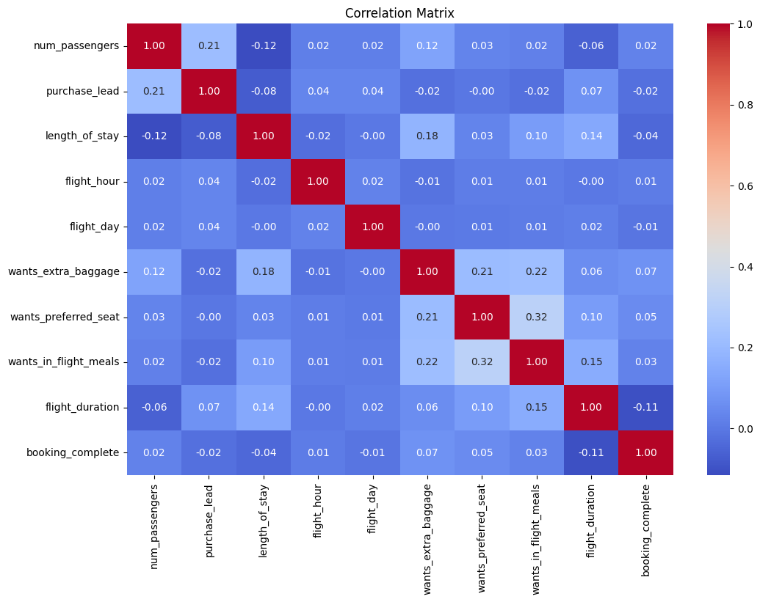
To predict whether a flight booking will be completed based on flight and passenger data.
Problem Statement:
Predict whether a flight booking will be completed based on flight and passenger data.
Model: Random Forest Classifier
Model Evaluation:
Accuracy: 0.83
Mean Cross-Validation Accuracy: 0.833075
The model shows good overall accuracy but struggles with minority class.

