Slide 1
Power Apps & Power Automate Champion Training
Ethan Irons Sr. Customer Engineer Microsoft Federal

Slide 2
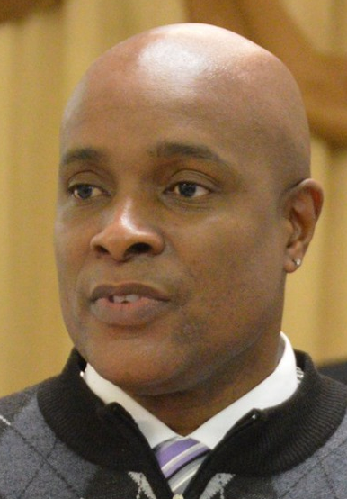

Welcome!
Experience
SharePoint
M365 Security
Fun Fact
Travel
Location
South Carolina
Contact
Your email
Ethan
Sr. Customer Engineer

Slide 3









Now it’s your turn!
What excites you about Power Platform?
What are your expectations for this session?

Slide 4
Course agenda
Day 1
Introduction to Microsoft Power Platform
Introduction to Power Automate
Introduction to Power Automate
Triggers & Actions​
Intermediate Topics ​
Advanced Topics
Day 2
Introduction to Power Apps
Introduction to Power Apps
Starting with Connectors, Screens, and Controls
Building with Controls, Fields, and Formulas
Implementing through Visual Designs

Slide 5
Course agenda
Day 1
Introduction to Microsoft Power Platform
Introduction to Power Automate
Introduction to Power Automate
Triggers & Actions​
Intermediate Topics ​
Advanced Topics
Day 2
Introduction to Power Apps
Introduction to Power Apps
Starting with Connectors, Screens, and Controls
Building with Controls, Fields, and Formulas
Implementing through Visual Designs
Day 3
SharePoint Workflows to Power Automate Migration Insights
Understand the feature/functionality comparison between SharePoint Workflows and Power Automate flows.
Review alternatives where corresponding Workflow features/functionality does not exist in Power Automate flows.
Refactoring a sample SharePoint 2010 Workflow to Power Automate through a hackathon.

Slide 6
Course Schedule
Start and Stop Times
9 am – 5 pm EDT
Lunch time
12 - 1 pm EDT
Breaks
Two 15-minute breaks

Slide 7
Course Lab Environment
DISCLAIMER: User Interface Changes and Features
The lab environment used in this course differs from your organization’s Microsoft 365 tenant. As result, there will be features that you’ll use that are not available in your organization’s tenant. Your instructor will make call outs to known features differences between our Commercial and US Government Microsoft 365 environments.
How to access the lab environment
Open your preferred browser and navigate to https://office.com
Click the Sign in button
Provide your Username and Password
In the Stay signed in? dialog, check Don’t show this again and click Yes
Microsoft 365 Credentials
Username: [firstname]@[tenantprefix].onmicrosoft.com
Password: Pass@word1!
Tenant Name: [pachamptraining05232022].onmicrosoft.com
Tenant Prefix: pachamptraining05232022
Each of you have a dedicated team site:
https://[pachamptraining05232022].sharepoint.com/sites/[Student #

Slide 8
Closing slide

